Slide 1


Lawrenceville Happenings Meeting:
Greenways
12/4/25, 6:30 p.m., Hop Farm Brewing (5601 Butler St)
Welcome! Please sign in at bit.ly/LUSignIn if joining online

Slide 2
Tonight’s Agenda
Welcome & Introductions
LC & LU Introductions
Stanton Heights Neighborhood Association Introduction
Overview of the City Greenways Program
Discussion about the Allegheny River Greenway
LU & LC Upcoming Calendars

Slide 3
Accessibility
LU and LC are committed to making these meetings accessible
Let us know about any accommodations you need to fully participate
If joining by Facebook Live, drop comments/questions in the chat

Slide 4
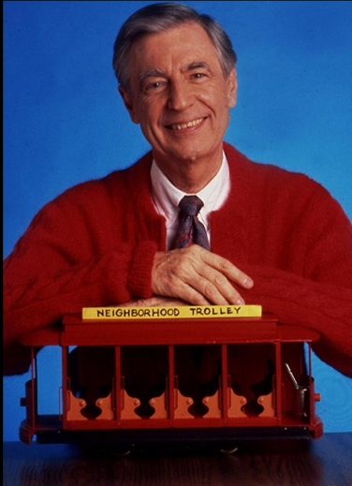
Community Agreements
Be neighborly.
Be respectful of all participants & hosts
Don’t denigrate groups of people
Give space for all to participate

Slide 5
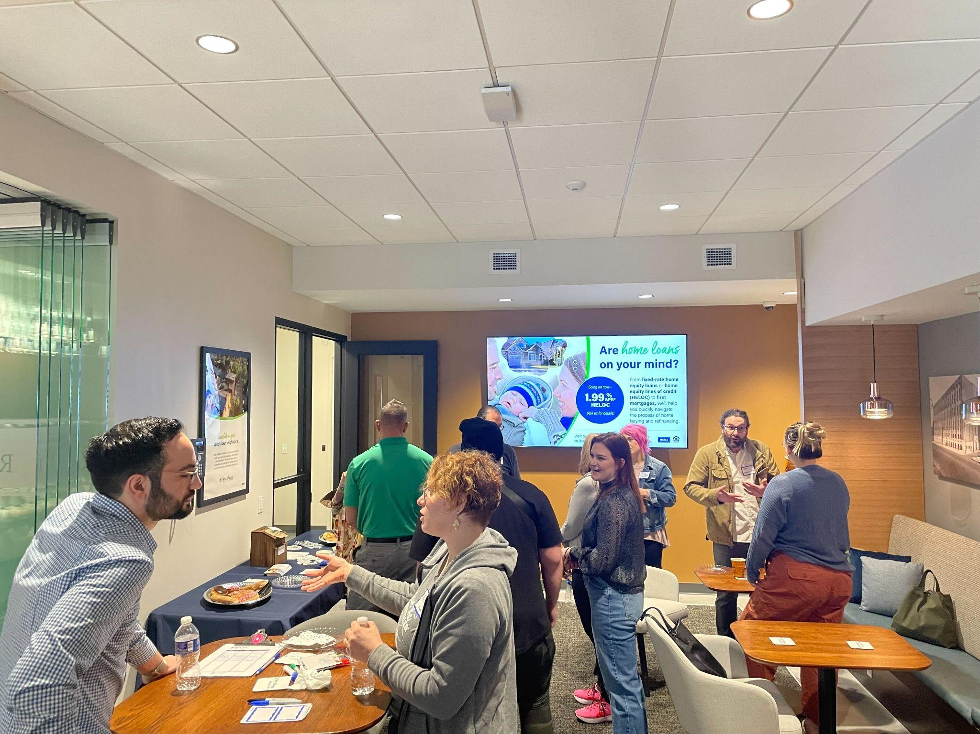

Lawrenceville Corporation
History: Formed in January 2000 as a merger of the Lawrenceville Development Corporation (LDC) and the Lawrenceville Business Association (LBA).
  Initial focus on blight in the neighborhood, development, artists and creatives (16.62 Design Zone)
Mission: Driven by the Lawrenceville community, the Lawrenceville Corporation acts as the catalyst and conduit for responsible and sustainable growth.
Board: Mostly comprised of residents, property owners, and business owners and elected by our membership

Slide 6
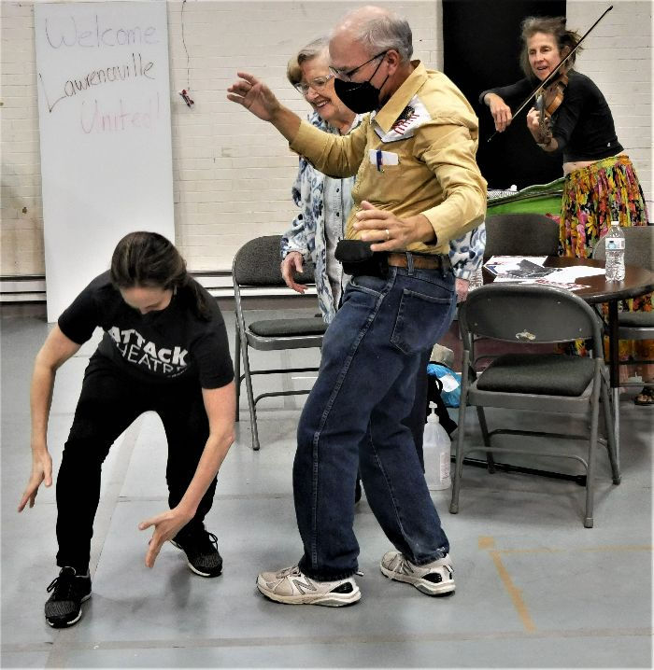
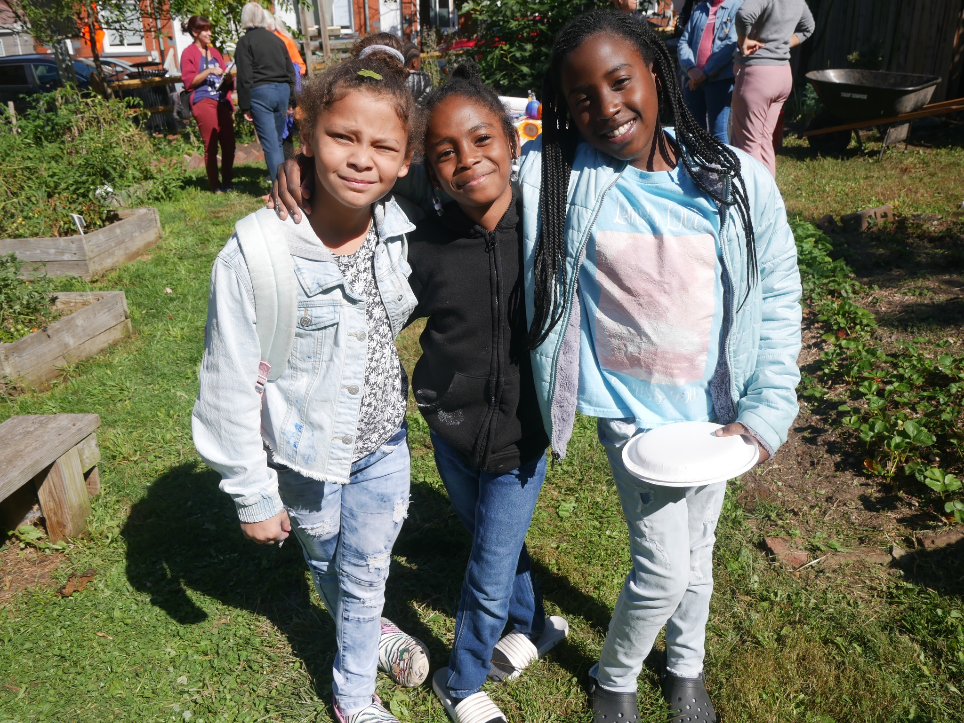
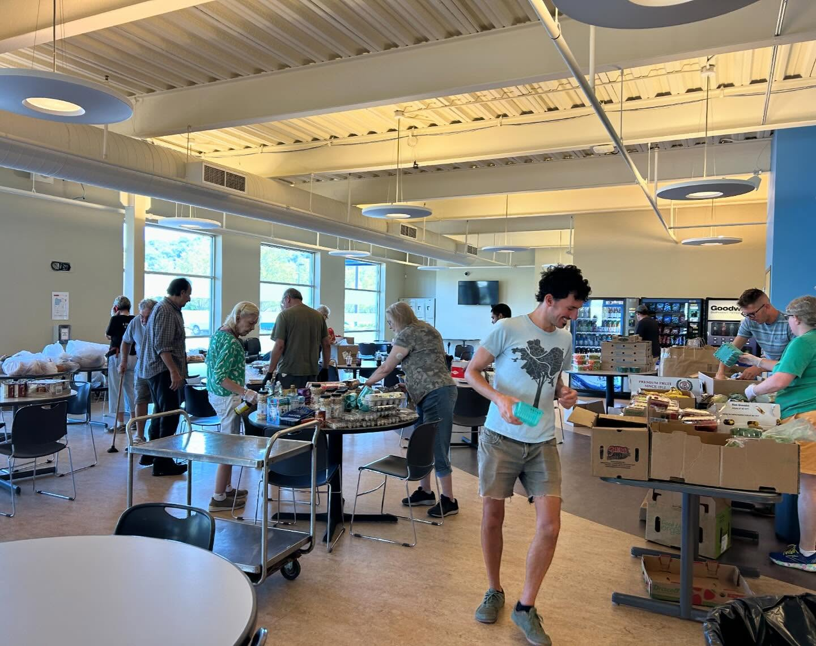
Lawrenceville United
Mission: to improve and protect quality of life for
all Lawrenceville residents
Membership of over 950 residents
Board comprised of all residents: elected by our membership
Programs: Lawrenceville Farmers Market, supporting older adults, free food distributions, cleaning & greening, direct support & case management, advocacy, and more.

Slide 7
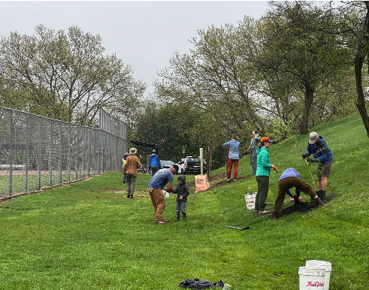

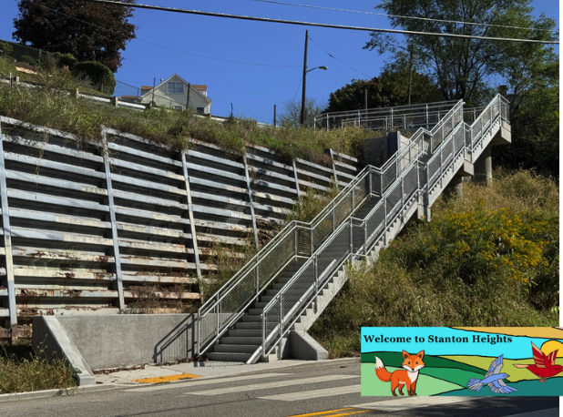

Slide 8

Planning Pittsburgh's Greenways
Lawrenceville
December 4, 2025
Notes:
We are looking for input on the potential expansion of city greenways to reflect the community’s vision for how these new green spaces should be used.

Slide 9
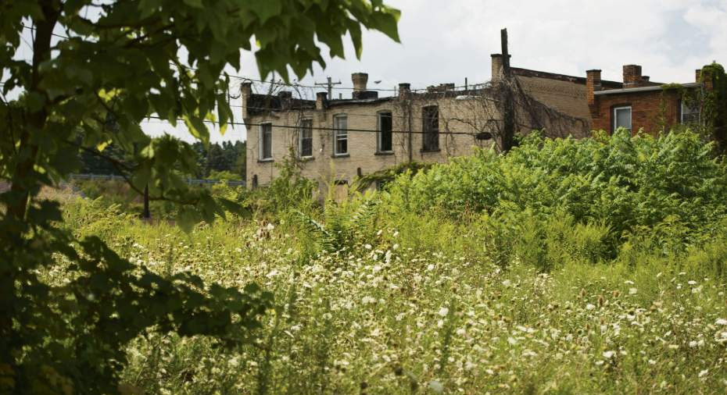
How many city-owned vacant lots currently exist in the City of Pittsburgh?

Slide 10


Project Origins
Vacant property in Pittsburgh:
    10,000 city-owned vacant parcels studied in this project
    “hold for study”
    3,000 are proposed as greenway
Existing landslide hazard risk
Interdepartmental collaboration
Trust for Public Land Park Equity Accelerator
Notes:
Why did we start this project?
Mac: vacant property
Isabella: TPL
Isabella: Existing landslide risk
Mac: VPTF, Interdepartmental collaboration
Ethos collaborative work
I&P landslide prone data
VPTF, interdepartmental collaboration Task Force and Ethos work and DPW DPW and Law asked us to review all city-owned vacant parcels to determine which should be recommended to be held from development due to landslide risk (safety issue framing)

Slide 11
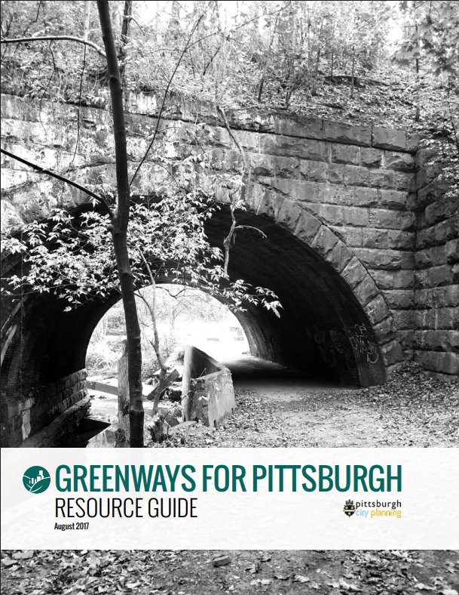
What is a greenway?
A permanently conserved, primarily passive open space that is stewarded primarily by the community and provides benefits such as minimizing landslide risk, reducing the effects of extreme heat, preserving tree canopy, and creating recreation opportunities.
12 existing legislated greenways
1,199 existing legislated greenway parcels
Notes:
Greenways 2.0 work and policy guide setting up this work and providing this definition
Why we like it
Why we want to change it/modify in the future
The fact that it existed highlighted the work that needs done

Slide 12

Benefits of Designating Green Space
Minimizes flooding and landslide hazard risk
Preserves existing tree canopy, preventing urban heat island effects
Unlocks investments in these green spaces through City funding and grants
Allows for community and non-profit stewardship
Supports greater mobility with improved connectivity and the creation of trails
Designated green space with signage creates a sense of shared ownership and deters dumping
Notes:
Emphasize that nothing has to change, apart from properties with landslide risk?

Slide 13
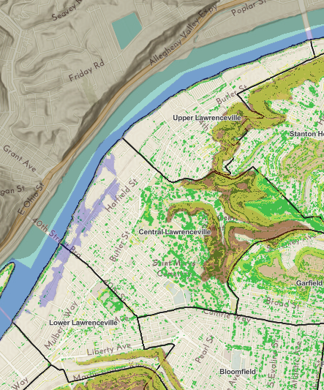
Environmental Map
Greenways parcels are mainly being selected on steeply sloped, landslide prone land – not ideal for development
Legend
Brown – Landslide Prone
Yellow – Steep Slopes
Green – Tree Cover
Notes:
Environmental map used for analysis
Publicly available resource

Slide 14
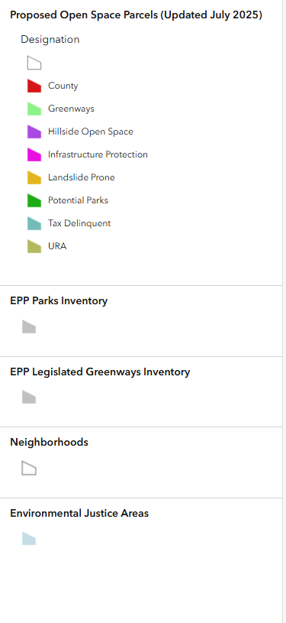
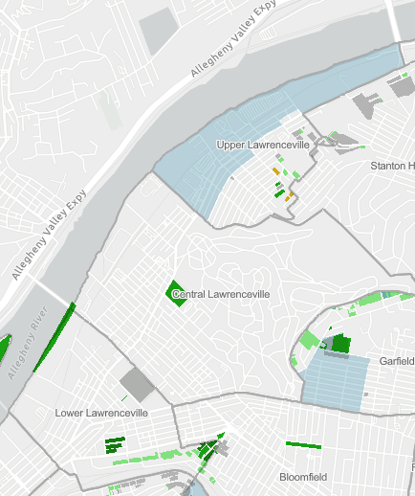
Notes:
https://pittsburghpa.maps.arcgis.com/apps/dashboards/7c4f4aa06c104bd481858b43088cbcba
Isabella:
Explain the different categories/colors
Explain methodology briefly – what data did we use to make these decisions
Sharable map for this particular area for the community to react to post-meeting
Ask them to share in the meeting but also give them time to react
Any reactions to how this land has been proposed?
Looks good no objections
Objection – want to see a house built
If there are objections, ask them to visit the Engage page, add a pin to the map
Invite them to acquire?
Share those disputed parcels with Council for their knowledge and to decide

Slide 15
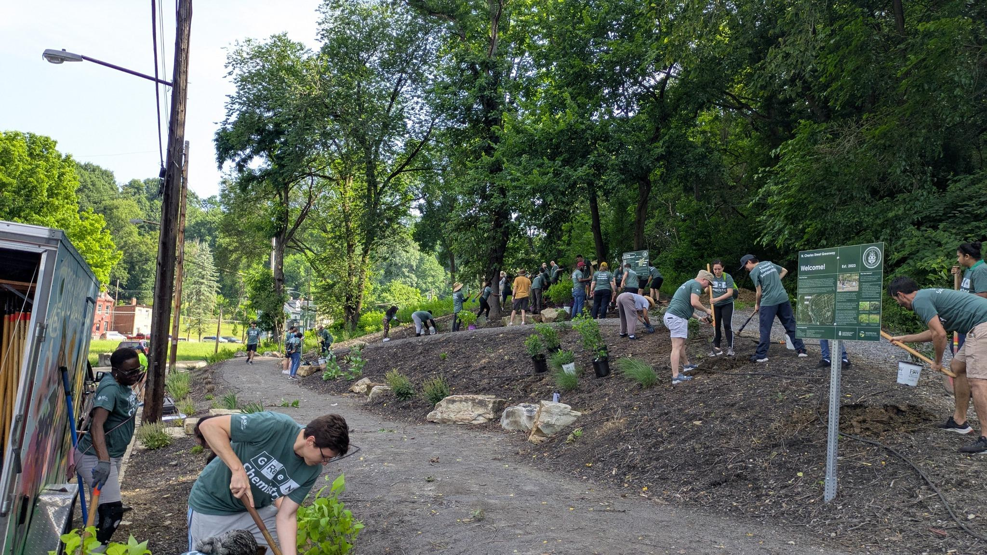
How could these spaces be reactivated?
Once designated, the land is permanently conserved and protected from sale
As these lands are currently “vacant lots”, designation unlocks funding and ability to apply for grants
Issues: dumping, invasives
Opportunities: signage, tree planting/orchards, trail building, urban ag/gardens
Notes:
Discuss DPW review process
Purpose of creating this program was to streamline a process for facilitating greater stewardship of these underutilized spaces. To make it easier for individuals, resident stewardship groups, and organizations alike have an easier time of obtaining site access and understanding what activities are possible in these spaces. To encourage their use!

Slide 16
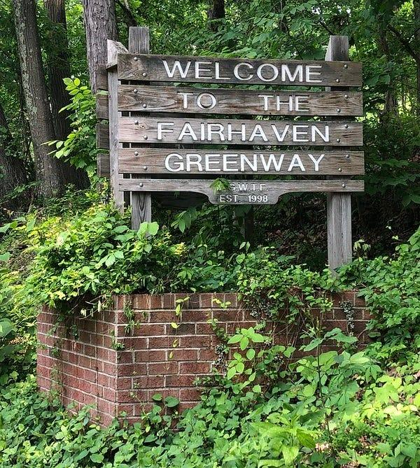
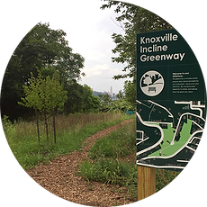
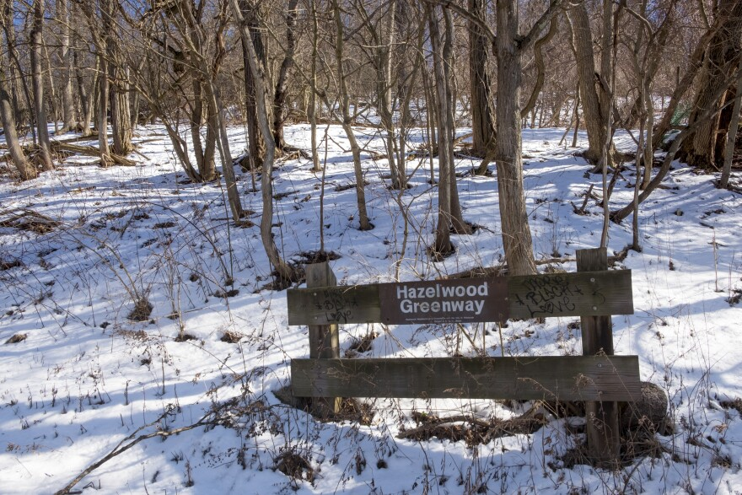
Naming & Signage
We are crowd-sourcing names for our potential new greenways
Signage can go a long way!
Notes:
Isabella

Slide 17
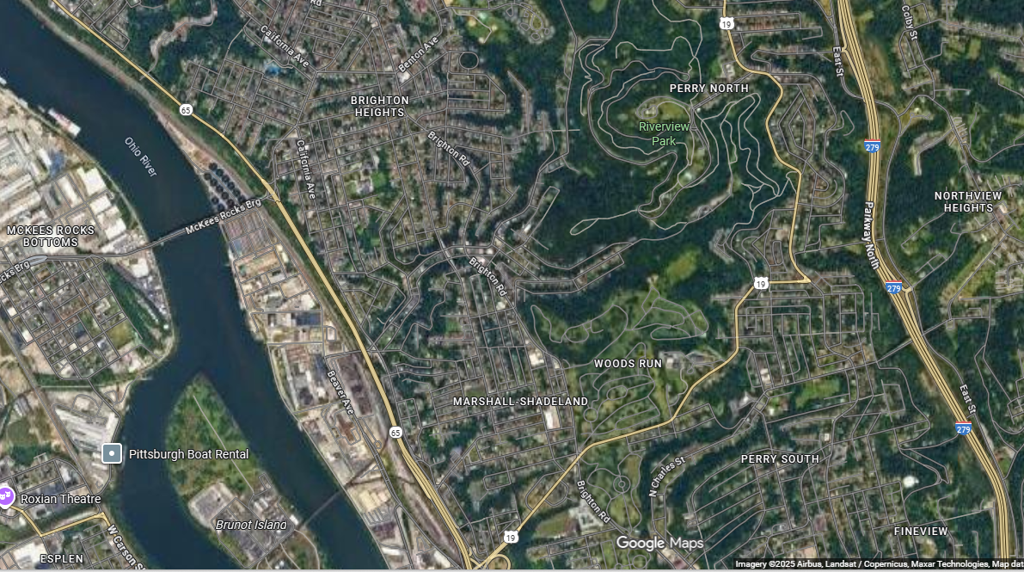
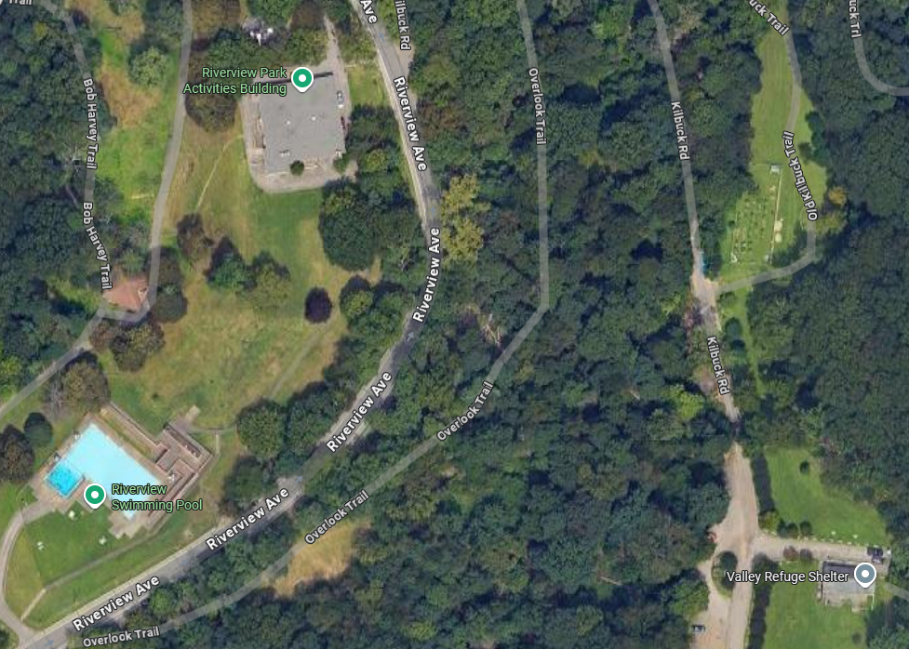
Notes:
Wooded area – Riverview Park
Found a flat underutilized area
These are sites we are seeking

Slide 18
Project Timeline
August 2024 – May 2025
September 2024 – May 2025
July 2025 – December 2025
2026
Geospatial Analysis Mapping
Code Update, Stewardship Agreement, and Volunteer App
Community Engagement
Designation, Legislation, Consolidation
Notes:
Purpose of this slide is to give everyone a picture of where we are an how long this has taken
Permanent designation, irreversible, makes the engagement aspect even more important
Working with real estate colleagues to recode these
This isn't the end of the engagement. Community engagement is ongoing Outlining how long it'll take to complete engagement and legislation process.
What do we mean by designation/legislation
Timeline for designation - Hoping to start the legislation process later this year after we've engaged everyone, so if they have additional feedback.
We have funding for signage
Naturalizing streets – where are they located? Are you leaving the roads in? What are they/what do you mean by that?
Parcel consolidation for improved data management

Slide 19
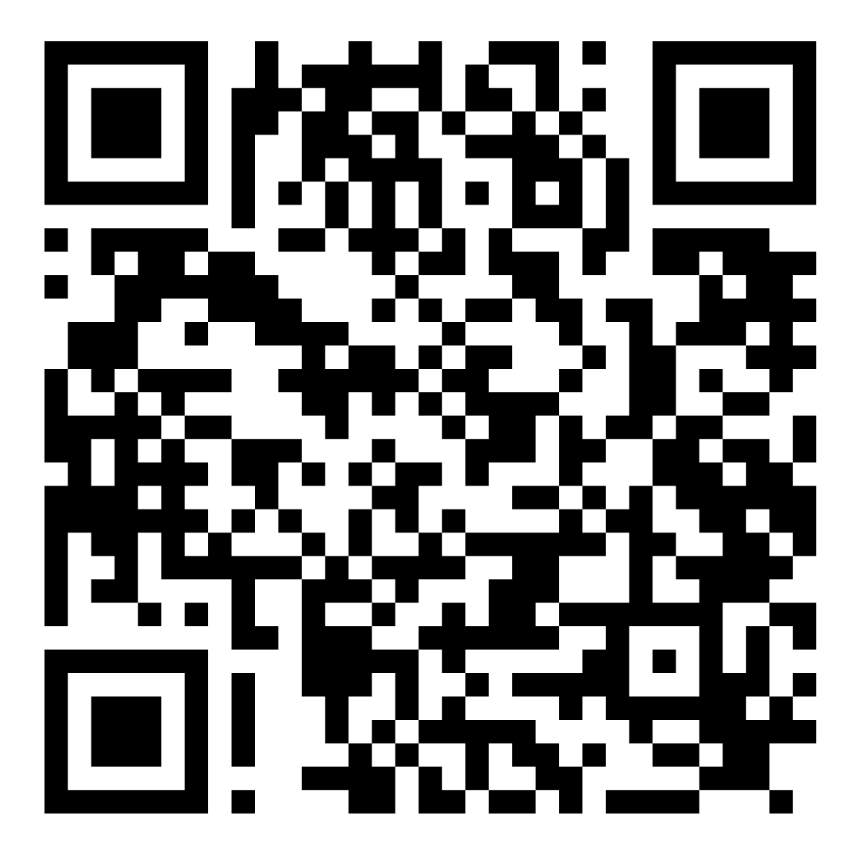
We want to hear from you!
Join our stewardship network! Email: greenways@pittsburghpa.gov
Share your voice on EngagePGH!
Contact us:
      Isabella Gross
      isabella.gross@pittsburghpa.gov
      Mackenzie Pleskovic
      mackenzie.pleskovic@pittsburghpa.gov
Greenways Expansion Planning
Engage Page
Notes:
Call out to Pittsburghers in the audience
This is how we are engaging folks at home "how to take action"

Slide 20
Approved Stewardship Activities
Low-Risk (volunteer application)
High-Risk (agreement required)
Invasive species removal
Painting
Landscape plantings at entrances
Litter or dump site cleanup
Mowing and string trimming
Restoration plantings and/or seeding
Beautification, landscaping, and plant beds
Vegetation management for access
View shed pruning
Tree management and tree stand maintenance
Tree planting and pruning
Snow removal (non-machinery based, no salt)
Fence repair, replacement, and installation
Seating, benches, shelters or picnic table construction, installation, repair, or replacement
Trail maintenance, paving, resurfacing
Building trails, installing trail markers, signage, and footbridges
Signage installation
Stream/waterway restoration
Slope repair or stabilization for landslide prevention
Sidewalks or hardscapes installation
Notes:
lot of text but so you understand what's high risk and low risk here
Highlight hand picked examples for high risk

Slide 21
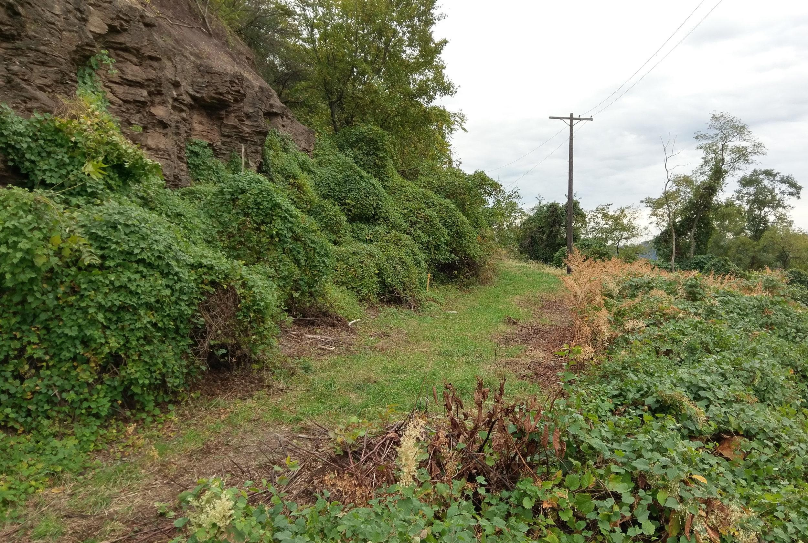
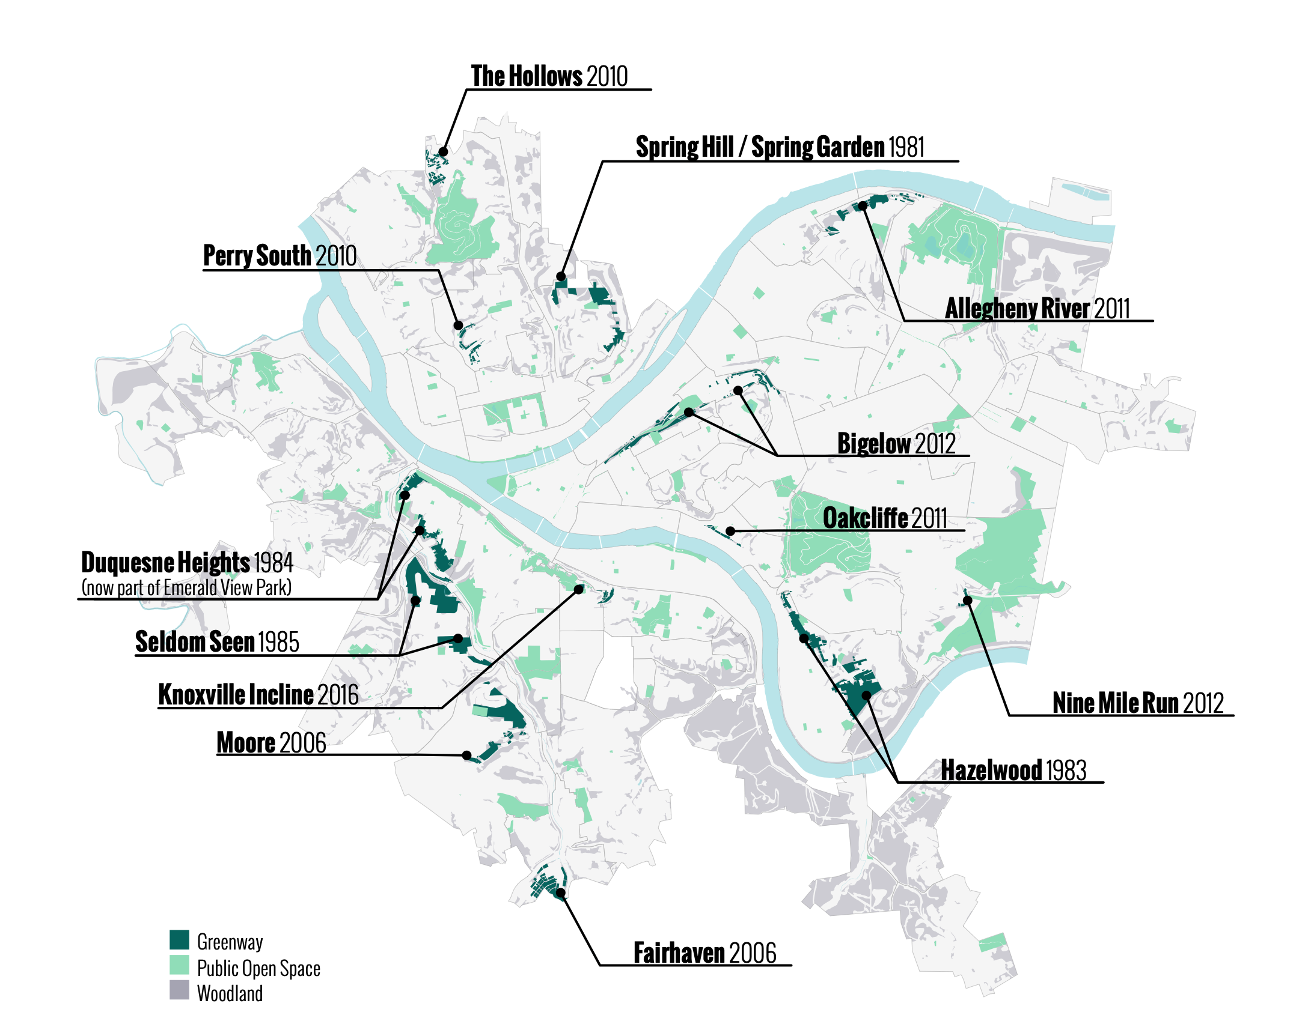
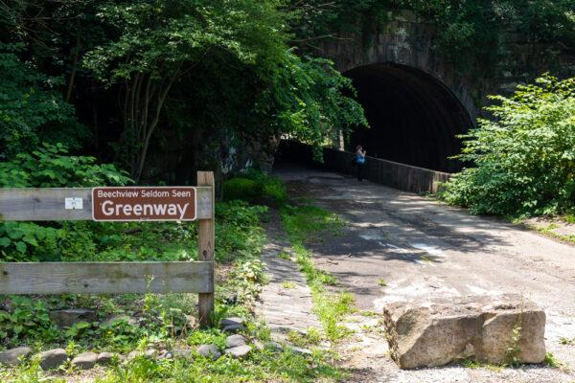
Existing Greenways
Hazelwood
Greenway
Notes:
Mackenzie:
Anyone been to an existing greenway?
12 existing greenways scattered throughout the city
Most stewarded by our non-profit groups

Slide 22
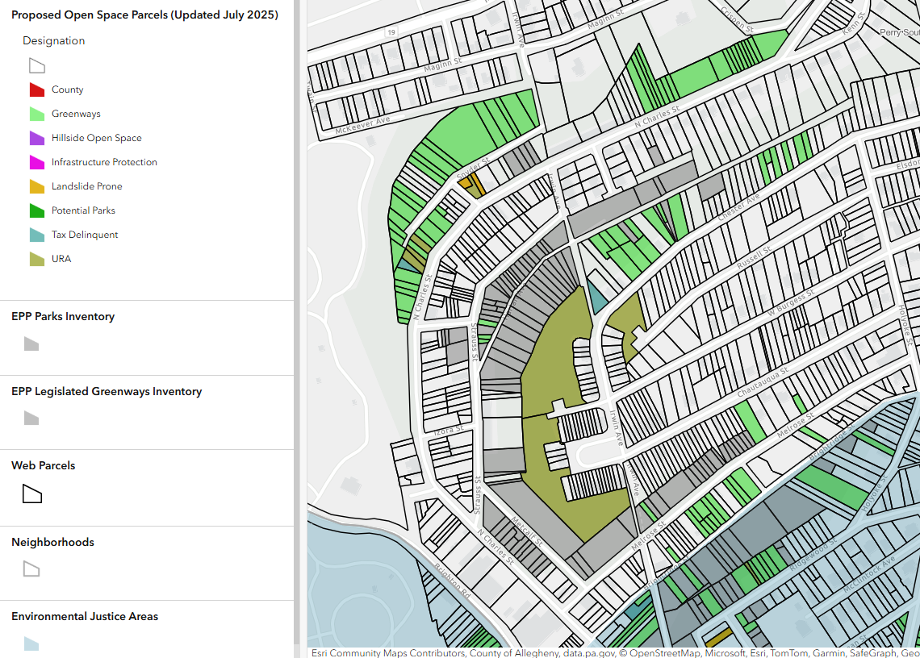
Notes:
Isabella:
Explain the different categories/colors
Explain methodology briefly – what data did we use to make these decisions
Sharable map for this particular area for the community to react to post-meeting
Ask them to share in the meeting but also give them time to react
Any reactions to how this land has been proposed?
Looks good no objections
Objection – want to see a house built
If there are objections, ask them to visit the Engage page, add a pin to the map
Invite them to acquire?
Share those disputed parcels with Council for their knowledge and to decide

Slide 23
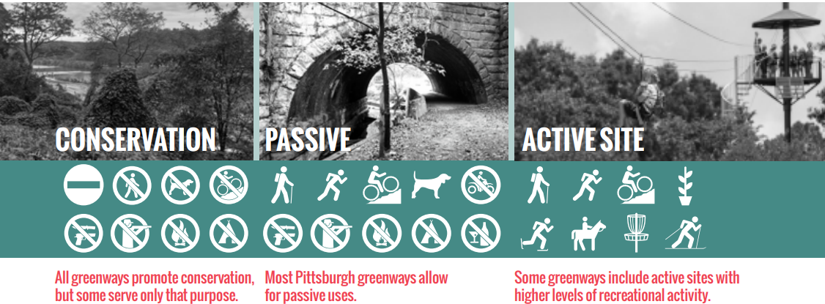
3 Types of Greenways
Notes:
Useful to qualify different types of greenways – not using this model
Conservation – inaccessible, unsafe, steeply sloped
Most of pittsburgh greenways are passive
Most of the new greenways will start out as conservation greenways
But some of them could be transformed into more active sites

Slide 24
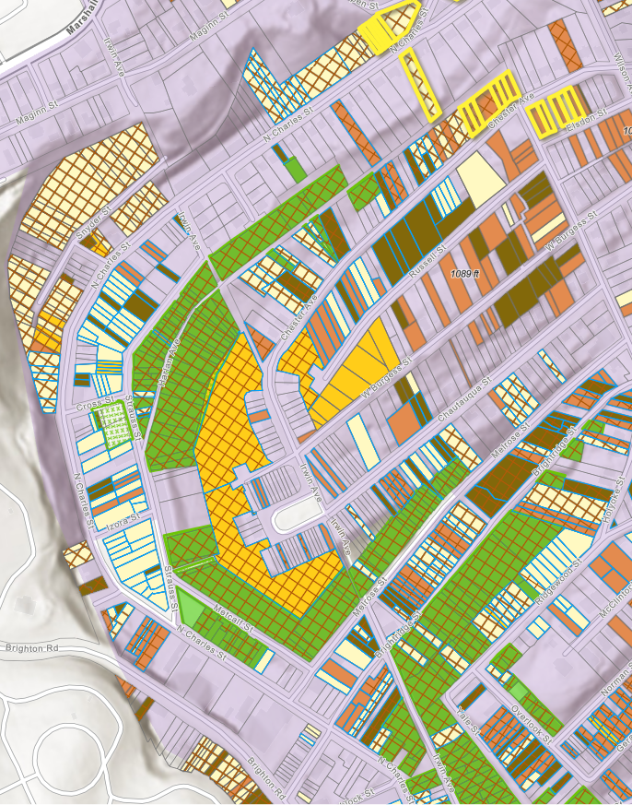
Trust for Public Land Map
Legend
Cross-hatch – Landslide prone
Light Yellow & Brown – City-owned
Green – Existing Greenway
Gold – URA-Owned
Red – Tax-Delinquent
Notes:
Explain the visual TPL geospatial analysis map

Slide 25
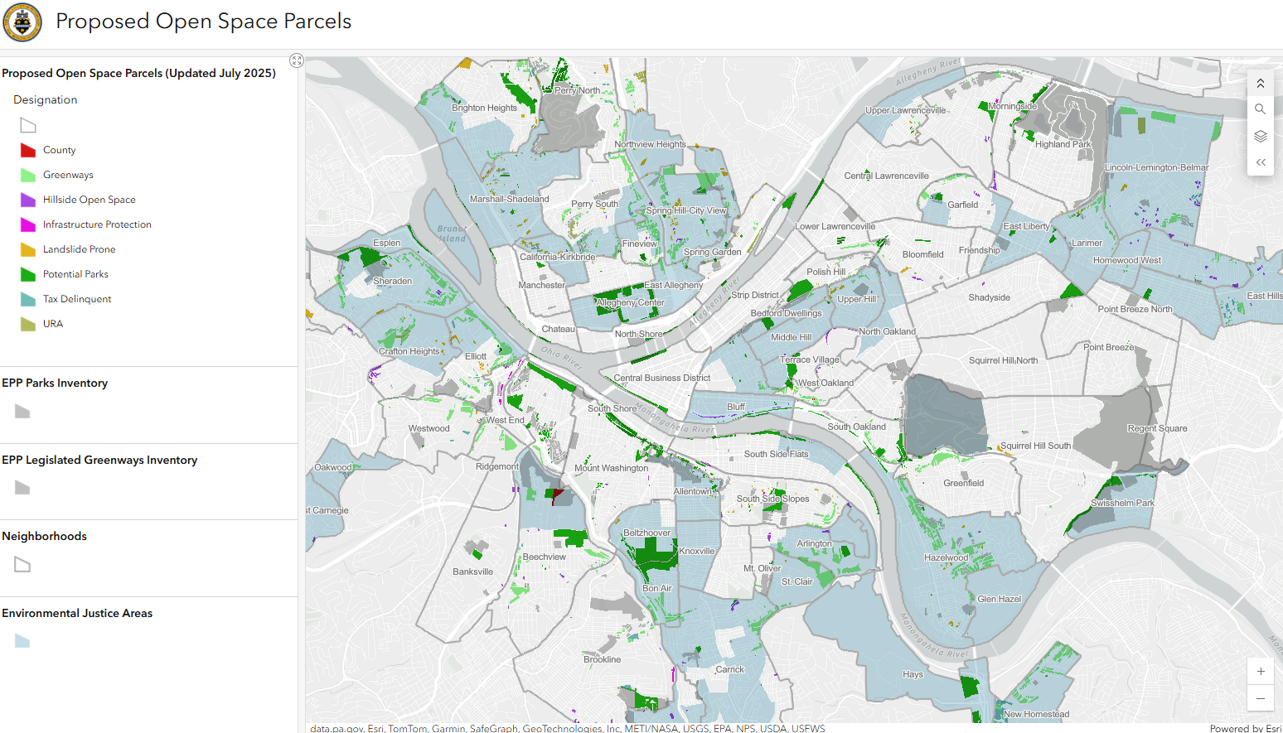

Slide 26
Questions

Slide 27
Upcoming Calendar
12/13-12/14: Cookie Tour - Butler Street & Penn Ave
12/13: Cookie Mall - Boys and Girls Club
12/14: Final day to apply for Affordable Units at Albion Lawrenceville lottery
12/24-1/1: LC and LU Offices Closed
1/31: Night at the Races - Teamsters Temple

Slide 28
Contact Information
Lawrenceville United Lawrenceville Corporation
412-802-7220 412-621-1616
info@LUnited.org info@lawrencevillecorp.com
www.lunited.org www.lvpgh.com
@lvilleunited @lvpgh
If you joined online, please sign in bit.ly/LUSignIn

