Slide 1
Lawrenceville Happenings Meeting:
PWSA, Hillman Cancer Center & Pittsburghers for Public Transit
11/07/24, 6:30 p.m., Healthy Active Living Center (4600 Butler St)
Welcome! Please sign in at bit.ly/LUSignIn if joining online

Slide 2
Tonight’s agenda
Welcome & Introductions
PWSA
Hillman Cancer Center
Bus Line Redesign - Pittsburghers for Public Transit
Open Q&A
LU & LC Upcoming Calendars

Slide 3
Accessibility
LU and LC are committed to making these meetings accessible
Let us know about any accommodations you need to fully participate
If joining by Facebook Live, drop comments/questions in the chat

Slide 4
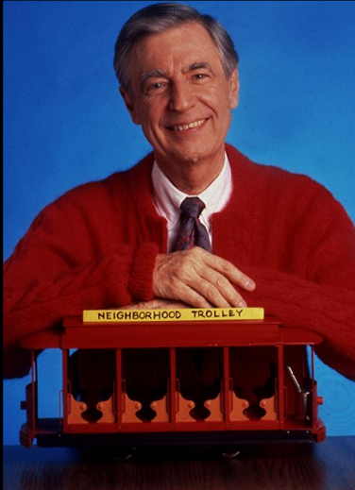
Community Agreements
Be neighborly.
Be respectful of all participants & hosts
Don’t denigrate groups of people
Give space for all to participate

Slide 5
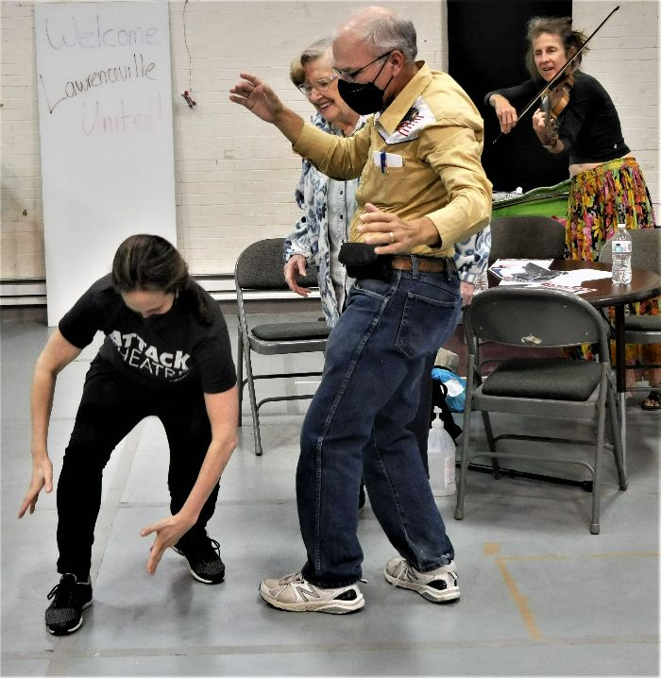
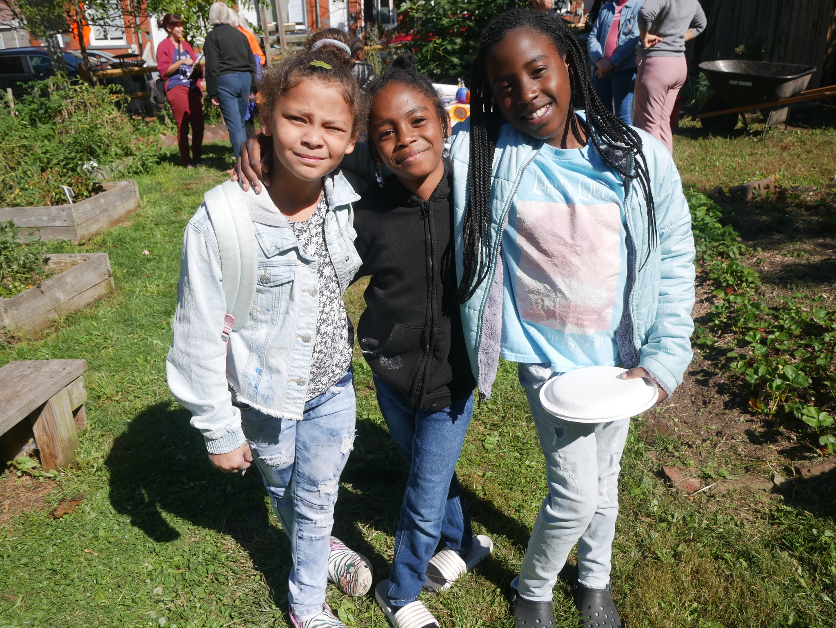
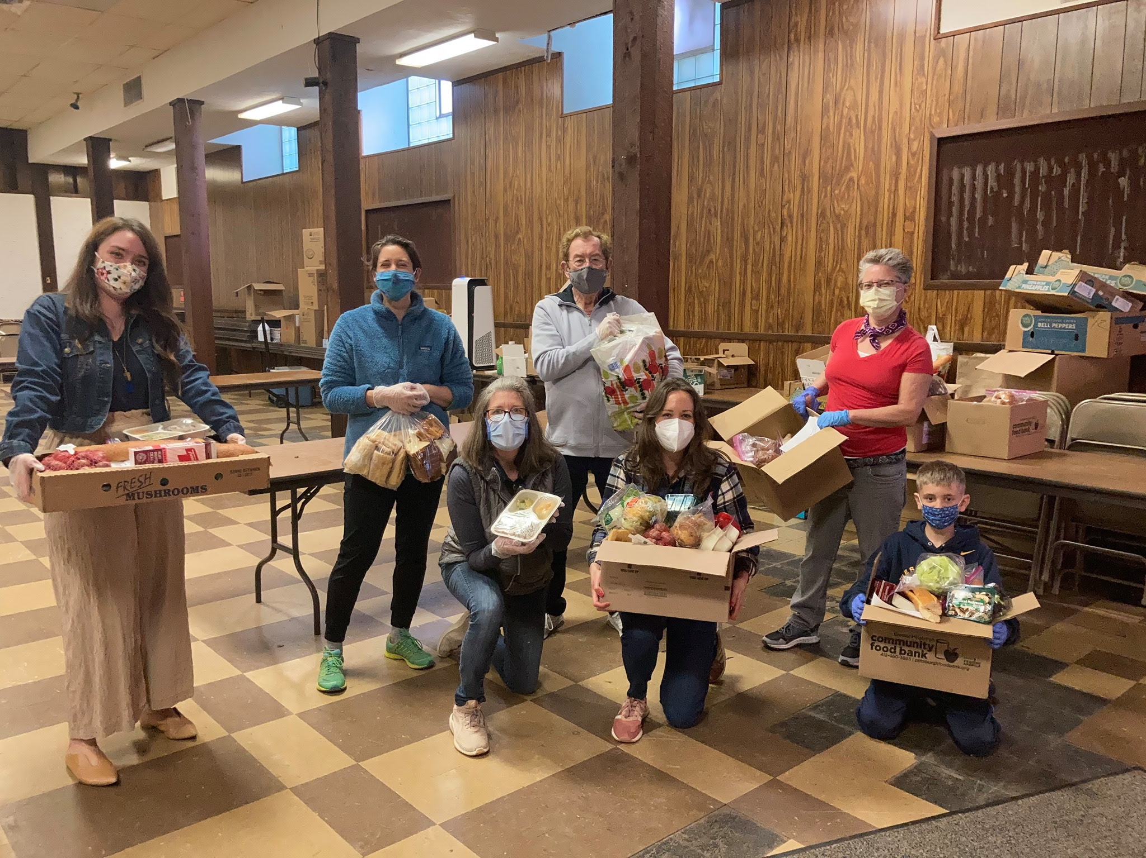
Lawrenceville United
Mission: to improve and protect quality of life for
all Lawrenceville residents
Membership of over 800 residents
Board comprised of all residents: elected by our membership
Programs: Lawrenceville Farmers Market, supporting older adults, free food distributions, cleaning & greening, direct support & case management, advocacy, and more.

Slide 6
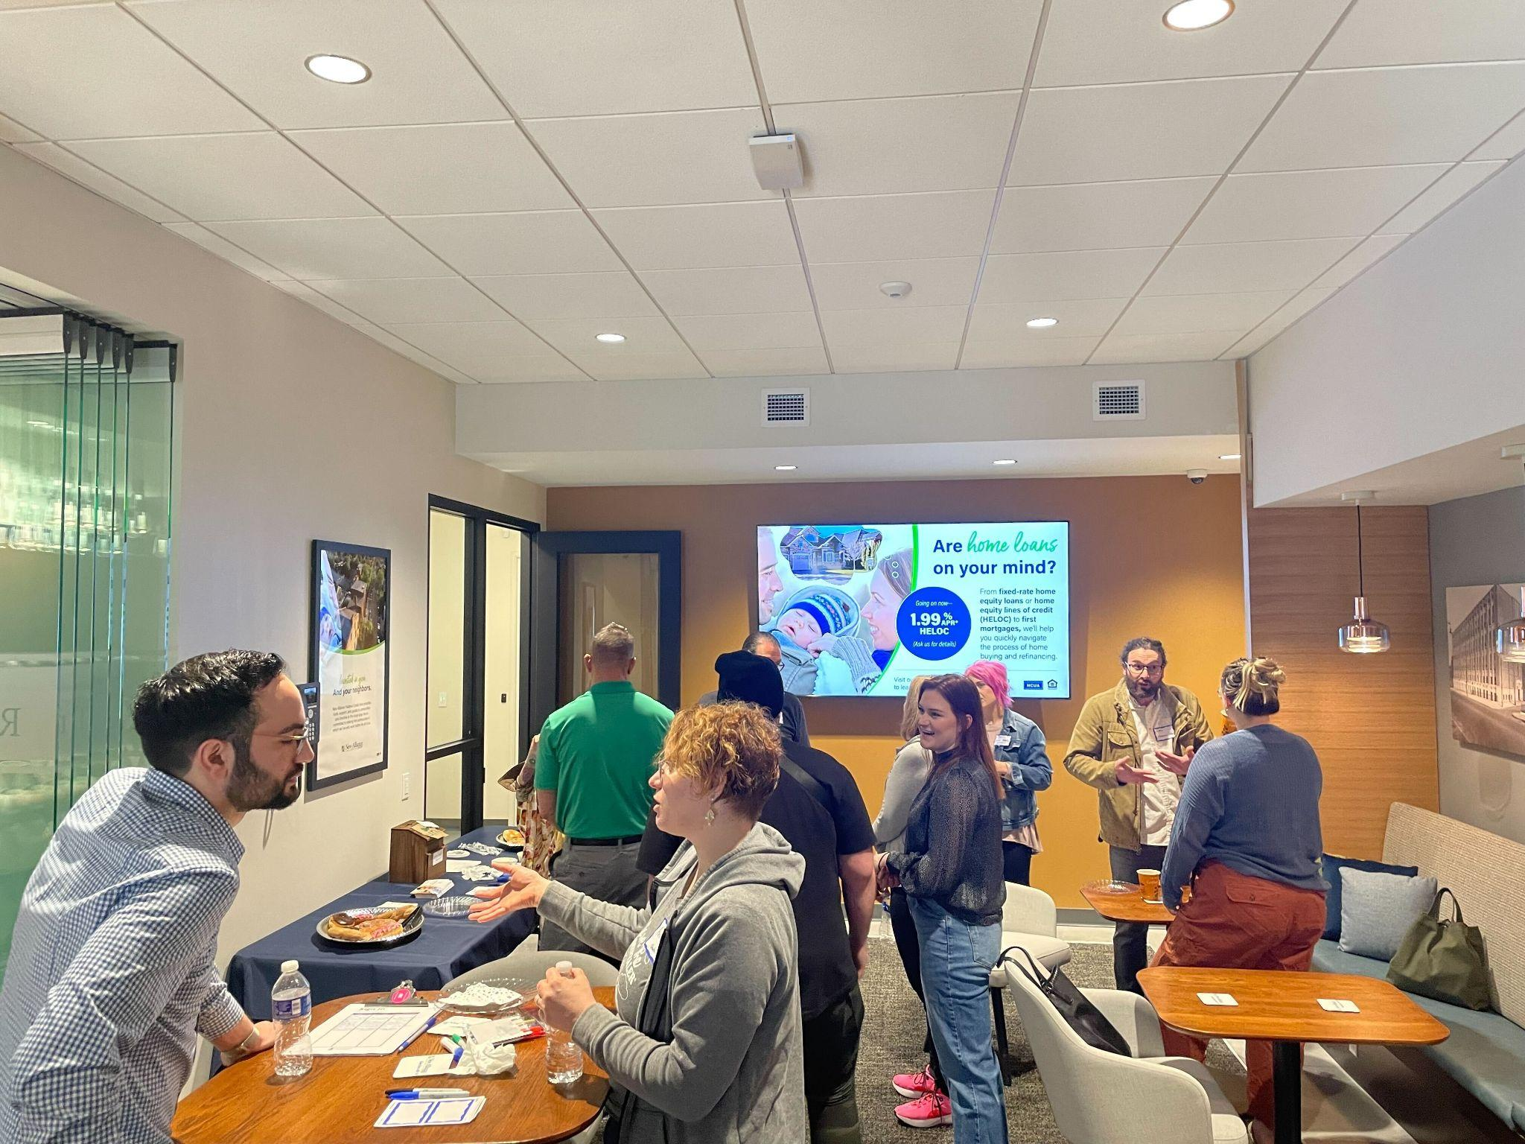
Lawrenceville Corporation
Mission: Driven by the Lawrenceville community, the Lawrenceville Corporation acts as the catalyst and conduit for responsible and sustainable growth.
Membership: About 100, primarily business owners
Board: Mostly comprised of residents, property owners, and business owners and elected by our membership - 16 members
Programs: Business district management, policy and advocacy, community planning and development, real estate development, and communications and marketing

Slide 7
Rachel Rampa
Senior Public Affairs Coordinator at Pittsburgh Water & Sewage Authority

Slide 42
PRT’s Bus Line Redesign
What we need to do.

Slide 43
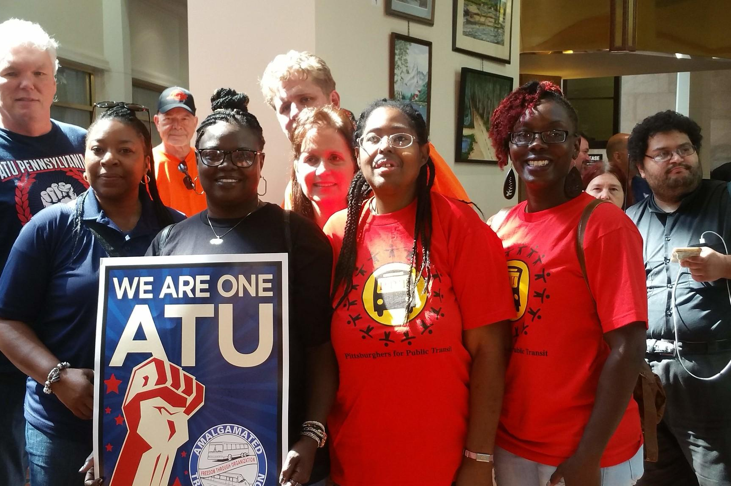
Who is PPT?
A grassroots union of transit riders, workers and neighbors.
Organizing for expanded, affordable and accessible public transit
To meet all transit needs, with no communities left behind

Slide 44
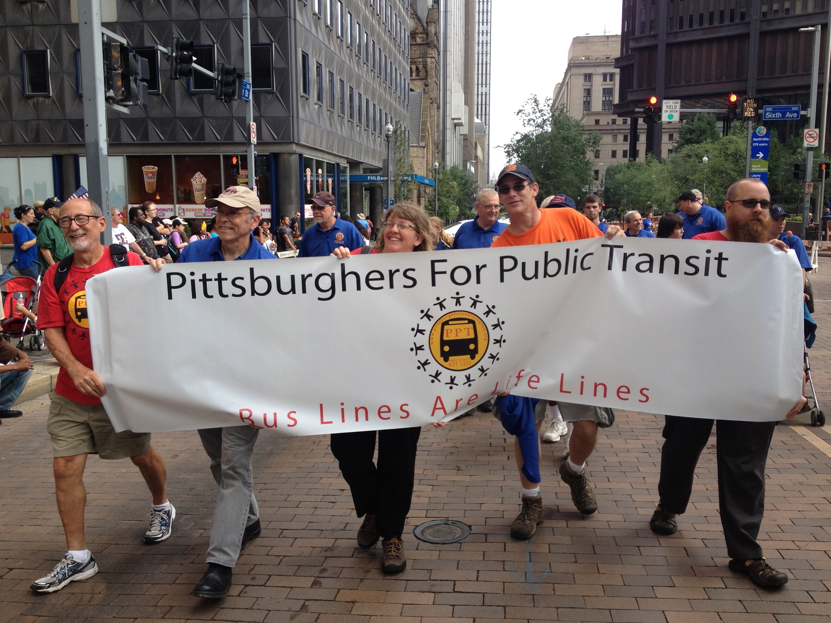
History
Founded in 2010
To oppose service cuts - 130 routes lost since 2006
Transit Deserts

Slide 45
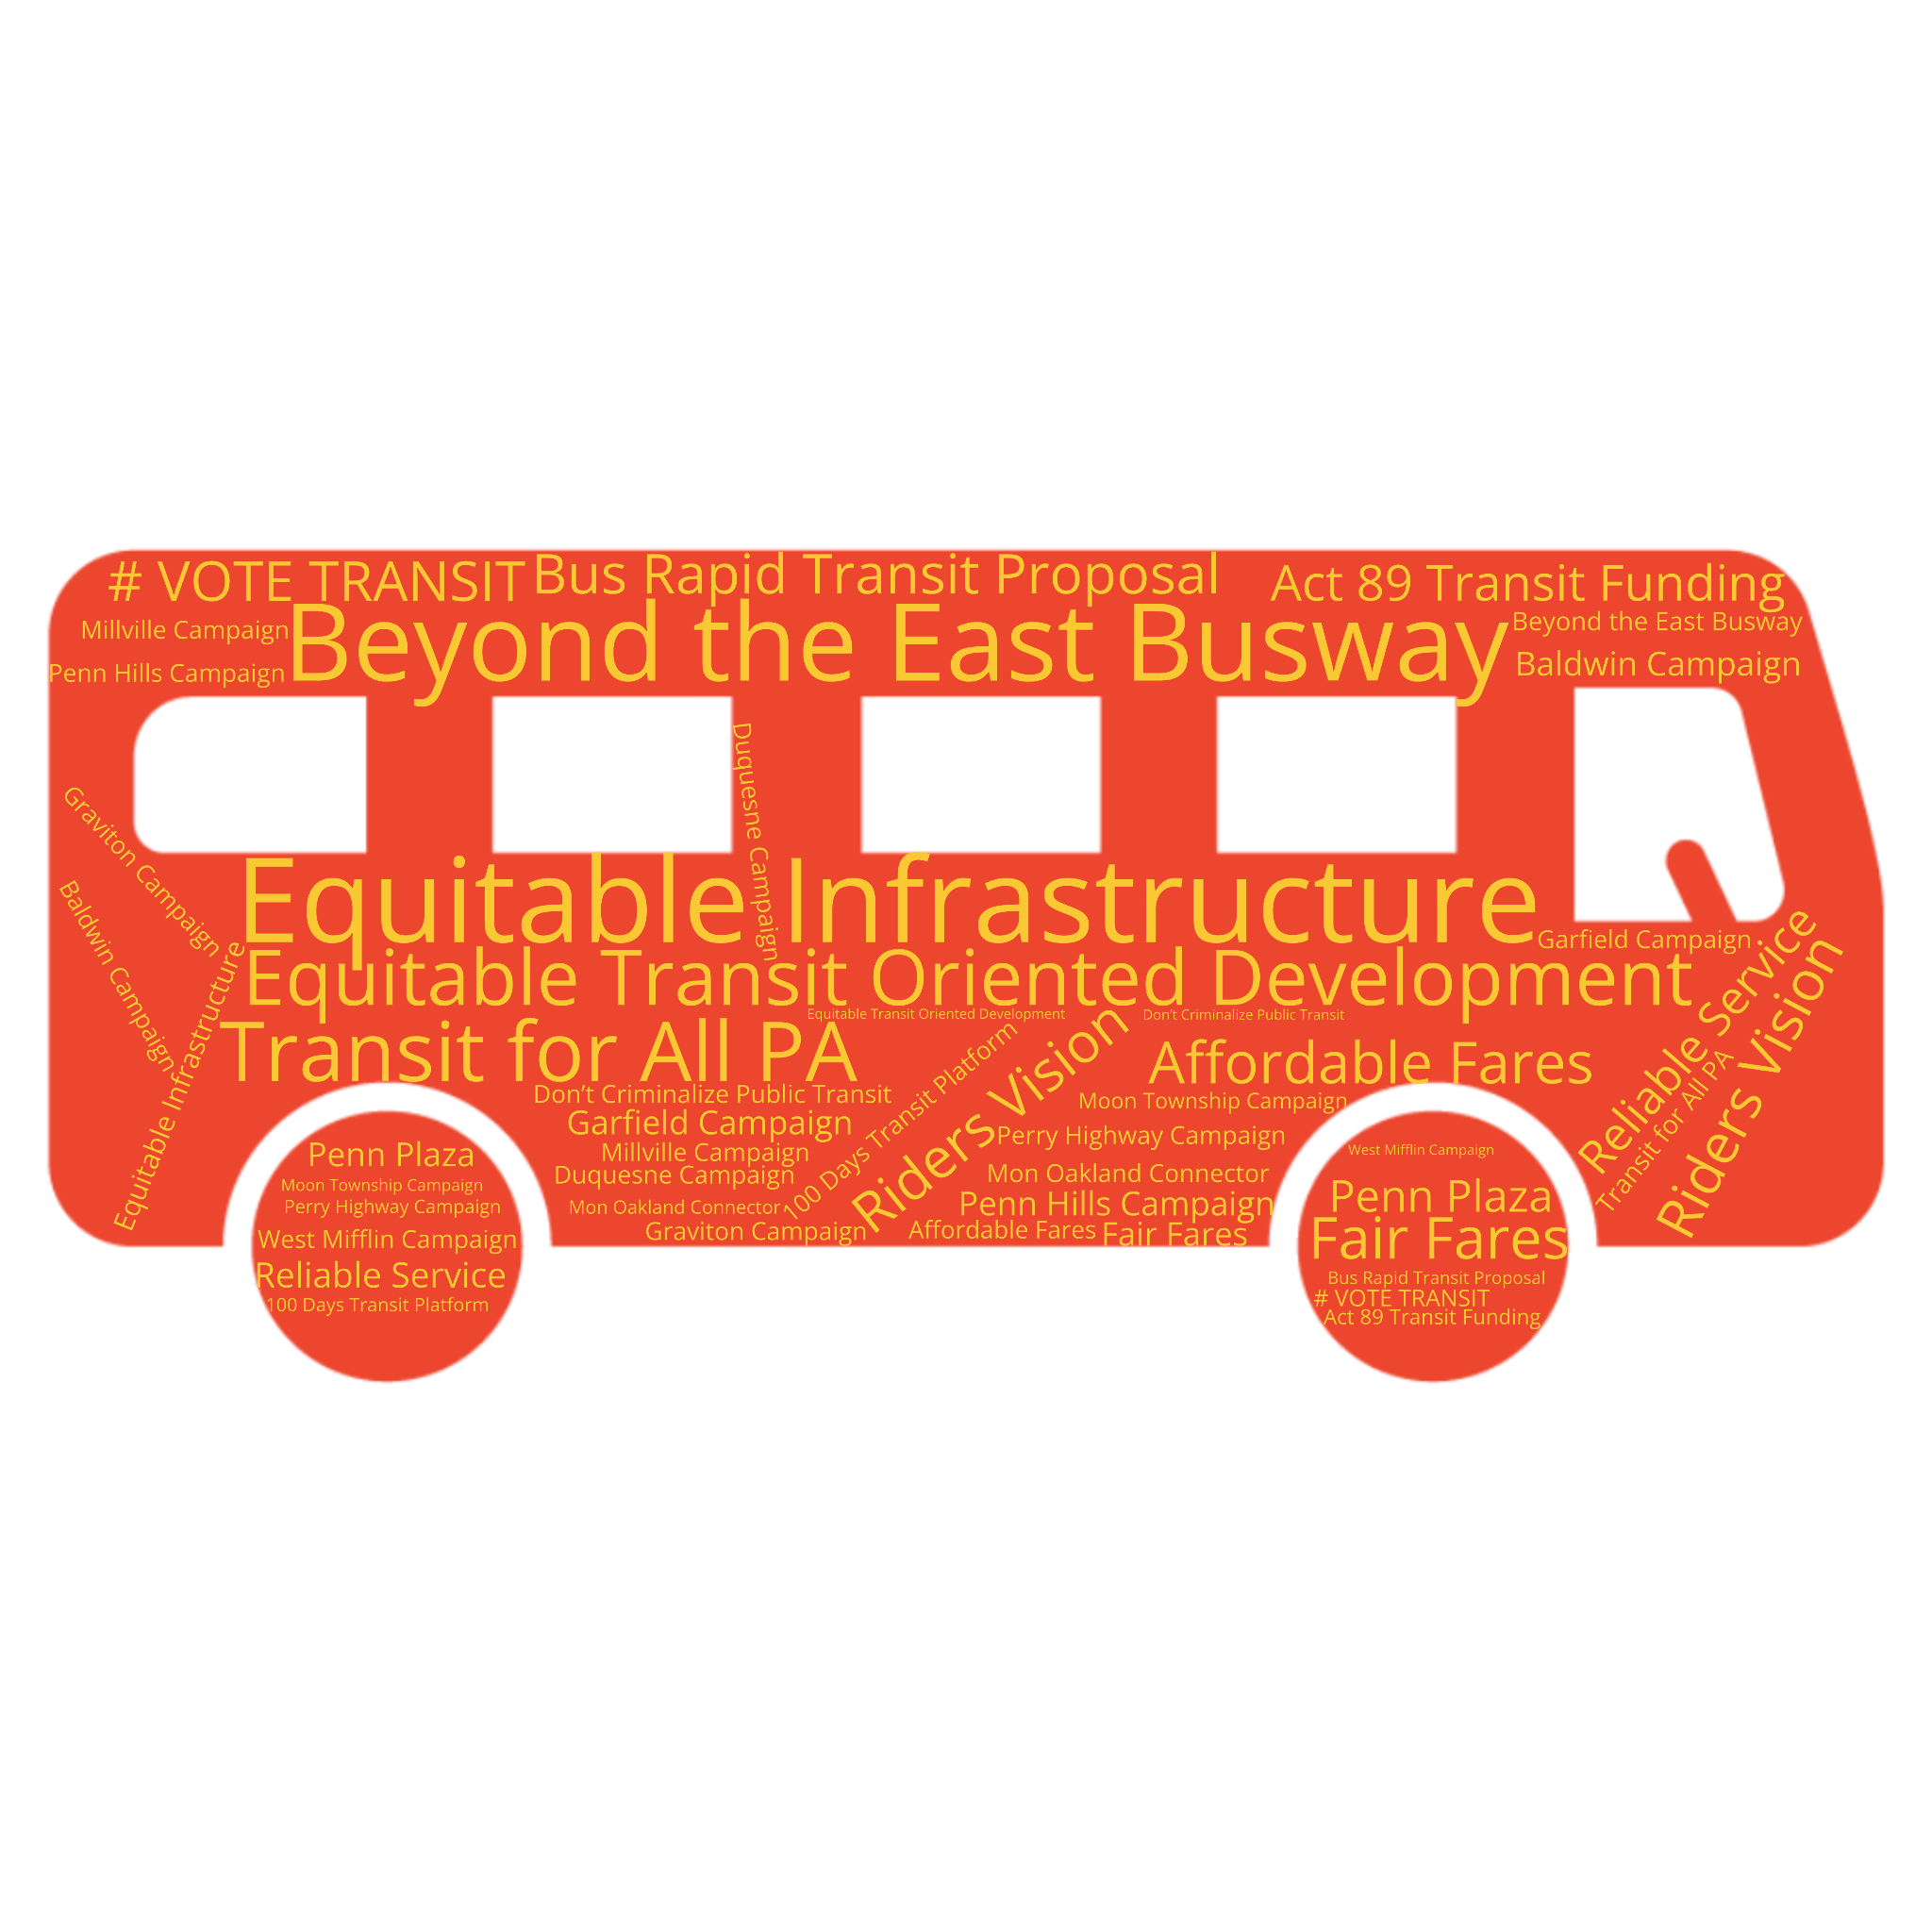
Some of our Campaigns…

Slide 46
PRT Bus Redesign

Slide 47
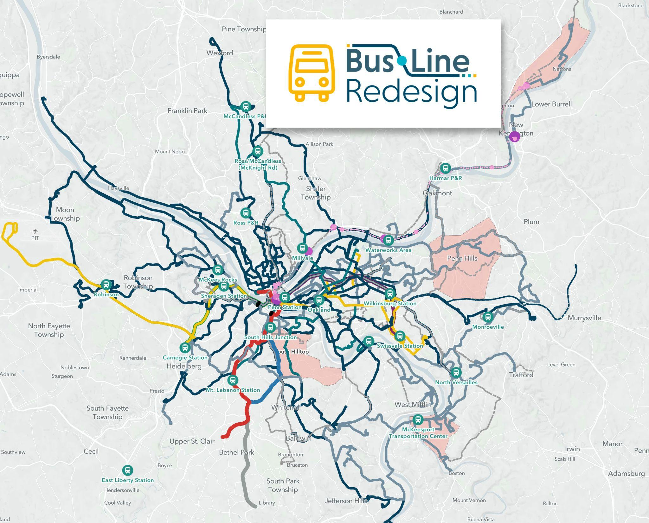
What’s Changing?
Nearly Every Route
Nearly Every Stop
Nearly Every Schedule

Slide 48
91 --> changing to D91, will stay roughly the same inbound, but end in Highland Park outbound and appears to have significantly less frequency. This is probably the top concern from my vantage point?
93 --> changing to 53 and eliminating Lawrenceville altogether
64 --> changing to N94, will extend to Millvale and East Lib station
88 --> changing to D88, will extend to Wilkinsburg station
54 --> changing to O99 and mostly cutting out Lawrenceville except for Liberty Ave. Will stop in Oakland
87 --> D87, will connect to East Lib & Stanton Heights
86 --> D86, extending to Penn Hills
O3: new route that will provide access to McCandless / McKnight Blvd / Millvale / Oakland
D81: new route that will provide access from Waterworks to downtown with Oakland & Hill District between
N84: new route that will provide access to Polish Hill, Hill District, South Side
Lawrenceville Impacts

Slide 49
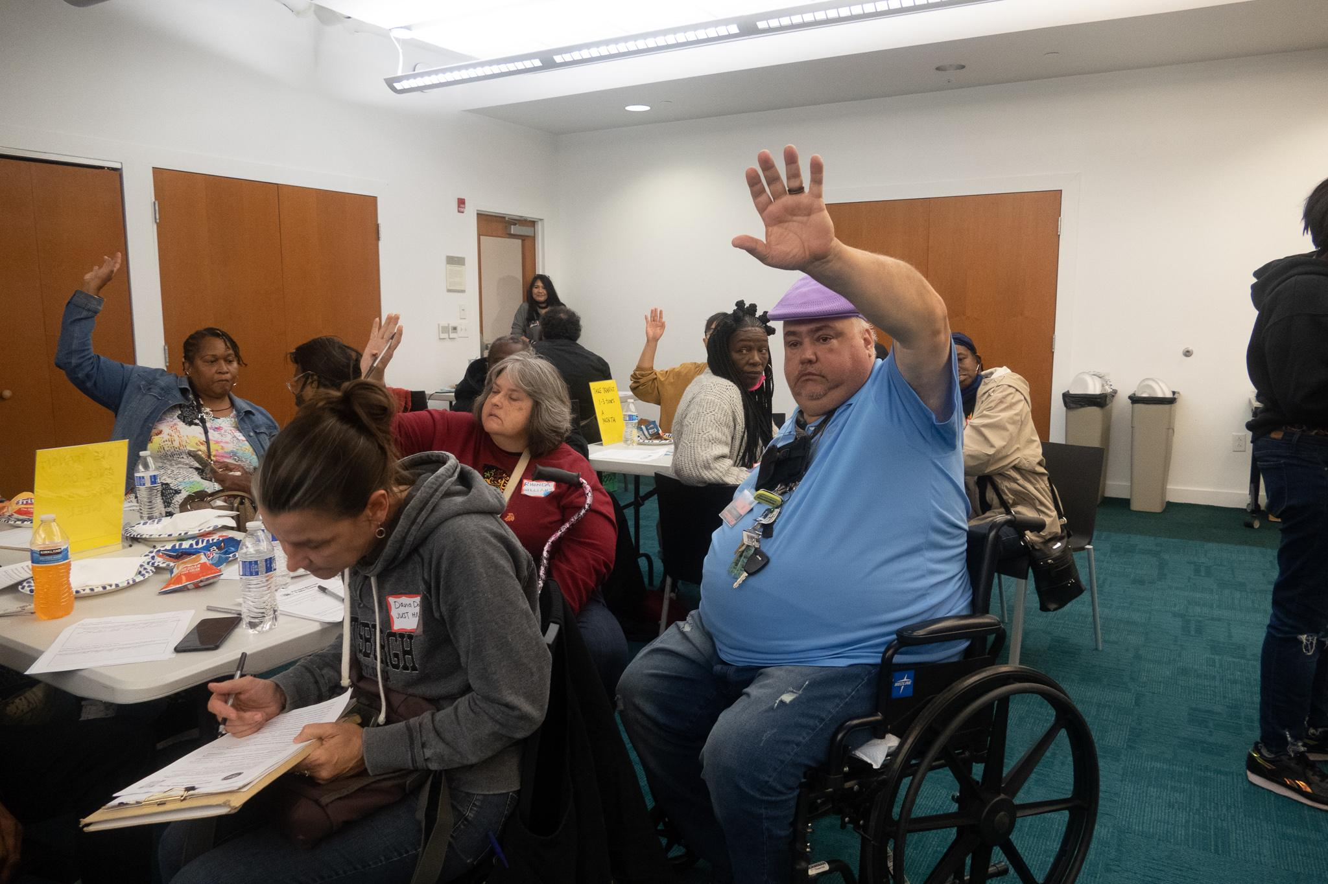
Your Voice Must Be Heard
Transit riders and transit workers organizing together
A redesign that works for all
engage.rideprt.org

Slide 50
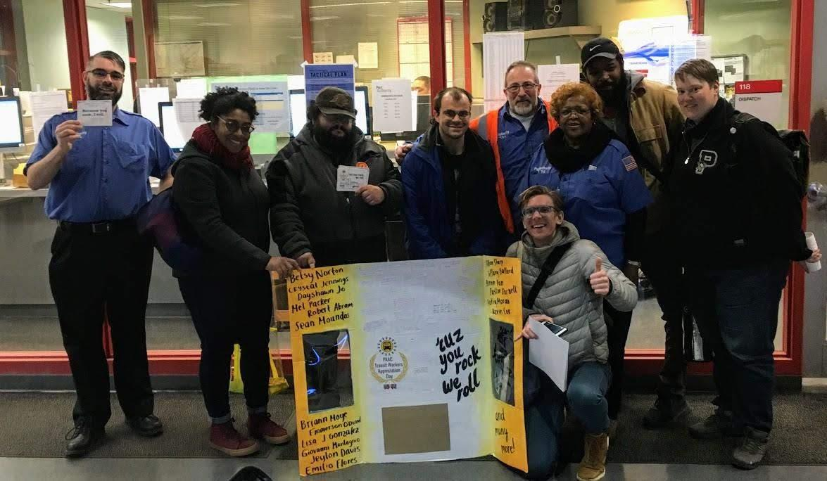
Review and Give Feedback
The Good Things

Slide 51
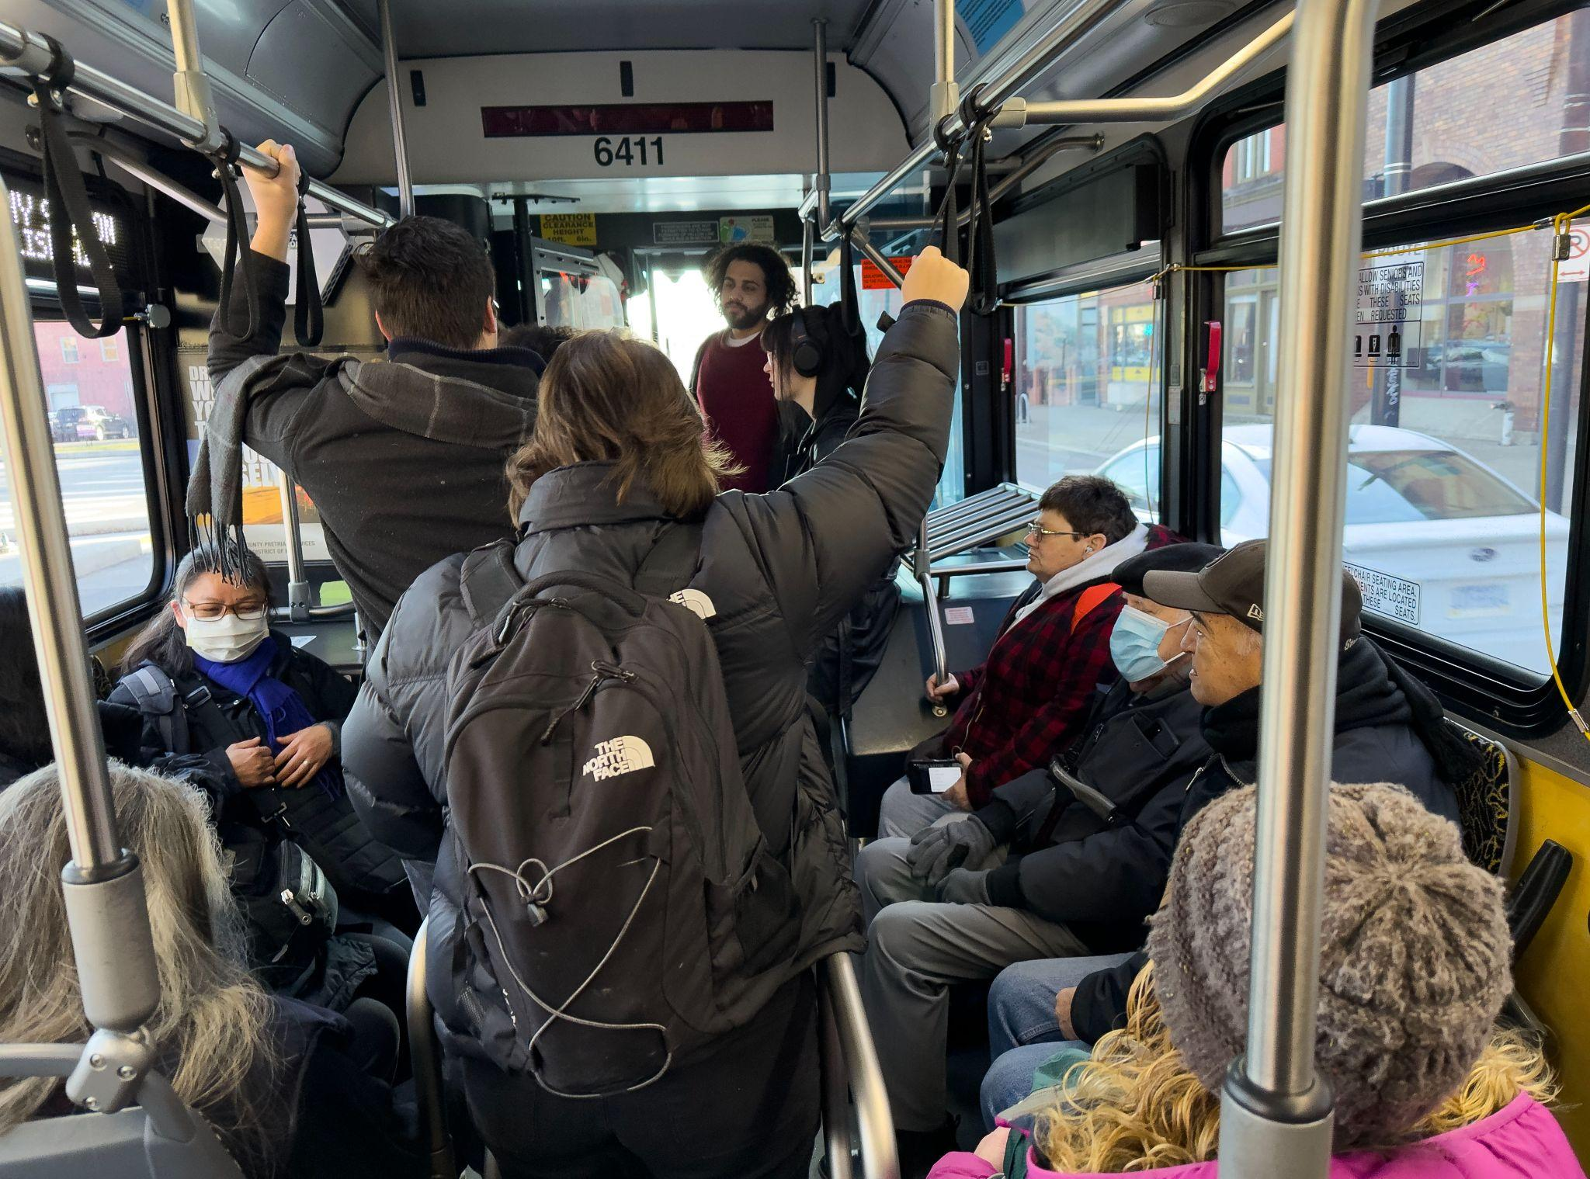
Review and Give Feedback
The Good Things
Service Quality

Slide 52
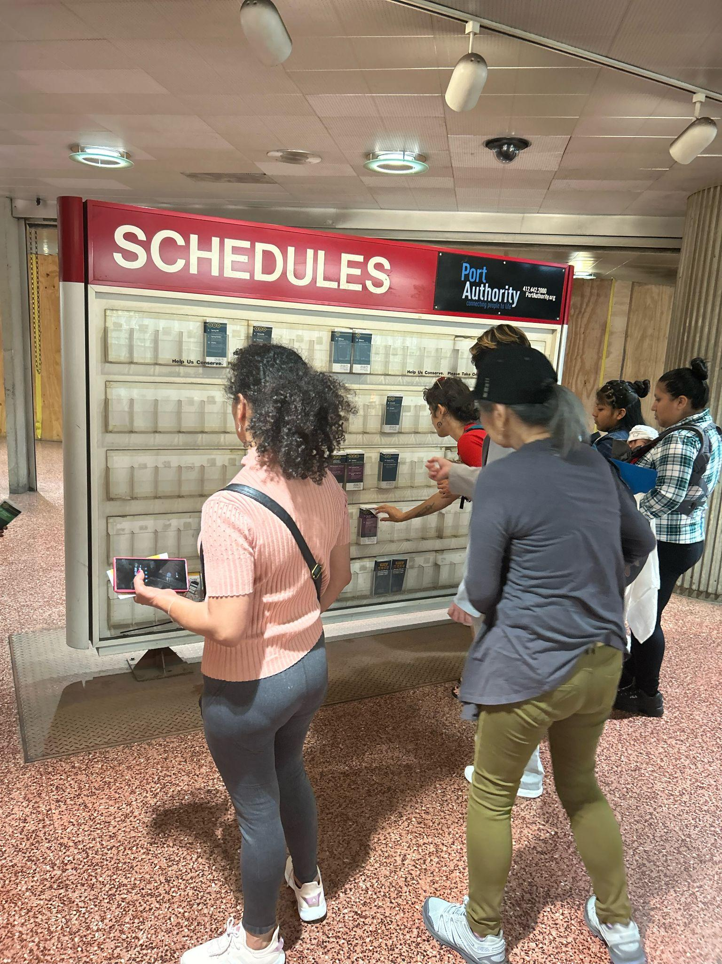
Review and Give Feedback
The Good Things
Service Quality
Key Destinations

Slide 53
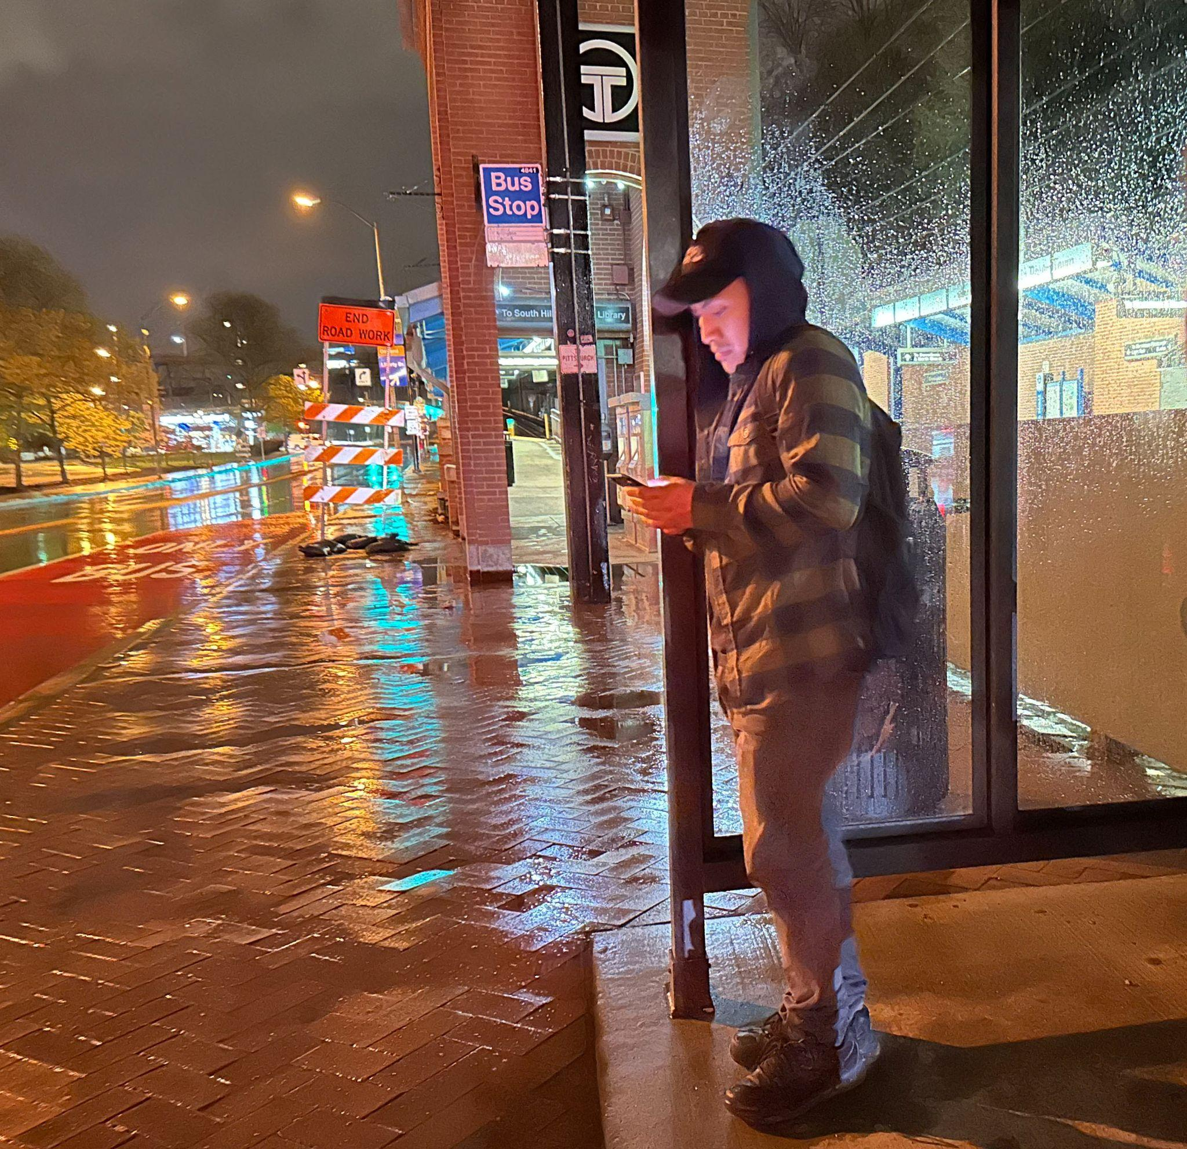
Review and Give Feedback
The Good Things
Service Quality
Key Destinations
Commute Times

Slide 54
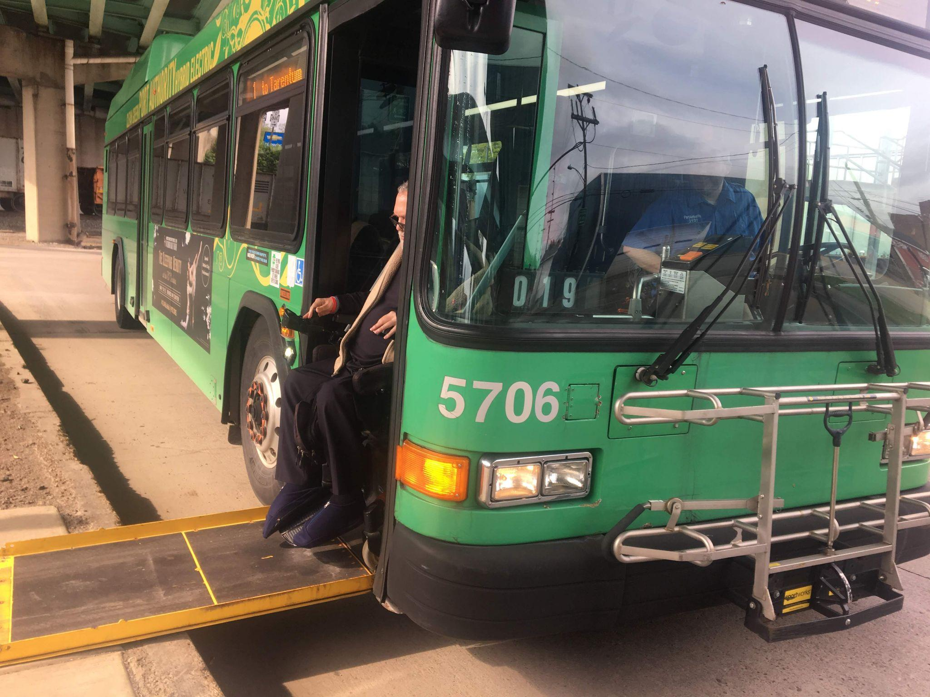
Review and Give Feedback
The Good Things
Service Quality
Key Destinations
Commute Times
Accessibility

Slide 55
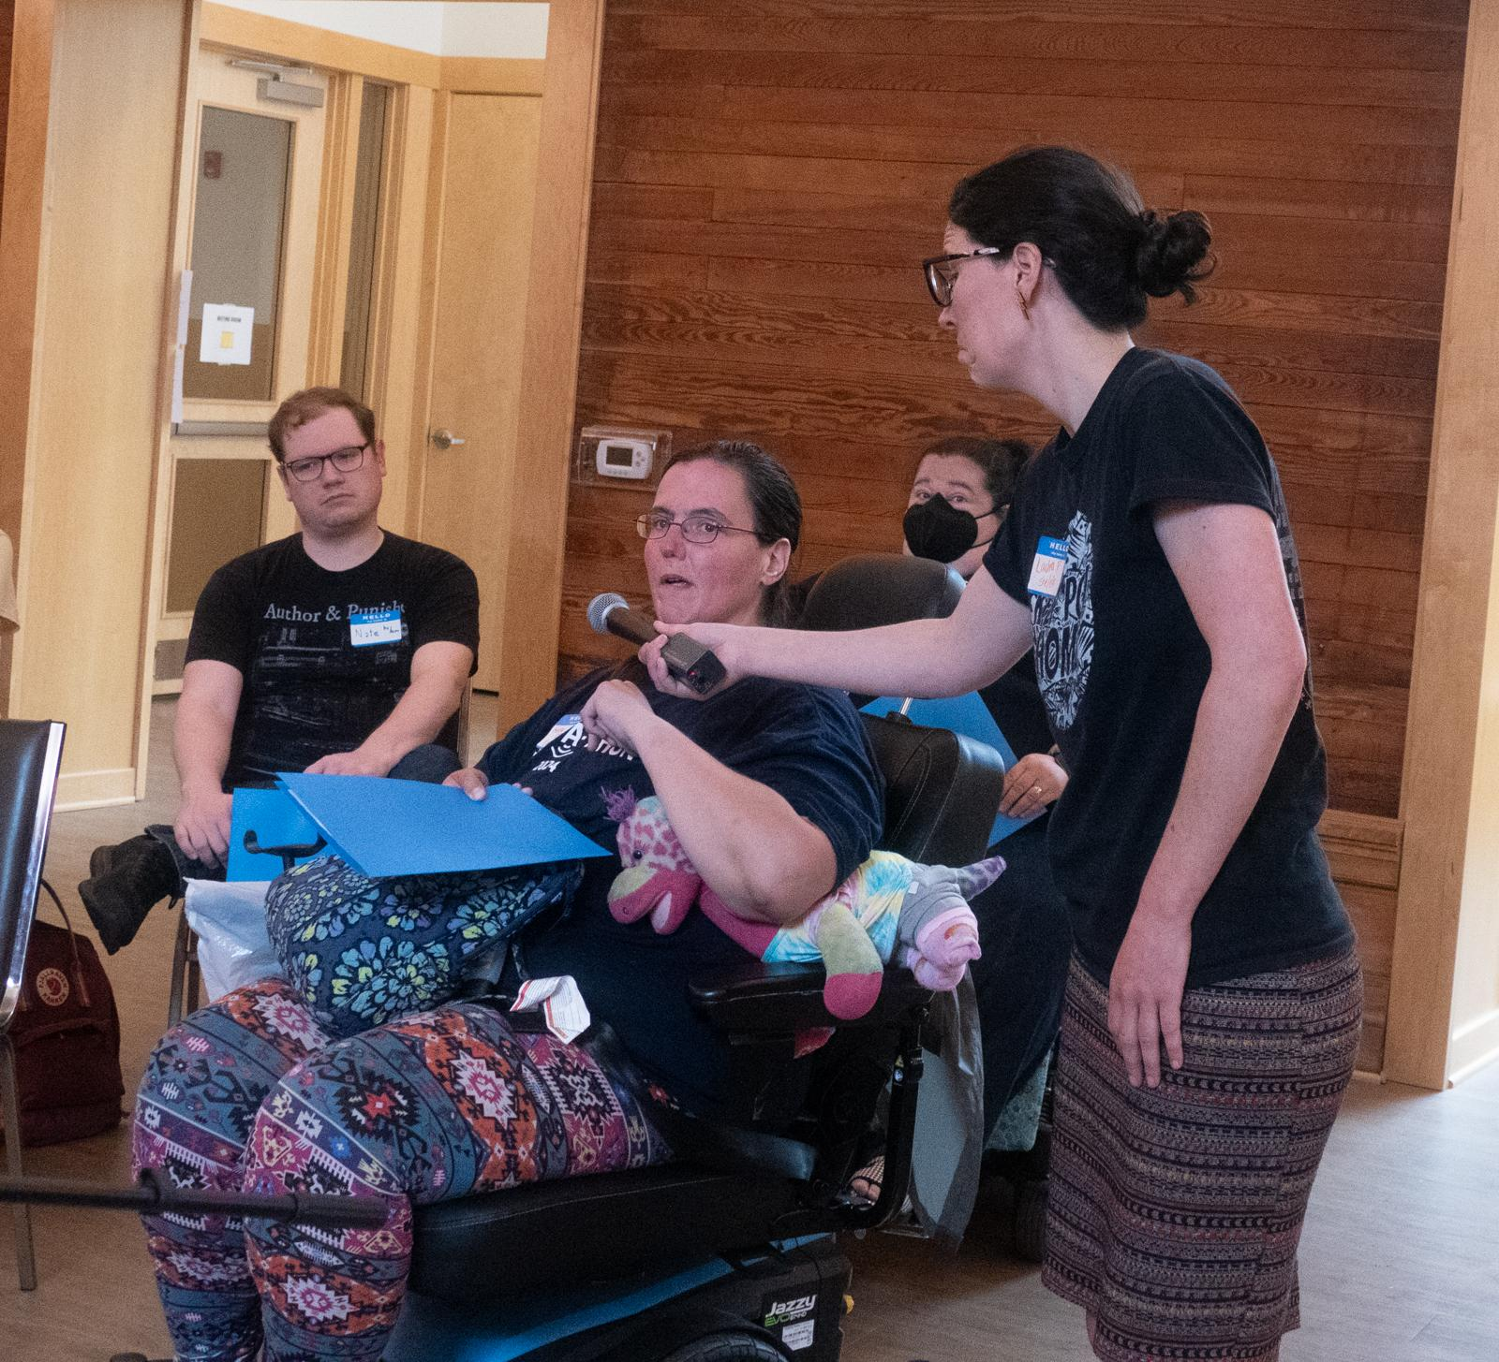
Review and Give Feedback
The Good Things
Service Quality
Key Destinations
Commute Times
Accessibility
Other Thoughts

Slide 56
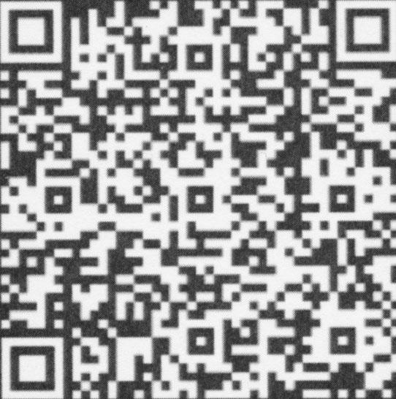
Sign On To Support A Transit System For All!
With changes this big,
we need to organize together
bit.ly/redesignforall

Slide 57
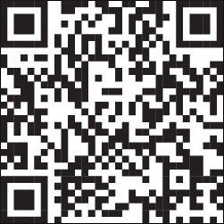
Pittsburghers for Public Transit
pittsburghforpublictransit.org

Slide 58
Opportunities for feedback/advocacy with PRT
Review the Draft Network 1.0
Ways to give input
Bus Line Redesign Events
PRT Community Meeting / Outreach with Lawrenceville coming in early 2025 (date is TBD)

Slide 59
Questions?

Slide 60
Upcoming Calendar
Every Tuesday (through 11/26) - Lawrenceville Farmers Market (115 Bay41)
12/5 - Lawrenceville United Member Meeting
12/14-12/15 - Cookie Tour along Butler St from 12-5 PM
12/14 - Cookie Mall at the Boys and Girls Club (4600 Butler St) from 1-4:30 PM
Tree lighting at 5 PM at Allegheny Cemetery

Slide 61
Comments, questions
Lawrenceville United Lawrenceville Corporation
412-802-7220 412-621-1616
info@LUnited.org info@lawrencevillecorp.com
If you joined online, please sign in bit.ly/LUSignIn if

