Slide 1
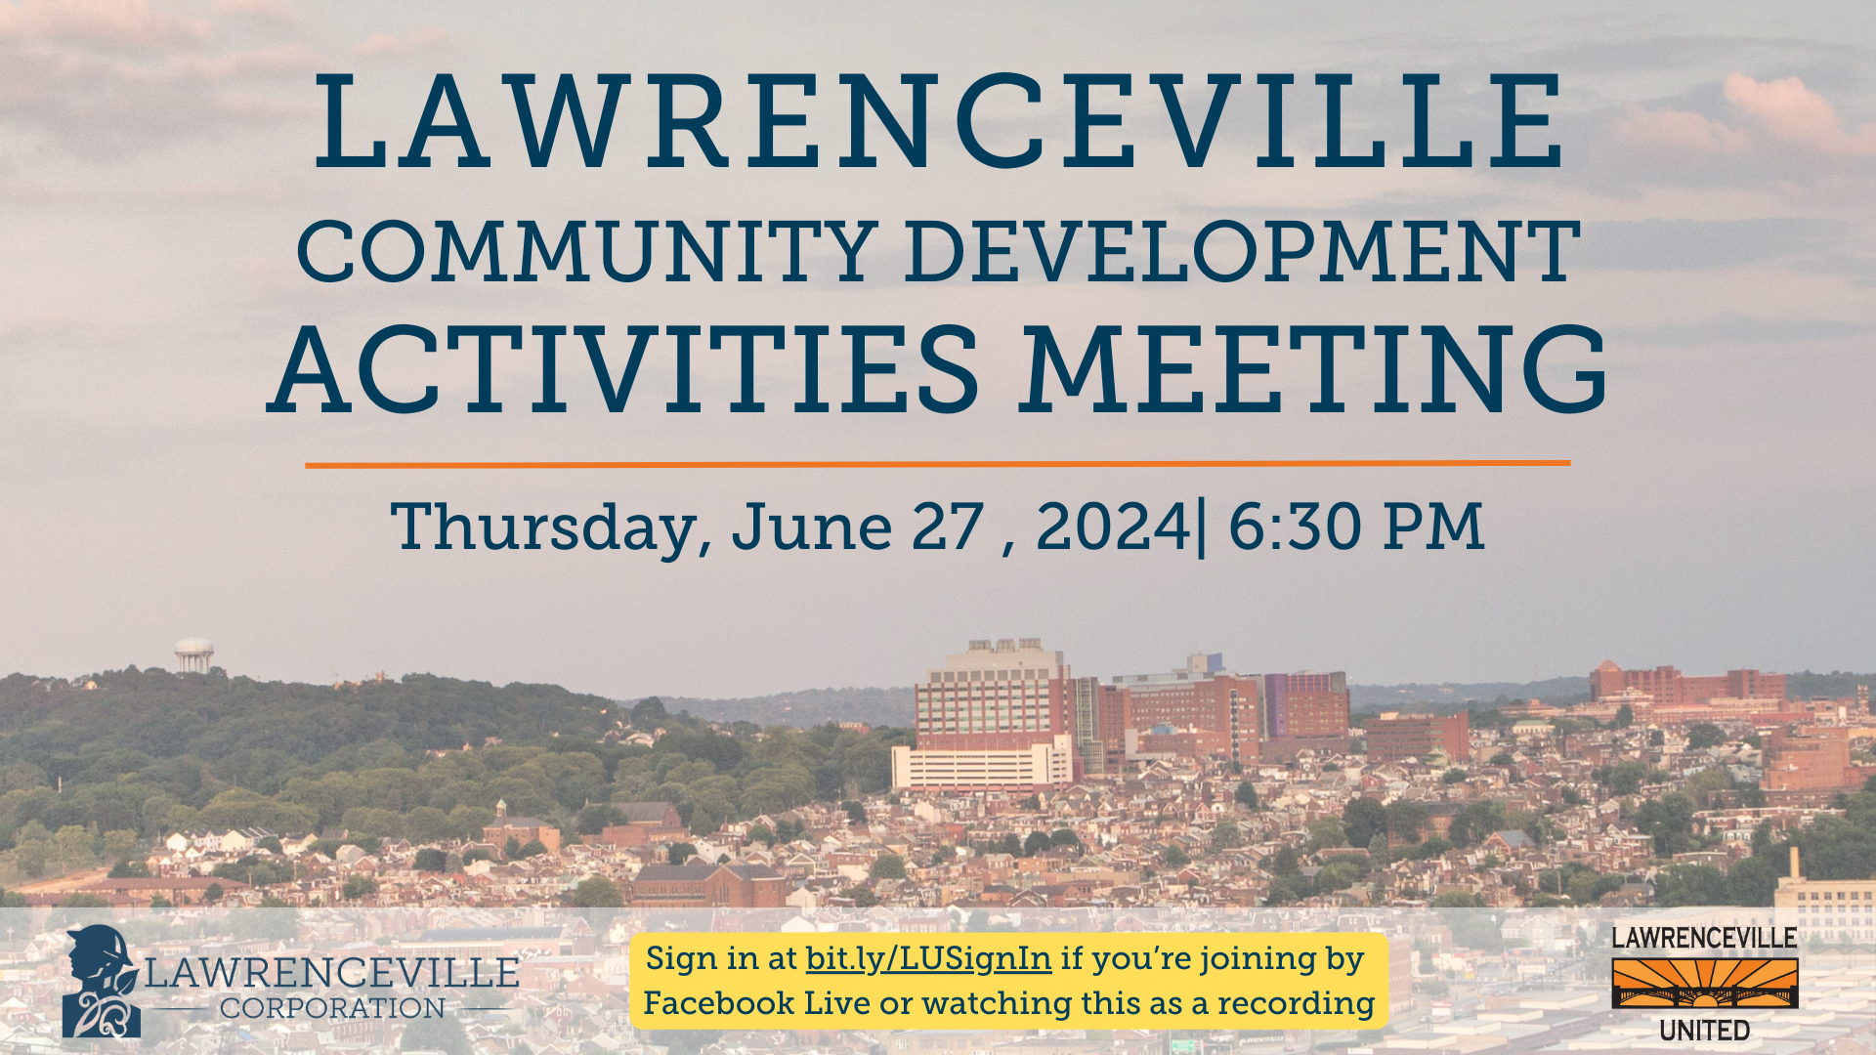
Notes:
dave

Slide 2


Agenda
Welcome & introductions
Community Process Overview and Agreements
About this process
Implementation steps
DOMI’s Parking Analysis Findings
Next steps
Q&A
Notes:
dave

Slide 3

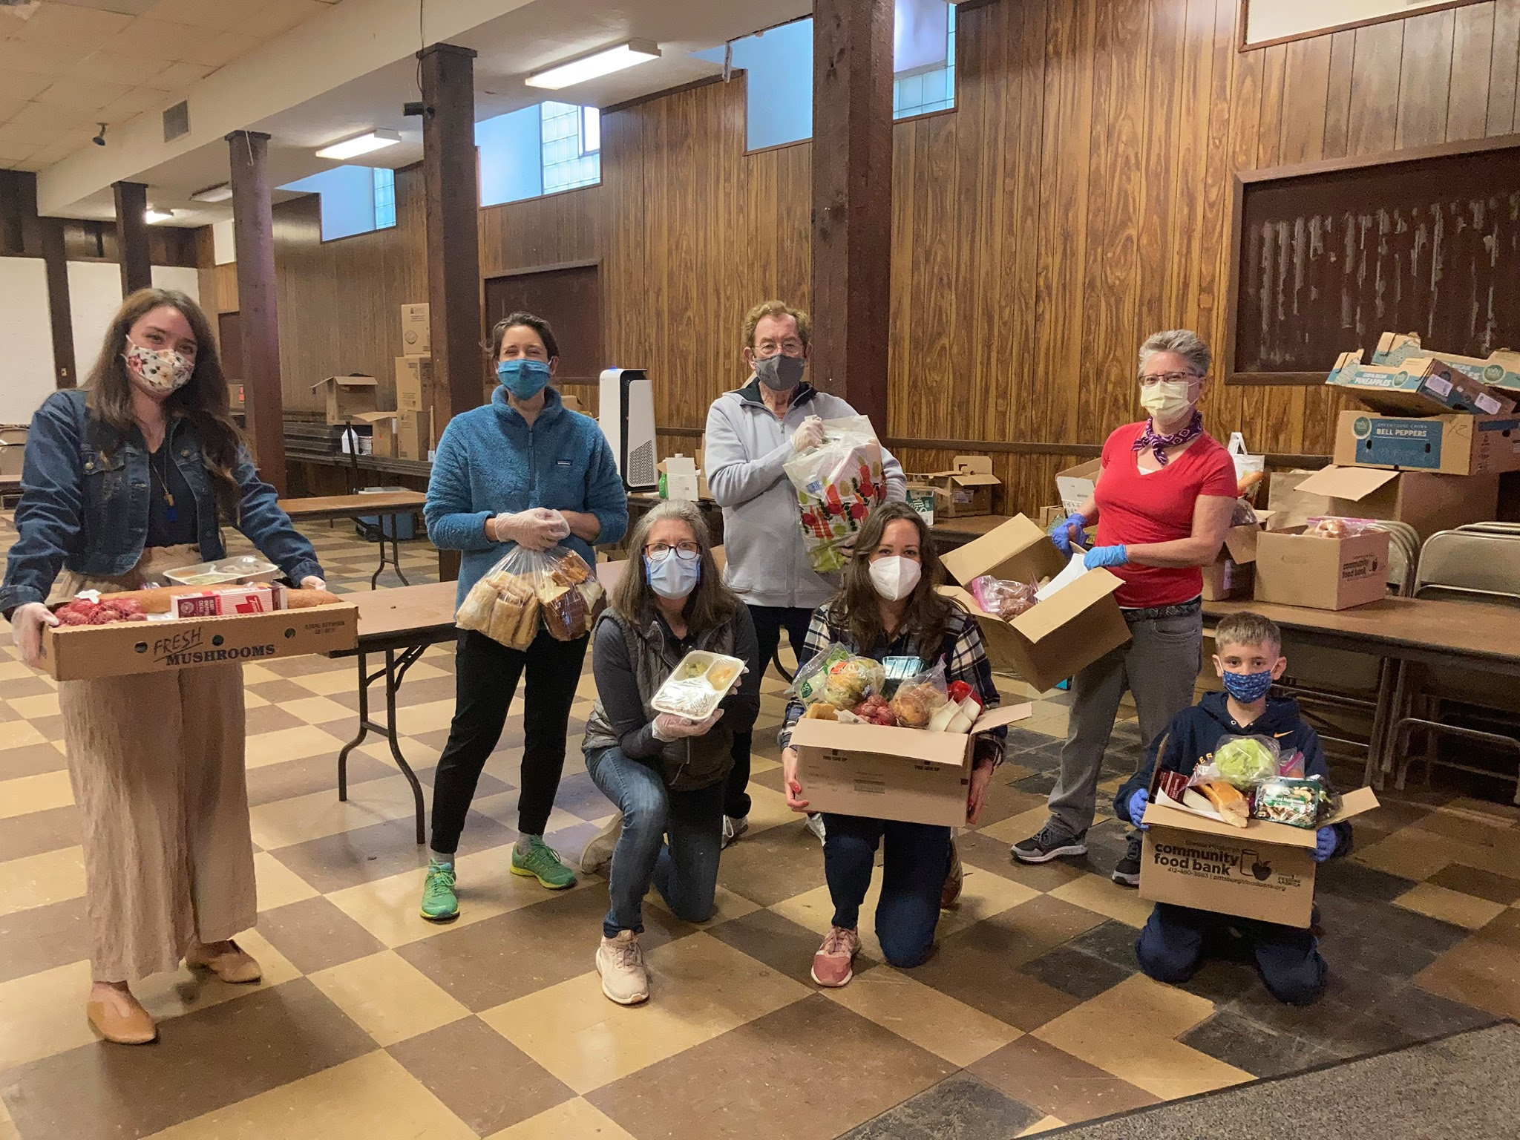
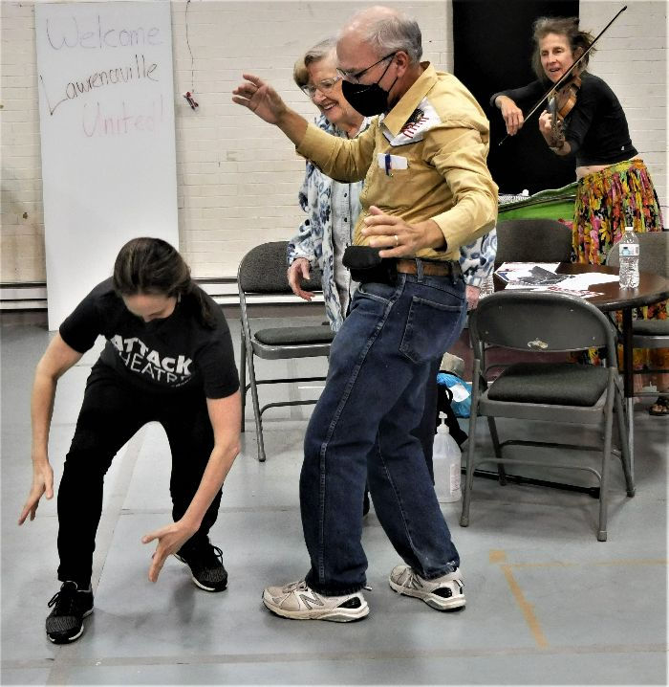
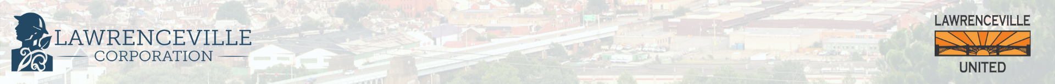
About Lawrenceville United
Mission: to improve and protect quality of life for all Lawrenceville residents
Membership of over 850 residents
Board comprised of all residents: elected by our membership
Programs: Lawrenceville Farmers Market, supporting older adults, free food distributions, cleaning & greening, direct support & case management, advocacy, and more.
Notes:
dave

Slide 4
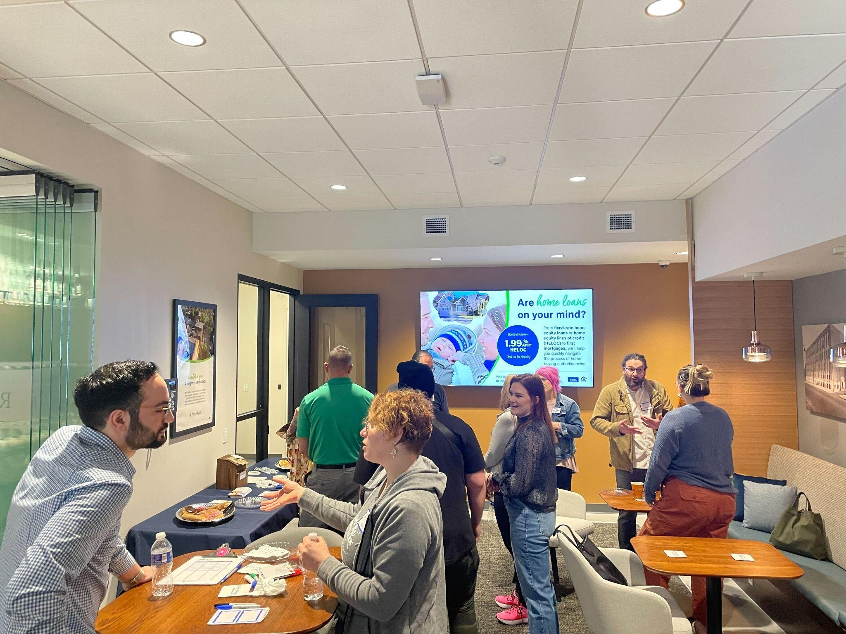

About Lawrenceville Corporation
Mission: Driven by the Lawrenceville community, the Lawrenceville Corporation acts as the catalyst and conduit for responsible and sustainable growth.
Membership: 120, primarily business owners
Board: Mostly comprised of residents, property owners, and business owners and elected by our membership - 16 members
Programs: Business district management, policy and advocacy, community planning and development, real estate development, events, and communications and marketing
Notes:
Sarah

Slide 5
Accessibility
Accessibility
LU and LC are committed to making these meetings accessible
Let us know about any accommodations you need to fully participate
If joining by Facebook Live, drop comments/questions in the chat

Slide 6
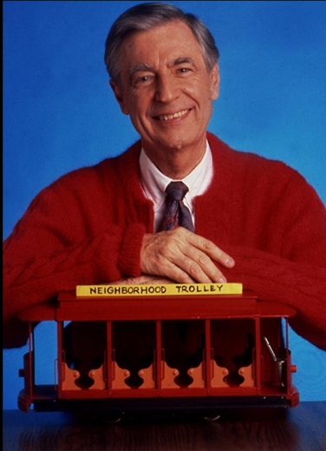
Community Agreements
Be neighborly.
Be respectful of all participants & hosts
Don’t denigrate groups of people
Give space for all to participate

Slide 7
Ground Rules
Hold all questions/comments until the end of the presentation (you can drop in the chat if you’re joining by Zoom / Facebook Live).
Raise your hand to make a question/comment. Please identify yourself and your relationship to the project.
Be respectful of all speakers & community members.
Limit questions/comments to 2 minutes each, with 1 clarification question/comment.
If time permits, we will call on individuals who’d like to ask or make a second question/comment.
Use the “feedback form” to ask more questions and give us your input
If ground rules are violated, we will ask you to leave. If it continues, we will end the meeting.

Slide 8
Why did we go through this process?
Grassroots organizing: mobility is critical to quality of life and improving foot traffic in business district
Community development: mobility & parking issues are major tension point
Community plans identify specific interventions to improve our public realm & manage parking demand, but progress has been slow
Neighborhood metrics: we deserve better
Notes:
Sarah

Slide 9
What is the Mobility Enhancement District?
The Mobility Enhancement District is legislation written by Councilwoman Deb Gross that aims to better manage parking demand along the commercial district in Lawrenceville, while funding much-needed mobility and infrastructure improvements to make Lawrenceville safer, more accessible, and easier to get around for all community members, while increasing foot traffic that our small business community depends on.
A dedicated, locally controlled source of funds for mobility improvements in Lawrenceville, which would come from:
New meters along Butler Street
Nighttime enforcement of meters
Dynamic pricing that would capture extra revenue when demand is at its peak
This is a 1 year pilot
Notes:
Sarah

Slide 10
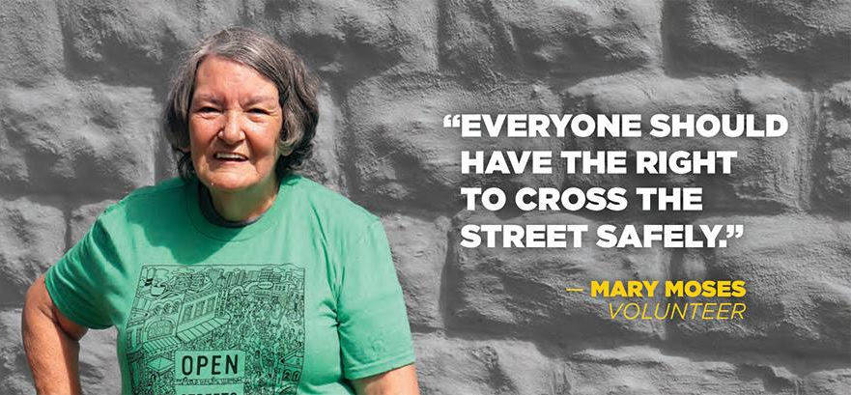
Goals for this program
Create positive, community-determined mobility enhancements to our neighborhood streets to benefit community members and visitors
Improve our public infrastructure
Manage parking demand more effectively
Notes:
SARAH

Slide 11
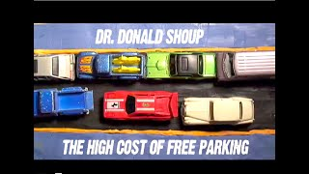
The High Cost of Free Parking with Dr. Donald Shoup
Notes:
SARAH

Slide 12
PROCESS over the past year
4/13/23: Kick-off meeting, feedback form opened
4/18/23: Open House #1 @ Trace Brewery
4/29/23: Open House #2 @ Ice House Studios
5/1/23: Open House #3 @ Boys & Girls Club
5/4/23: Feedback form closed
5/11/23: Public Process close out
10/4/23 and 10/23/23: Council hearings
10/23/23: Legislation passes
11/2023-Present: Implementation Phase
Notes:
Sarah

Slide 13
Initial questions we asked
How can we improve mobility in Lawrenceville?
How might a Mobility Enhancement District support these goals?
Should we consider new metered parking locations?
Should we consider changes to existing meter enforcement?
Should we consider new or amended Residential Permit Parking?
Notes:
SARAH

Slide 14
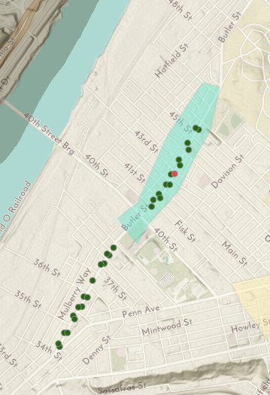
Where are current meters?
Butler Street from 34th - 46th
Enforced 8 AM to 6 PM, Mon-Sat at $2/hr
  4 hour max in Lower LV
  2 hour max in Central LV
*Additional off-street metered lot between 52nd and McCandless on Butler Street
Notes:
Sarah

Slide 15
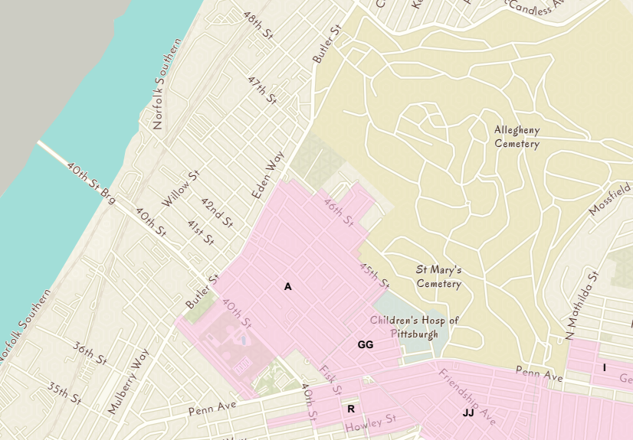
Where is there Residential Permit Parking?
Notes:
Sarah

Slide 16
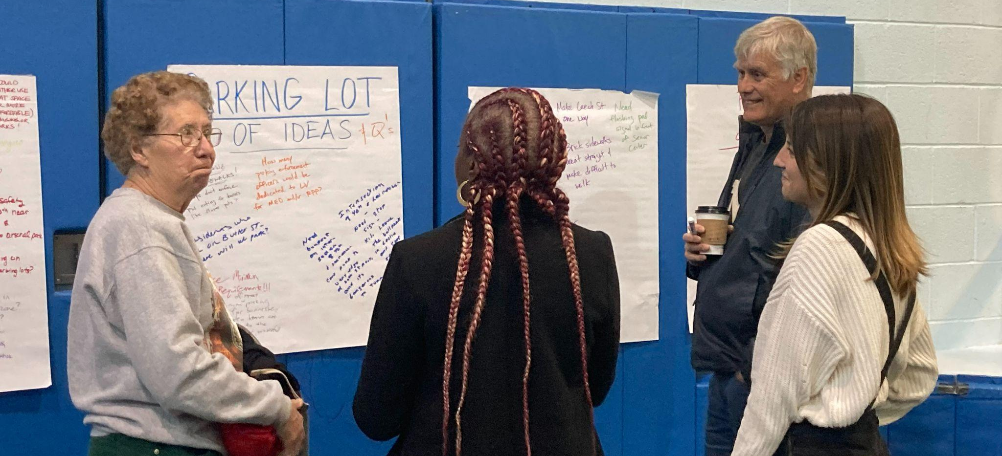
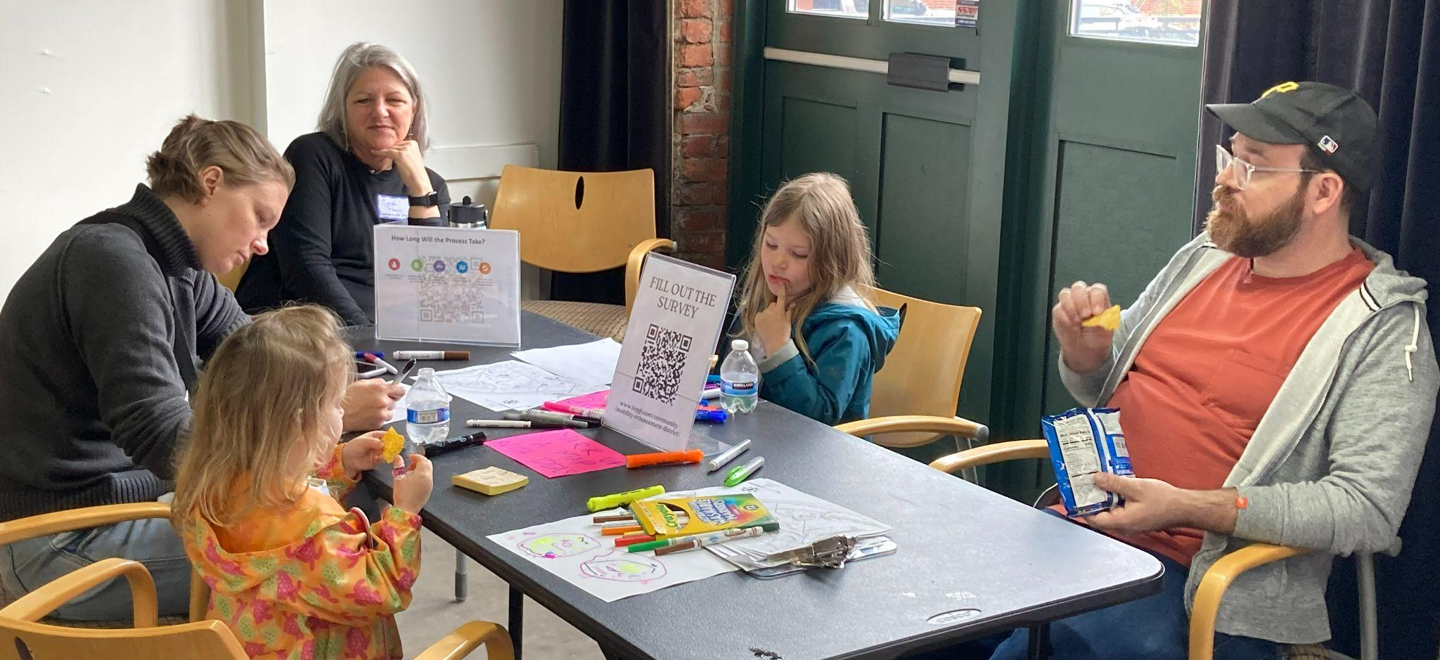
ENGAGEMENT by the numbers:
Attendance: 110+
Survey Responses: 189
Social Media: 17,500
E-comms: 7,400
Phone calls & conversations: A LOT
Notes:
Sarah

Slide 17
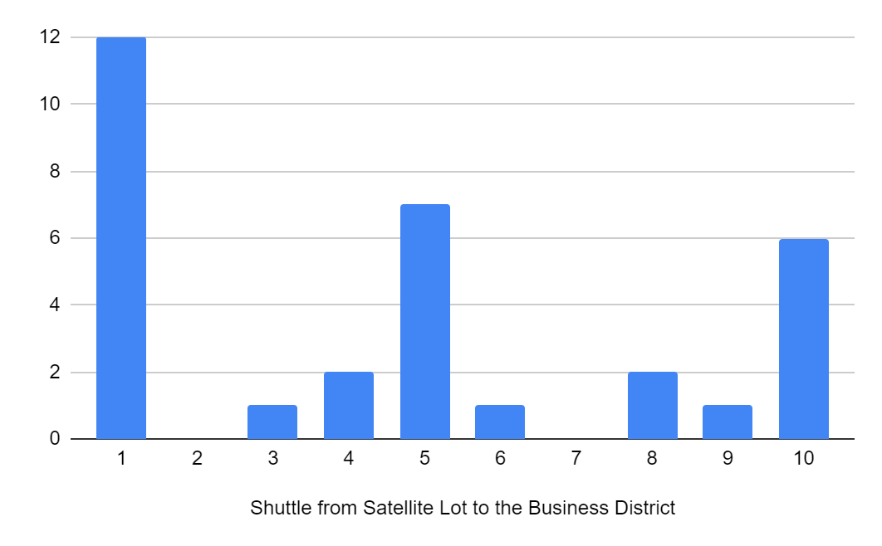
How would you like to see MED funds used?
Some interest in shuttle among business owners
Top 3
Safety improvements for Pedestrians and Cyclists
Accessibility Improvements
Traffic Calming
Notes:
dave

Slide 18
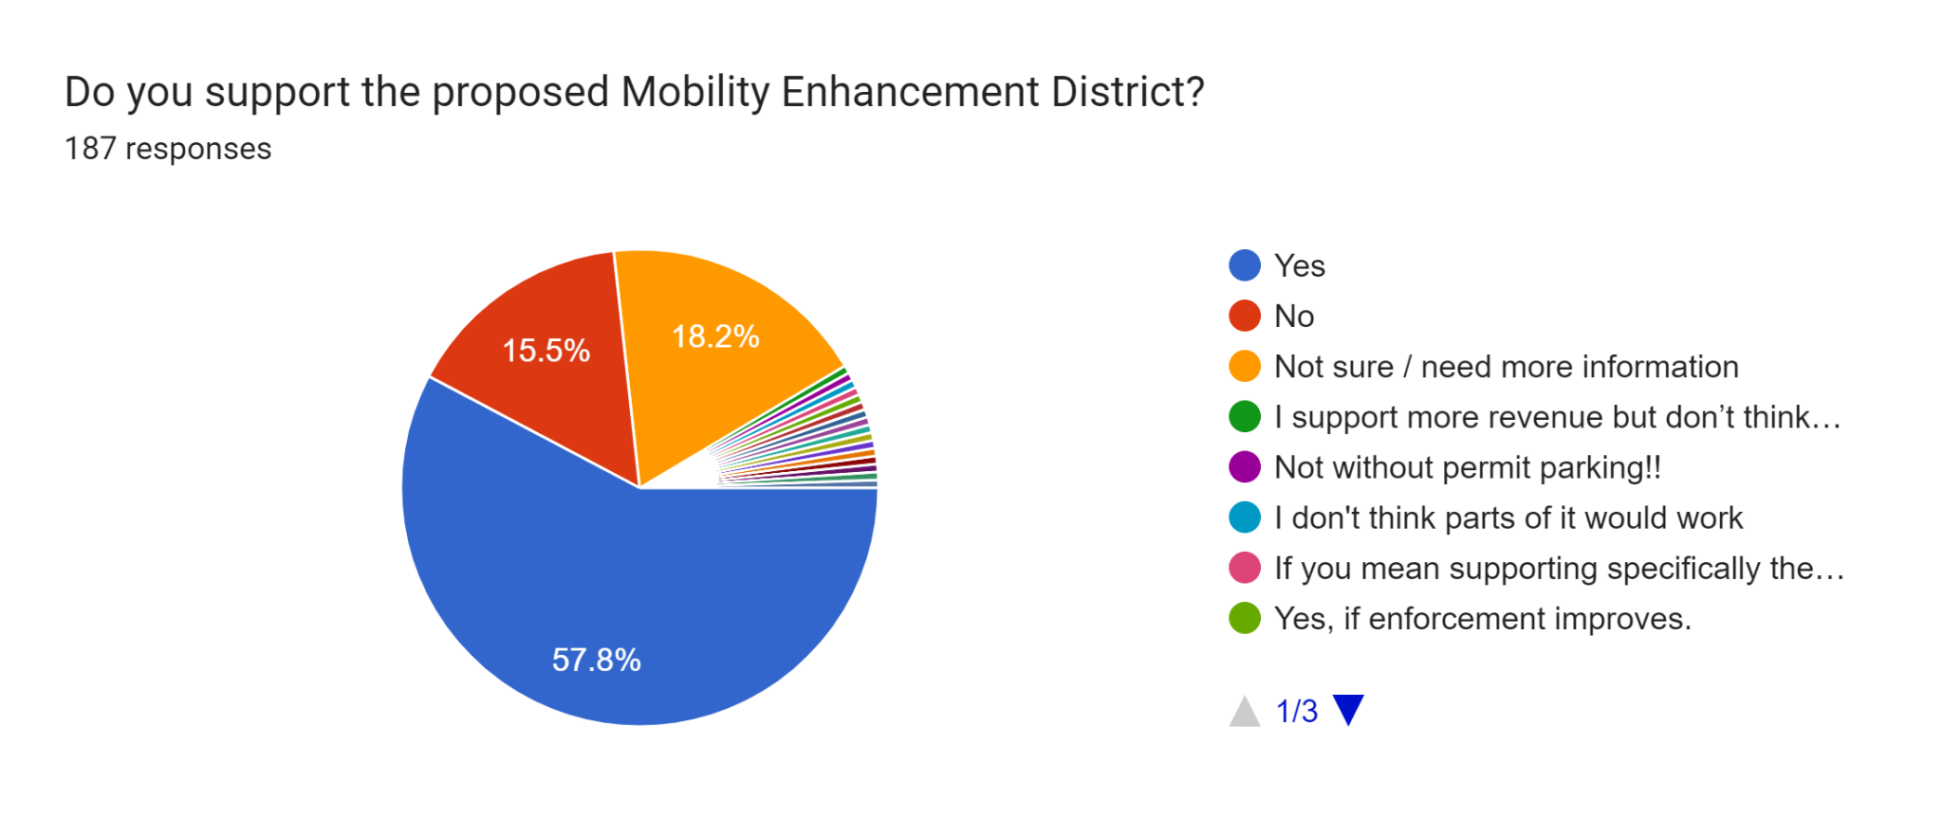

Slide 19
Questions We Heard | Implementation Solutions
Meters will hurt foot traffic to business or affect momentum in district | Meters encourage turnover and don’t allow cars to park all day long - parking can be managed more effectively
Where will employees park | Not implementing new RPP zones or changing existing zones,
Want transparent process for use of funds | Legislation includes community process
Capital Budget should be used for improvements | Not enough funds available. Dedicated funding source will stay in Lawrenceville
Need to monitor and collect data before making a change | Parking analysis of current utilization has been completed
Enforcement matters | Ticket by mail option

Slide 20
Implementation Process
Convened working group with LU, LC, DOMI, PPA, Dist 7 Implementation Plan
Establish Fund criteria
Determine Specifics of MED
  Times
  Rates
  Locations
Complete Parking analysis
Investigate Enforcement Options with Parking Authority
Notes:
Sarah

Slide 21
NEXT STEPS:
Mobility Enhancement District
Finalize Meter Locations
Coordinate with Parking Authority on Enforcement
Install Signage and Meters
If there are RPP changes - process takes 6-9 months - 2025
Continue to evaluate and look at other potential options and tools

Slide 22

DOMI Evaluation of MED Recommendations
June 27, 2024

Slide 23
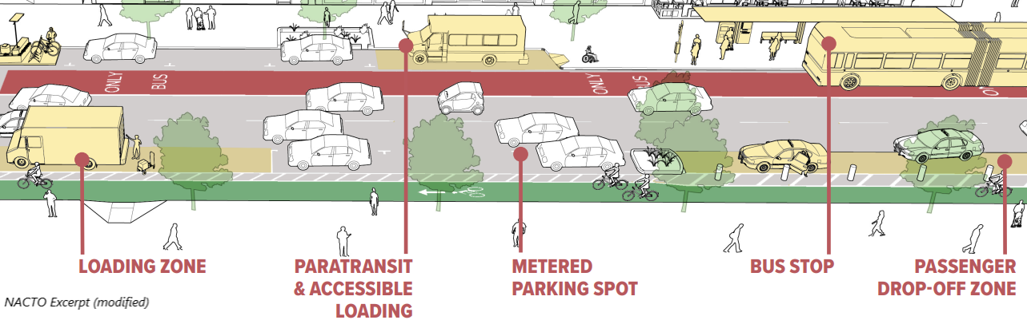
Principles of Curbside Management .
There is a limit to the amount of available curb space and many competing needs & demands. Setting curbside regulations allow us to balance needs between users.
Paid on-street public parking is an expected and essential piece of vibrant commercial districts.
Pricing of this limited and valuable curb space ensures turnover in areas with high demand.
Notes:
If pricing is too low, it incentives drivers to park longer, meaning there are less spaces available for other drivers.
Appropriate pricing ensures somewhere between 60-80% occupancy at peak times.

Slide 24
Curbside Responsibilities
Responsibility for on-street parking is a joint effort between PPA and DOMI.
  DOMI designates the curb (for example: free parking, paid parking, loading, etc.)
  PPA is the enforcer of the curb regulation DOMI sets.
If Council legislates an area to be dynamic hours, DOMI and PPA can jointly advise on extended hours for meters to be enforced.
While DOMI and PPA recommend pricing, dynamic pricing of meters is approved by the Department of Finance.

Slide 25
MED - What DOMI was asked to Evaluate
New Meter Zones: Butler Street, 46th Street to 57th Street
New Hybrid RPP Zone: Main Street, Penn Avenue to Liberty Avenue
  Not included in today's presentation
Expanded Hours of Enforcement for Existing Zones
  Not included in today's presentation
Notes:
Existing metered parking from 34th Street to 46th Street, enforceable from 8am-6pm, Mon-Sat.

Slide 26
MED - What is the process from here?
Determine Paid Parking Locations
Determine Hours of Enforcement and Pricing
Identify kiosk locations and signage plan
We are here!
Notify stakeholders of upcoming curb changes
Confirm dynamic hours and pricing w/ Finance Dept
Revenue projections inform spending plan
Install Signage and Kiosks
New paid parking areas go live
Community process to determine spending plan

Slide 27
Evaluation Criteria
DOMI developed the following benchmarks to evaluate the appropriateness of converting free on-street parking to paid parking areas:
Average utilization across all parking studies is greater than 60%
80% utilization in any one study period
15% of vehicles parked longer than 1 hour
*Each block only needs to meet one of the above criteria for us to consider changing the curb designation to paid parking
Notes:
Residential Permit Parking Areas can be created with 75% utilization
Like the existing RPP Area requirements within §549.03

Slide 28
Layering the Data
In addition to the data collected in our parking studies, DOMI considers the following criteria when evaluating creating new paid parking areas:
  Mixed Use – Commercial and Residential
    In mixed used contexts without RPP nearby, adding metered parking to the commercial district will have limited impacts to the ability for residents to park near their home
  Existing or complimentary curb designations
    Ensure that new loading zones are included in areas where we are installing meters so that loading needs are met
    Consider accessible parking spaces in newly created metered parking areas
    Preserve existing loading zones and transit stops

Slide 29
Using Data to Inform Curbside Recommendations
High Utilization
High Turnover
Commercial Context
Efficient Curb Use
High Utilization
Low Turnover
Commercial Context
Price the Curb to Encourage Turnover
High Utilization
Low Turnover
Residential Context
Candidate for RPP
Low Utilization
Low Turnover
Residential Context
Free Parking
Low Utilization
Low Turnover
Commercial Context
Free Parking

Slide 30
Methodology
Study Area: Butler Street, 46th Street to 57th Street
Data collected between 8am-6pm across three (3) days, varying days of the week and times of day
Vehicles within the study area were recorded with PPAP’s LPR (License Plate Recognition) technology
After one (1) hour, the number of parked vehicles were documented, and a percentage was calculated based on the total number of approximate on-street parking spaces available per block

Slide 31
Butler Street – Data Collection
Block | # of Spaces | Avg. Utilization | Max Utilization | Avg. % Parked Longer Than 1 Hour | Meets DOMI Evaluation Criteria
46th Street – 47th Street | 35 | 56 | 71 | 25 | ✔
47th Street – 48th Street | 15 | 58 | 60 | 57 | ✔
48th Street – 49th Street | 6 | 72 | 83 | 73 | ✔✔✔
49th Street – 50th Street | 13 | 41 | 46 | 81 | ✔
50th Street – 51st Street | No Parking | No Parking | No Parking | No Parking | No Parking
51st Street – 52nd Street | 46 | 62 | 72 | 66 | ✔✔
52nd Street – 53rd Street | 40 | 72 | 85 | 61 | ✔✔✔
53rd Street – 54th Street | 22 | 82 | 100 | 74 | ✔✔✔
54th Street – 55th Street | 27 | 42 | 63 | 69 | ✔
55th Street – 56th Street | 24 | 21 | 25 | 50 | ✔
56th Street – 57th Street | 4 | 8 | 25 | 33 | ✔
*Data collected 4/18/24, 4/19/24, 5/3/24

Slide 32
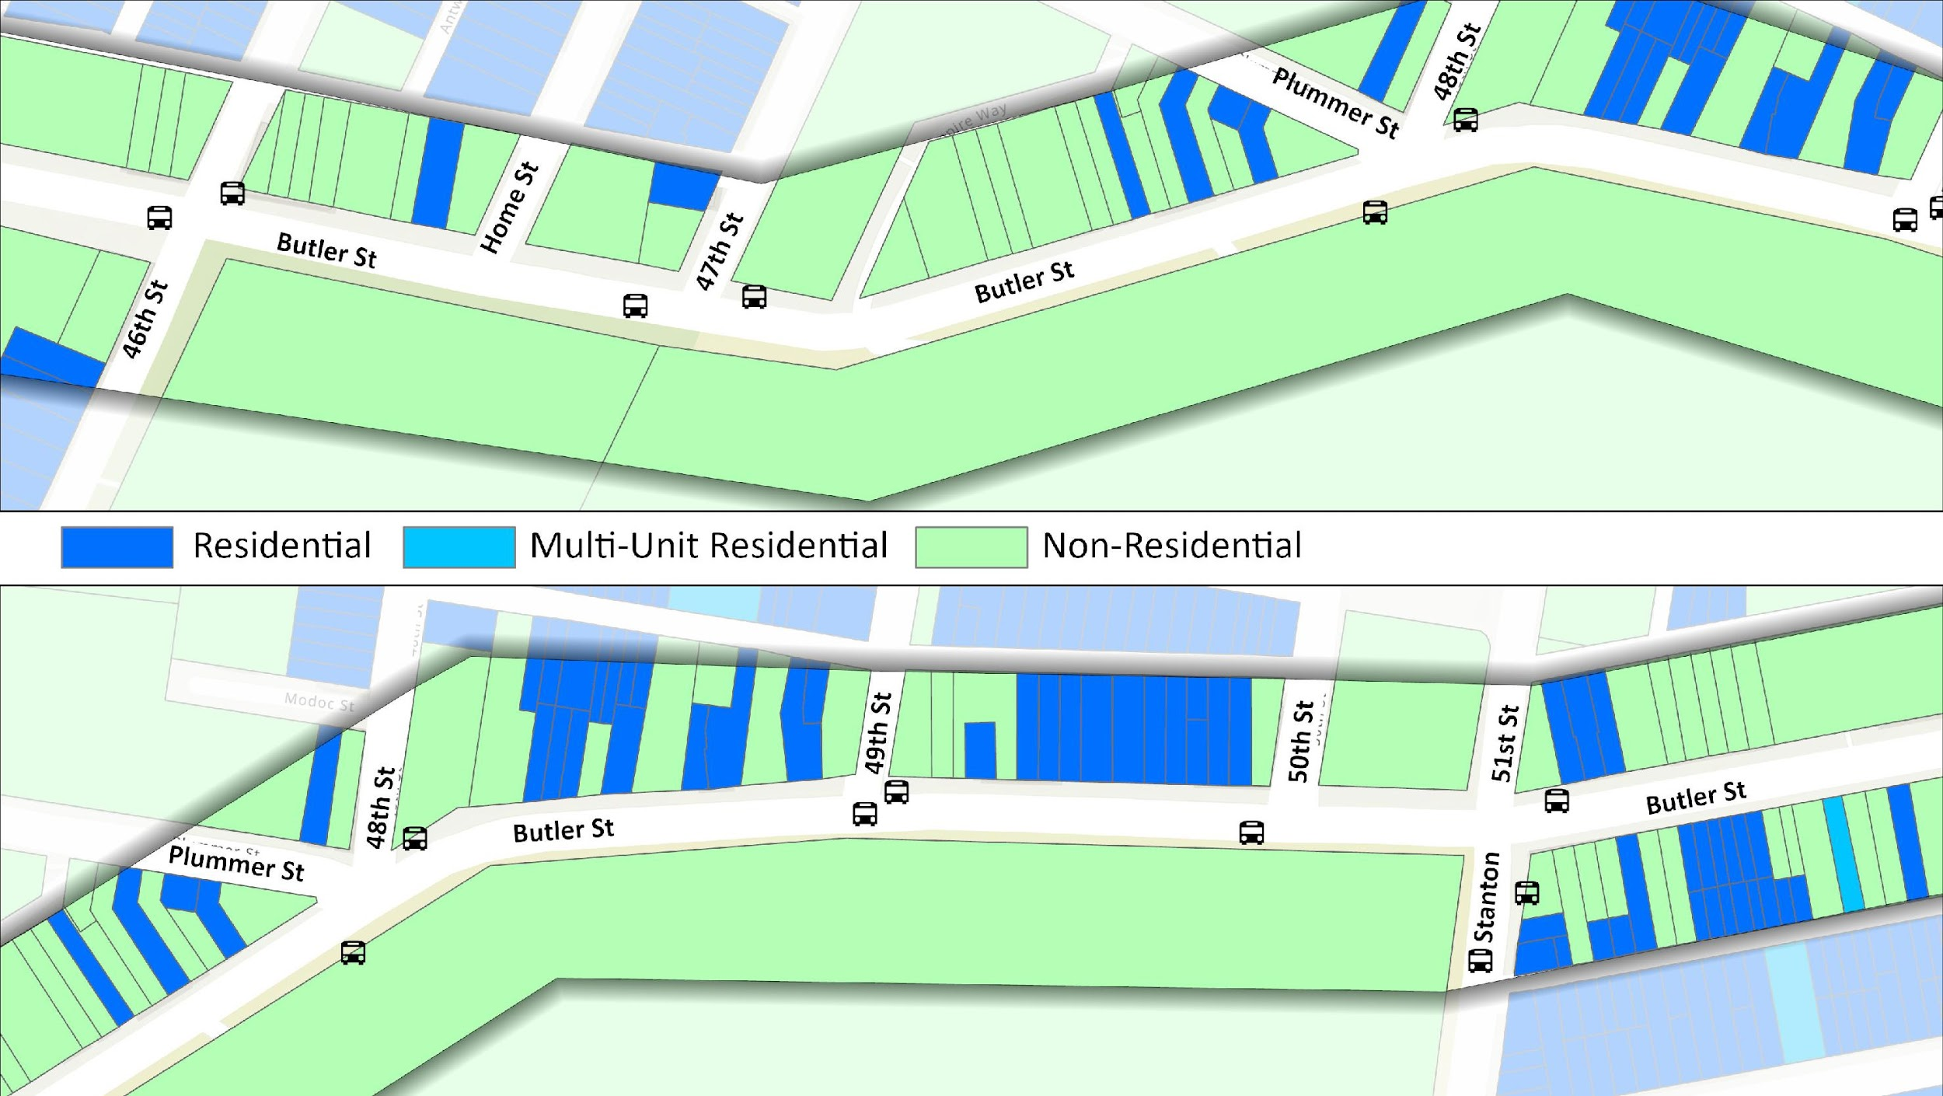
Land Use Context
46th to Plummer
No parking this side
Plummer to Stanton
No parking this side

Slide 33
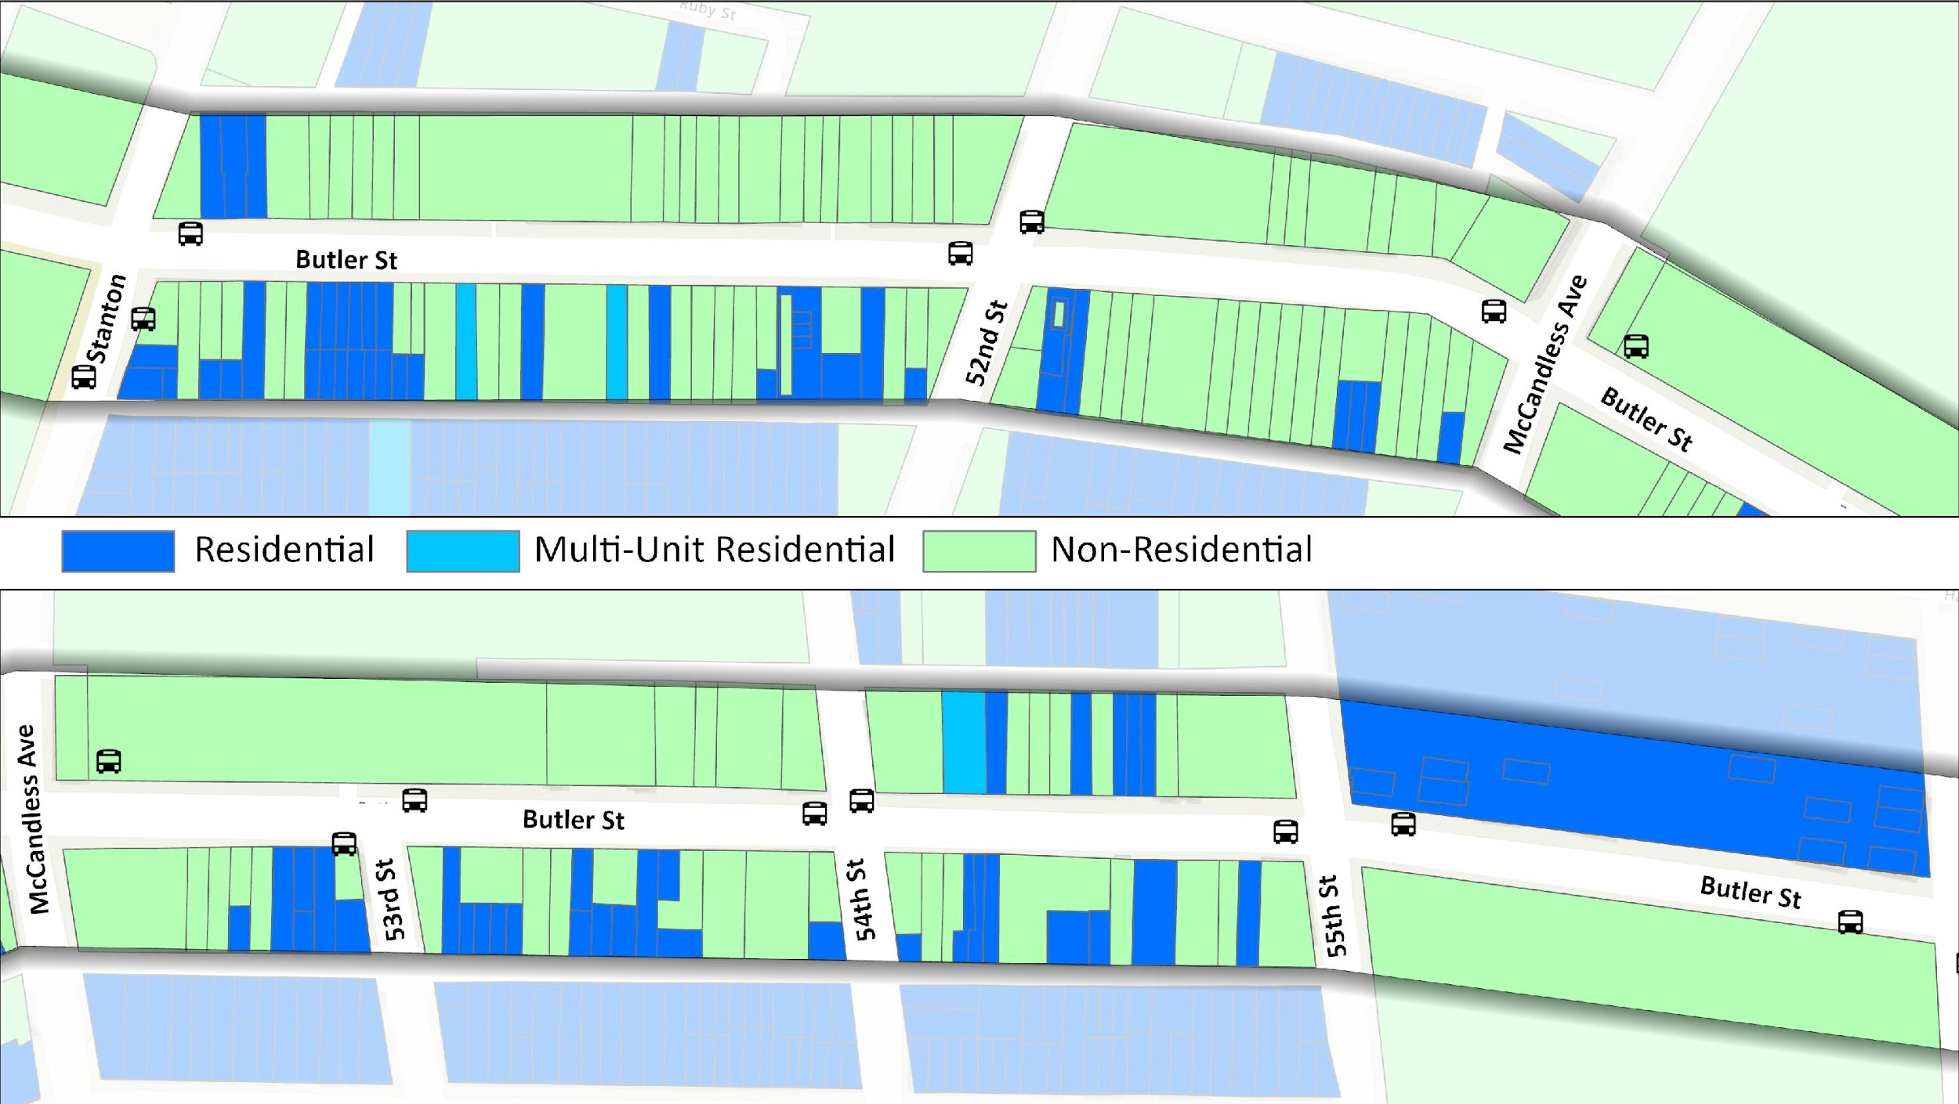
Land Use Context
Stanton to McCandless
McCandless to 55th
No parking this side

Slide 34
Summary of DOMI’s Evaluation
Butler St (46th to 54th)
  Implementing additional paid parking
    8am-6pm, Monday – Saturday
    $2/hour
  Evaluate expanded hours of enforcement and dynamic pricing after new meters are in place
  Monitor Butler from 54th to 57th to see how utilization of unregulated blocks changes

Slide 35
Next Steps:
Process for Installing New Meters
  PPAP coordinates with the Department of Finance to approve dynamic pricing scheme per the community's recommendations
  DOMI coordinates with PPAP to install metered parking kiosks and the relevant signage as determined by DOMI's parking studies

Slide 36
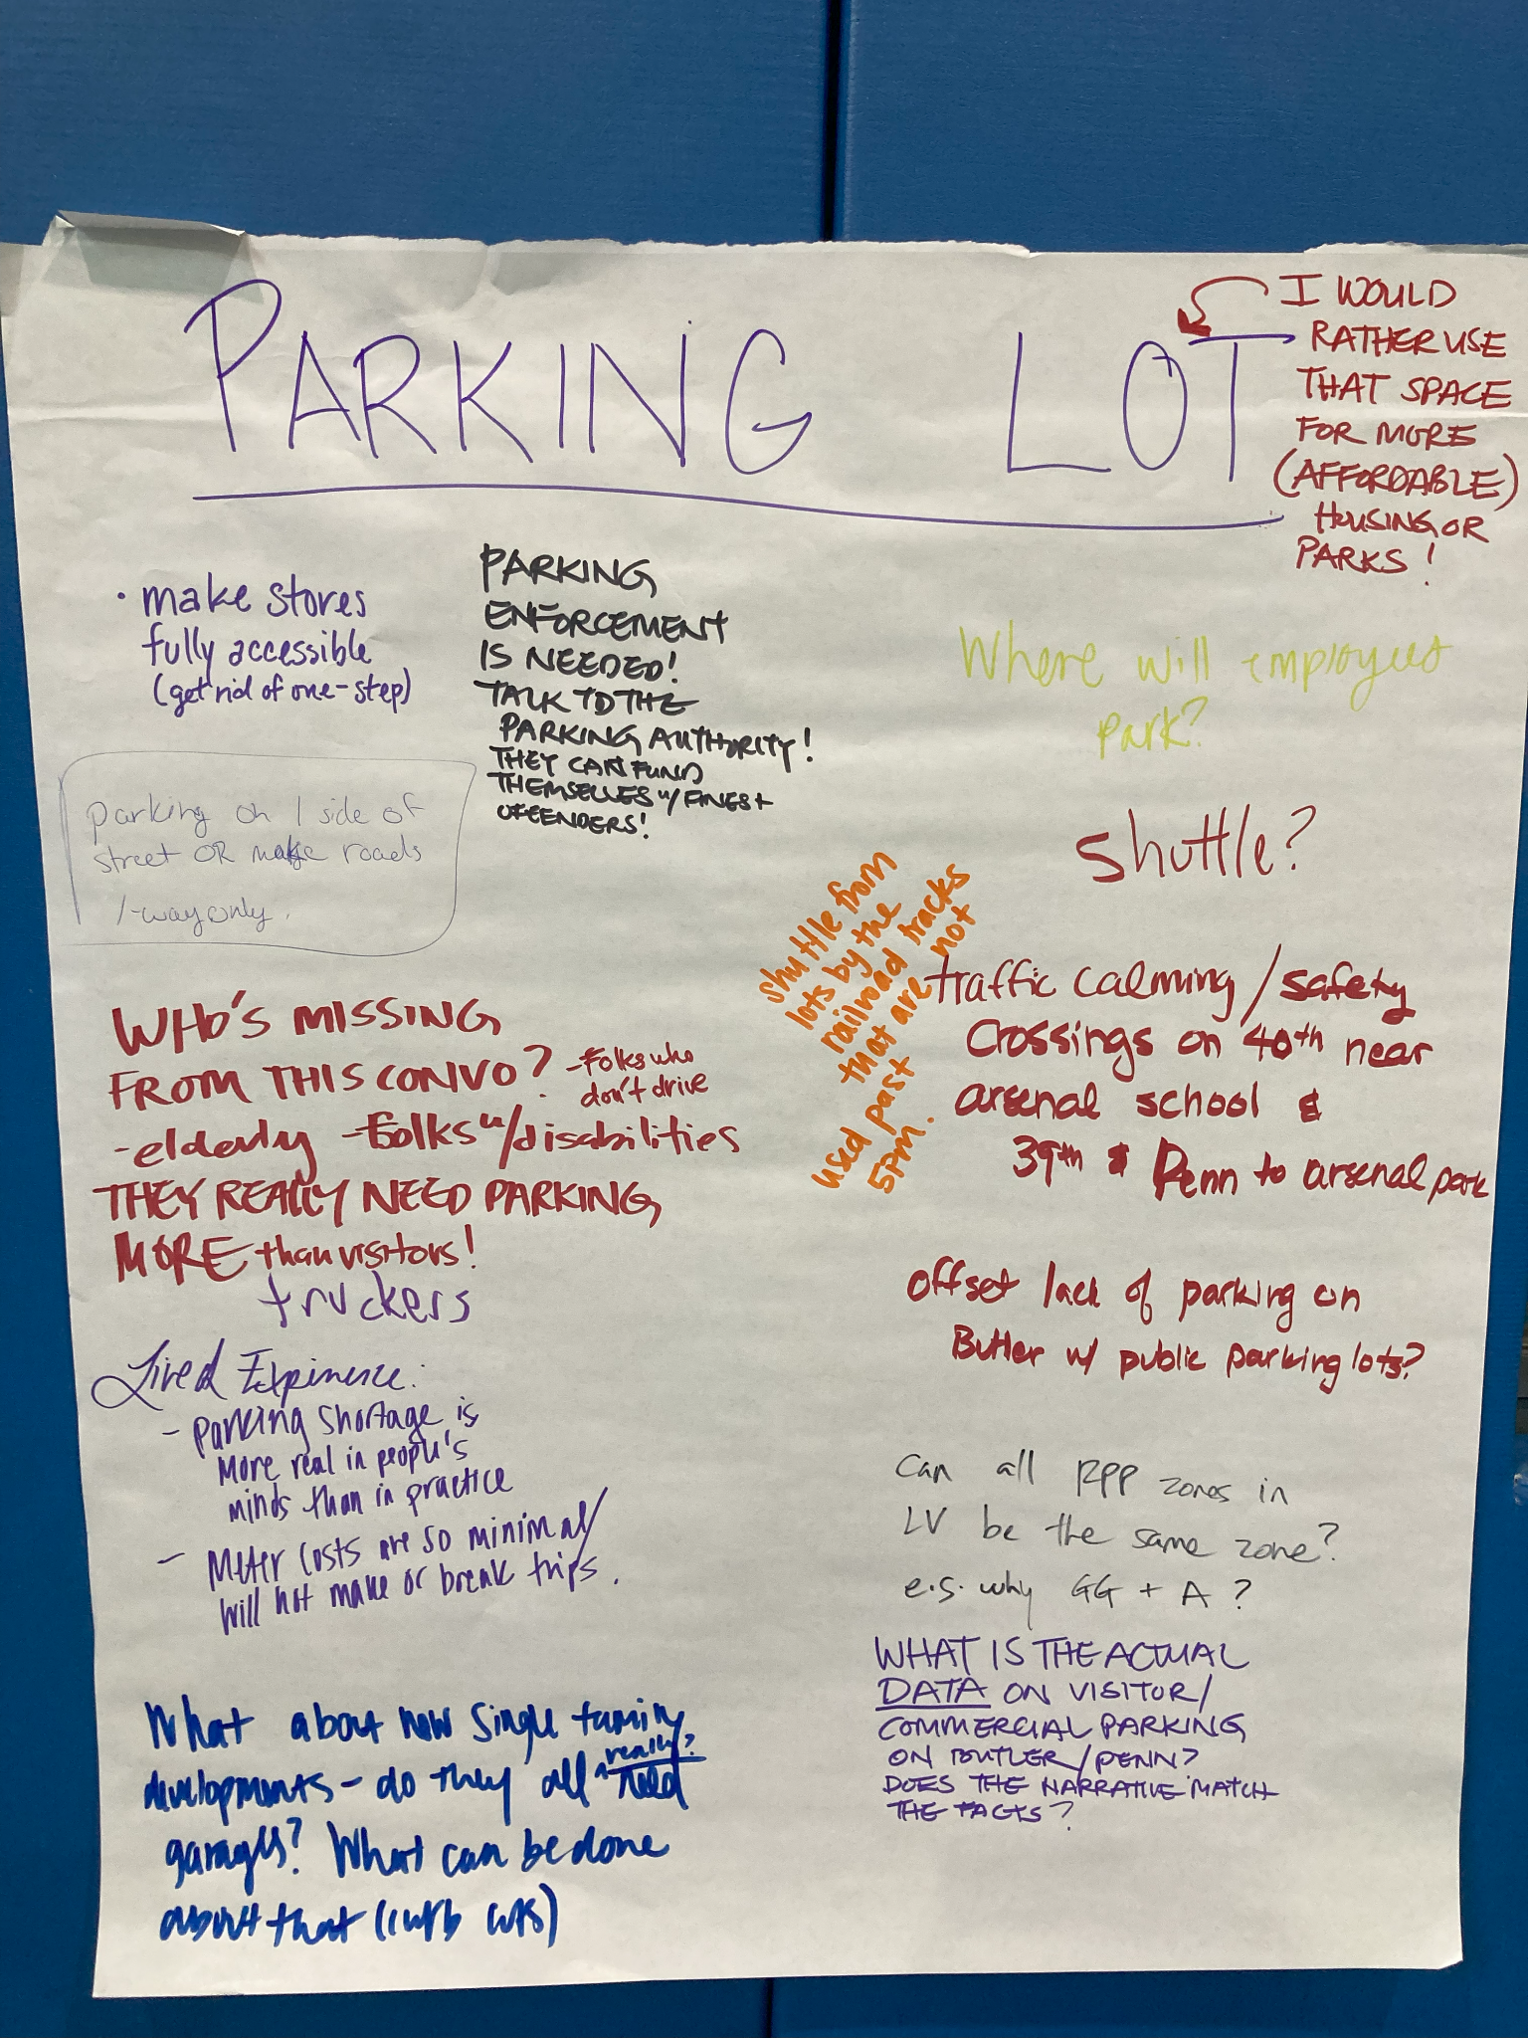
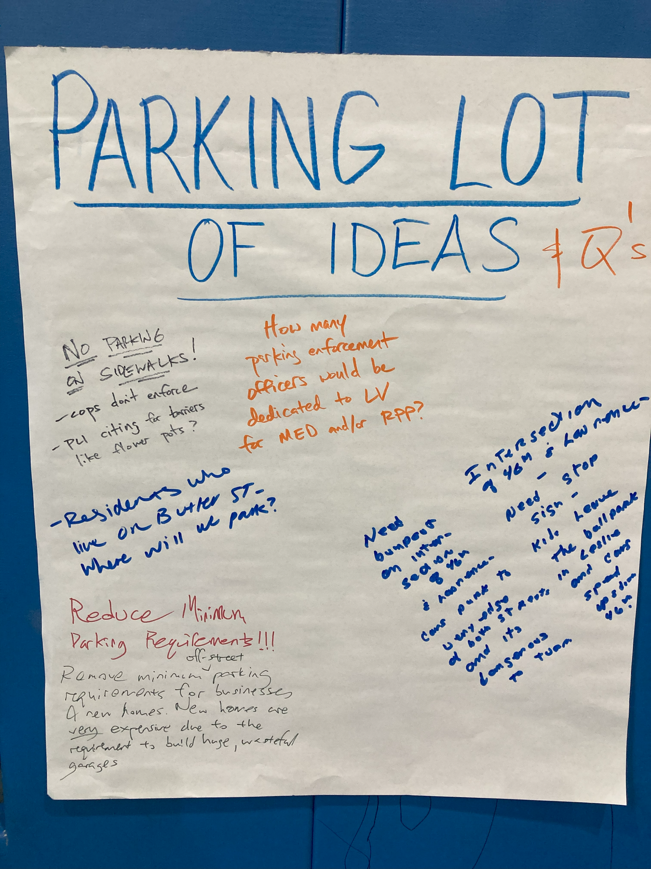
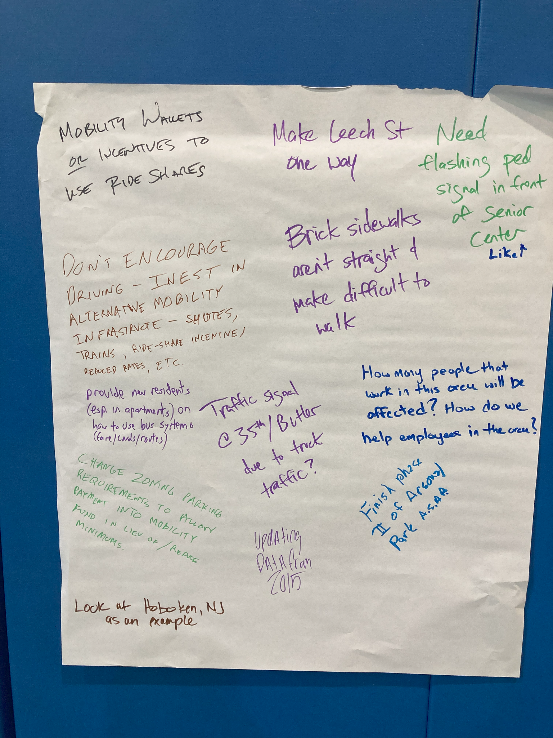
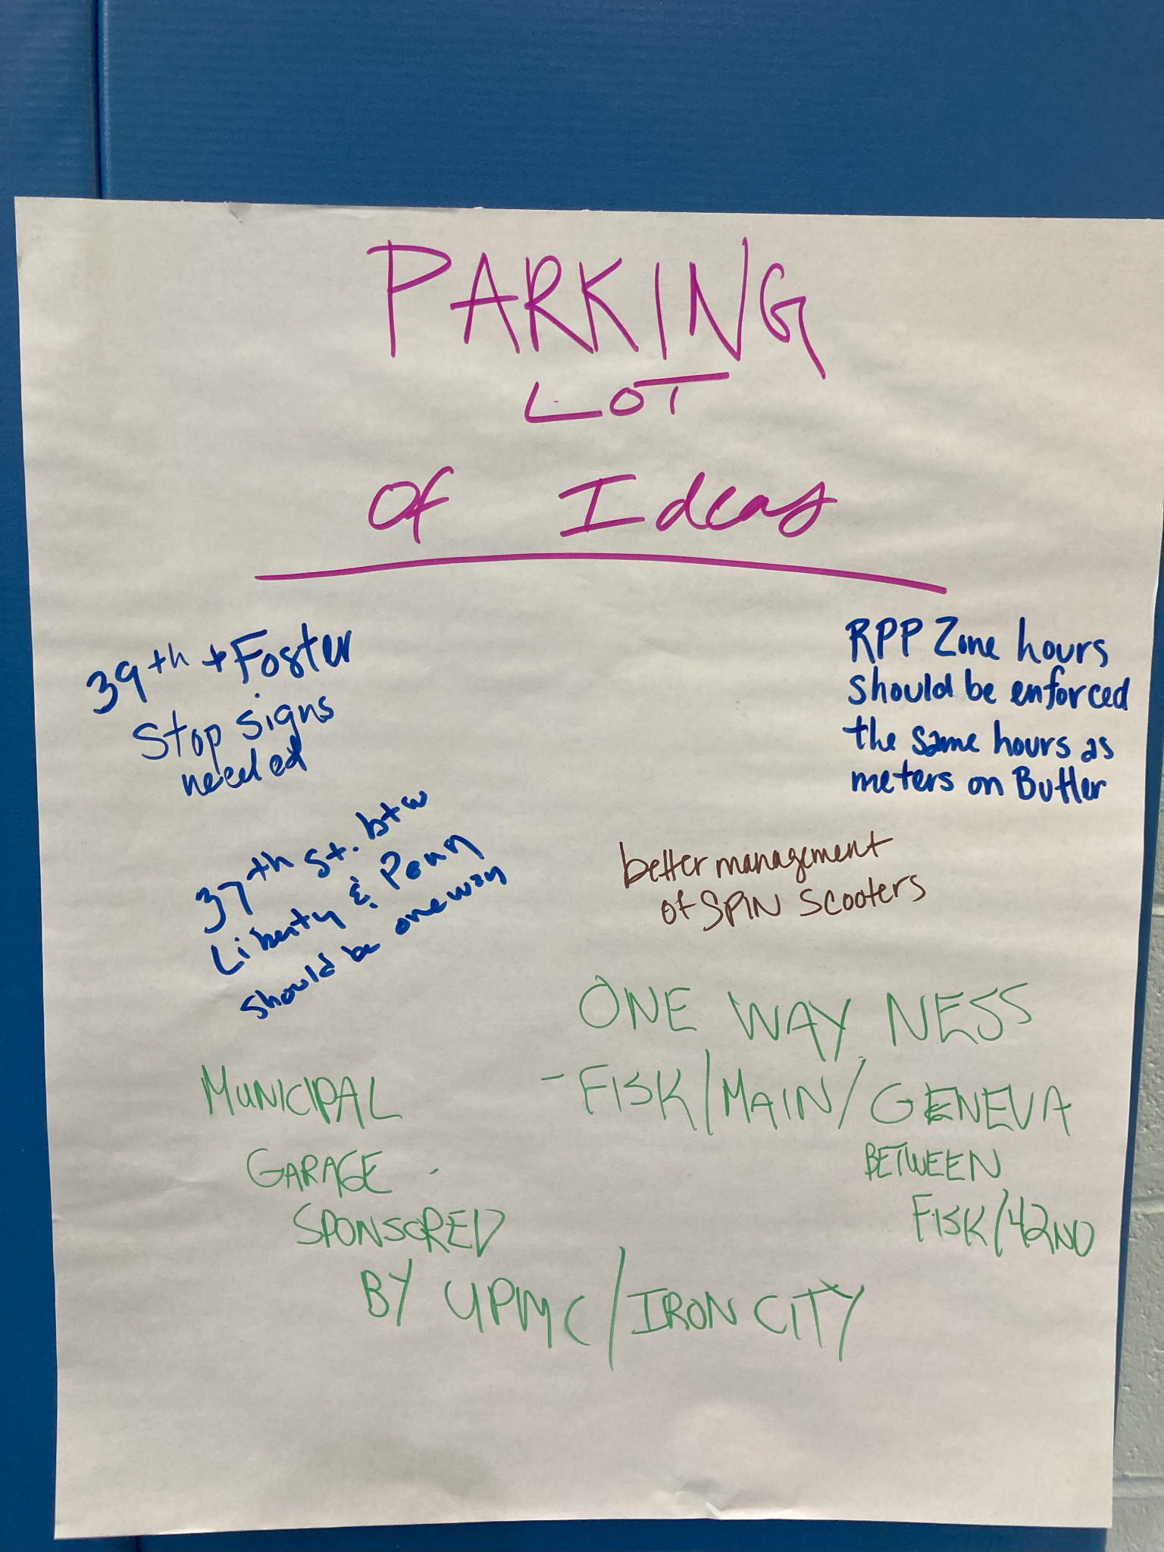
NEXT STEPS: Getting creative
Improving enforcement, especially parking on sidewalks
How can we encourage better utilization of existing lots?
Use Hybrid RPP as a parking utilization tool

Slide 37
What is a hybrid RPP area?
For existing or new RPP areas
All the privileges of RPP zone for residents, visitors, and non-residents with permits
The hybrid RPP parking meter rate will not exceed the geographically closest parking meter zone
Parking meters for people not covered by RPP, visitor permit, or non-resident permit
Revenue eligible for collection by Mobility Enhancement District
Notes:
Sarah

Slide 38

Lawrenceville cares about mobility
Stay engaged: we’re not going anywhere!
Join Better Streets Lawrenceville
  https://better-streets-lawrenceville.mailchimpsites.com/

Slide 39
Q&A /Comments/Feedback
If in person: Paper feedback forms are available
If joining online or watching recording: Please visit to bit.ly/MED06-2024 provide feedback
*If joining online*: Please sign in at bit.ly/LUSignIn to ensure you receive follow up communications about this meeting
Lawrenceville Mobility Enhancement Engage Page
  https://engage.pittsburghpa.gov/lawrenceville-med

Slide 40
THANK YOU!
Lawrenceville United
412-802-7220 - info@LUnited.org
Lawrenceville Corporation
412-621-1616 - info@LawrencevilleCorp.com

