Slide 1


Lawrenceville Happenings Meeting:
Community Led Initiatives
07/11/24, 6:30 p.m., Attack Theatre (212 45th St)
Welcome! Please sign in at bit.ly/LUSignIn if joining online

Slide 2
Tonight’s agenda
Welcome & Introductions
Parking Pad Palooza
Better Streets Lawrenceville
Bernard Dog Run
Organizing a Clean Up
Open Q&A
LIVE! In Lawrenceville Planning Committee
LU & LC Upcoming Calendars

Slide 3
Accessibility
LU and LC are committed to making these meetings accessible
Let us know about any accommodations you need to fully participate
If joining by Facebook Live, drop comments/questions in the chat

Slide 4
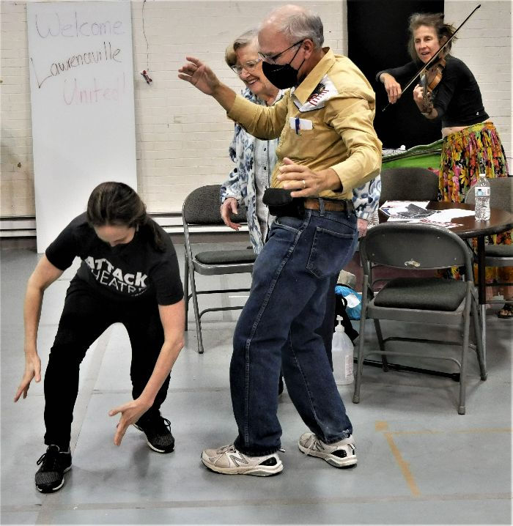
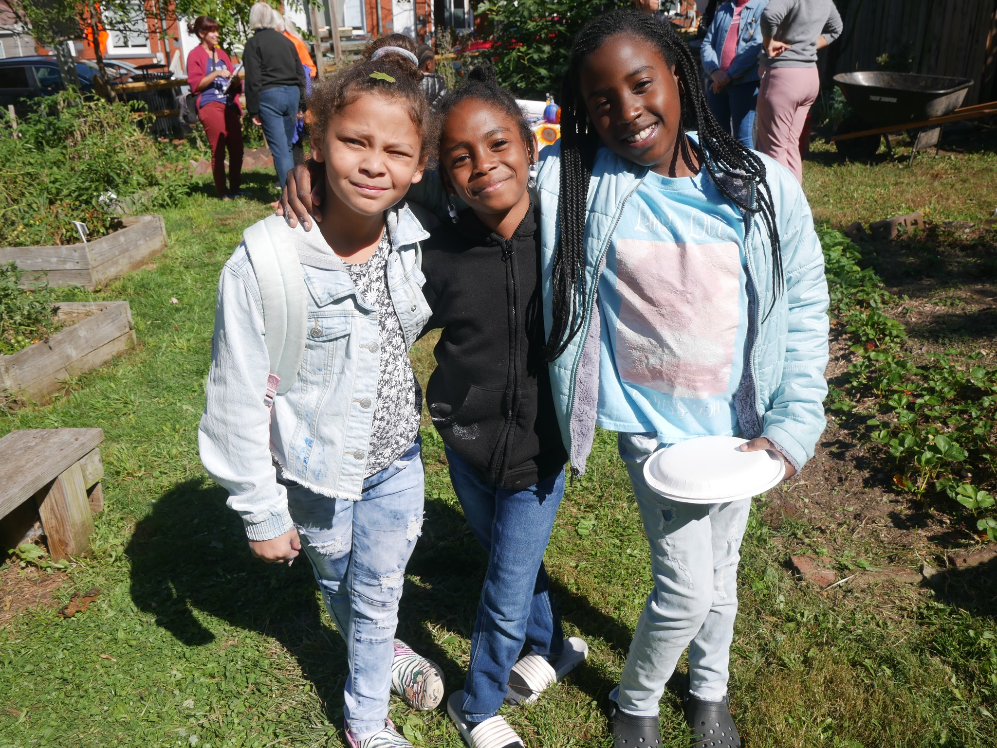
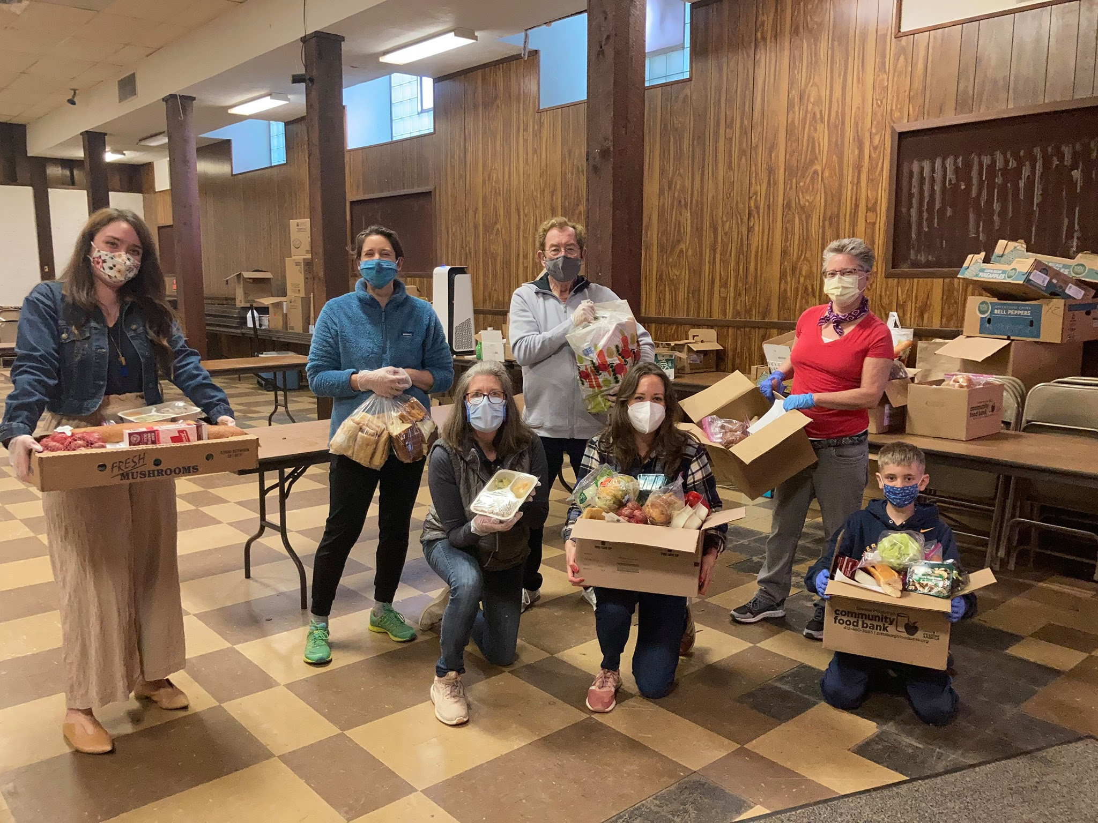
Lawrenceville United
Mission: to improve and protect quality of life for
all Lawrenceville residents
Membership of over 850 residents
Board comprised of all residents: elected by our membership
Programs: Lawrenceville Farmers Market, supporting older adults, free food distributions, cleaning & greening, direct support & case management, advocacy, and more.

Slide 5
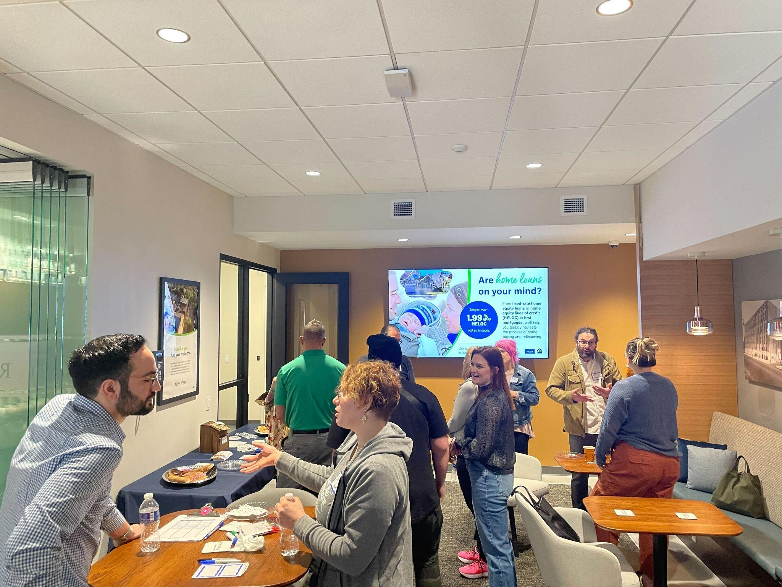

Lawrenceville Corporation
Mission: Driven by the Lawrenceville community, the Lawrenceville Corporation acts as the catalyst and conduit for responsible and sustainable growth.
Membership: About 100, primarily business owners
Board: Mostly comprised of residents, property owners, and business owners and elected by our membership - 16 members
Programs: Business district management, policy and advocacy, community planning and development, real estate development, and communications and marketing

Slide 6
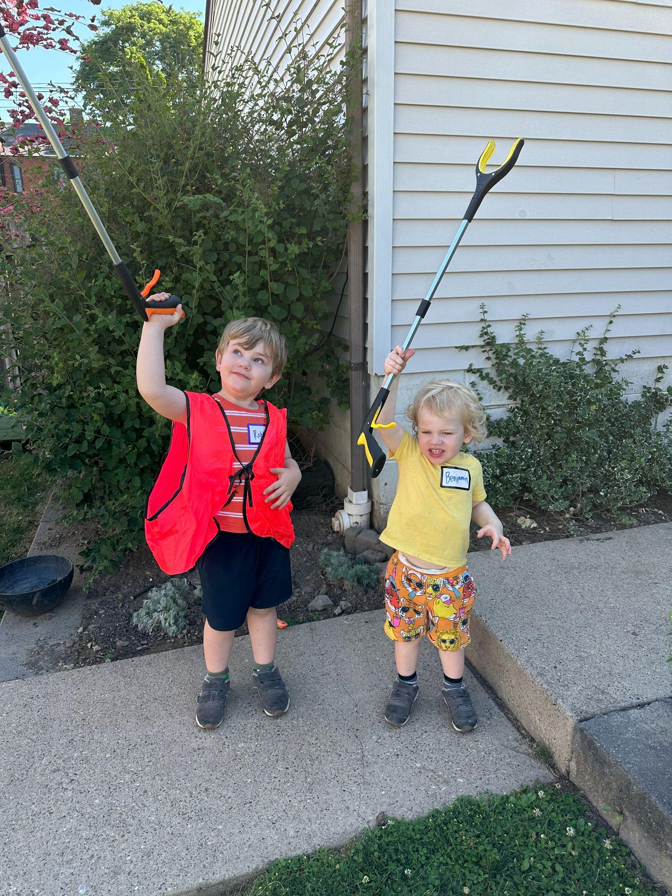
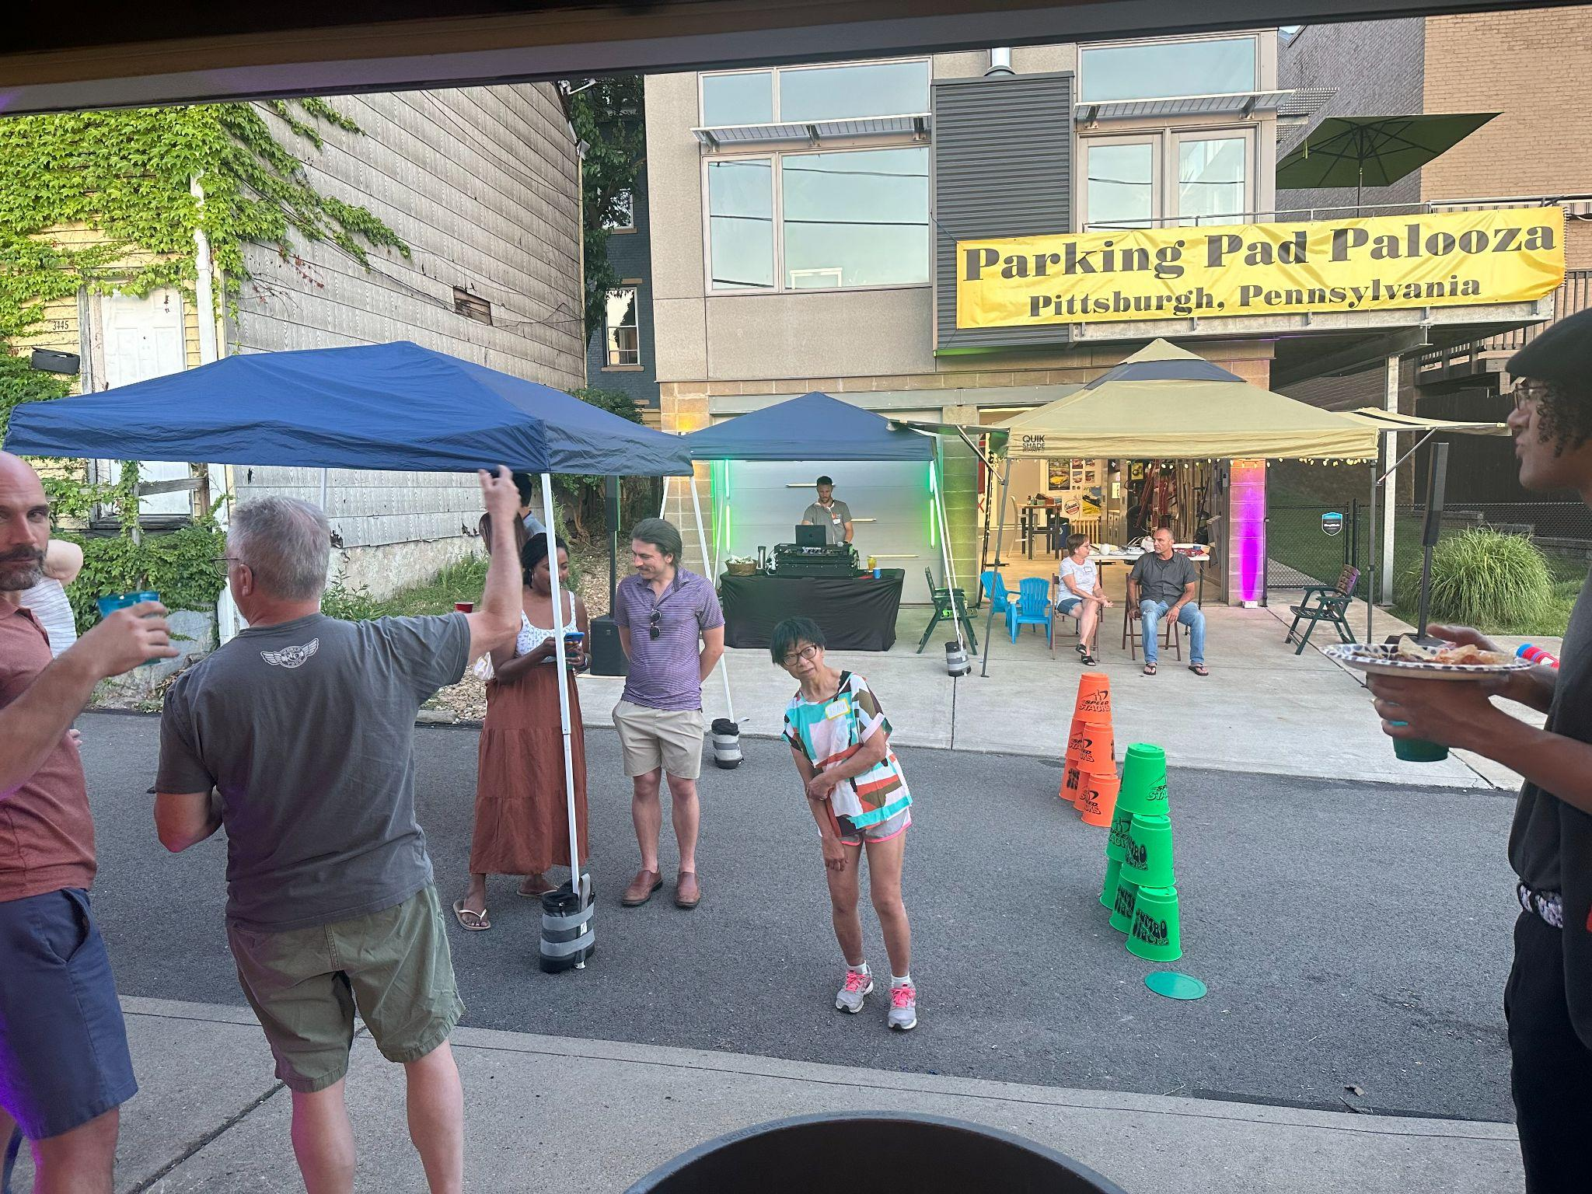
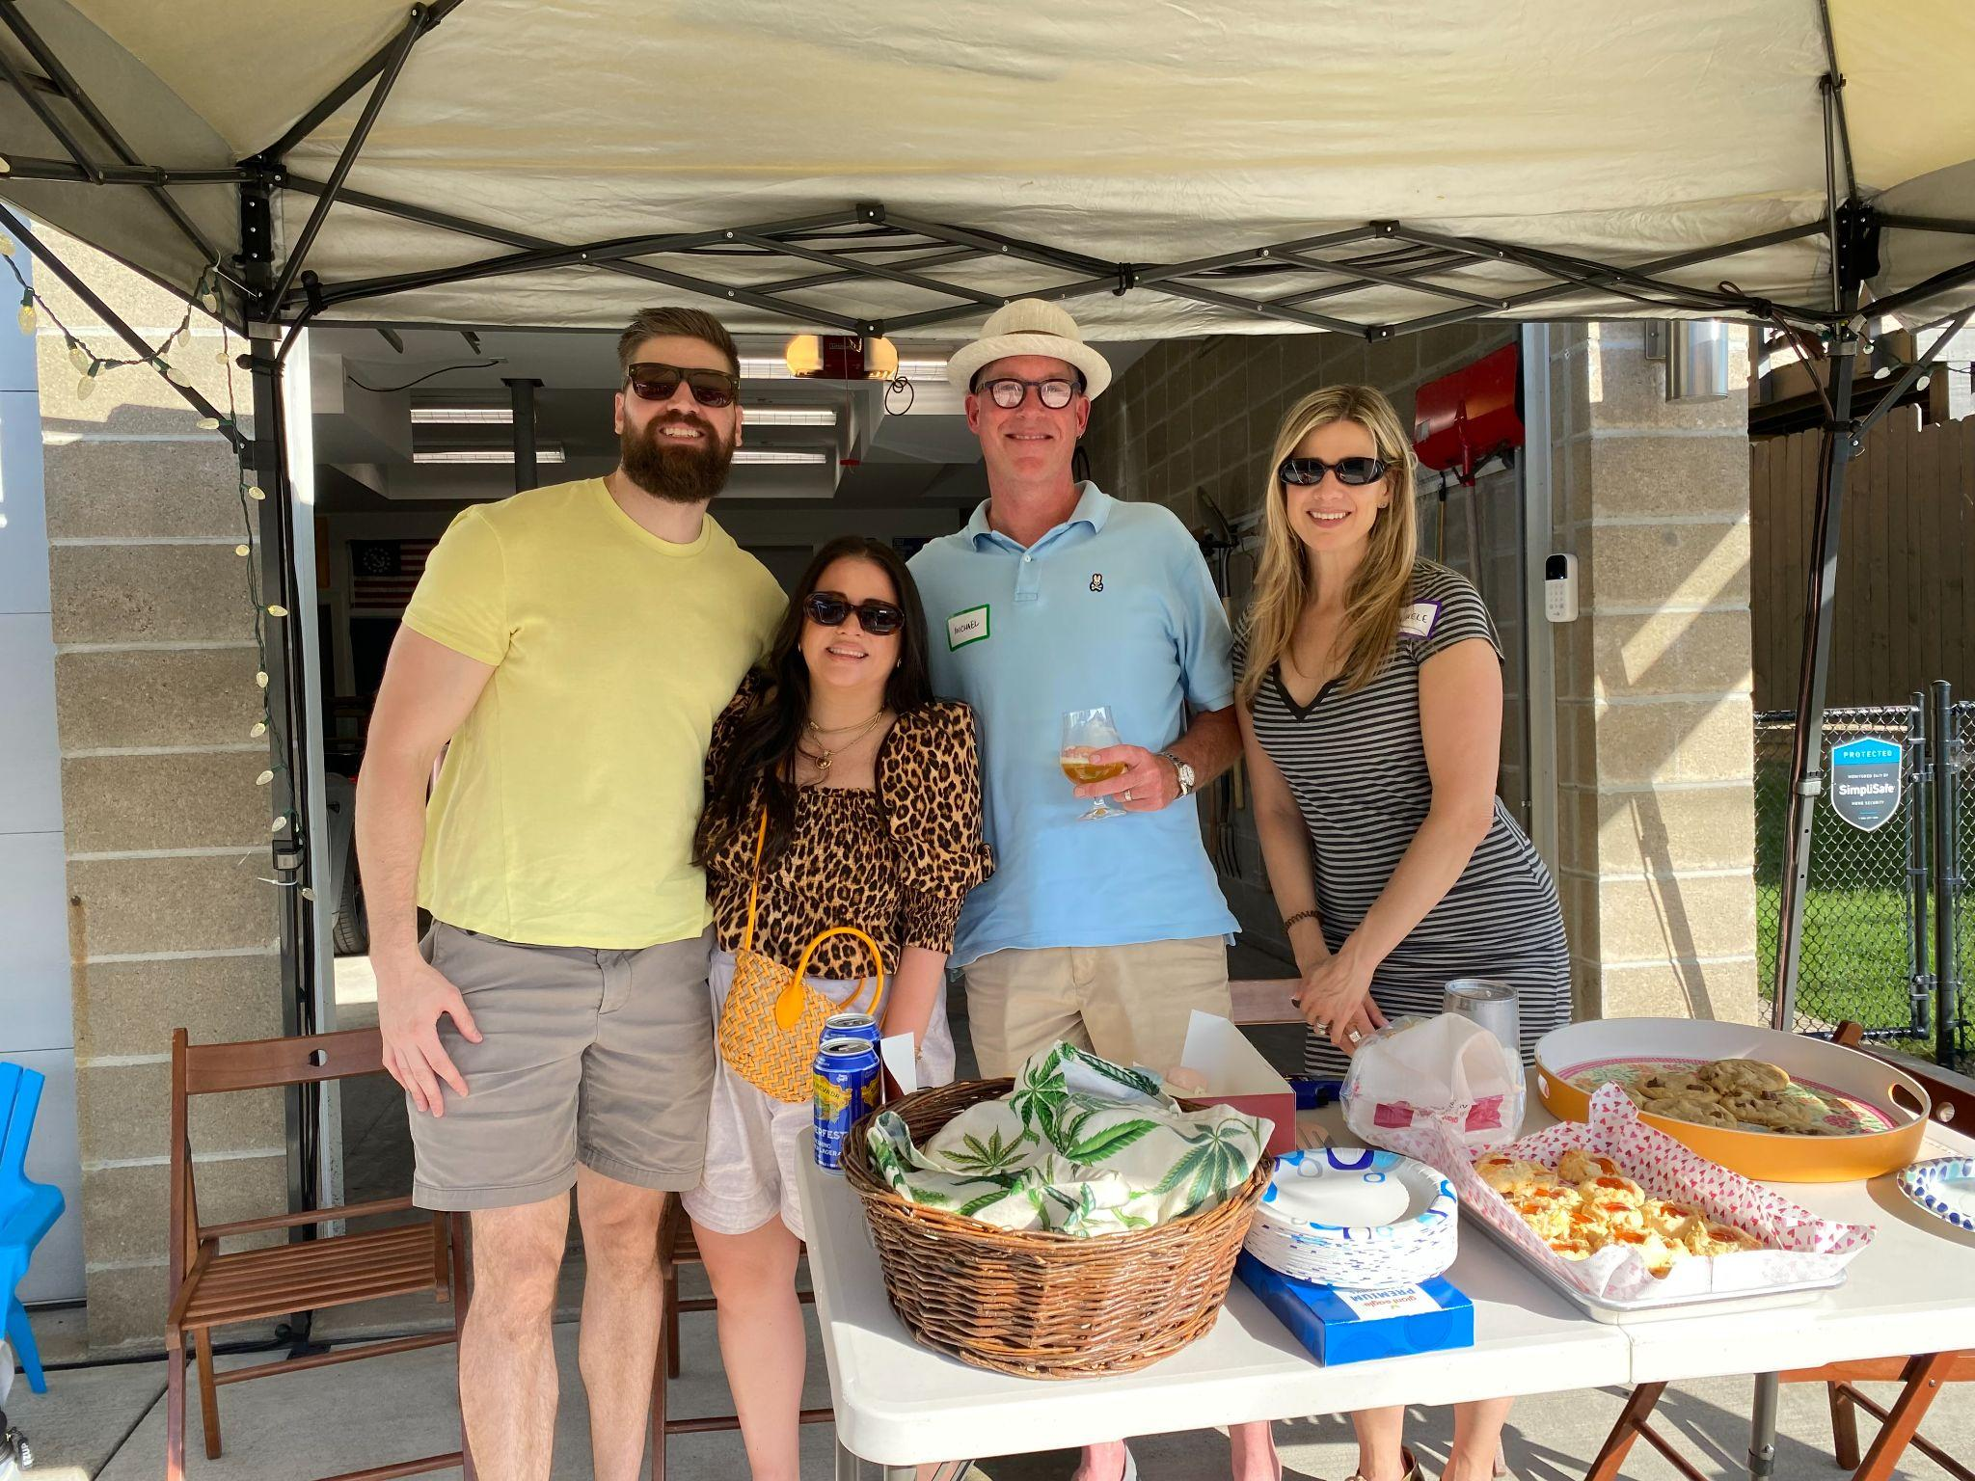
Parking Pad Palooza

Slide 7
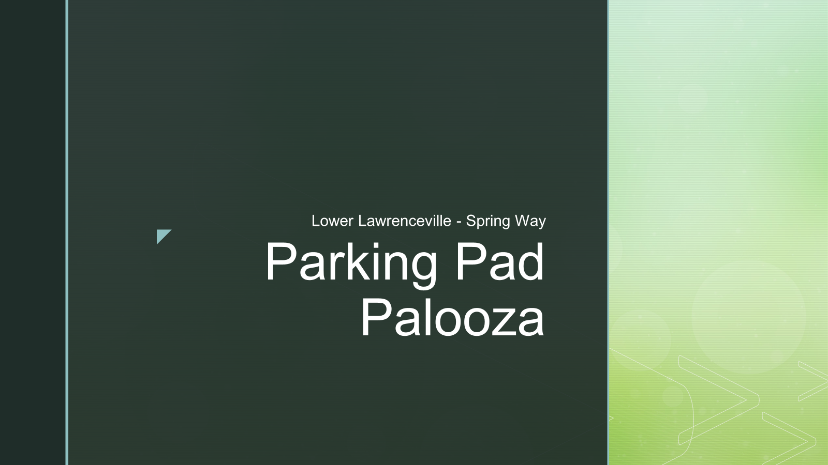
Parking Pad Palooza

Slide 8
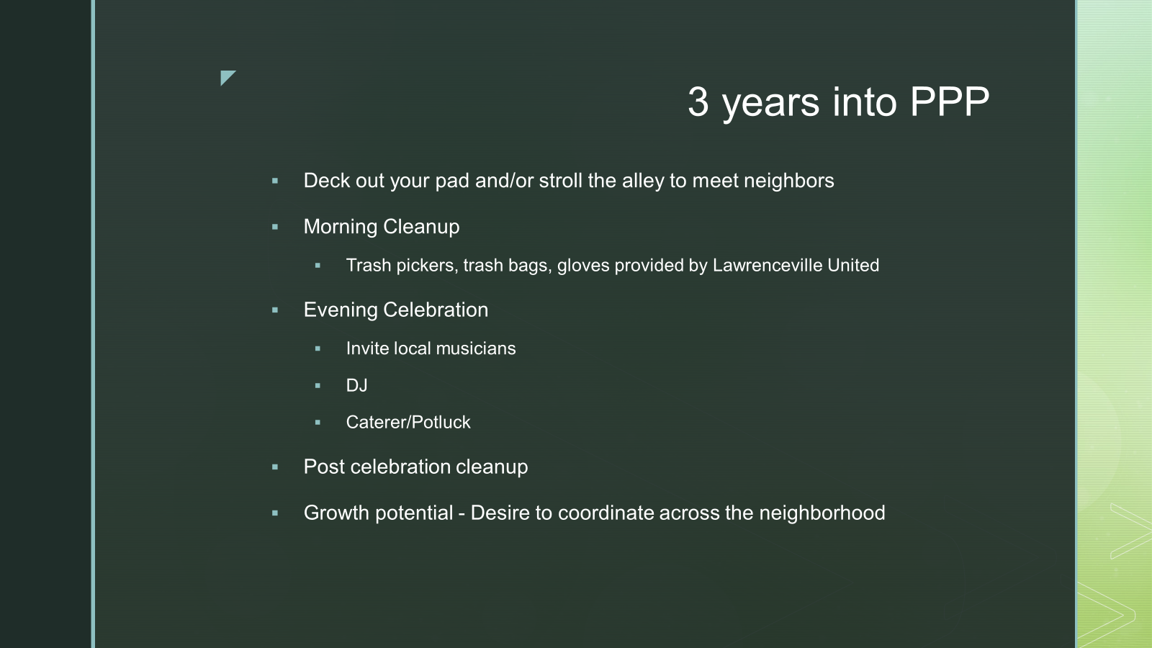
Parking Pad Palooza

Slide 9
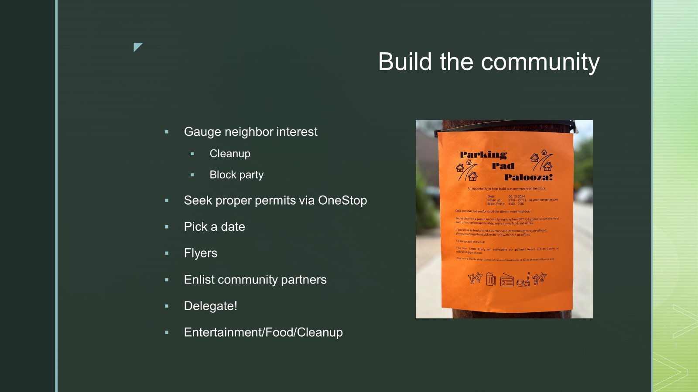

Slide 10
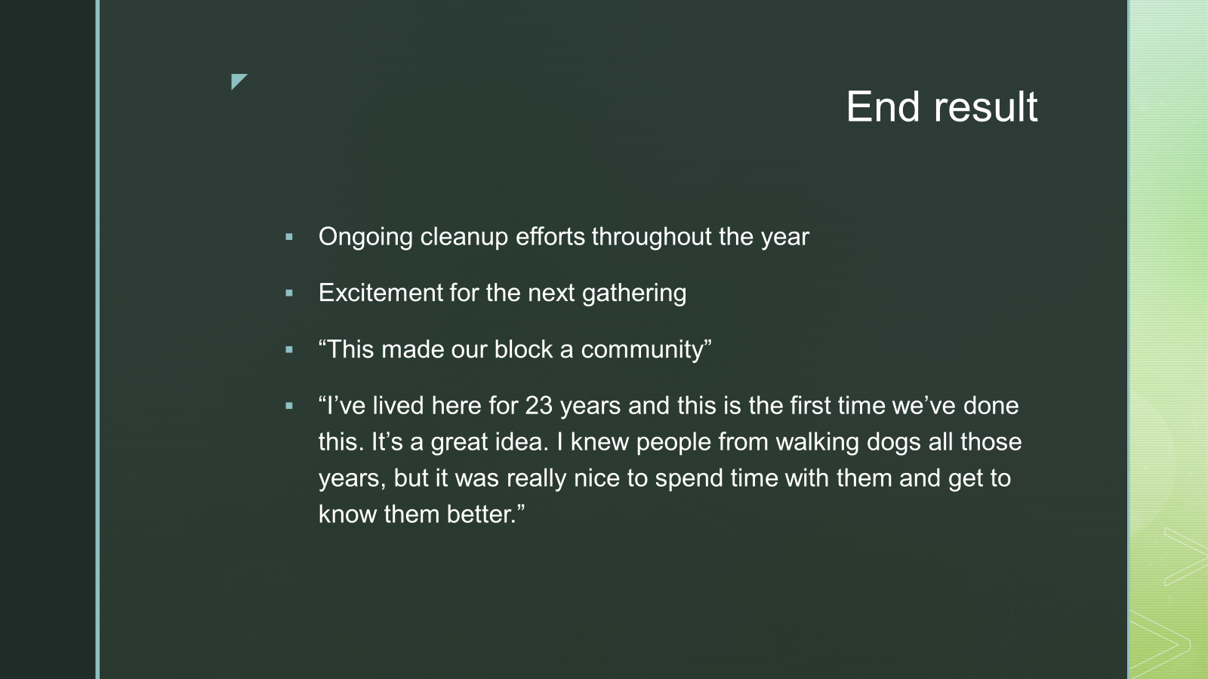

Slide 11
Special Event Permits
Special Events Permit – OneStopPGH
Permits must be completed at least 7 business days ahead of event
A Block Party can only take place on weekends, Federal Holidays and on Halloween.
All block parties must take place between 10:00am and 10:00pm.
Barricades will be provided by City once the block party is approved
$25 fee
Further Block Party policies here

Slide 12
Want a Parking Pad Palooza?
For help in planning, contact Jill Boldin:
713-854-0157
contact@happenstancecafe.com

Slide 13
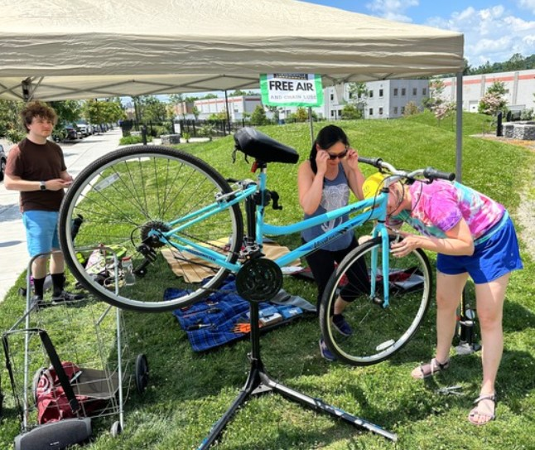

Better Streets Lawrenceville
https://better-streets-lawrenceville.mailchimpsites.com/

Slide 14
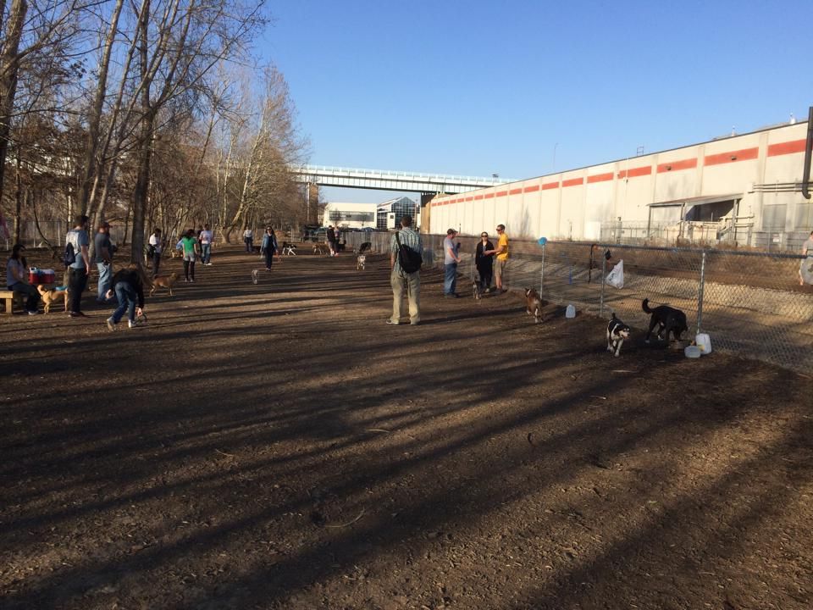
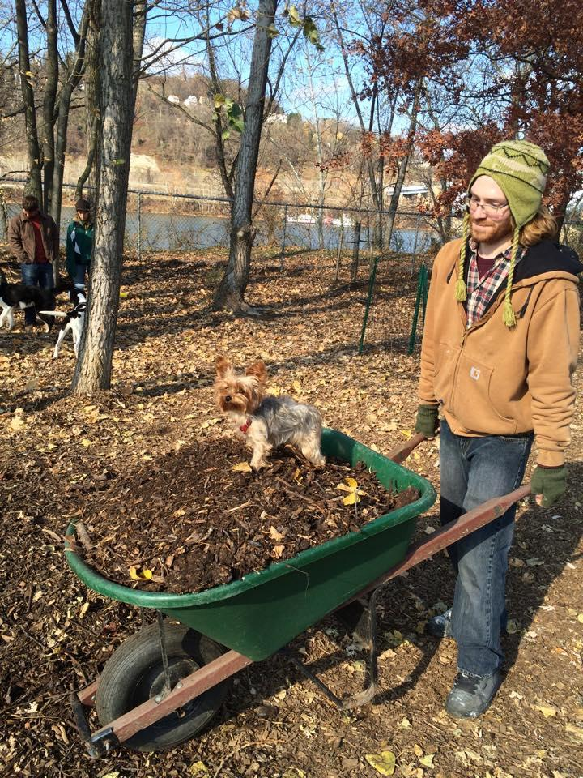
Bernard Dog Run

Slide 15
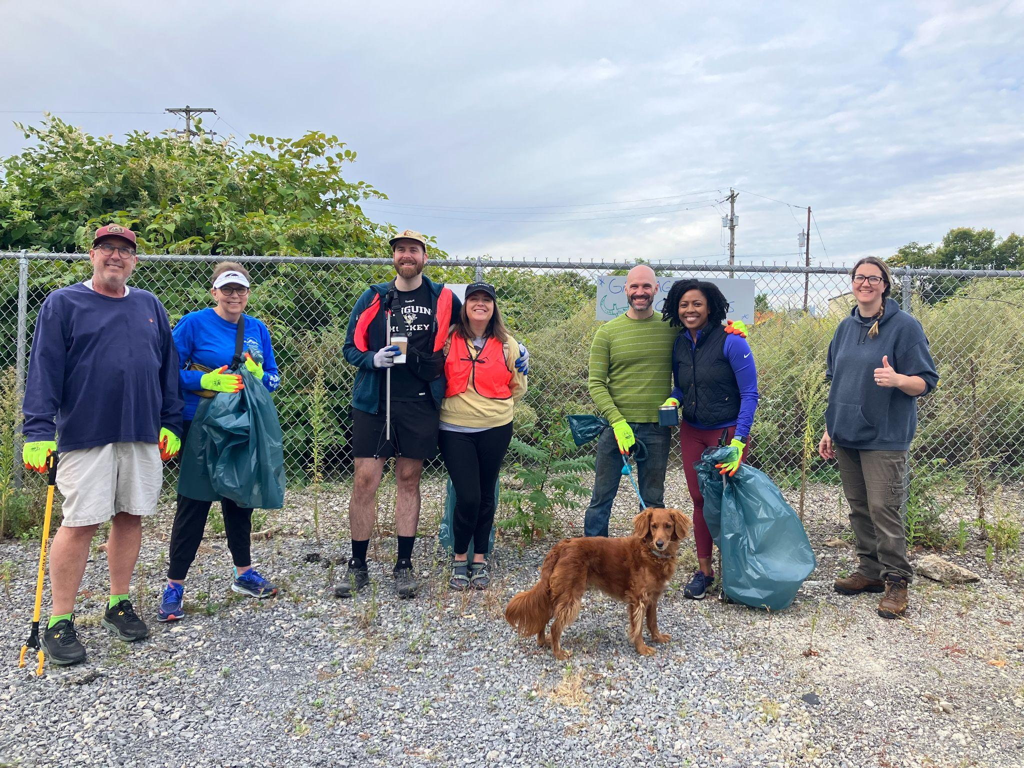
Organizing Your Own Clean Up
Volunteer Clean Up Application
& LU Support

Slide 16
OPEN Q&A

Slide 17
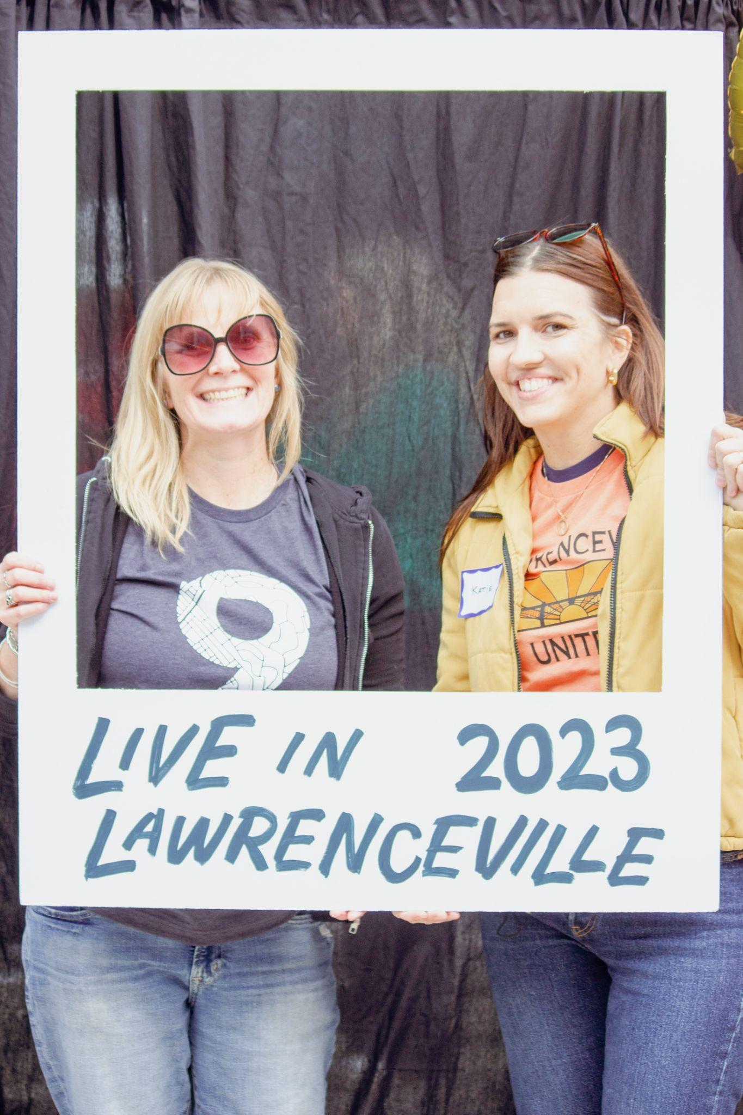
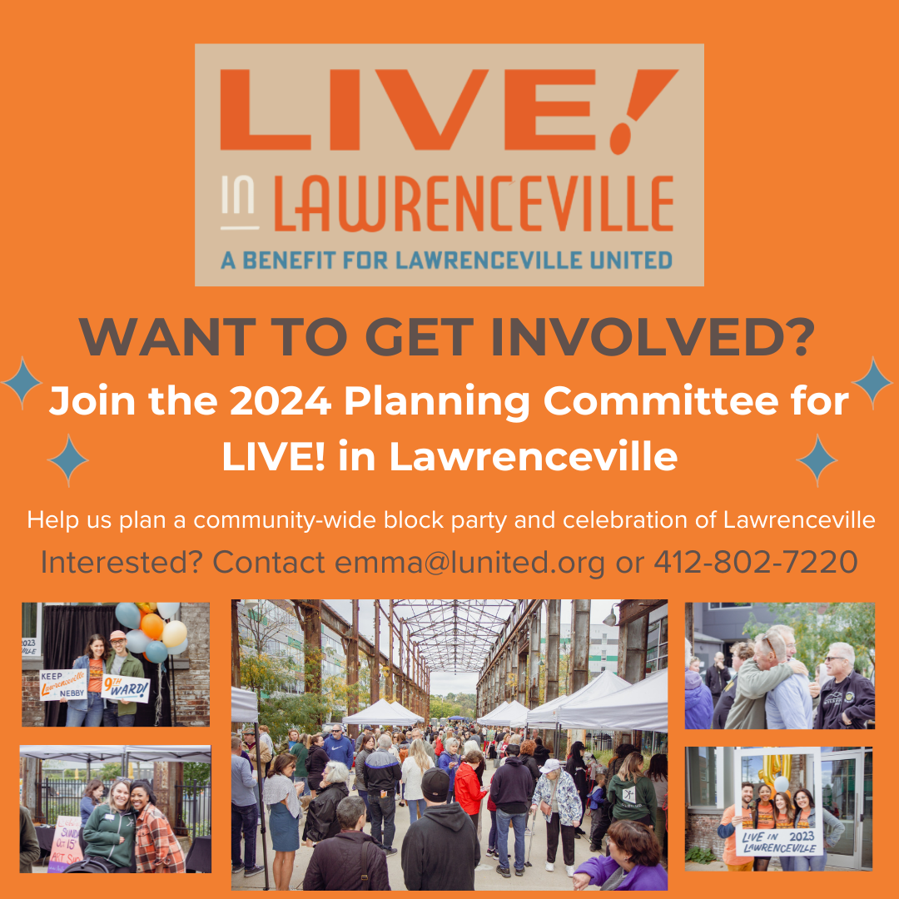
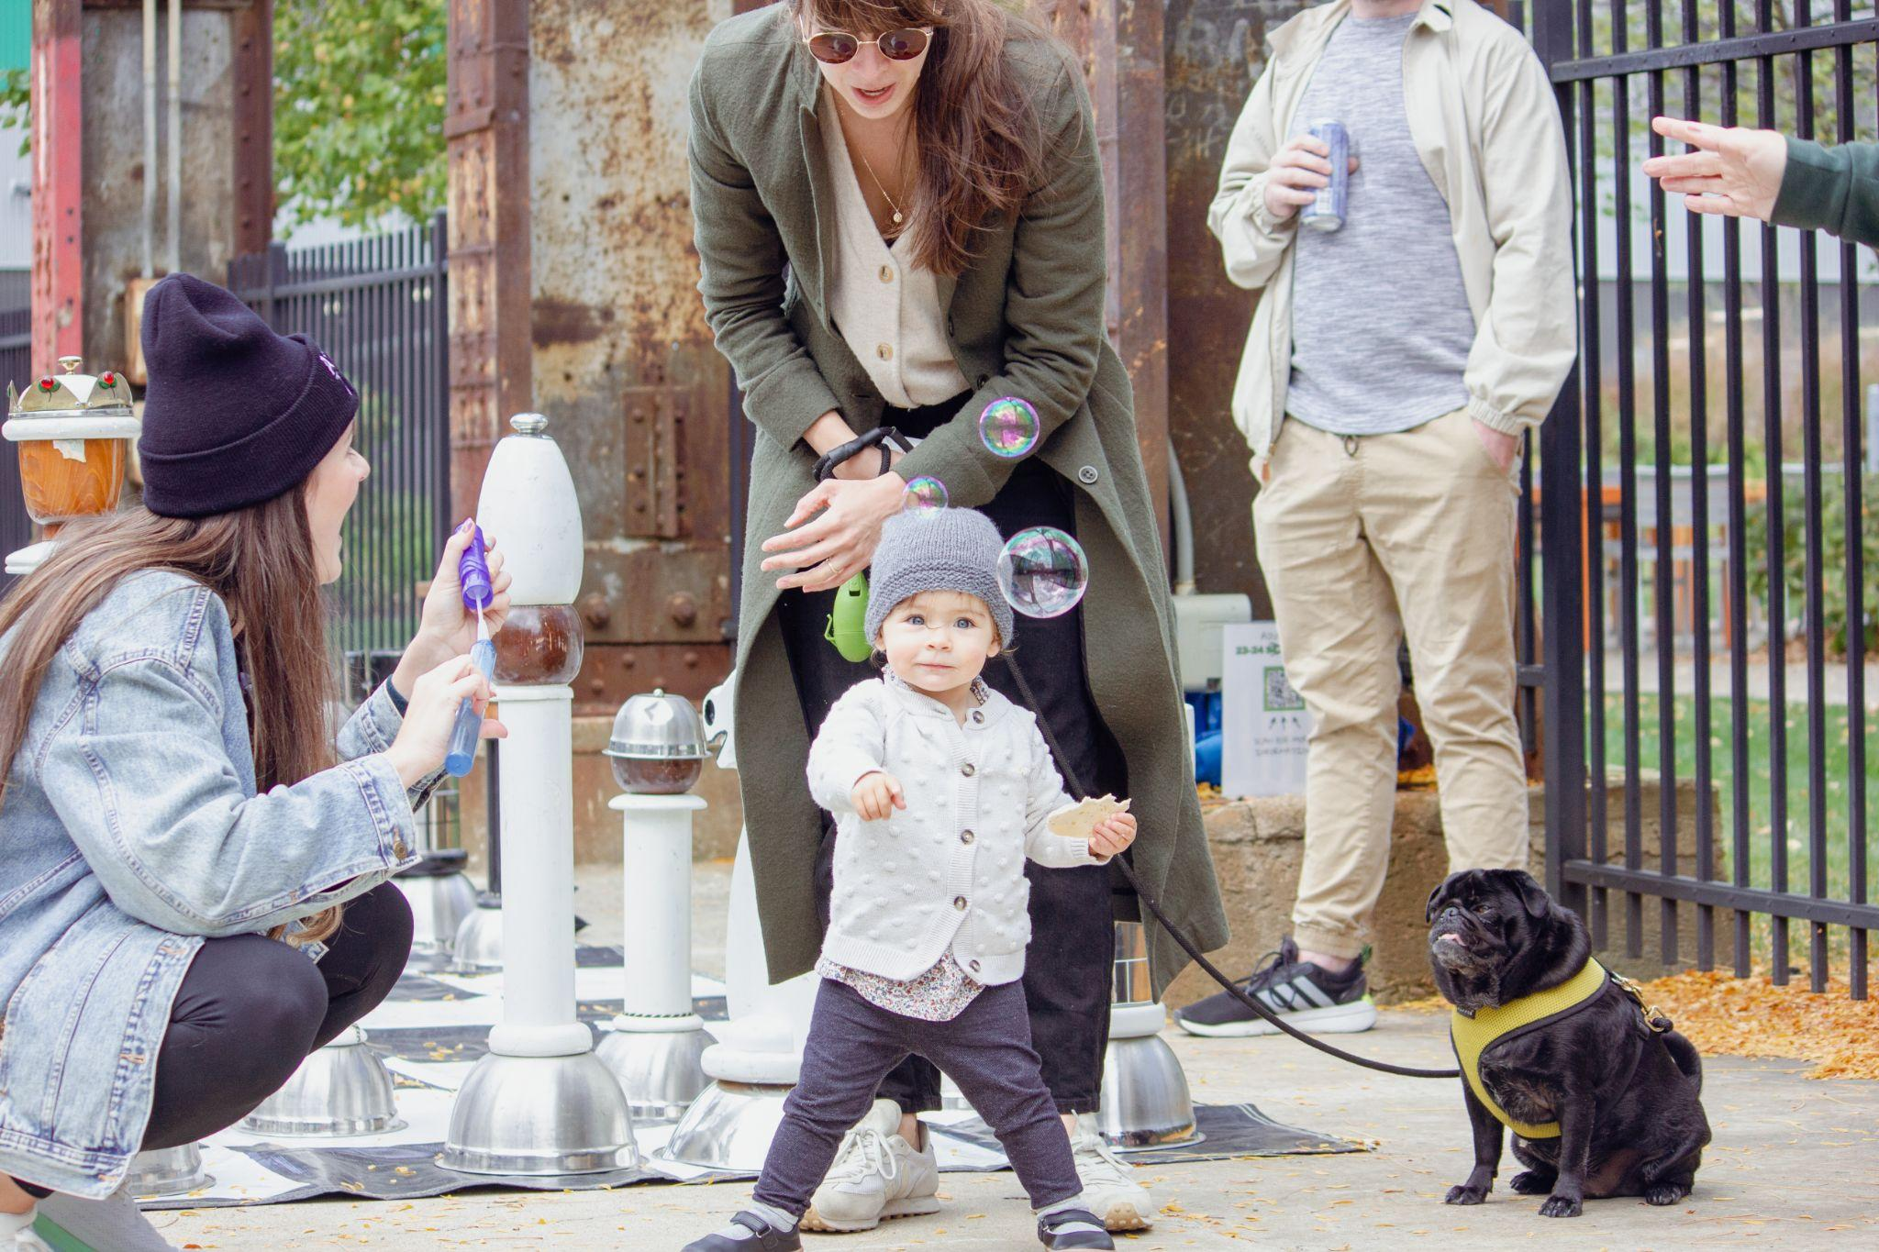
Help Plan LIVE! In Lawrenceville

Slide 18
Upcoming Calendar
Tuesdays (until 11/26) - Lawrenceville Farmers Market at Bay41 (115 41st St) from 3-7 PM
7/13 - Bernard Dog Park Clean Up from 9-11 AM
7/16 - Blood Drive at LFM (115 41st St) from 2:30-7 PM
7/24 - Coffee + Tea Business Networking at Wild Rose (5312 Butler St) from 8-10 AM
8/8 - Better Streets Lawrenceville Zoom Meeting at 12 PM
8/8 - Happenings: Neighbor Mixer from 6:30-8 PM
9/21 - Garbage Olympics
9/25 - Lawrenceville Corporation Annual Meeting

Slide 19
Comments, questions
Lawrenceville United Lawrenceville Corporation
412-802-7220 412-621-1616
info@LUnited.org info@lawrencevillecorp.com
If you joined online, please sign in bit.ly/LUSignIn if joining online

