Slide 1
Penn Avenue and Main Street Traffic Safety Improvements
Jan Raether
Infrastructure Engagement Specialist
Mayor's Office
jan.raether@pittsburghpa.gov

Slide 2
Agenda
Vision Zero – Why are we doing this?
Main Street
Penn Avenue
Penn/Main Intersection
Other projects
Questions

Slide 3
Vision Zero
Fatal Crashes are increasing at every level across the country, and Pittsburgh is no different.
21
Fatal Crashes in 2023†
7
Fatal Pedestrian Crashes in 2023†
71%
Increase in fatal crashes§
9
Fatal Crashes in 2024
(Through April 25th)
† Fatal crashes investigated by the PBP in 2023
§ Between 2018 – 2022

Slide 4
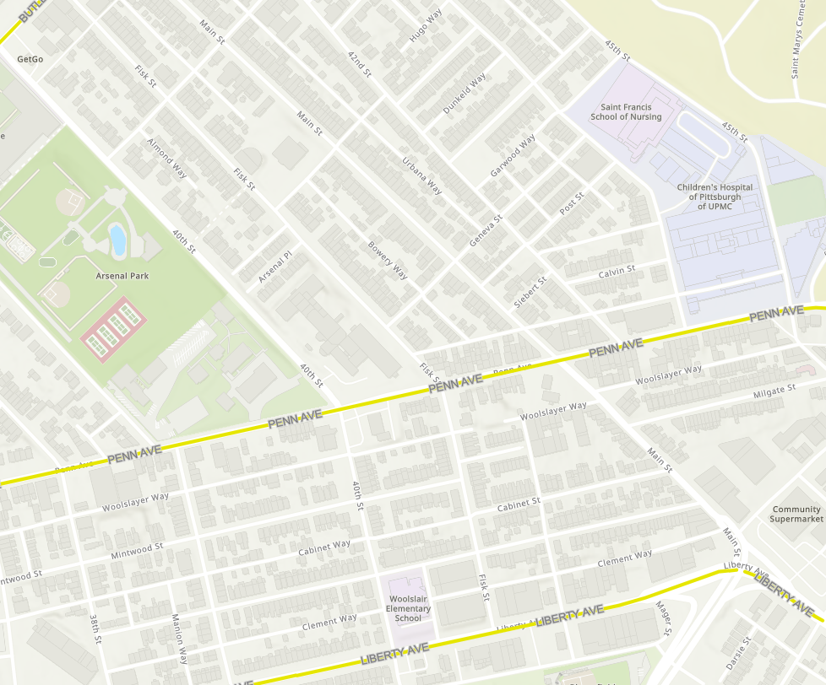
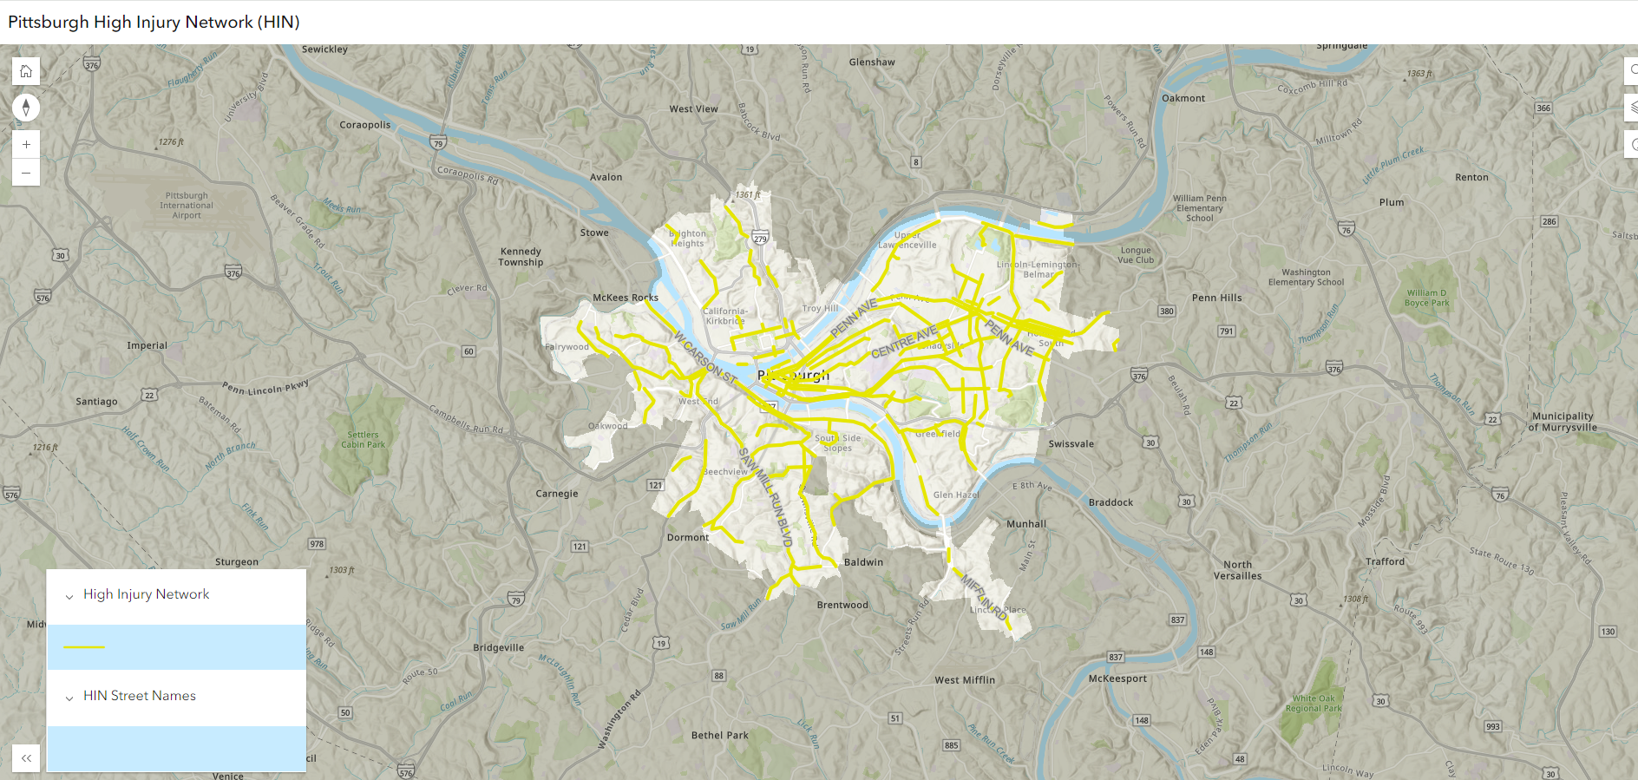
Vision Zero - High Injury Network
2018-2022
Penn/39th - 7 crashes
Penn/Fisk - 12 crashes
Penn/Main - 10 Crashes
Main St. - 8 Crashes
Main Street
Penn/Main
Penn/Fisk
Penn/39th

Slide 5
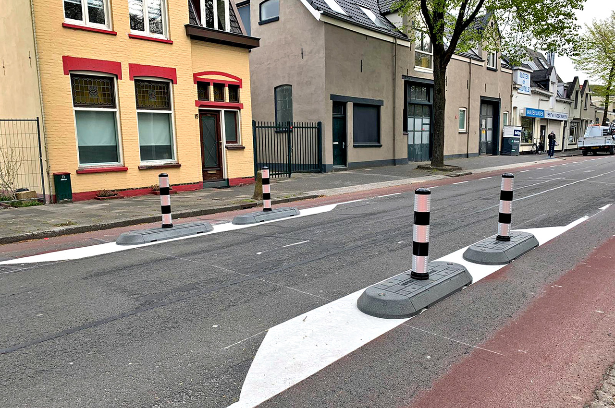
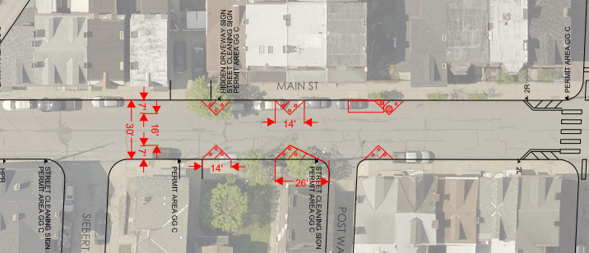
Main Street - Chokers
Reinforce a yield condition
Protect parked cars
Increase off-sidewalk parking
Some parking reduction

Slide 6
Main Street - Chokers
These locations are not finalized, but targeting mid-block

Slide 7
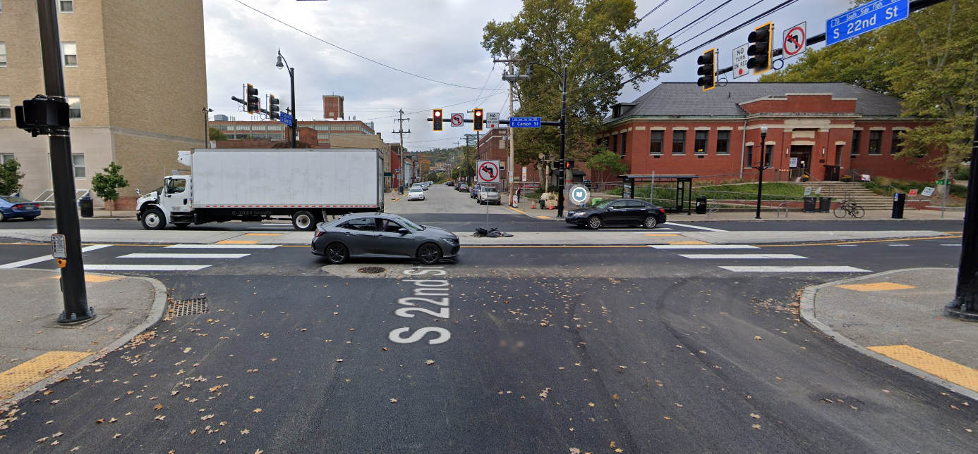
Penn Ave @ 39th and Fisk - Diverters
Limits through traffic and forces drivers to make safer turning movements.
Encourages turning at signalized intersections.

Slide 8
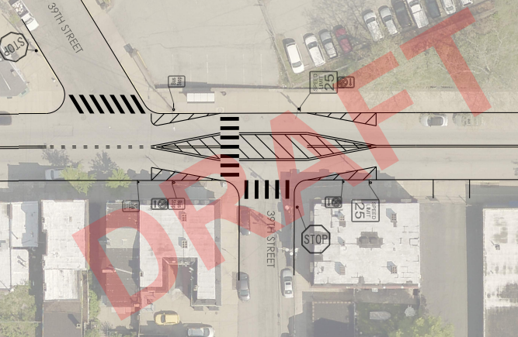
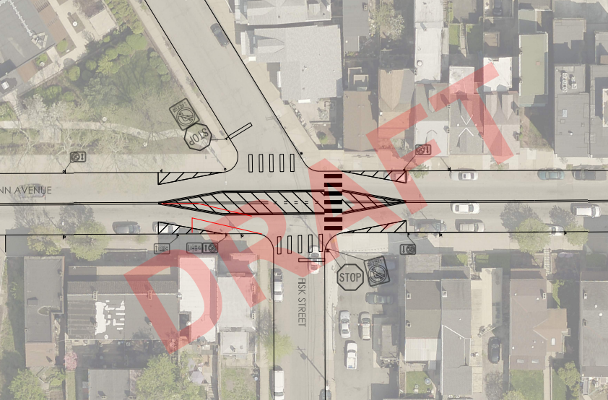
Penn Ave @ 39th and Fisk - Diverters
Pedestrian refuge island
New crosswalk across 39th
Northbound 39th – Right turn only
Southbound 39th – No change
Penn Ave – Horizontal deflection
Improved Sightlines – parking restrictions on Penn
Pedestrian refuge island
Northbound Fisk – Right turn only
Southbound Fisk – Right turn only
Penn Ave – Horizontal deflection
Improved sightlines – parking restrictions on Penn

Slide 9
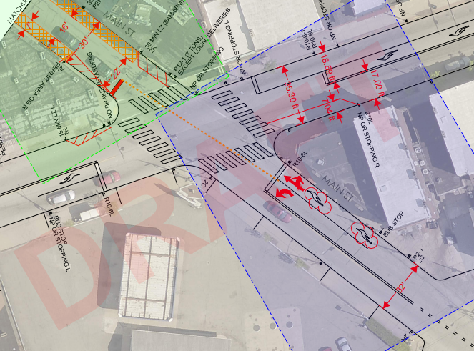
Penn/Main Intersection – Phase 2
Remove dedicated right turn lane and replace with combined through and right turn lane. Dedicated left turn lane.
This project is on a slightly longer timeline.

Slide 10
Other Projects/Improvements
Additional wayfinding pavement markings/signage by the trail under 40th St bridge
Penn Ave (Strip District) - 31st to 22nd proposed rightsizing (reducing from 2 lanes to 1), planned for 2025.
Bit.ly/pennavestrip
"Penn Ave Rightsizing" on EngagePGH

Slide 11
Thank you!
Construction expected Summer 2024
90% design and construction updates will be posted to the project's Engage page.
Next Steps:
Engage Page:
Coming Soon!
Questions? jan.raether@pittsburghpa.gov

