Slide 1
Herron Station: Station Area Plan
Community Meetings – Round 3
Lawrenceville United – 2.8.24

Slide 2
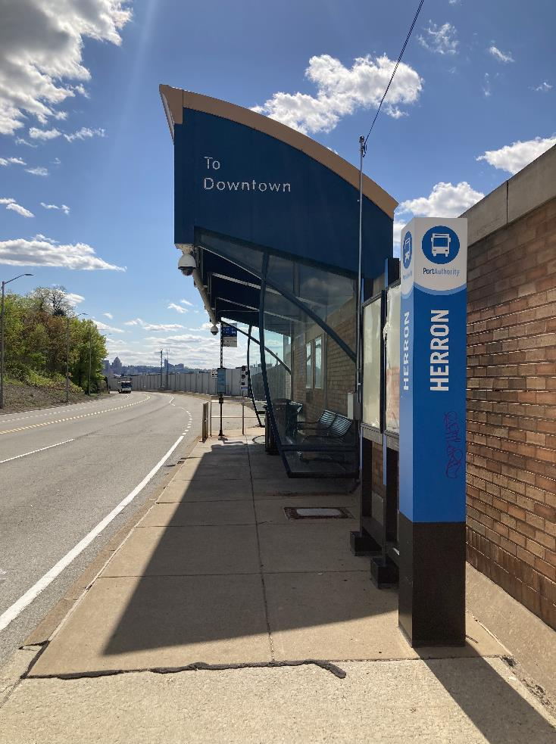
Today's Objectives
Project background
How did we get here?
What we heard
Herron Avenue Station Area design
Hillside
Platform
Street level
Concurrent projects
Landscaping and sustainability
Wayfinding
Next steps

Slide 3
Project Background
What is station area planning?
Why Herron Station?

Slide 4
PRT’s Approach to Herron Station
Station access – making it easier and safer for people to get to the station, prioritizing upgrades that make the station accessible for all riders
Station design – making PRT facilities more comfortable and easier to use
TOD feasibility – coordinate with the City and URA to investigate how nearby developments can be better connected to high-quality service at Herron Station and identify community goals for future TOD offsite
City, Other Gov’t Officials
Community Members and Stakeholders
Internal TOC Committee

Slide 5
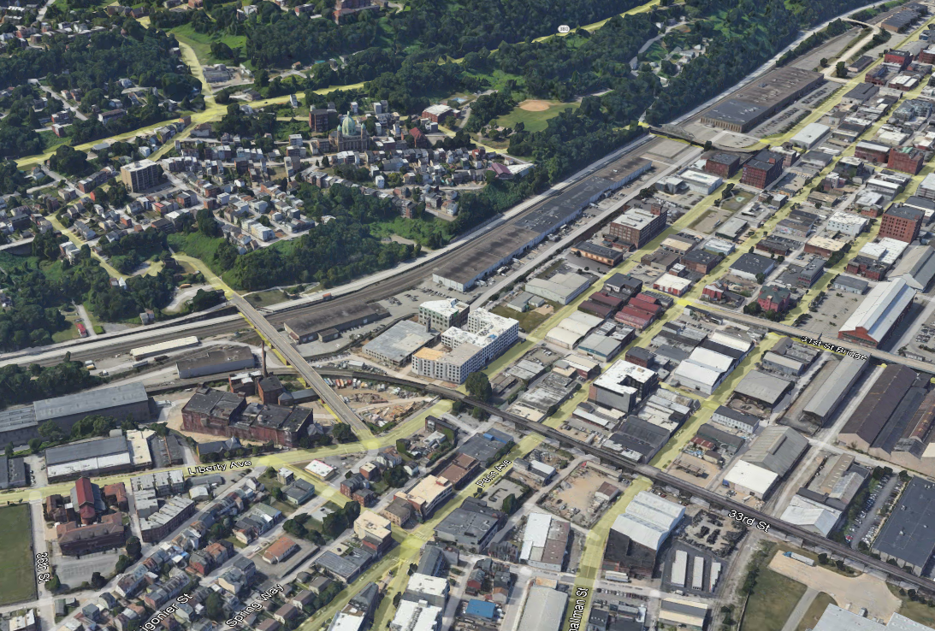
Herron Station
Herron Station is isolated and underutilized
The Herron Station area has become attractive for new development, creating new ridership potential ​
PRT and community partners want to make transit a safe, comfortable, and easy choice for new residents, employees, and visitors.
Polish Hill
Herron Station
Strip District
Lower Lawrenceville

Slide 6
How Did We Get Here?
Forms of engagement
What did we hear?

Slide 7
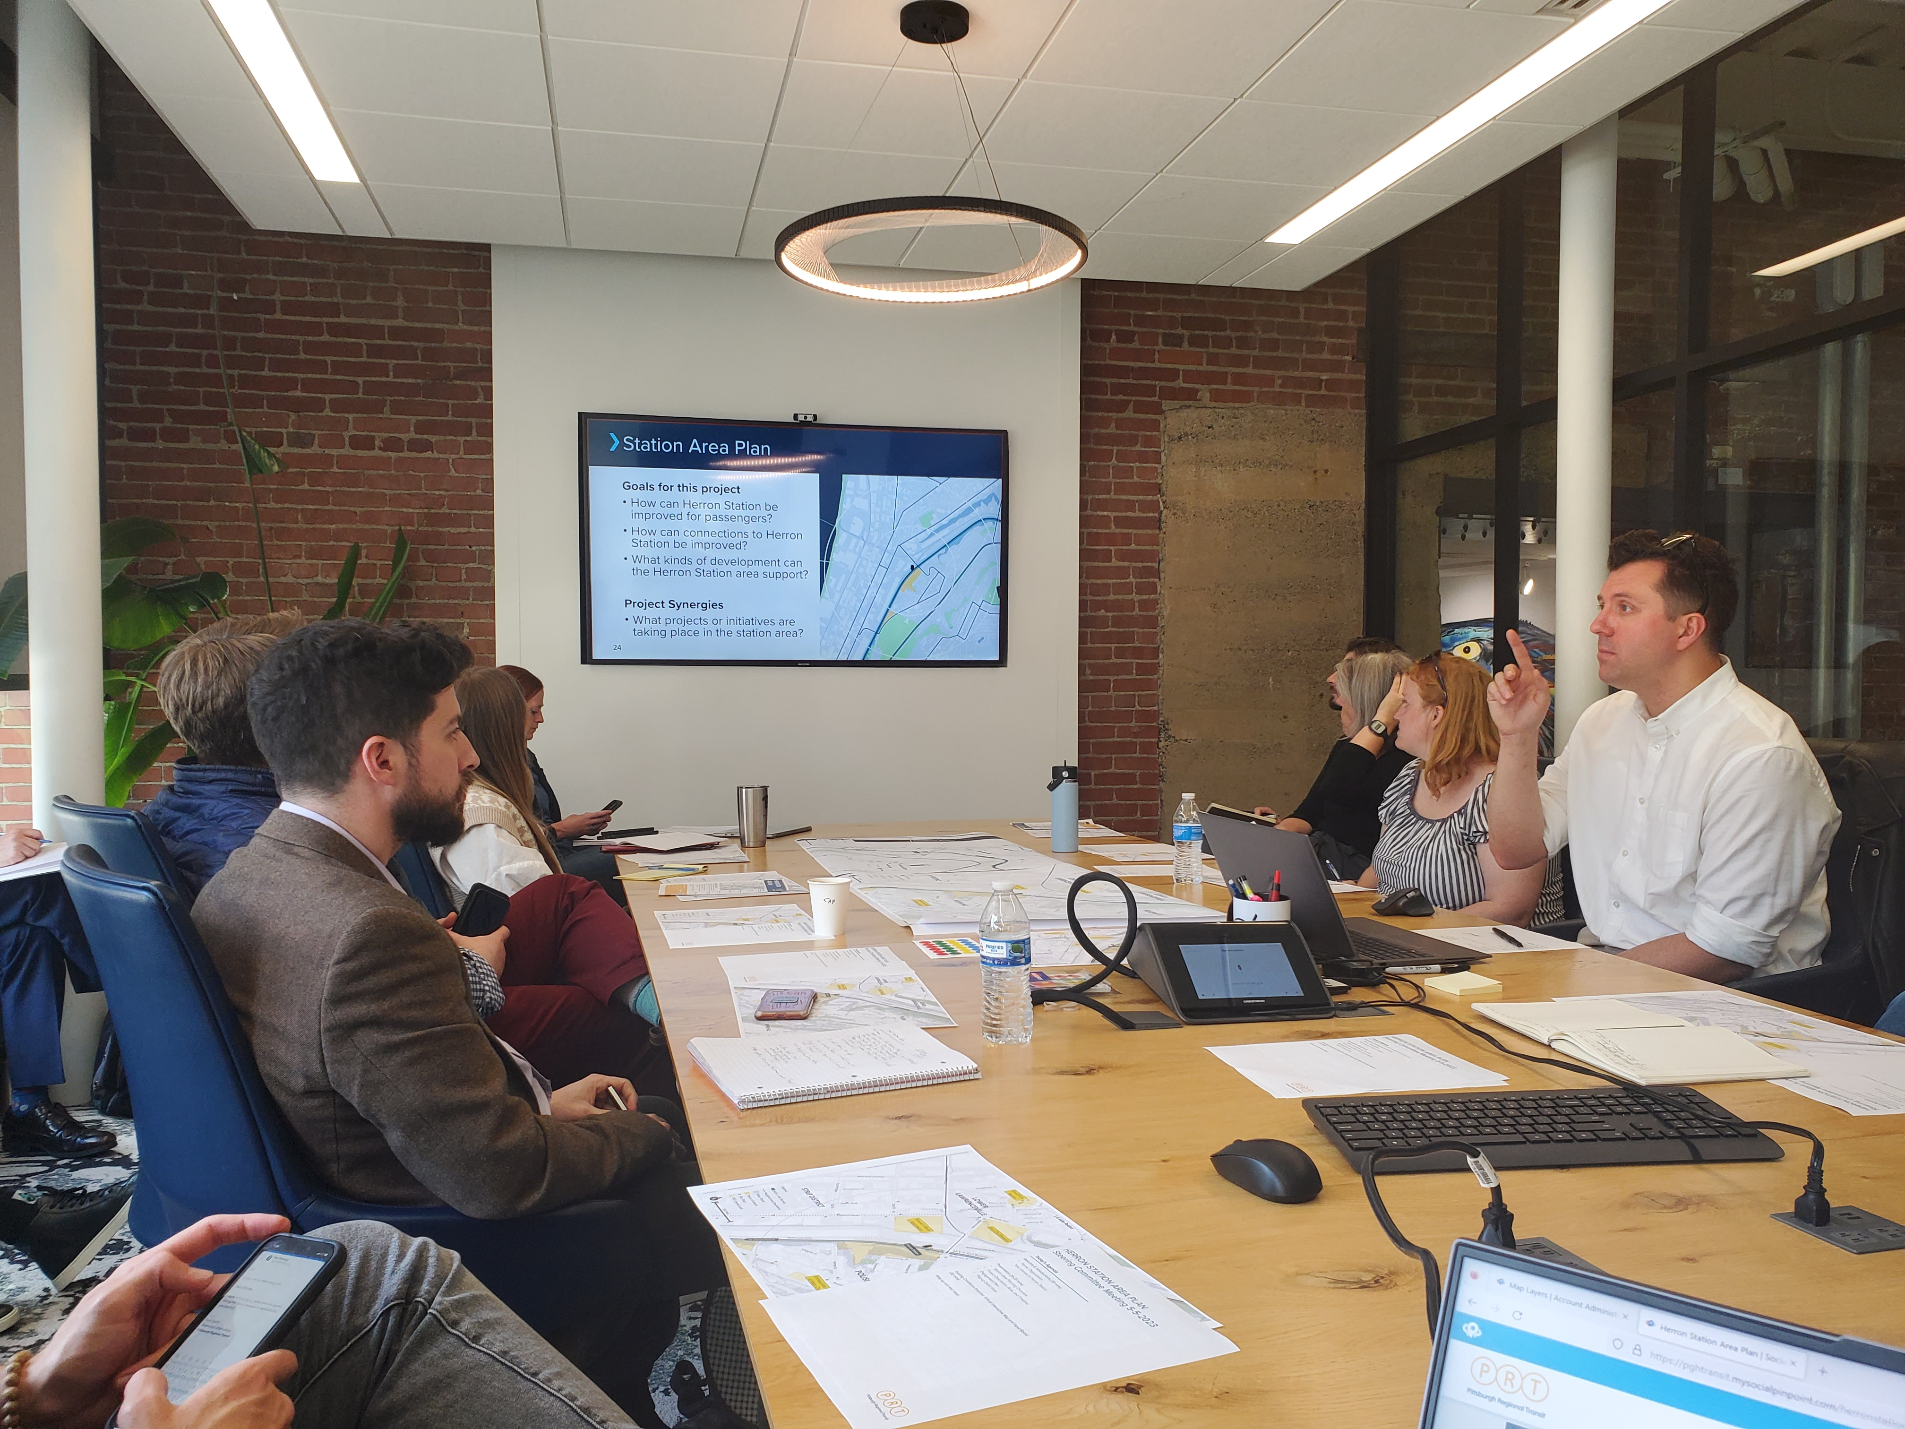
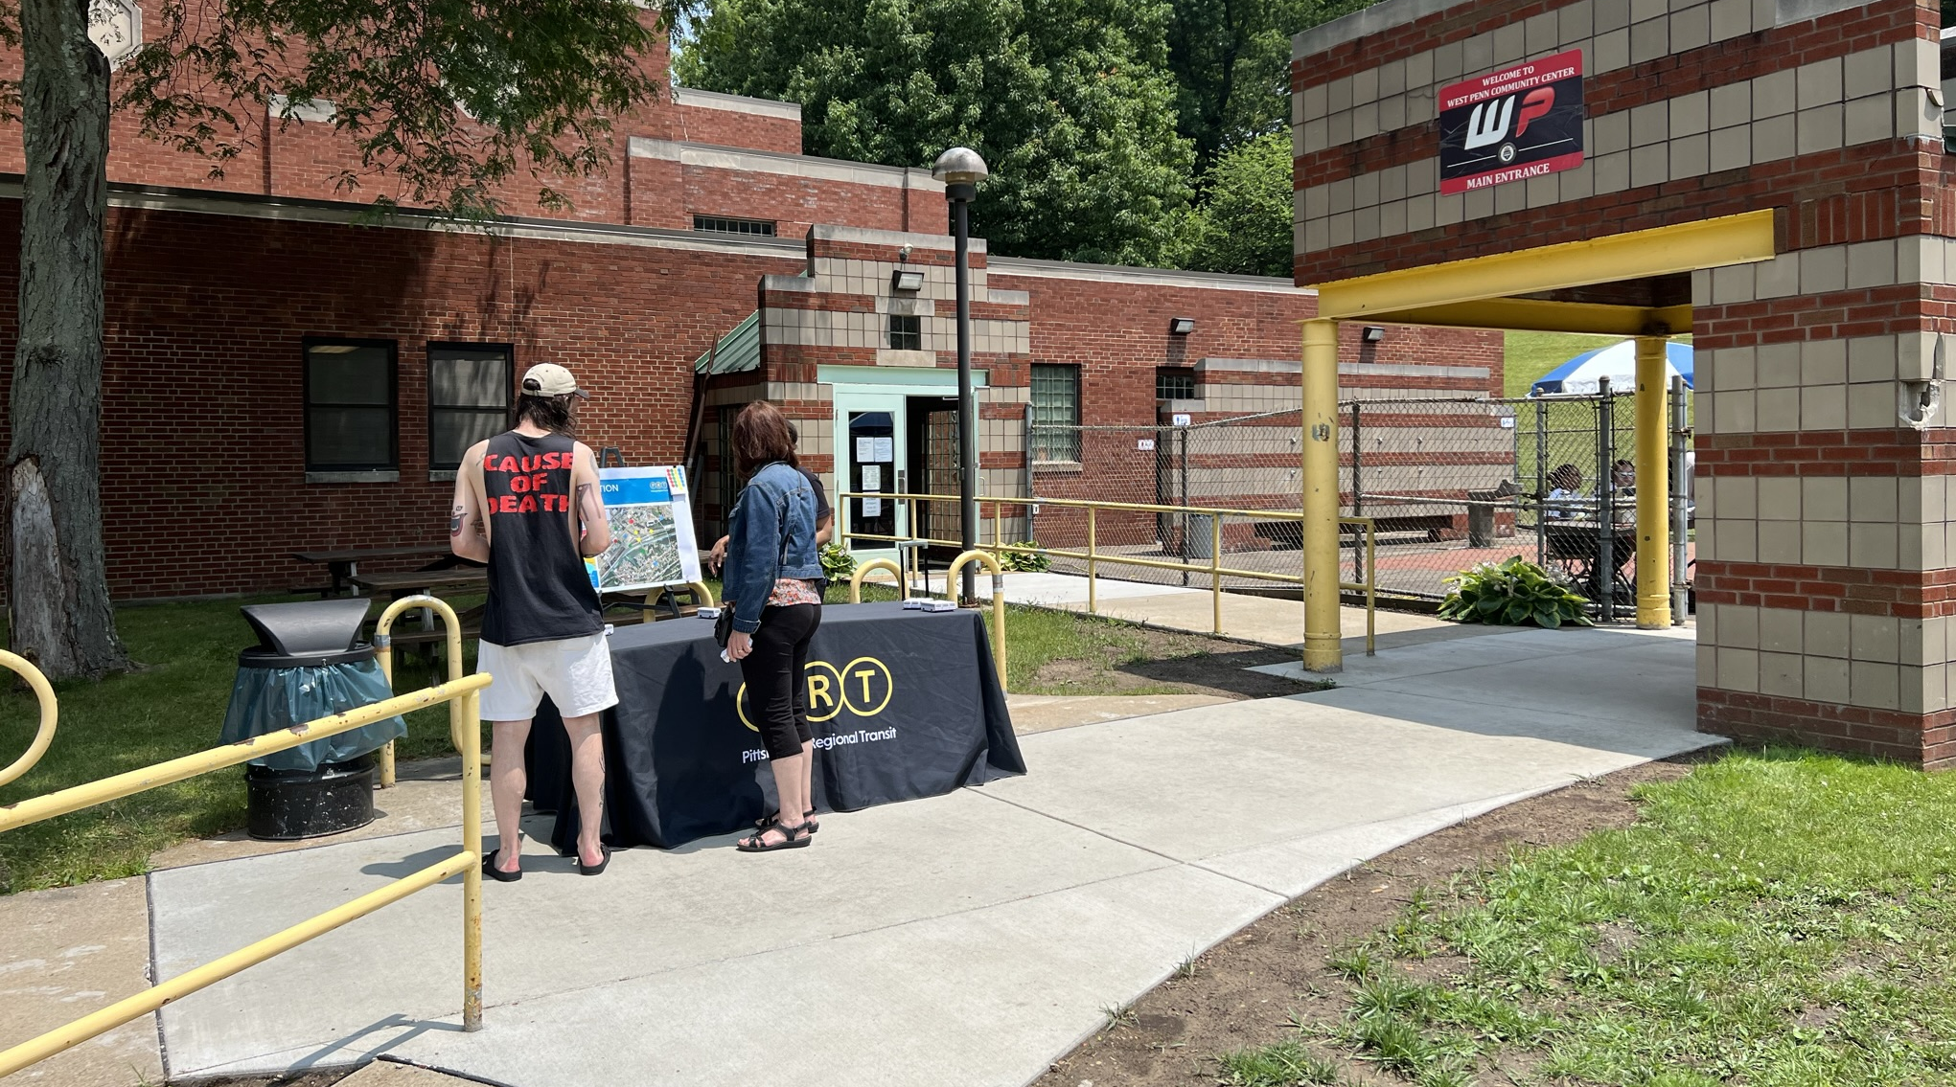
Community Engagement
Steering Committee with representatives from adjacent neighborhoods and relevant organizations
Transit Oriented Communities Committee, and internal PRT team with project matter experts
Community engagement in three phases with many types of events

Slide 8
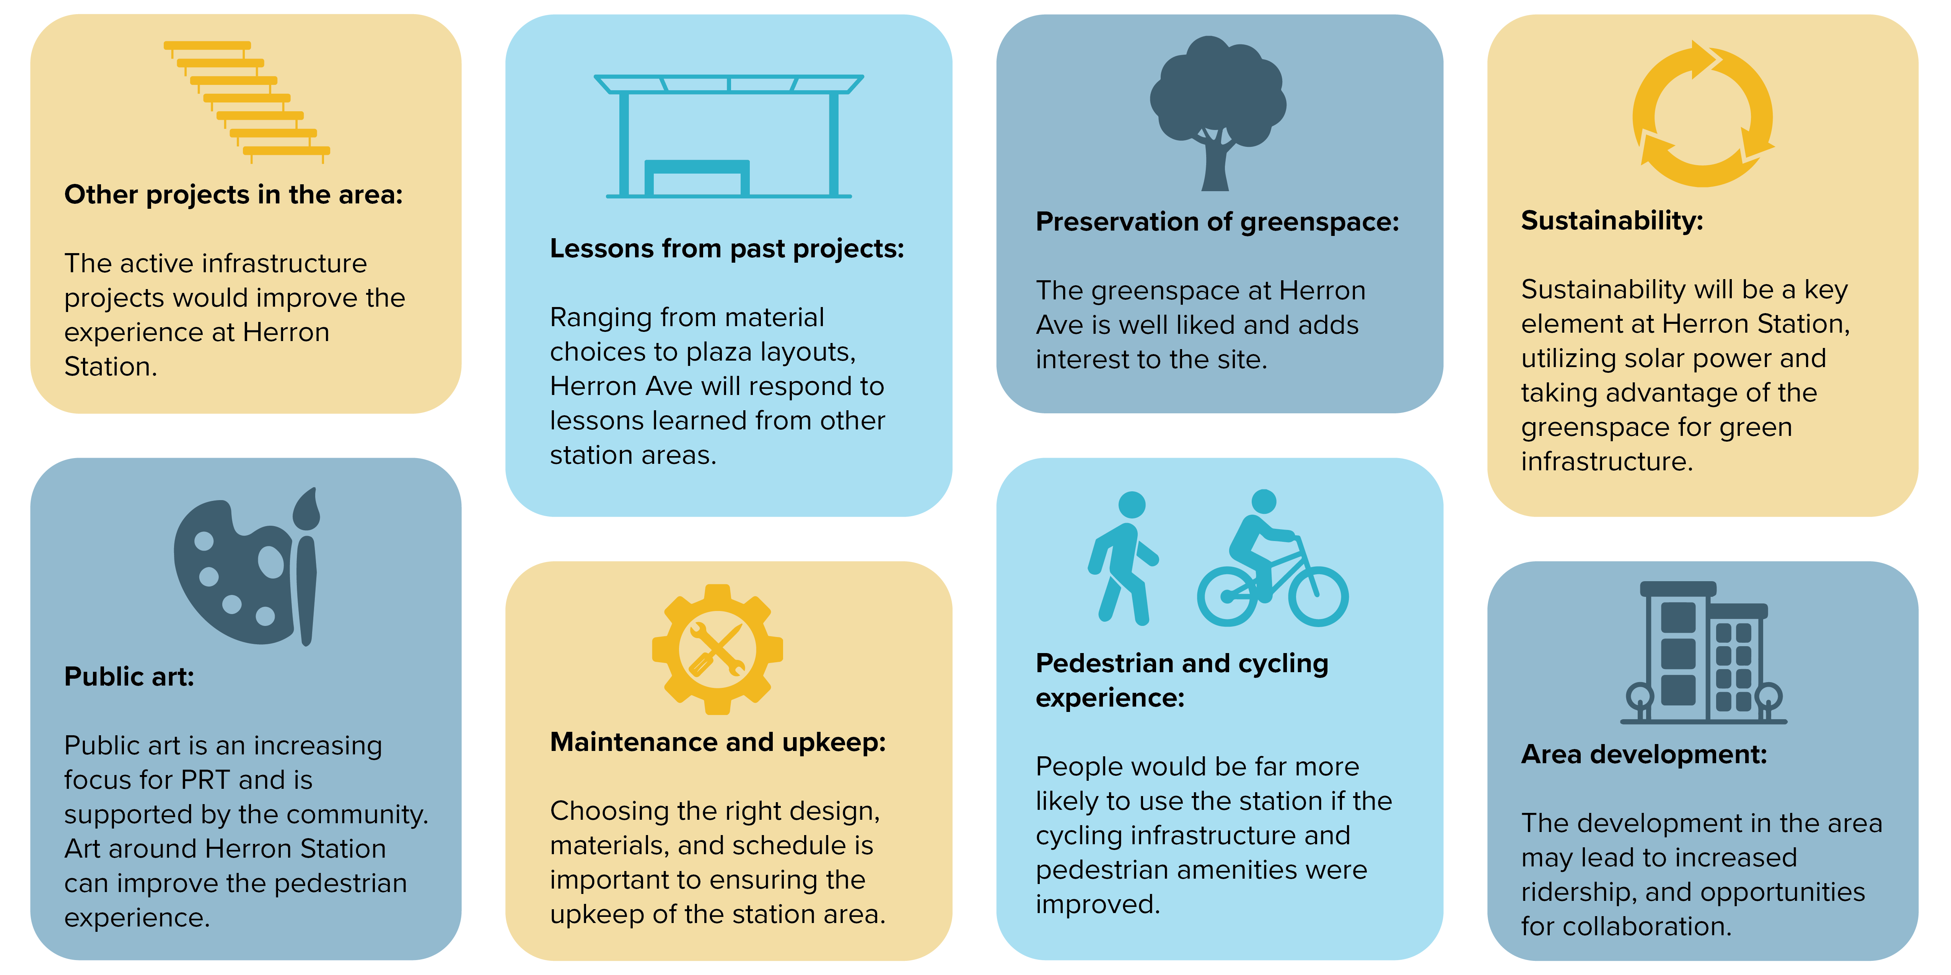
What did we hear?

Slide 9
Herron Station Design
Station Area
Concurrent projects
Landscaping and sustainability
Wayfinding

Slide 10
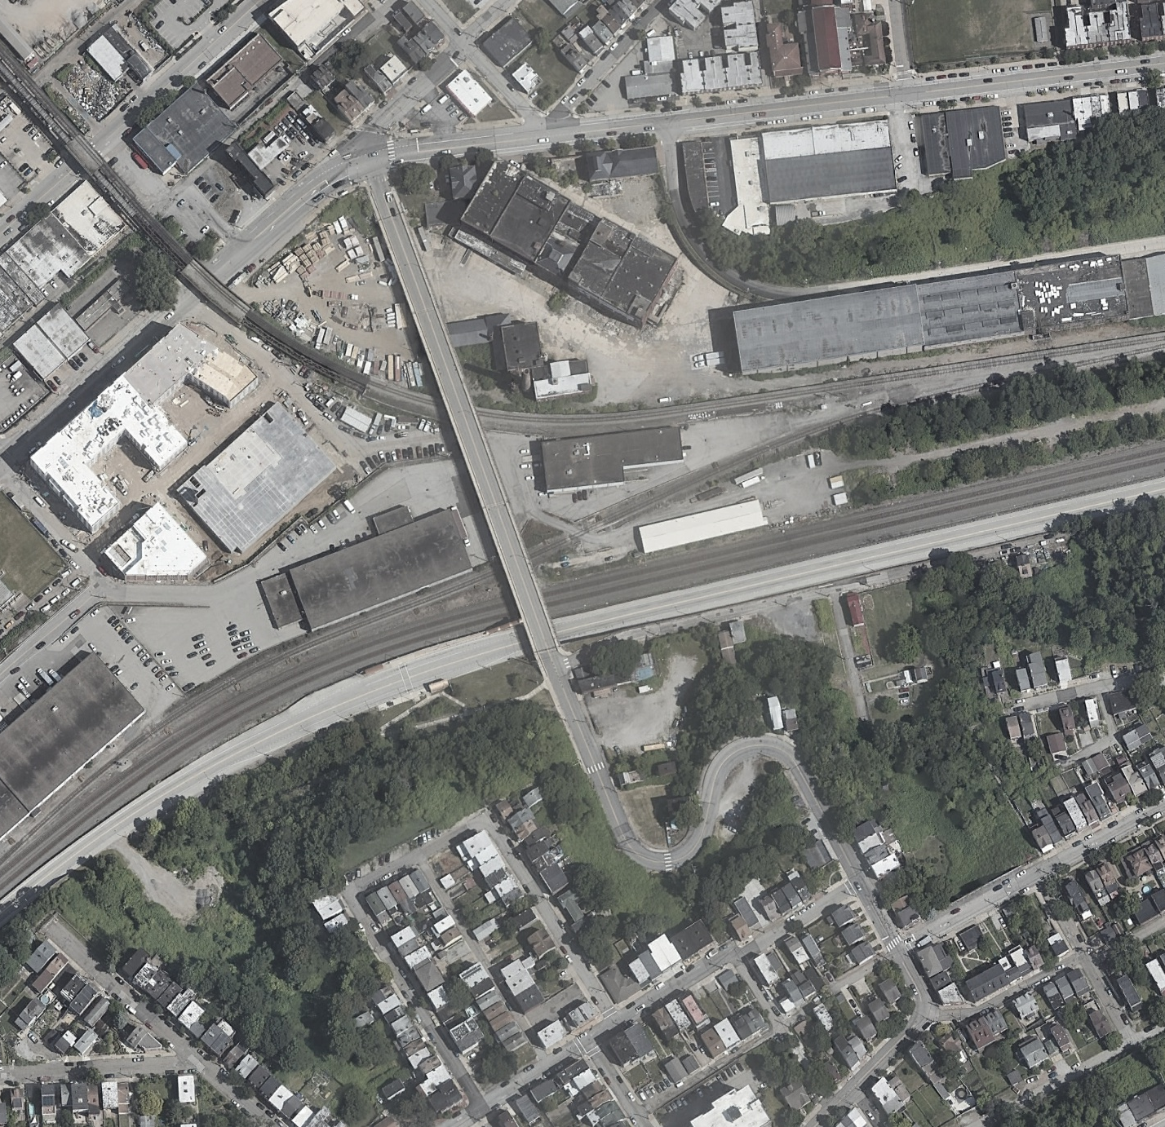
Station Opportunity Areas
1
4
1
Station Area Gateways
5
2
Herron Ave bridge to Lawrenceville
4
1
2
3
Downing Street stairs
3
4
Neighborhood Wayfinding Signage
Legend:
5
Intersection of Liberty & Herron
Herron Station 10% design
Future area project
4

Slide 11
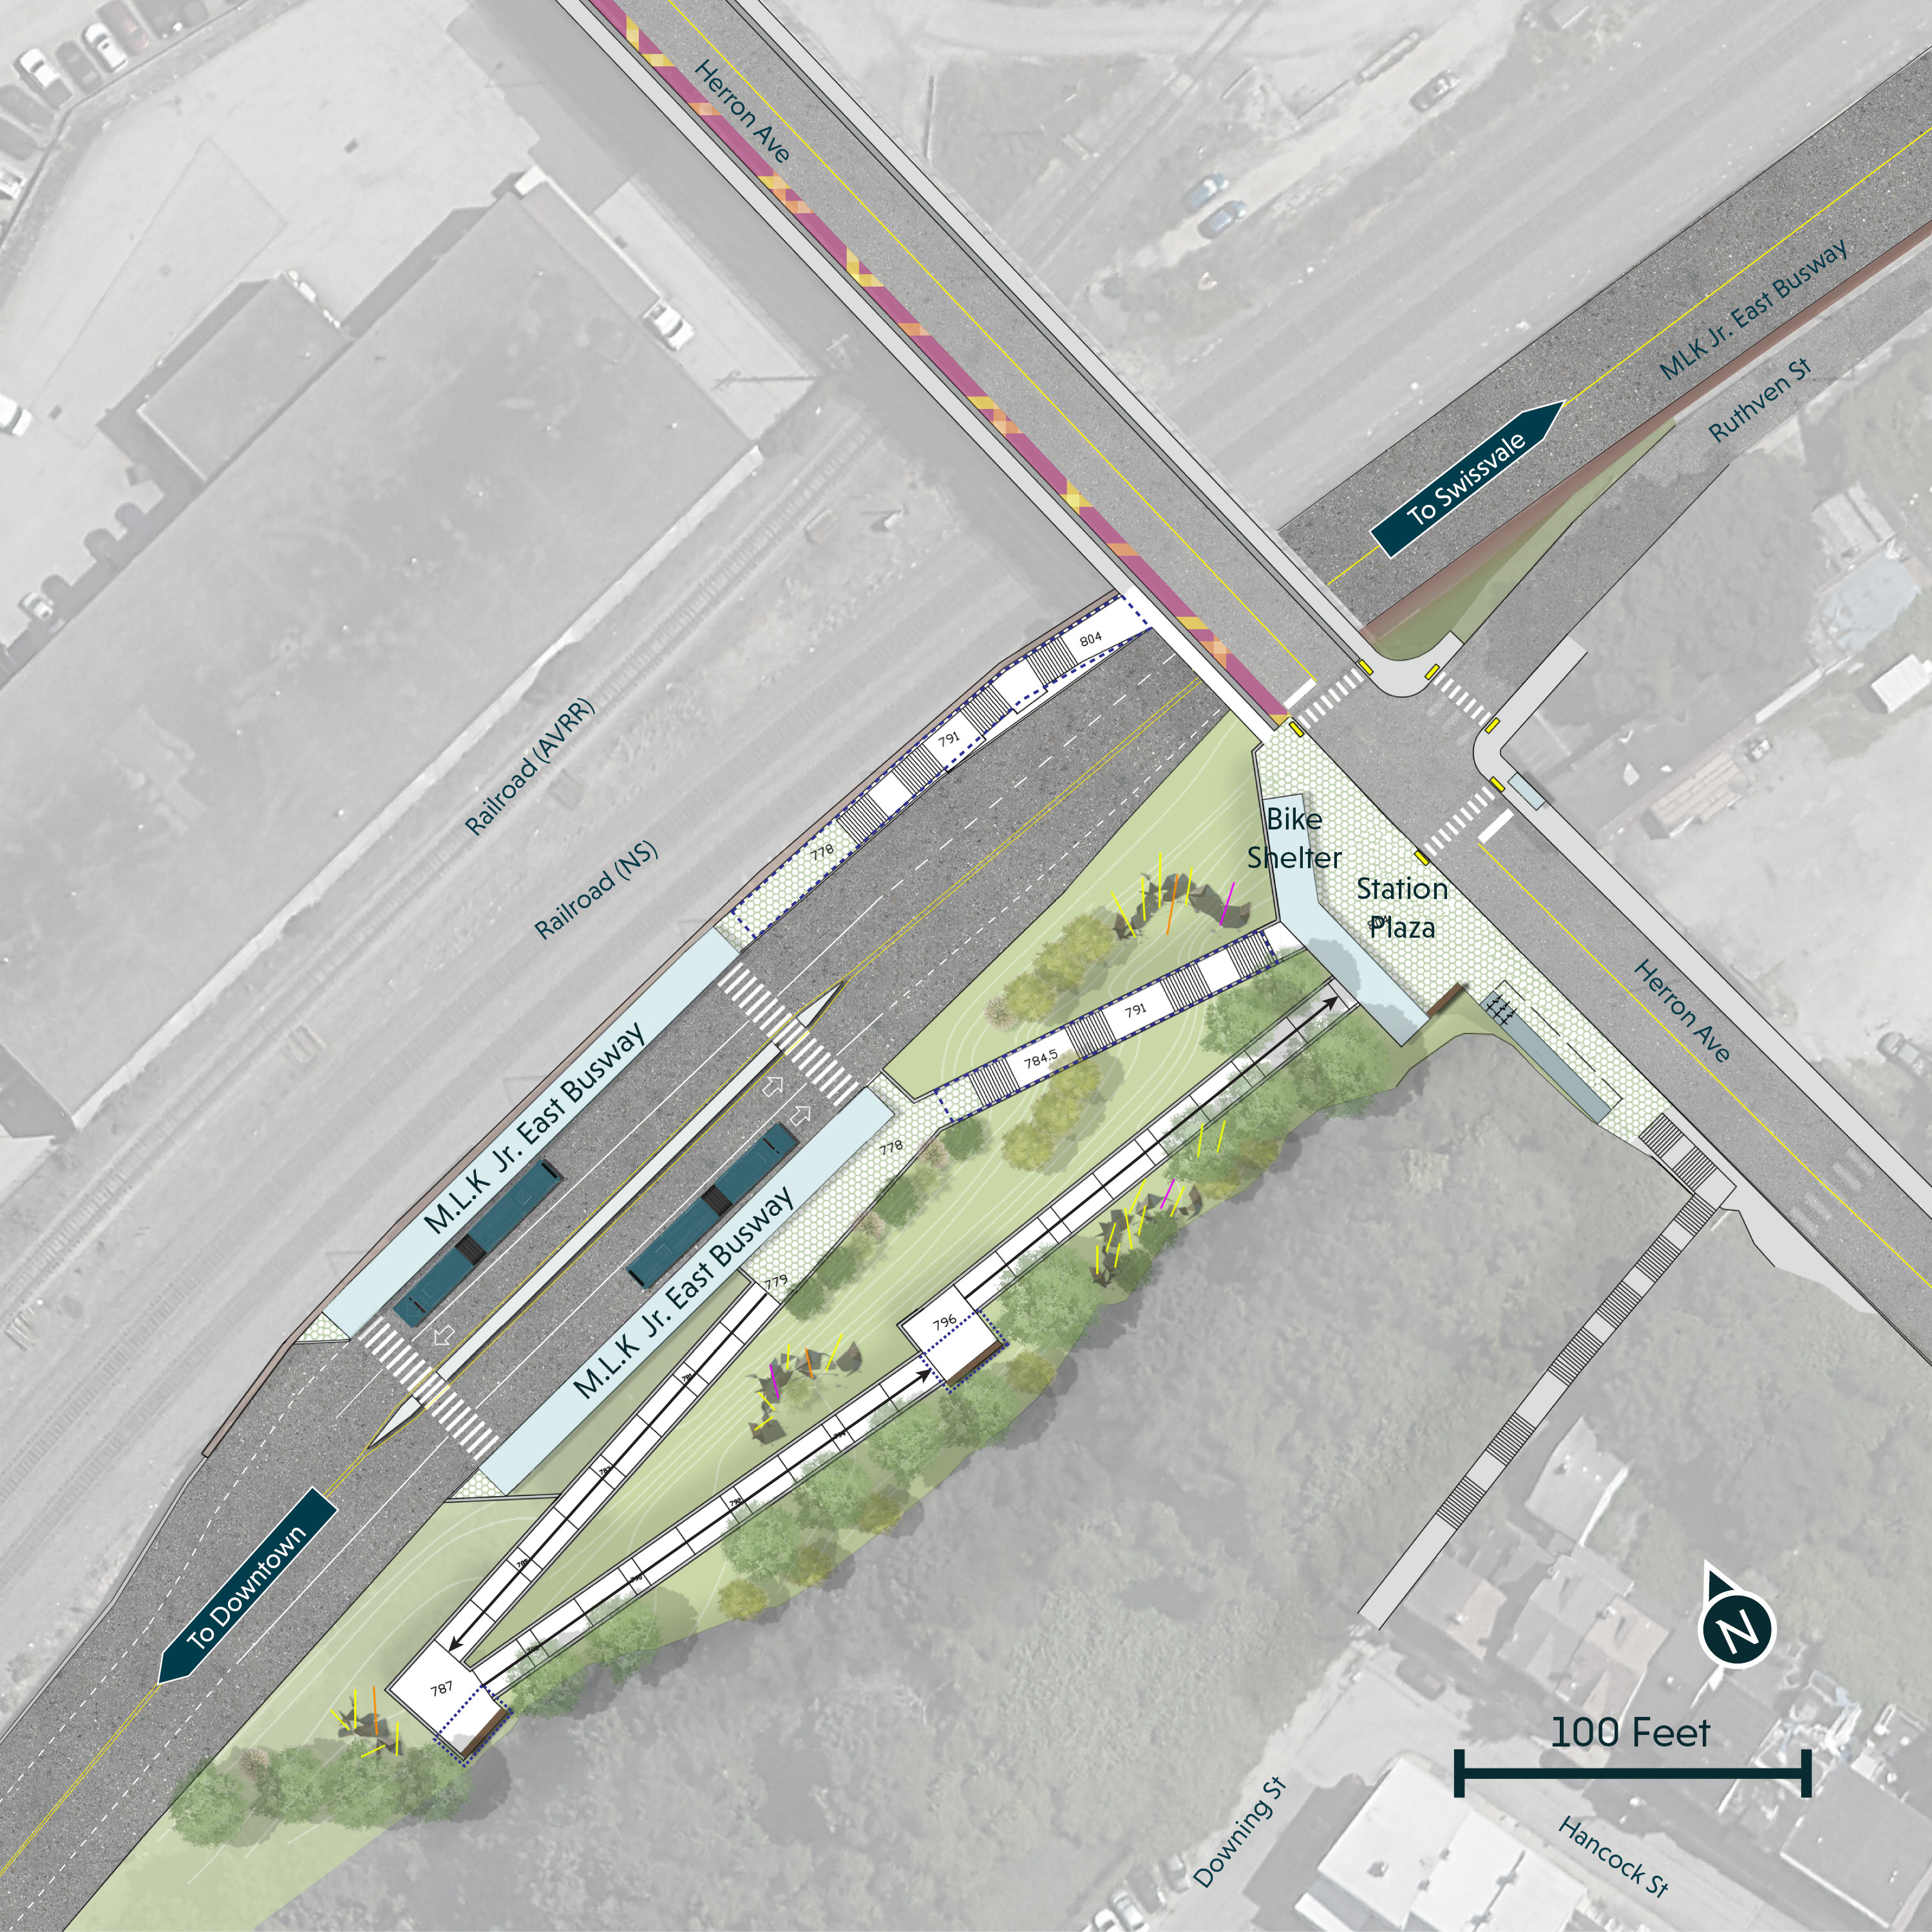
Station Design
Key Design Elements:
Street-level plaza at Herron Avenue with longer street frontage to increase visibility. Plaza includes bike parking, a POGOH station, seating, and ticket vending machine (TVM).
ADA access is 10 ft wide with 1:16 slope with integrated landings.
Stairs and ramps are covered with canopies.
On-street bus stops are aligned at the intersection and integrated with the plaza treatment.
Proposed pedestrian safety improvements at the intersection of Herron Ave and Ruthven St.
Removal of invasive species and planting of native species
1
2
5
3
3
1
4
4
3
5
6
6
2
3

Slide 12
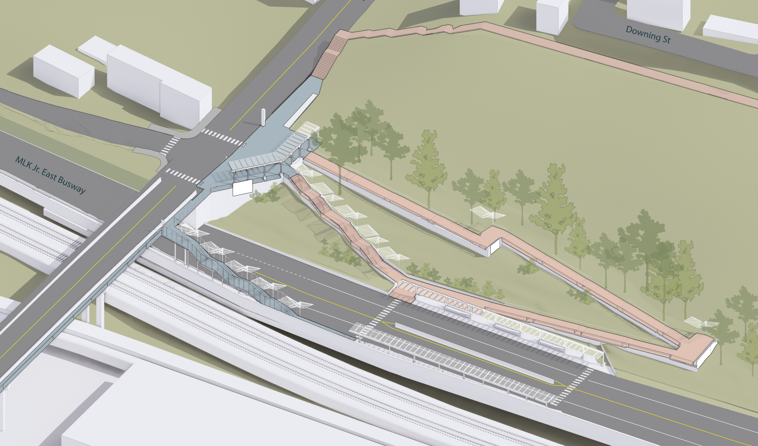
Station Design – Aerial view
Downing St. Stairs
Integrated Plaza Shelter with Covered Bike Parking, Seating, TVM
Landscape design in the station area and on the cliff
ADA Accessible Ramp (10 foot wide, 1:16 slope)
Canopies at Landing and Mid Ramp
Improved Inbound Stair and Canopy
Updated Busway Platforms, Shelter, Seating (12 feet x 160 feet)
N

Slide 13
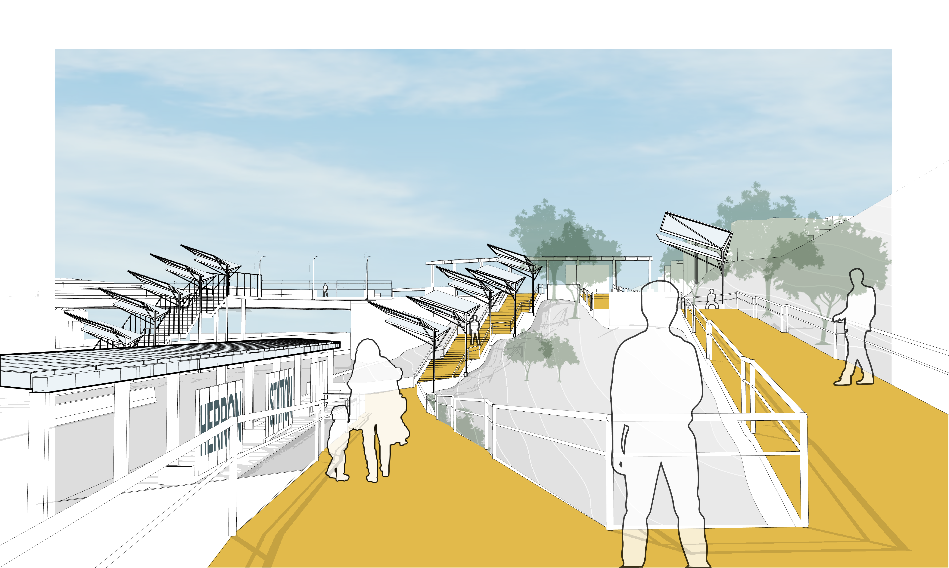
Station Design – View from the Ramp

Slide 14
Station Design – View of Plaza

Slide 15
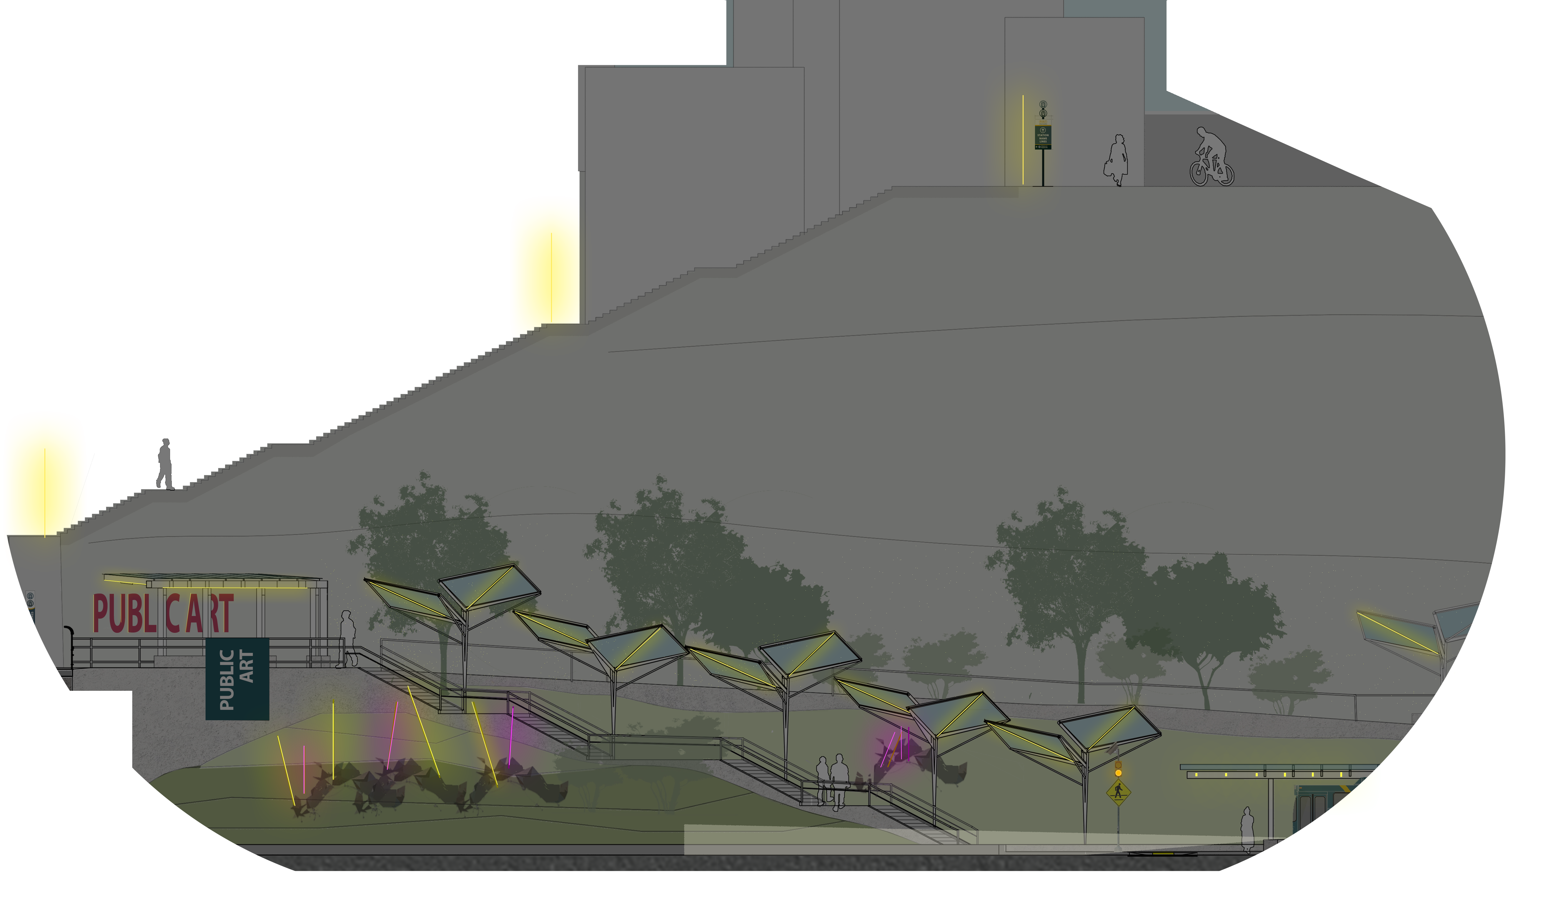
Station Design – Nighttime view of Cliff Face

Slide 16
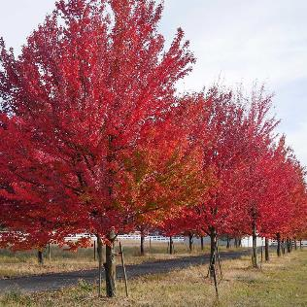
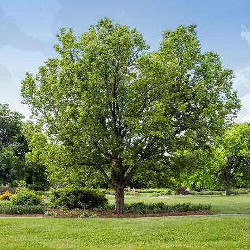
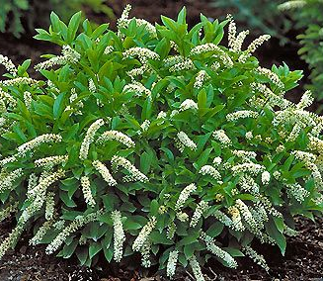
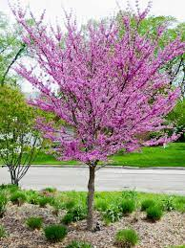
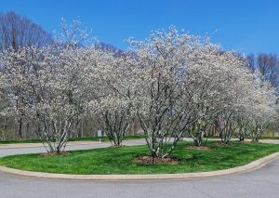
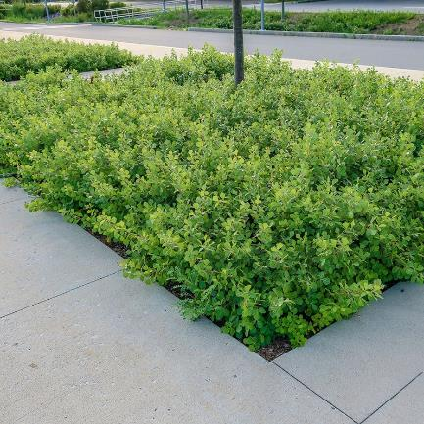
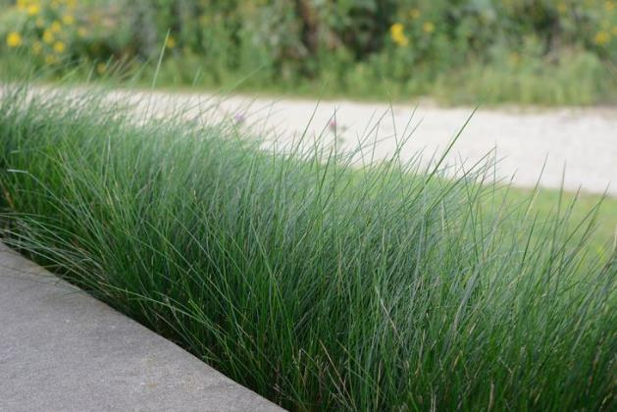
Station Design – Landscape and Sustainability
Mix of native canopy and understory trees
Planting will vary based on if forest rehabilitation is pursued
With forest rehabilitation
The ground would be treated the same as the forest areas
Without forest rehabilitation
Plant "no-mow" grasses, which will suppress the encroachment of invasives

Slide 17
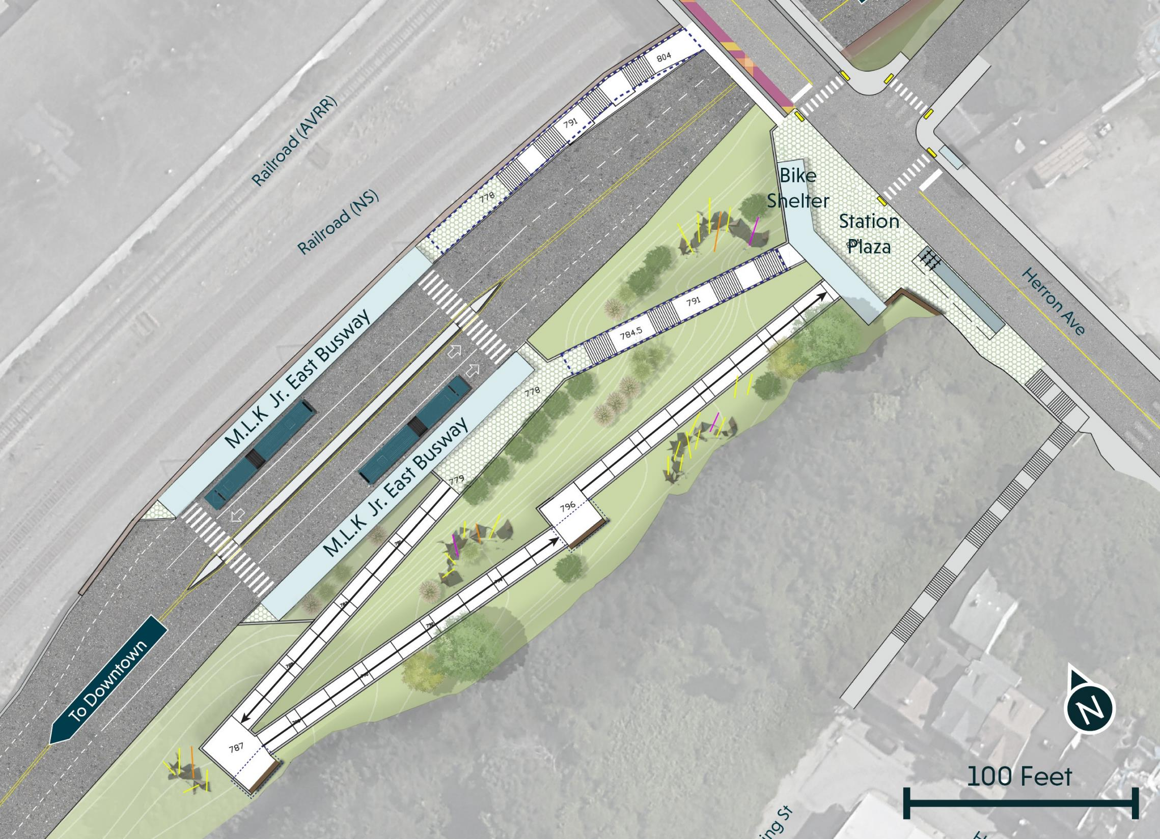
Station Design – Proposed Landscape Plan
Landscape Zones:
Forest Edge
Steep Slopes (low shrub plantings)
Platform Edge (bouldered swale – coordinated with stormwater management plan
Forest Rehabilitation Areas
Canopy Tree
Understory Tree
Large Shrubs groupings
1
2
2
3
2
3
4
1
4
2
1

Slide 18
Next Steps
Future projects
Finalize 10% design
Next phase

Slide 19
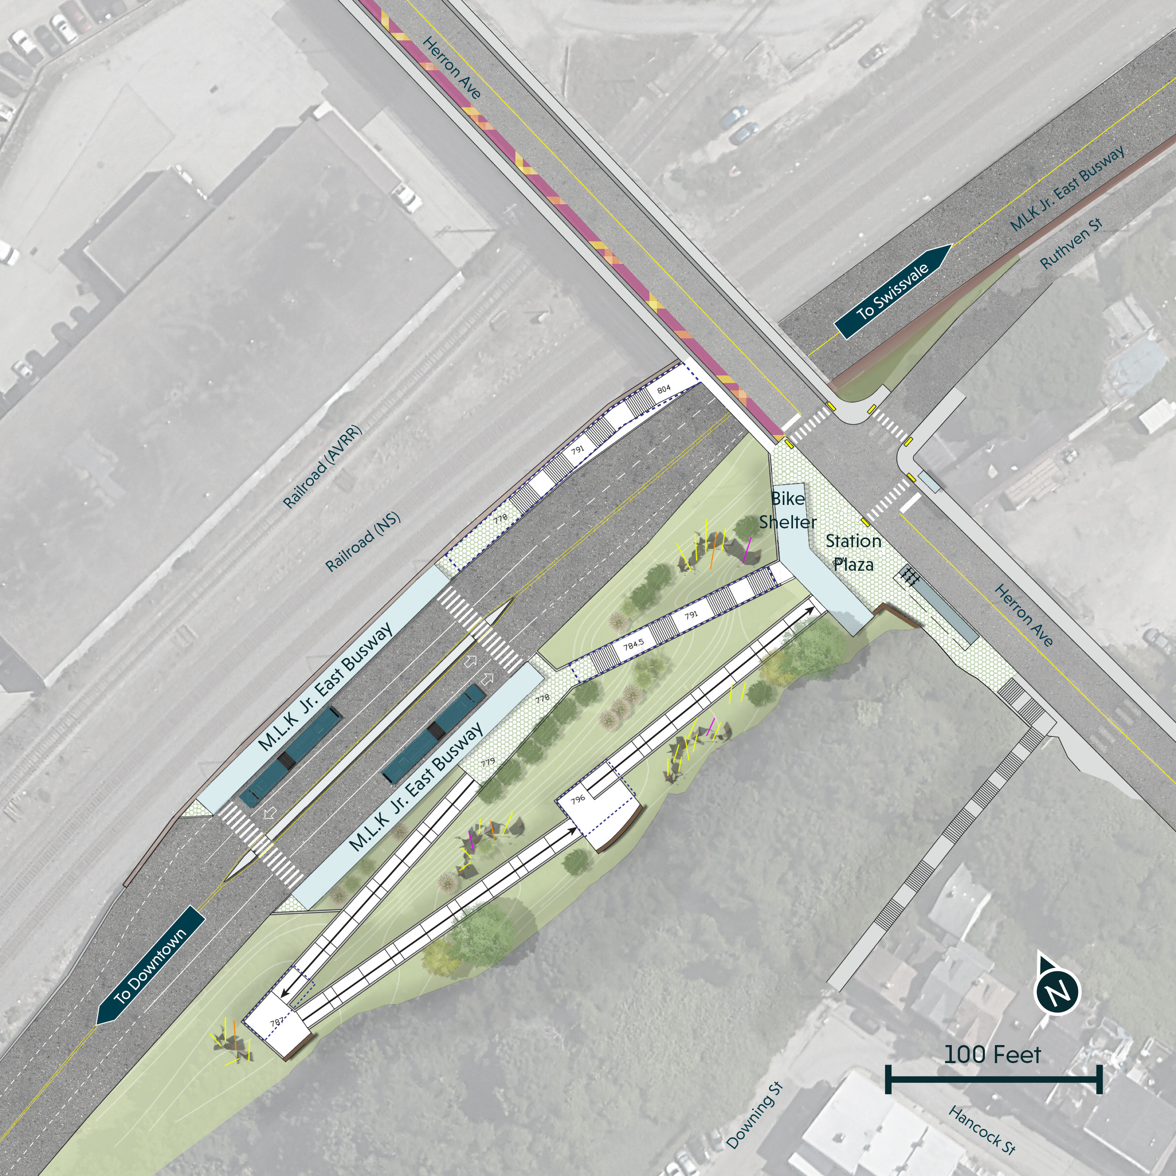
Station Design – DOMI Coordination Strategy
PRT & DOMI: Multiple Partnership Opportunities Over Time Set a quarterly meeting for Herron Station Area with review of each Key Coordination Topic
A – Station Plaza, Ruthven/Herron intersection and Herron Ave traffic calming
B – Downing Street Stairs Reconstruction
C – Station Area Wayfinding Strategy
D - Herron Ave Bridge near-term and long-term changes, including connection to 33rd Street
E – Improvements to the Herron Ave & Liberty Ave gateway
C
D
A
B
C
Notes:
Maintain an issues log with potential resolutions and points needing additional research or 3rd-party coordination (i.e. railroads for D, developers at E)
Memorialize key decisions in writing with Concurrence documents at design milestones (could include any or all of 30%, 60%, 90%, construction drawings)

Slide 20
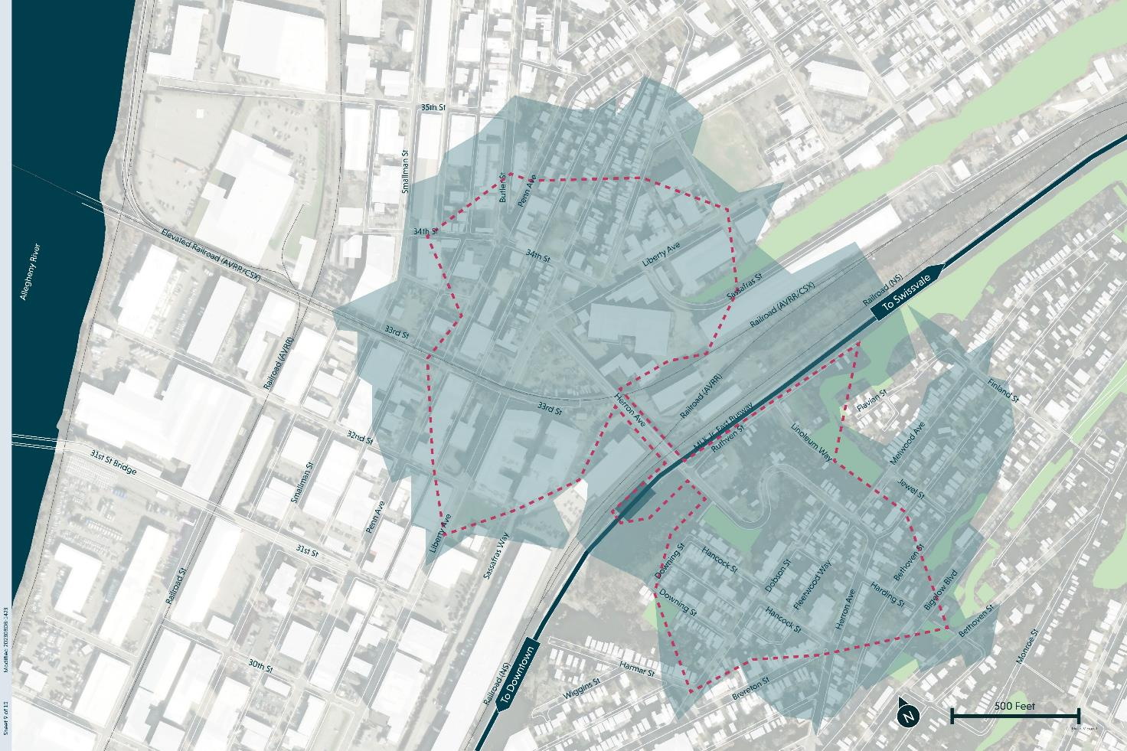
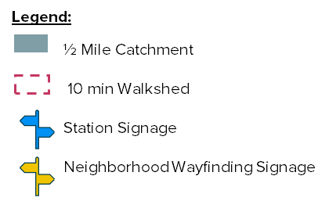
Station Area Wayfinding Strategy Map
Herron Station
Downing St stairs
Doughboy Square
Liberty Ave & 37th St
Smallman St & 32nd St
Herron Ave & Liberty Ave
Brewers Block
Harding Way stairs
Bigelow Blvd & Herron Ave
3
4
6
7
5
1
2
8
9

Slide 21
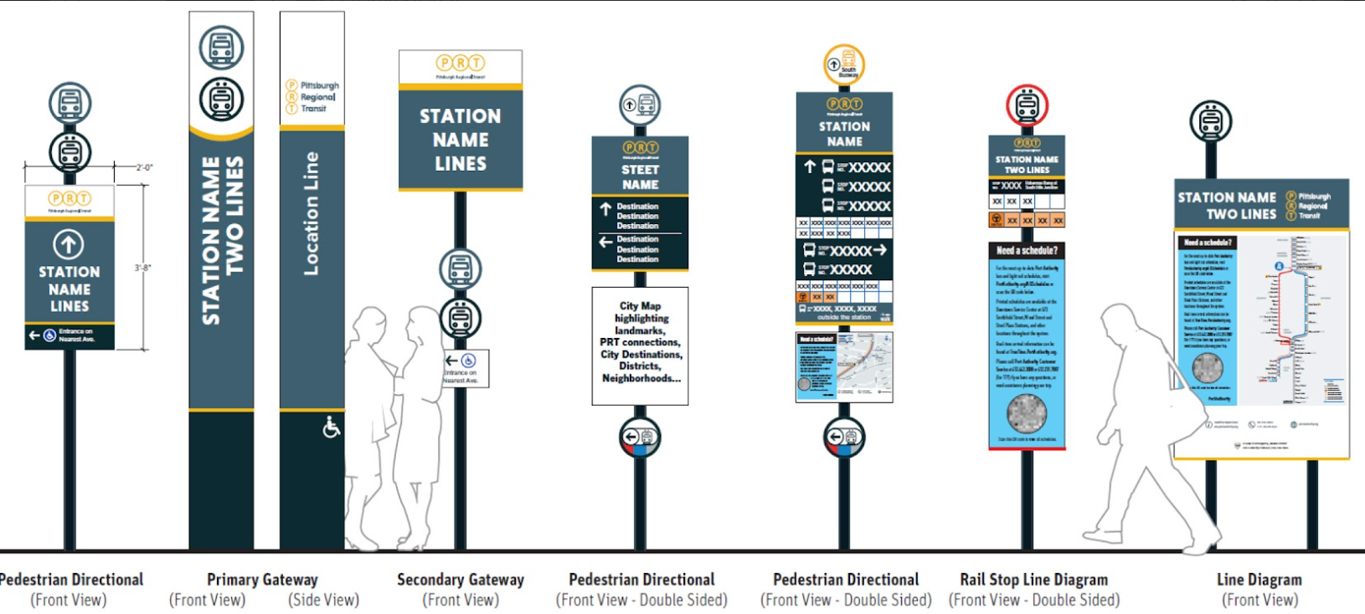
Station Area Wayfinding – PRT Signage Types

Slide 22
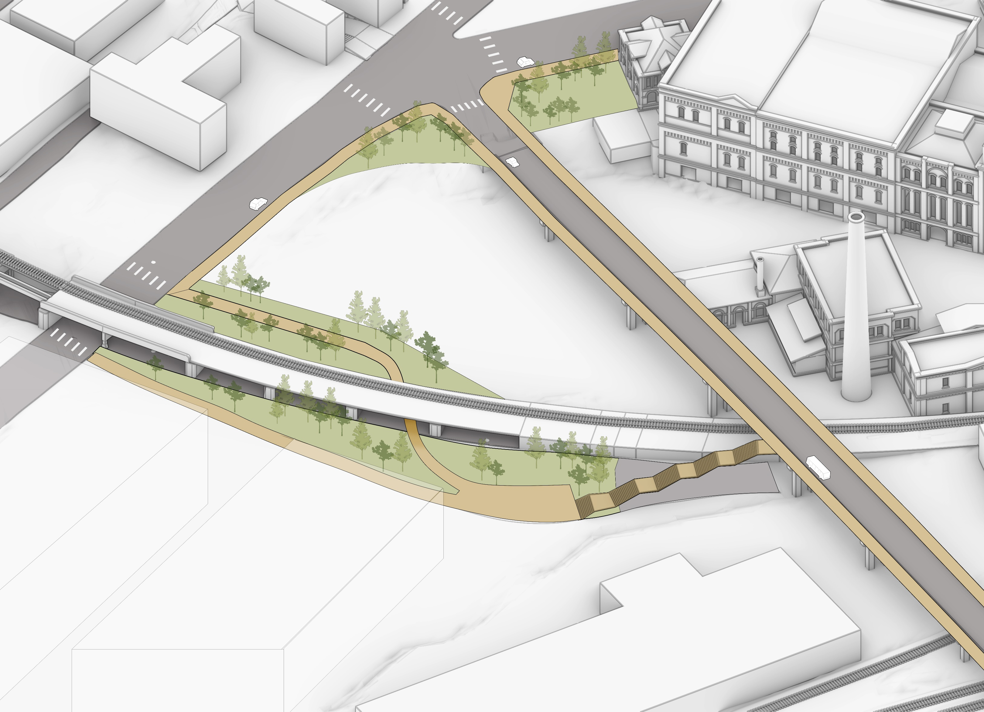
Strip District Gateway – DOMI & Community Coordination
Iron City Brewing
Install crosswalks at 33rd St
Liberty Ave
Railroad park
33rd St
Elevated Railroad (AVRR/CSX)
Brewers Block
Landing plaza
Staircase to bridge connection

Slide 23
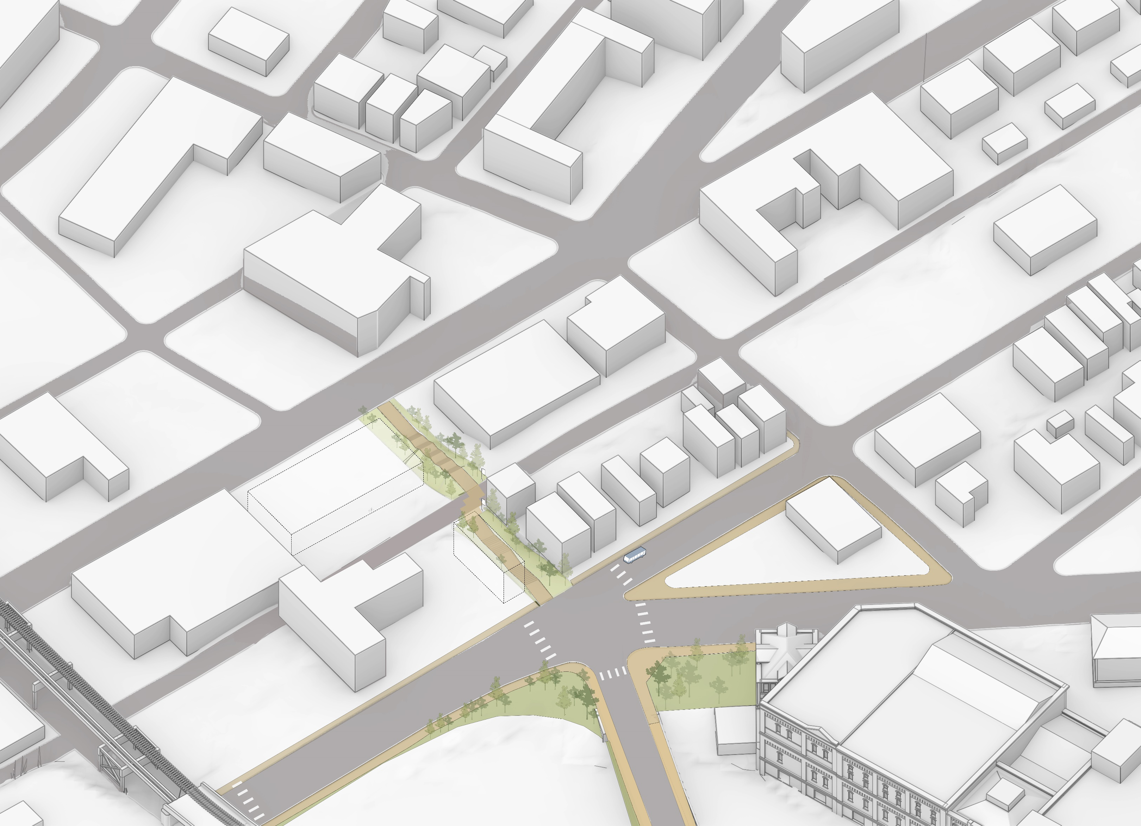
Lawrenceville Gateway – DOMI & Community Coordination
Doughboy Square
Connection to Penn Ave from the intersection
Penn Ave
34th St
Add a crosswalk on the west side of the intersection
Ligonier St
Gateway to Herron Ave Bridge
Liberty Ave
Elevated Railroad (AVRR/CSX)
Iron City Brewing

Slide 24
Potential Station Area Improvement Sequencing
Upgrade Herron Station Platforms and Access Points
Potential Greenspace on Downing St
Add On-Bridge Shelters
PRT
New Stairs to Polish Hill
Herron Ave Bridge Rebuilt
Street Safety Investments in the walkshed
Strip District Gateway Improvements
Partners
Herron Ave & Ruthven St Intersection Improvements
Lawrenceville Gateway Improvements
Widen Sidewalks and Rebuild Safety Barriers
Extend Herron Ave Bridge Life by 15-20 Years
Short Term
Mid Term
Long Term

Slide 25
Implementation Strategies
Strategy | Description | Leaders | Development Priority
Rezone to promote TOD outcomes | Encourage an equitable mix of transit-supportive uses in station areas to service people from diverse income-groups. | City DCP | TOD Principles, Affordability, Mobility/Connectivity, Public Space
Establish Affordable Housing Targets at Corridor | Set station area targets of units to be affordable, with a priority for a long term of affordability and for very-low and low income and/or transit-dependent populations. | PRT, HACP, URA | Affordability
Affordable Ground Floor Space for Local/MWBE Businesses + Community Space | Developers can support legacy and local/MWBE businesses by offering affordable and favorable lease terms to these businesses in ground-floor spaces of commercial and mixed-use development. | Developers, City, URA | Affordability, Economic Opportunity
Consider TRID Study | Taxes attributable to new improvements are set-aside in a fund to finance public improvements or community benefits within the boundaries of a defined zone. | City DCP, URA | All
Community Ownership Over Development Process | Establish a consistent process across all through neighborhoods with opportunities for community input/feedback throughout, managed in a way that’s consistent with existing community processes. | Community groups | Community Ownership

Slide 26
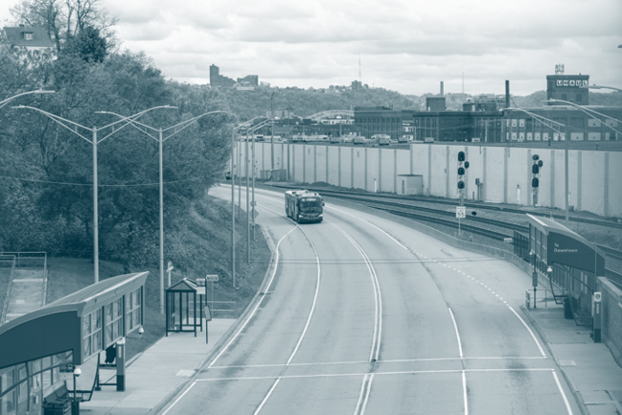
Next Steps for Herron Station
What the plan is to move from 10% design forward. What comes next?
Final Online Public Meeting:
Thursday, February 15th at 6pm
Publish Final Station Area Plan
March 2024
Funding
Design
Construction

Slide 27
Thank you!

