Slide 1
Sign-in Sheet: https://forms.gle/g5Krk2ycaov9KF867

Slide 2
Tonight’s Agenda
Welcome
Introduction
Accessibility
URA Request for Proposals for 6111 Butler St
History of the 62nd Street Site
Current RFP process
Review of community plans - LU & LC
Q&A
Community input
Upcoming Events, Meetings & Closing (5 mins)

Slide 3
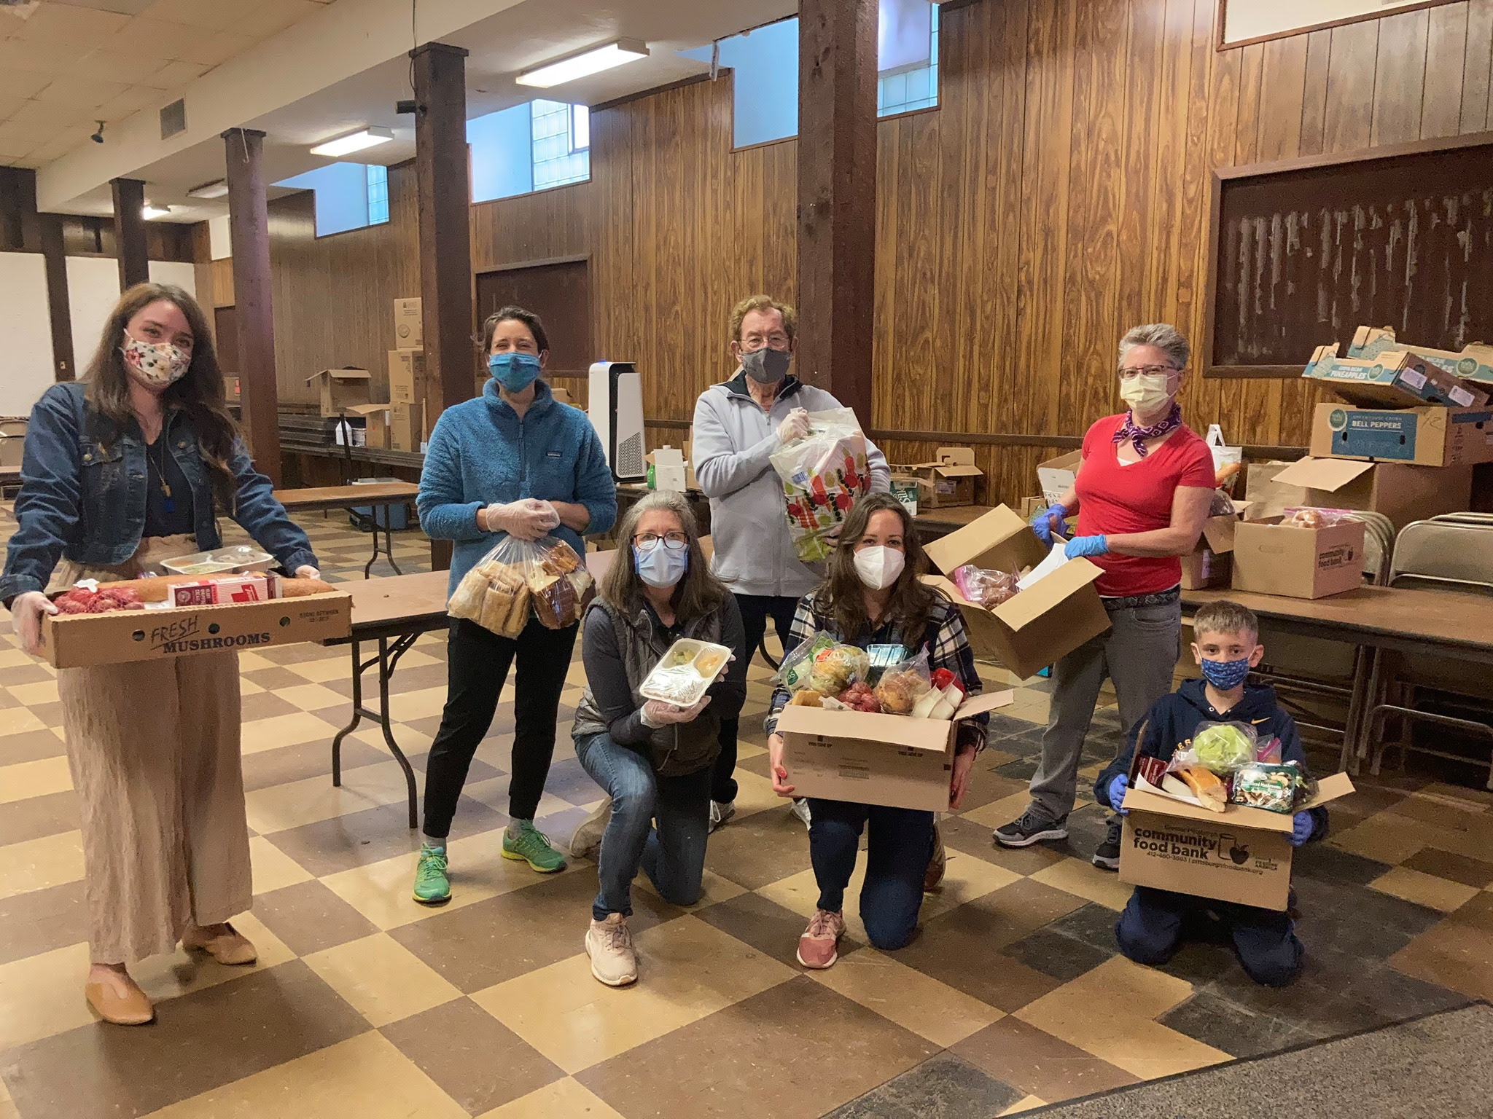
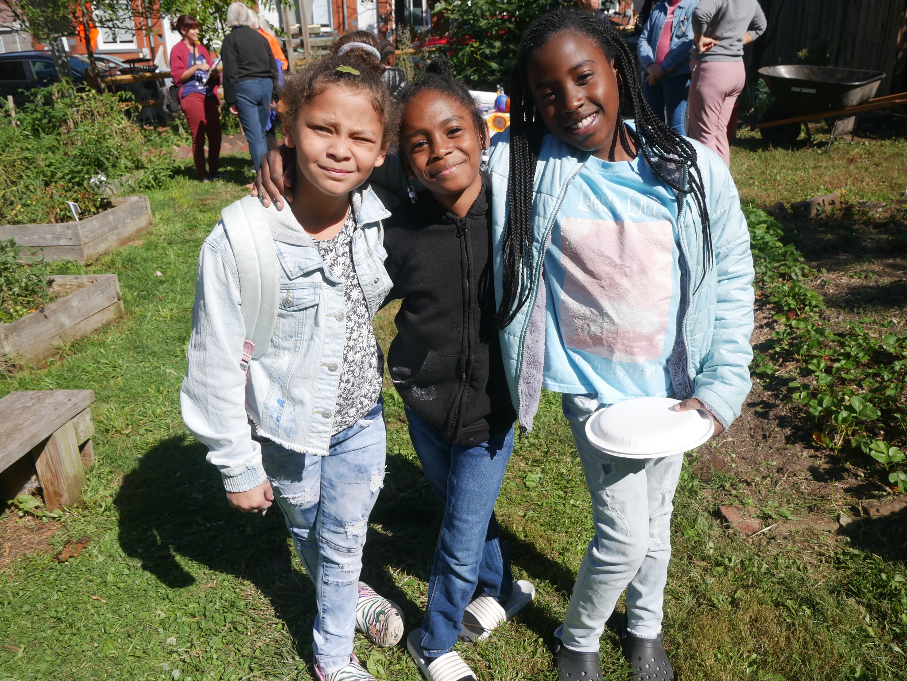
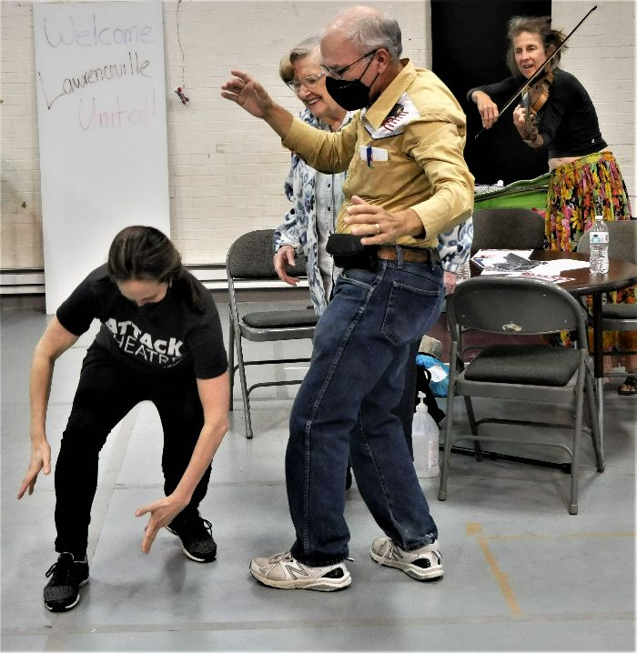
Mission: to improve and protect quality of life for all Lawrenceville residents
Membership of over 800 residents
Board comprised of all residents: elected by our membership
Programs: Lawrenceville Farmers Market, supporting older adults, free food distributions, cleaning & greening, direct support & case management, advocacy, and more.

Slide 4
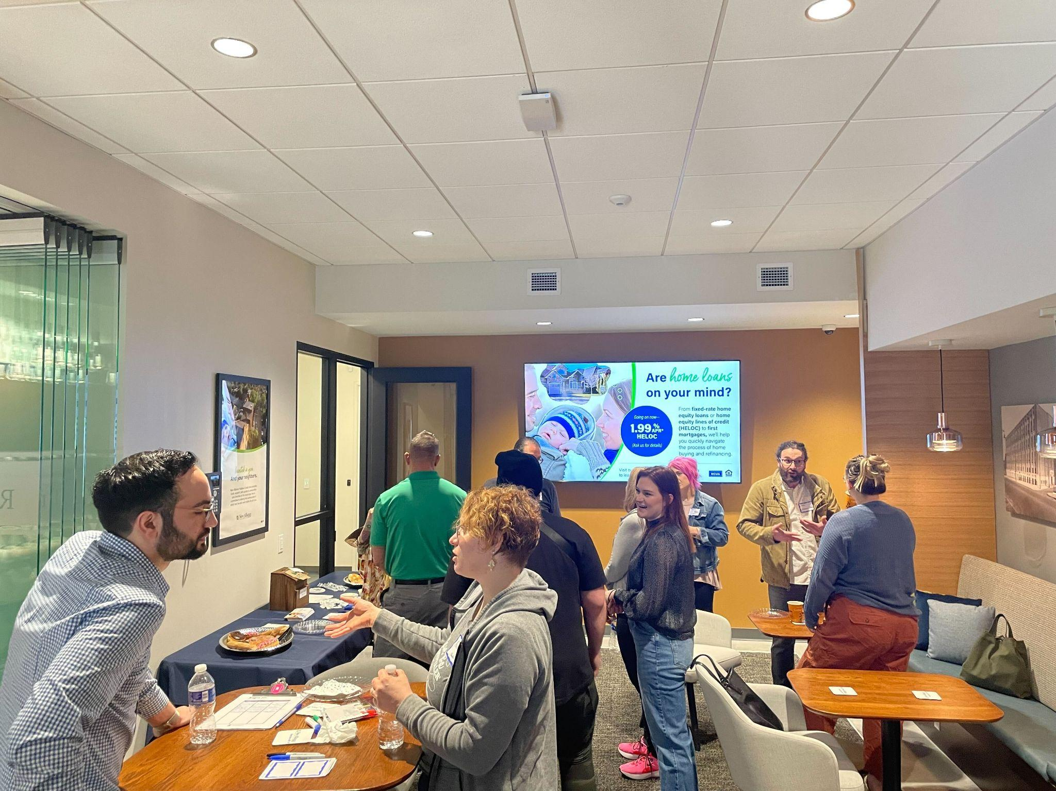
Mission: Driven by the Lawrenceville community, the Lawrenceville Corporation acts as the catalyst and conduit for responsible and sustainable growth.
Membership: About 125, primarily business owners
Board: Mostly comprised of residents, property owners, and business owners and elected by our membership - 16 members
Programs: Business district management, mobility, policy and advocacy, community planning and development, real estate development, and communications and marketing
History: Formed in January 2000 as a merger of the Lawrenceville Development Corporation (LDC) and the Lawrenceville Business Association (LBA)

Slide 5
Accessibility
Accessibility
LU and LC are committed to making these meetings accessible
Let us know about any accommodations you need to fully participate
If joining by Facebook Live, drop comments/questions in the chat

Slide 6
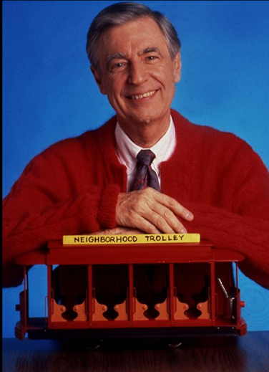
Community Agreements
Be neighborly.
Be respectful of all participants & hosts
Don’t denigrate groups of people
Give space for all to participate

Slide 7
URA: 6111 Butler Street

Slide 8
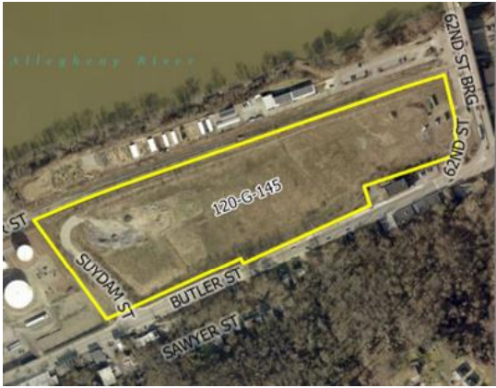
Site History
Former Steel Roll Mill
Act II Site
Remediation Required
Construction Activity
Demolition
Site Grading
Stoplight
Access Road
Storm and Sanitary Sewers
Stormwater Management Facility
Delivery of Clean Fill
Tree Pittsburgh Development

Slide 9
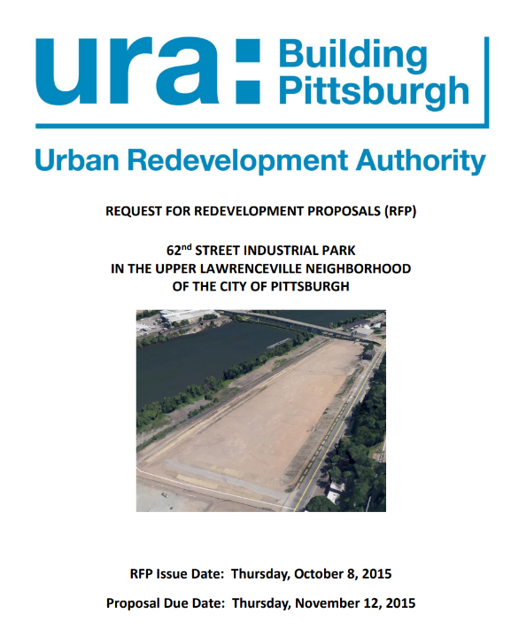
History of Development Prospects
2008 - URA begins acquiring property
2010 - Buncher Company Warehouse &
Office Space
2013 - Paragon Food Processing
2015 - RFP Released
All proposal submissions rejected
2015- Present - Multiple Proposals:
Collier Development relocation of Iron City Brewing Company
Kowalski Movie Studio
Landmark Flex Industrial
Tree Pittsburgh Non-Profit Operations
Peduto Administration Public Works Facility

Slide 10
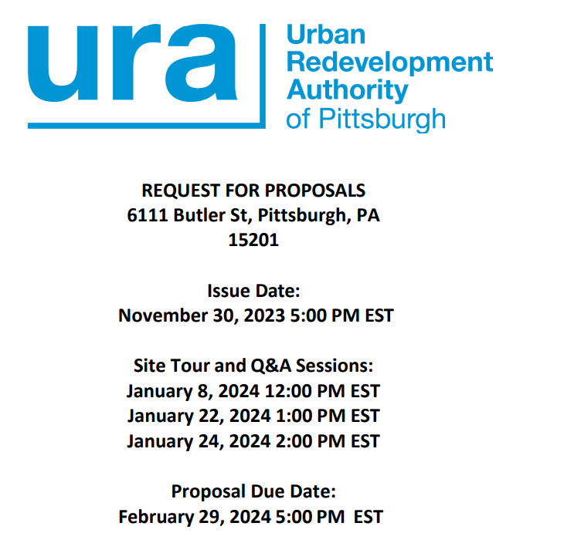
URA REQUEST FOR PROPOSALS (RFP)
62nd St
RFP Goal to select a developer optimizing for :
Neighborhood planning goals
Building density
Job creation
Ecological design
Green facility operations
Relocation of local heavy industry, traffic reduction

Slide 11
What Happens Next?
Opportunity for Community Feedback?

Slide 12
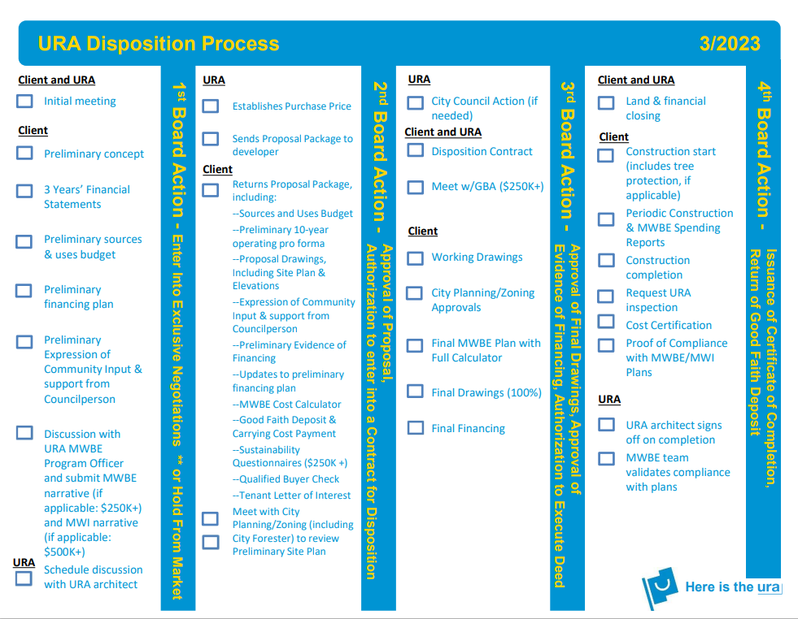

Slide 13
Review of Community Plans

Slide 14
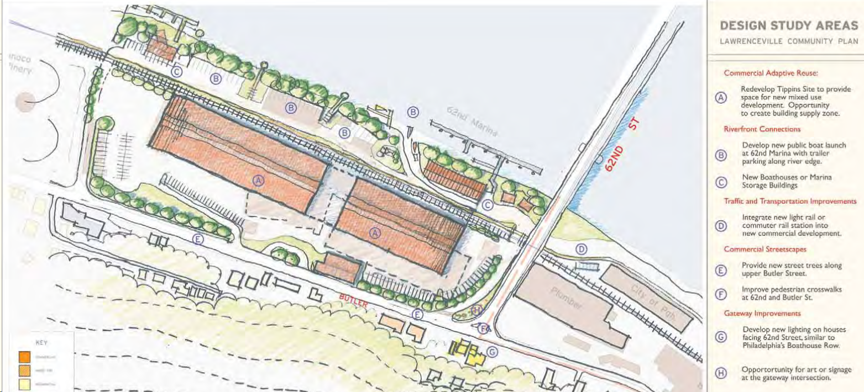
Lawrenceville Community Plan (2006)
Make Lawrenceville more attractive. Acquire and improve properties at important neighborhood entry points
Provide traffic/streetscape improvements and development catalysts at 62nd Street gateway
New lighting, public art, street tree plantings
Opportunity for riverfront access
Public boat launch
Renovate mill, mixed-use development

Slide 15
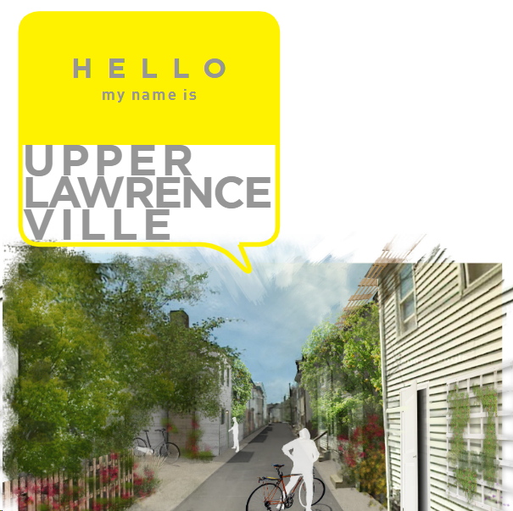
Upper Lawrenceville Vision Plan (2013)
Calls for “housing for all”
Embraces “neighborhood culture of making things,” locally owned businesses
Desire for community spaces
Day care, community center, classrooms or other places for art and DIY classes, public meeting spaces, community gardens, playgrounds, school, outdoor recreation such as trails and river access
Access to healthy food
Access to river

Slide 16
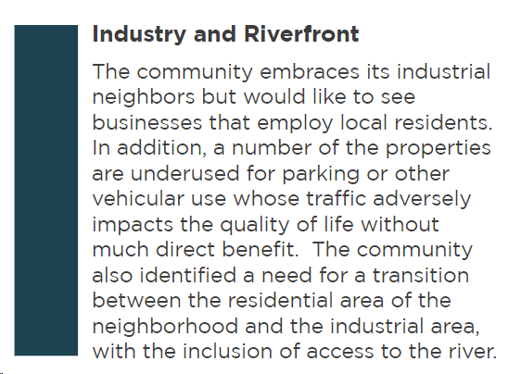
Upper Lawrenceville Vision Plan (2013)
Recommendation: Maintain the Industrial Character by Welcoming Compatible Industries
Density of jobs
Businesses that take advantage of non-vehicular transportation
Businesses that don’t have negative environmental impacts such as noise, air quality, water quality.
Respect for companies that manufacture or craft things.

Slide 17
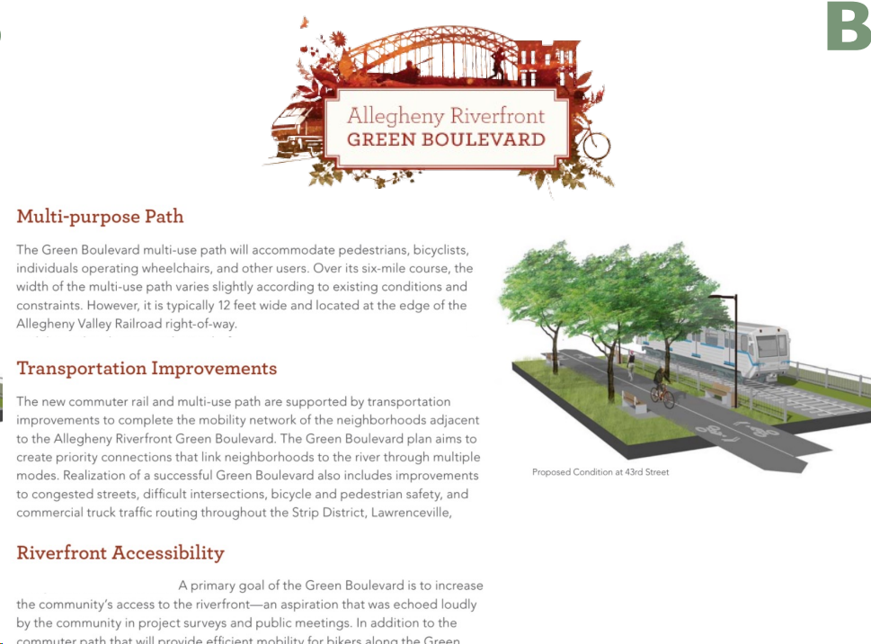
Green Boulevard Plan (2010)
Multi-modal pathway from downtown to Highland Park
Riverfront accessibility
Riverbank stabilization
Ecological enhancements
Stormwater mgmt
Soil improvement
62nd Street marina / floating wetland park

Slide 18
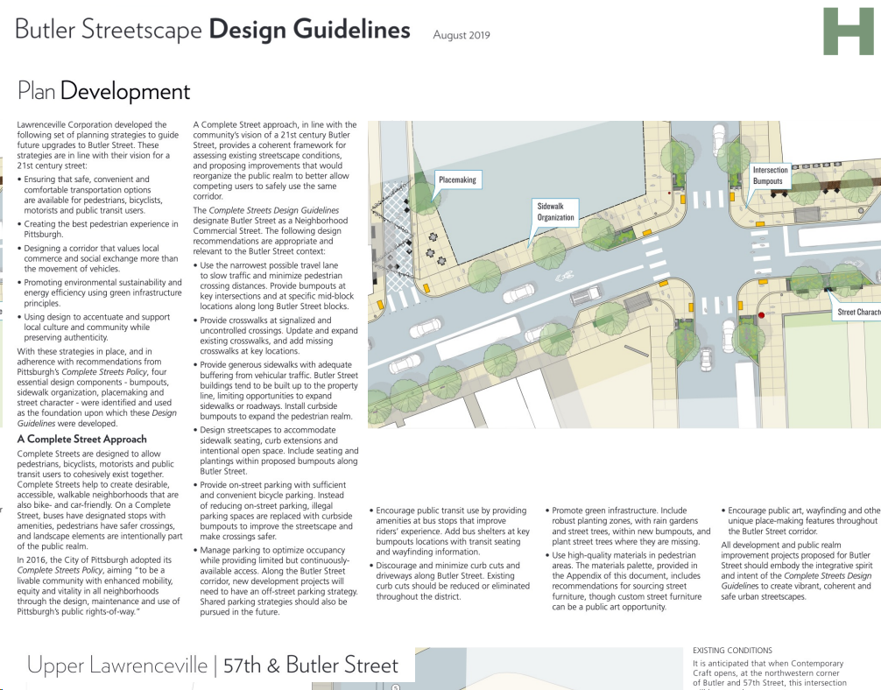
Butler Street Design Guidelines (2019)
Provide detail on streetscape improvements using Complete Streets framework

Slide 19
Other important context
Tree Pittsburgh Campus Vision
No-waste facility
Allegheny Valley Rapid Transit
Long-term plans for rapid transit from New Kensington to Downtown
Bike(+) Plan, Better Streets Lawrenceville advocacy
Desire to free up industrial uses in heavy residential areas to connect people to river
Eco Campus exploration
Climate Action Plan

Slide 20
Lawrenceville Community Development Scorecard
Livability
Publicly accessible use(s) that serve residents of the broader neighborhood
Economic development
Opportunities to promote local small business development, arts/cultural-based businesses, and entrepreneurial activities
Committed to supporting MWDBE companies and jobs
Transportation
Prioritizes affordable and sustainable modes of transportation
Environment
Exceeds tree requirements
Promotes or maintains access to green space
Free from environmental hazards

Slide 21
Q&A

Slide 22
Community Input & Discussion

Slide 23
Discussion Questions
Are there other community goals/priorities that we’re missing?
What do you want LU, LC, and the URA to consider when reviewing proposals?

Slide 24
Exercise
Creates density of jobs
Supports Upper Lawrenceville identity of manufacturing / making things
Supports locally-owned & MWDBE businesses
Promotes environmental health & sustainability
Creates community spaces
Relocates industrial uses & traffic congestion + frees up land for housing
Supports non-vehicular mobility
Use is compatible with increasing riverfront access
Promotes public art
Provides an attractive entryway to Upper Lawrenceville
WHAT ELSE???

Slide 25
Community Updates and Discussion

Slide 26
Closing Announcements
Sign in before you leave: bit.ly/LUSignIn if joining virtually
Feedback form for people catching this after the fact: bit.ly/feedback62

Slide 27
Closing Announcements
February 28th 5-7pm - Sips and Brews @ Cork Harbour - LC’s monthly networking event
March 14th 5:30-7pm - March Happenings Meeting - Review of Annual Crime Statistics @ CLP Pittsburgh
March 27th 8:00-10am - Coffee and Tea @ Lola’s Eatery - LC’s monthly networking event
March 28th 6:30-8pm - CDAM about the Mobility Enhancement District. Location TBD
April 11th - April Happenings Meeting - Volunteer & Advocacy Fair @ Lawrence Hall

Slide 28
Right to Counsel+ Petition
In partnership with the Housing Justice Table, Lawrenceville United is petitioning for City Council to adopt a Right to Counsel citywide. This potential ordinance would provide tenants with legal representation in the event of an eviction.
Sign the petition before you leave tonight!
bit.ly/RTCnow

Slide 29
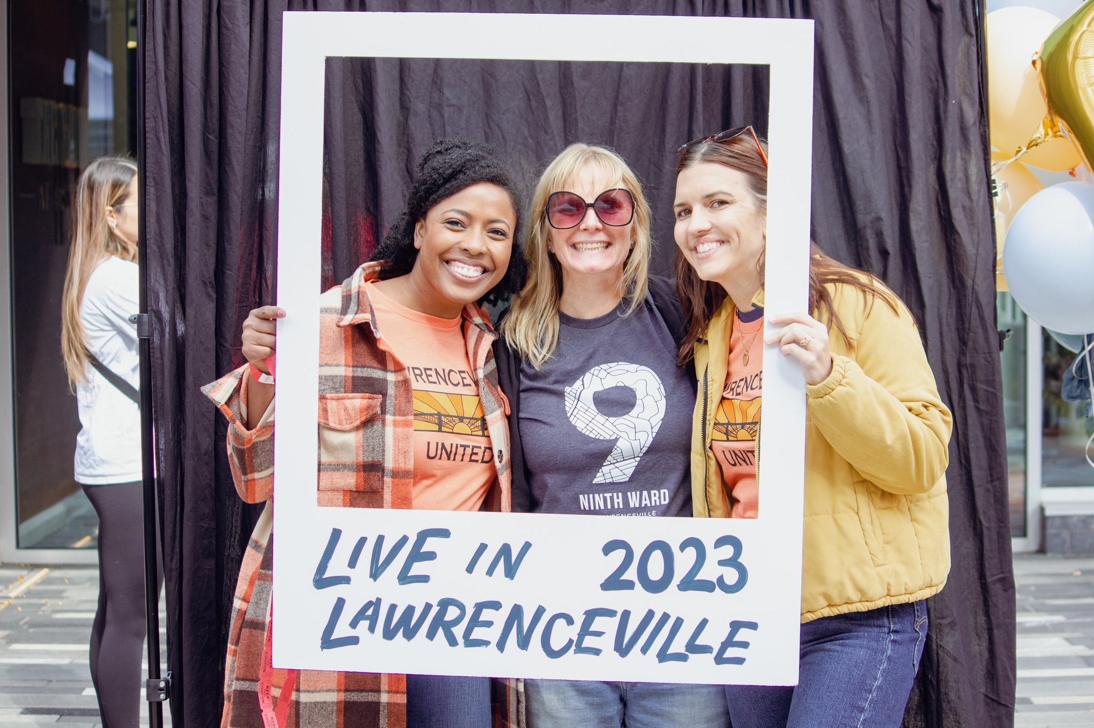
Closing Announcements
We’re hiring! - Farmers Market Assistant Manager
More info at www.LUnited.org
Applications are due 3/1/24
We’re recruiting! - LU Board of Directors
More info at www.LUnited.org
Must be member by 3/1/24
$5/year or $35/lifetime

Slide 30
Lawrenceville Corporation
info@lawrencevillecorp.com
412-621-1616
Lawrenceville United
info@LUnited.org
412-802-7220
Thank you!
Notes:
Add Rachel

