Slide 1
Lawrenceville Happenings Meeting:
Neighborhood Trash
11/9/23, 6:30 p.m., Goodwill (118 52nd Street)
Welcome! Please sign in at bit.ly/LUSignIn if joining online

Slide 2
Tonight’s agenda
Welcome & Introductions
Background on Neighborhood Trash Concerns
Addressing Neighborhood Trash Concerns
Department of Public Works Environmental Services - Christopher Mitchell (Anti-Litter Specialist)
Department of Public Works - Eric Contakos (Inspections Supervisor)
Animal Care & Control – Coralie Campobasso (Administrative Coordinator)
Mayor’s Office – Ashley Bryant (Community Liasion)
Open Q&A
LU & LC Upcoming Calendars

Slide 3
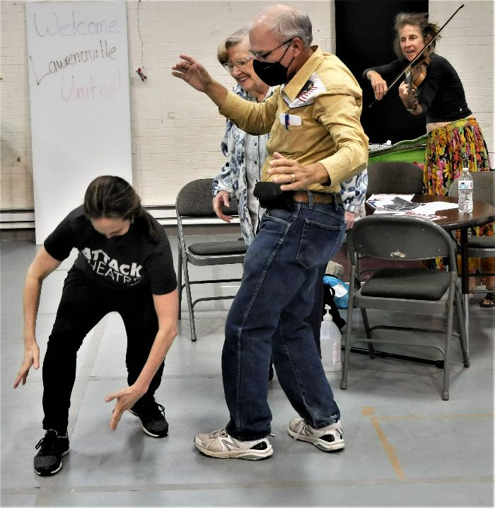
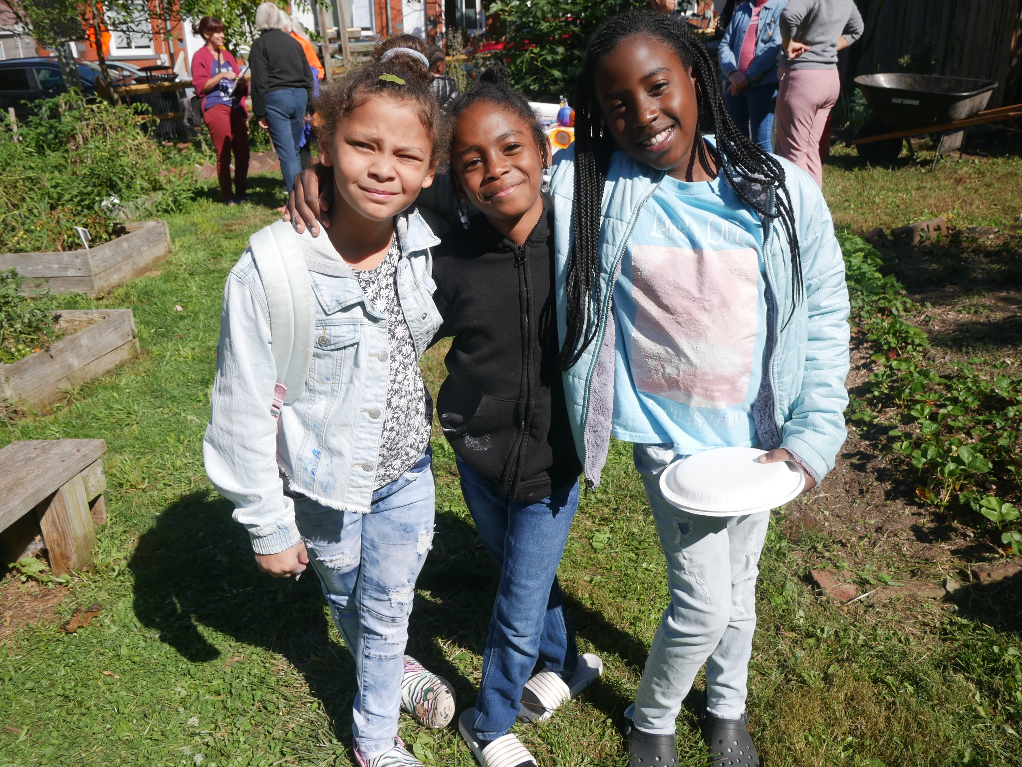
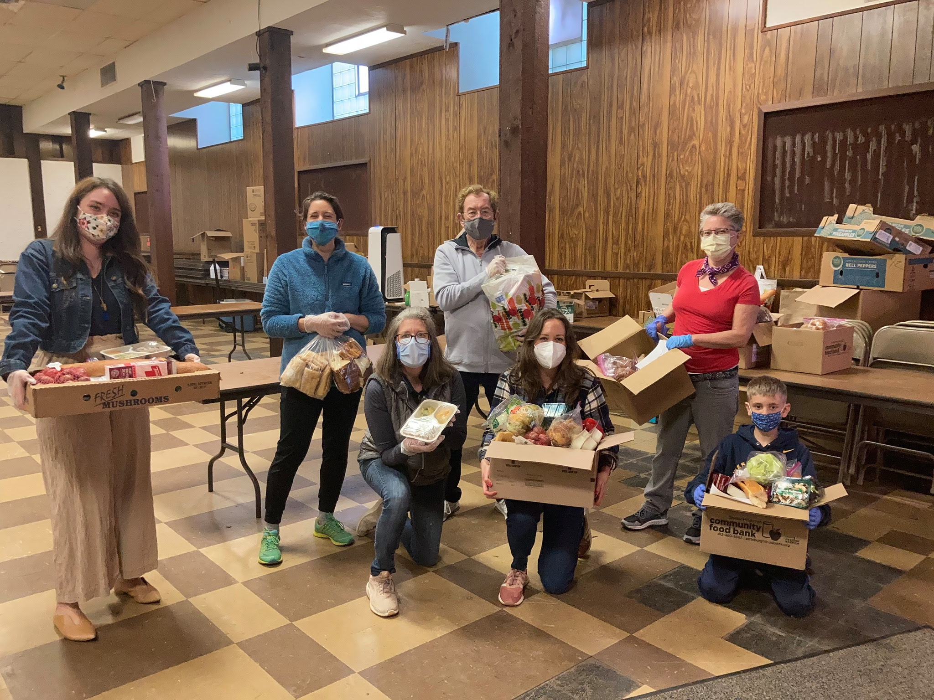
Lawrenceville United
Mission: to improve and protect quality of life for
all Lawrenceville residents
Membership of over 800 residents
Board comprised of all residents: elected by our membership
Programs: Lawrenceville Farmers Market, supporting older adults, free food distributions, cleaning & greening, direct support & case management, advocacy, and more.

Slide 4
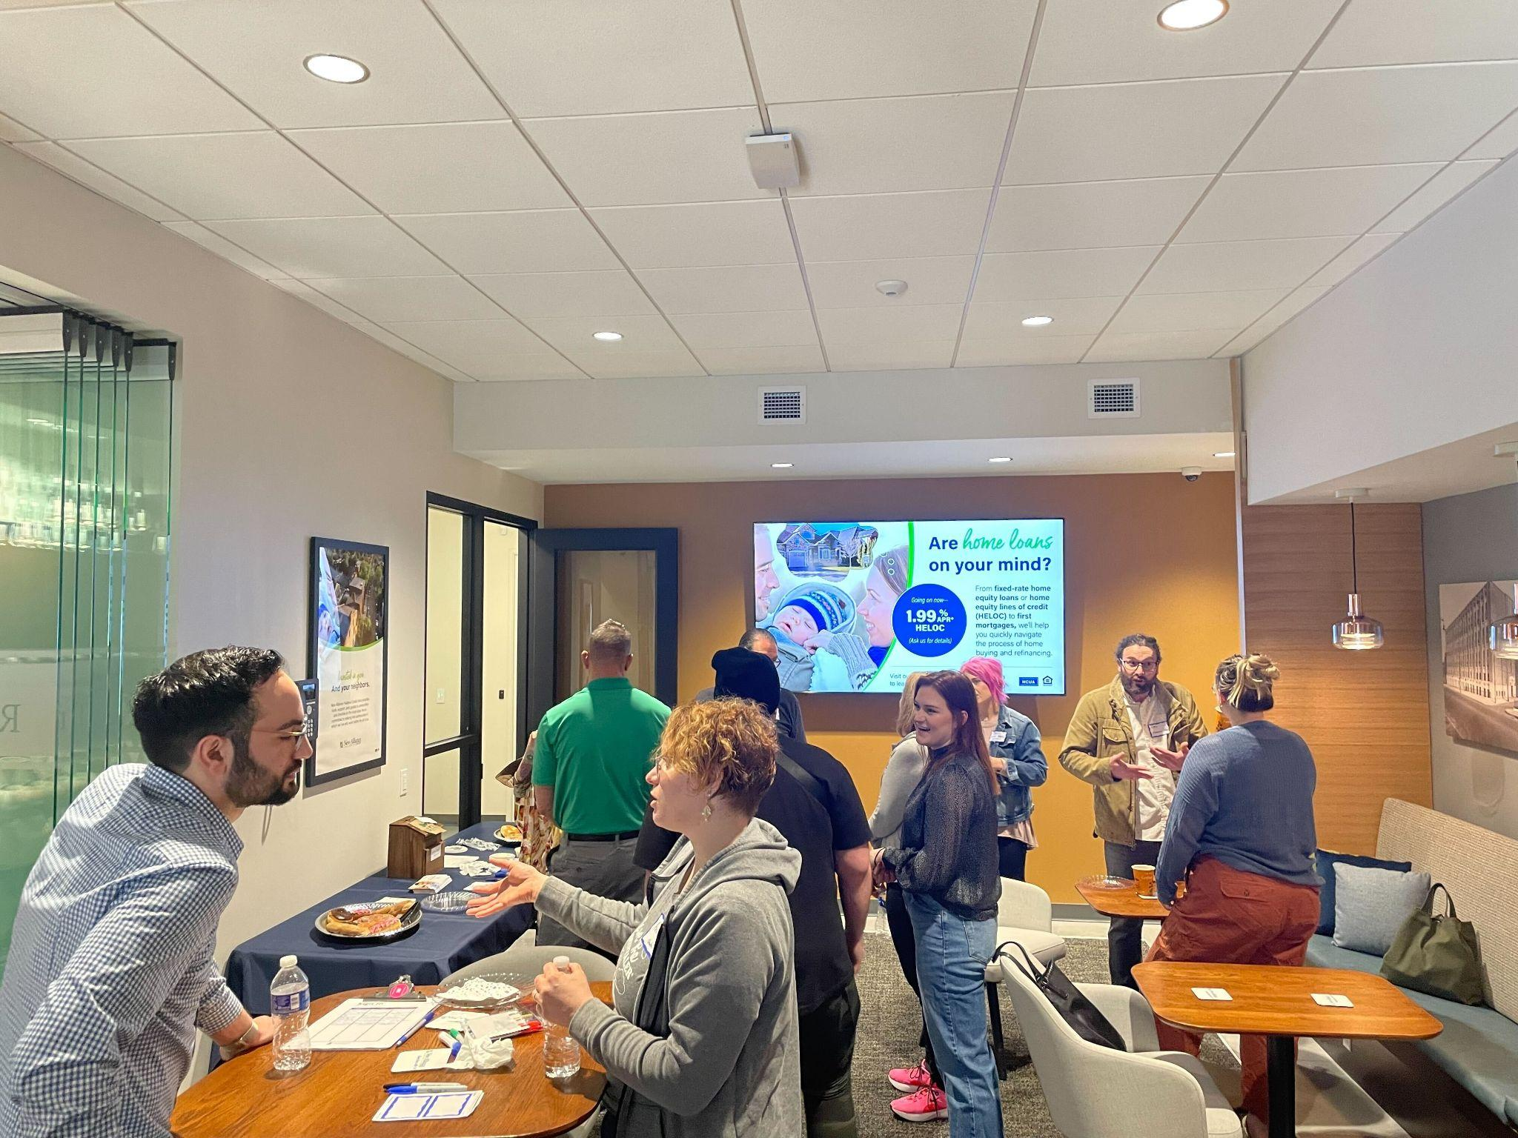
Lawrenceville Corporation
Mission: Driven by the Lawrenceville community, the Lawrenceville Corporation acts as the catalyst and conduit for responsible and sustainable growth.
Membership: About 100, primarily business owners
Board: Mostly comprised of residents, property owners, and business owners and elected by our membership - 16 members
Programs: Business district management, policy and advocacy, community planning and development, real estate development, and communications and marketing

Slide 5
Lawrenceville Happenings
2nd Thursday of each month
Rotate between Upper, Central, and Lower Lawrenceville
Let us know what topics you’d like to see us cover!
info@LUnited.org or 412-802-7220
Community Development Activities Meetings
4th Thursdays of the month (as needed)

Slide 6
Why are we talking about trash?
Lawrenceville housing is dense
With homes close together and tight sidewalks/streets, we have seen
Trash/recycling left on curbs and sidewalks throughout the week
Neighbors of various mobilities needing to use the street instead of the sidewalk as a result of trash/recycling being out continuously
As popularity of Butler Street has increased, especially for weekend visits, we’ve seen an increase in trash in alleyways and on sidewalks/streets

Slide 7
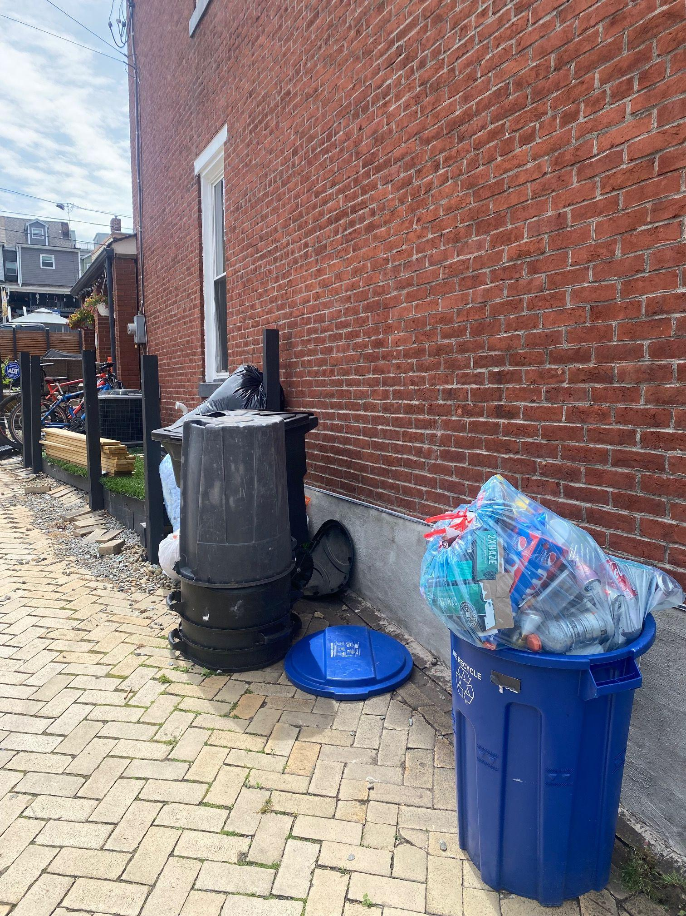
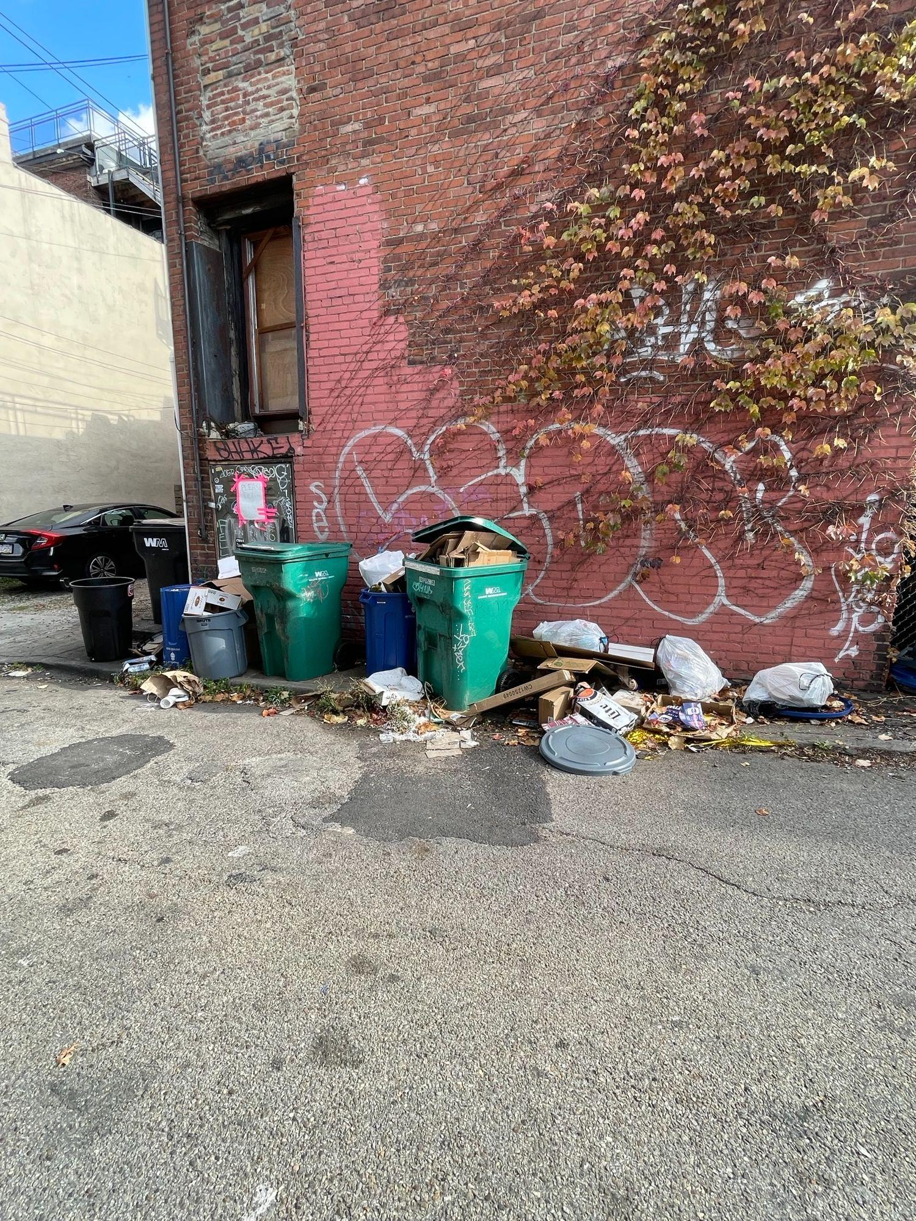
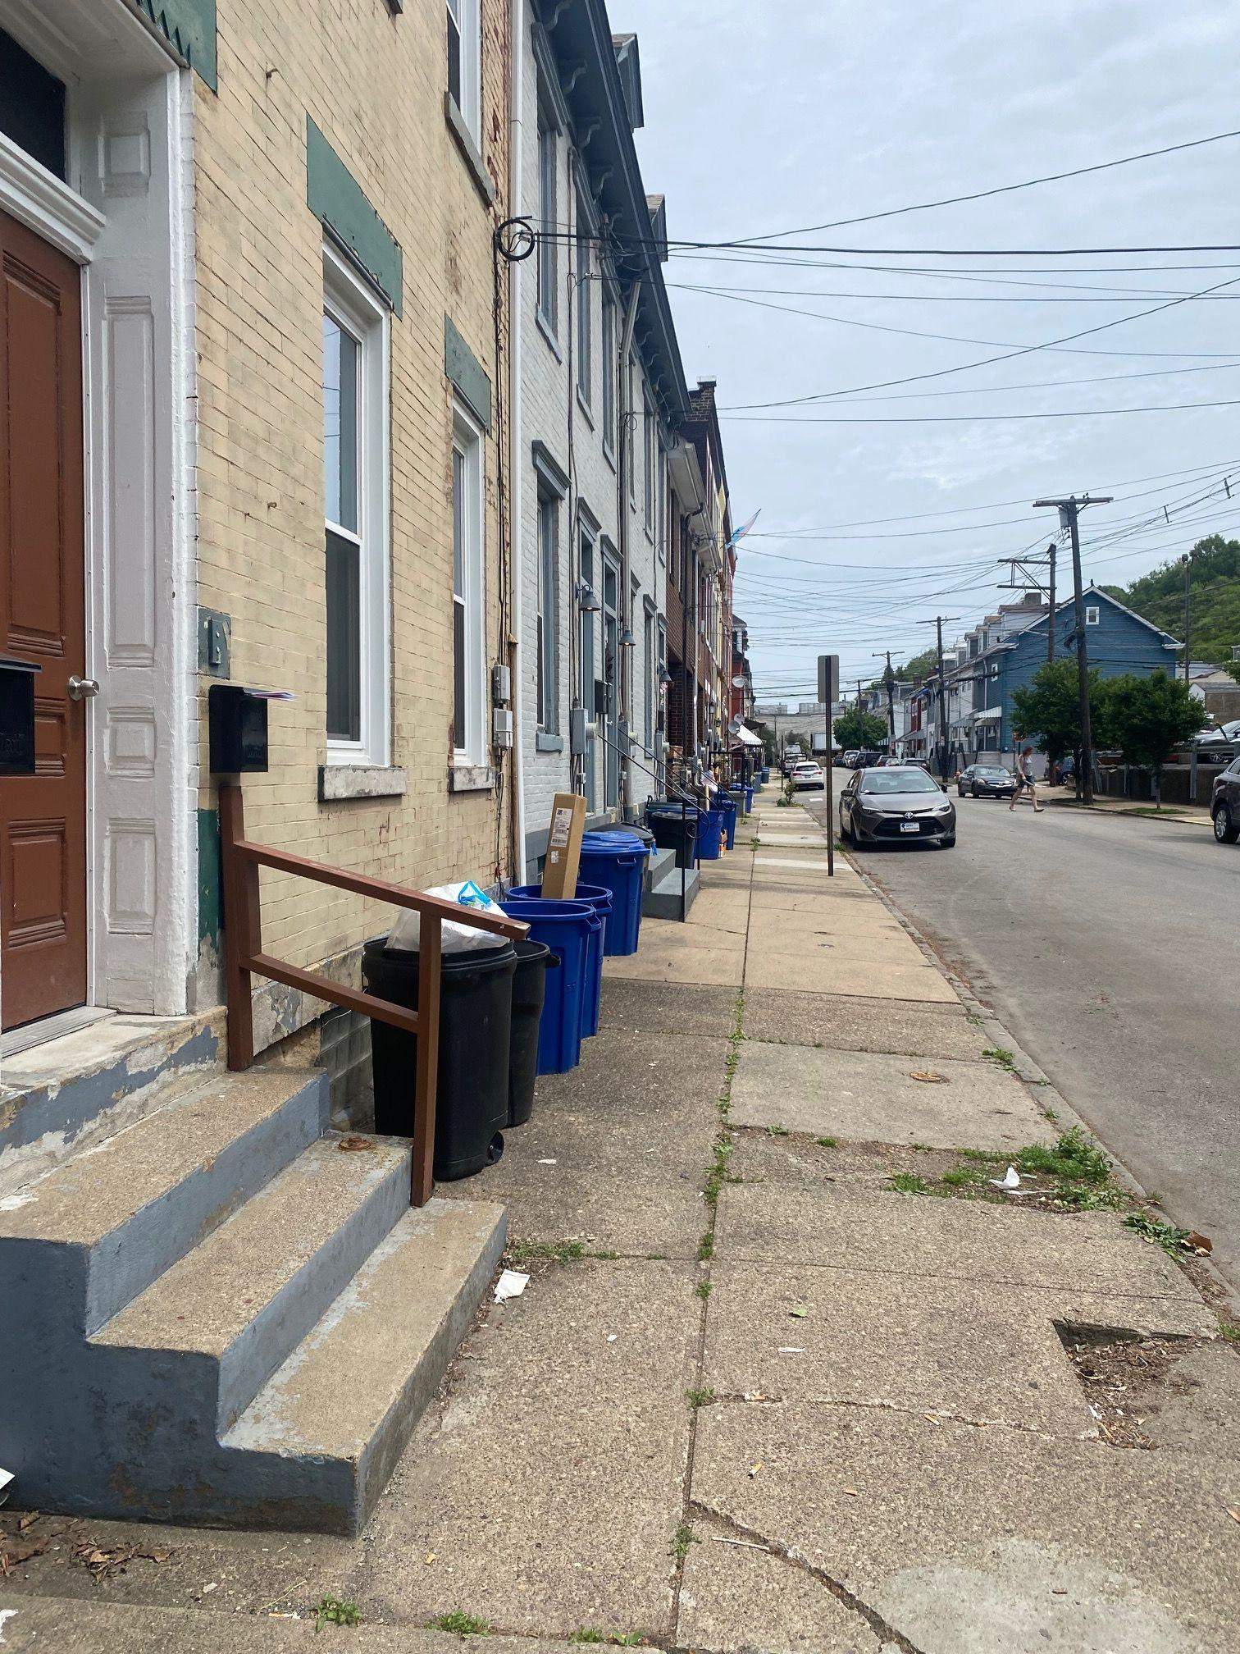
Neighborhood Trash Concerns
10th Ward neighbors resident advocacy
Trash in the alleyways behind Butler St

Slide 8
Christopher Mitchell
Anti-Litter Specialist with
Department of Public Works - Environmental Services

Slide 9
Eric Contakos
Inspections Supervisor with
Department of Public Works

Slide 10
Coralie Campobasso
Administrative Coordinator with
Animal Care & Control

Slide 11
Ashley Bryant
Community Liaison with
The Mayor’s Office

Slide 12
Steps Forward
Utilize 311 and select “Refuse Violations”
Participate in Garbage Olympics
Create a monthly/semi-regular trash pick up day with neighbors

Slide 13
OPEN Q&A

Slide 14
Upcoming Calendar
Lawrenceville Farmers Market every Tuesday (through 11/21)
11/11 - Bernard Dog Park Clean Up
11/13 - Duncan Park Workday
11/30 - CDAM on 135 51st St
12/5 - Mobility Enhancement District Celebration
12/9-12/10 - Cookie Tour
12/9 - Cookie Mall
12/9 - Bernard Dog Park Clean Up
12/12 - AdvantAGE Member Craft Disco
12/14 - CDAM on 3634 Penn Ave

Slide 15
Comments, questions
Lawrenceville United Lawrenceville Corporation
412-802-7220 412-621-1616
info@LUnited.org info@lawrencevillecorp.com

