Slide 1
Spring Membership Meeting + Board Elections
Wed. 6/8/2023, 6:30 PM
Goodwill Workforce Development Center & Facebook Live
Sign in at: bit.ly/LUSignIn

Slide 2
Tonight’s agenda
Welcome & introductions
Board elections
LU updates
Open Q&A

Slide 3
Accessibility Notes
LU is committed to making these meetings accessible.
Please let us know if you need anything else to participate fully.
We will monitor the chats of the Facebook Live video

Slide 4
Mission & Vision
Mission: Lawrenceville United works to improve and protect the quality of life for all Lawrenceville residents.
Vision: We envision a welcoming, diverse, and empowered community that works together to ensure all residents have what they need to thrive.

Slide 5
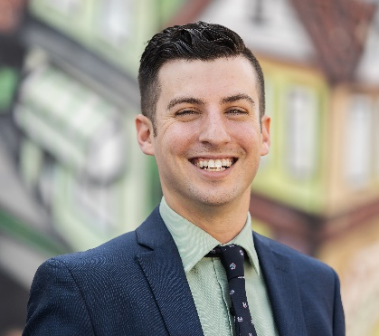
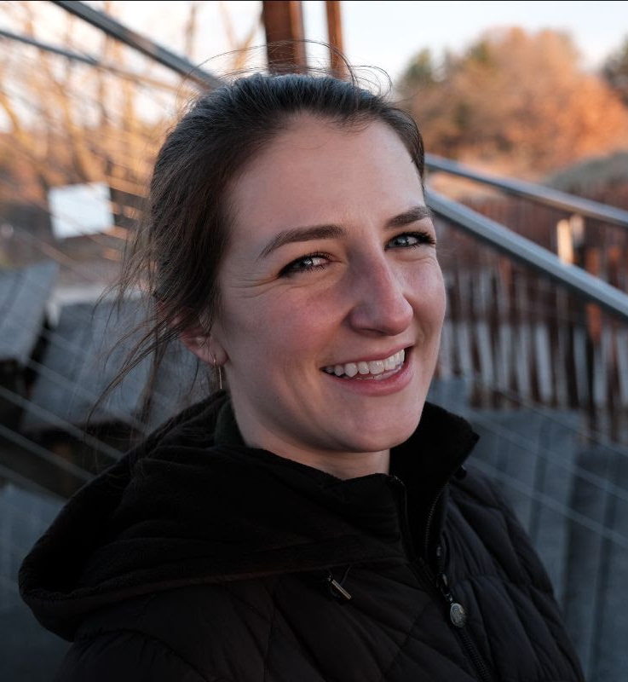
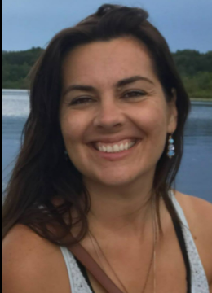
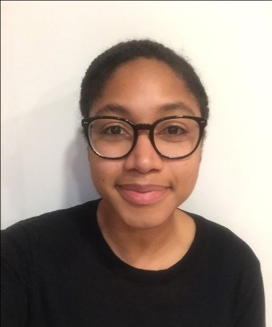
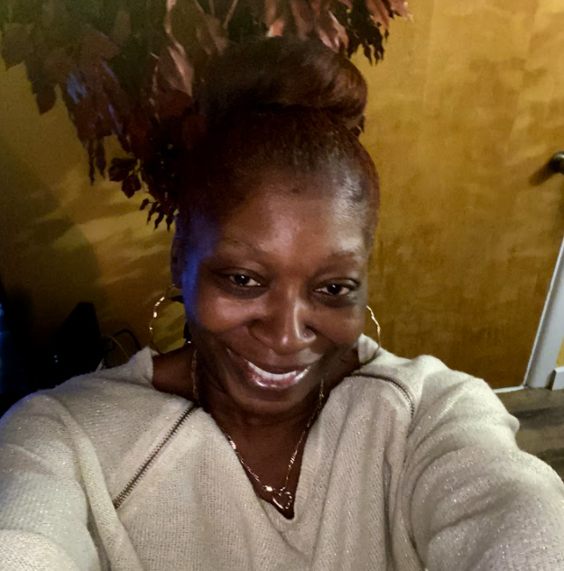
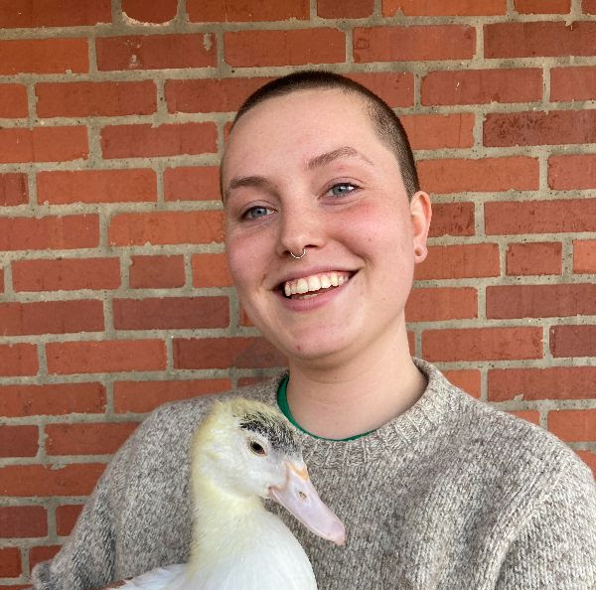
Who we are
Full Time:
Interns:
Jaden Michalski
Lizzie Stehr
Joey Schulhoff
Dave Breingan (he/him)
Executive Director
Emma Gamble
Community Engagement
& Program Manager
Part time:
Aurora Smith
Shared Finance Manager
Bryanna Johnson (she/her)
Farmers Market Manager
Dorothenia Nicholson (she/her)
Case Manager
Bre Stanton
Assistant Farmers Market Manager

Slide 6
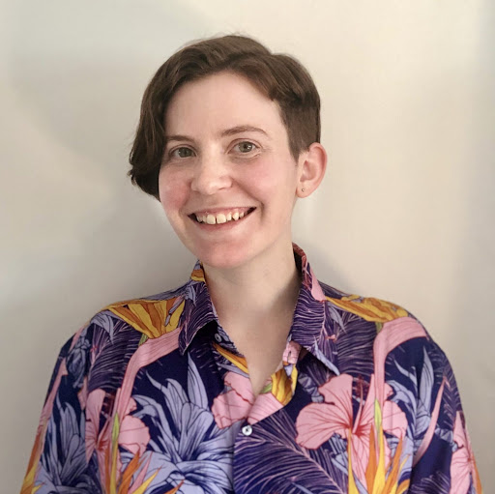
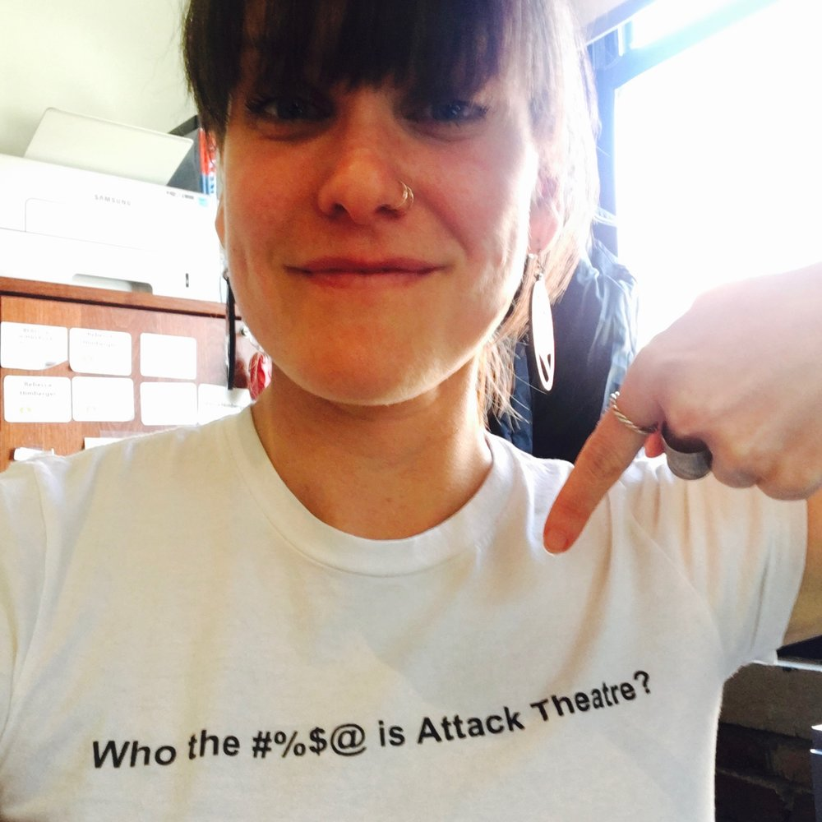
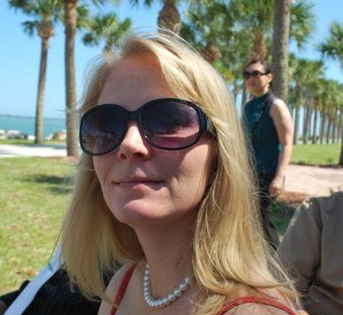
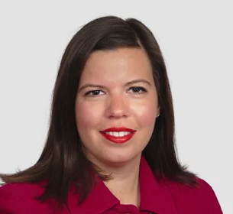
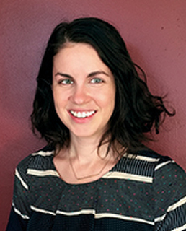
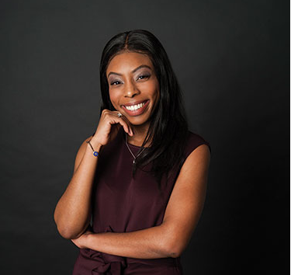
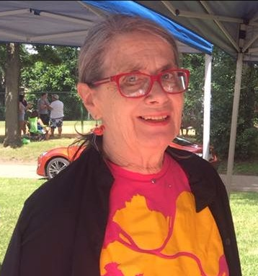
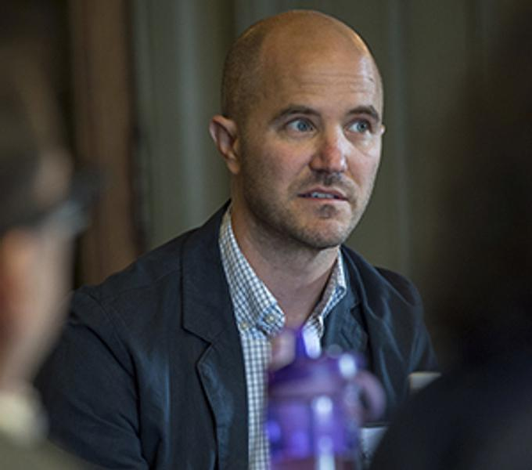
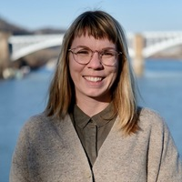
Our 2022-2023 Board
Alyssa Cypher (they/them)
President
Tienne Wolff (he/him)
Rebecca Himberger
(She/her)
Treasurer
Sarah Koenig
(she/her)
Sacoyia Reed
(she/her)
Secretary
Marcus Shoffner
(he/him)
Vice President
Laura Bunting
(she/her)
Emily Howe
(she/her)
Katie McAuley
(she/her)
Lindsay Powell
(she/her)
Nancy Gippert
(she/her)
Dan Kubis
(he/him)
John Atem
(he/him)
Ashley Varrato
(she/her)
Notes:
DAN

Slide 7
What the Board does
Sets the strategic direction for LU
Adopts annual budget & provides fiscal oversight
Hires and evaluates the Executive Director
Evaluates performance of the organization
Establishes policies & helps LU carry out its work

Slide 8
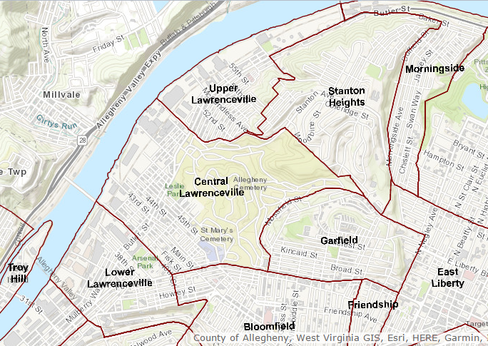
The Board structure
Democratically elected by you!
2 year terms
Odd years: 6 “By Ward” seats -- 2 seats for each “Ward”
Even years: 9 “At Large” seats

Slide 9
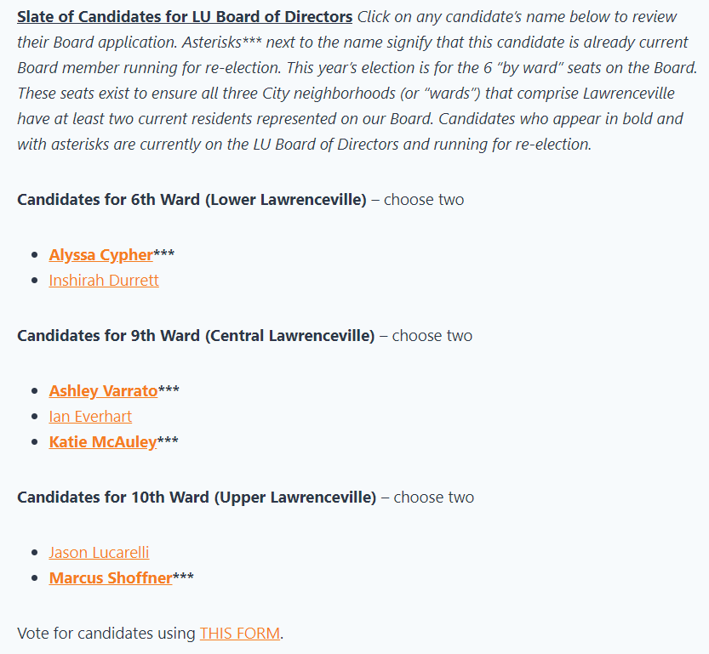
Voting process
Check out candidate bios & vote at bit.ly/VoteLU23
Can also vote by mail
Deadline to vote: Wednesday, 6/21
Not a member?
Become one today: http://www.lunited.org/about/membership/

Slide 10
Board Structure (all 2 year terms)
6th Ward | 9th Ward | 10th Ward
Inshirah Durrett | Ashley Varrato*** | Marcus Shoffner***
Lyss Cypher*** | Ian Everhart | Jason Lucarelli
 | Katie McAuley***
At-Large Seats
Lindsay Powell | Nancy Gippert | Emily Howe
Rebecca Himberger | Sarah Koenig | Dan Kubis
[Vacant] | Sacoyia Reed | Tienne Wolff
***Candidates in bold are current Board members running for re-election
Notes:
DAN

Slide 11
Tonight’s agenda
Welcome & introductions
Board elections
LU updates
Open Q&A

Slide 12
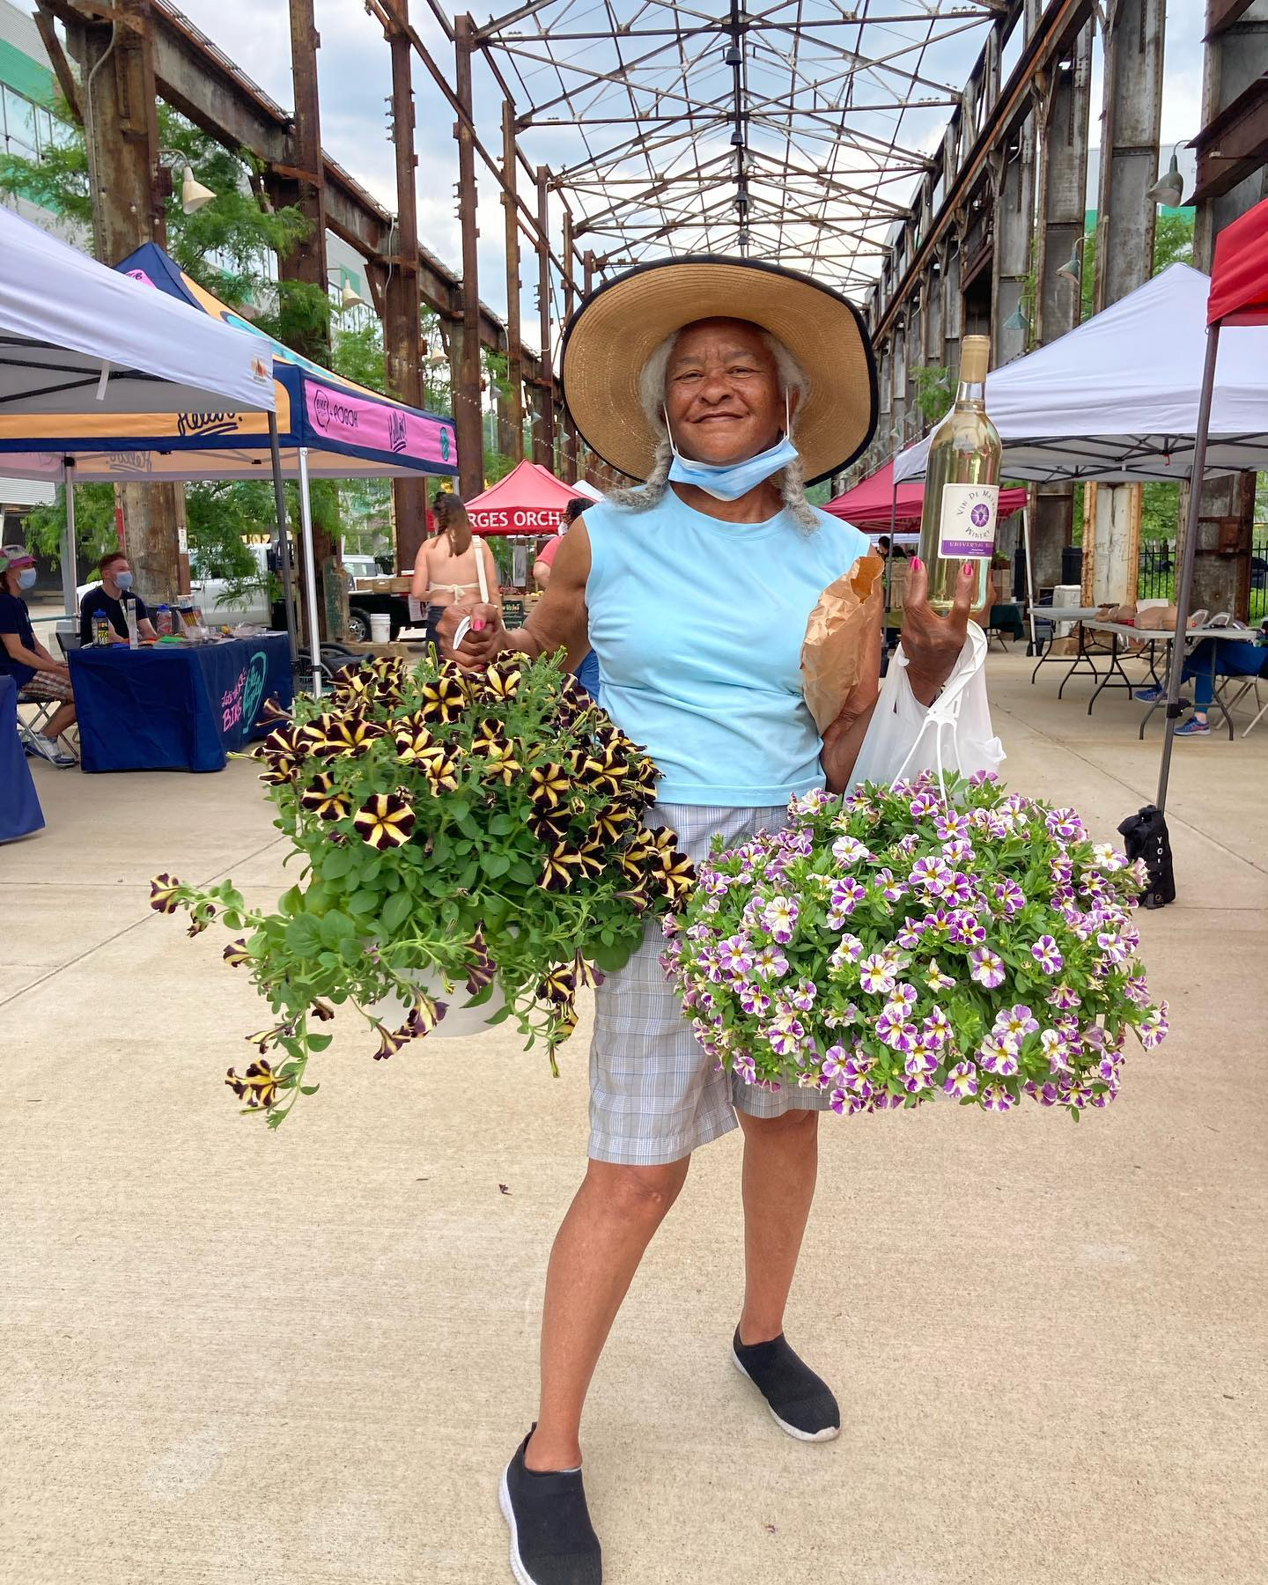
Lawrenceville Farmers Market
Every Tuesday 3-7 PM until Thanksgiving except 7/4
Bay 41 (41st & Willow)
Free parking at Ice House gravel lot + TechMill after 4 PM
Stretch SNAP dollars by 40%
Programming:
NEW: ACCESS rides from key senior institutions
Mutual aid board
Weekly partners: Seniors, Families/Kids, Community Health, Mutual Aid

Slide 13
Affordable Housing
HOME REPAIRS
Whole Home Repairs - applications due 6/30
Homeowner Assistance Program - opens 6/26, but LU supporting folks now
Program administration starting soon
Inclusionary zoning
65 units required and counting!
Lawsuit update
Case management ongoing

Slide 14
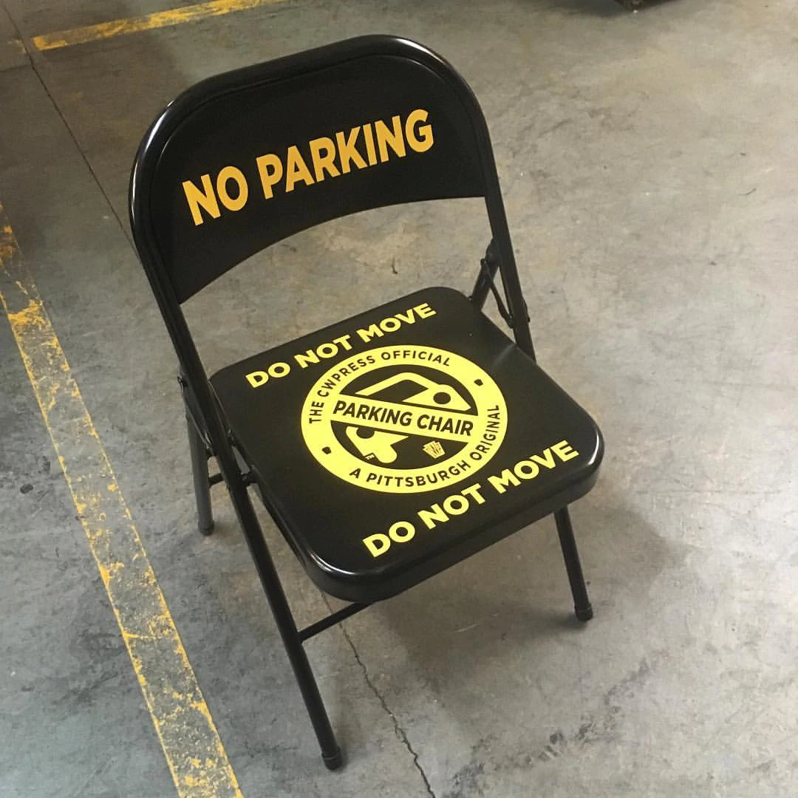
Mobility Enhancement District

Slide 15
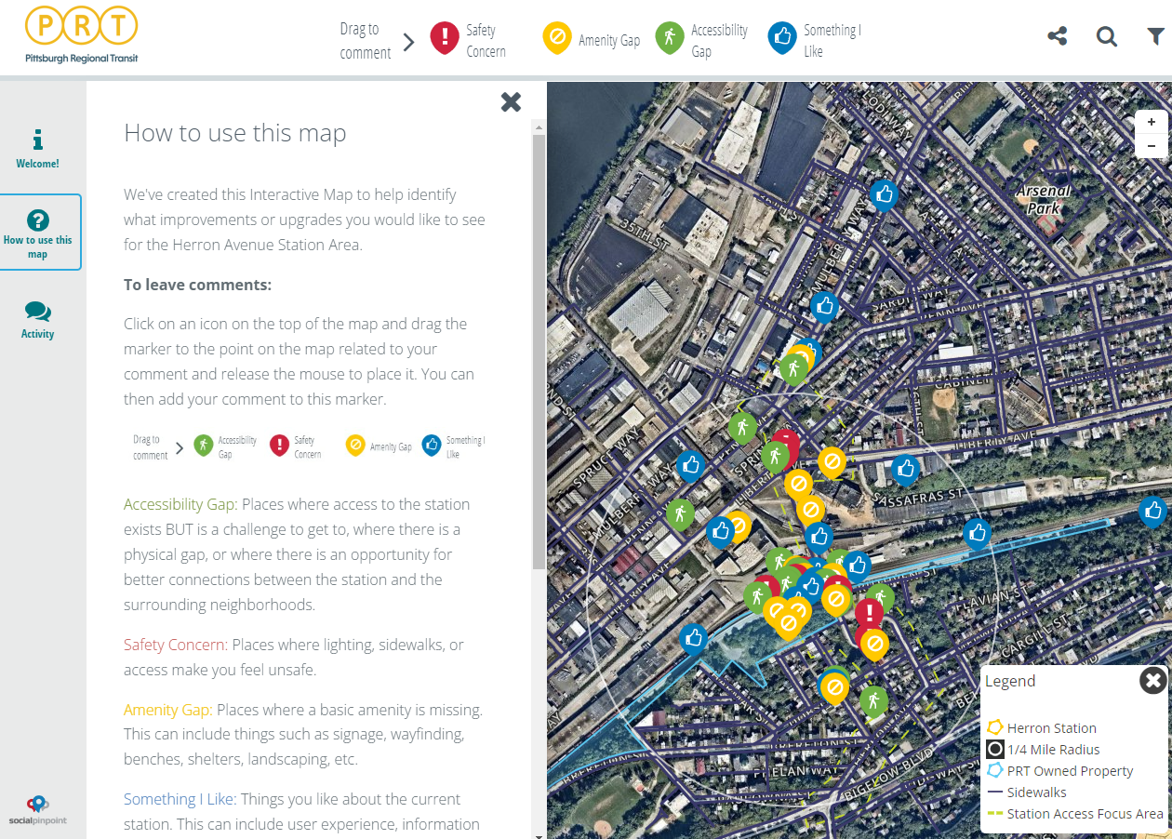
Community Planning: Herron Ave Station

Slide 16
Duncan Park

Slide 17
Honoring our “wisdom keepers”

Slide 18
LU & LC Joint Strategic Planning

Slide 19
Other ways to get involved
Join a Committee!
Equity & Inclusion
Development & Membership
Housing
Lawrenceville Farmers Market
Lawrenceville Tree Tenders
Tree Park
Friday food distributions – Drivers
Lawrenceville Organic Community Gardens
Duncan Park Neighbors
So much more!
Notes:
NANCY

Slide 20
Tonight’s agenda
Welcome & introductions
Board elections
LU updates
Open Q&A

Slide 21
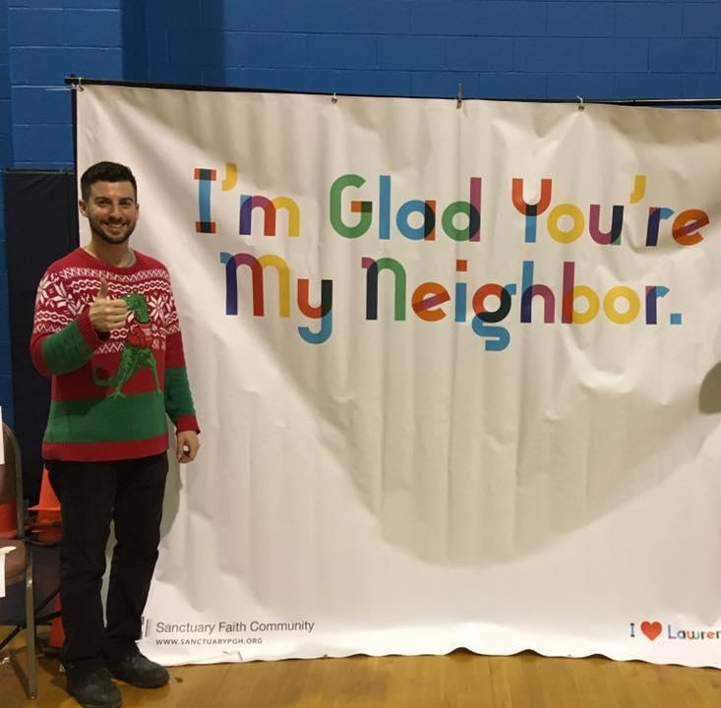
See ya next time!
Monthly “Happenings Meeting”
Second Thursdays at 6:30 p.m.
Monthly “Development Activities Meeting”
Fourth Tuesdays at 6:30 p.m.
Contact us
412-802-7220
info@LUnited.org
118 52nd Street, Suite 2026
(Goodwill Workforce Development Center)
Don’t forget to sign in before you leave: bit.ly/LUSignIn

