Slide 1
Sign in at bit.ly/LUSignIn if you’re joining by Facebook Live or watching this as a recording

Slide 2
Tonight’s Agenda
Welcome (10 minutes)
Introduction
Accessibility & Community Agreements
BikePGH: Open Streets (10 minutes)
Community Process Overview (5 minutes)
Proposed Liquor License - LH Hospitality Co at 4609 Butler Street (50 minutes)
Presentation - 20 minutes
Q&A -30 minutes
Community Discussion (10 mins)
Upcoming Events & Closing (5 mins)
Sign in at bit.ly/LUSignIn if you’re joining by Facebook Live or watching this as a recording

Slide 3
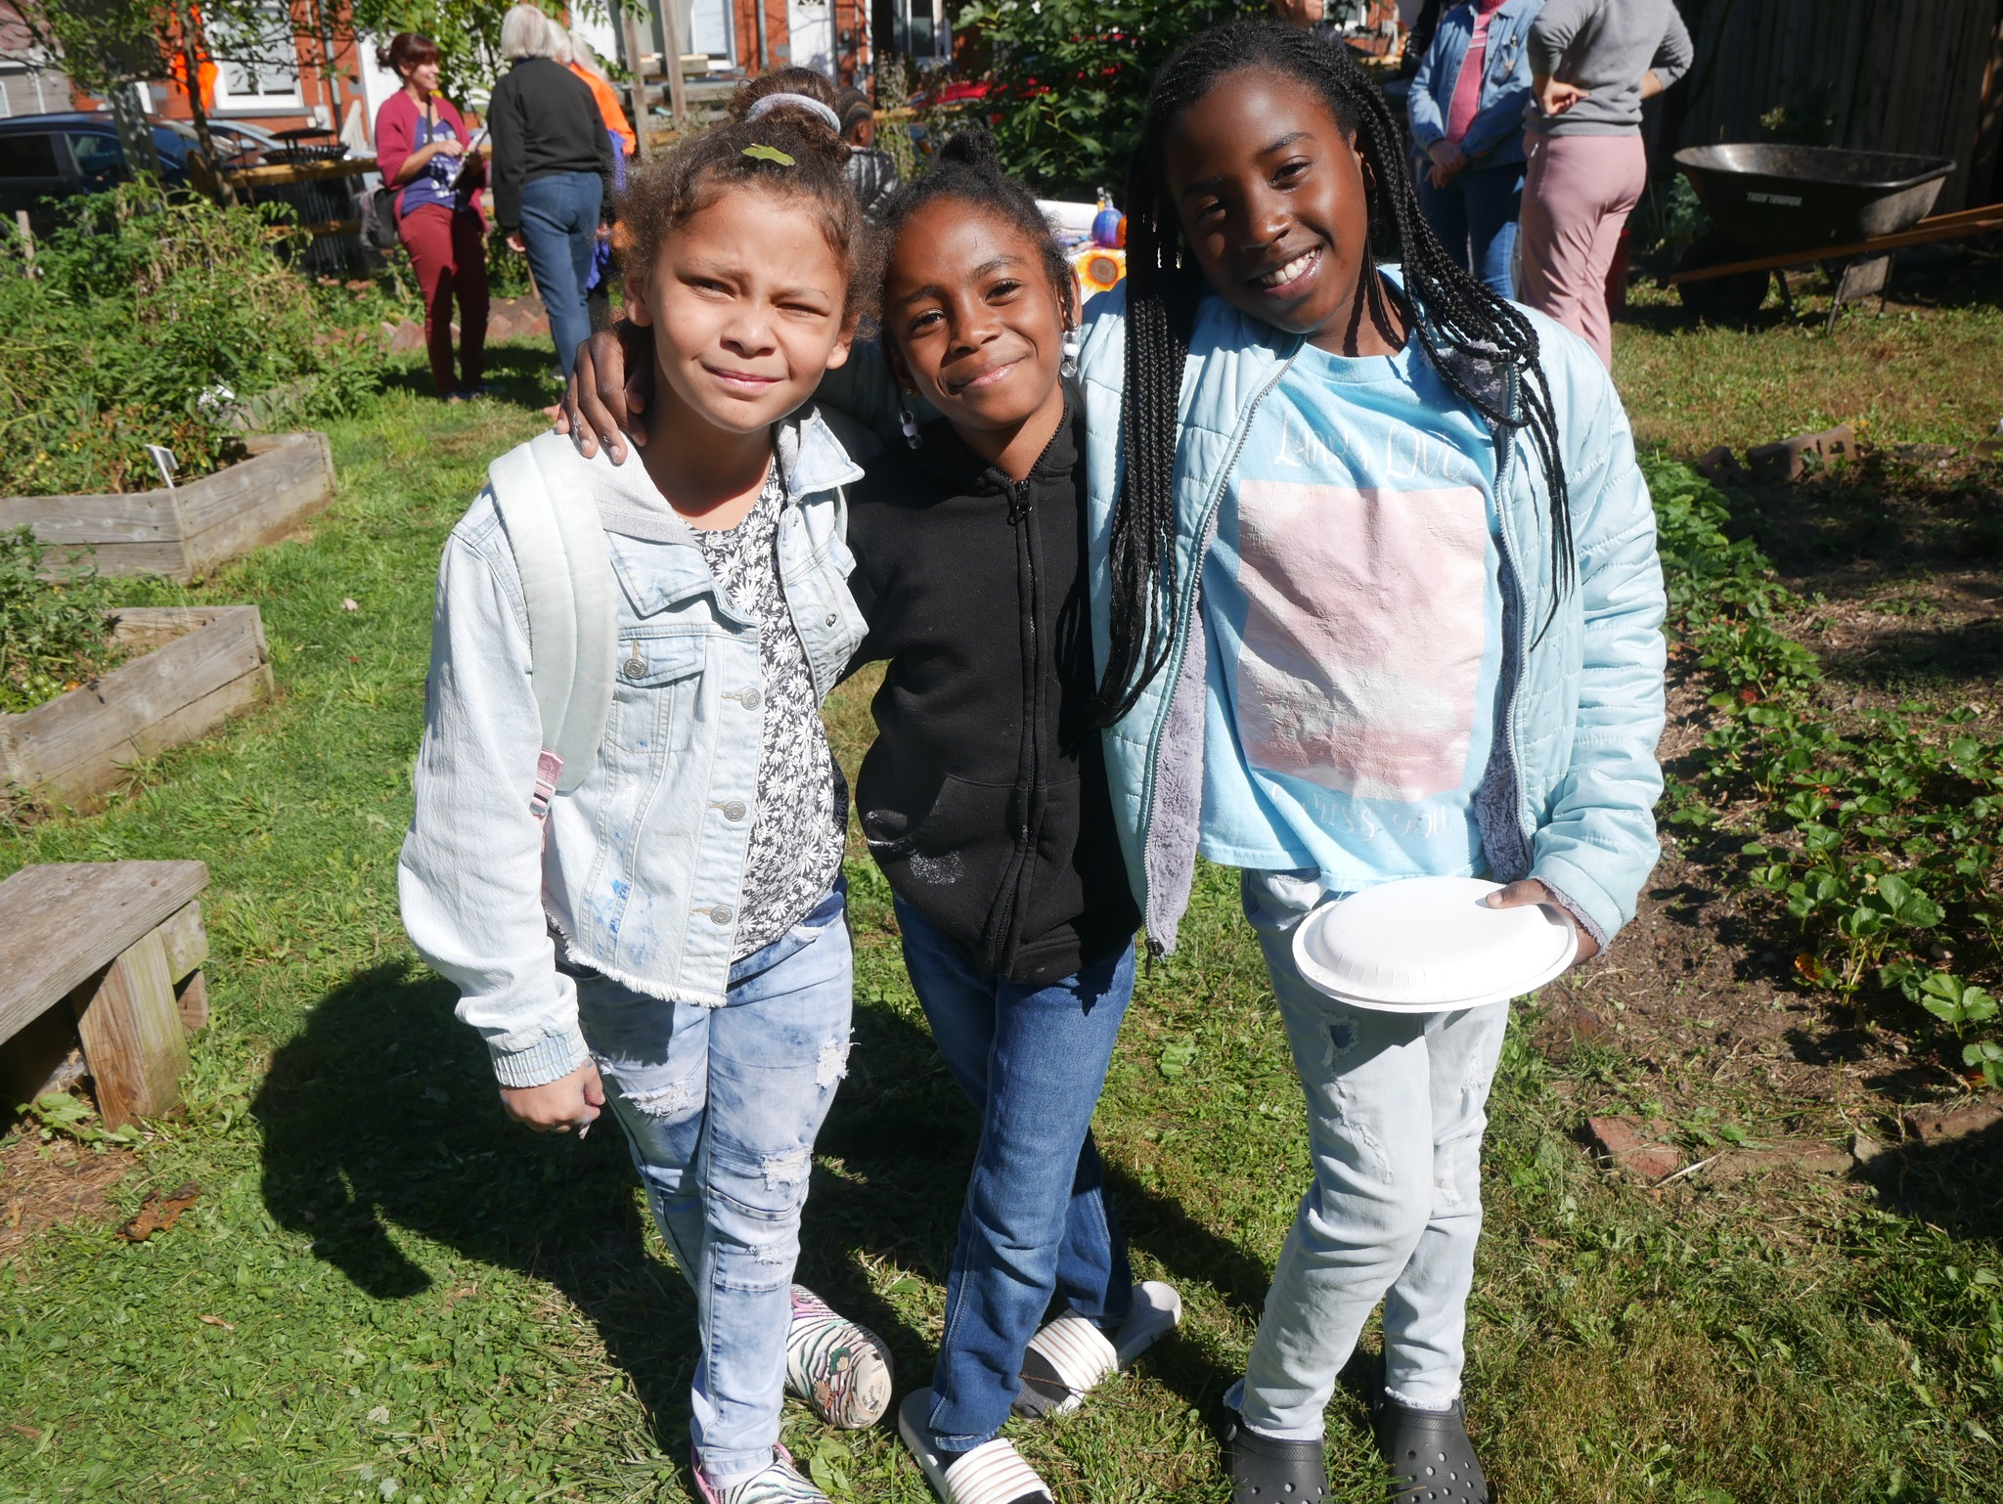
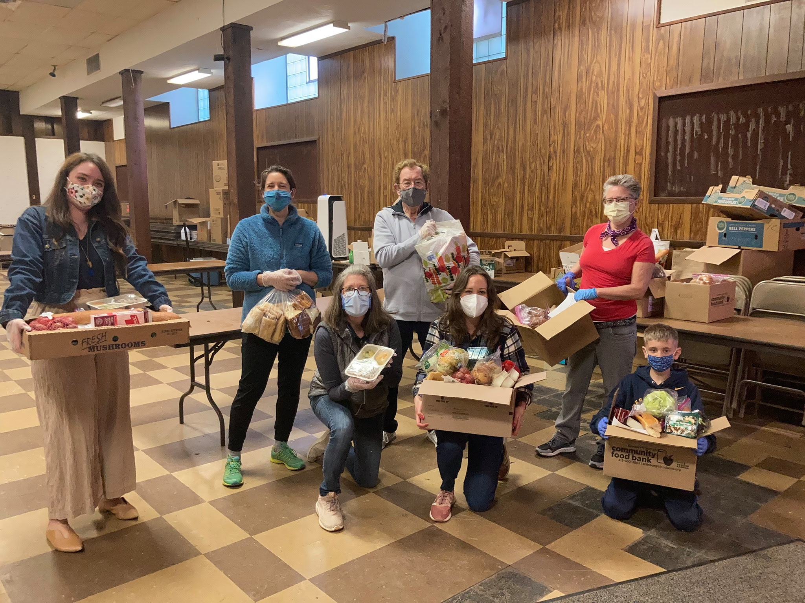
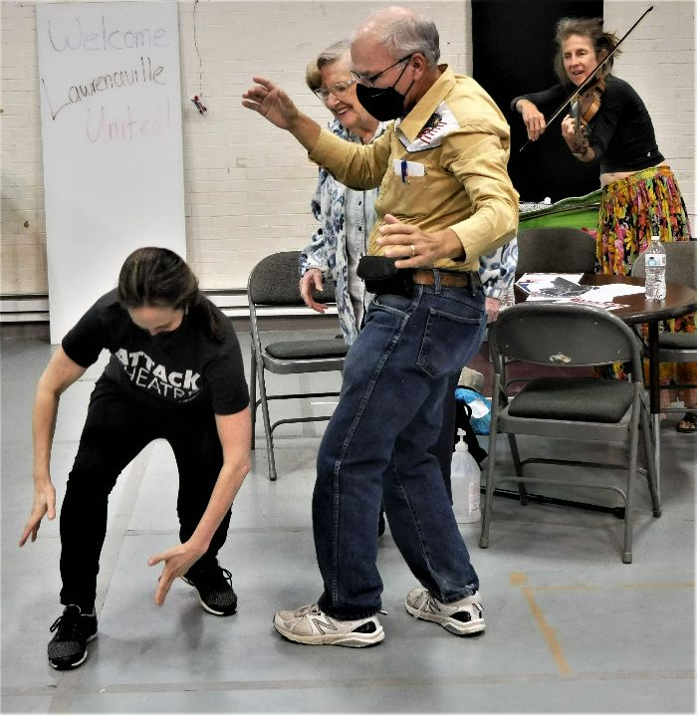
About Lawrenceville United
Mission: to improve and protect quality of life for all Lawrenceville residents
Membership of over 800 residents
Board comprised of all residents: elected by our membership
Programs: Lawrenceville Farmers Market, supporting older adults, free food distributions, cleaning & greening, direct support & case management, advocacy, and more.

Slide 4
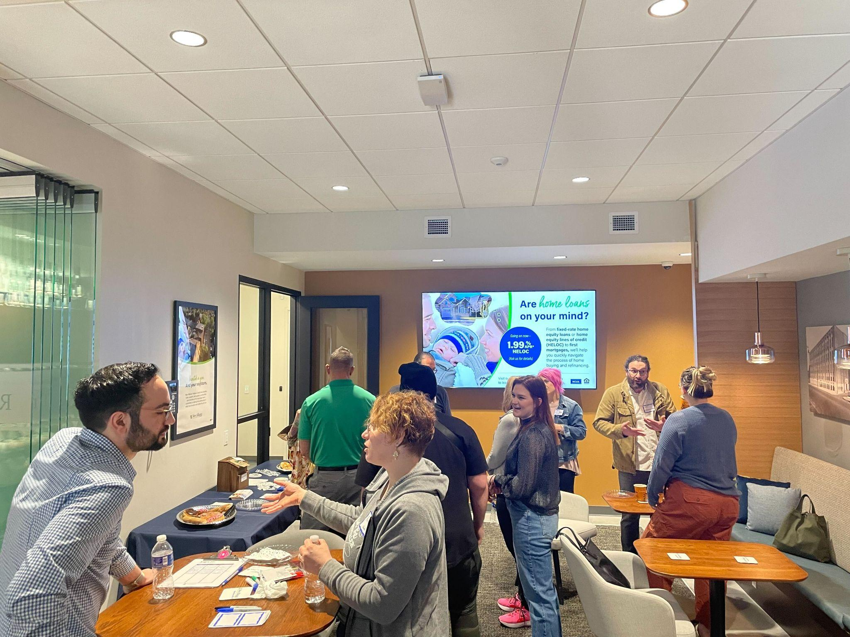
About Lawrenceville Corporation
Mission: Driven by the Lawrenceville community, the Lawrenceville Corporation acts as the catalyst and conduit for responsible and sustainable growth.
Membership: About 100, primarily business owners
Board: Mostly comprised of residents, property owners, and business owners and elected by our membership - 16 members
Programs: Business district management, policy and advocacy, community planning and development, real estate development, and communications and marketing

Slide 5
Safety & Accessibility
This meeting is being streamed on Facebook.
We will be monitoring the Facebook chat for questions and comments
Project sheet can be found at https://tinyurl.com/LVilleHall
Feedback form can be found at bit.ly/4609Butler
Please let us know your accessibility needs

Slide 6
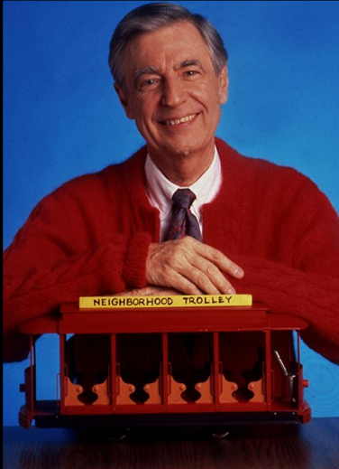
Community Agreements
Be neighborly.
Be respectful of all participants & hosts
Don’t denigrate groups of people
Give space for all to participate

Slide 7
Ground Rules
Hold all questions/comments until the end of the presentation (you can drop in the chat if you’re joining by Zoom / Facebook Live).
Raise your hand to make a question/comment. Please identify yourself and your relationship to the project.
Be respectful of all speakers.
Limit questions/comments to 2 minutes each, with 1 clarification question/comment.
If time permits, we will call on individuals who’d like to ask or make a second question/comment.
Use the “feedback form” to ask more questions and give us your input
If ground rules are violated, we will ask you to leave. If it continues, we will end the meeting.

Slide 8
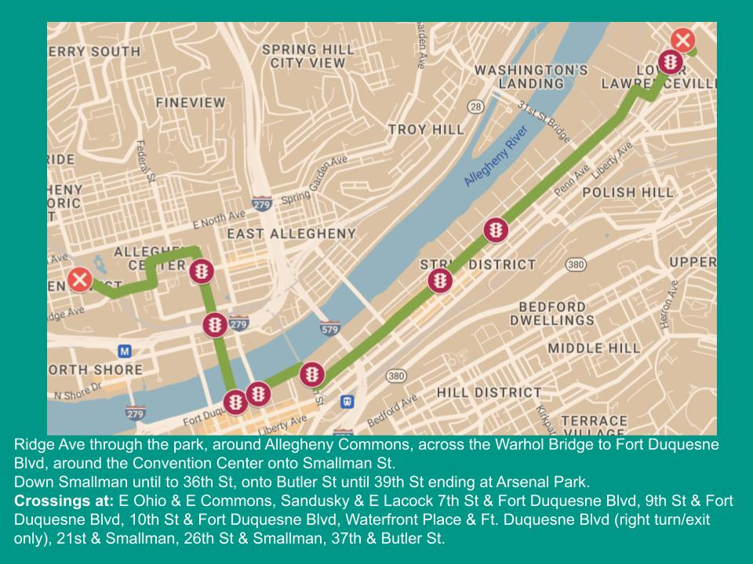

Slide 9
Community Process Overview

Slide 10
Background
Co-facilitated by LU & LC since 2011
6 development projects & 6 liquor licenses vetted in 2022
Goals:
Inform neighbors and collect direct feedback
Equip neighbors to participate in public processes
Build relationships between developers, businesses, and neighbors
Build consensus and ensure compliance with community plans and priorities

Slide 12
Projects that Trigger the Process
Requires approvals from the Zoning Board of Adjustments, Planning Commission, URA, PA Liquor Control Board, City Council, Air Quality Permitting AND…
Meets one of the following criteria:
4+ residential units
New structures or expansions over 2,400 square feet
Requires use variance or zoning change
Liquor license application or transfer
OR… Has potential community-wide impact

Slide 13
Clarifying LU and LC’s role
We are not part of the development team
We did not recruit this developer
We have no authority to intervene in private transactions of property. The community process kicks in when there is a public process of some kind (in this case, transfer of a Liquor License).

Slide 14
Liquor License at 4609 Butler Street

Slide 15
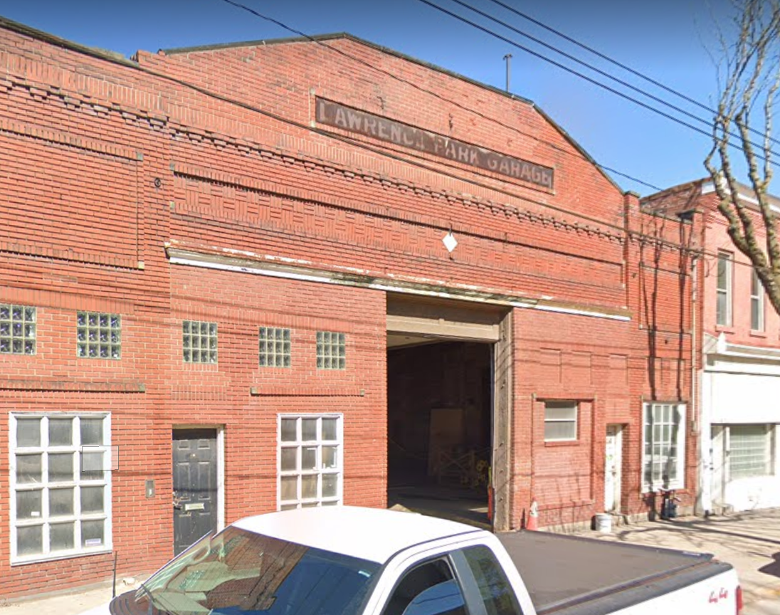
History with Community Process
4609 Butler Street / Lawrence Hall
June 2018 - community meeting #1 on 4609 Butler
July 2018 - Zoning hearing for parking variance and use
September 2018 - Zoning Board conditionally approves
October 2018 - Appeals filed by Ray Czachowski and the Abbey
May 2019 - Judge James overturns ZBA decision
September 2019 - Community meeting on parking carousel at 4751 Butler St (Park LV) - revised plan
October 2019 - Community meeting with revised plan for 4751 Butler St
Nov 2019 - Zoning hearing for 4751 Butler
Feb 2020 - Zoning Board grants approvals
Mar 2020 - second appeal by Ray Czachowski
Mar 2022 - Commonwealth Court rules in favor of Lawrence Hall
Notes:
“R” licensees may serve liquor, wine and beer products. The licensee can sell up to 192 fluid ounces of beer products, in original containers, for take-out purposes. “R” licensees may not sell any single, open container of alcoholic beverage for consumption outside the establishment.

Slide 16
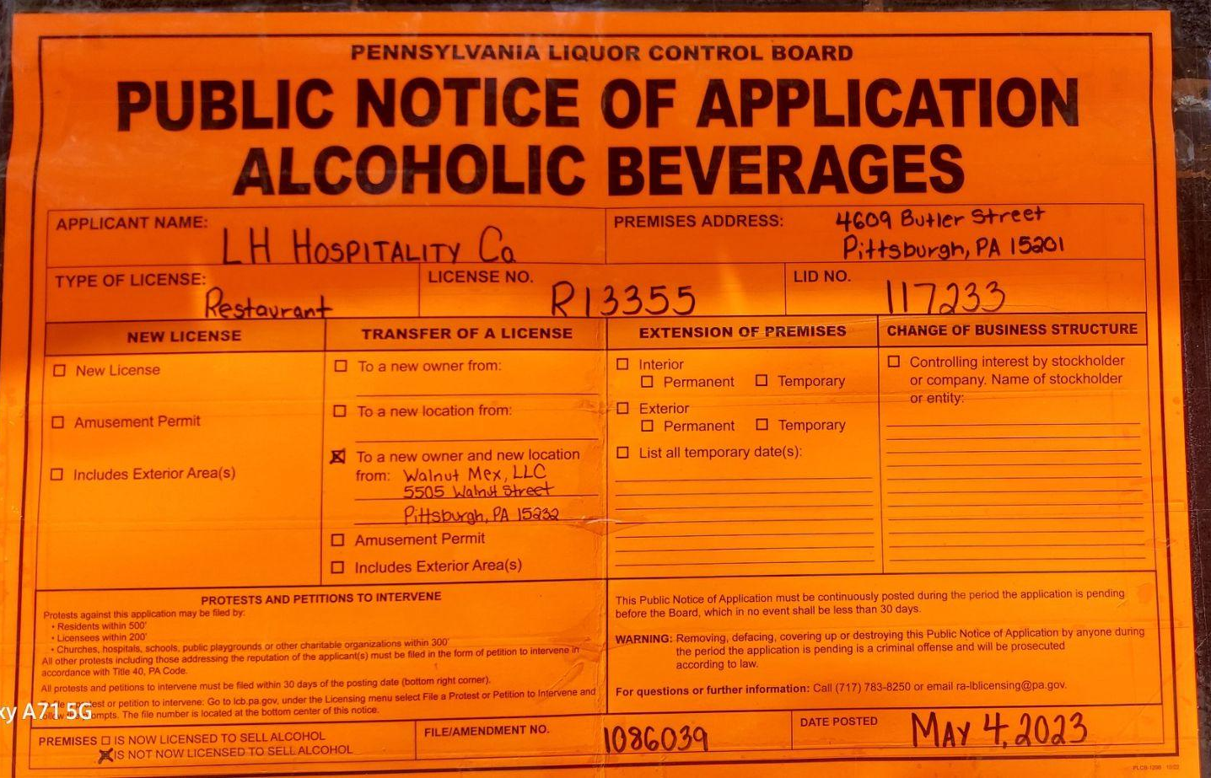
LH Hospitality Co
4609 Butler Street / Lawrence Hall
Liquor License Information:
License Type: Restaurant License
Double Transfer: Person & Place
License Number: R-13355
Applicant: LH Hospitality Co
Owner: Brett Minarik, Phoebe Fraser, Adam Harvey
License Manager: Adam Harvey
Date Posted: 05/04/2023
Vision: To set a new standard for food service hospitality in Pittsburgh. We take care of each other in the building first and foremost. In creating a supportive, team-oriented, and hospitable work environment we will foster a welcoming environment for our guests, whom we will serve with a comprehensive and unwavering commitment to hospitality.
Notes:
“R” licensees may serve liquor, wine and beer products. The licensee can sell up to 192 fluid ounces of beer products, in original containers, for take-out purposes. “R” licensees may not sell any single, open container of alcoholic beverage for consumption outside the establishment.

Slide 21
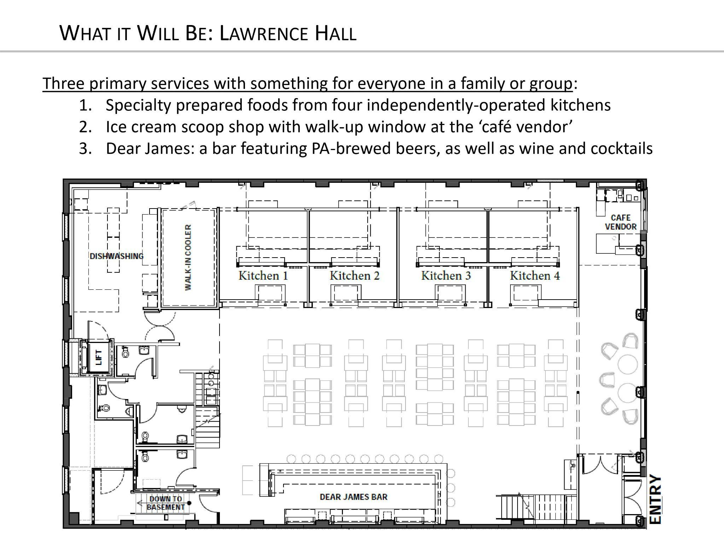

Slide 22
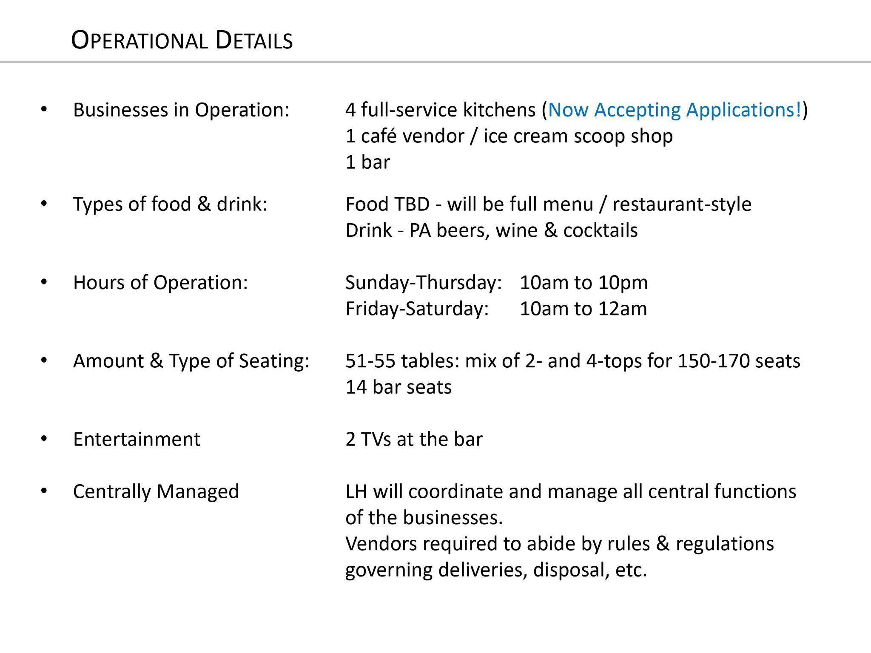

Slide 25
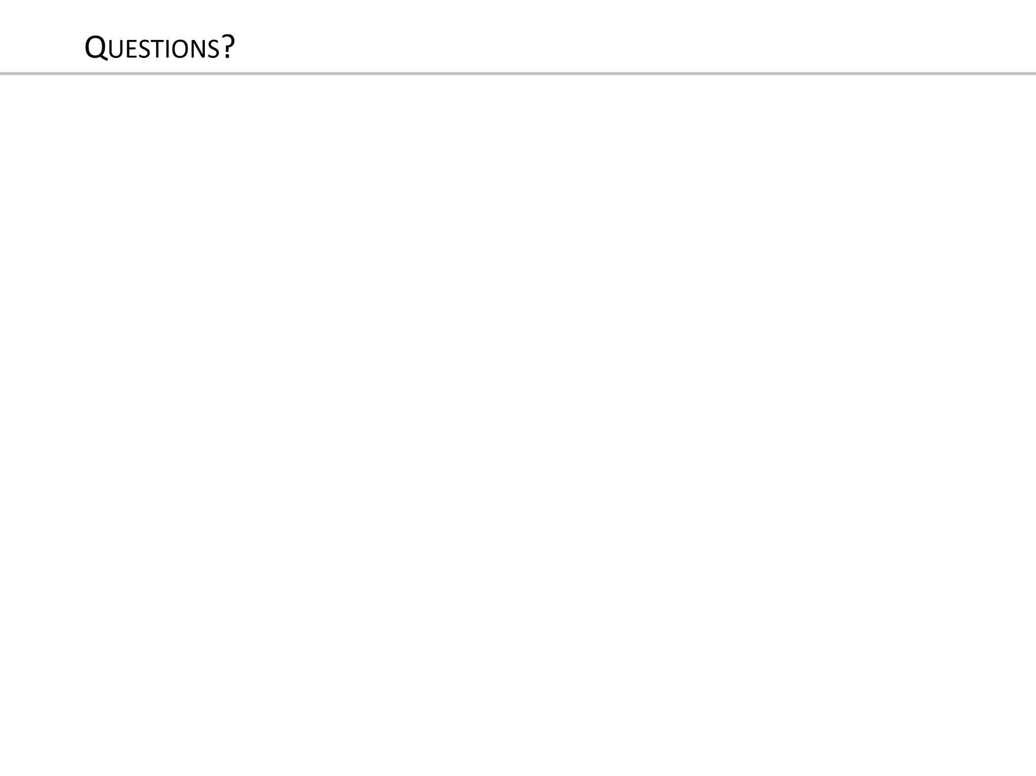

Slide 26
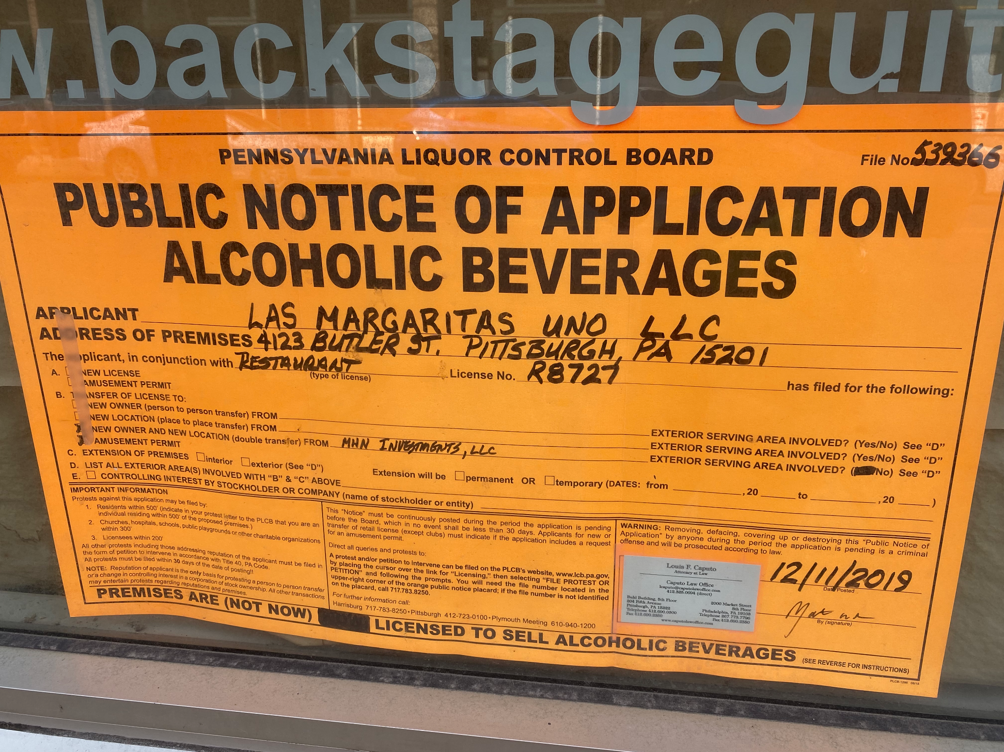
How do I engage with the PLCB process as an individual?
Breakdown of PA State Liquor License Types:
https://www.paliquorlicenseco.com/understanding-types-of-pa-liquor-licenses/
If you see a liquor license placard in the neighborhood, email abi@lawrencevillecorp.com or dave@lunited.org

Slide 27
Community Discussion

Slide 28
Next steps
Make sure you signed in
Facebook Live: bit.ly/LUSignIn
Give us your feedback
bit.ly/4609Butler
Meeting video/presentations will be shared on LU’s website at www.LUnited.org
Contact LU with any other questions/input
412-802-7220 | info@LUnited.org

Slide 29
Upcoming Events
Lawrenceville Farmers Market Tuesdays, 3-7 PM @ Bay 41 (41st & Willow)
LU Spring Member Meeting & Board Elections - June 8th @6:30, Goodwill
LC Annual Meeting Celebration -June 14th @5-8pm, Tryp Hotel
LV Pride - June 17th - various locations throughout Lawrenceville
Open Streets - June 25th - North Side, Strip District, Lawrenceville

Slide 30
Lawrenceville United
info@LUnited.org
412-802-7220
Lawrenceville Corporation
info@LawrencevilleCorp.com
412-621-1616
Thank you!
Notes:
Add Rachel

