Slide 1
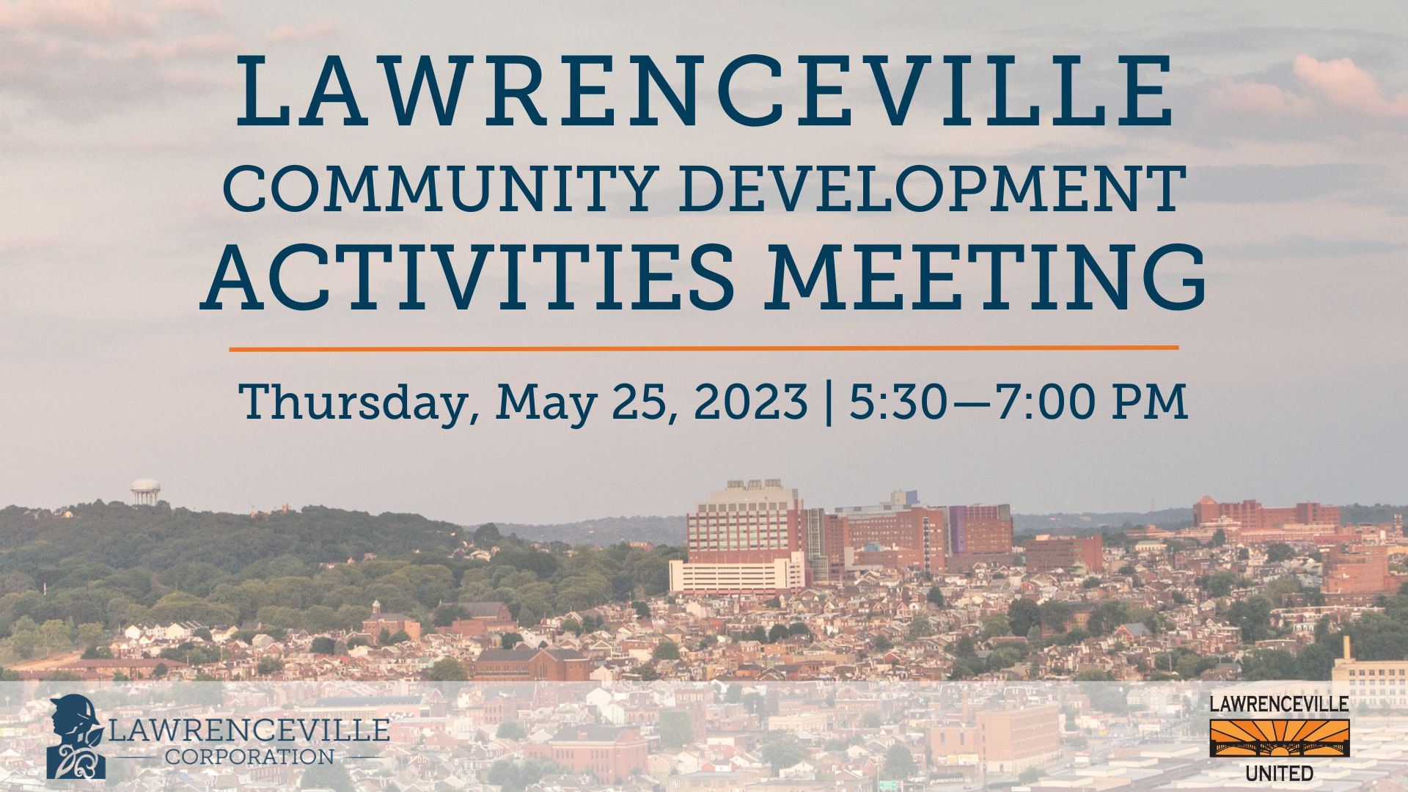
Sign in at bit.ly/LUSignIn if you’re joining by Facebook Live or watching this as a recording

Slide 2
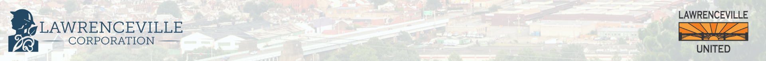
Tonight’s Agenda
Welcome (15 minutes)
  Introduction
  Accessibility & Community Agreements
Community Process Overview (5 minutes)
Proposed Development - UPMC Heart Institute on 45th Street (50 minutes)
  Developer Presentation - 20 minutes
  Q&A -30 minutes
Closed Community Conversation (15 mins)
Upcoming Events & Closing (5 mins)
Sign in at bit.ly/LUSignIn if you’re joining by Facebook Live or watching this as a recording

Slide 3
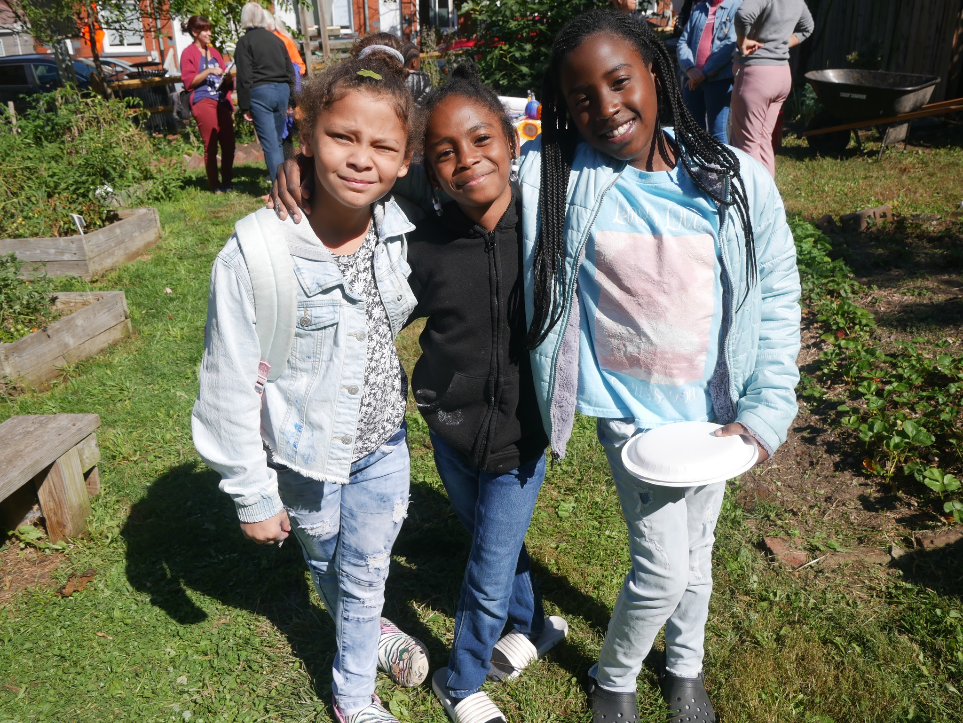
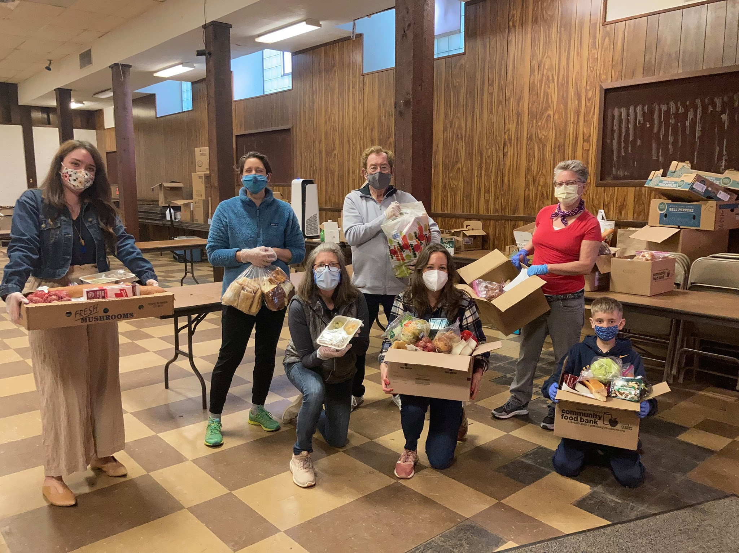
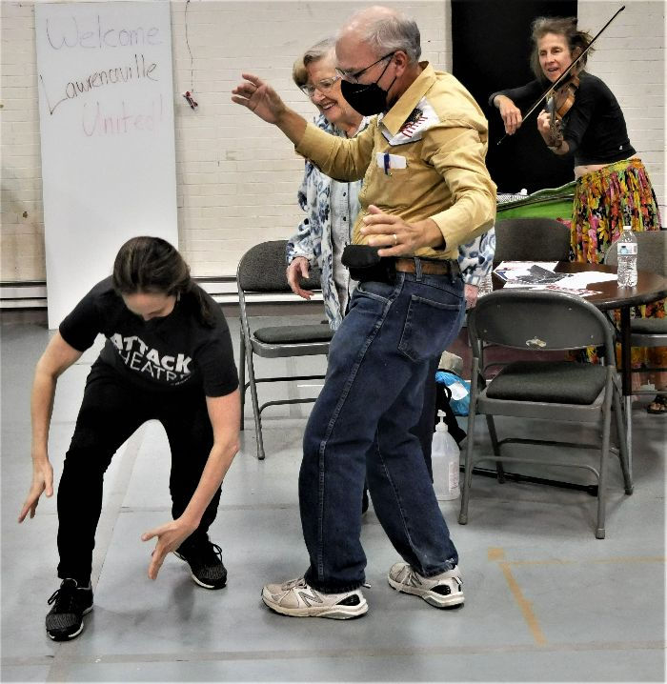
About Lawrenceville United
Mission: to improve and protect quality of life for all Lawrenceville residents
Membership of over 800 residents
Board comprised of all residents: elected by our membership
Programs: Lawrenceville Farmers Market, supporting older adults, free food distributions, cleaning & greening, direct support & case management, advocacy, and more.

Slide 4
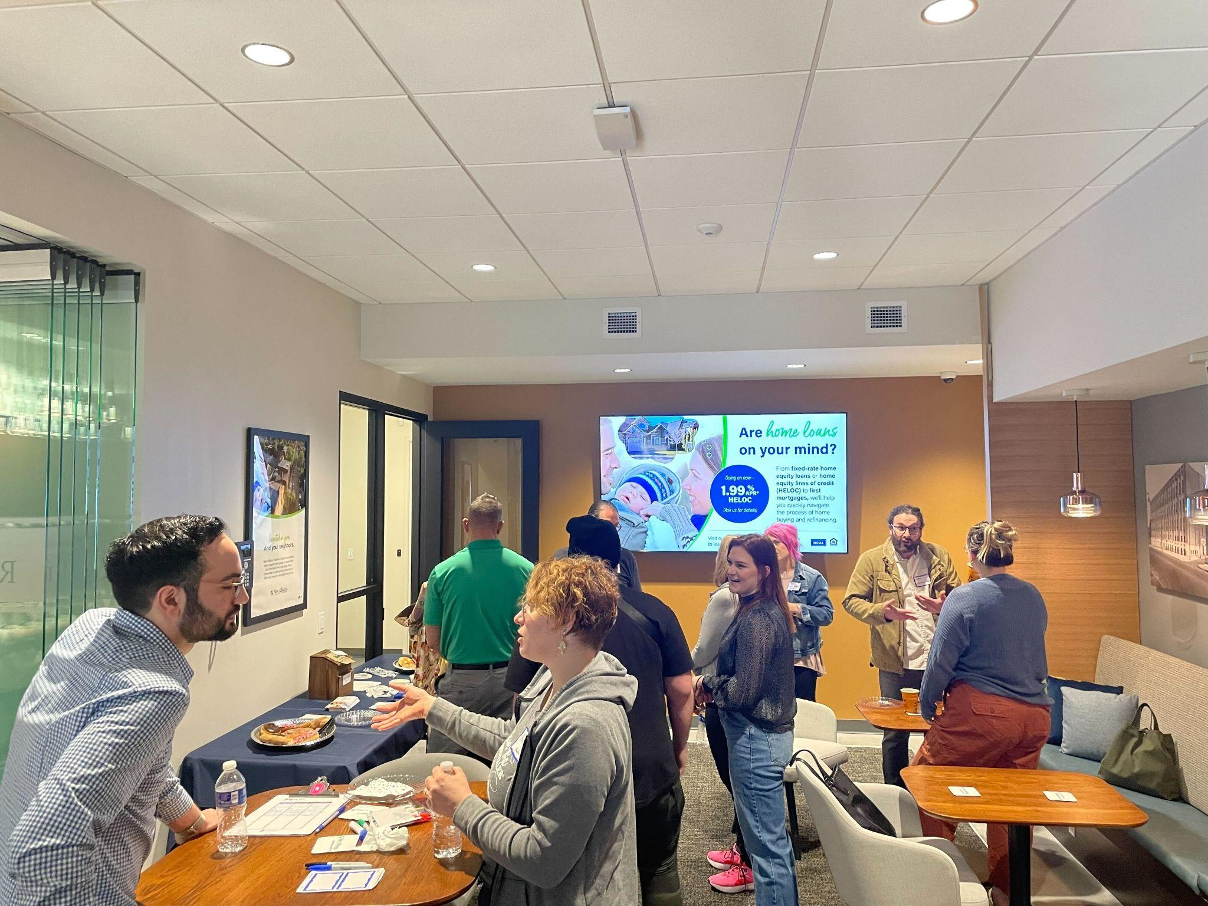

About Lawrenceville Corporation
Mission: Driven by the Lawrenceville community, the Lawrenceville Corporation acts as the catalyst and conduit for responsible and sustainable growth.
Membership: About 100, primarily business owners
Board: Mostly comprised of residents, property owners, and business owners and elected by our membership - 16 members
Programs: Business district management, policy and advocacy, community planning and development, real estate development, and communications and marketing

Slide 5
Safety & Accessibility
This meeting is being streamed on Facebook.
  We will be monitoring the Facebook chat for questions and comments
  Project sheet can be found at bit.ly/UPMCHeartInfo
  Feedback form can be found at bit.ly/UPMCHeartInstitute
Please let us know your accessibility needs

Slide 6
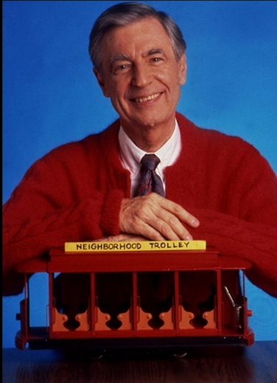
Community Agreements
Be neighborly.
Be respectful of all participants & hosts
Don’t denigrate groups of people
Give space for all to participate

Slide 7
Ground Rules
Hold all questions/comments until the end of the presentation (you can drop in the chat if you’re joining by Zoom / Facebook Live).
Raise your hand to make a question/comment. Please identify yourself and your relationship to the project.
Be respectful of all speakers.
Limit questions/comments to 2 minutes each, with 1 clarification question/comment.
If time permits, we will call on individuals who’d like to ask or make a second question/comment.
Use the “feedback form” to ask more questions and give us your input
If ground rules are violated, we will ask you to leave. If it continues, we will end the meeting.

Slide 8
Community Process Overview

Slide 9
Background
Co-facilitated by LU & LC since 2011
6 development projects & 6 liquor licenses vetted in 2022
Goals:
  Inform neighbors and collect direct feedback
  Equip neighbors to participate in public processes
  Build relationships between developers, businesses, and neighbors
  Build consensus and ensure compliance with community plans and priorities

Slide 10
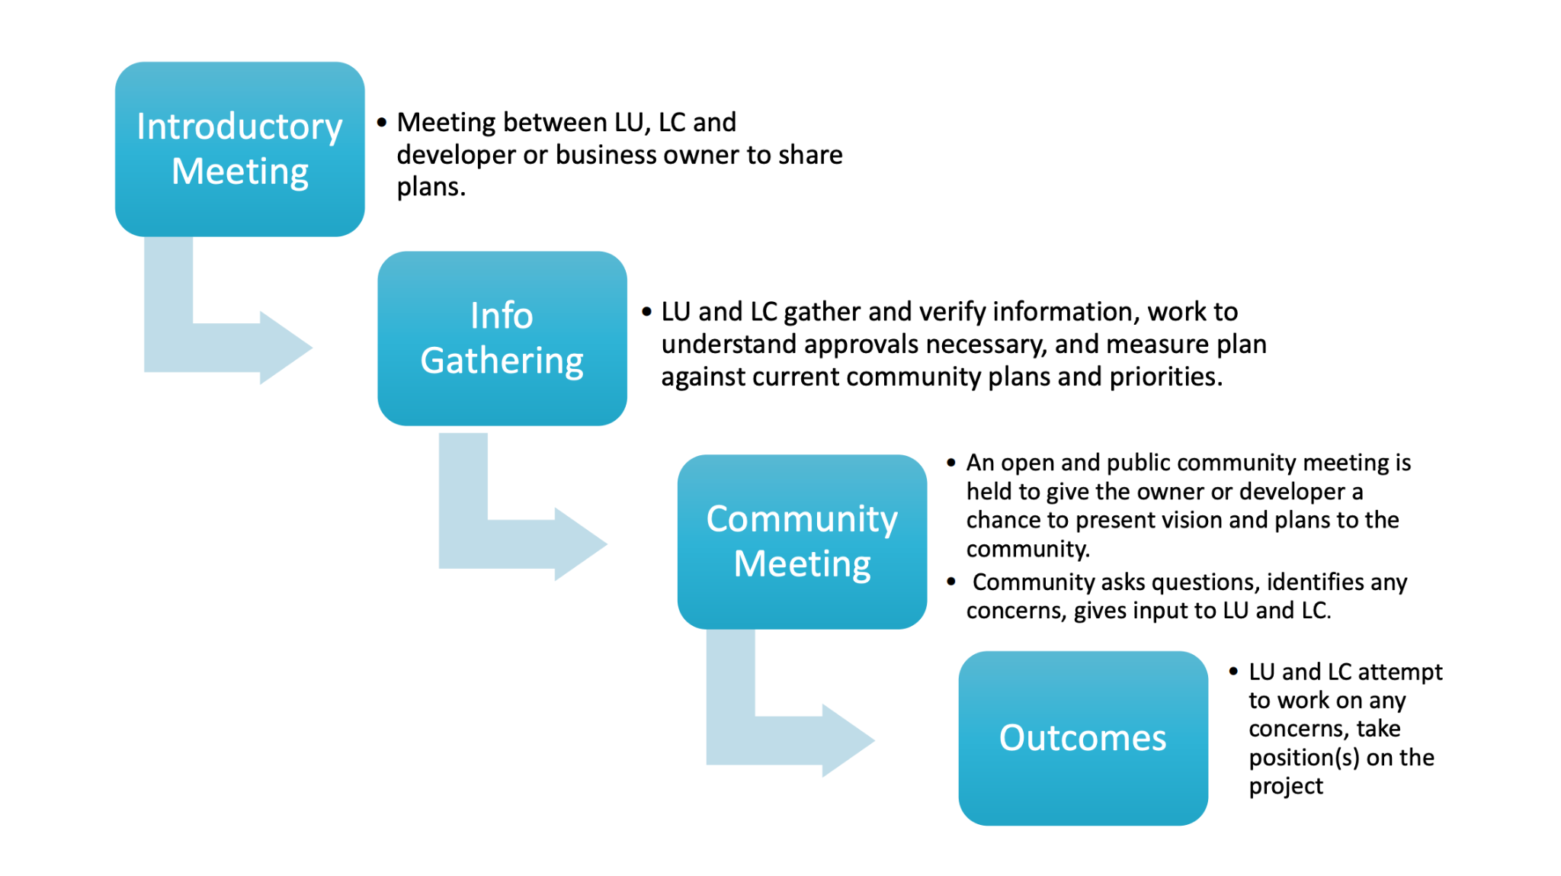

Slide 11
Projects that Trigger the Process
Requires approvals from the Zoning Board of Adjustments, Planning Commission, URA, PA Liquor Control Board, City Council, Air Quality Permitting AND…
Meets one of the following criteria:
  4+ residential units
  New structures or expansions over 2,400 square feet
  Requires use variance or zoning change
  Liquor license application or transfer
  OR… Has potential community-wide impact

Slide 12
Clarifying LU and LC’s role
We are not part of the development team
We did not recruit this developer
We have no authority to intervene in private transactions of property. The community process kicks in when there is a public process of some kind (in this case, review from Planning Commission and Zoning Board).

Slide 13
UPMC’s Proposed Heart Institute Development
Developer Presentation

Slide 14
UPMC’s Proposed Heart Institute Development
Q&A

Slide 15
Closed Community Conversation

Slide 16
Next steps
Make sure you signed in
  Facebook Live: bit.ly/LUSignIn
Give us your feedback
  bit.ly/UPMCHeartInstitute
Meeting video/presentations will be shared on LU’s website at www.LUnited.org
We will contact participants when Planning Commission and Zoning Board hearings are scheduled
Contact LU with any other questions/input
  412-802-7220 | info@LUnited.org

Slide 17

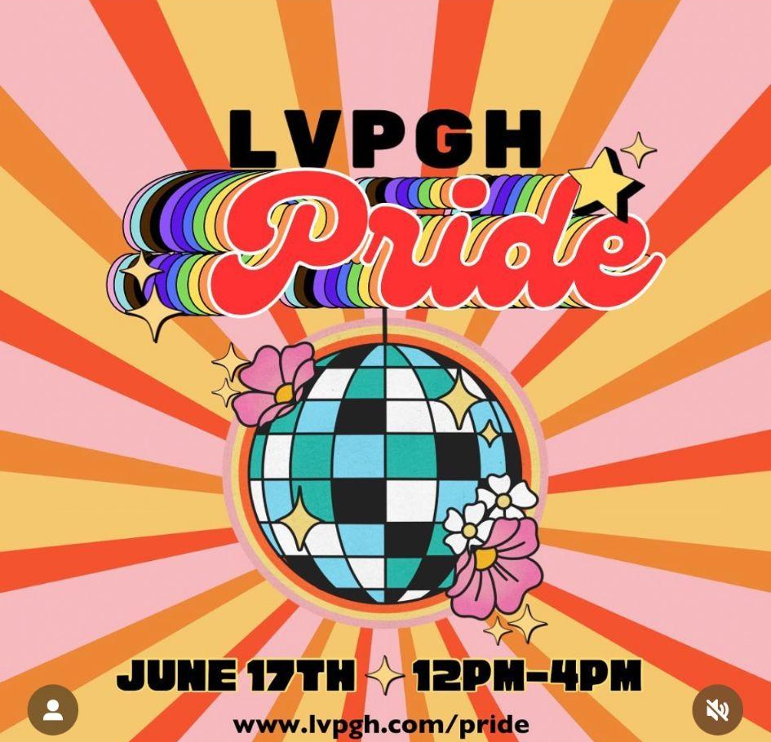
Upcoming Events
Lawrenceville Farmers Market Tuesdays, 3-7 PM @ Bay 41 (41st & Willow)
CDAM on Lawrence Hall, 6/1 at 5:30 PM at CLP Fisk
LU Spring Member Meeting & Board Elections - June 8th @6:30, Goodwill
LC Annual Meeting Celebration -June 14th @5-8pm, Tryp Hotel
LV Pride - June 17th - various locations throughout Lawrenceville

Slide 18
Lawrenceville United
info@LUnited.org
412-802-7220
Lawrenceville Corporation
info@LawrencevilleCorp.com
412-621-1616
Thank you!
Sign in at bit.ly/LUSignIn if you’re joining by Facebook Live or watching this as a recording
Notes:
Add Rachel

