Slide 1
NIED’S HOTEL
Giving new life to a Lawrenceville legend: Four Pittsburgh entrepreneurs plan to restore and reimagine Nied's Hotel

Slide 2
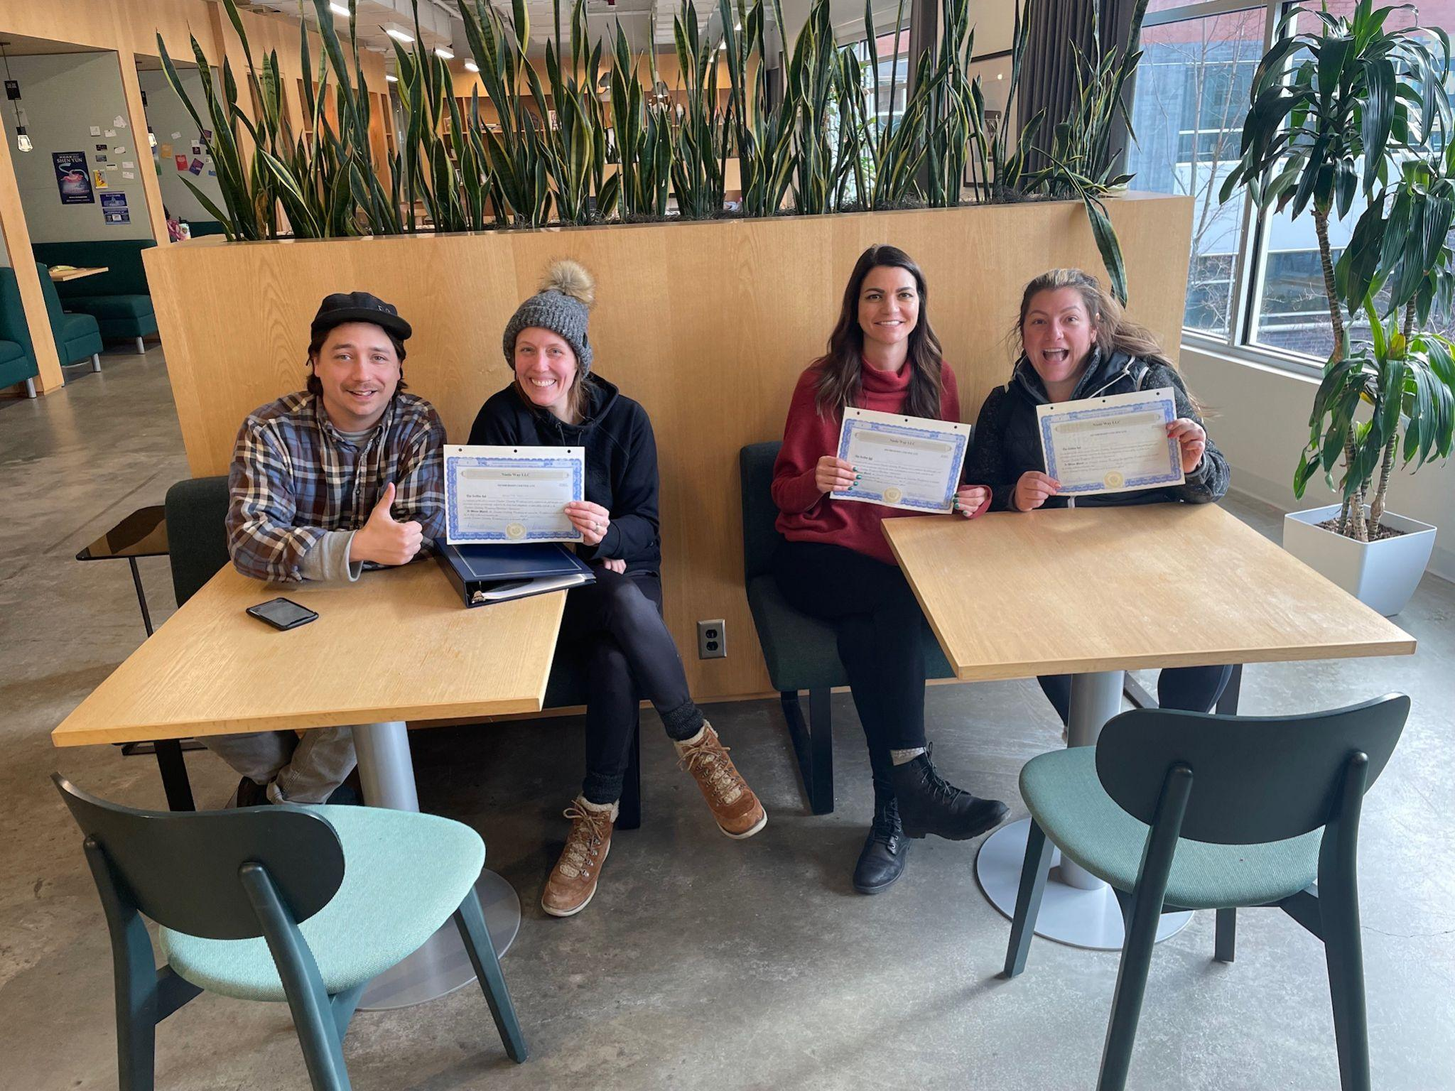
Who
We Are
Tom Barr Culinary Operations
Brigette Davitt Project Mgmt & Design
Leigh Yock Bar/Restaurant Operations
Mary Verratti Hotel Mgmt & Operations
Chef/Founder of Spirit in Lawrenceville, harnessing hospitality, cooking & event production for sincere, memorable experiences.
Entrepreneur, investor, artist, designer, and educator. Tenured professor turned real estate investor & hospitality specialist.
Entrepreneur with exp. in management, HR, marketing, event planning/production in art, live music, bar/rest. & advertising.
HR, operations, and customer service. Leadership & mgmt w/ Target, Lowes & Amazon. Real estate investor. Strategic, people-focused problem solver.

Slide 3
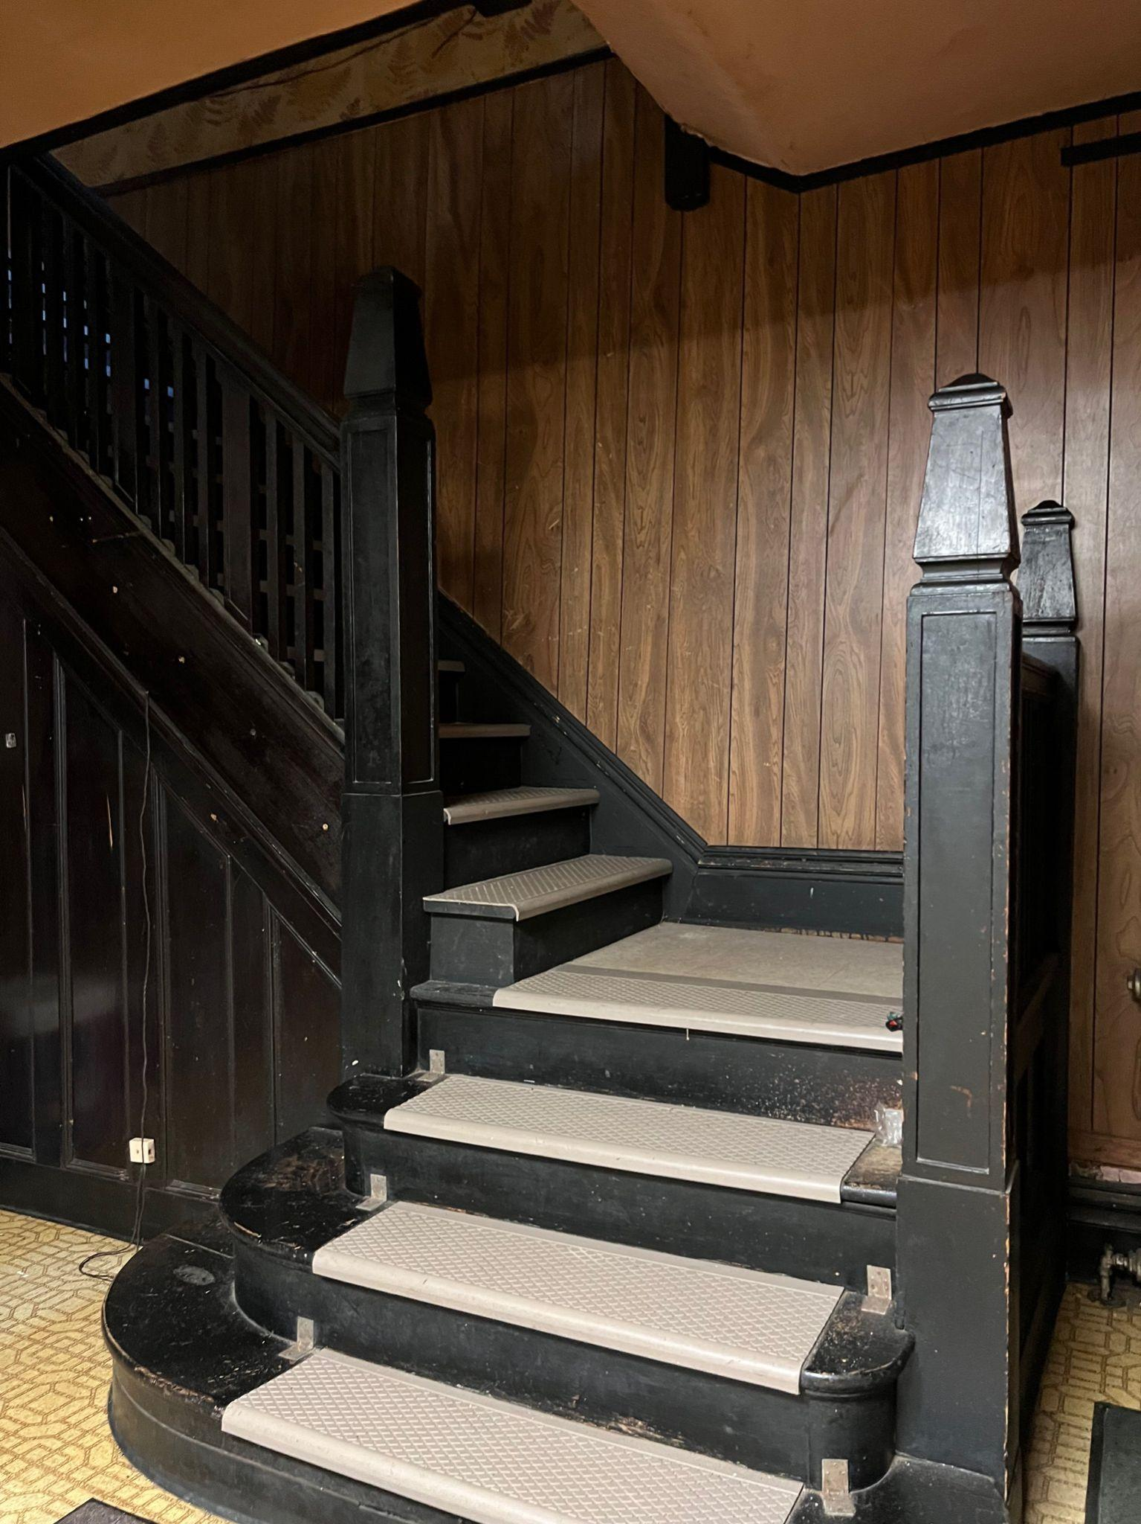
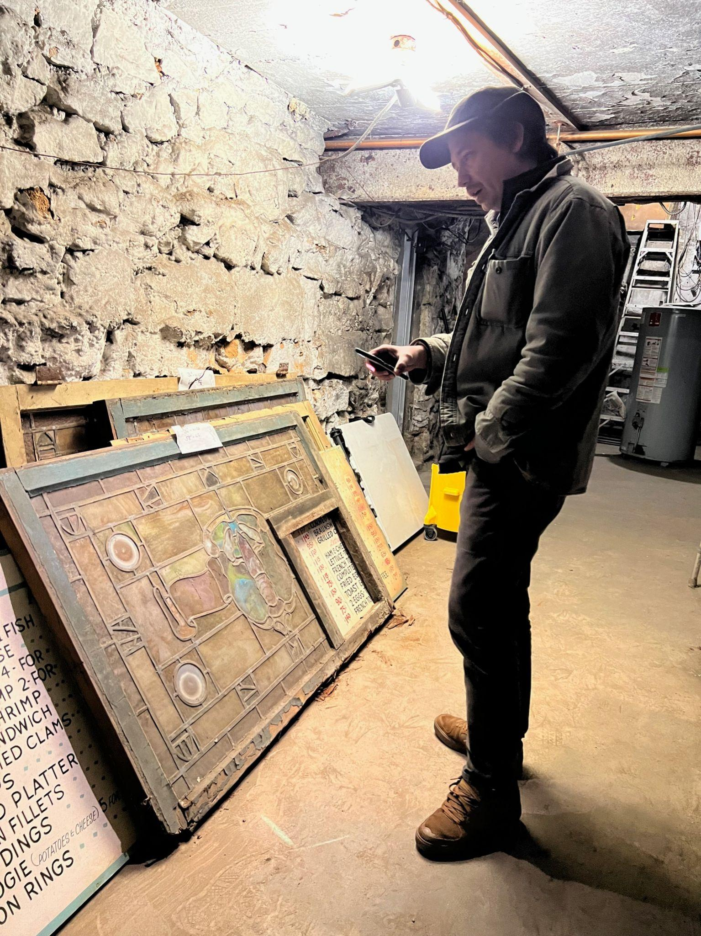
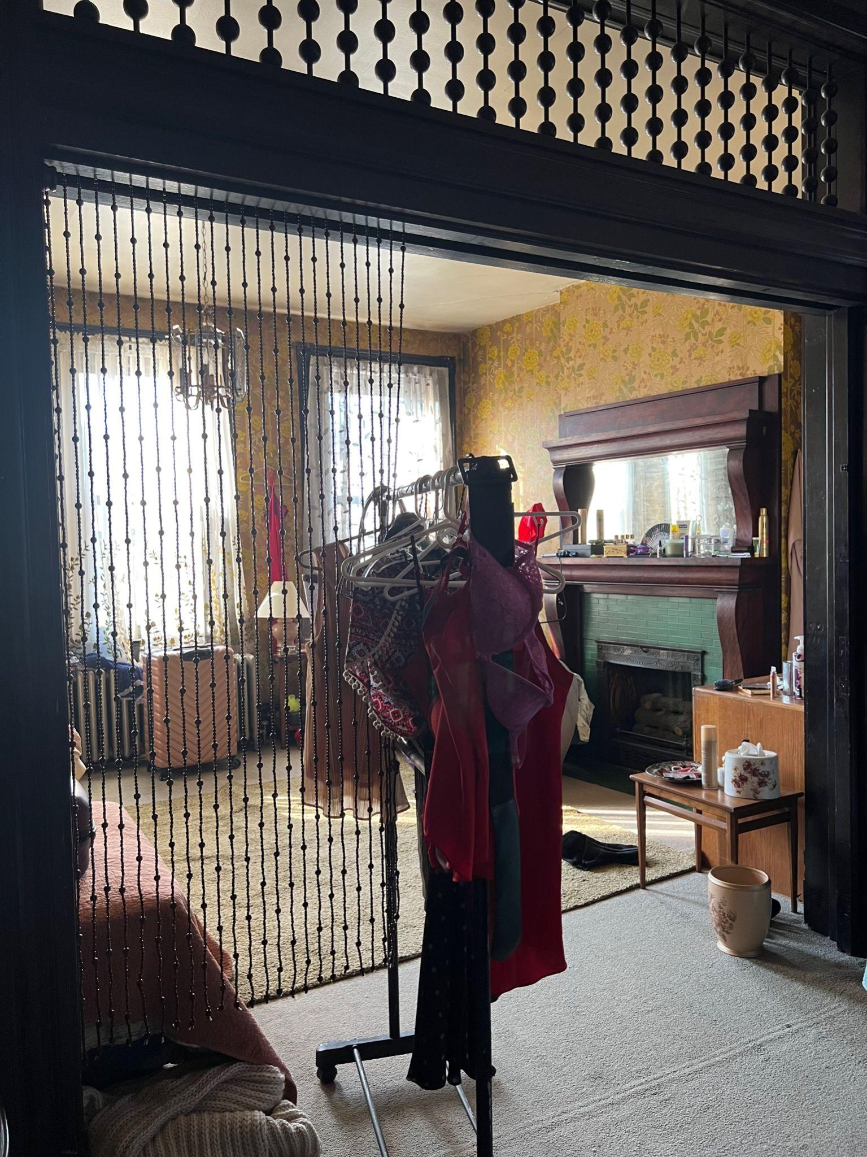
The History
Preserving this local legend is crucial for maintaining the cultural heritage and historical significance of Lawrenceville. It also represents an opportunity for community revitalization and economic growth.

Slide 4
The Plan

Slide 5
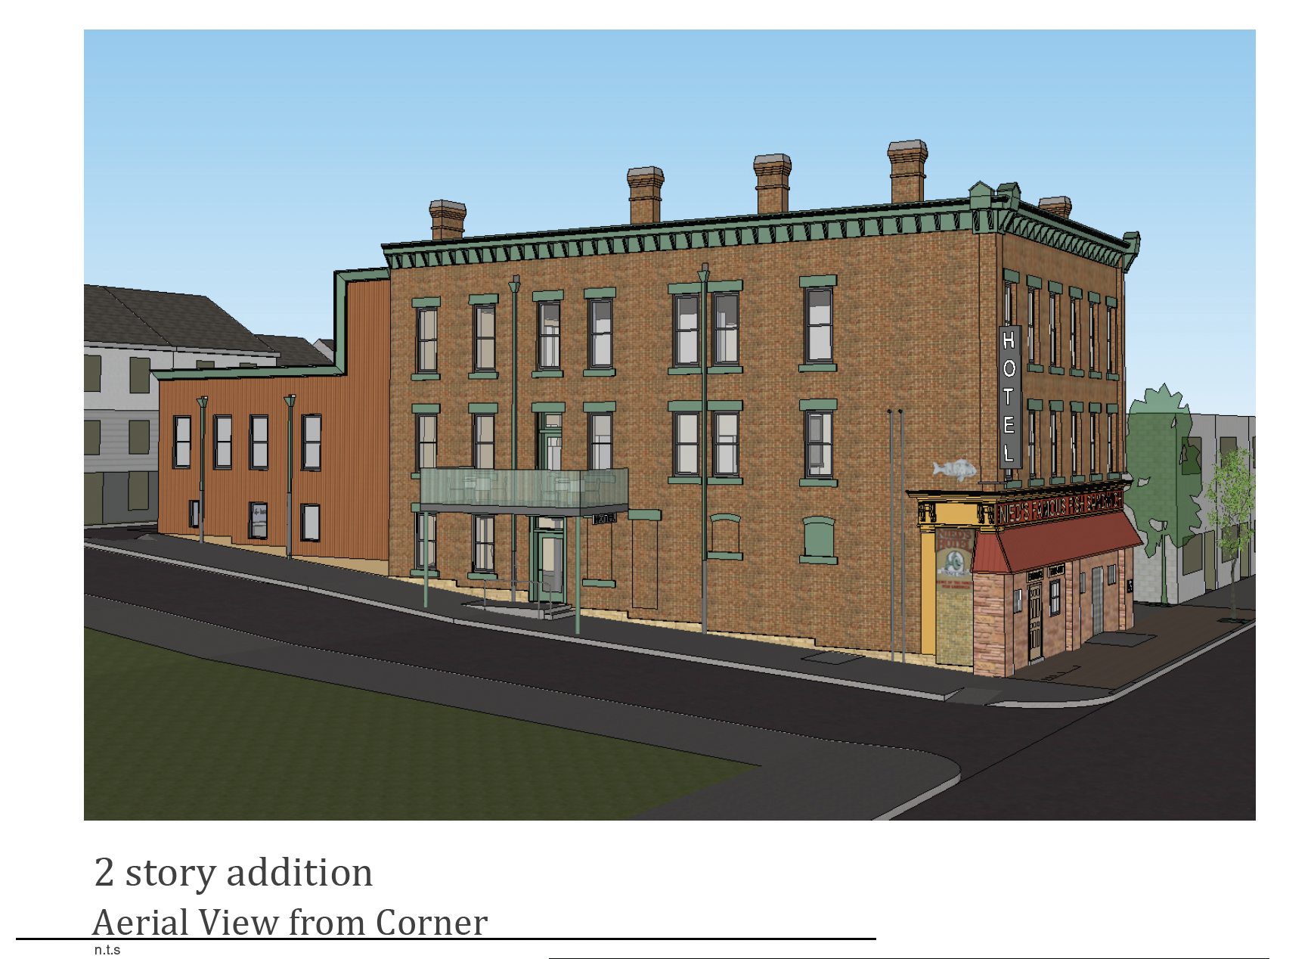

Slide 6
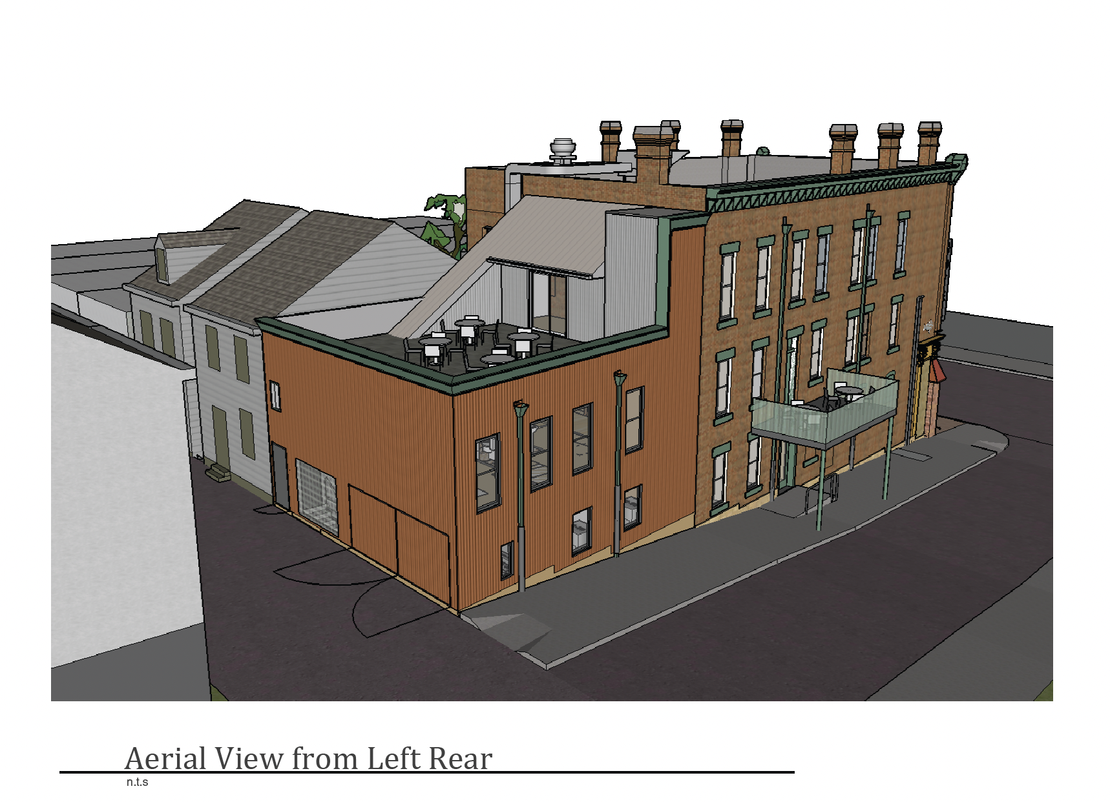

Slide 7
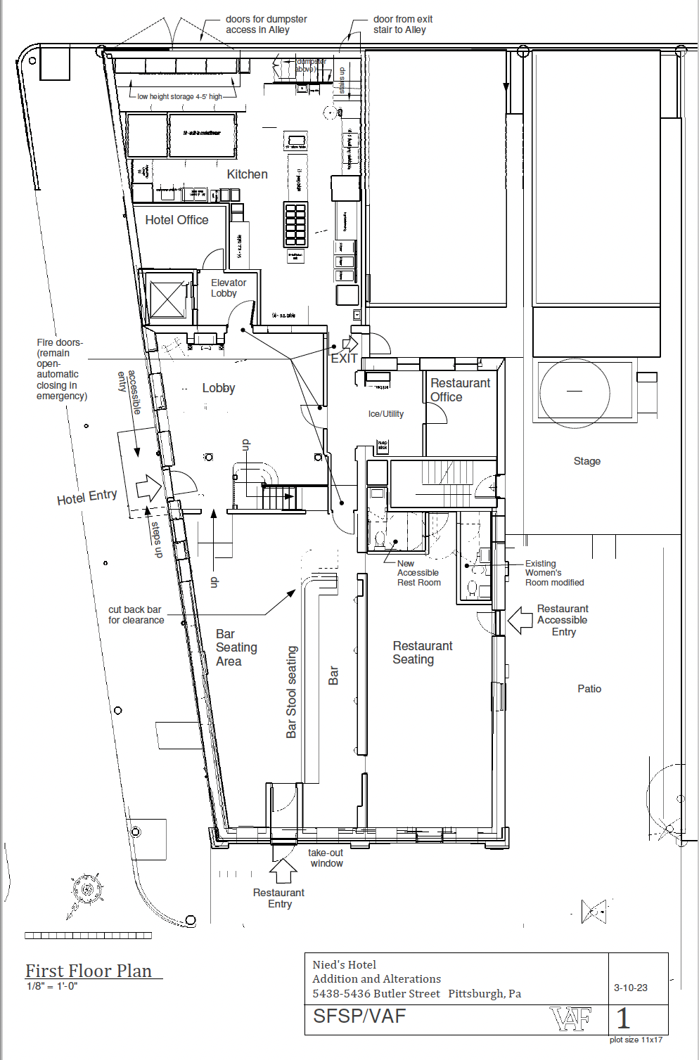

Slide 8
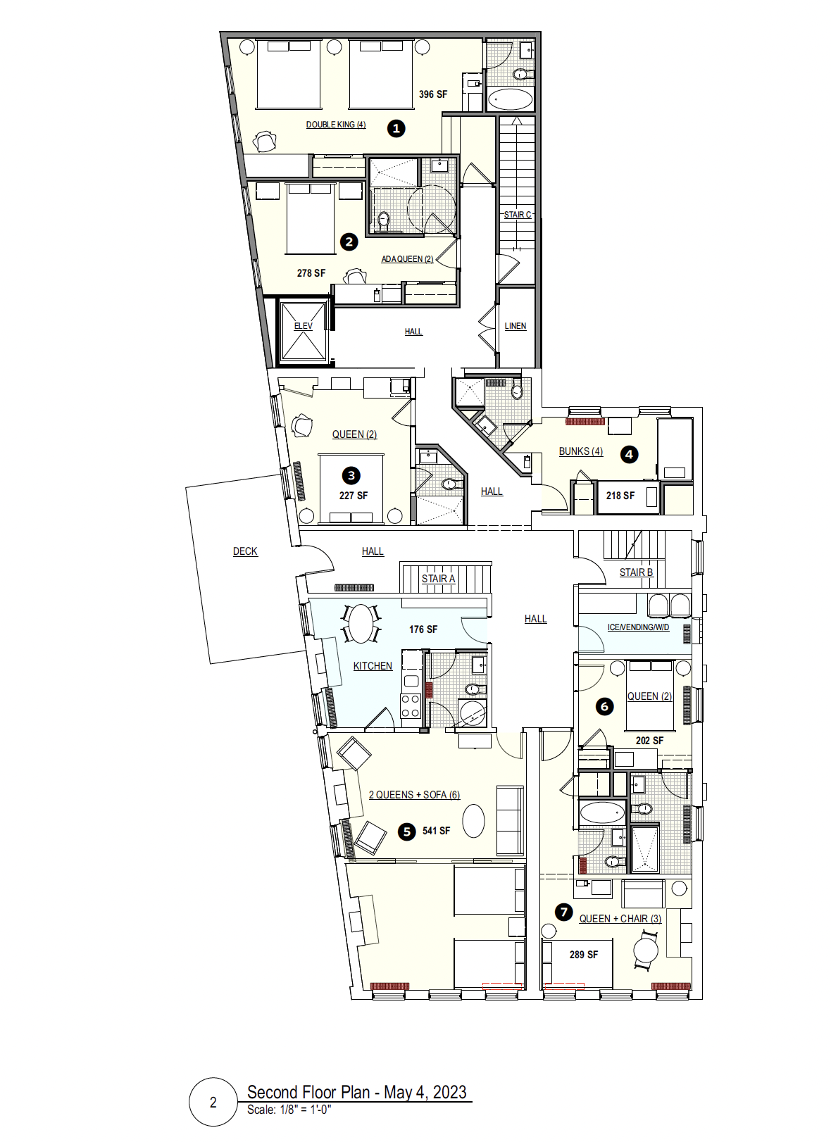
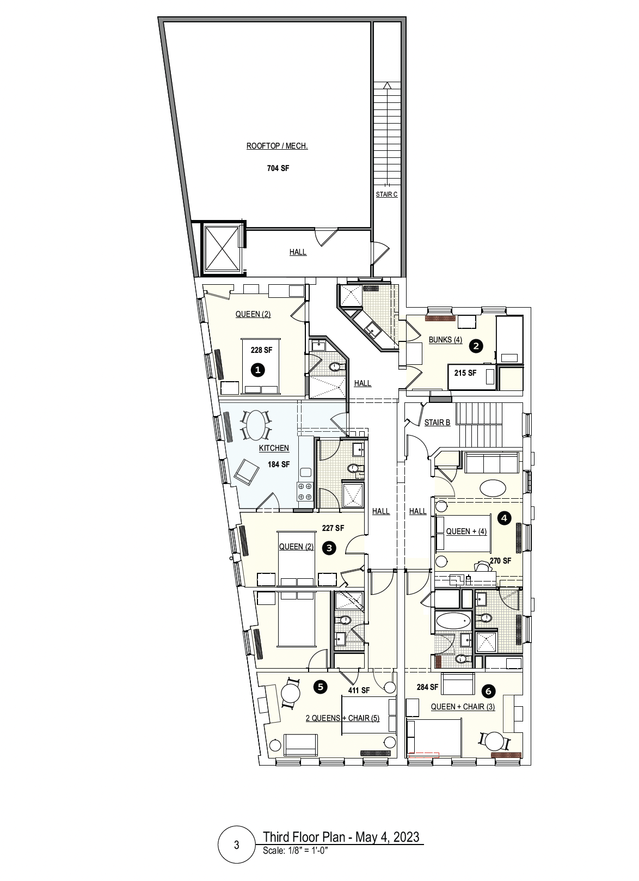

Slide 9
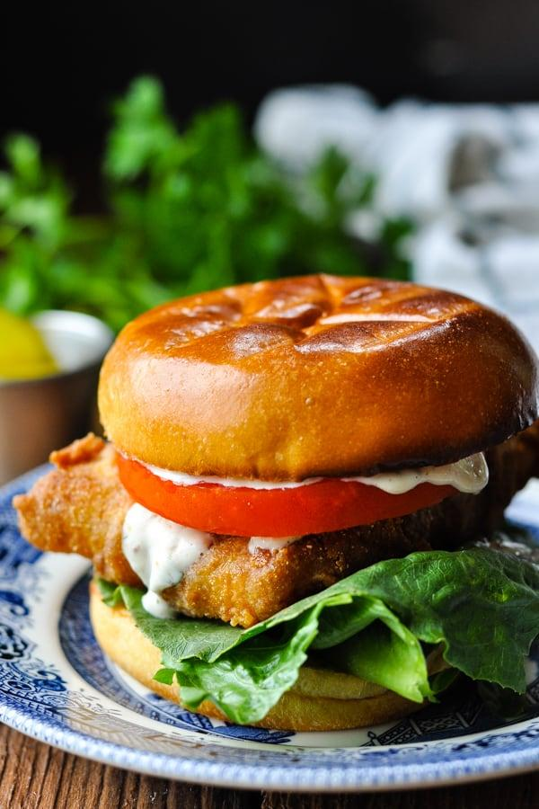
The Food
SANDWICHES
#1 Famous Fish Sandwich Haddock, American cheese, pickles, tartar sauce on a roll
($12/small + no fries) ($13.5/small + fries ) ($16.5/large + fries)
Buffalo Chick’n Schnitzel chickpea cutlet, romaine, banana peppers, red onion, ranch ona potato bun $12 (v)
Smash Burger red onion, American cheese, pickles, special sauce on a potato bun *single/ $10.5 *double/ $12.5 *triple/ $14.5
Potato Burger
hashbrown, red onion, American cheese, pickles, special sauce on a potato bun (v) *single/ $9.5 *double/ $11.5 *triple/ $13.5
*Sandwiches come with a choice of fries, coleslaw or *sub onion rings $3

Slide 10
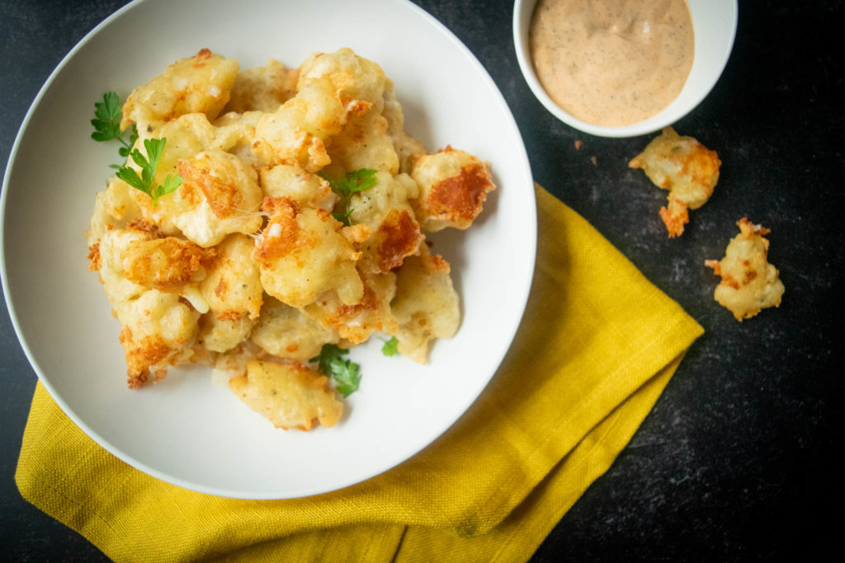
BASKETS
Fried Calamari & Banana Peppers w/ marinara $14.5
Fried Artichoke & Mushroom w/ garlic aioli $13.5 (v)
Fried Pickles & Cheese Curds w/ honey mustard $11 (v)
APPETIZERS
Nachos tortilla chips smothered in beer cheese, banana peppers, sour cream, & black olives $1)
*add avocado $2.5 *add hashbrown $3 *add schnitzel $4 (v, GF)
Lil’ or Big Salad Romaine, HB Egg, Seedless Cukes, Radish, & red onion w/ Ranch or House Vin $11/$14
*Add Bleu Cheese $2 *Add Avocado $2.5 *Add hashbrown $3 *Add Schnitzel $4 (v, GF)

Slide 11
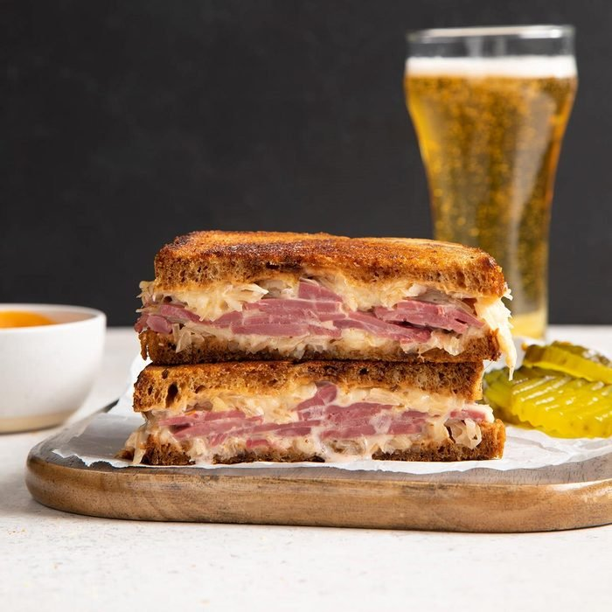
SPECIALS
Wed- BLFP
Bacon, Lettuce, fried pickles, garlic aioli, on griddled Texas toast $12.5
*add avocado $2.5 *add Joddo’s tomato $1.5 (seasonal)
Thurs- House-made Corned beef
house mustard, pickled red onion on rye bread $14.5
Fri- Nied’s Cheese Steak
beer cheese, griddled onions, banana peppers & Nied’s sauce on baguette $14.5
Sat- Fried Shrimp or Pork Belly Chicharrones Basket w/ Nied’s sauce $15
Sun- Hoagie
soppresata, mortadella, coppa, fresh mozz, LTO, & House Vinaigrette on baguette $14.5
*Specials come with a choice of fries, coleslaw, or *sub onion rings $3

Slide 12
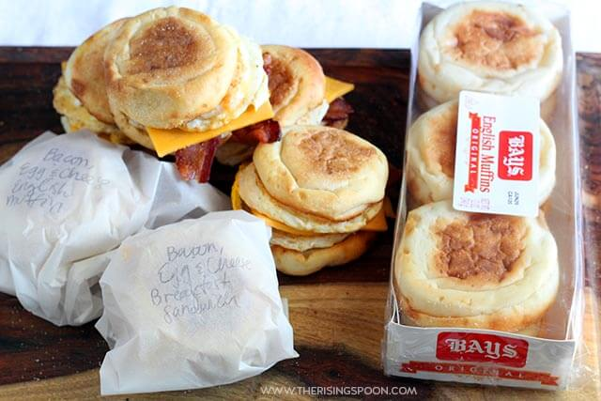
BREAKFAST eggs are bodega-style (folded scrambled), sunny or over
Beignets
3ct. w/ powdered sugar $6 (v)
2 eggs w/ toast $7 (v)
2 eggs w/ hash browns $8.5 (v)
2 eggs w/ bacon or sausage $10.5
2 eggs w/ hash brown, bacon, or sausage & toast $14
Egg Sandwich
House English muffin, bodega egg & American cheese w/ Nied’s sauce $9
(v) *add avocado $2 .5*add bacon $2 *add sausage $3
Breakfast Burrito
big tortilla, bodega egg, cheese, Nied’s sauce $10 (v) *add sour cream
$1 *add avocado $2.5 *add bacon $2 *add sausage $3
Pancakes
maple syrup & butter $9 (v)

Slide 13
Guest Accomodations
To allow for the most accessible lodging options we have developed a plan that includes multiple room options for guests ranging from singles and couples, to families and larger groups. The single family properties located at 5435 and 5437 Dresden Way will be utilized as affordable veteran’s and artist-in-residence housing.

Slide 14
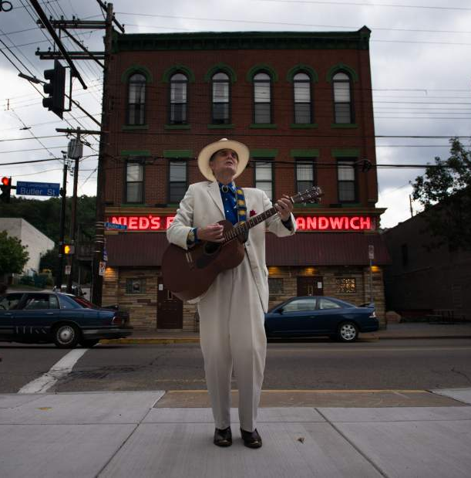
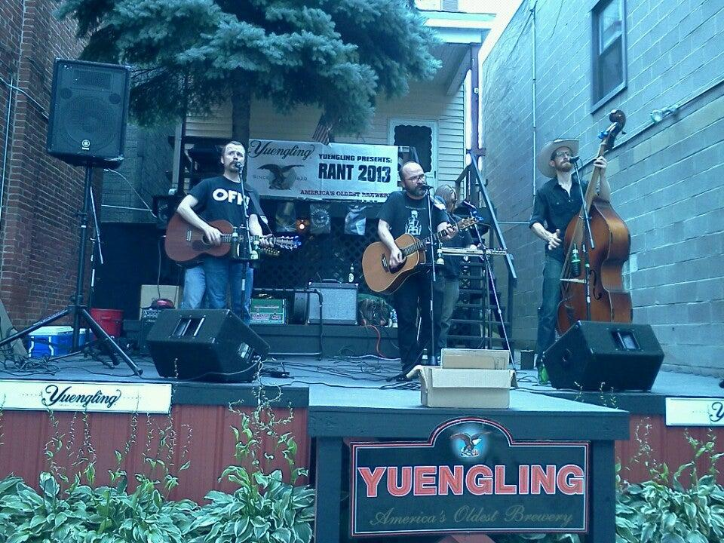
Entertainment

Slide 15
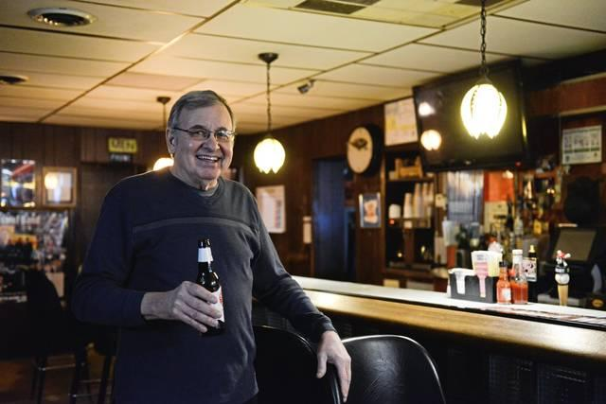
Thanks.

