Slide 1


Lawrenceville Happenings Meeting:
Mobility Enhancement District & possible Residential Permit Parking changes - CLOSE OUT
5/11/2023, 6:30 p.m., Goodwill WDC
Welcome! Please sign in at bit.ly/LUSignIn if joining online
Notes:
dave

Slide 2
Tonight’s agenda
Welcome & introductions
About this process
What we heard
Next steps
Q&A
Welcome! Please sign in at bit.ly/LUSignIn if joining online
Notes:
dave

Slide 3
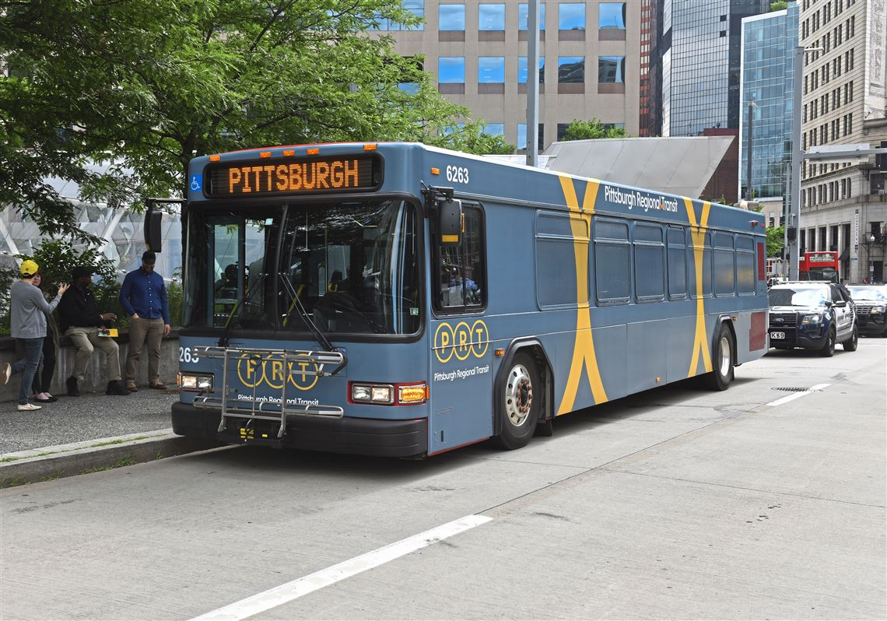

Pittsburgh Regional Transit
In the hallway!
Notes:
dave

Slide 4
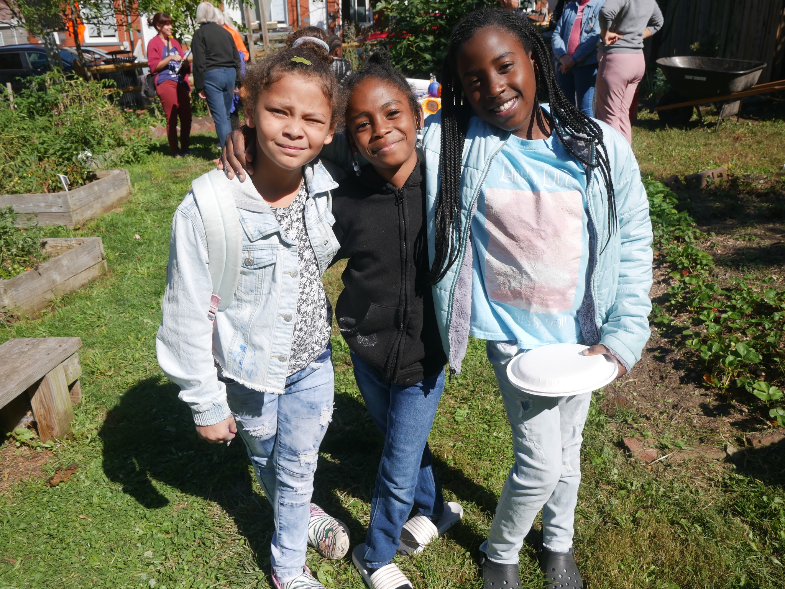
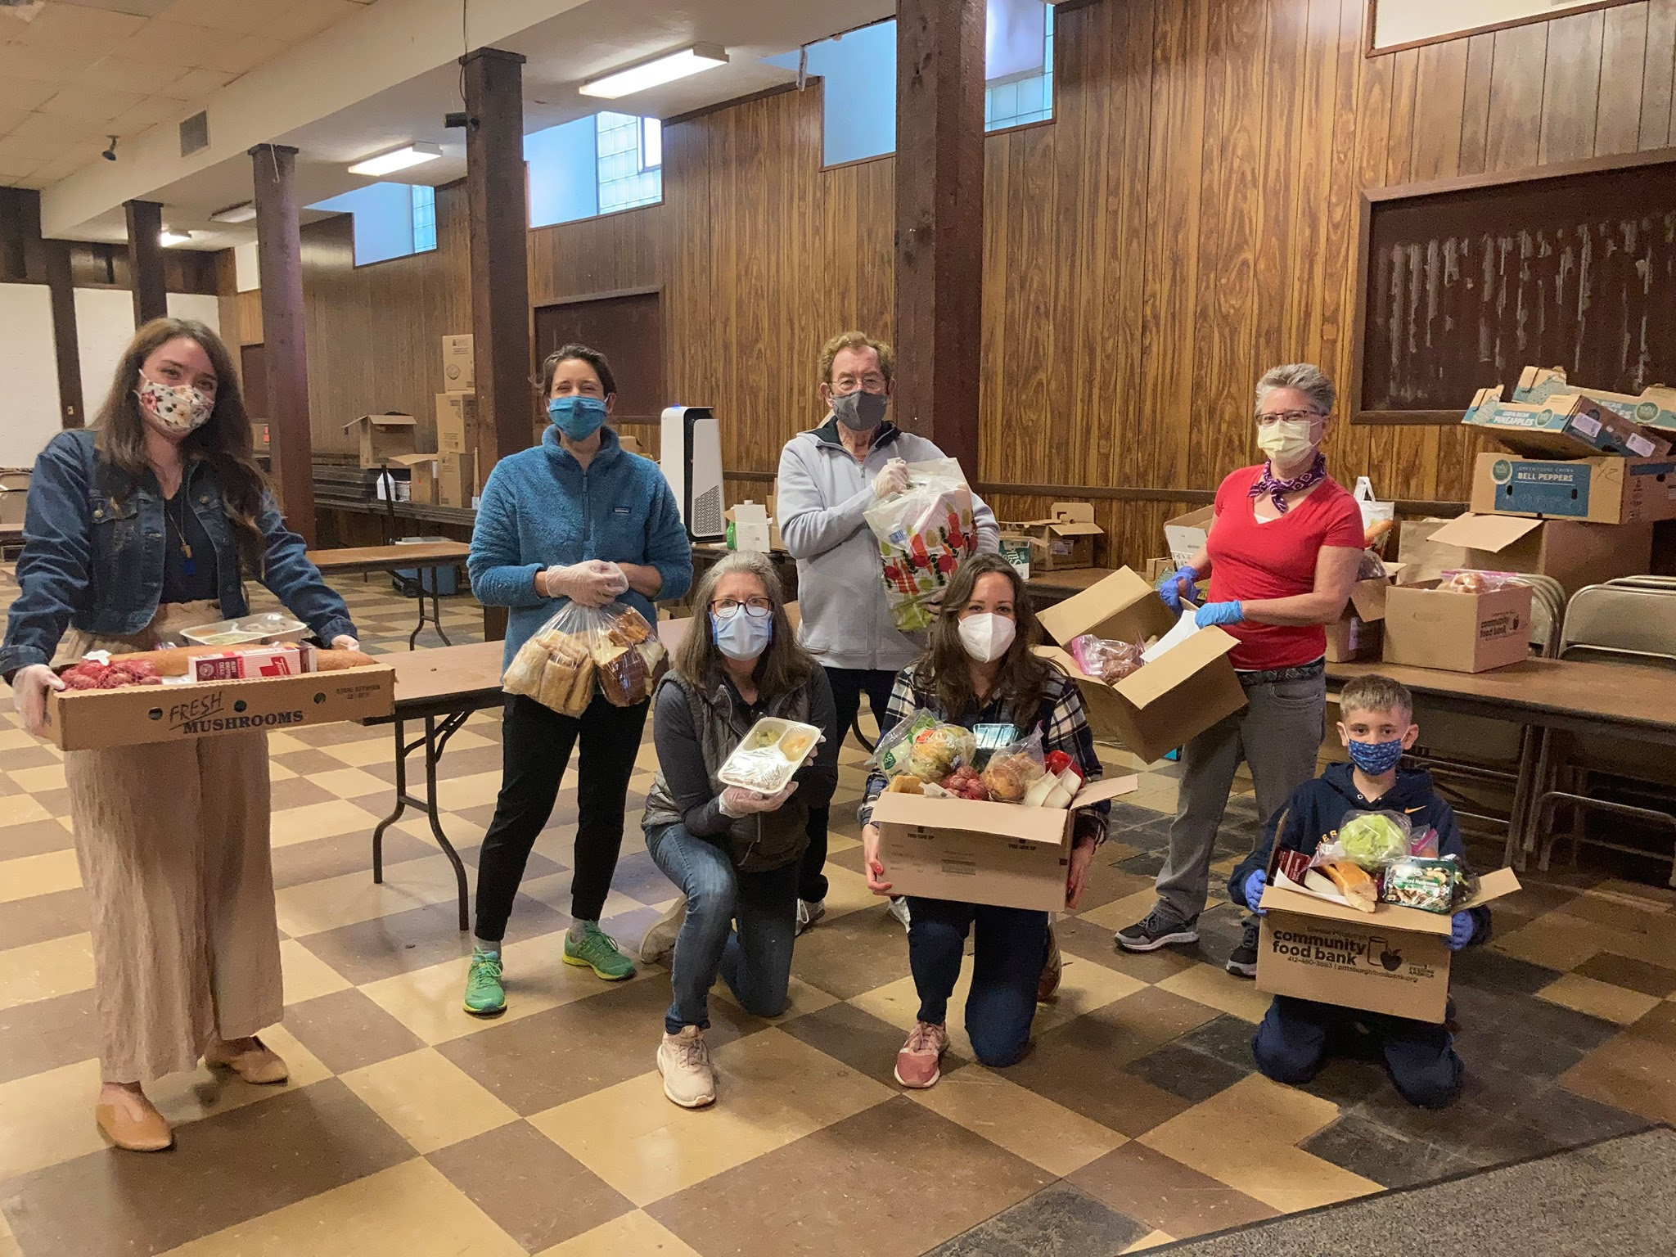
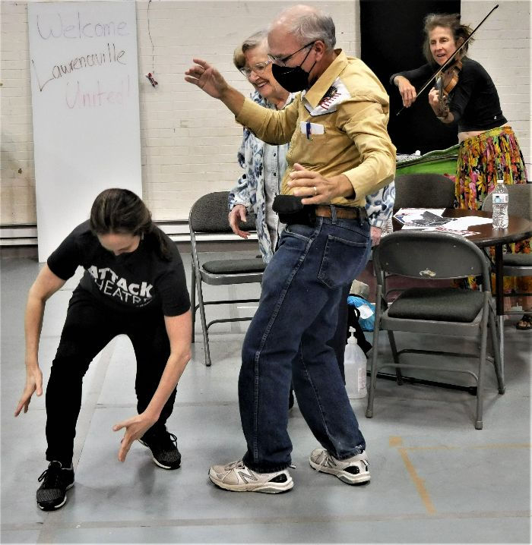
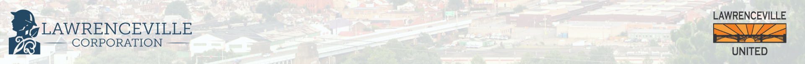
About Lawrenceville United
Mission: to improve and protect quality of life for all Lawrenceville residents
Membership of over 800 residents
Board comprised of all residents: elected by our membership
Programs: Lawrenceville Farmers Market, supporting older adults, free food distributions, cleaning & greening, direct support & case management, advocacy, and more.
Notes:
dave

Slide 5
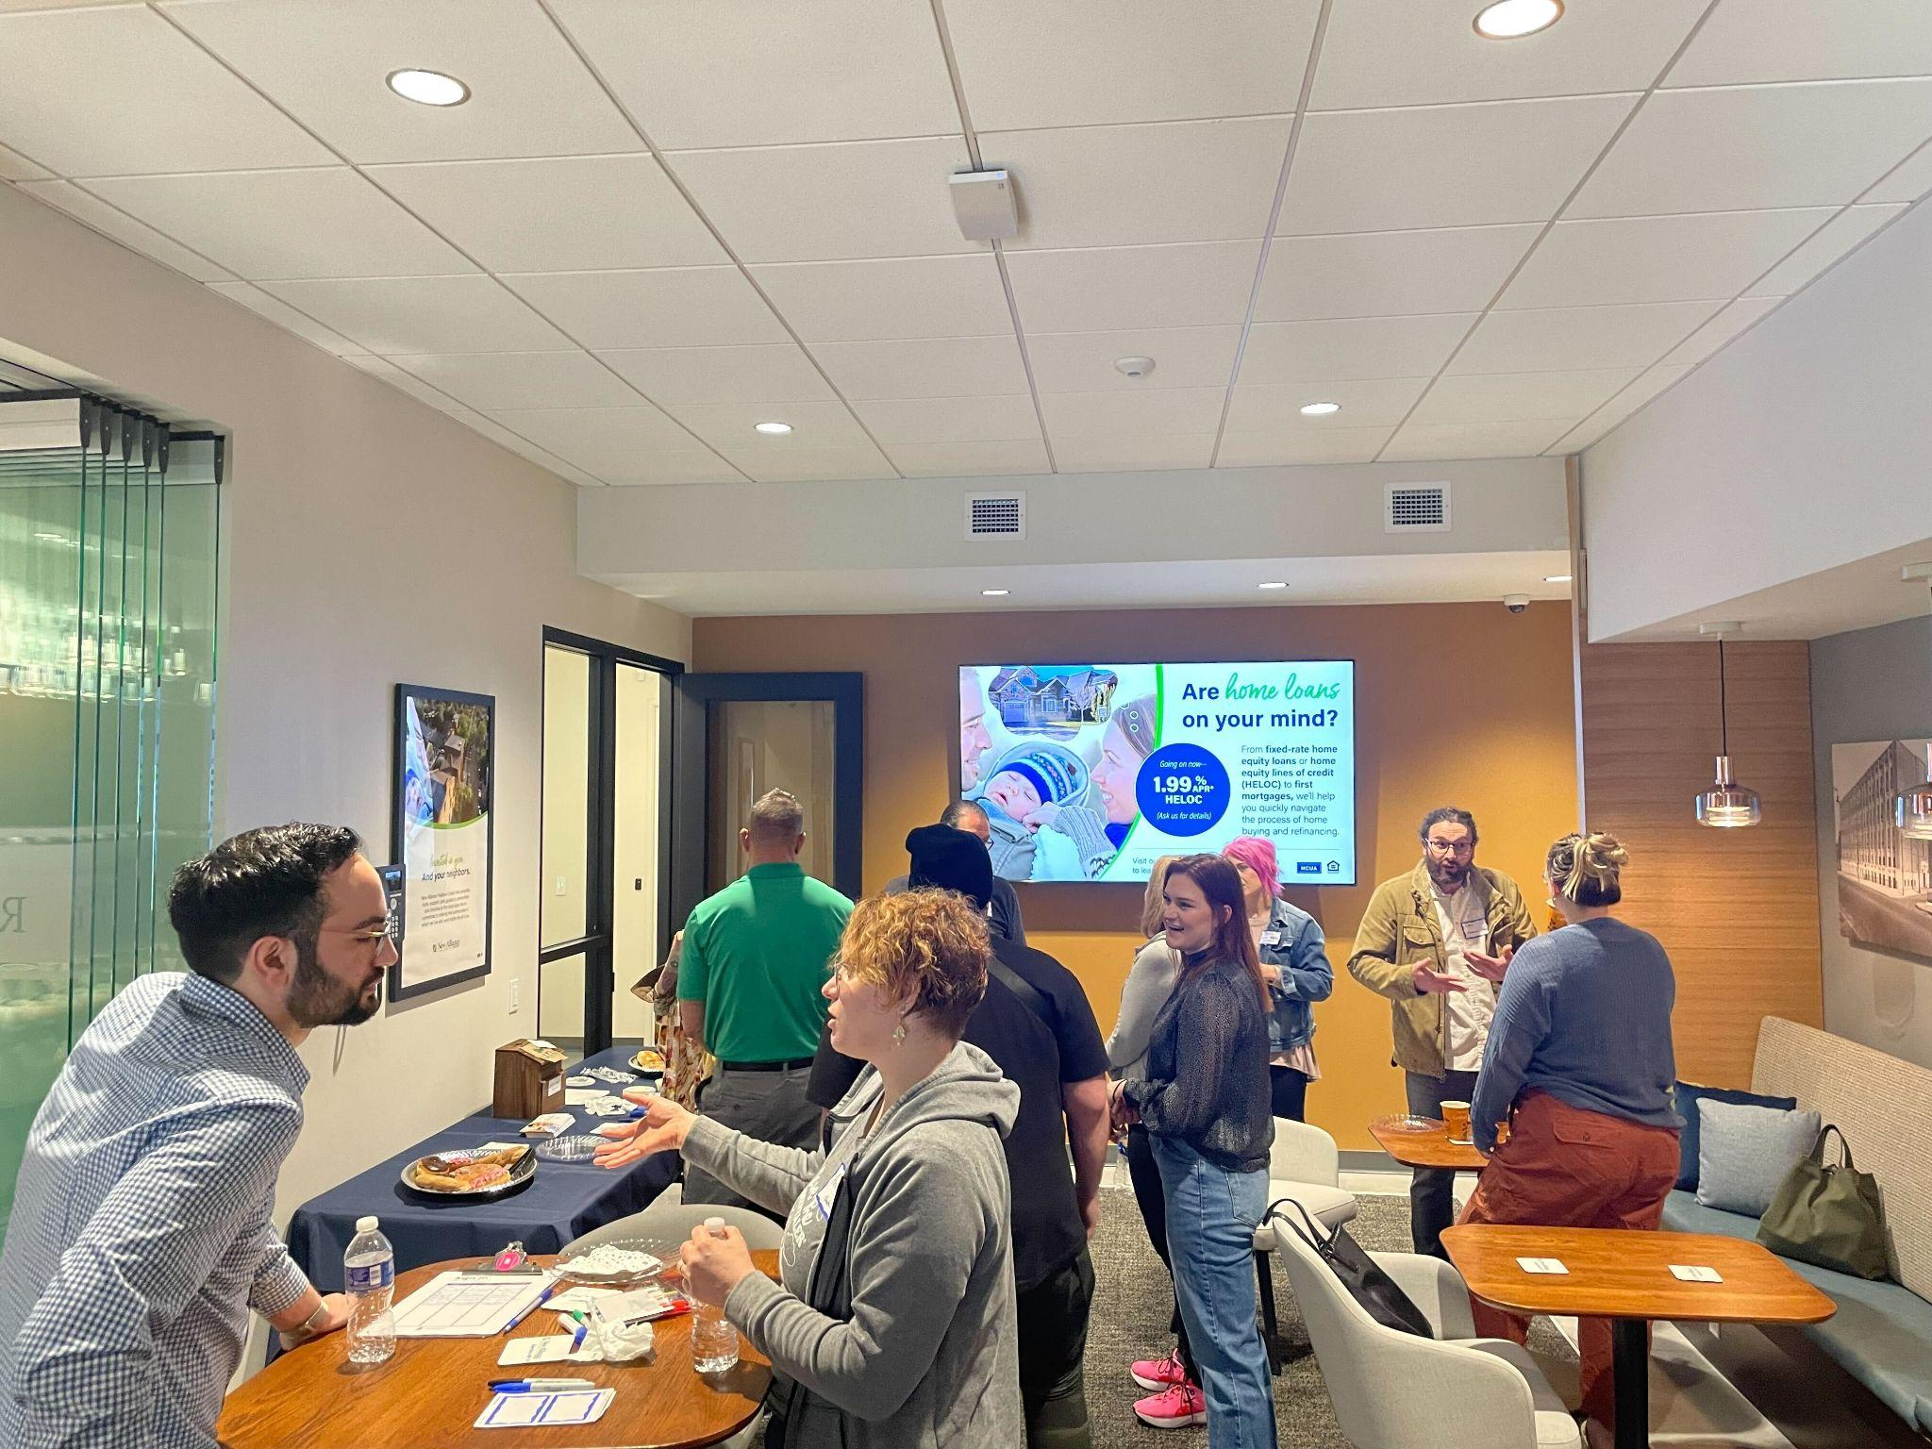

About Lawrenceville Corporation
Mission: Driven by the Lawrenceville community, the Lawrenceville Corporation acts as the catalyst and conduit for responsible and sustainable growth.
Membership: 120, primarily business owners
Board: Mostly comprised of residents, property owners, and business owners and elected by our membership - 16 members
Programs: Business district management, policy and advocacy, community planning and development, real estate development, events, and communications and marketing
Notes:
Sarah

Slide 6
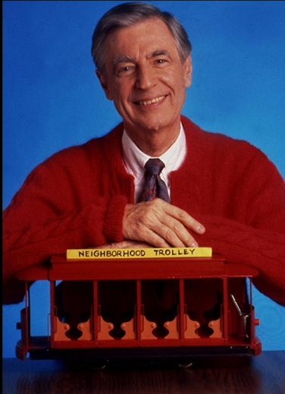
Community Agreements
Be neighborly.
Be respectful of all participants & hosts
Don’t denigrate groups of people
Give space for all to participate
Notes:
sarah

Slide 7
Ground Rules
Hold all questions/comments until the end of the presentation (you can drop in the chat if you’re joining by Facebook Live).
Raise your hand to make a question/comment. Please identify yourself and your relationship to the project.
Be respectful of all speakers.
Limit questions/comments to 2 minutes each, with 1 clarification question/comment.
If time permits, we will call on individuals who’d like to ask or make a second question/comment.
Use the “feedback form” to ask more questions and give us your input
If ground rules are violated, we will ask you to leave. If it continues, we will end the meeting.
Notes:
sarah

Slide 8
Why did we go through this process?
Grassroots organizing: mobility is critical to quality of life and improving foot traffic in business district
Community development: mobility & parking issues are major tension point
Community plans identify specific interventions to improve our public realm & manage parking demand, but progress has been slow
Neighborhood metrics: we deserve better
Notes:
Sarah

Slide 9
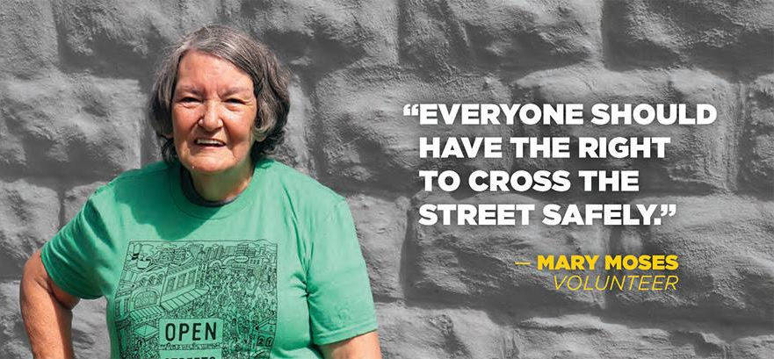
Goals for this process
Create positive, community-determined mobility enhancements to our neighborhood streets to benefit community members and visitors
Improve our public infrastructure
Manage parking demand more effectively
Notes:
SARAH

Slide 10
Key questions to answer
How can we improve mobility in Lawrenceville?
How might a Mobility Enhancement District support these goals?
Should we consider new or amended Residential Permit Parking?
Notes:
SARAH

Slide 11
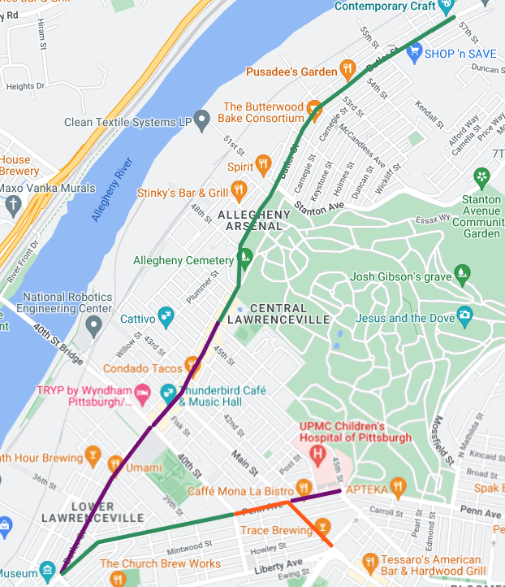
Mobility Enhancement District
Legislation introduced by Councilwoman Gross
  In Committee right now
Would create dedicated, locally controlled source of funds for mobility improvements in Lawrenceville from:
  New meters along commercial corridors of Butler and Penn
  Nighttime enforcement of meters (“dynamic hours”)
  “Dynamic pricing” would allow increased parking rates to respond to high parking demand
Notes:
Sarah

Slide 12
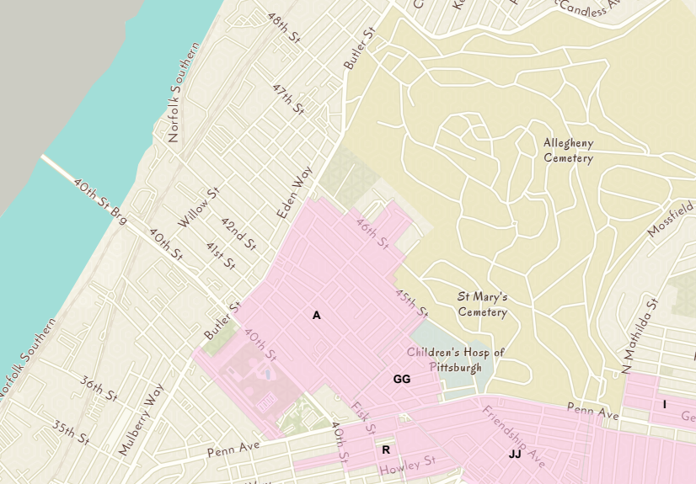
Residential Permit Parking
Questions:
Change hours of enforcement?
Create new RPP areas where there’s high parking demand?
Introduce hybrid RPP areas?
Notes:
Sarah

Slide 13
What is a hybrid RPP area?
For existing or new RPP areas
All the privileges of RPP zone for residents, visitors, and non-residents with permits
The hybrid RPP parking meter rate will not exceed the geographically closest parking meter zone
Parking meters for people not covered by RPP, visitor permit, or non-resident permit
Revenue eligible for collection by Mobility Enhancement District
Notes:
Sarah

Slide 14
PROCESS over the past month
4/13: Kick-off meeting, feedback form opened
4/18: Open House #1 @ Trace Brewery
4/29: Open House #2 @ Ice House Studios
5/1: Open House #3 @ Boys & Girls Club
5/4: Feedback form closed
TONIGHT: Thurs 5/11, 6:30 - 8 pm - close out
Notes:
Sarah

Slide 15
Landing page at bit.ly/LVmobility2023
Recap from kickoff
Descriptions and graphics
FAQ page
Link to MED legislation
Survey data
Notes:
Sarah

Slide 16
OUTREACH about this process
Bulletin article: every property in Lawrenceville
Door-to-door flyering of Butler/Penn and key community institutions
Mailings and robodials to 300 older adults
Church bulletins
Mailchimp, SalesForce databases for LU & LC
Facebook, Instagram, Twitter, NextDoor
Asked partners to share
Notes:
Sarah

Slide 17
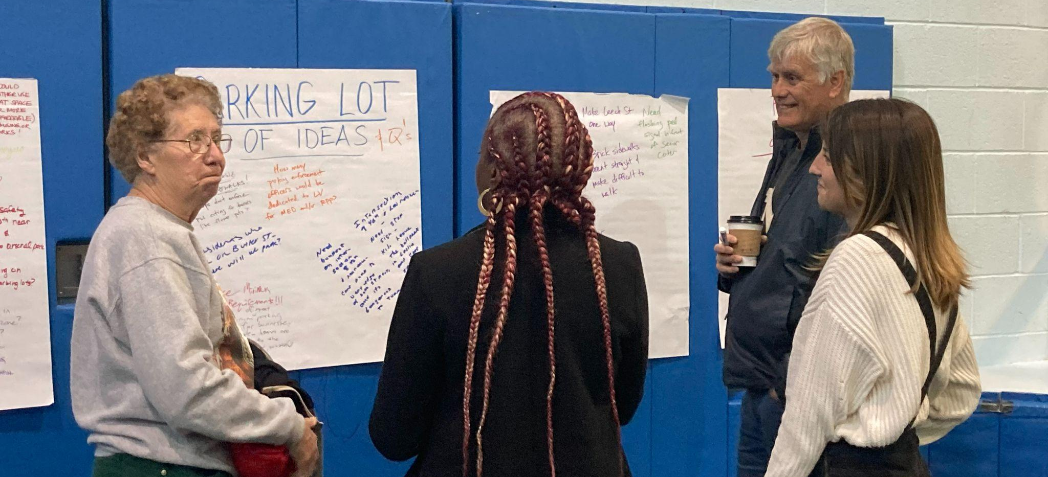
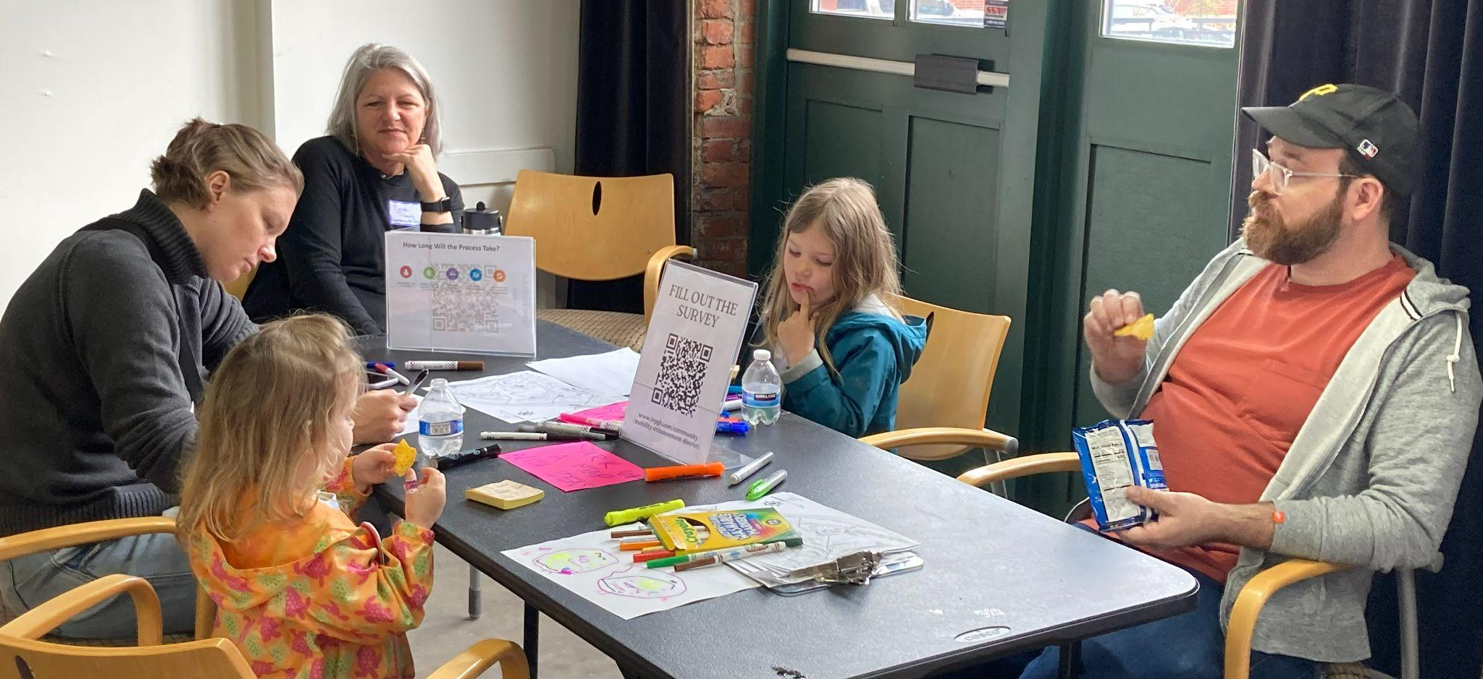
ENGAGEMENT by the numbers:
Attendance: 110+
Survey Responses: 189
Social Media: 17,500
E-comms: 7,400
Phone calls & conversations: ALOT
Notes:
Sarah

Slide 18
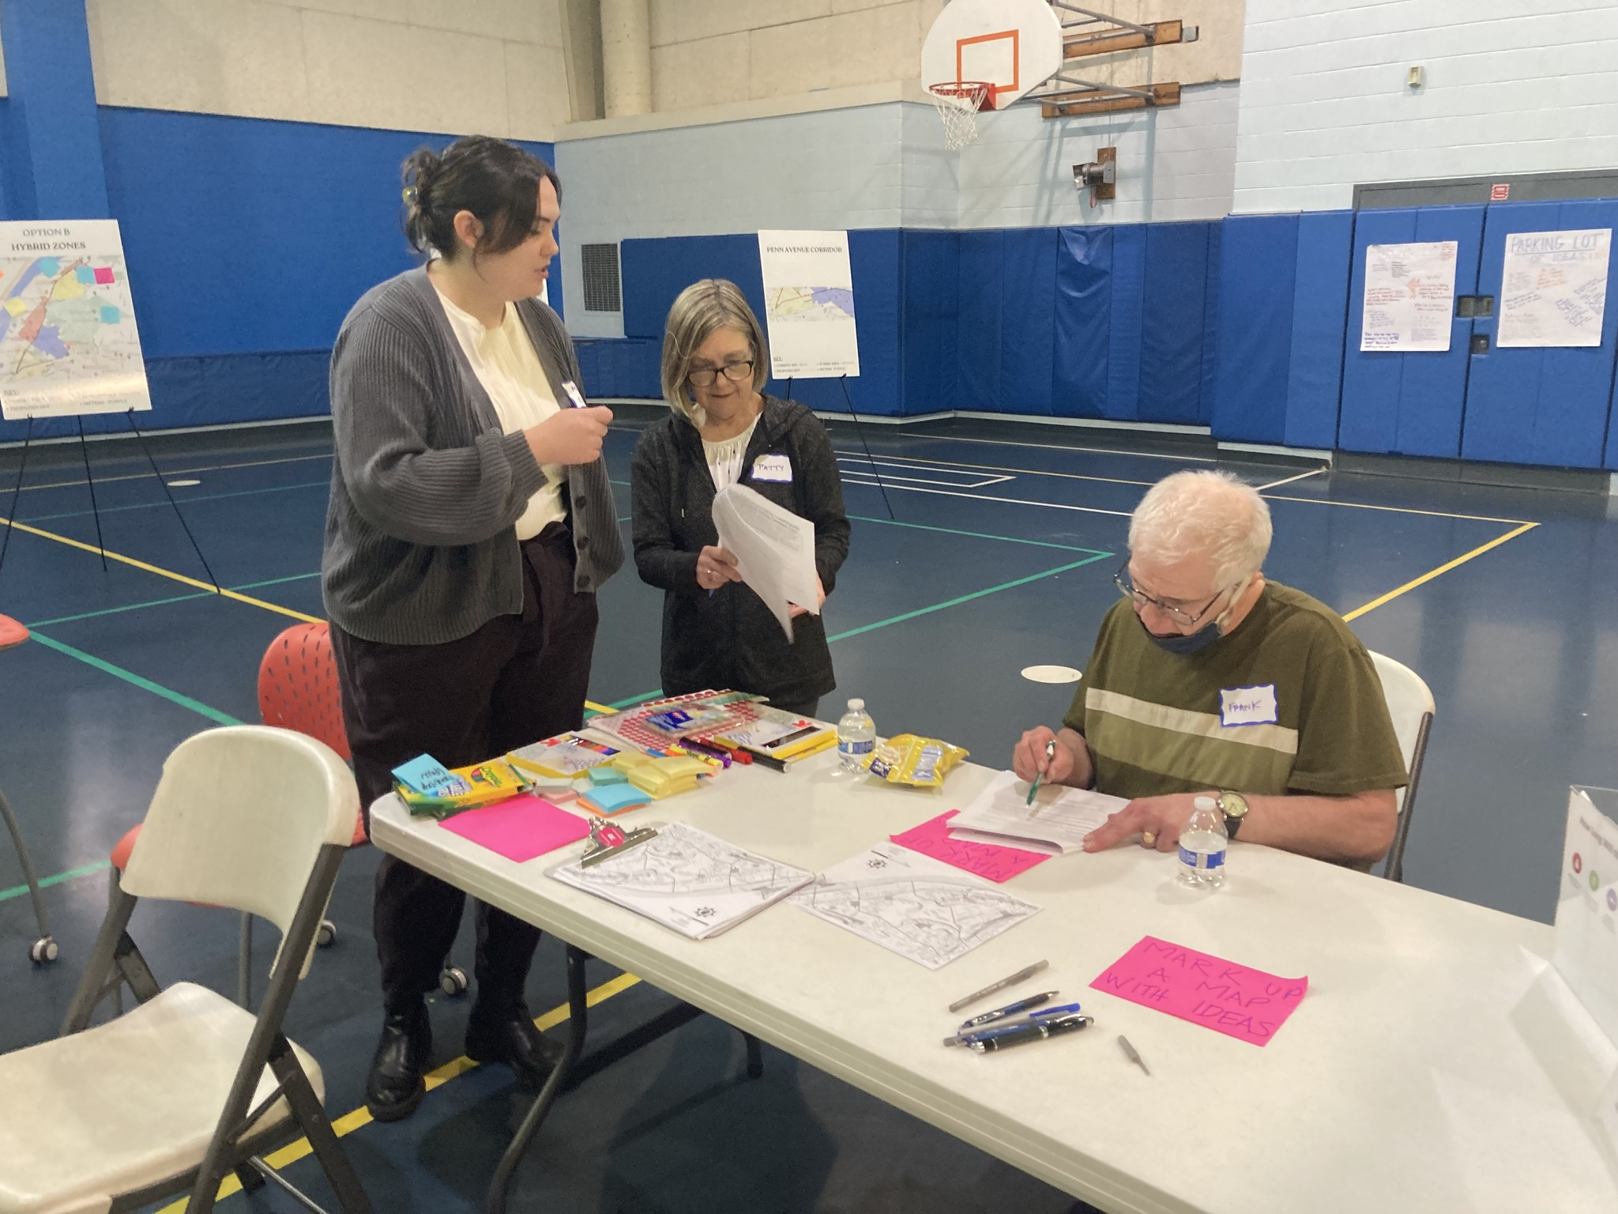
WHAT WE HEARD
Notes:
Sarah to passoff to dave

Slide 19
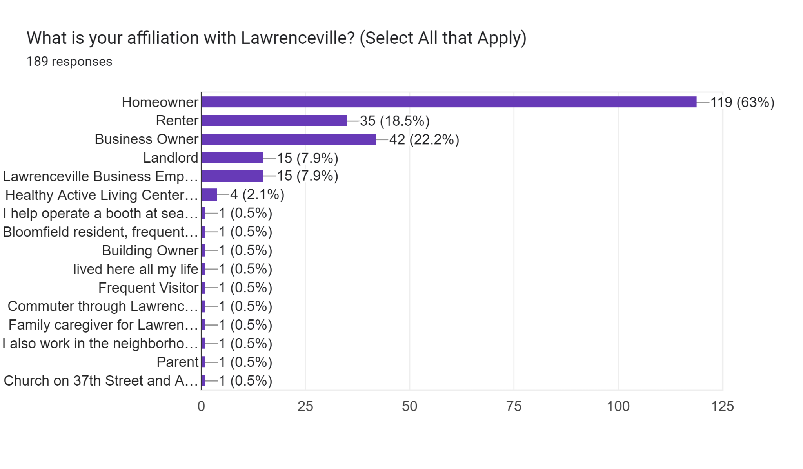
Who completed the survey?
Notes:
Dave

Slide 20
Who completed the survey?
Lower Lawrenceville - 49
Central Lawrenceville - 87
Upper Lawrenceville - 46
Bloomfield - 3
Unknown - 1
Notes:
dave

Slide 21
What challenges to mobility do you currently face in Lawrenceville?
“The intersections at 47th & Butler and 40th & Butler feel unsafe when I am walking.”
“Lack of enforcement of existing laws/ordinances.”
“Parking is often difficult near our home, especially evenings.”
“Sidewalks are broken. Drivers park on them and block them. Not enough bike lanes. Waiting for the 91 in the snow sucks.”
“There’s no parking for business customers because cars remain parked on Butler all day ”
“more crosswalks / more visible crosswalks would be great”
Notes:
dave

Slide 22
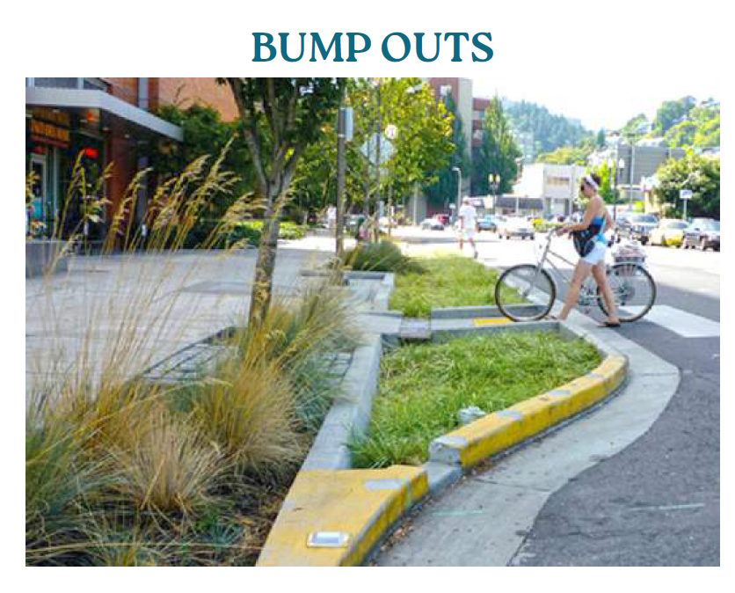
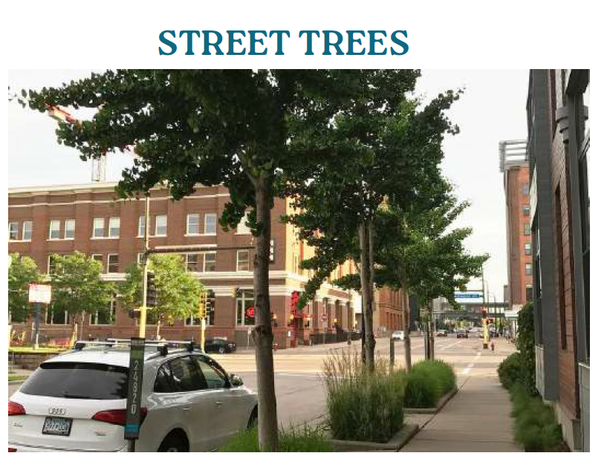
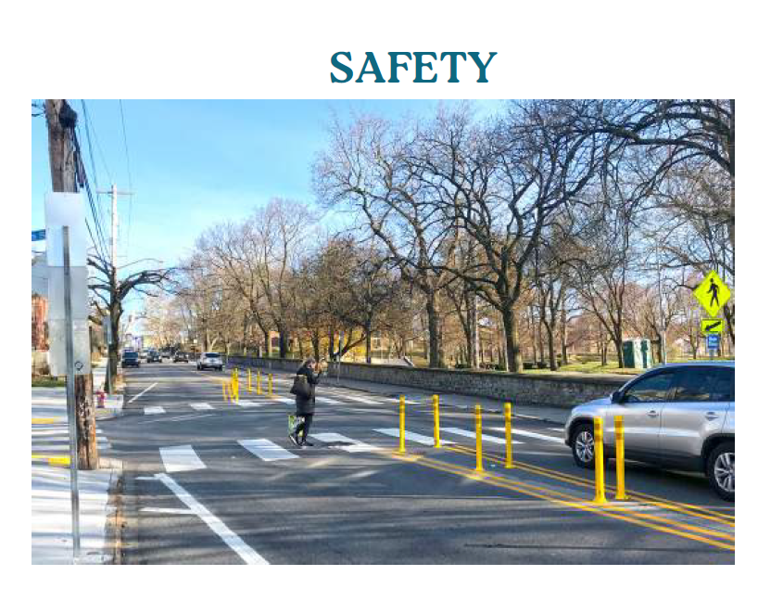
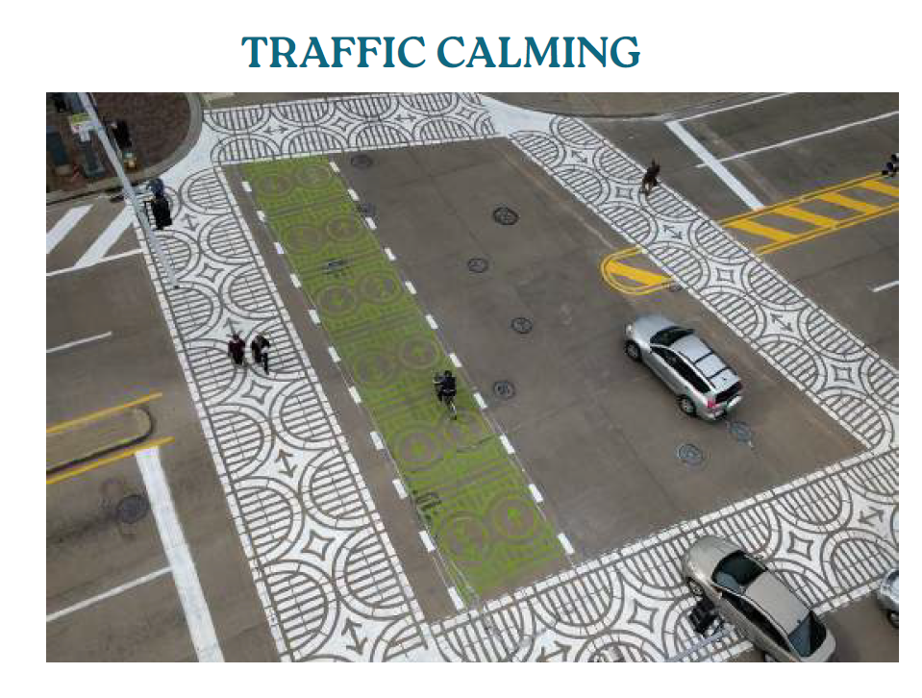
How would you like to see MED funds used?
Notes:
dave

Slide 23
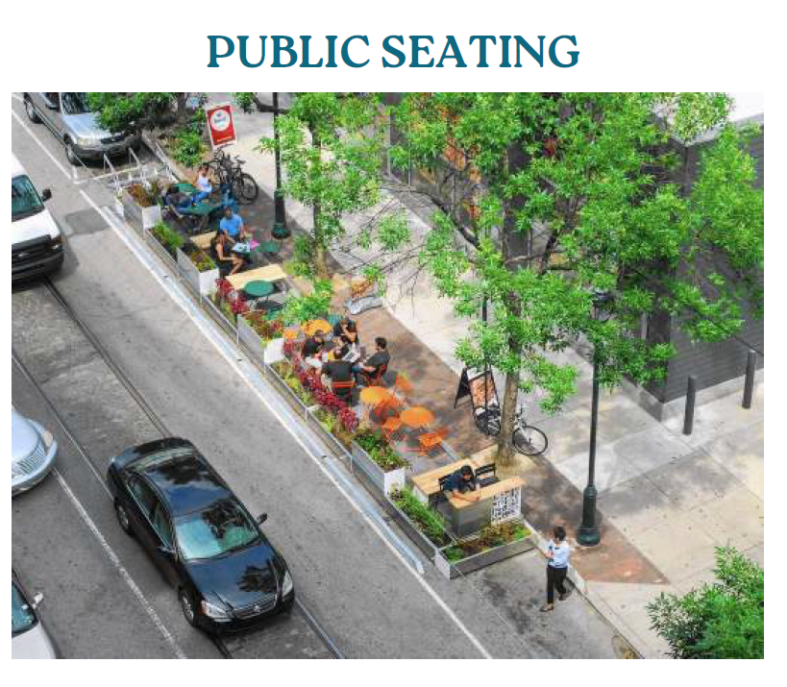
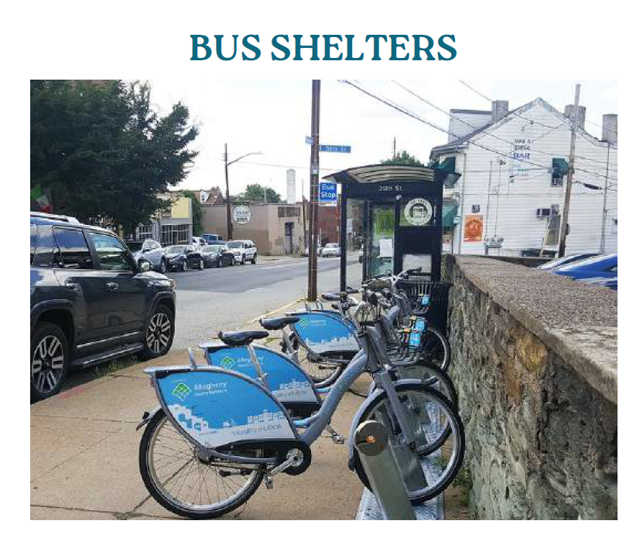
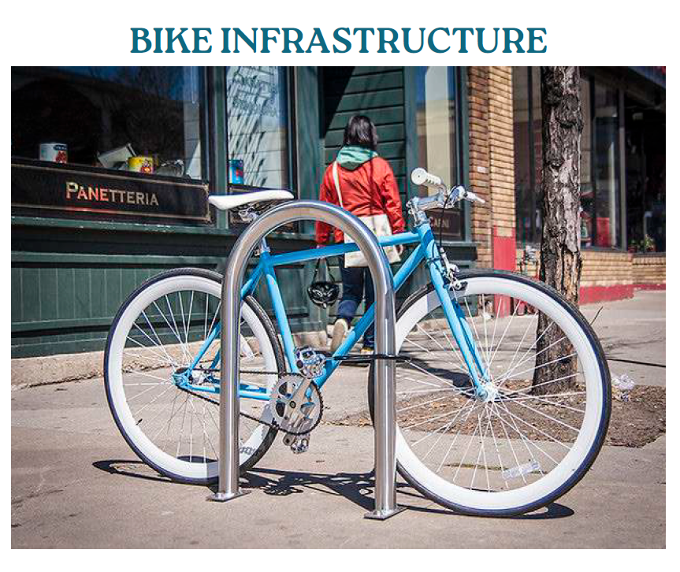
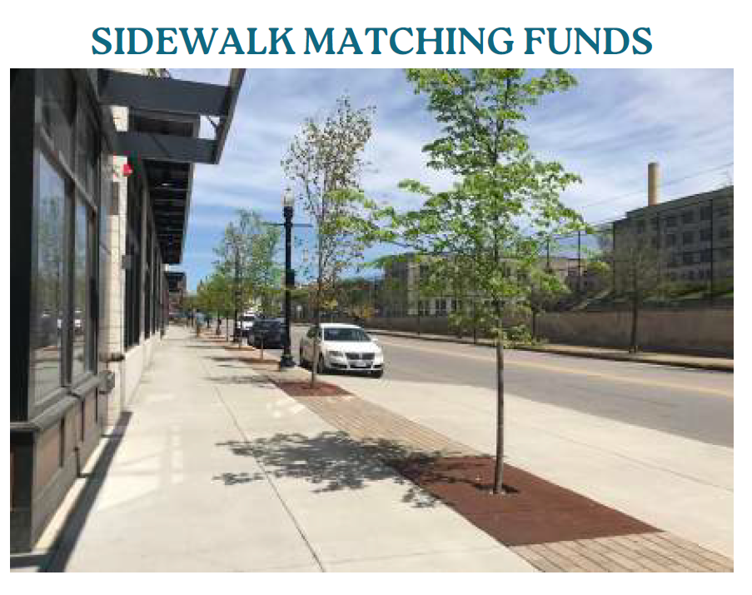
How would you like to see MED funds used?
Notes:
dave

Slide 24
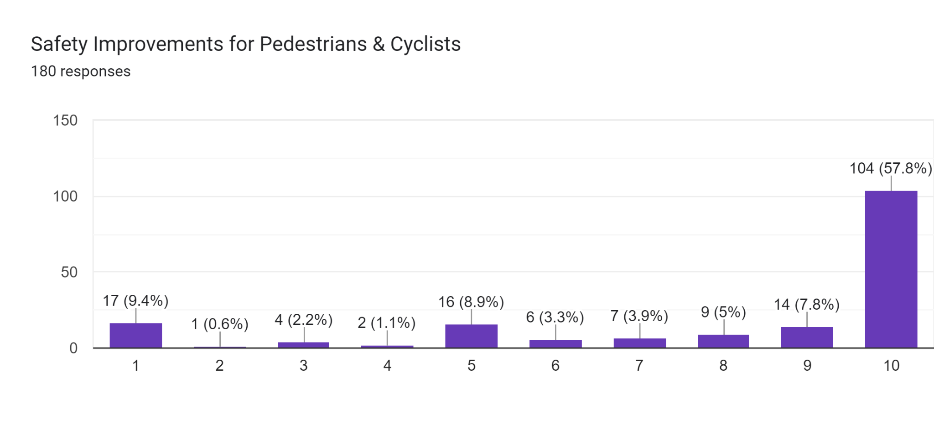
How would you like to see MED funds used?
Notes:
dave

Slide 25
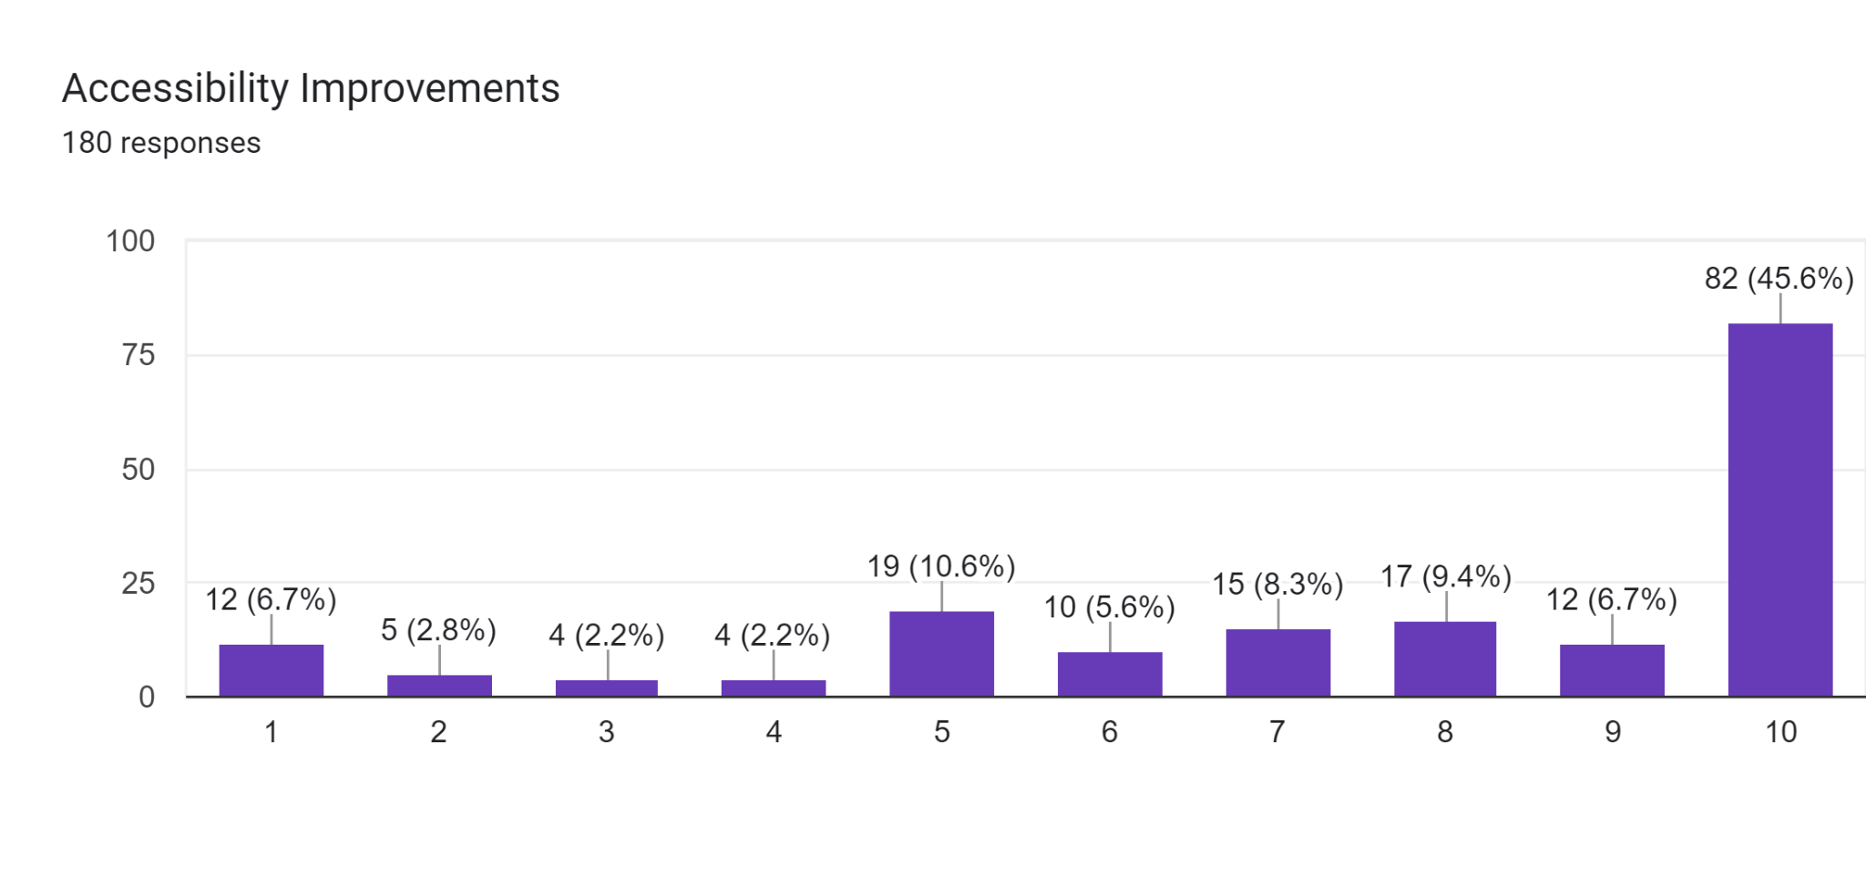
How would you like to see MED funds used?
Notes:
dave

Slide 26
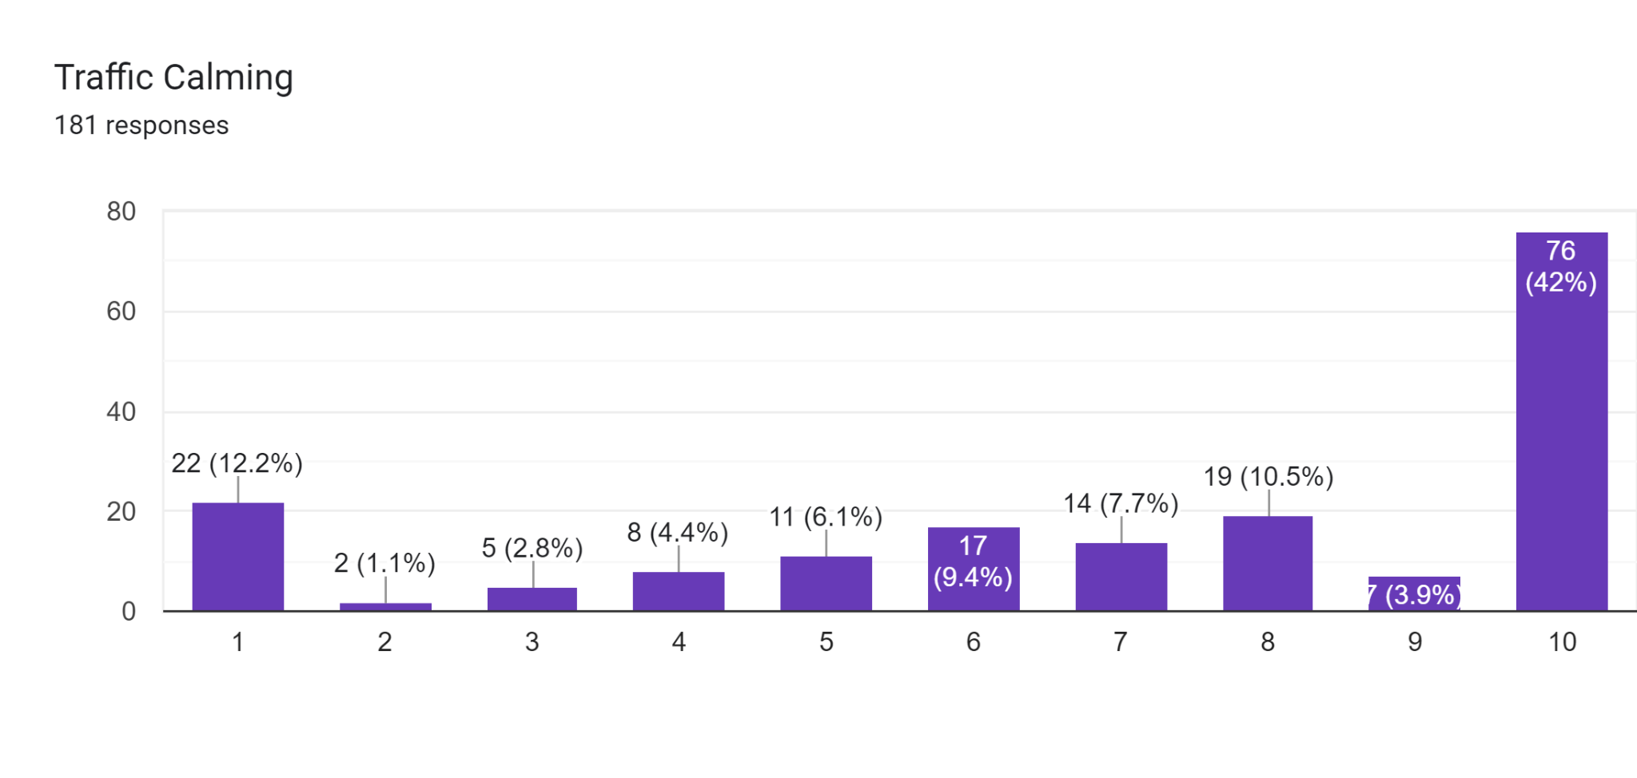
How would you like to see MED funds used?

Slide 27
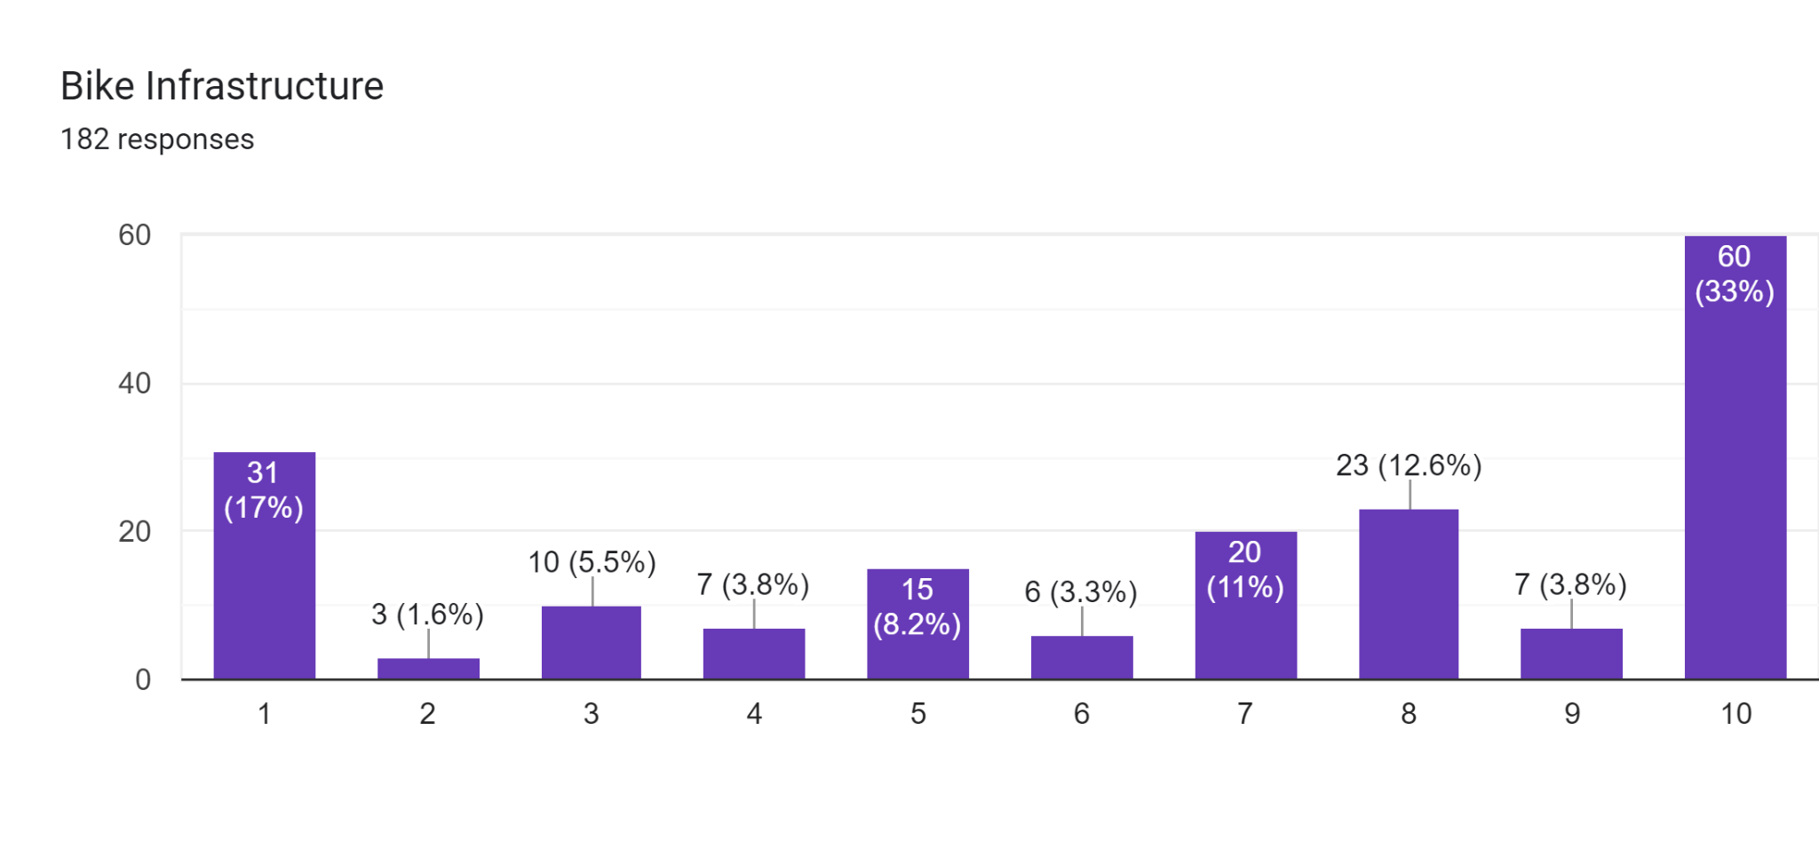
How would you like to see MED funds used?

Slide 28
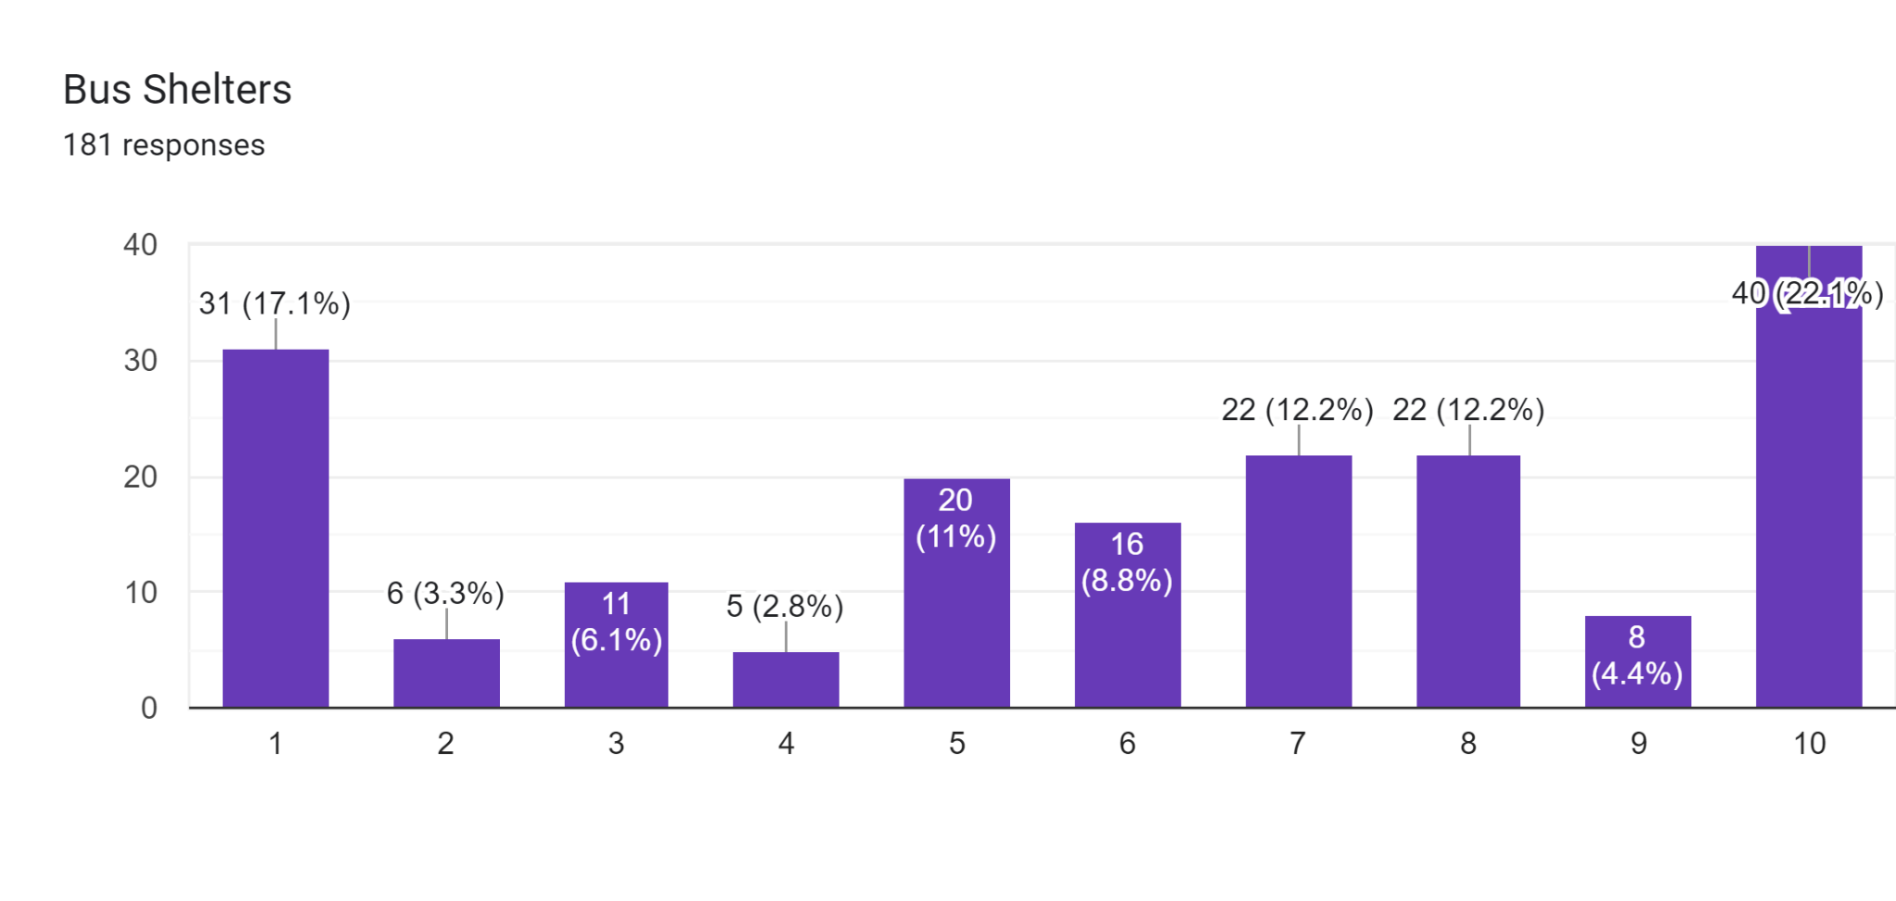
How would you like to see MED funds used?

Slide 29
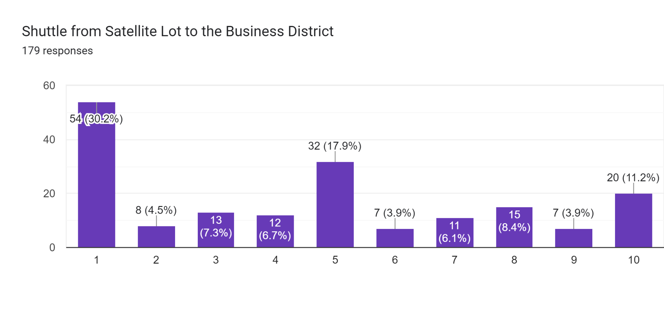
How would you like to see MED funds used?

Slide 30
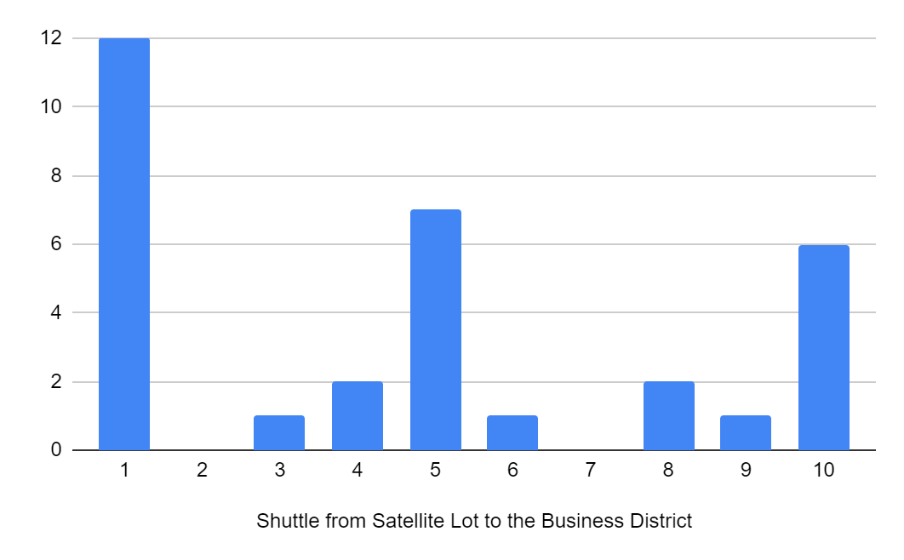
Shuttle interest among business owners

Slide 31
Other priorities you have for uses of these funds
“Seating, lighting, and street trees.”
“Cleaning business district, beautification.”
“Adding parking”
“Speed bumps”
“There should, in no way, be money used for car based infrastructure. It should be turned into less of a highway, more of a neighborhood ”
“I would love to see Green Blvd receive some funding. Basically anything that offers an alternative to driving.”
Enforcement:
Crossing guard
Ticketing/fines for illegal parking
Traffic cameras

Slide 32
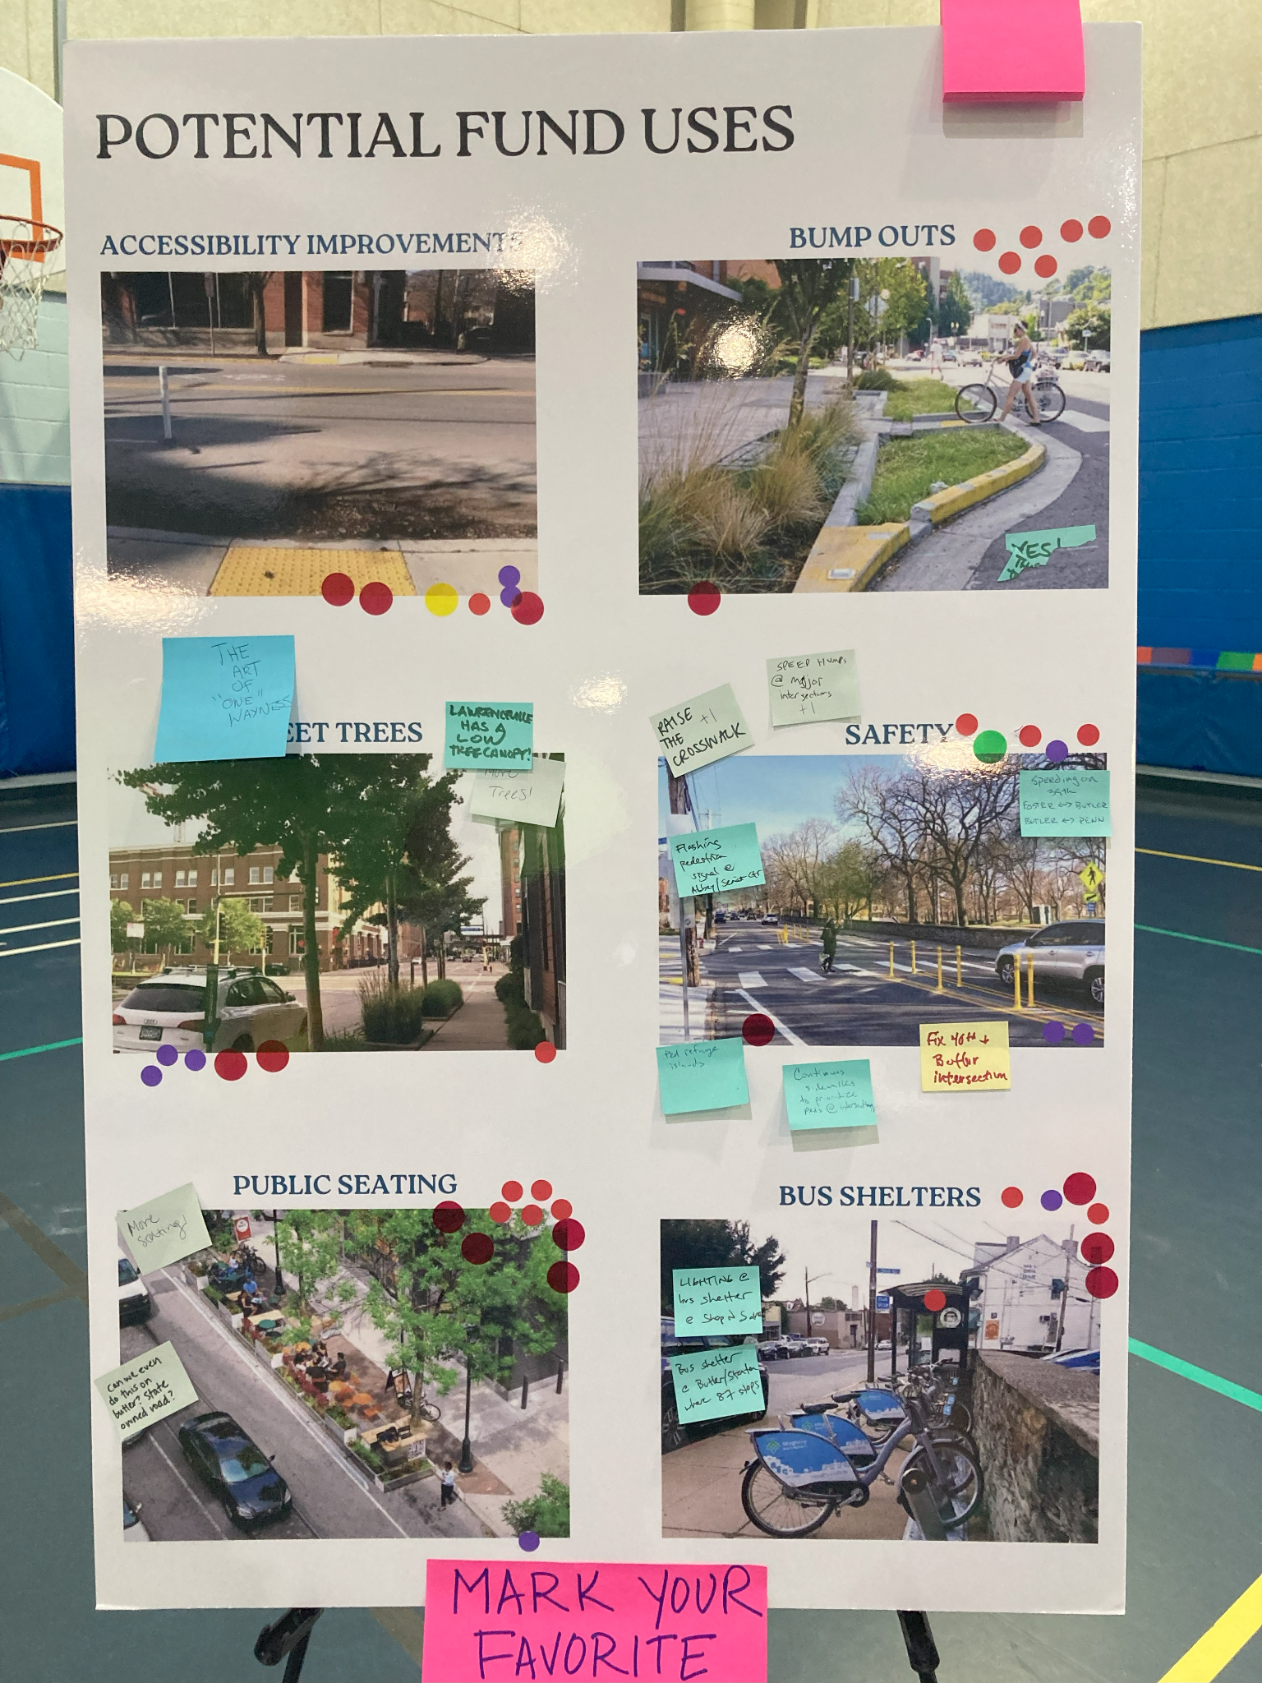
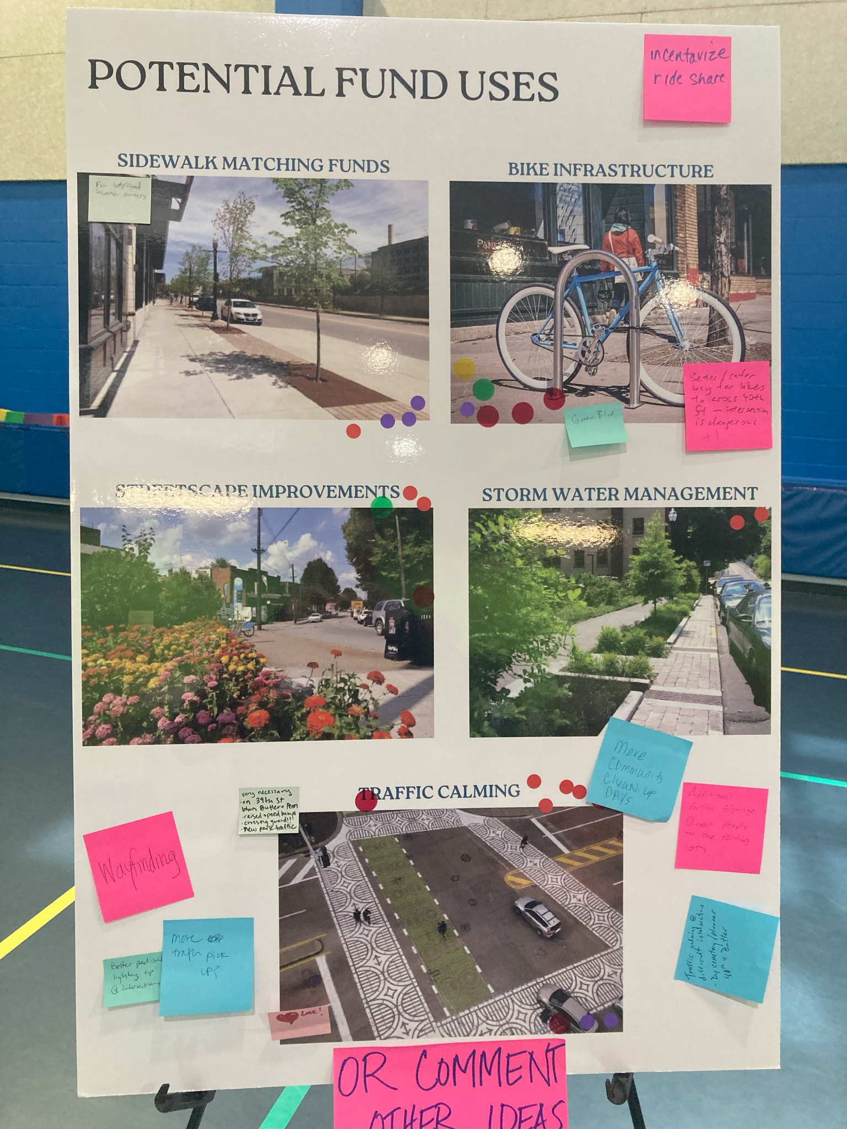
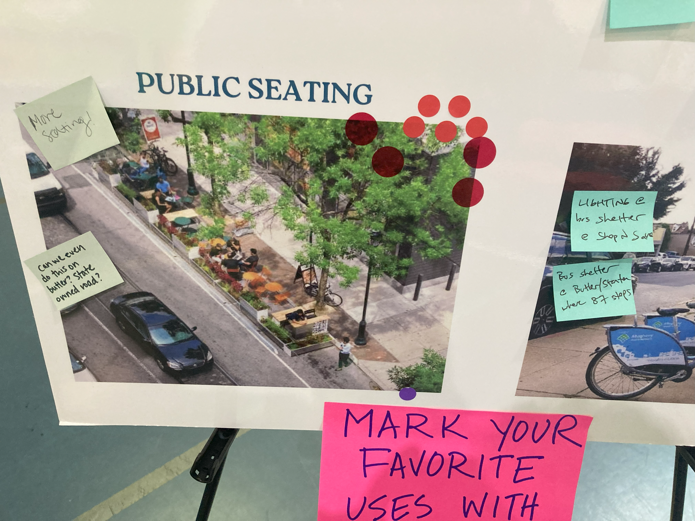
Other priorities you have for uses of these funds

Slide 33
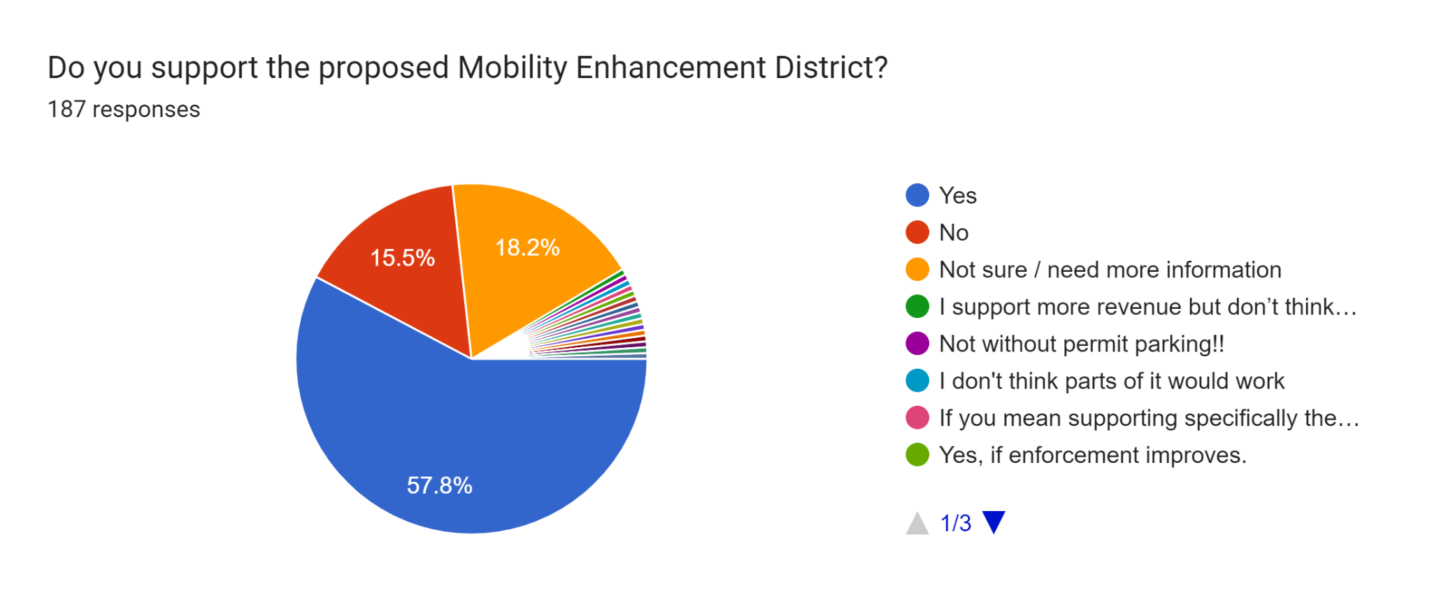

Slide 34
MED responses - among RESIDENTS
64.5% support
11.2% oppose
15.8% not sure

Slide 35
MED responses - among BUSINESSES
36.6% support
34.1% oppose
19.5% not sure

Slide 36
MED responses - among WORKERS
37.5% support
18.8% oppose
37.5% not sure

Slide 37
“I like that these plans intend to fund adding accessibility and safety provisions throughout the neighborhood.”
“My concern mostly lies with adding resident only parking throughout central Lawrenceville on the river side of Butler St.”
“We have to consider both residents’ AND businesses’ needs. You won’t have a bustling neighborhood without both.”
“The demand for more parking in evenings and weekends is very exciting! Parking demand reflects the energy and excellence of both new and long-standing businesses, bars, and restaurants in Lawrenceville!”
“I like that metered parking would include all of Butler Street”
“Please consider how much the parking meters and stricter parking rules will affect Upper Lawrenceville. “

Slide 38
What we heard
Worried that meters will hurt foot traffic to businesses, but also many businesses want meters to increase available nearby parking
Anxiety about how new policy will affect district’s momentum
  Upper Lawrenceville, Penn/Main corridors
Where will my employees park?
Hour maximum is important - we want to make it possible for people to spend a day in Lawrenceville
Want to know who the decision-maker is on use of funds and have a transparent process for how funds are spent
Why do we need this? Capital budget should provide these improvements

Slide 39
What we heard
Change is hard: let’s not move too fast - monitor & collect data
Enforcement matters

Slide 40
Residential Permit Parking
Key questions
Is there demand for new RPP areas?
Is there demand for nighttime hours of enforcement?
Is there demand for hybrid RPP areas?

Slide 41
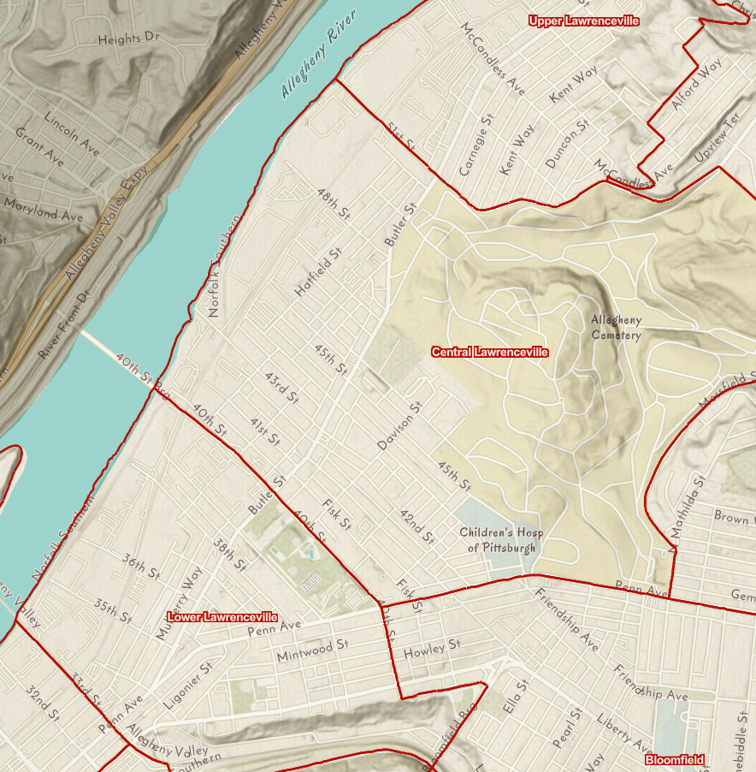

Slide 42
Creating new RPP areas: ELIGIBILITY
Eligibility requirements -- one of the following:
Identification in neighborhood plan that’s been adopted by City Planning Commission
70% of households within the area petition to have RPP
Letter of request from Council Member
Parking Permit Officer’s own discretion

Slide 43
Amending existing RPP: ELIGIBILITY
Eligibility requirements -- one of the following:
Identification in neighborhood plan that’s been adopted by City Planning Commission
Petition from majority of households within the area
Parking Permit Officer’s own discretion

Slide 44
Process for adding or modifying RPP
9-12 month process:
Parking study (or updated parking study)
Recommendation from DOMI
Planning Commission hearing and recommendation
Resolution by City Council

Slide 45
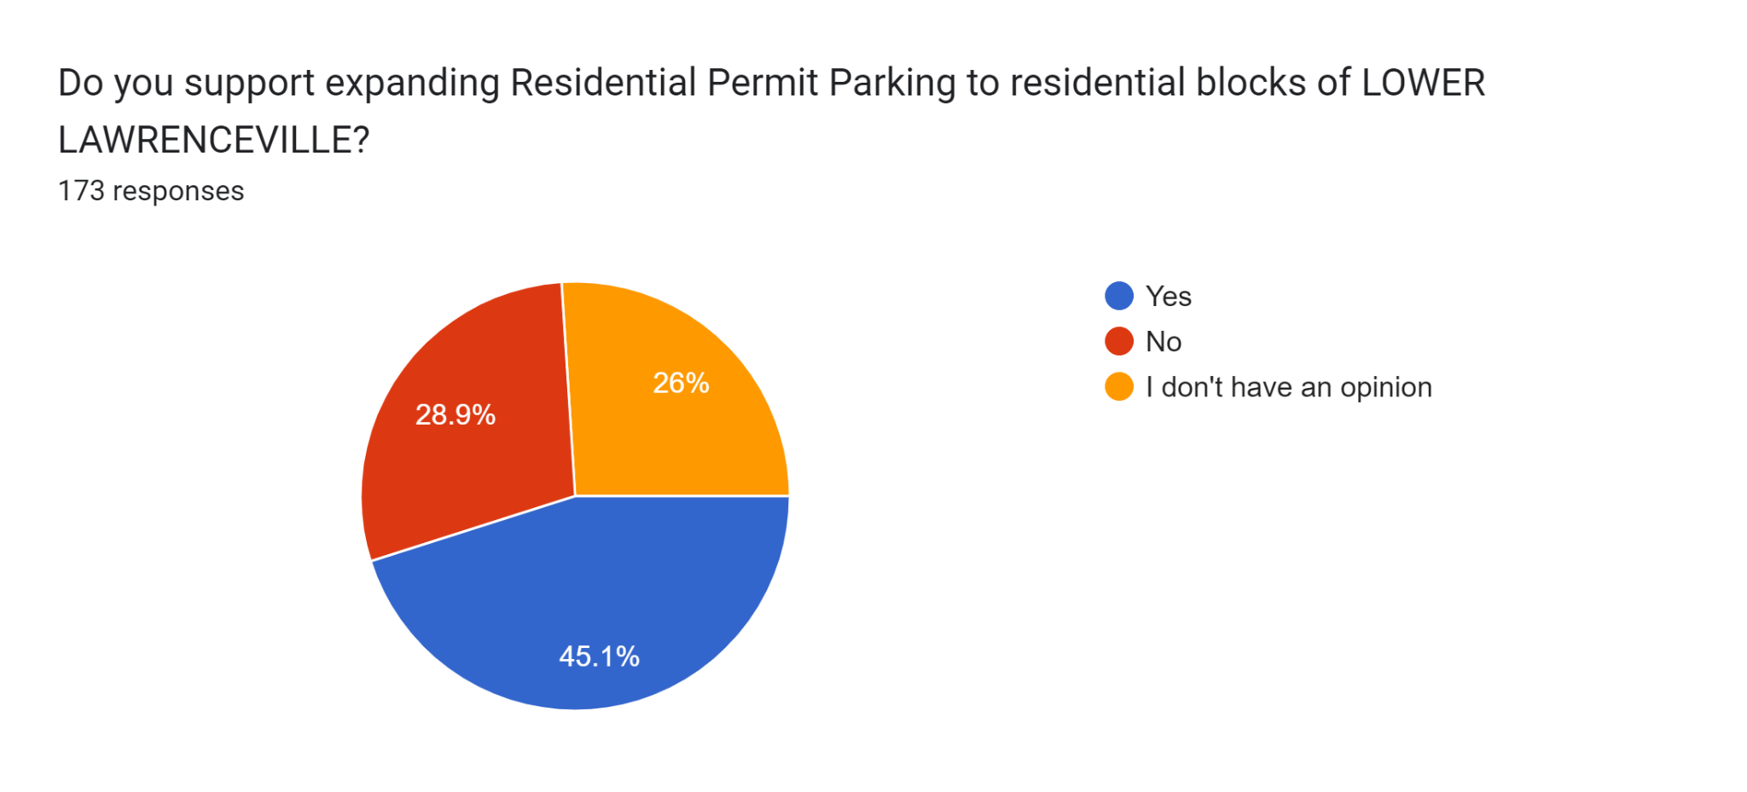
Lower Lawrenceville

Slide 46
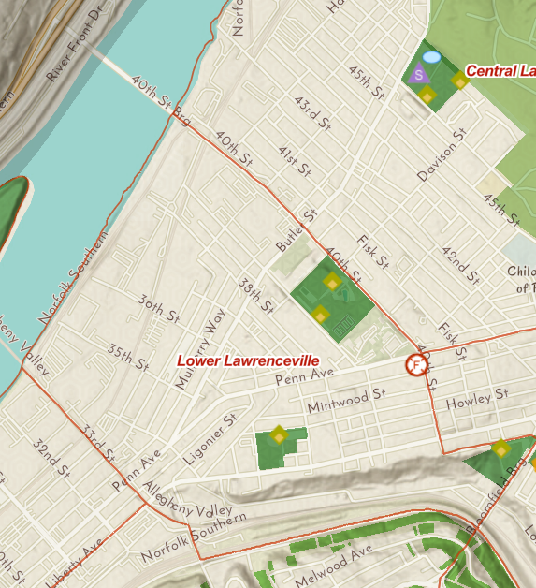
Lower Lawrenceville - RESIDENTS
RPP
53.7% support vs. 41.5% oppose
Nighttime
63.6% support vs. 30.3% oppose
Hybrid
41.5% support vs. 43.9% oppose

Slide 47
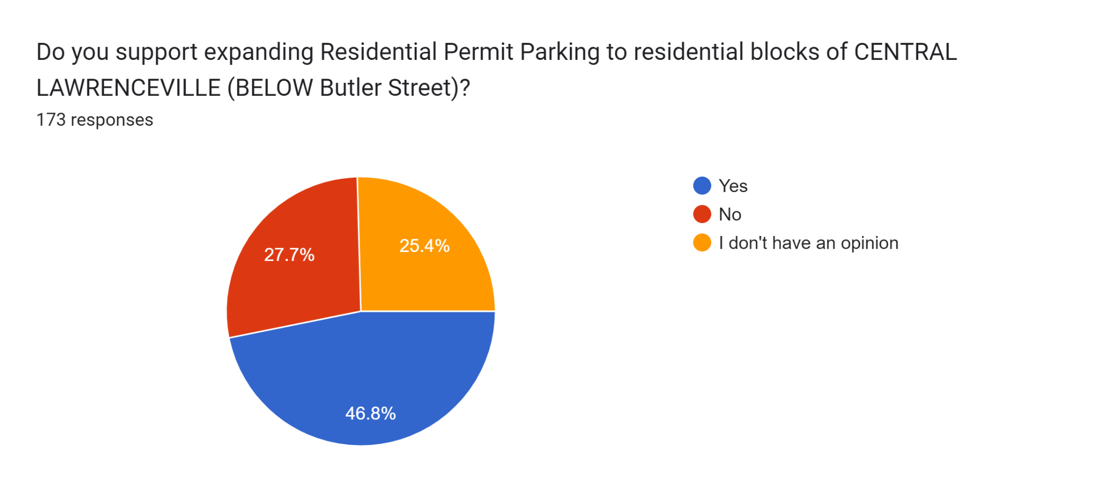
Central Lawrenceville - BELOW

Slide 48
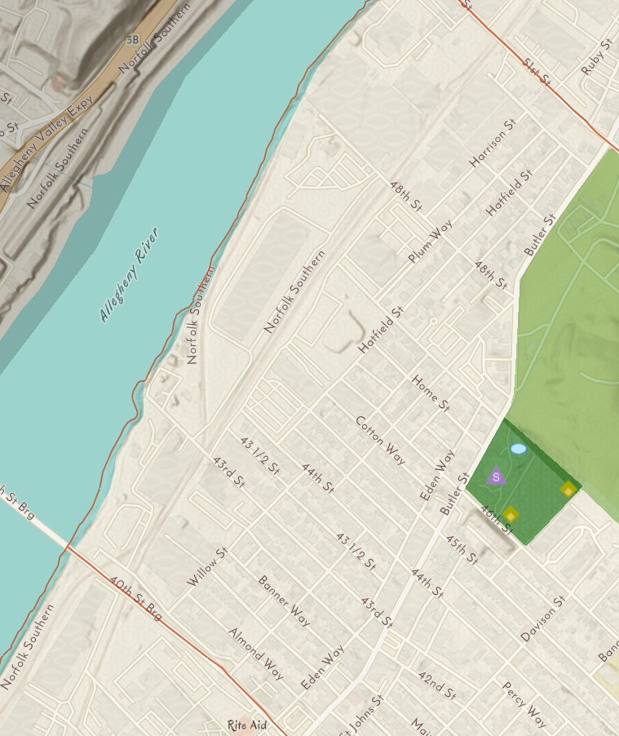
Central Lawrenceville (BELOW) - RESIDENTS
RPP
66.7% support vs. 33.3% oppose
Nighttime
59.1% support vs. 13.6% oppose
Hybrid
36.4% support vs. 33.3% oppose

Slide 49
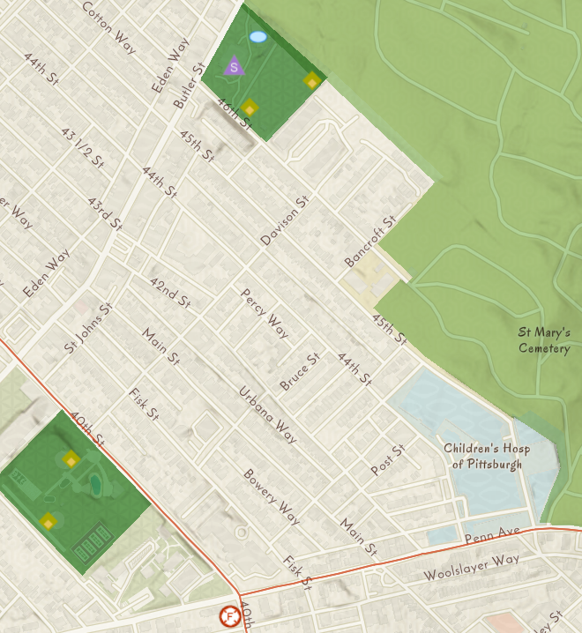
Central Lawrenceville (ABOVE) - RESIDENTS
RPP
80% of comments were positive about it, but negative comments were notable
Where you are on the hill matters
Nighttime
61.3% support vs. 29.0% oppose
Hybrid
54.8% support vs. 35.5% oppose

Slide 50
In general, how is the current Residential Permit Parking in CENTRAL LAWRENCEVILLE working for you?
“Mostly happy, though concerned about the increase in outsiders parking in the RPP area with the installation of meters.”
“No it is a thousand times worse than it was prior to RPP”
“It’s fine, enforced regularly, parking not a problem and annual cost not a personal barrier.”
“We’re happy with it. Except that renewing it each year with multiple documents is onerous.”
“At night when Tbird, Belvedere etc open is when there is the toughest parking challenge.”

Slide 51
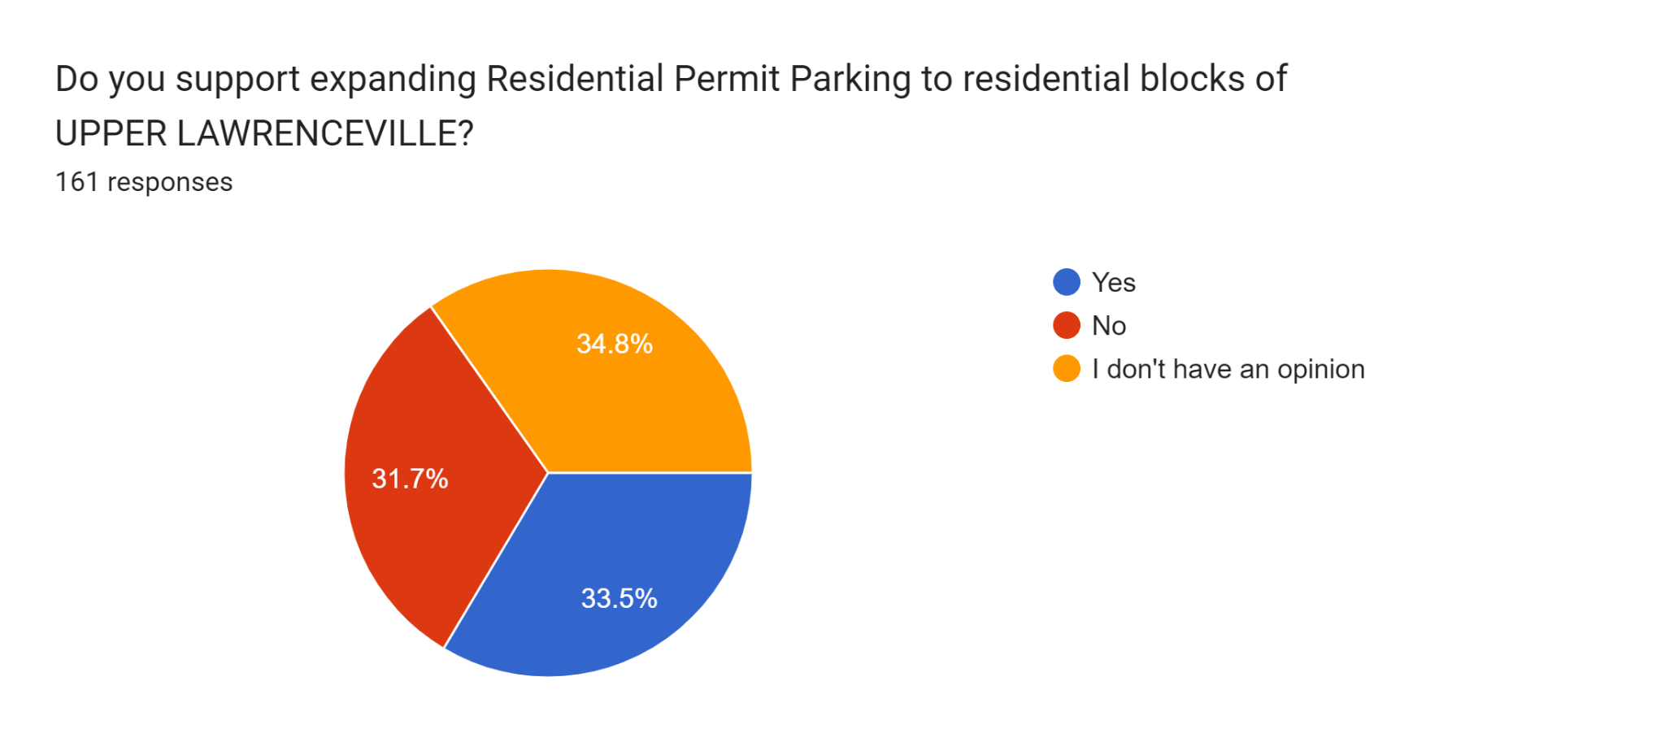
Upper Lawrenceville

Slide 52
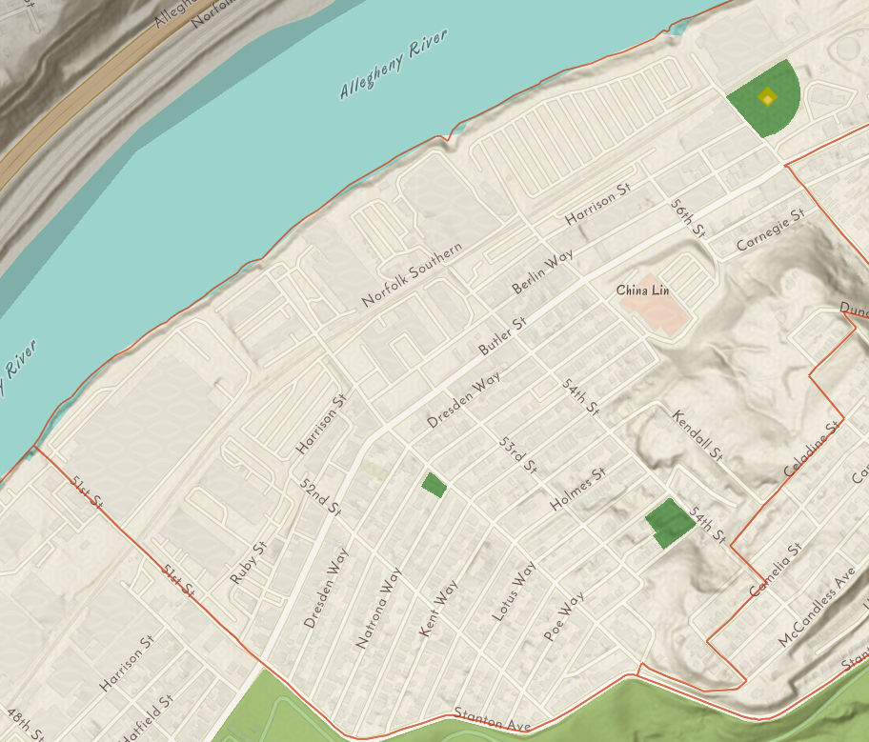
Upper Lawrenceville - RESIDENTS
RPP
35.5% support vs. 54.8% oppose
Nighttime
41.9% support vs. 48.4% oppose
Hybrid
32.3% support vs. 54.8% oppose

Slide 53
RPP takeaways from survey
Businesses & workers concerned about parking options with more aggressive options for new RPP and meters
Existing RPP area had the most positive reactions to RPP
No new areas had 70% of resident support, although Central Lawrenceville (BELOW Butler) was very close
Central Lawrenceville (ABOVE Butler) seems positive on nighttime enforcement
Upper Lawrenceville residents do NOT want RPP
Attitudes about RPP carried over to attitudes about hybrid and nighttime
Residents of Central Lawrenceville seem somewhat open to hybrid

Slide 54
Summarizing main RPP concerns
Visitor passes
Administrative burden
Enforcement
Cost / equity
Would like one RPP zone
Want more info / if it ain’t broke, don’t fix it
“I live and operate a business in Lower Lawrenceville. Currently, there is plenty of street parking available nearby and it is easy, uncomplicated, and hassle free for my household and business patrons. I like the simplicity.”
“I’m concerned about visitor parking. If we have a dinner party or have grandparents visit, it just adds another complication.”
“Paying $20 a year for not guaranteed parking spot on a public street is pretty frustrating and then needing to jump through hoops to have friends or family visit.“

Slide 55
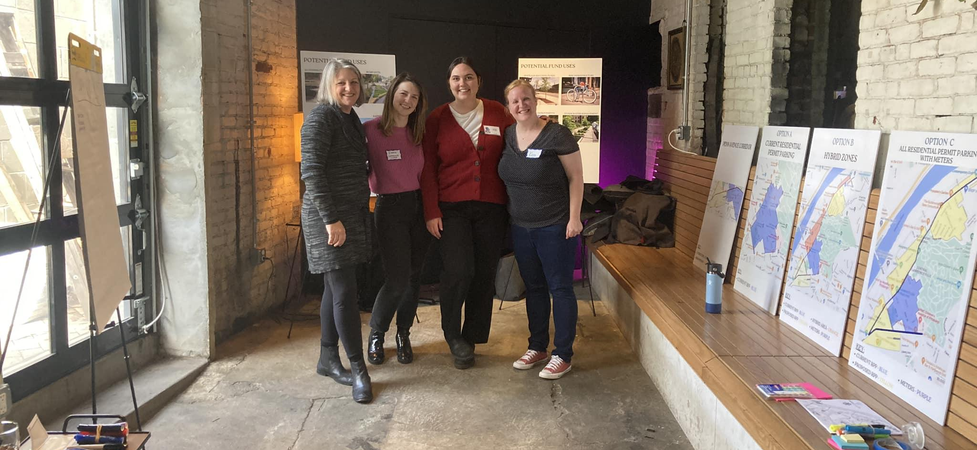
A word of thanks

Slide 56
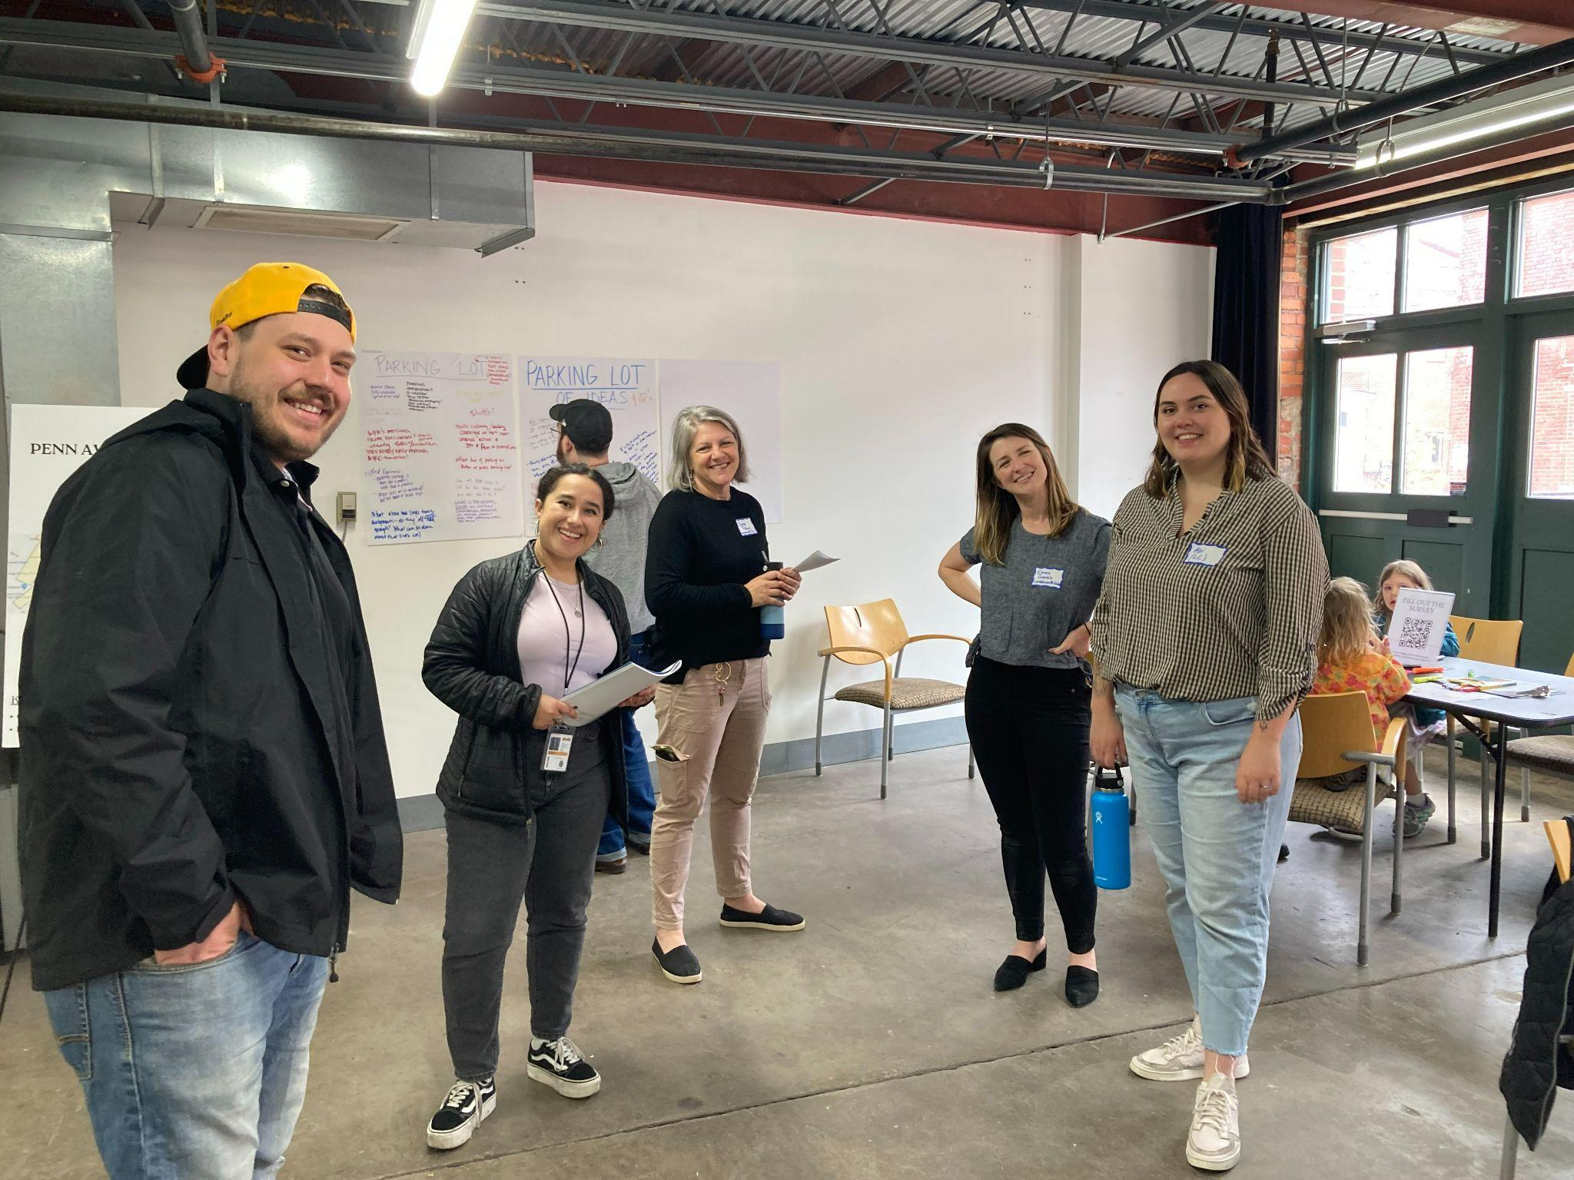
NEXT STEPS

Slide 57

Lawrenceville cares about mobility
Stay engaged: we’re not going anywhere!
Data collection:
  You can 311 by calling 311, Tweeting @Pgh311, or using form on City’s website
  LU & LC are adding all your mobility concerns to a list that we can share with 311 and elected officials
  We will publicly share anonymized feedback
Join Better Streets Lawrenceville
  https://better-streets-lawrenceville.mailchimpsites.com/

Slide 58
Capital budget season
Give your input on budget priorities for the 2024 City of Pittsburgh Capital and Operating Budgets
  Register & complete the survey at: https://engage.pittsburghpa.gov/2024-city-pittsburgh-budgets
2023 Meeting Dates & Locations
  Sat 5/13 at 1 PM - VIRTUAL
  Wed 5/17 at 6 PM - Phillips Rec Center
  Thurs 5/18 at 6 PM - Manchester Citizens Corp. Center
  Thurs 6/1 at 6 PM - Sheraden Senior Center
  Wed 6/7 at 6 PM - Homewood Senior Center

Slide 59
NEXT STEPS:
Mobility Enhancement District
Ordinance is currently in Committee
  Back on agenda on 5/24
  Currently working through amendments based on feedback
Based on your feedback, LU and LC are pushing for:
  Clarity on how decisions will be made about use of funds
  Community members deserve a voice
  Make sure parking time durations aren’t too short
Public hearing at City Council in early June
D7 funds for Parking Study

Slide 60
NEXT STEPS:
Residential Permit Parking
Strongly mixed feedback points to a more tailored approach
Parking study is necessary to make these changes anyway
Alternative if you don’t want to wait:
  Petition your neighbors: 70% of households
  Contact LU for assistance

Slide 61
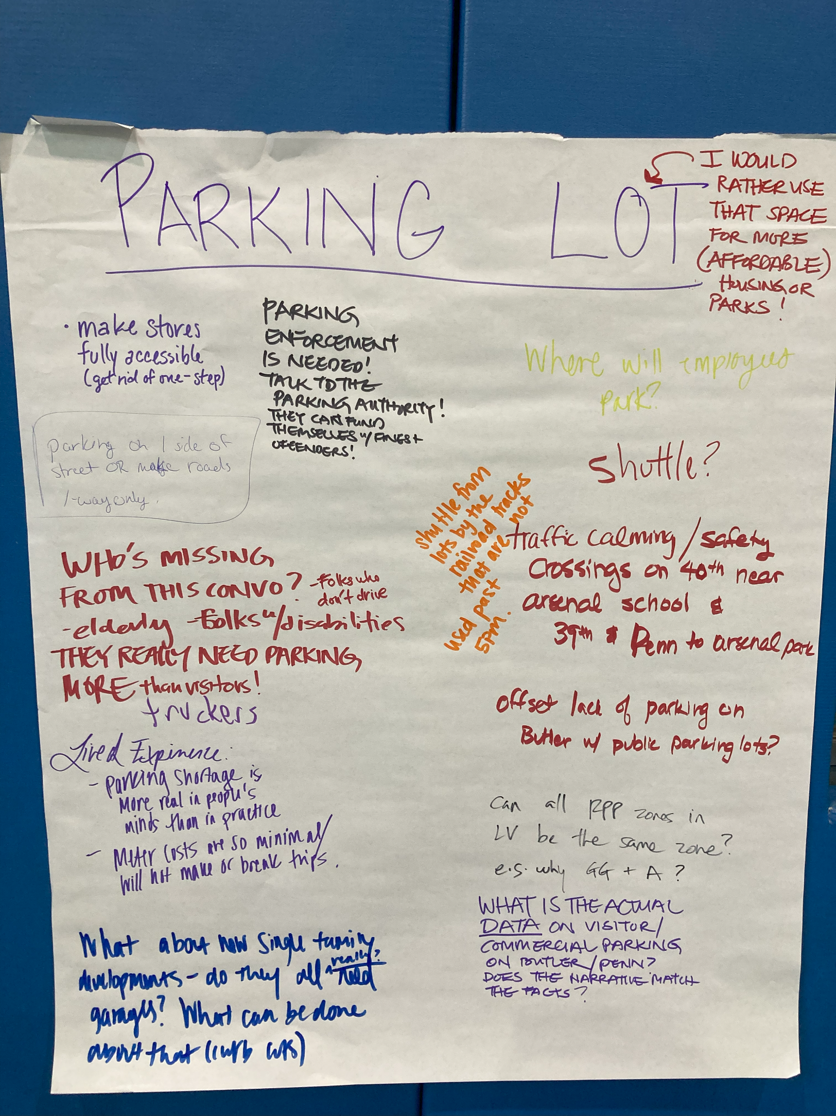
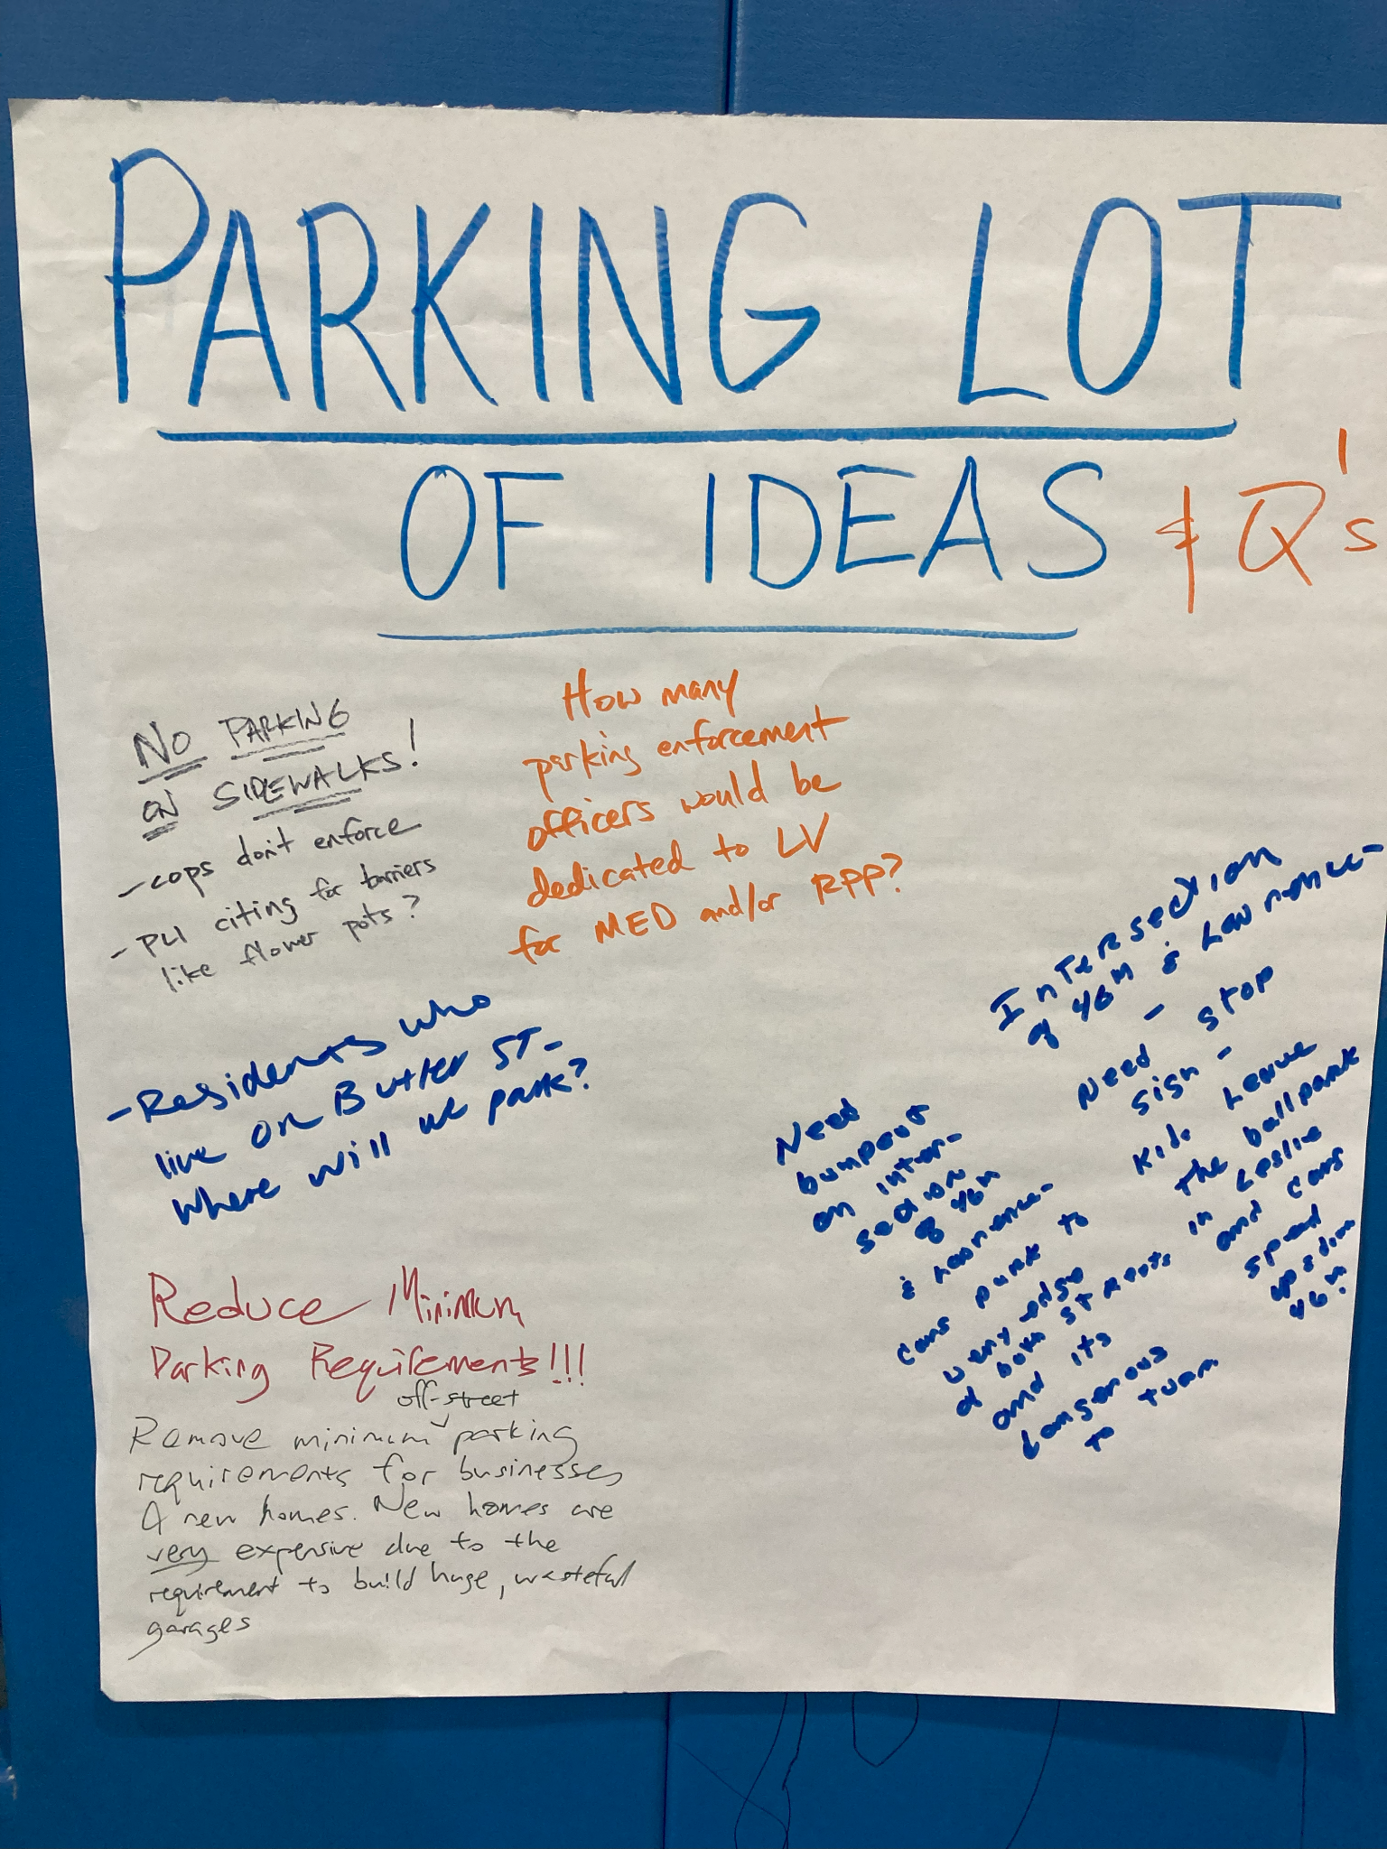
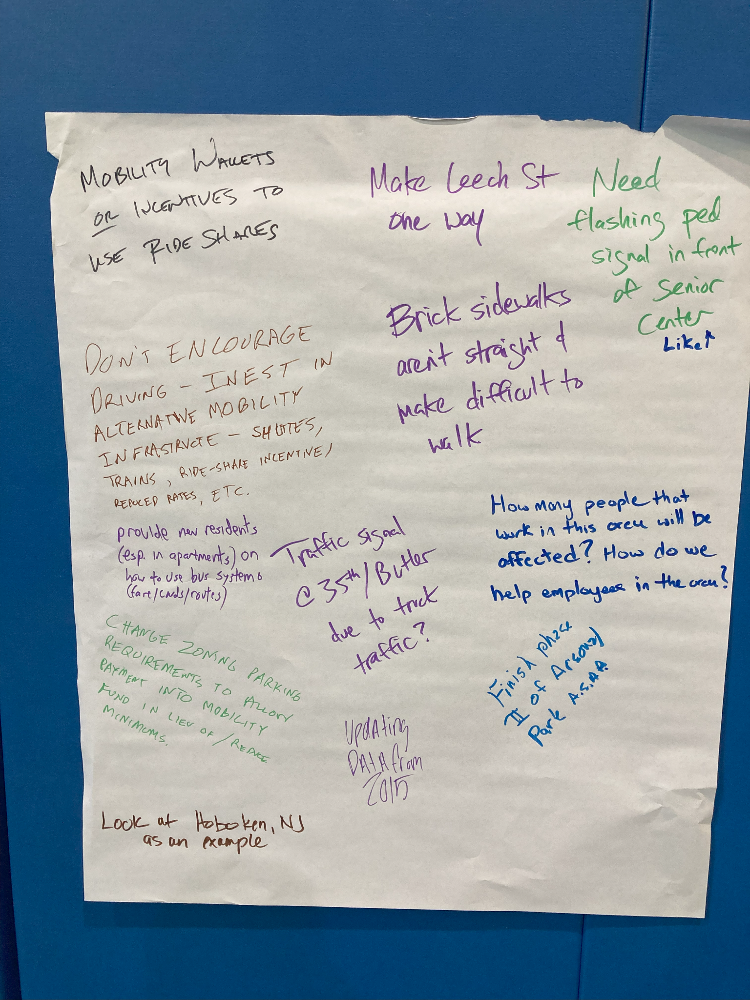
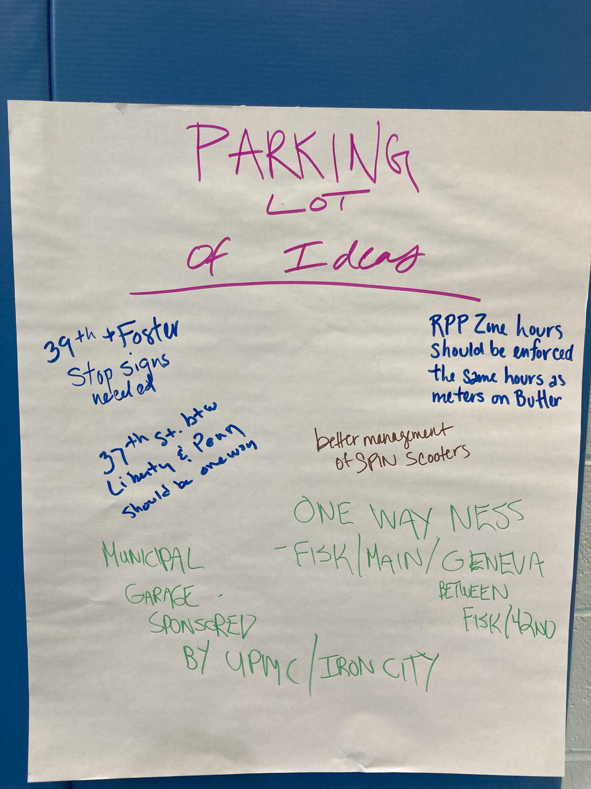
NEXT STEPS: Getting creative
Improving enforcement, especially parking on sidewalks
How can we encourage better utilization of existing lots?

Slide 62
Q&A / comments
Please identify yourself
Please remember our community agreements
Be neighborly.
Be respectful of all participants & hosts
Don’t denigrate groups of people
Give space for all to participate

Slide 63
THANK YOU!
Lawrenceville United
412-802-7220 - info@LUnited.org
Lawrenceville Corporation
412-621-1616 - info@LawrencevilleCorp.com
Please sign in at bit.ly/LUSignIn if joining online

