Slide 1
MAY
Sign-in Sheet: https://forms.gle/g5Krk2ycaov9KF867

Slide 2
Tonight’s Agenda
Welcome (10 minutes)
Introduction
Accessibility
Liquor License at 5438 Butler Street (25 minutes)
Presentation
Q&A
Other Community Updates (10 minutes)
Lawrenceville Farmers Market
Upcoming Meetings
Lawrenceville Pride
General Discussion (10 mins)
Upcoming Events & Closing (5 mins)

Slide 3
Accessibility
Accessibility
LU and LC are committed to making these meetings accessible
Let us know about any accommodations you need to fully participate
If joining by Facebook Live, drop comments/questions in the chat

Slide 4
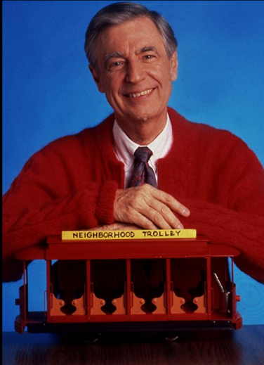
Community Agreements
Be neighborly.
Be respectful of all participants & hosts
Don’t denigrate groups of people
Give space for all to participate

Slide 5
Liquor License at 5438 Butler Street

Slide 6
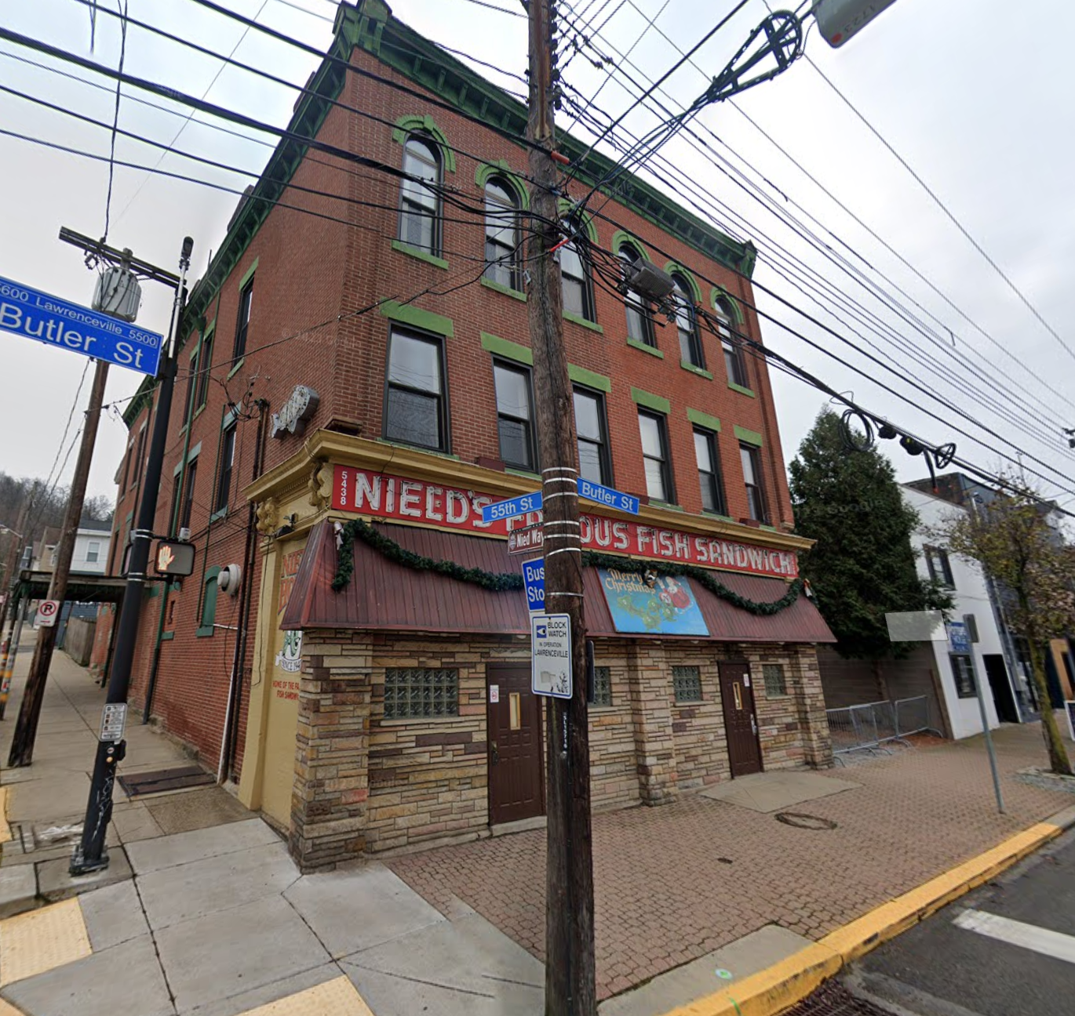
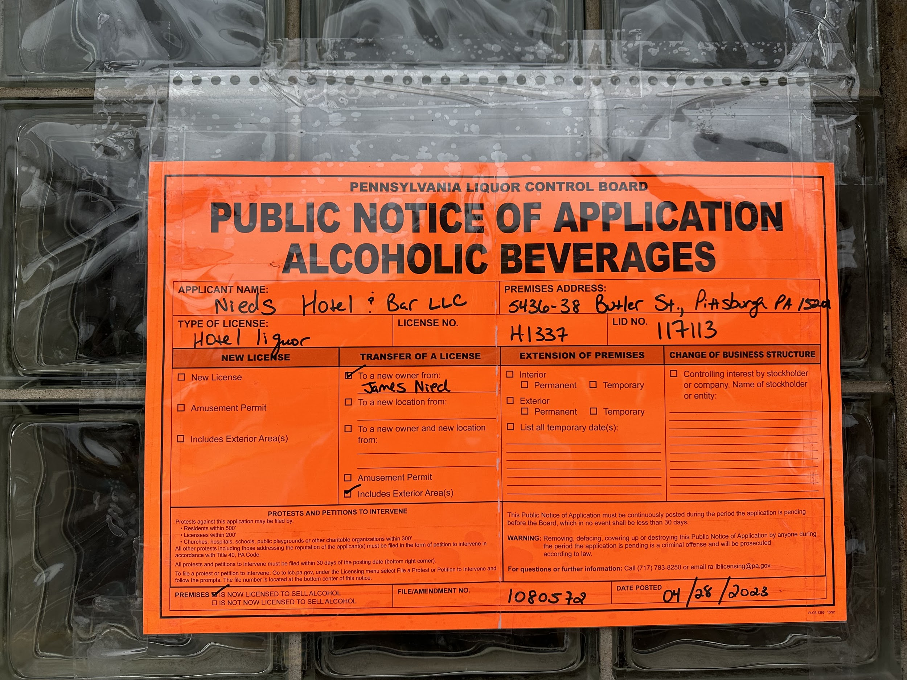
Nieds Hotel & Bar LLC
5438 Butler Street
Liquor License Information:
License Type: Hotel Liquor
Person to Person Transfer
License Number: H-1337
Applicant: Nieds Hotel & Bar LLC
Owner: Brigette Davitt, Mary Verratti, Tom Barr, Leigh Yock
License Manager: Same as above
Date Posted: 04/28/2023
Includes exterior area
Looking to pursue Amusement Permit if needed based on Hotel license
Vision: Home of the legendary Nied's Fish Sandwich, our commitment to maintaining this local favorite is at the heart of our mission. Our plan to renovate and preserve the hotel interiors will allow us to offer a unique historic experience.
Notes:
“R” licensees may serve liquor, wine and beer products. The licensee can sell up to 192 fluid ounces of beer products, in original containers, for take-out purposes. “R” licensees may not sell any single, open container of alcoholic beverage for consumption outside the establishment.

Slide 7
Ownership:
Brigette Davitt, Mary Verratti, Tom Barr, Leigh Yock
Leigh and Tom of Spirit on 51st Street
Brigette and Mary of We Buy Homes PGH
Place:
Consolidated Lot of 6,603 sf
Interior renovations to include updates to bar/restaurant and 13 fully renovated hotel rooms.
Seats: TBD
Parking: street parking, will lease parking spots near by if needed
Plan on fix current signage
Will offer the back dining room and upstairs event space for private parties on occasion

Slide 8
Business Plan:
Customer Demographic - Lawrencevillians, CH employees, foodies, travelers, groups, etc.
Days/ Hours of Operation and Alcohol Service: 5-7 days a week for breakfast, lunch and dinner. Beer/Wine/Cocktails service: 7am-2am
Cheap local beer on draft and available in can
A range of liquor from well to eclectic high end
Few by the glass wine options
Prices range from $5-15.
Food: Sandwiches, fries, coleslaw, burgers, fried baskets, salad, apps, ice cream, specials ($5-16.50) Breakfast items including: beignets, eggs, pancakes, etc ($6-14)
10-12 Employees
Entertainment: jukebox and occasional performances (acoustic/piano/etc)
Mostly background music level. When there are performances, it would always be at appropriate levels as not to disturb hotel guests.
Kids allowed with supervision until 9pm
Trash/Recycling: Dumpsters for trash and recycling will be located in an enclosure behind the building on Dresden Way.

Slide 9
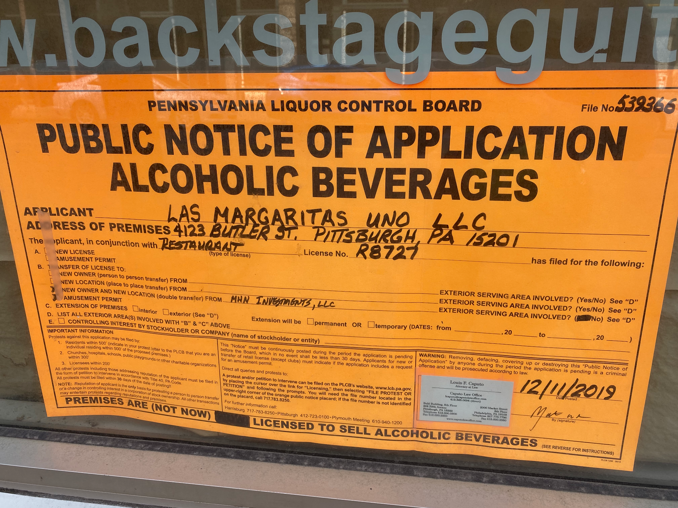
How do I engage with the PLCB process as an individual?
Breakdown of PA State Liquor License Types:
https://www.paliquorlicenseco.com/understanding-types-of-pa-liquor-licenses/
If you see a liquor license placard in the neighborhood, email abi@lawrencevillecorp.com or dave@lunited.org

Slide 10
Community Discussion

Slide 11
Community Updates and Discussion

Slide 12
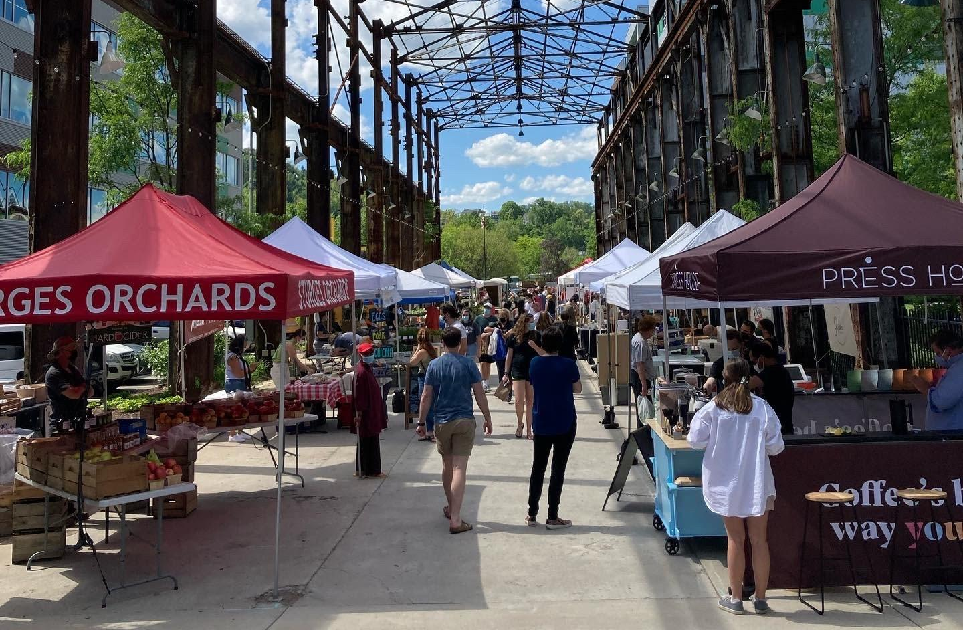
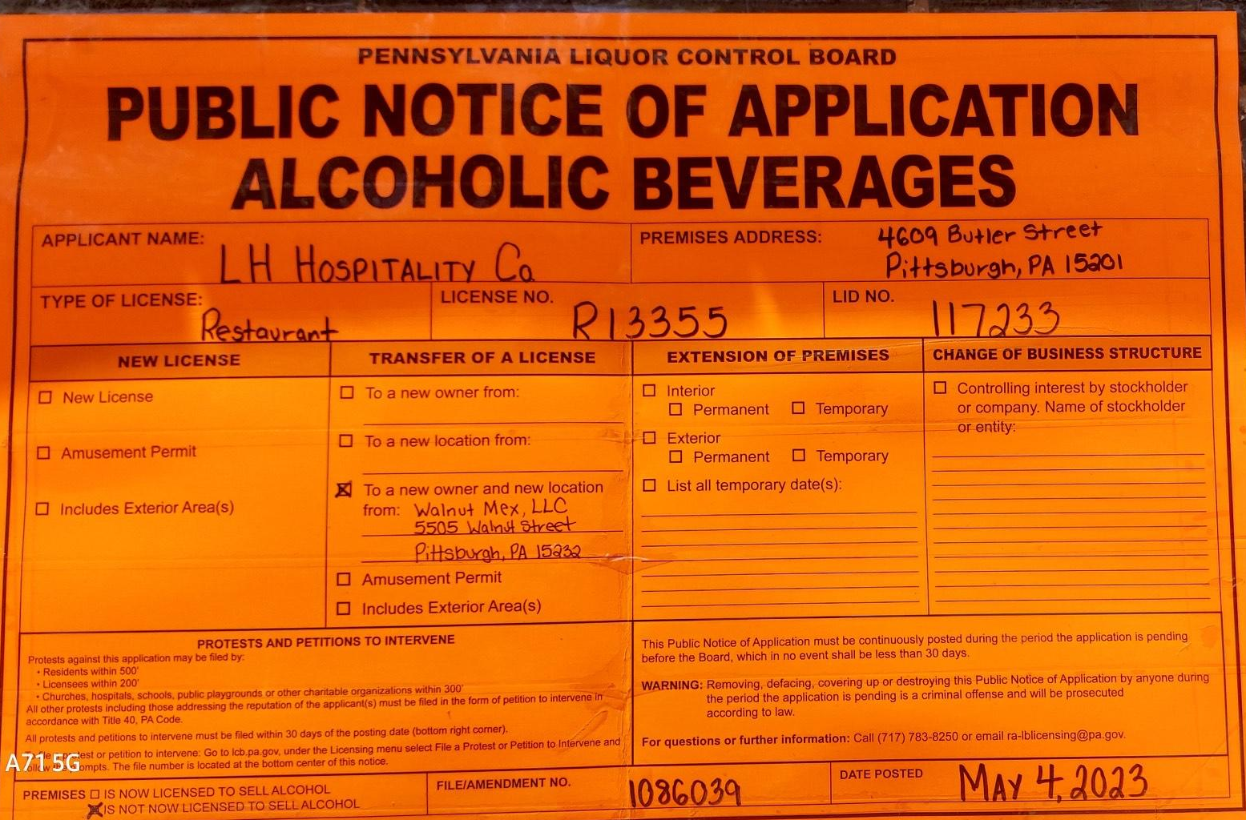
Upcoming Events
Tuesdays, 3-7pm - Lawrenceville Farmers Market at Bay 41 (located at 41st Street and Willow)
May 25th: CDAM - UPMC Children’s Heart Institute - Located above Mid-Campus Garage
Thursday, May 25th - 5:30pm @ Library
June 1st: CDAM - 4609 Butler Street - LH Hospitality Co. Liquor License CDAM
Thursday, June 1 - 5:30pm @ Library
Saturday, June 17th, 12pm-4pm - LVPGH Pride Follow @lvpghpride

Slide 13
Lawrenceville Corporation
info@lawrencevillecorp.com
412-621-1616
Lawrenceville United
info@LUnited.org
412-802-7220
Thank you!
Notes:
Add Rachel

