Slide 1

Ann Sanders
anns@justharvest.org
412-254-8261

Slide 2
Applying for Public Benefits

Slide 3
CAOs are closed! How can I apply?
You can apply online through COMPASS at https://www.compass.state.pa.us/
A community partner, such as Just Harvest can complete the application over the phone with you. For application assistance you can call 412-431-8960x 602.
You can request a paper application be mailed to you by calling the CAO and leaving your address in the phone tree prompt. Liberty District: (412) 565-2652
Notes:
For application assistance you can call 412-431-8960x 602 and leave a voicemail. Our staff is working remotely and will call you back. We're getting a lot of calls and it is taking us a few days to get back to folks. Weare working with county DHS to identify ways we can partner with other groups to assist folks back sooner.

Slide 4
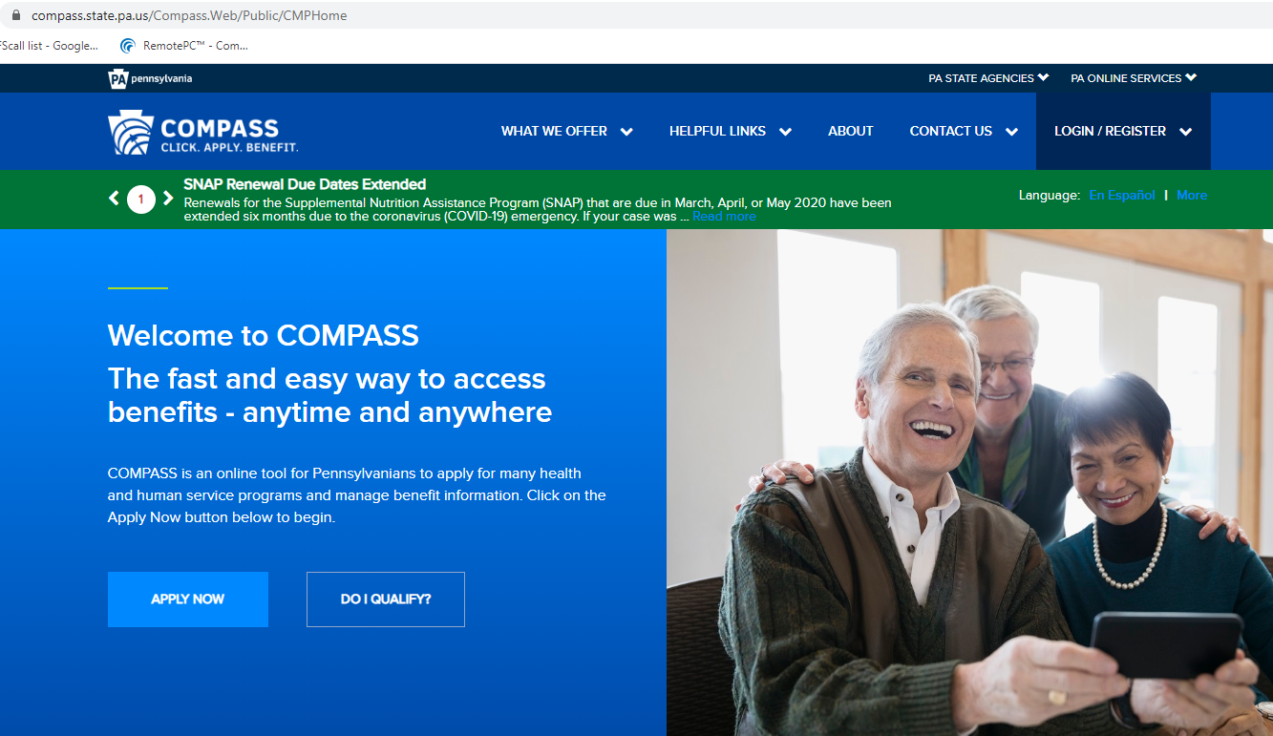
COMPASS
Notes:
COMPASS is the name of the state's application service for SNAP, medical assistance, LIHEAP long term care, school meals, child care subsidies, and cash assistance. You can submit one application for any of those benefits at once. It does ask some confusing questions, so sometimes people do get stuck.
Have any of you tried to use COMPASS and had issues - I'd be happy to hear about them! Helen can provide you with my contact information.

Slide 5
Changes in applying since COVID-19
SNAP
  Fewer documents required
  No interviews
Medical Assistance
  No documentation required except for citizenship
  Extra Unemployment Insurance ($600/wk) does not count as income.

Slide 6
Changes in applying since COVID-19
LIHEAP season ended April 10.
  BUT the state has said they will open up crisis for those who face utility shut offs again in mid-May and run until August or until they run out of funds.

Slide 7
SNAP: Supplemental Nutrition Assistance Program
“Emergency Allotments”
  They are also giving out more in SNAP benefits.
  SNAP benefits are based on household size, income, and expenses.
  If you aren't already receiving the maximum amount, then you will get an extra payment about 2 weeks later that will top off their benefits to bring them up to maximum amount for their household size.
  These emergency allotment payments will occur for as long as there is a federal emergency declaration

Slide 8
SNAP: Supplemental Nutrition Assistance Program
SNAP eligibility is determined by income, household size and age.
Household Size | Gross Monthly Income (160% FPL) | Gross Monthly Income for HH with Person(s) 60 or Older or Disabled | Benefit Range
1 | $1,666 | $2,082 | $16- $194
2 | $2,256 | $2,820 | $16- $355
3 | $2,845 | $3,556 | $16- $509
4 | $3,434 | $4,292 | $16- $646
Each Additional Member | $590 | $738 | Add $146

Slide 9
SNAP: Supplemental Nutrition Assistance Program
Unlike other programs, SNAP has several other guidelines beside gross income
Net income limit – gross income subtracting out a variety of deductions:
  Rent/mortgage
  Utilities
  Child care or dependent care
  Child support
  Medical costs for people with disabilities and for elderly individuals

Slide 10
SNAP for Seniors
Only half of all eligible seniors apply for SNAP.
There is an Elderly/disabled Simplified Application Process (ESAP) for elderly & disabled households. It’s only 2 pages!
This is only for households where ALL members are either age 60+ or have a disability and no one is working.
Recertifications are every 3 years, not every year.

Slide 11
SNAP Gaps
Average person receives $1.40 per meal - it’s not a sufficient amount. Maximum is $2.14 per meal.
Restrictions not based on income:
Work Requirement for “Able-Bodied Adults without Dependents” slated to go into effect April 1. Suspended by Congress due to COVID 19
College Student work requirement - students must either work 20 hours per week, receive work study, have a child, disability, or participate in a job-training program to qualify.
Immigration rules
Delivery options

Slide 12
Staying on benefits
People often lose their benefits because they do not complete a Semi-Annual Review or Recertification. One important thing all recipients must do is report changes to:
Their address and phone number
Who lives in their household
Changes in income and expenses
TO REPORT CHANGES: Need to call the Customer Service Center at 1-877-395-8930 or using MyCOMPASS mobile app or desktop

Slide 13
Filling in the School Meals Gap
The state also applied to run a program called Pandemic-EBT
Each family with a student who is eligible to receive a free or reduced price meal a card that has a SNAP-like benefit with the value of the breakfast and lunch meals lost during the school shutdown, about $370 dollars.
If you receive SNAP, the benefit will be deposited onto the SNAP card. All other families will get a card mailed to them.
The state's plan hasn't been approved yet, so this is still all in development. We'll share news as we have it!

Slide 14
Child Nutrition Programs: WIC
WIC is for:
Pregnant women
Post-partum women
Breastfeeding women
Infants, toddlers, and children UP to age 5.
WIC has an income limit of 185% FPL, and also a requirement that there is a nutritional need for the participating family member. For WIC purposes, the unborn child counts as a household member.

Slide 15
Child Nutrition Programs: WIC
WIC is for anyone who is raising kids who are under age 5: grandparents, single dads, etc.

Slide 16
Child Nutrition Programs: WIC
WIC is provides specific foods (limited to specific brand names and package sizes) that are known to meet a nutritional need.
They also provide lactation services and nutrition education. WIC staff are RDNs.
The food package now comes on a SmartCard - which is is reloaded with benefits every three months at the WIC clinic. Benefits do not roll over month to month and need to be used in the month that they are for.

Slide 17
How to apply for WIC:
WIC:
To apply call 1-800-WIC-WINS or online at https://www.pawic.com/

Slide 18
Questions?

Slide 19
Where to turn?
SNAP:
Apply Online: https://www.compass.state.pa.us/
Talk to Just Harvest SNAP assistance team: 412-431-8960 x602
Tips for communicating with DHS while CAOs are closed: https://www.justharvest.org/dhs-offices-are-closed-what-you-need-to-know/
Long Paper application can be downloaded from: https://www.dhs.pa.gov/Services/Assistance/Pages/Apply-for-Benefits.aspx

Slide 20
Where to turn?
Senior SNAP/ ESAP:
Brochures & more information: http://bit.ly/SNAPolderadults
Flier with medical expense deduction information: https://bit.ly/2Ijb5en
Paper ESAP application forms: http://bit.ly/simpleSNAP

Slide 21
Where to turn?
SUMMER FOOD:
To find a site: text “FOOD” to 877-877 or
Call 2-1-1 for the United Way hotline to hear site locations and meal schedules
or visit the USDA Summer Meal Site Finder: https://www.fns.usda.gov/summerfoodrocks
SCHOOL MEALS:
Apply Online at: https://www.compass.state.pa.us/
Contact your school district with questions or concerns.
AFTER SCHOOL MEALS:
Call 2-1-1 for the United Way hotline to find an afterschool programs.

Slide 22
Where to turn?
Home Delivered Meals, Farmers Market Nutrition Vouchers, and Congregate Meals:
Contact your local Area Agency on Aging for help with home delivered meals, farmers market nutrition vouchers, and places that serve congregate meals. You can find the agency contact information here:
https://www.aging.pa.gov/local-resources/Pages/AAA.aspx

