Slide 2
Better Streets Intersection Survey
“Safer pedestrian crossing at 40th and Butler. There are so many vehicles making turns that the pedestrian crossing signals are basically useless.”
“Takes forever to get a pedestrian crossing signal to get from one side of Butler to the other.”
“Sidewalk bump outs at Main & Penn to promote safer turns.”
“Cars go so fast up 44th St toward Penn and the hospital that it can get very dangerous... More stop signs or speed bumps are necessary.“

Slide 3
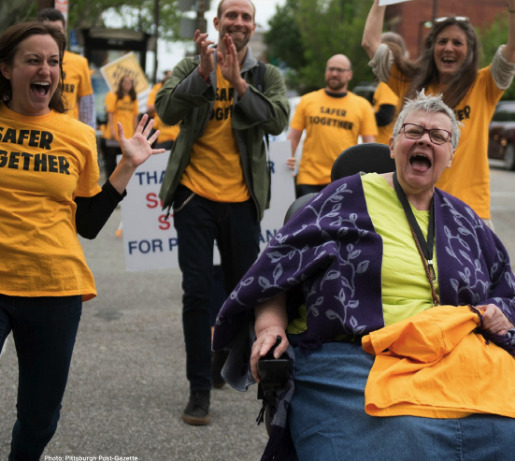
Crossings, with Lively Pittsburgh
“Rose, a 72-year-old Lawrenceville resident we met during The Crossings, pop-up street performances to ignite visibility around pedestrian safety, told us she lived in her senior apartment building five and a half years— but never once attempted to cross the street.”

Slide 4
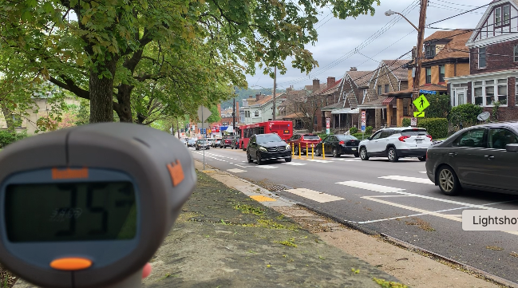
40th and Davison
“40th is dangerous for all non-vehicles, but this crosswalk is a yield to peds crosswalk, and no one does. Literally, no one. Those who cut across the bridge come flying up that hill and those of us on foot take our lives into our hands trying to safely make it into the park. It's crazy.”

