Slide 1
Traffic Calming Toolbox
Craig Toocheck and Paige Anderson
Staff Engineers
Department of Mobility & Infrastructure
City of Pittsburgh
Lawrenceville United
July 16, 2019

Slide 2
SAFER STREETS
Slow speeds
Lower volumes
Improved crossings

Slide 3
Calming Traffic
Visual controls
Vertical controls
Horizontal controls
Operational controls

Slide 4
1. VISUAL CONTROLS: MAKE STREETS (SEEM) SMALLER
Slows speeds

Slide 5
On Street Parking
Visual Control
Characteristics
Visually narrows the street
Creates friction and uncertainty which slows speeds
Typical use
Most street types
Considerations
Not effective where parking demand is low
Must have adequate space to ensure safety

Slide 6
Yield Streets
Visual Control
Characteristics
Narrow bi-directional travel ways force drivers to slow and yield when approaching opposing traffic.
Typical use
Appropriate to low volume residential streets or most alleys.
Considerations
Emergency vehicle access and movement.
Vehicle volumes.
Street width and availability of open curbside space to pull over.

Slide 7
Narrow Lanes
Visual Control
Characteristics
Visually or physically narrow travel ways
Typical use
Visual narrowing is appropriate on most street types
Actual narrow travel ways appropriate to low volume streets
Considerations
Maintenance of striping
Movement of vehicles on yield streets

Slide 8
Vertical enclosure
Visual Control
Characteristics
Vertical edge to the street
Gives a sense of enclosure naturally slowing travel speeds
Typical use
Any street type
Considerations
Can be accomplished with built structures or street trees
The closer together vertical elements are, the more effective the traffic calming effect
Trees take time to grow; large buildings are not appropriate in all contexts

Slide 9
2. Vertical CONTROLS: elements to force slower speeds or negotiation
Slows speeds

Slide 10
Speed Hump
Vertical Control
Characteristics
Gentle grade
Moderately slow design speed (15 – 20 MPH)
Typical use
Low and moderate volume residential and mixed use streets
Considerations
Snow removal and maintenance
Not appropriate on hills with grades over 8%
Gentler than speed “bumps”

Slide 11
Raised Crosswalk
Vertical Control
Characteristics
Slows speeds at crossings
Moderately slow design speed (15 – 20 MPH)
Typical use
Low to moderate volume streets
Marked crosswalks
Midblock locations
Considerations
Crossing must be at safe location
Pedestrian demand volumes
Drainage

Slide 12
Raised Intersection
Vertical Control
Characteristics
Crosswalks and intersection interior are raised above street grade
Often includes mixed patterns or materials
Typical use
Commercial street intersections
High pedestrian volume areas
Considerations
Cost
Pedestrian volumes
Maintenance
Drainage

Slide 13
3. HORIZONTAL CONTROLS:
Narrow street or force shifting to slow speeds

Slide 14
Raised Median
Horizontal Control
Characteristics
Paved or vegetated area raised above street grade separating traffic lanes
Typical use
Moderate to higher volume streets
Typically better on streets with few vehicle access points
Considerations
Cost
Maintenance
Driveways
Grade and sightlines
Pedestrian crossings

Slide 15
CURB EXTENSION / BUMPOUT
Horizontal Control
Characteristics
Extension of the curbline toward the centerline of the street
Can be achieved via physical curb, paint, pavement removal or other techniques
Improves visibility of people crossing
Typical use
Appropriate on most street types
Paired with crosswalks can narrow pedestrian crossing distance and improve visibility
Considerations
Street cleaning and snow removal
Maintenance and cost
Drainage

Slide 16
Choker / Neckdown
Horizontal Control
Characteristics
Pair of bulbouts narrowing the travelway of the street
Typical use
Low to moderate volume streets
Considerations
Street cleaning and snow removal
Maintenance and cost
Drainage

Slide 17
TIGHTER Corner Radii
Horizontal Control
Characteristics
Tightened curb radii at corner
Can be achieved through curb, paint or attenuators
Typical use
Intersections with few large turning vehicle types
Considerations
Design vehicle
Pedestrian crossing
Cost
Street operations
Drainage

Slide 18
Chicane
Horizontal Control
Characteristics
Devices causing the deflection of vehicle travel direction – often multiple times within a segment
On streets with parking on one side, can be made by shifting parking from one side to the other
Typical use
Low volume residential streets
Considerations
Can be accomplished with paint, planting, on-street parking and/or vertical elements
Street maintenance and sweeping
Cost

Slide 19
Mini Roundabout
Horizontal Control
Characteristics
Painted or curbed circle in the middle of an intersection to deflect vehicle line of travel
Maintains existing curblines
Truncates driver sightline
Typical use
Intersection of low volume residential streets
Few large vehicles
Typically replaces 4-way stops
Considerations
Community support for maintenance and sponsorship
Cost

Slide 20
4. Operational controls:
CHANGE HOW MOTORISTS MAY USE THE STREET
Signs and regulations

Slide 21
Stop Controls
Operational Control
Characteristics
Signage or signals
Includes 2-way and 4-way stops, yields, and signalized controls
Typical use
Intersections
Considerations
Traffic volumes and direction of travel to meet warrants
Sightlines
Often low compliance for 4-way stop or yield controls
Braking and acceleration impacts

Slide 22
one-way Street Operations
Operational Control
Characteristics
Street operates in one direction only
When used for traffic calming, intended to reduce traffic volumes by limiting access
Typical use
Various street types
Considerations
Network operations
Unintended effects on vehicle travel speed and volume

Slide 23
Opposing one-way
Operational Control
Characteristics
Street changes direction at a cross street prohibiting through traffic
Typical use
Minor streets intersection with larger volume streets
Considerations
Network operations
Legibility of signage
Local access
Consequences on street travel speeds

Slide 24
Turn and access Restrictions
Operational Control
Characteristics
Signage indicating turn or access restrictions
May be temporal or perpetual
Typical use
Various street types
Considerations
Generally low compliance
Enforcement challenges

Slide 25
Diverter
Horizontal Control
Characteristics
Device to prohibit the through movement of traffic
Can provide through movement for other modes
Typical use
Intersection of low volume streets with higher volume thoughways
Eliminate cut through traffic or reduce traffic volumes
In conjunction with neighborhood bikeways
Considerations
Traffic operations and access

Slide 26
5. TRY things out
Interim treatments can be used on a trial basis

Slide 27
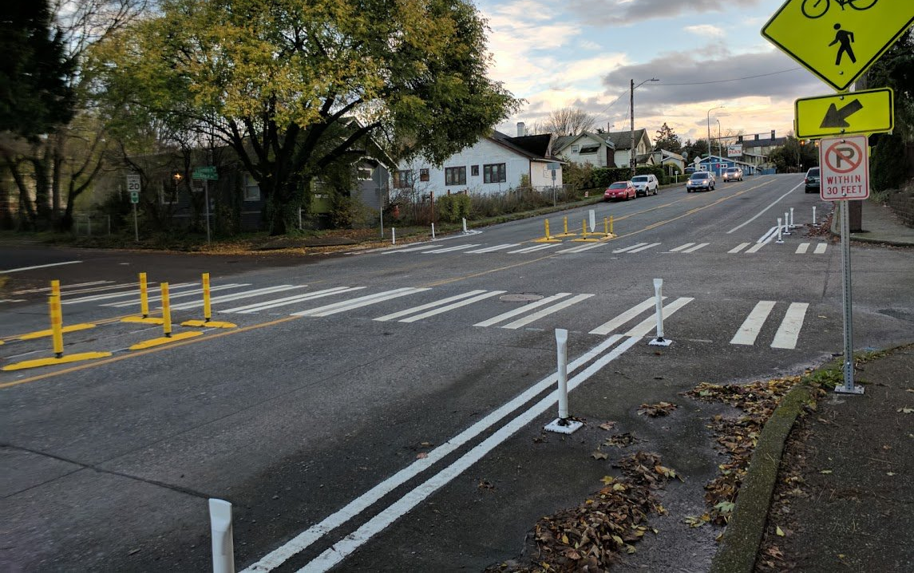
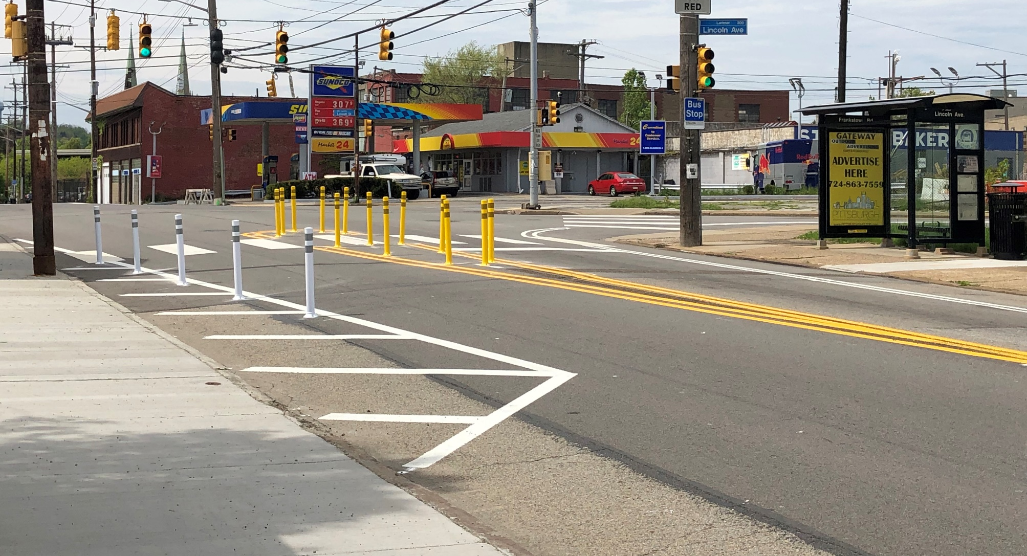
INTERIM Refuge Island
Horizontal Control
Characteristics
Can be installed temporarily on a trial basis
A high-visibility crosswalk and pedestrian refuge island, built using interim materials (Seattle, WA)
Trial pedestrian refuge islands built from flexposts (Frankstown Ave., Larimer)

Slide 28
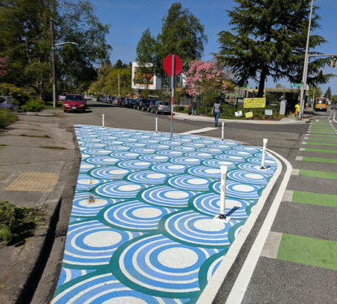
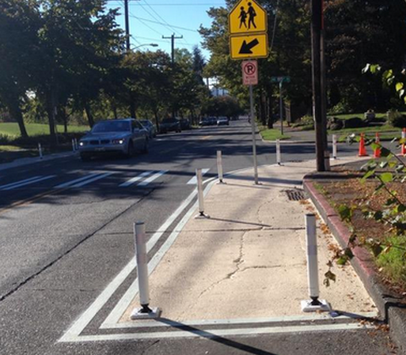
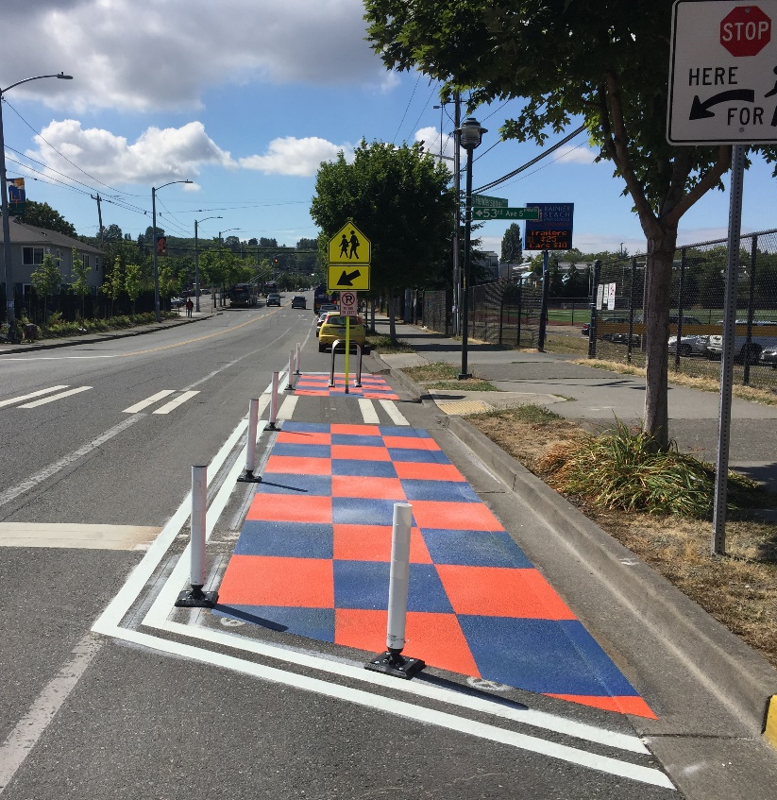
INTERIM BUMPOUT
Horizontal Control
Characteristics
Can be installed temporarily on a trial basis
Can be permanent where issues like drainage prohibit concrete construction
Interim curb extensions using paint and flexposts (Seattle, WA)

Slide 29
6. IMPROVE PEDESTRIAN AND BIKE NETWORK
Marked crosswalks don’t necessarily mean safer
Slower speeds improve safety and yielding for everyone on the street
Neighborways: slow speed, low volume streets create safe and comfortable corridors for walking, jogging, biking, playing, etc.

Slide 30
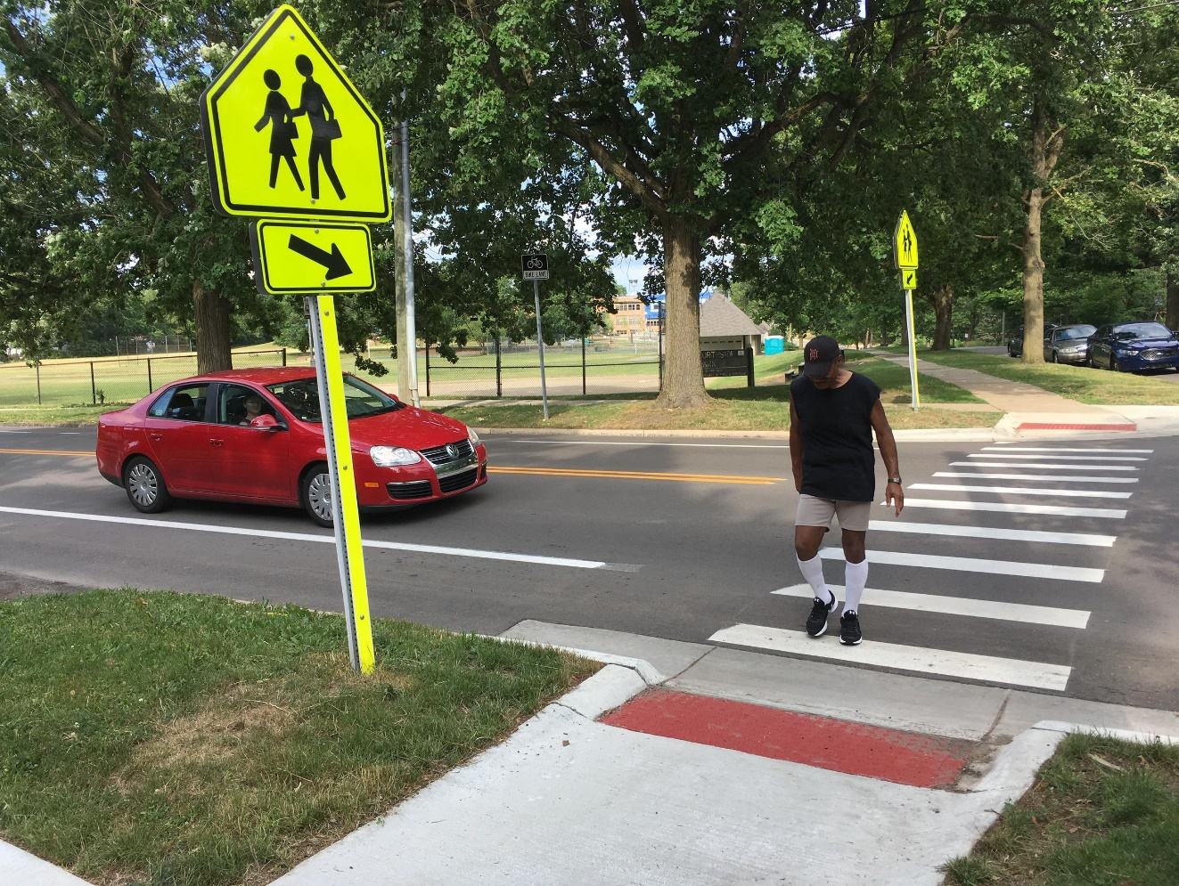
MARKED Crosswalk
Visual/Operational Control
Characteristics
Legal crosswalks exist at (almost) every intersection
Markings can show the location of a crosswalk at select locations
Typical use
Low to moderate volume streets
2-3 lanes
Considerations
Crossing must be at safe location
Lighting
False sense of security: does not guarantee motorists will yield
Does not reduce speeds
Pair with refuge island/signage
High-visibility crosswalks can improve yielding to pedestrians when speeds are slow enough.

Slide 31
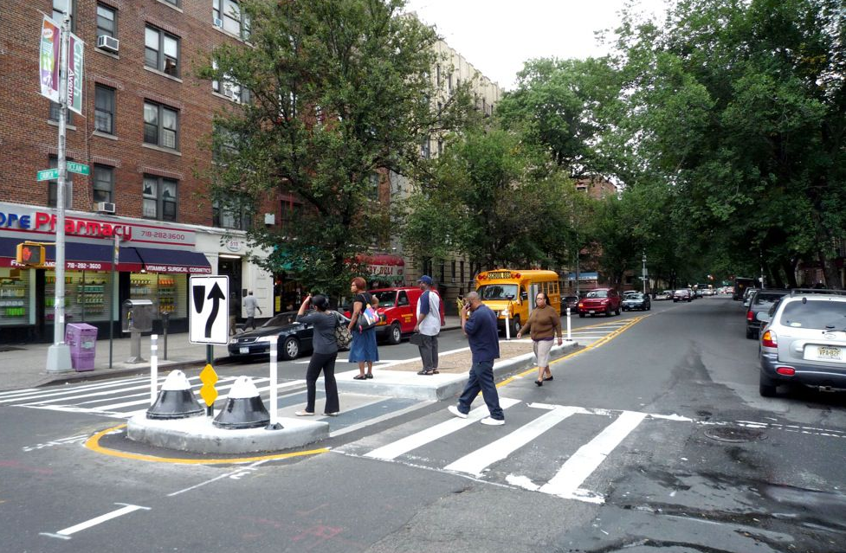
Pedestrian Refuge Island
Horizontal Control
Characteristics
Concrete island in middle of the street
Typical use
Streets where there are long gaps between signalized intersections
Where yielding is poor
On wide streets
Considerations
At intersections, can make turns more difficult for trucks or buses
Maintenance
A concrete pedestrian refuge island provides a
place to wait and slows traffic (New York City)

Slide 32
Neighborways
Traffic Calmed Corridors
Characteristics
Uses a combination of traffic calming treatments to slow traffic speed and volumes.
Prioritizes walking, biking, jogging, playing, etc.
Creates comfortable streets people of all ages and abilities.
Typical use
Residential streets.
Usually parallel to main routes that are busier and less comfortable.
Considerations
Integrate wayfinding to help people find and stay on the Neighborway corridor.

Slide 33
7. NEXT STEPS
The traffic calming process

Slide 34
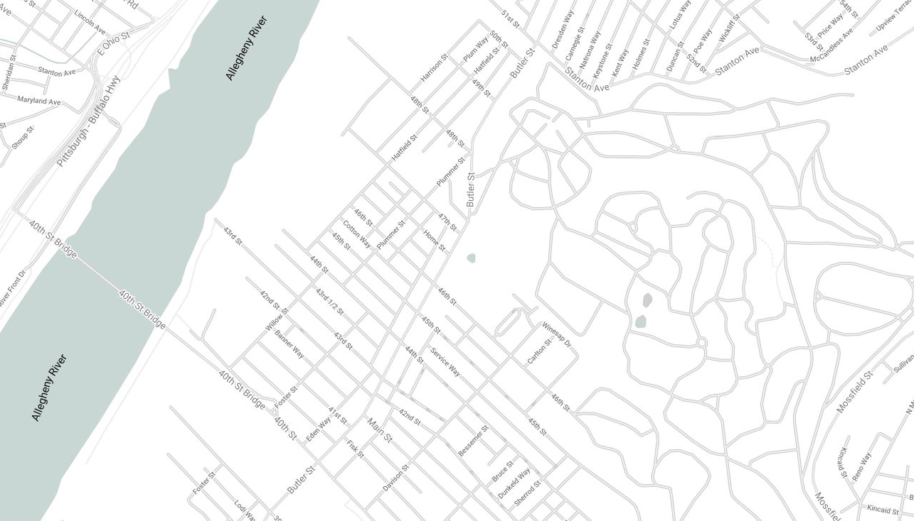
Central Lawrenceville neighborway
N
HATFIELD STREET
44th
WILLOW STREET
PHASE 1: SUMMER 2019

Slide 35
TELL US WHAT YOU THINK
Trouble Spots in Lawrenceville
Write on map or use post-it notes to mark trouble spots.
Report paving/pothole concerns directly to 311.

