Slide 1
Public Safety Meeting
July 16, 2019
Notes:
Intros (5 mins)
Who am I/we?
What is BikePGH? Advocacy, Community, Education
A couple people share concerns they have and what they hope to clear up

Slide 2
People on Bikes
What to Expect & What to Know:
Overall Laws & Guidelines
PA Bicycle Driver’s Manual
#1 advice: Be predictable
Follow the law; stop at red lights/stop signs
Lights
Where bicyclists can/cannot bike
Bicyclists must take the lane in the direction they are heading
Notes:
Bikers on the road (10 mins)
What to expect and what to know
Overalls laws & guidelines - Bicycle Driver’s Manual
Follow the law, stop at red lights/stop signs & be predictable
Use hand-signals to communicate,
Where bicyclists can and cannot bike; must stay in right-most (turning) lane

Slide 3
People on Bikes
The Bicyclist's Perspective:
People on bikes often act in ways that they think will make them safer
Taking the lane
Visibility
Door-zone danger
Debris, Potholes, Snow
Indicating that it’s not safe to pass
Left turns
Notes:
Bikers on the road (10 mins)
The bicyclist’s perspective:
Bikers often act in ways that they think will make them safer
Danger of the Door-zone & taking the lane

Slide 4
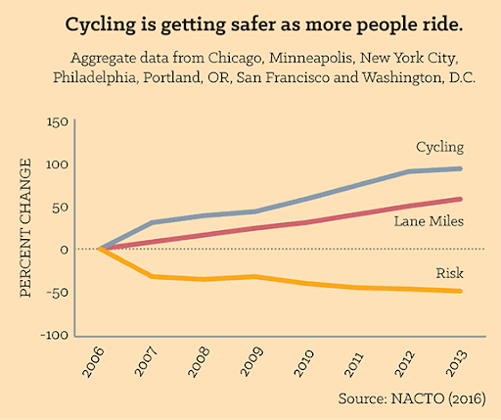
People on Bikes
More People On Bikes & Bike Lanes = Reduced Risk:
The more people get around by bike, the safer it is
“safety in numbers” rule first discovered by researcher Peter Jacobsen
Bike infrastructure and slower motorized vehicle speeds increase # of riders
Notes:
Bikers on the road (10 mins)
More cyclists + better lanes = reduced risk:
In various studies completed, it shows that the number of instances of bicyclists following traffic laws is actually slightly higher than drivers. It says that better street design and infrastructure would actually make the most significant difference is the safety for all users.
The more people get around by bike, the safer it is, according to the “safety in numbers” rule first popularized by researcher Peter Jacobsen.
“In cities that are building protected bike lane networks, cycling is increasing and the risk of injury or death is decreasing.” NACTO, 2016 (show risk / ridership graph)
“NACTO’s new analysis of seven major cities across the U.S. shows that, as cities build more bike lanes, the number of cyclists on the street increases, and the individual risk of a cyclist being killed or severely injured drops, often dramatically. The investment in bike lanes spurs additional cycling, increasing visibility and further reducing risk for all cyclists.“

Slide 5
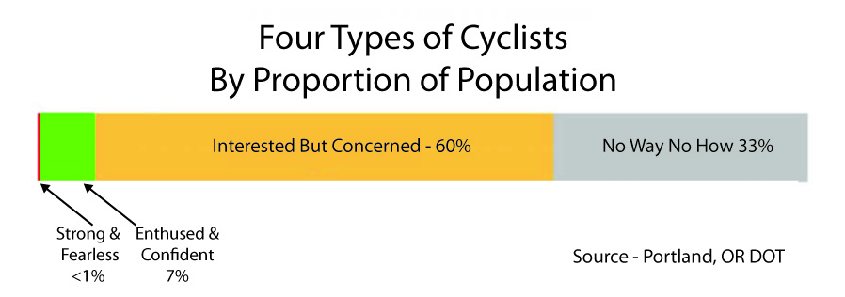
People on Bikes
Notes:
Bikers on the road (10 mins)
Types of Infrastructures: sharrows, bike-only lanes, protected bike lanes, 2-stage turn box, green left turn box, Upcoming BRT project in Oakland area - dedicated bus-only & bike-only lanes; keep in mind:

Slide 6
Types of Bike Infrastructure
Notes:
Bikers on the road (10 mins)
Types of Infrastructures: sharrows, bike-only lanes, protected bike lanes, 2-stage turn box, green left turn box, Upcoming BRT project in Oakland area - dedicated bus-only & bike-only lanes; keep in mind:

Slide 7
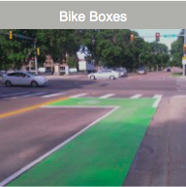
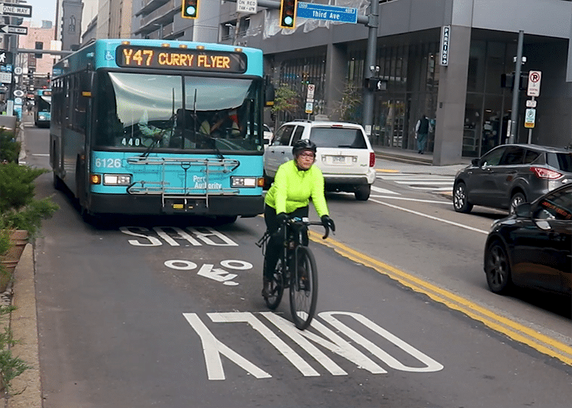
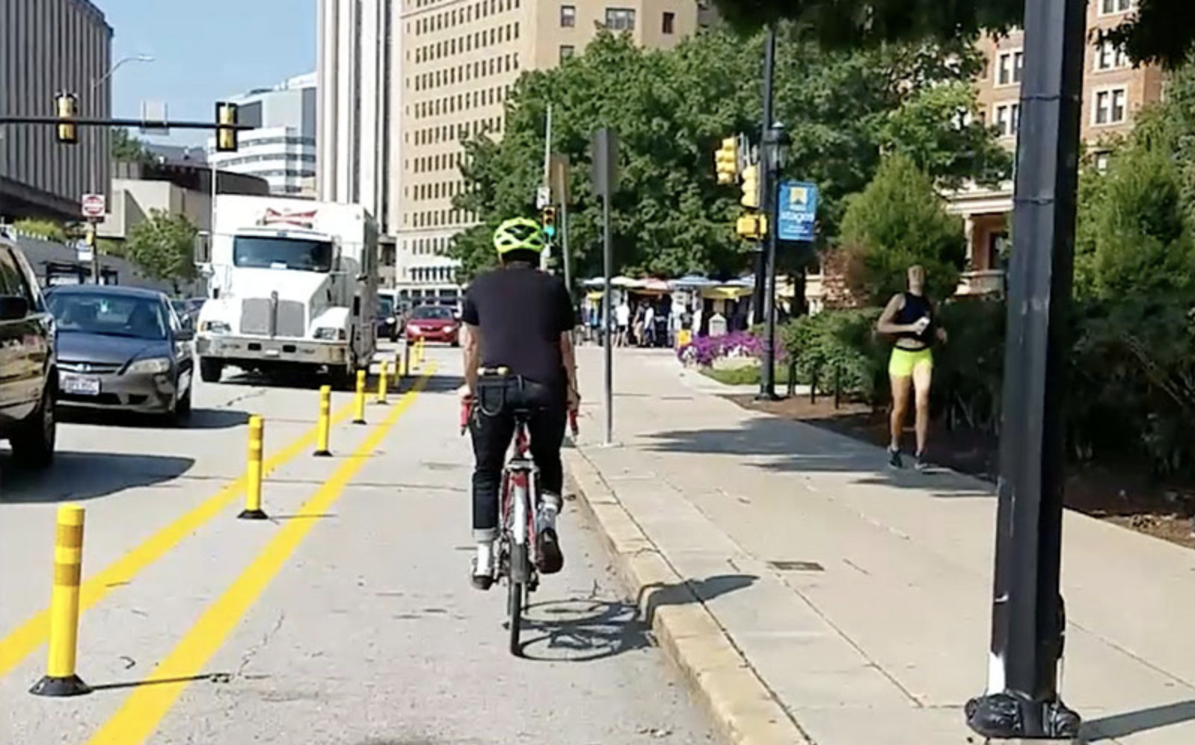
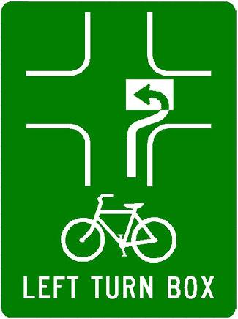
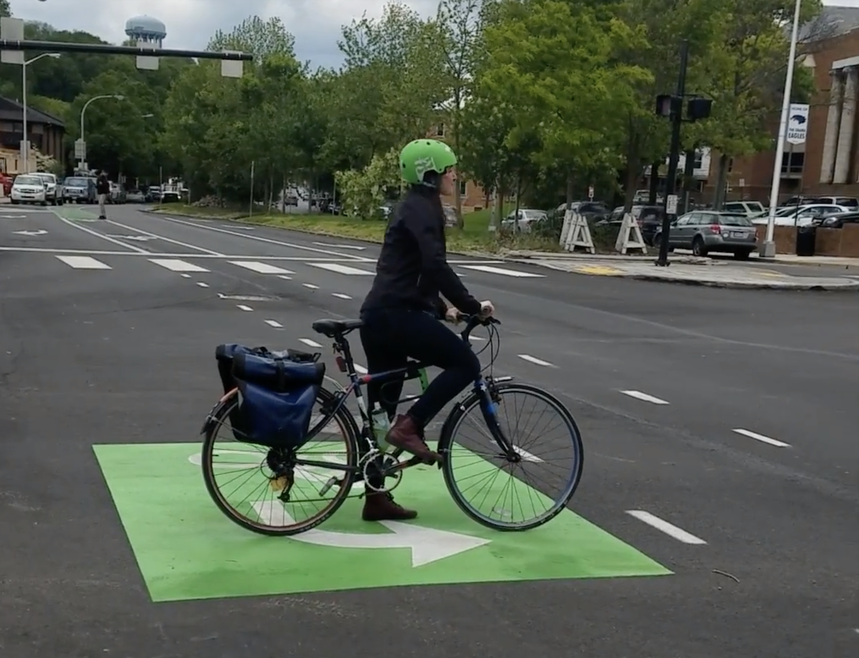
Bus-Bike Lane
2-Stage Turn Box
Notes:
Bikers on the road (10 mins)
Types of Infrastructures: sharrows, bike-only lanes, protected bike lanes, 2-stage turn box, green left turn box, Upcoming BRT project in Oakland area - dedicated bus-only & bike-only lanes; keep in mind:

Slide 8
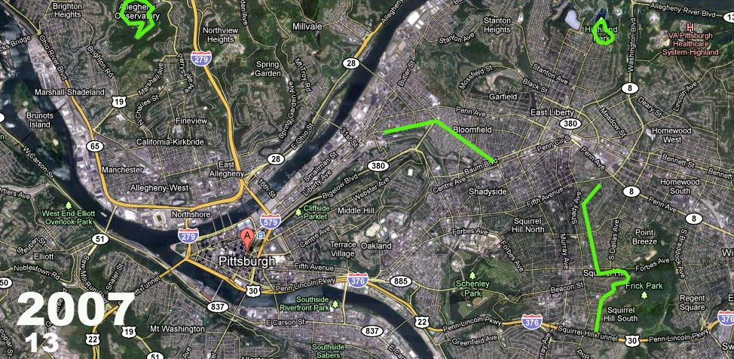
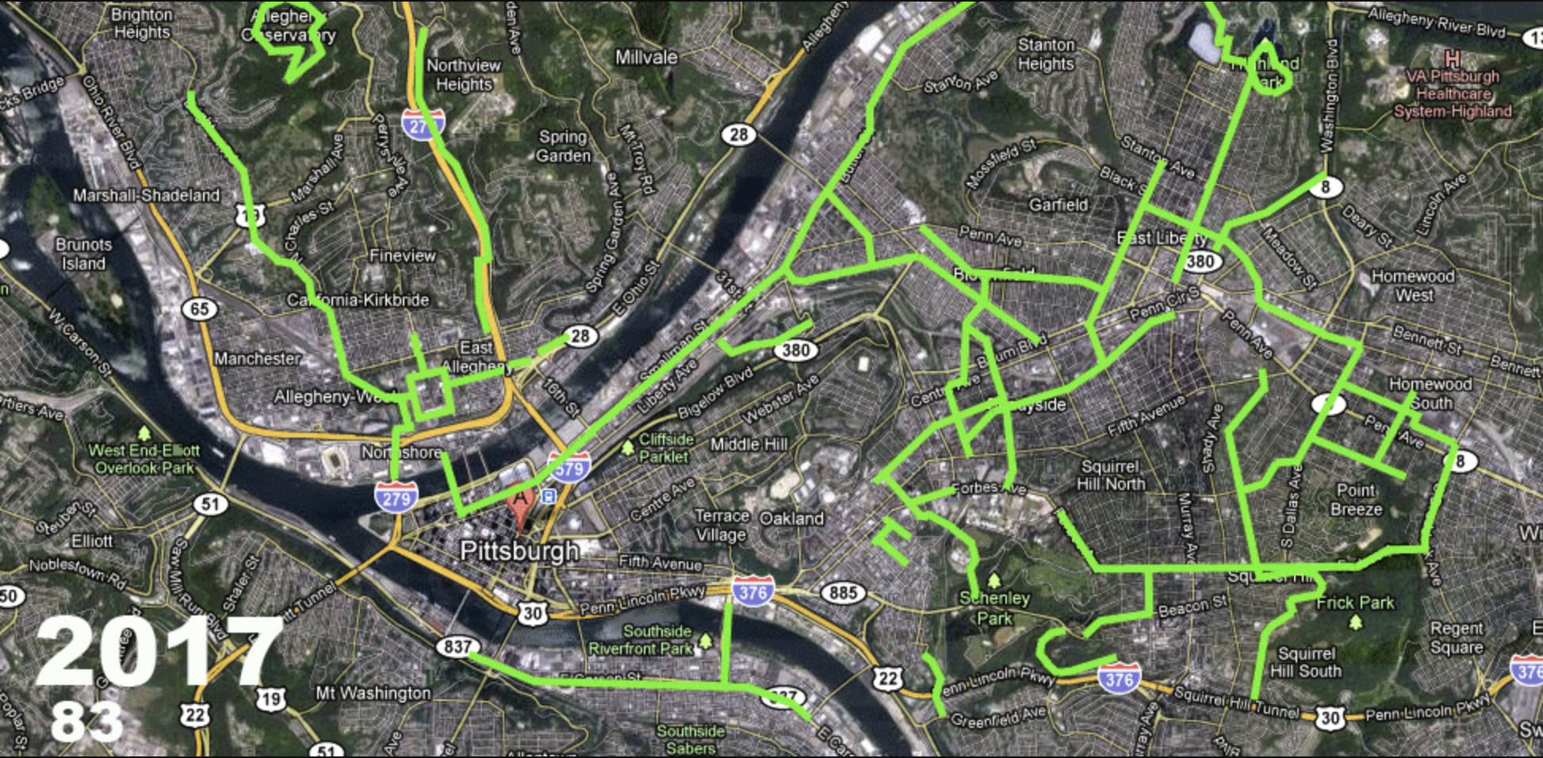
Notes:
Bikers on the road (10 mins)
Types of Infrastructures: sharrows, bike-only lanes, protected bike lanes, 2-stage turn box, green left turn box, Upcoming BRT project in Oakland area - dedicated bus-only & bike-only lanes; keep in mind:

Slide 9
Policy
Complete Streets Policy, 2016
How it will inform future construction projects
All projects must consider all road users
Pittsburgh Bike Plan
Due: Fall 2019
Notes:
Bikers on the road (10 mins)
Complete Streets Policy and Pittsburgh

Slide 10
Debrief
Take Home Resources
Q&A
Stay in touch!
Eric Boerer, Advocacy Director
eric@bikepgh.org
Office: 412-325-4334
bikepgh.org
Notes:
Takeaways
Handheld Info cheat-sheet for drivers
BikePGH resources: Bike Map, Biking 101 Guide, Crash card, How To Videos, Stickers, PA Bicycle Driver’s Manual

