Slide 1
Combatting Extremist and Hate-Based Violence Through Community Engagement & Empowerment
January 28, 2019
Lawrenceville united

Slide 2
Welcome!
Please sign in with Goodwill reception
Help yourself to water or some snacks
Childcare is in Interview Room 1-A: please sign your child in with Katie
If you need a break: Interview Room 1-B is available
Bathrooms are out the doors to the left
Note to media: please no cameras, microphones, or direct quotes from community members during meeting without their permission

Slide 3
Tonight’s Agenda
Welcome
Community agreements
Local background
A word from the Jewish Federation
Presentation from the FBI
Q&A

Slide 4
Warning
Content from tonight’s presentation contains offensive material, including photos of hate-based activity targeting specific groups of people.
Interview Room 1-B is available if you need a break.

Slide 5
Community Agreements

Slide 6
Community Agreements
Take care of yourself: use Interview Room 1-B if you need a break.
Be respectful of everyone: we will not tolerate comments that denigrate groups of people
“Literary moment”
Speak from your own experience
“Ouch”: if someone makes a statement that you find hurtful, let them know why
“Oops”: if you have said something that was hurtful, do your best to apologize and avoid in the future.
Please hold questions and comments until the end of the presentation. We will allow 1 question and 1 follow-up during the Q&A to make sure that everyone gets to ask a question.
Expect and accept non-closure
If community members share personal stories, what’s shared here stays here, but what’s learned here leaves here

Slide 7
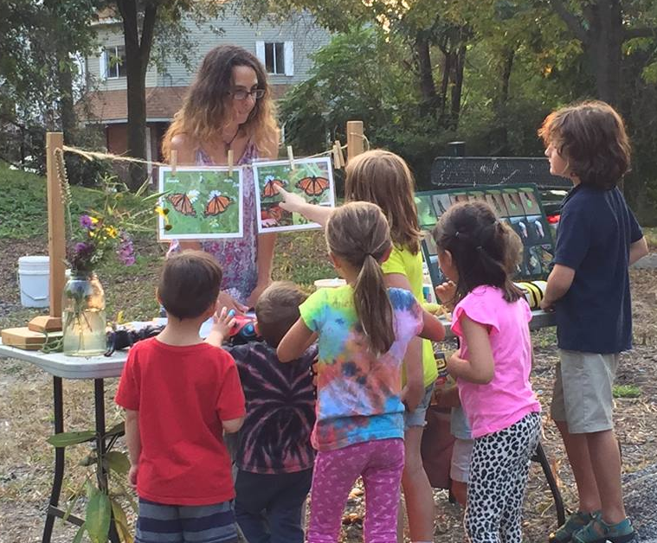
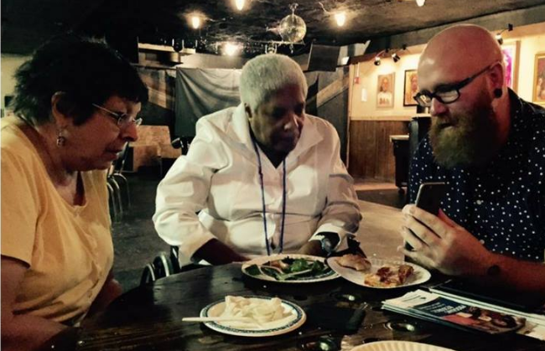
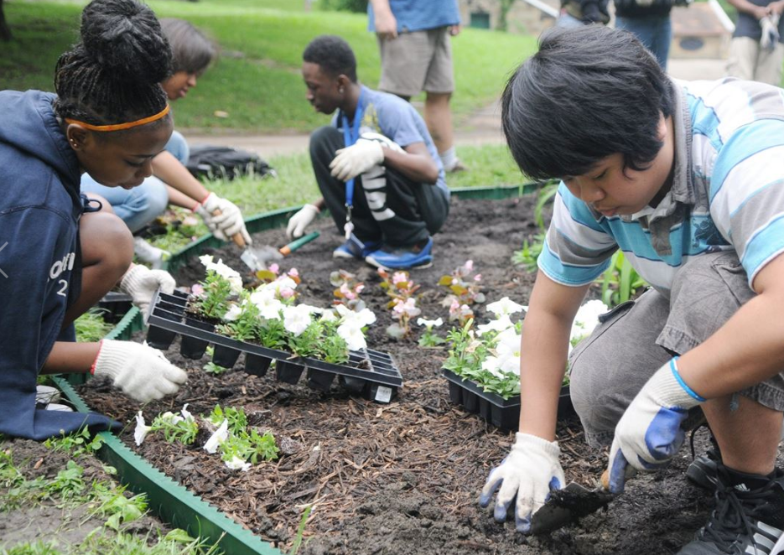
About Us
Mission: Improve and protect quality of life for all Lawrenceville residents
Membership of over 500 residents
Board of Directors comprised of residents: elected by membership
Programs: Public Safety, PEP Rally, AdvantAGE, Farmers Market, Cleaning and Greening, Community Events, advocacy, and more.

Slide 8
Why We’re Here
12 separate incidents reported to Lawrenceville United in the past 6 months:
Three acts of vandalism against a minority-owned business
7 reports of flyers from a national white supremacist / neo-Nazi organization
Anti-Semitic defacement of a storefront the night after Tree of Life: specifically called out an individual and business
Appearances of swastikas, “SS bolts,” and KKK symbols

Slide 9
Context
Other acts of intimidation or hate based on identity (race, LGBTQ, immigrants and refugees, gender, gender identity, etc.)
Violent crimes: down 25% in Lawrenceville between 2017 and 2018
Violent crimes in Lawrenceville 2018 are 1/3 of what they were 5 years ago.
Total crime went up in 2018, due to 42% increase in property crimes in 2018 (still 11% decrease over 5 year average).
Total crime rate per 1,000 people was about ½ that of Zone 2’s average in 2018, well below the City of Pittsburgh average.

Slide 10
A word from Jewish Federation

Slide 11
Objectives
Increased reporting of incidents of hate or bias-related violence and property both nationally & in Western PA
Differentiate between First Amendment-protected activity, hate-related acts of violence, and violent extremism
Inform community members of basic signs, symbols, and behavioral indicators which may be exhibited by violent extremists to enhance the community’s ability to identify, intervene, and prevent violence
Shift focus from prosecution to prevention through community engagement and empowerment

Slide 12
What is a Federal Hate Crime?
Criminal offenses motivated, in whole or in part, by the offenders’ bias against the following protected classes:
Race
Religion
National origin
Ethnicity
Disability
Sexual orientation
Gender
Gender identity
Notes:
*Terms in Bold: Based on biases of actual or perceived. This is a result of the Matthew Shepard and James Byrd, Jr. Hate Crimes Prevention Act of 2009.

Slide 13
Hate Crime Statutes
Title 18 USC § 245-Federally Protected Activities
Force or threat of force based on Race, Color, Religion, National Origin
Title 18 USC § 247-Church Arson Prevention Act
Defacing, damaging, destroying religious real property; obstructing a person’s free exercise of religious beliefs
Title 18 USC § 249-Hate Crimes Prevention Act
Prohibits bodily injury (or attempts) due to actual or perceived Race, Color, Religion, National Origin, Religion, Gender Identity, Sexual orientation, and Disability
Title 42 USC § 3631-Fair Housing Act
Prohibits interference with housing rights based on Race, Color, Religion, National Origin, Gender, Disability, Familial Status

Slide 14
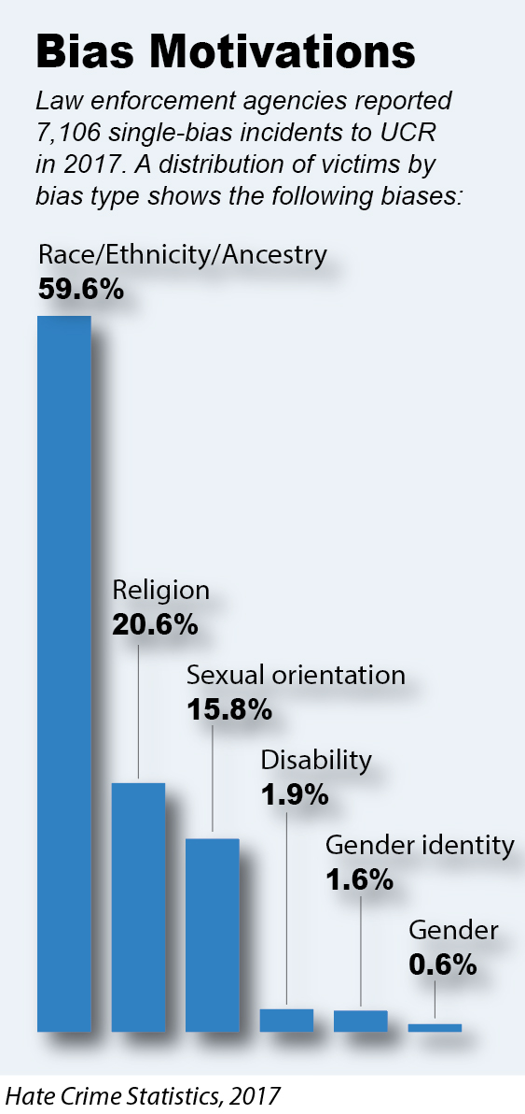
National Hate Crimes
7,106 single-bias incidents in 2017
8,493 victims
Religious Bias (1,564 incidents)
Jewish – nearly 60%
Islamic – over 17%
Racial/Ethnic Bias (4,131 incidents)
anti- Black/African American – nearly 49%
anti-White – nearly 18%

Slide 15
Free Speech
The First Amendment to the Constitution allows for the free expression of both offensive and hateful speech
Organizing a gathering to promote hate
Circulating offensive materials
Posting bigoted views online
→FBI cannot and does not “surf” for offensive or hateful speech or materials.
Notes:
Hate Crime- Traditional crime, such as assault or battery, motivated in part by a bias against the protected characteristics of an individual, a group, or an establishment.
Hate Incident- An act, by conduct or through words, motivated in part by a bias against the protected characteristics of an individual, a group, or an establishment in which there is no violation of the law.

Slide 16
Free Speech
The First Amendment is not extended to:
Criminal acts based on intolerance; or
Purposefully intimidating speech; or
Actions which can be interpreted by a reasonable person to be a serious intent to cause harm; or
Planning, preparation, commission, and/or facilitation of violence.
Notes:
Hate Crime- Traditional crime, such as assault or battery, motivated in part by a bias against the protected characteristics of an individual, a group, or an establishment.
Hate Incident- An act, by conduct or through words, motivated in part by a bias against the protected characteristics of an individual, a group, or an establishment in which there is no violation of the law.

Slide 17
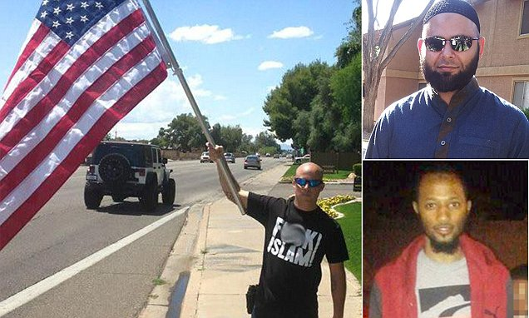
Hate Crime vs. Free Speech
A true Threat puts the recipient in fear of bodily harm

Slide 18
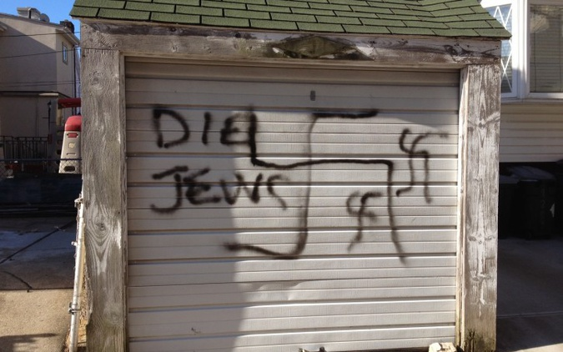
Hate Crime vs. Free Speech
A true Threat puts the recipient in fear of bodily harm

Slide 19
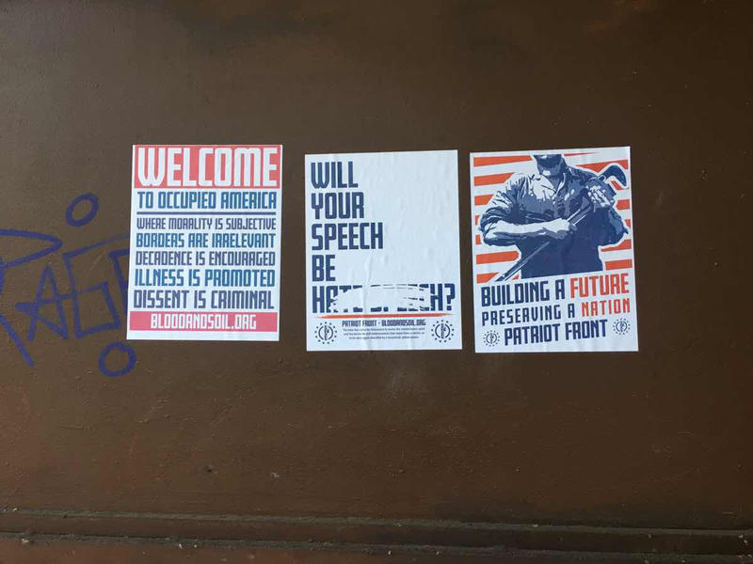
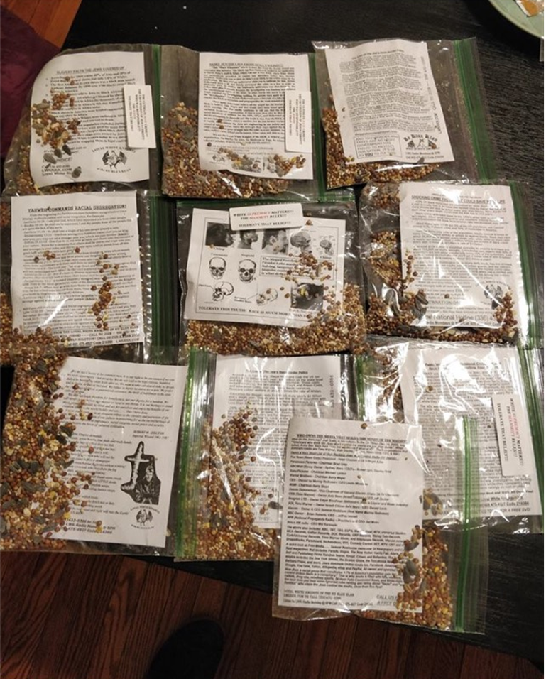
Hate Crime vs. Free Speech
A true Threat puts the recipient in fear of bodily harm

Slide 20
Intelligence Value
Hate-related propaganda, hateful speech, etc., may not rise to the level of a federal crime
→ Still of intelligence value and key to identification, intervention, and prevention

Slide 21
Key Considerations
WE - family members, friends, peers, co-workers, staff, and all community members are the keys to preventing acts of violence by active shooters and violent extremist
WE ALL need to be aware of some of the signs, symbols, and behavioral indicators often exhibited by extremists before they engage in hate crimes or other acts of violence
WE must move from reactive to proactive – working as a community to IDENTIFY, INTERVENE, and above all, PREVENT individuals from mobilization to violence

Slide 22
Key Considerations
No accurate demographic or “profile” for violent extremists (W/M highest statistically)
Focus must be on behavioral indicators over ideology
Goal – Prevention over prosecution – we can NOT prosecute our way to prevention
Seeing something is NOT enough - WE ALL must DO something as identifying and ACTING on indicators is crucial to intervention and prevention

Slide 23
Behavioral Indicators
Grievance narrative
Personal grievance vs. Collective grievance
“Leakage” – FBI Active Shooter Study
Vital intelligence value
51% - leaked intent to engage in violence
54% who observed leakage did NOTHING
83% communicated ONLY with the active shooter

Slide 24
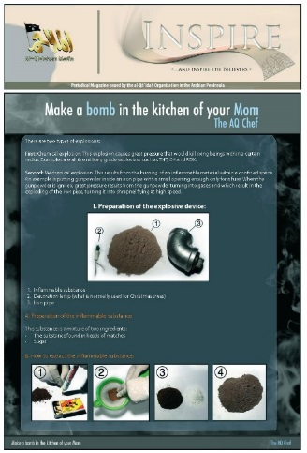
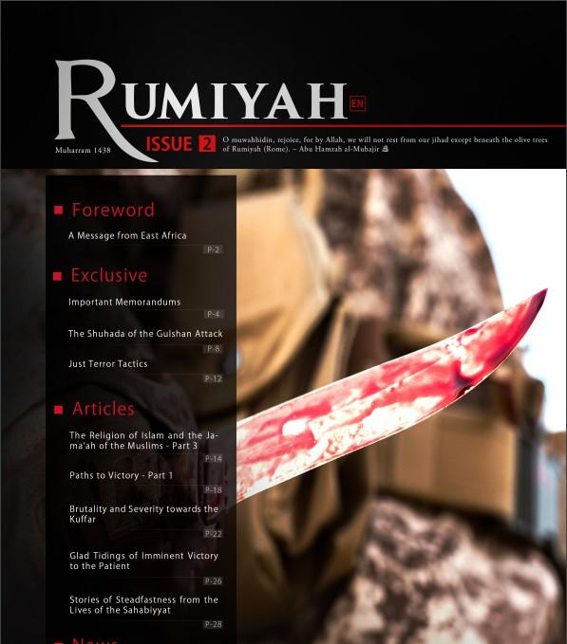
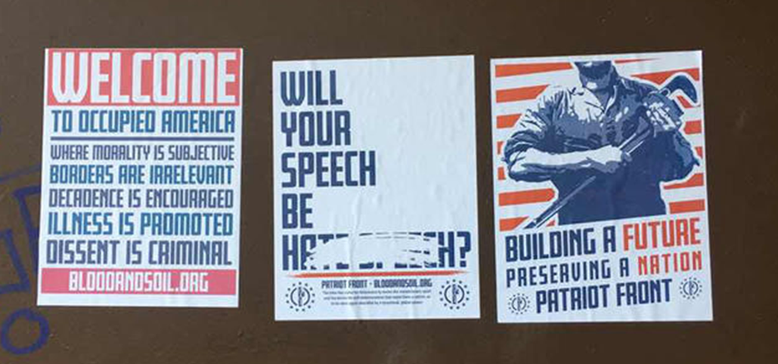
Behavioral Indicators
Increased consumption/sharing of propaganda

Slide 25
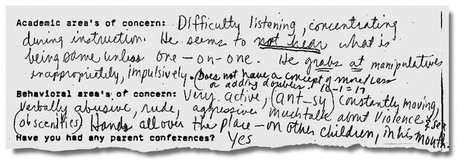
Behavioral Indicators
History of violence/fascination with violence
Violent history does not equal criminal history

Slide 26
Behavioral Indicators
Praising past attacks (warrior mentality)
Omar Mateen – suspended for 5 days on 9/13/2001 – “rule violation” (celebrated the terrorist attacks??)
Planning and preparation
Triggering event/life crisis

Slide 27
Racially Motivated Extremism
Communication with other threat actors
Social media, gaming platforms, encrypted messaging applications
Online recruitment/mobilization of at-risk, socially isolated, & marginalized individuals (youth)
Leverage desire to belong – to be a part of something bigger
Echo effect reinforces narrative
Signs/symbols reinforce ideological identity

Slide 28
Signs & Symbols

Slide 29
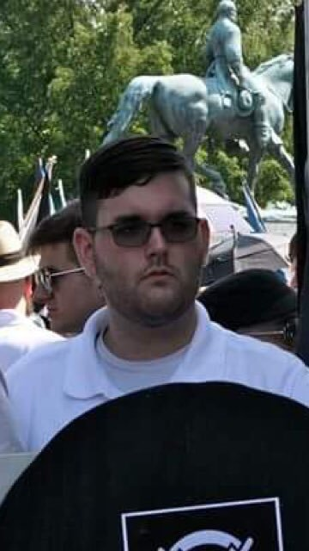
Extremist Indicators
Marginalized/at-risk - father killed by drunk driver before his birth
History of mental health/adjustment issues and failures
History of violence directed against mother – multiple calls to Florence PD – wielding knife; struck mother in head with phone
Teacher at Cooper HS (Union, KY) described Fields’ fascination with Hitler/Nazis – racist views
2015 trip to Dachau – “This is where the magic happened”
James Alex Fields Jr.

Slide 30
Community Engagement
FBI Limitations (Resources and First Amendment Restrictions)
FBI cannot “fish” on social media
FBI cannot identify all fliers, stickers, graffiti, etc. in neighborhoods
FBI is not a first responder; please call 911 during emergencies
If the community is not reporting it, we may not know about it
Reporting is a piece of a larger puzzle
Community-based reporting – empowers identification, intervention, and prevention while protecting the reporter (anonymous)

Slide 31
Resources
FBI Pittsburgh
412-432-4000
FBI Online Tips and Public Leads
www.fbi.gov/tips
Western Pennsylvania All Hazards Fusion Center
WPAHFC@pa.gov

Slide 32
Contact Information
Jade Burka
Intelligence Analyst
jburka@fbi.gov
Matthew Trosan
Supervisory Intelligence Analyst
mtrosan@fbi.gov
412-432-4461
Madisyn Moore
Staff Operations Specialist
mmoore4@fbi.gov
John Pulcastro
Supervisory Intelligence Analyst
jppulcastro@fbi.gov
412-432-4243

Slide 33
Keep in Touch
118 52nd Street, Suite 2026
Pittsburgh, PA 15201
412-802-7220
info@LUnited.org
www.facebook.com/LawrencevilleUnited
Twitter: @LVilleUnited

