Slide 1
Inclusionary Zoning in Lawrenceville
Department of City Planning
November 5, 2018

Slide 2
Overview
Interim Planning Overlay District
Need, Purpose and Intent
Applicability
Inclusionary Zoning (IZ) Policy Standards
Question and Answer

Slide 3
Inclusionary Zoning in Lawrenceville: Proposal
Inclusionary Zoning Interim Planning Overlay District (IPOD-6)
What is an IPOD?
Tool that provides TEMPORARY zoning controls in a specific area of the City where existing zoning doesn't provide sufficient standards for the area's current activities.
Does not replace an area's base zoning.
Can only add more controls, cannot add incentives.
Once approved by City Council, an IPOD is in place for 18 months. It can be extended an additional six months by Council.
Intent is to be replaced by permanent zoning through further study

Slide 4
Inclusionary Zoning in Lawrenceville: Proposal
Mandatory – requires affordable units as a part of development
Putting the policies of the IH/IZ Working Group into legislation
Will include:
Details for amount of units affordable
Details for income limits of affordable units
Standards for affordable units
Pricing Standards
Monitoring and Compliance
Automatically achieves the Incentive-based IZ in the Riverfront (RIV)

Slide 6
Need
To ensure that:
Diverse housing options continue to be available in the Lawrenceville neighborhood.
The neighborhood can continue to offer new housing units at a variety of price points.

Slide 7
Purpose & Intent
To leverage development pressure by connecting the production of affordable housing with the current market production of housing units.
To encourage diverse and balanced housing is available for households at a variety of income levels
Utilizing sites in IPOD-6 as opportunities to build more mixed-income developments. Because remaining land appropriate for residential development within the IPOD-6 is limited, it is essential that a reasonable proportion of such land be developed into housing units affordable to very low, low, moderate and middle-income residents and working people.

Slide 8
Applicability
What projects will need to provide affordably-priced units?
Every new construction, substantial rehabilitation, or conversion / reuse project with 20 or more residential units for sale or for rent.

Slide 9
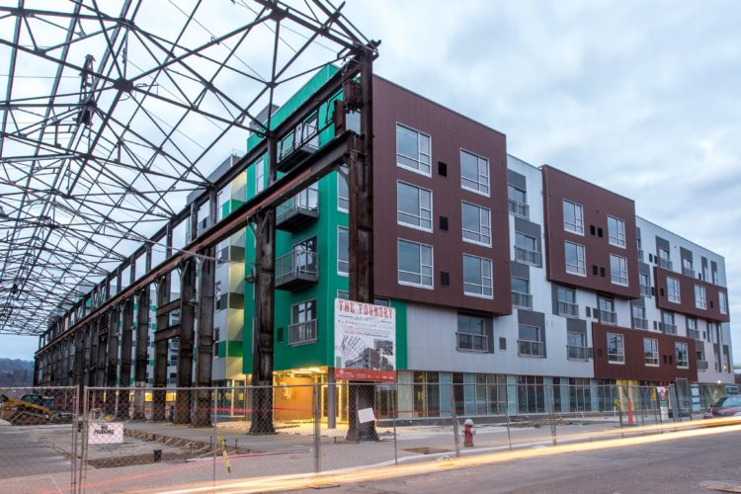
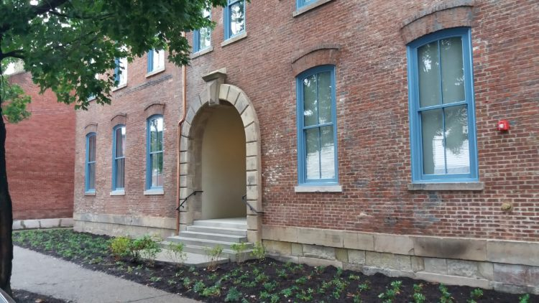
Applicability
Foundry at 41st Street: 191 units
Bayard School Lofts: 11 apartments

Slide 10
Applicability (recent projects)
Project | Units
Milhaus Phase I | 243
The Foundry | 191
Mews on Butler | 67
Doughboy Square Apartments | 45
Heartland Homes | 31
McCleary Condos | 25
Total to date: | 602
Project | Units
The Wainwright | 15
Mintwood Warehouse | 17
Bayard School Lofts | 11
Butler Street Lofts | 13
Squareview Apts | 11
Shoppes at Doughboy | 11
TOTAL | 78

Slide 11
Standards
What income levels may participate?
To rent, a household can't earn more than 50% AMI.
To own, a household can't earn more than 80% AMI.
Notes:
To rent, a household can't earn more than 50% AMI.
To own, a household can't earn more than 80% AMI.

Slide 12
Standards
How will affordable units be priced?
Units will be priced at no more than 30% of income (based on AMI standards)
Notes:
A general rule of thumb is that a household shouldn't spend more than 30% of its income on housing.

Slide 13
What is Allowable Pricing in Allegheny County?
Notes:
IN CASE THERE ARE QUESTIONS:

Slide 14
Standards
How many of the units will need to be priced affordably?
10% of units, rounding up if a fraction.
Examples:
21 units constructed
21 x .10 = 2.1
So 3 units would be constructed

Slide 15
Standards
Project | Units | 5% | 10% | 15%
Milhaus Phase I | 243 | 12 | 24 | 36
The Foundry | 191 | 10 | 19 | 29
Mews on Butler | 67 | 3 | 7 | 10
Doughboy Square Apartments | 45
Heartland Homes | 31 | 2 | 3 | 5
McCleary Condos | 25 | 1 | 3 | 4
Total to date: | 602 | 28 | 56 | 84

Slide 16
Standards
How long will units remain affordably priced?
35 years.
Notes:
This could be where we mention monitoring and compliance.

Slide 17
Standards
Will affordable units be different from market-rate units?
No.
They will need to be scattered throughout the building.
They will need to be the same size, have the same finishes, and have access to the same amenities.
Notes:
This could be where we mention monitoring and compliance.

Slide 18
Standards
Do the affordable units all need to be constructed on site?
A developer can put affordable units on another site, as long as they meet the following conditions:
Affordable units have to be built before, or at the same time, as market-rate units.
The other site can't be more than ¼-mile from the original site. It also can't be directly adjacent to the original site.
The off-site location must have comparable public transit service
Notes:
This could be where we mention monitoring and compliance.

