Slide 2
Welcome!
Grab some pizza!
Check out visual notes from last time
Grab meeting notes from last time

Slide 3
Agenda
Introductions and ground rules – 6:00-6:10 p.m.
Recap of last meeting + community voices – 6:10-6:20 p.m.
Inclusionary Zoning as a tool to preserve affordability – 6:20-6:55 p.m.
Q&A regarding inclusionary zoning – 6:55-7:15 p.m.
Break out groups – 7:15-7:45 p.m.
Report out and next steps – 7:45-8 p.m.

Slide 4
About Tonight
Meeting #1 was held on Tuesday, 9/25 – State of Housing in Lawrenceville, Displacement, and What’s Being Done About It
TONIGHT: Meeting #2: Wednesday 10/17 – Inclusionary Zoning – A Tool to Preserve Affordability
Meeting #3: Monday, 11/5 – Community Feedback & Call to Action

Slide 5
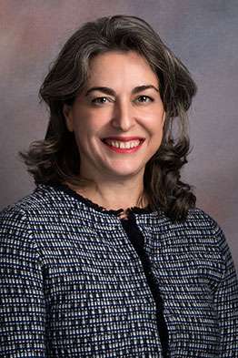
Who we are

Slide 6
Community Agreements: be neighborly
Take care of yourself
Be respectful of everyone: don’t denigrate groups of people
“Literary moment”
Speak from your own experience
Make space, take space
“Ouch”: if someone makes a statement that you find hurtful, let them know why
“Oops”: If you have said something that was hurtful – do your best to apologize and avoid it in the future
One microphone
Expect and accept non-closure
No one knows everything, together we know a lot
Save questions for the Q&A period. Share the time, ID yourself. If you have additional questions, send them in and we’ll follow up with answers

Slide 7
Agenda
Introductions and ground rules – 6:00-6:10 p.m.
Recap of last meeting + community voices – 6:10-6:20 p.m.
Inclusionary Zoning as a tool to preserve affordability – 6:20-6:55 p.m.
Q&A regarding inclusionary zoning – 6:55-7:15 p.m.
Break out groups – 7:15-7:45 p.m.
Report out and next steps – 7:45-8 p.m.

Slide 8
Recap of last meeting
See our website (www.LUnited.org) for full presentation
Meeting notes from break-outs are available at the sign-in table + answers to questions

Slide 9
What is “affordable housing” anyway?
Housing is deemed affordable when no more than 30% of household income is spent on housing: rent or mortgage, plus other housing costs like utilities.
Affordable housing typically refers to housing that is affordable to households at a certain percentage of Area Median Income (AMI). Based on Pittsburgh metro area and differs for household size.
Affordable rental housing typically caps at 50-60% AMI or below
Affordable owner-occupied housing typically caps at 80% AMI

Slide 10
Greater Pittsburgh Area Median Income
 | Household Size
 | 1 | 2 | 3 | 4 | 5
50% AMI | $25,450 | $29,050 | $32,700 | $36,300 | $39,250
70% AMI | $34,930 | $39,900 | $44,870 | $49,840 | $53,830
80% AMI | $40,700 | $46,500 | $52,300 | $58,100 | $62,750
100% AMI | $50,900 | $58,100 | $65,400 | $72,600 | $78,500

Slide 11
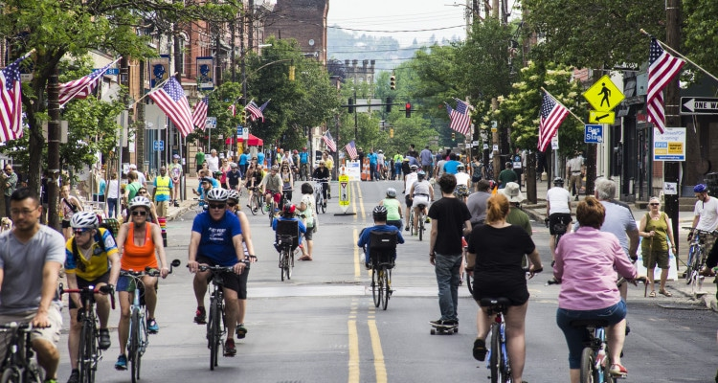
A growing neighborhood…
Crime rates down, schools/transportation improving
Lawrenceville among top neighborhoods for # of residential building permits
Over 700 units complete, underway, or approved in multi-family residential development in past 5 years
Lawrenceville among fastest growing millennial neighborhoods: 52% increase for 15201 from 2011 to 2016

Slide 12
…but not for all
Median home sale price eclipsed what a buyer at 80% AMI can afford in 2012 and continues to climb
Rent also climbing, especially for poorer residents
Median 1-BR rent = $1,300 for past 12 months, according to Rentometer.com, compared to $713, which is what a renter at 50% AMI can afford.
Lawrenceville lost over half (120) of its Housing Choice Voucher (Section 8) units between 2011 and 2016
Evictions disproportionately affecting one-parent renters with kids
Loss of 31% of black residents between 2013 and 2016, 83% loss of “some other race”
Losing children, low-income residents, long-time homeowners

Slide 13
Questions from last time
Why not use more of the houses that are already here?
Have property taxes increased in ways that affect people’s affordability?
How can I get involved in the process of affordable housing?
How specific will parameters be with inclusionary zoning?

Slide 14
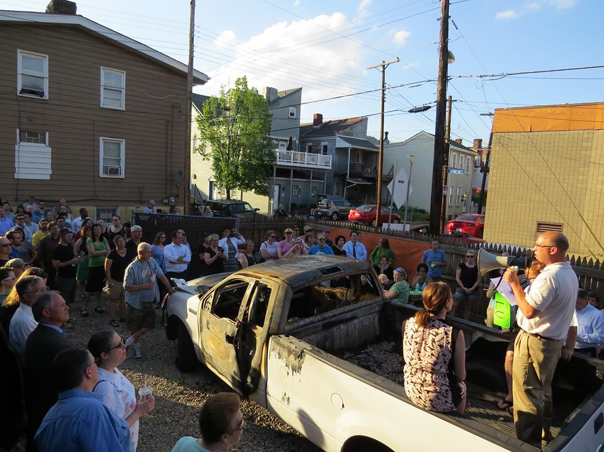
Community Voices

Slide 15
Agenda
Introductions and ground rules – 6:00-6:10 p.m.
Recap of last meeting + community voices – 6:10-6:20 p.m.
Inclusionary Zoning as a tool to preserve affordability – 6:20-6:55 p.m.
Q&A regarding inclusionary zoning – 6:55-7:15 p.m.
Break out groups – 7:15-7:45 p.m.
Report out and next steps – 7:45-8 p.m.

Slide 17
Why Inclusionary Zoning?
886 jurisdictions with inclusionary housing programs in 25 states, with over 170,000 units created
Increasingly prevalent tool for producing affordable housing in light of shrinking federal funds
Useful to share the benefits of growth, maintain economic integration
Studies confirm that it’s effective at creating affordable housing in areas with lower concentrations of poverty, higher-performing schools
Montgomery County: half of affordable housing production was created by IZ
Southern California: IZ creating as many units annually as LIHTC

Slide 18
Potential Impact Locally
Project | Units | 5% | 10% | 15%
Milhaus Phase I | 243 | 12 | 24 | 36
The Foundry | 191 | 10 | 19 | 29
Mews on Butler | 67 | 3 | 7 | 10
Doughboy Square Apartments | 45
Heartland Homes | 31 | 2 | 3 | 5
McCleary Condos | 25 | 1 | 3 | 4
Total to date: | 602 | 28 | 56 | 84

Slide 19
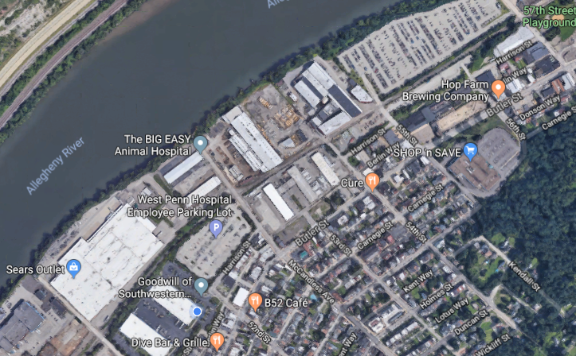
Still lots of land to be developed
61 acres of large “hinge” properties in Lawrenceville that have uncertain future and have potential to be redeveloped for residential

Slide 20
Agenda
Introductions and ground rules – 6:00-6:10 p.m.
Recap of last meeting + community voices – 6:10-6:20 p.m.
Inclusionary Zoning as a tool to preserve affordability – 6:20-6:55 p.m.
Q&A regarding inclusionary zoning – 6:55-7:15 p.m.
Break out groups – 7:15-7:45 p.m.
Report out and next steps – 7:45-8 p.m.

Slide 21
Agenda
Introductions and ground rules – 6:00-6:10 p.m.
Recap of last meeting + community voices – 6:10-6:20 p.m.
Inclusionary Zoning as a tool to preserve affordability – 6:20-6:55 p.m.
Q&A regarding inclusionary zoning – 6:55-7:15 p.m.
Break out groups – 7:15-7:45 p.m.
Report out and next steps – 7:45-8 p.m.

Slide 22
Break Out Groups
Based on what you heard tonight, what do you see as the opportunities and challenges about an IZ program in Lawrenceville?
What should the goals of an IZ program in Lawrenceville be – how should we measure success?
What questions do you still need answered, and what would you like us to focus on at the next meeting?

Slide 23
Community Agreements: be neighborly
Take care of yourself
Be respectful of everyone: don’t denigrate groups of people
“Literary moment”
Speak from your own experience
Make space, take space
“Ouch”: if someone makes a statement that you find hurtful, let them know why
“Oops”: If you have said something that was hurtful – do your best to apologize and avoid it in the future
One microphone
Expect and accept non-closure
No one knows everything, together we know a lot
Save questions for the Q&A period. Share the time, ID yourself. If you have additional questions, send them in and we’ll follow up with answers

Slide 24
Agenda
Introductions and ground rules – 6:00-6:10 p.m.
Recap of last meeting + community voices – 6:10-6:20 p.m.
Inclusionary Zoning as a tool to preserve affordability – 6:20-6:55 p.m.
Q&A regarding inclusionary zoning – 6:55-7:15 p.m.
Break out groups – 7:15-7:45 p.m.
Report out and next steps – 7:45-8 p.m.

Slide 25
Next Steps
Turn in any outstanding questions
Fill out the dot sheet as you leave
Presentation and break out group notes will be posted on LU’s website: www.LUnited.org
Third and final meeting is Monday, November 5th from 6-8 p.m.: Community Feedback and Call to Action
Keep in touch: 412-802-7220 and info@LUnited.org

