Slide 1

Affordable Housing in Pittsburgh
Department of City Planning
October 17, 2018

Slide 2
Overview
Affordable Housing Task Force
Affordable Housing Task Force Key Findings & Recommendations
Inclusionary Zoning Working Group
Inclusionary Zoning Report
Inclusionary Zoning in Lawrenceville
Next Steps

Slide 3
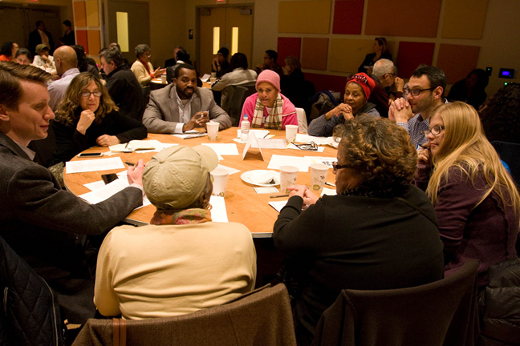
Affordable Housing Task Force
Executive Order issued by Mayor William Peduto creating the Affordable Housing Task Force
26 members including elected officials, market-rate & affordable housing developers, community organizers, and advocates
Four committees:
Policy and Recommendations
Community Engagement
Needs Assessment
Feasibility

Slide 4
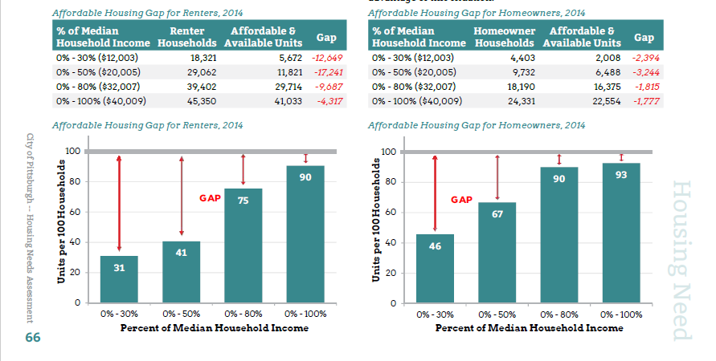

Slide 5
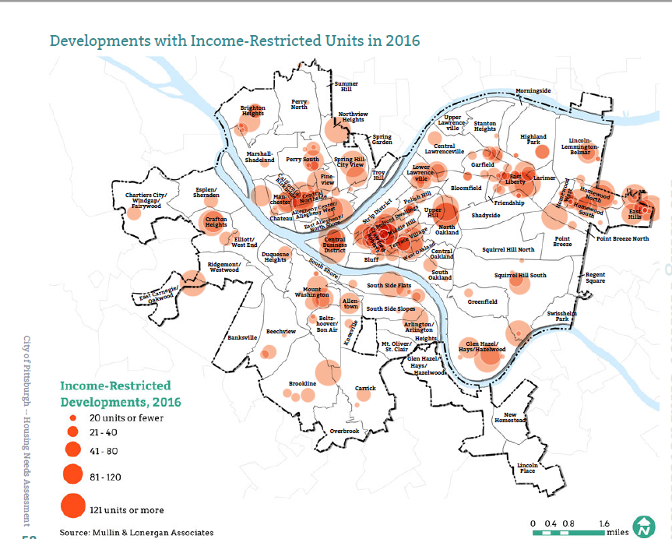

Slide 6
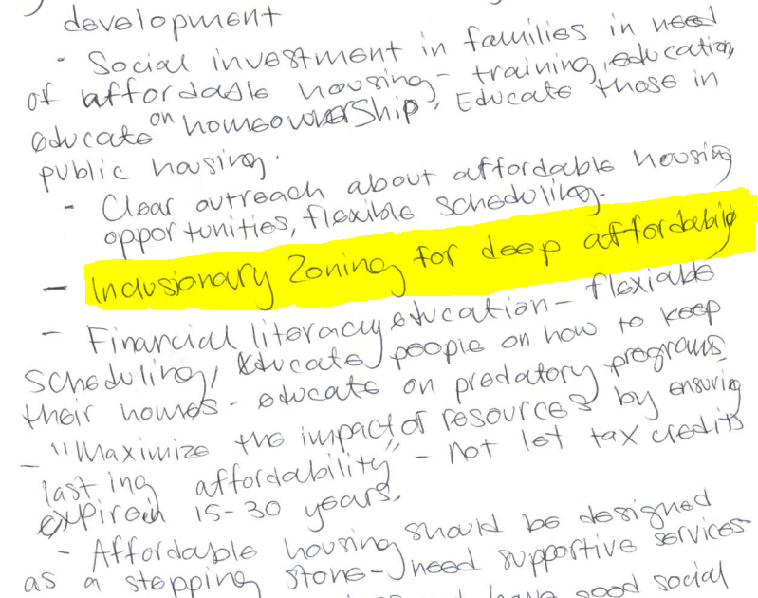
Community Engagement
Total number of participants: 425
Total number of surveys: 284
Five public meetings

Slide 7
Background: Affordable Housing Task Force Recommendations and Actions
Housing Opportunity Fund
$10 Million dedicated annually
Increased Utilization of 4% LIHTC (Low Income Housing Tax Credit)
URA (Urban Redevelopment Authority) Committee Established
Inclusionary Housing
Incentive Zoning and Inclusionary Housing Report (2017)
Preservation of Existing Affordable Housing
Public Housing Expiration Warning and Preservation System
Protection of Existing Homeowners and Tenants
Direction to develop a Longtime Owner Occupants (LOOP) Program

Slide 8
Affordable Housing Task Force Recommendations Website
http://pittsburghpa.gov/dcp/ahtf/index.html

Slide 9

Grounded Solutions Network
Oakland, California based Grounded Solutions Network (GSN) supports strong communities from the ground up. They work nationally, connecting local experts with the networks, knowledge and support they need.
GSN helps promote housing solutions that will stay affordable for generations so communities can stabilize and strengthen their foundation, for good.

Slide 10
Inclusionary Zoning Working Group
Low – Moderate income residents (2)
Housing Advocate Organizations (2)
Community and Non-Profit Development Groups (2)
Public and Private Finance Institutions (2)
Market-Rate Real Estate Developers (3)
Legal Experts (2)

Slide 11
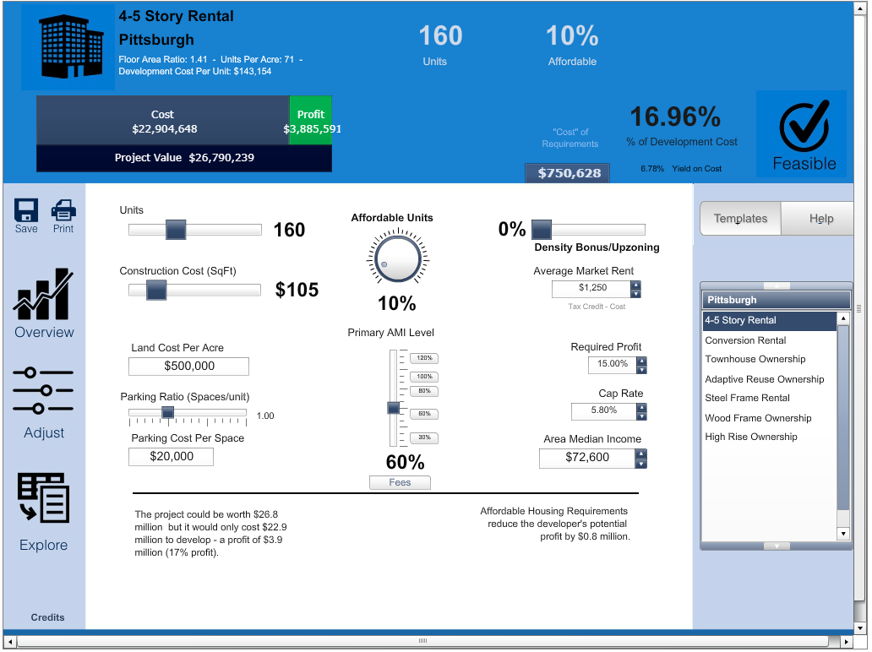

Slide 12
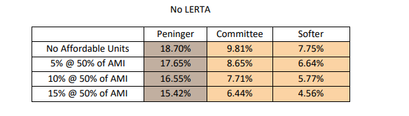

Slide 13
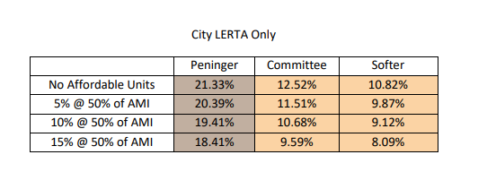

Slide 14
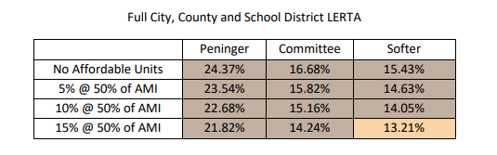

Slide 15
Inclusionary Zoning Report
Incentivized Mandatory Framework
By-Right LERTA (Local Economic Revitalization Tax Assistance)
Citywide Scope with Geographic Variation Only by Market Type
Type and Tenure of Development
Project Threshold Size
Income Qualifications and Pricing
Section 8

Slide 16
Inclusionary Zoning Report, Cont.
4% Low-Income Housing Tax Credit (80/20)
Duration of Affordability Requirements
Off-Site Performance Option
Design Standards
Location and Access for On-Site Units
Variance Process
Monitoring and Compliance

Slide 17
Inclusionary Zoning Report Website
http://pittsburghpa.gov/dcp/index.html

Slide 18
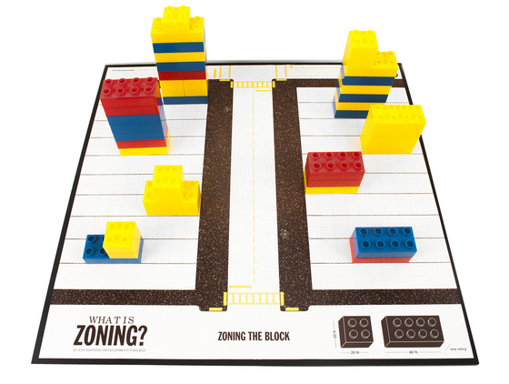
What is Zoning?
Zoning is a tool used by cities to promote the general welfare of the City and its residents by allowing the reasonable use of property to shape buldings, blocks, and neighborhoods. Zoning can regulate things like:
The use of property
Building height & size (bulk)
Setbacks
Design elements
Parking
Landscaping
Signage

Slide 19
What is Inclusionary Zoning?
Inclusionary Zoning (IZ) is a tool achieves the intent of zoning through:
Tying the construction of affordable housing to that of market-rate housing.
Requiring / encouraging new residential development to make a percentage of the units affordable to residents of a certain income level (typically low- or moderate-income residents).

Slide 20
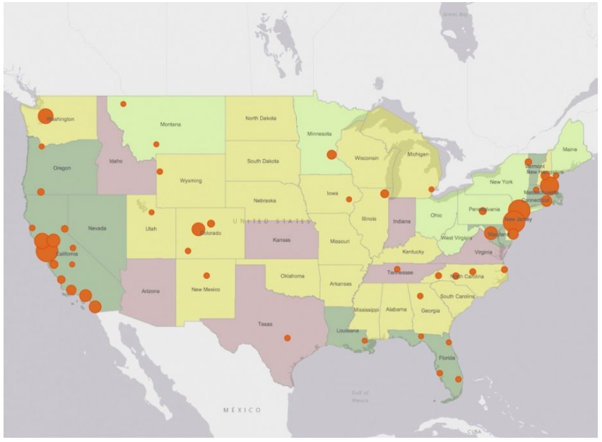
Inclusionary Zoning Programs

Slide 21
Types of Inclusionary Zoning
Mandatory
Requires a developer to provide affordable units
Incentive-based: provides affordable units in exchange for incentives:
Height bonus
Density bonus
Parking relief
Change in zoning
Other financial benefits

Slide 22
Inclusionary Zoning in Pittsburgh
Where?
Uptown Public Realm (UPR) - adopted December 2017
Riverfront Zoning District (RIV) - adopted July 2018
How?
Incentive-based through Performance Points
Points earned depend on level of affordability (60% AMI vs 80% AMI) and type of housing (sale or rent)
Points can be used for additional height (in both districts) or to build closer to the river (RIV)

Slide 23
Inclusionary Zoning in Lawrenceville: Proposal
Inclusionary Zoning Interim Planning Overlay District (IPOD-6)
What is an IPOD?
Tool that provides TEMPORARY zoning controls in a specific area of the City where existing zoning doesn't provide sufficient standards for the area's current activities.
Does not replace an area's base zoning.
Can only add more controls, cannot add incentives.
Once approved by City Council, an IPOD is in place for 18 months. It can be extended an additional six months by Council.
Intent is to be replaced by permanent zoning through further study

Slide 24
Inclusionary Zoning in Lawrenceville: Proposal
Previous IPODs
IPOD-1: Oakland (2001)
Replaced by Oakland Public Realm District
IPOD-2: Walnut Street (2002)
Expired – no new zoning developed
IPOD-3: Baum-Centre (2003)
Converted to Baum-Centre Corridor Overlay
IPOD-4: Uptown (2015)
Expired and replaced with new zoning developed during through community planning
IPOD-5: Riverfront (2016)
Expired and replaced with new zoning developed during through community process

Slide 25
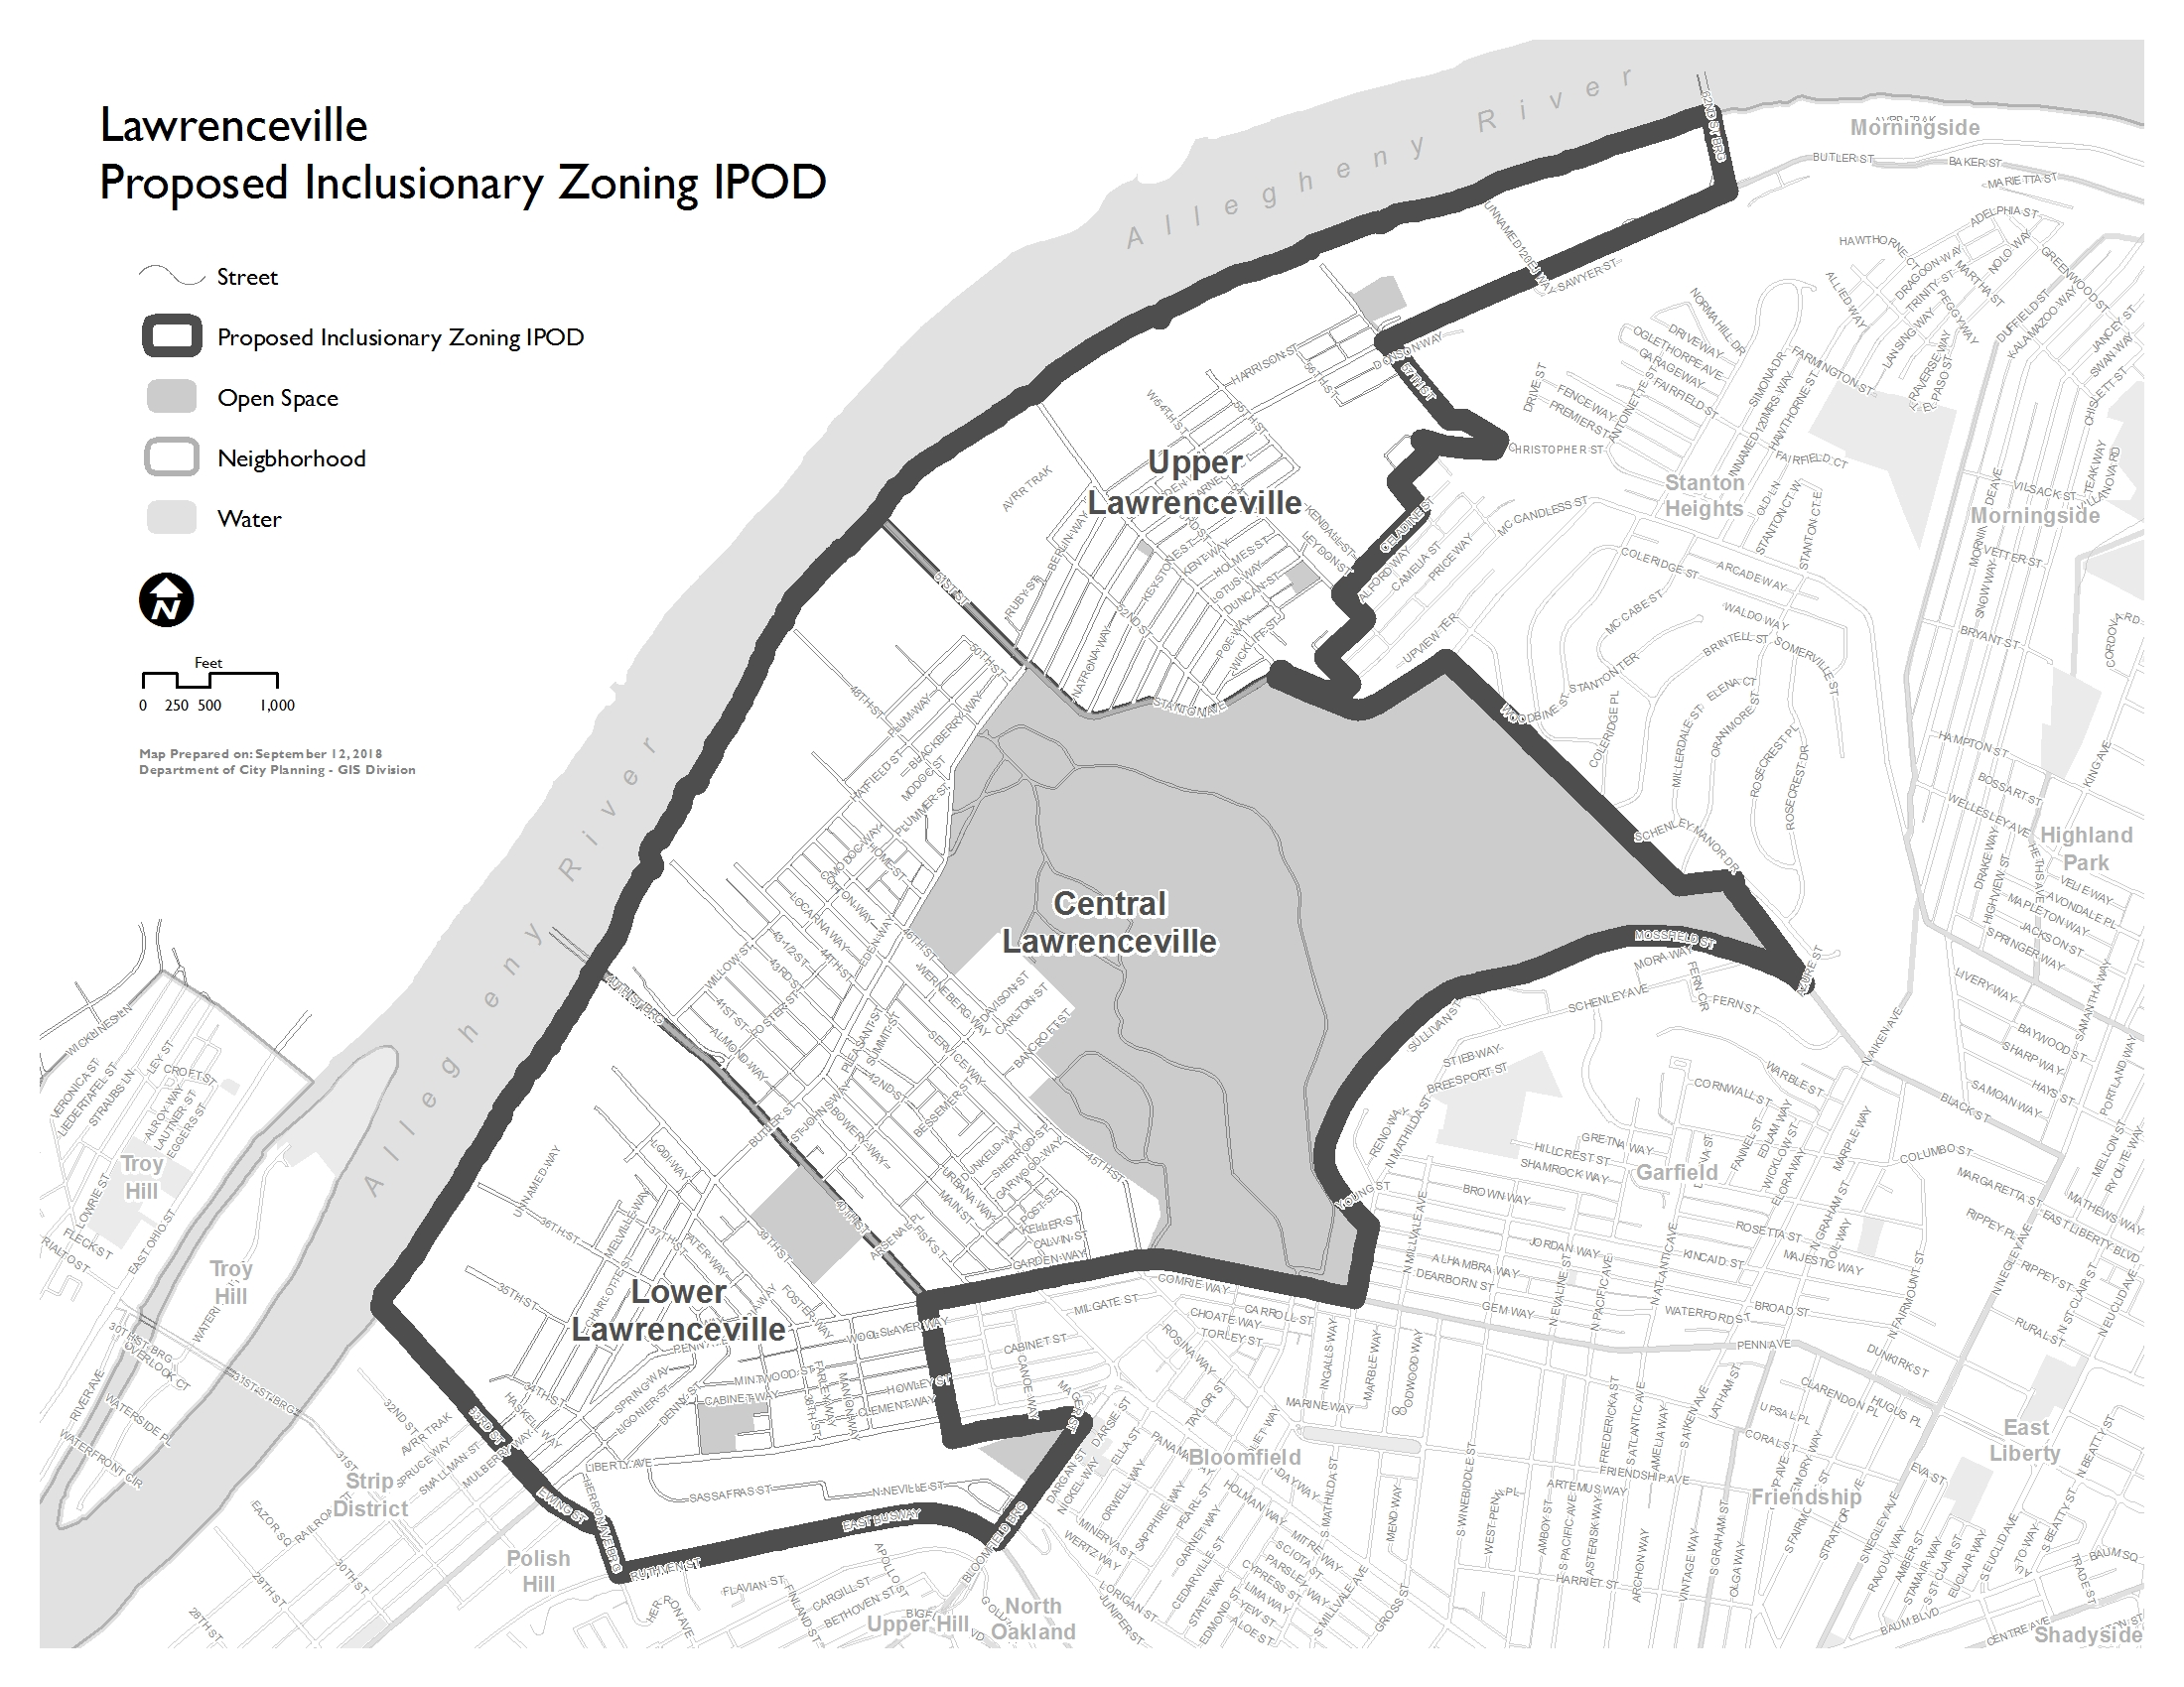

Slide 26
Inclusionary Zoning in Lawrenceville: Proposal
Mandatory – requires affordable units as a part of development
Putting the policies of the IH/IZ Working Group into legislation
Will include:
Details for amount of units affordable
Details for income limits of affordable units
Standards for affordable units
Pricing Standards
Monitoring and Compliance
Automatically achieves the Incentive-based IZ in the Riverfront (RIV)

Slide 27
Next Steps / Schedule
Draft Inclusionary Zoning Interim Planning Overlay District (IPOD-6)
Work with City Departments (Law, URA, HACP, Finance)
Community Meeting – November 5th
Discuss any outstanding questions from tonight
Discuss details of IZ Proposal (IPOD-6)
Incorporate Feedback into refined draft
Meet with Developers – November
Introduction of Legislation – November / December

Slide 28


