Slide 1
Community Meeting on Draft Operating Permit for McConway and Torley
November 16, 2017
6:30 p.m.
Arsenal middle school

Slide 2
Agenda
1. Welcome & introductions
2. Purpose of the meeting, ground rules, why this matters
3. ACHD presentation on draft operating permit for McConway and Torley
4. Q&A
5. Next steps

Slide 3
Who We Are
- Lawrenceville United (LU ) is an inclusive, resident-driven non-profit organization that works to improve and protect the quality of life for all Lawrenceville residents.
- Lawrenceville Corporation (LC)’s mission is to act as a catalyst and conduit for responsible growth and reinvestment in the Lawrenceville community.
- Allegheny County Health Department (ACHD)’s mission is to protect, promote, and preserve the health and well-being of all Allegheny County residents, particularly the most vulnerable.
ACHD’s Air Quality Program is responsible for protecting the public’s health by regulating air pollutants within Allegheny County, enforcing federal pollution standards, and permitting industrial sources of air pollution.

Slide 4
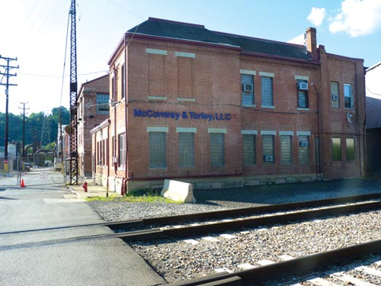
McConway and Torley
One of Pittsburgh’s oldest steel foundries and has been in operation since 1868
Manufactures steel castings for the railcar industry and sells products in both national and international markets
Owned by Dallas-based Trinity Industries, #539 on the 2017 Fortune 500 list in 2017
420 employees in 2014

Slide 5
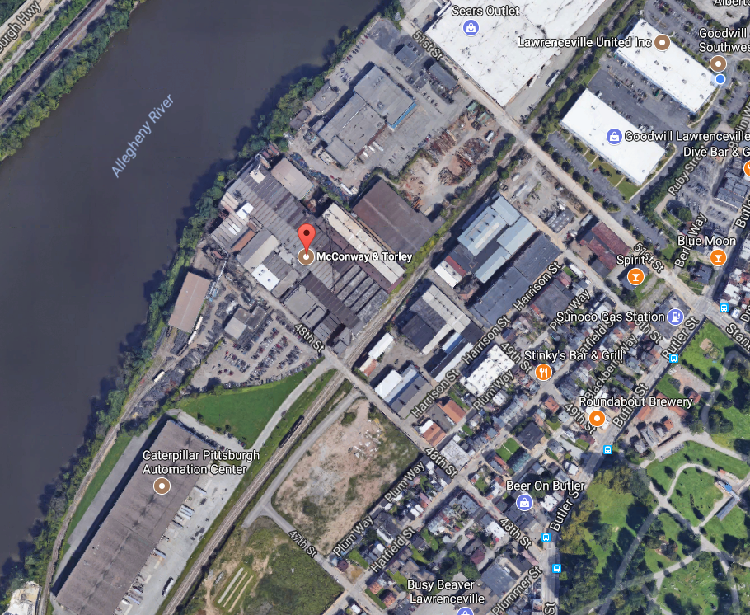

Slide 6
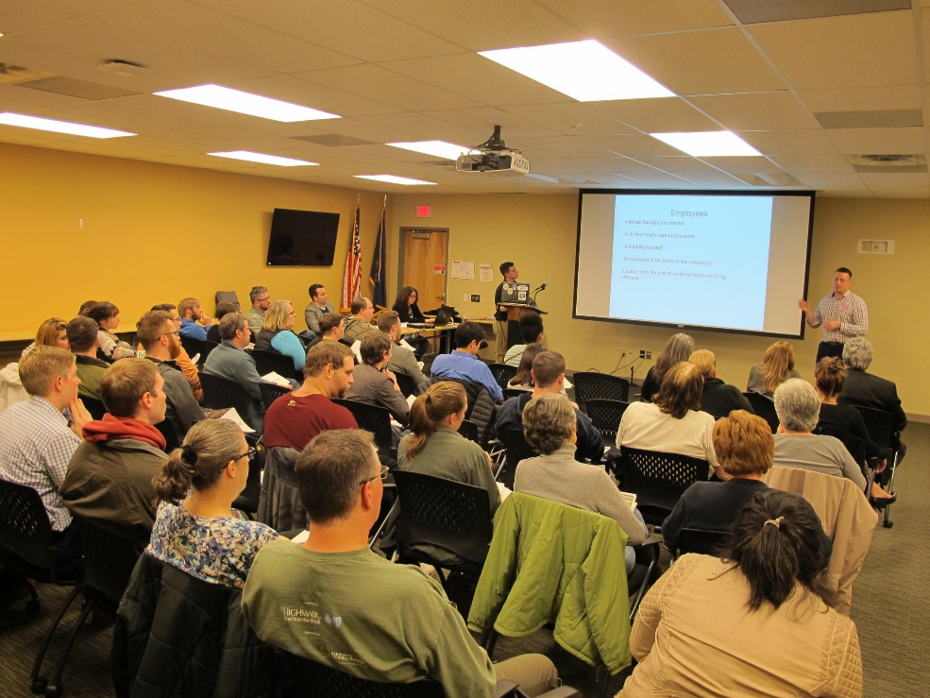
Purpose of the meeting
Tonight is intended to be an INFORMATIONAL meeting with Allegheny County Health Department, so that the community can better understand what’s in the draft operating permit for McConway and Torley, and how it was created
This is NOT a public hearing, or a debate

Slide 7
Opportunities to make comments
Again, tonight is NOT a public hearing, but there are opportunities for you to engage before the end of the public comment period on December 4, 2017, and we encourage you to reach out to the community groups with feedback/input.
PUBLIC HEARING: Monday 12/4 at 6 p.m. at Arsenal Middle School auditorium (220 40th Street). To register to speak, call Karen Sagel at (412) 578-8115 no later than 4 p.m. on Friday, December 1, 2017. Written copies of comments should be submitted at the time of testimony.
Written comments may be submitted to ACHD by emailing aqpermits@alleghenycounty.us or by mail:
301 39th Street
Pittsburgh, PA 15201-1811
Contact your friendly resident advocacy organization, Lawrenceville United, at 412-802-7220, info@LUnited.org, or 118 52nd Street (Suite 2026), Pittsburgh, PA 15201

Slide 8
Ground Rules
Please hold all questions for the end of the presentation. We will go back to a slide if there is a specific question or comment, so please jot own notes that you may want to revisit when we open it for Q&A.
Once opened for Questions and Comments, please raise your hand and only proceed with your question or comment once you have been acknowledged by the facilitator. Please also identify yourself by name, and also your relationship or interest in the issue.
Please be respectful of all speakers, including those asking questions and making comments.
Questions/ comments will be limited to 2 minutes each. A clarification question or comment will be permitted.
If time permits, we will call on individuals who would like to ask or make a second or additional question or comment.
Please also use index cards available if you’d like to submit a comment or question but are not able to in the meeting. We will compile as part of notes from the meeting.
If the ground rules are violated or ignored, we will ask the individual to leave the meeting, and if it continues, we will end the meeting.

Slide 9
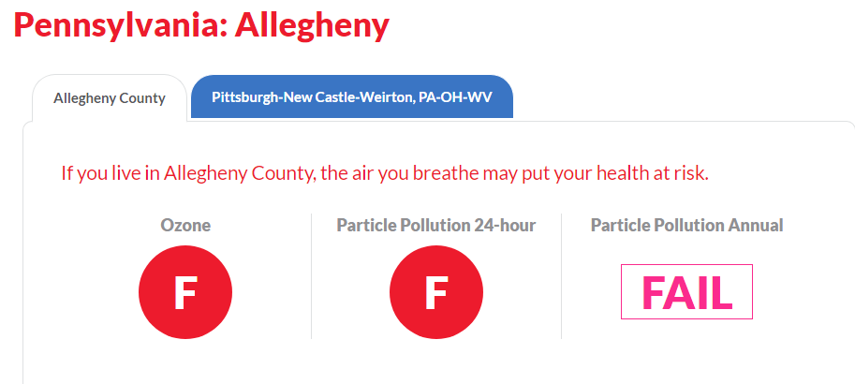
Why This Matters – Air Quality in Pgh
Pittsburgh ranks as the #8 most polluted city in America by year round particle pollution, #17 by short-term particle pollution
Ranked the most polluted city in 2008, so we have improved
Pittsburgh also ranks as #29 for high ozone days out of 228 metropolitan areas
Allegheny County received an “F” for both particle pollution and high ozone days in 2017
American Lung Association,
State of the Air 2017

Slide 10
Why This Matters – Air Quality in Pgh
Air pollution is the 4th highest-ranking risk factor for death globally, and the 10th highest-ranking risk factor in the United States (Breathe Easy Millvale)
The health effects of air pollution include increased risks of cardiovascular disease, lung cancer, asthma & respiratory disease, reproductive and developmental outcomes (Breathe Easy Millvale). Other health risks from pollution include susceptibility to infections, shortness of breath, wheezing and coughing, asthma attacks, and premature death (American Lung Association).
Most at risk: elderly, those with lung and heart disease, children, and groups that work, play, and exercise outdoors (Breathe Project). Studies have also shown that low socioeconomic status increased the risk of premature death from fine particle pollution (American Lung Association).

Slide 11
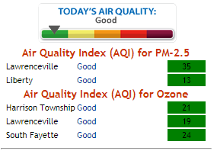
Why This Matters – Air Quality in Pgh
The largest aggregated source of local particle pollution in Allegheny County (28% of total emissions) is industrial processing including coke battery production, steel mills, metal processing and chemical manufacturing.
The second most common source (20%) is residential fuel consumption for heating; wood burning (e.g. fireplaces, wood stoves) contributes the vast majority of this source.
(Breathe Project)

Slide 12
Pollutants
Criteria Pollutants – 6 defined by the EPA: particle pollution, ozone, carbon monoxide, sulfur dioxide, nitrogen oxides, and lead.
EPA designates what level of these six pollutants is the upper health limit in our ambient air -- National Ambient Air Quality Standards (NAAQS)
Hazardous air pollutants – known or suspected to cause cancer or other serious health effects, such as reproductive/birth effects, or adverse environmental effects.
187 designated by the EPA

Slide 13
Relevant Pollutants for M&T
Operating as a synthetic minor source of:
carbon monoxide (CO)
Operating as a minor source of:
particulate matter less than 10 microns in diameter (PM10)
particulate matter less than 2.5 microns in diameter (PM2.5)
volatile organic compounds (VOCs)
nitrogen oxides (NOX)
sulfur dioxide (SO2)
hazardous air pollutants (HAPs)
Also relevant and included in the emission limits of the draft operating permit:
benzene (5th largest source of all stationary air pollution sources in Allegheny County in 2016)
manganese (5th largest source of all stationary air pollution sources in Allegheny County in 2016)
chromium (8th largest source of all stationary air pollution sources in Allegheny County in 2016)

Slide 14
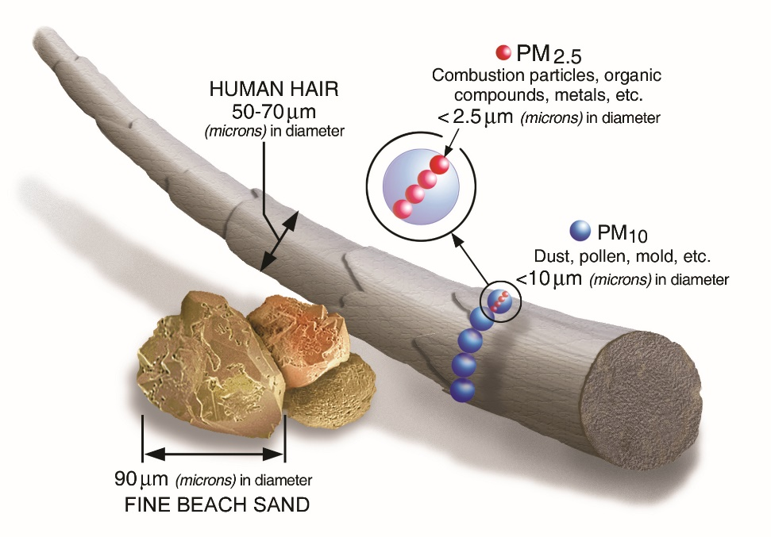
Relevant Pollutants – Particulate Matter (PM2.5 and PM10)
“The size of particles is directly linked to their potential for causing health problems. Controls are needed for particles that are 10 micrometers in diameter or smaller because those are the particles that generally pass through the throat and nose and enter the lungs. Once inhaled, these particles can affect the heart and lungs and cause serious health effects.” (ACHD.net)
Linked to the following health problems:
Increased respiratory symptoms, such as irritation of the airways, coughing, or difficulty breathing
Decreased lung function
Aggravated asthma
Development of chronic bronchitis
Irregular heartbeat
Nonfatal heart attacks
Premature death in people with heart or lung disease

Slide 15
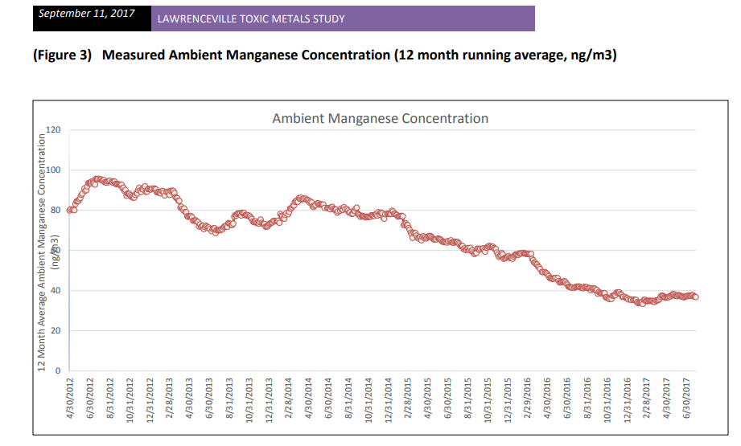
Relevant Pollutants – Manganese
Exposure to high levels can experience health problems involving the nervous system, and undesirable effects on brain development in children (ATSDR).

Slide 16
Speak up!
PUBLIC HEARING: Monday 12/4 at 6 p.m. at Arsenal Middle School auditorium (220 40th Street). To register to speak, call Karen Sagel at (412) 578-8115 no later than 4 p.m. on Friday, December 1, 2017. Written copies of comments should be submitted at the time of testimony.
Written comments may be submitted to ACHD by emailing aqpermits@alleghenycounty.us or by mail:
301 39th Street
Pittsburgh, PA 15201-1811
Contact your friendly resident advocacy organization, Lawrenceville United, at 412-802-7220, info@LUnited.org, or 118 52nd Street (Suite 2026), Pittsburgh, PA 15201

