Slide 1
Review of the McConway & Torley Air Operating Permit
Lawrenceville United
November 16, 2017

Slide 2
Introductions
JoAnn Truchan, P.E. – Section Chief of Engineering & Permitting
David Good – Air Quality Engineer III

Slide 3
The Purpose of Tonight’s Meeting
Give you an overview of McConway & Torley and their operations.
Explain how we evaluate the processes at McConway & Torley and quantify them into a permit.
Show how an air permit helps to protect the citizens of Lawrenceville.
Hopefully help you to become more informed so you can comment during this public comment period.

Slide 4
What’s in a Permit?
The 7 Major Sections to an Air Permit
Contact Information
Facility Description
General Conditions
Site Level Terms and Conditions
Emission Unit Level Terms and Conditions
Alternative Operating Scenarios
Emissions Limitations Summary

Slide 5
What’s in a Permit? (cont’d.)
Section V – Emission Unit Level Terms and Conditions
There’s a section for each process or major piece of equipment
Restrictions
Testing
Monitoring
Recordkeeping
Reporting
Work Practice Standards

Slide 6
What’s in a Permit? (cont’d.)
The Technical Support Document describes the reasons the conditions were included in the permit.
Any applicable federal, state, or local regulations
Descriptions of how emissions limits were developed

Slide 7
What’s in a Permit? (cont’d.)
The Comment/Response Document
Addresses all comments submitted during the public comment period that are germane to the permit.
Either revises the permit in response to the comment, or gives a reason why no change was made.

Slide 8
Agenda
McConway & Torley (M&T) Facility – What is a Steel Foundry?
Sources of Air Emissions at M&T
Summary of Potential Emissions at M&T
Process and Operation Changes Over the Last 3 Years
Changes in Potential Air Emissions
Monitoring Data
Sources of Toxicity
The Next Steps

Slide 9
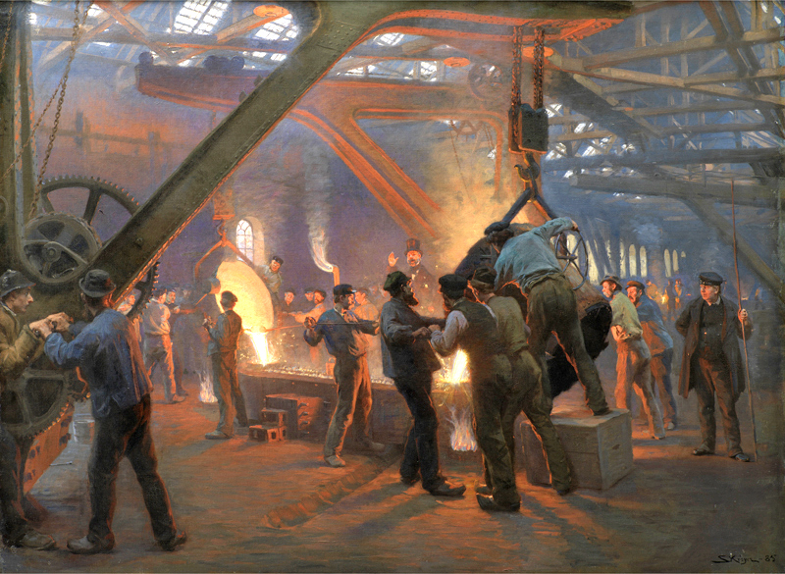
What is a Foundry?
A foundry is a factory that produces metal castings. Metals are cast into shapes by melting them into a liquid, pouring the metal in a mold, and removing the mold material or casting after the metal has solidified as it cools.

Slide 10
McConway & Torley Overview
Steel Foundry that manufactures railroad castings
Melting Operations:
Scrap metal melted in two (2) Electric Arc Furnaces.
Molten steel tapped into ladle and transferred to pour area.
Molten steel poured into sand molds with phenolic resin cores to create shapes/voids.
Mold/Core Operations
Molds made from compressed sand.
Cores made from a 99% sand and 1% resin mixture.
Shakeout: releases casting from mold.
Finishing Operations: grinding and sand blasting.

Slide 11
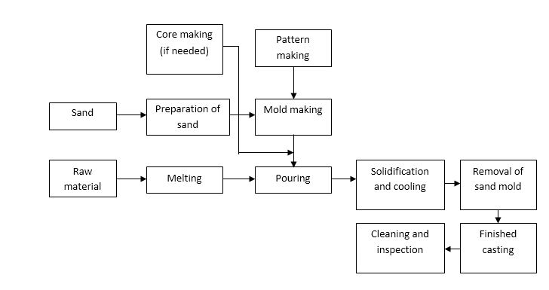
Scrap Metal

Slide 12
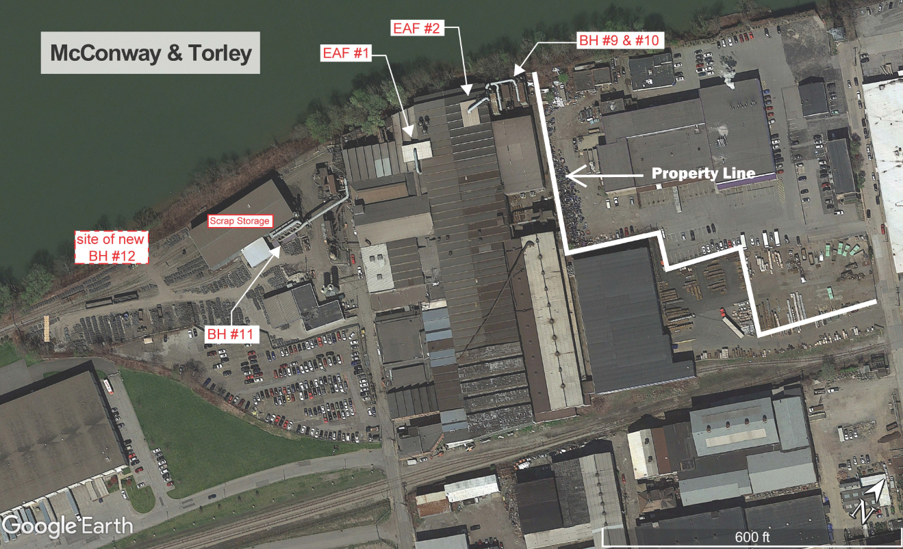
BH #2 &#6
Metals Monitor

Slide 13
Agenda
McConway & Torley (M&T) Facility – What is a Steel Foundry?
Sources of Air Emissions at M&T
Summary of Potential Emissions at M&T
Process and Operation Changes Over the Last 3 Years
Changes in Potential Air Emissions
Monitoring Data
Sources of Toxicity
The Next Steps

Slide 14
Sources of Air Emissions at M&T
Electric Arc Furnace (Melting)
Particulate matter and metal HAPs (hazardous air pollutants)
Carbon Monoxide, Nitrogen Oxides, Volatile Organic Compounds, HAPs
Pouring
Particulate matter and metal HAPs (hazardous air pollutants)
Carbon Monoxide, Volatile Organic Compounds, HAPs
Cooling
Carbon Monoxide, Volatile Organic Compounds, HAPs
Shakeout – release of casting from mold
Particulate matter and metal HAPs (hazardous air pollutants)
Carbon Monoxide, Volatile Organic Compounds, HAPs
Mold/Core Operations
Sand Particulate mater, Volatile Organic Compounds, HAPs
Finishing Operations - grinding and sand blasting.
Metal particulate matter

Slide 15
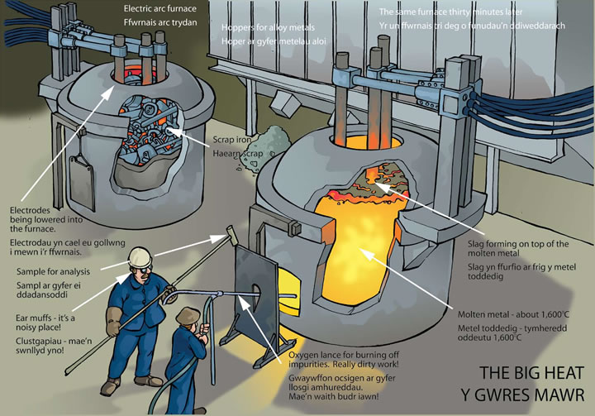

Slide 16
McConway & Torley Pollution Control Devices
6 Baghouses to capture/collect filterable particulate matter and metals.
2 Scrubbers to control odors from core-making operations.
Total Building Enclosure:
Cumulative air flow from the 6 baghouses creates a negative pressure differential inside the building.
All air exiting from the building goes through 1 of the 6 baghouses.

Slide 17
Agenda
McConway & Torley (M&T) Facility – What is a Steel Foundry?
Sources of Air Emissions at M&T
Summary of Potential Emissions at M&T
Process and Operation Changes Over the Last 3 Years
Changes in Potential Air Emissions
Monitoring Data
Sources of Toxicity
The Next Steps

Slide 18
POLLUTANT | ANNUAL EMISSION LIMIT (tons/year)*
PM10 | 52.94
PM2.5 | 52.03
Nitrogen Oxides | 45.38
Sulfur Oxides | 25.1
Carbon Monoxide | 96.25
Volatile Organic Compounds | 7.94
Benzene | 1.21
Metal HAPs | 0.16
Chromium | 0.014
Manganese | 0.10
Total HAPs | 7.90
* A year is defined as any consecutive 12-month period.

Slide 19
Agenda
McConway & Torley (M&T) Facility – What is a Steel Foundry?
Sources of Air Emissions at M&T
Summary of Potential Emissions at M&T
Process and Operation Changes Over the Last 3 Years
Changes in Potential Air Emissions
Monitoring Data
Sources of Toxicity
The Next Steps

Slide 20
Process and Operation Changes
Installation Permit no. 13
Total Enclosure
Facility-wide Emissions Measurements

Slide 21
Installation Permit No. 13
Replacement of Baghouses 5 & 8 with single dust collector (Baghouse No. 12)
New sand reclaim units
Increased airflow (180,000 vs 110,000 ACFM)
Lower particulate emissions
Recycling of sand
Less material use
Lower frequency of truck traffic

Slide 22
Total Building Enclosure
Operation of all 6 baghouses simultaneously creates negative pressure within main building.
Verified by EPA Method 204 testing in May of 2015 and visual observation during other tests.
Fugitive emissions (not directly captured by a baghouse) now must exit 1 of the 6 baghouses.
Significantly reduces potential particulate and metals emissions.

Slide 23
Facility-wide Emissions Measurements
Total Building Enclosure directs ALL emissions within the main foundry building to the 6 baghouses (only exit points).
Allows for ALL emissions to be measured at the outlet of the 6 baghouses.
Processes with emissions that were previously impossible to quantify (pouring, cooling, etc.) can now be measured.
Emissions (benzene, VOC, etc.) that were previously estimated via EPA emission factors or mass balance can now be measured directly.

Slide 24
7-Baghouse Test
ACHD & M&T negotiated for over a year on developing a testing protocol to measure the emissions on all 7 (at the time) of their baghouses.
Testing took place over two days in November of 2016
8 hours of testing each day to quantify the following pollutants:
Carbon Monoxide & Nitrogen Oxides
Volatile Organic Compounds
Hazardous Air Pollutants:
Benzene, Phenol, Toluene, Ethylbenzene, Xylenes, Hexane, Aniline, Naphthalene, Cresols.

Slide 25
7-Baghouse Test Results
Facility is NOT a major source of any pollutant.
Emissions quantified and tied to a functional unit of production: [pounds of pollutant/ton of steel melted].
Gaseous emissions (carbon monoxide, VOC, HAPs, etc.) will be measured as the sum of emissions from all 6 baghouses going forward.

Slide 26
Agenda
McConway & Torley (M&T) Facility – What is a Steel Foundry?
Sources of Air Emissions at M&T
Summary of Potential Emissions at M&T
Process and Operation Changes Over the Last 3 Years
Changes in Potential Air Emissions
Monitoring Data
Sources of Toxicity
The Next Steps

Slide 27
Changes in Emissions Estimates
Pollutant | 2015 Draft Permit (tons/year) | November 2017 Draft Permit (tons/year)
PM10 | 99.5 | 52.9
Nitrogen Oxides | 28.8 | 45.4
Carbon Monoxide | 27.1 | 96.3
Volatile Organic Compounds | 34.0 | 7.9
Benzene | 9.67 | 1.21
Manganese | 0.7 | 0.10
Total HAPs | 15.8 | 7.9

Slide 28
Agenda
McConway & Torley (M&T) Facility – What is a Steel Foundry?
Sources of Air Emissions at M&T
Summary of Potential Emissions at M&T
Process and Operation Changes Over the Last 3 Years
Changes in Potential Air Emissions
Monitoring Data
Sources of Toxicity
The Next Steps

Slide 29
Lawrenceville Metals Monitor
Located near the edge of M&T property line.
Collects a PM-10 sample that is analyzed for Manganese, Total Chromium and Lead.
Installed in April 2011 and operates for 24 consecutive hours every three days.
Installation Permit No. 7 (issued January 21, 2011) mandated that it be operated for 36 consecutive months.

Slide 31
Agenda
McConway & Torley (M&T) Facility – What is a Steel Foundry?
Sources of Air Emissions at M&T
Summary of Potential Emissions at M&T
Process and Operation Changes Over the Last 3 Years
Changes in Potential Air Emissions
Monitoring Data
Sources of Toxicity
The Next Steps

Slide 32
Air Toxics (HAPS)
Those pollutants that are known or suspected to cause cancer or other serious health effects, such as reproductive effects or birth defects, or adverse environmental effects. EPA is working with state, local, and tribal governments to reduce air toxics releases of 187 pollutants to the environment.

Slide 33
ACHD Air Toxics Guideline
“The best available recognized and peer reviewed science should be used to conduct risk assessments required by this policy.”
Sources of Toxicity Hierarchy
Tier 1 - EPA’s Integrated Risk Information System (IRIS)
Tier 2 - EPA’s Provisional Peer Reviewed Toxicity Values (PPRTVs)
Tier 3 - Other Toxicity Values (CAL EPA, ATSDR, etc.)
“The hierarchy defined in this Section may be altered for specific air toxics if it can be demonstrated to the Department’s satisfaction that the information obtained by following the hierarchy does not represent the best available science.”

Slide 34
Sources of Toxicity Information for Manganese
IRIS
50 ng/m³ (chronic lifetime exposure)
Last Updated 1993
Cal EPA
90 ng/m³ (chronic lifetime exposure)
Last Updated 2008
Agency for Toxic Substances and Disease Registry (ATSDR)
300 ng/m³ (chronic lifetime exposure)
Last Updated 2012

Slide 35
Agenda
McConway & Torley (M&T) Facility – What is a Steel Foundry?
Sources of Air Emissions at M&T
Summary of Potential Emissions at M&T
Process and Operation Changes Over the Last 3 Years
Changes in Potential Air Emissions
Monitoring Data
Sources of Toxicity
The Next Steps

Slide 36
M&T Permitting Overview
11 Installation Permits issued over the last 20 years.
Operating Permit drafted and submitted for public comment in January & March of 2015:
Total Building Enclosure was not proven by M&T until May of 2015.
Significantly changes emissions estimates.
Allows for measurement of fugitive (uncaptured) emissions sources such as pouring/cooling operations, which were unknown at the time.
New Operating Permit drafted and submitted for public comment on November 2, 2017:
Incorporates all of the changes noted in this presentation.
In public comment until December 4, 2017.
Public hearing on December 4, 2017.

Slide 37
Agenda
McConway & Torley (M&T) Facility – What is a Steel Foundry?
Sources of Air Emissions at M&T
Summary of Potential Emissions at M&T
Process and Operation Changes Over the Last 3 Years
Changes in Potential Air Emissions
Monitoring Data
Sources of Toxicity
The Next Steps

Slide 38
So What’s Next?
Review the permit and make informed comments.
A copy of the draft permit and Technical Support Document can be found at:
http://www.achd.net/air/index.php
Comments can be submitted to:
aqpermits@alleghenycounty.us

Slide 39
Final thoughts?

