Slide 1
Introduction to Air Quality Permitting
Lawrenceville United
October 4, 2017

Slide 2
Agenda
Introductions
The Purpose of This Presentation
About the Air Quality Program
The Permitting Process
What is an Air Permit?
Other Permitting Activities
Citizen Involvement in the Permitting Process
The Next Steps

Slide 3
Introductions
JoAnn Truchan, P.E. – Section Chief of Engineering & Permitting
David Good – Air Quality Engineer III

Slide 4
Agenda
Introductions
The Purpose of This Presentation
About the Air Quality Program
The Permitting Process
What is an Air Permit?
Other Permitting Activities
Citizen Involvement in the Permitting Process
The Next Steps

Slide 5
Why are we here today?
To give the citizens of Lawrenceville an overview of the permitting process so you can make informed decisions, informed comments, and ask informed questions about permits when the time comes.
We are not here to discuss the specifics of McConway & Torley … at least not yet.
When the time comes, we will be happy to meet with you again to discuss the permit in detail.

Slide 6
Agenda
Introductions
The Purpose of This Presentation
About the Air Quality Program
The Permitting Process
What is an Air Permit?
Other Permitting Activities
Citizen Involvement in the Permitting Process
The Next Steps

Slide 7
About the Air Quality Program
We are a program in the Allegheny County Health Department’s Division of Environmental Health
There are 5 different Sections:
Engineering & Permitting
Enforcement
Monitoring
Planning
Asbestos

Slide 8
About the Air Quality Program
Deputy Director – Jim Kelly
Program Manager – Jayme Graham
Planning –
Sandra Etzel
Monitoring – Darrell Stern
Asbestos –
Don Horgan
Permitting – JoAnn Truchan
Enforcement – Dean Deluca

Slide 9
Measure the air
Identify problems
Monitoring
Verify source compliance or receive complaint
Compliance Engineering/ Inspection
Develop plan
Planning/ Modeling
Educate & Promote Voluntary Action
Emissions Inventory/source testing
Permit Engineering
Verify Source
Information
Control Stationary Sources

Slide 10
Agenda
Introductions
The Purpose of This Presentation
About the Air Quality Program
The Permitting Process
What is an Air Permit?
Other Permitting Activities
Citizen Involvement in the Permitting Process
The Next Steps

Slide 11
The Permitting Process
32 Major Sources
71 Synthetic Minor Sources
312 Minor Sources

Slide 12
The Permitting Process
Receipt and review of application
Drafting of the permit and technical support document, with internal review
30-day Public comment period, sometimes including a public hearing
Written response to comments
Issuance of the permit

Slide 13
Agenda
Introductions
The Purpose of This Presentation
About the Air Quality Program
The Permitting Process
What is an Air Permit?
Other Permitting Activities
Citizen Involvement in the Permitting Process
The Next Steps

Slide 14
What’s In a Permit?
There are 2 kinds of permits:
Installation Permits
Operating Permits
If a company is meeting the requirements of their installation permits, they are not out of compliance by not having an operating permit.

Slide 15
What’s in a Permit? (cont’d.)
An issued permit has 3 parts:
The Permit itself
The Technical Support Document
The Comment/Response Document

Slide 16
What’s in a Permit? (cont’d.)
The 7 Major Sections to an Air Permit
Contact Information
Facility Description
General Conditions
Site Level Terms and Conditions
Emission Unit Level Terms and Conditions
Alternative Operating Scenarios
Emissions Limitations Summary

Slide 17
What’s in a Permit? (cont’d.)
Section V – Emission Unit Level Terms and Conditions
There’s a section for each process or major piece of equipment
Restrictions
Testing
Monitoring
Recordkeeping
Reporting
Work Practice Standards

Slide 18
What’s in a Permit? (cont’d.)
The Technical Support Document describes the reasons the conditions were included in the permit.
Any applicable federal, state, or local regulations
Descriptions of how emissions limits were developed

Slide 19
What’s in a Permit? (cont’d.)
The Comment/Response Document
Addresses all comments submitted during the public comment period that are germane to the permit.
Either revises the permit in response to the comment, or gives a reason why no change was made.

Slide 20
Sample Comment/Response Document

Slide 21
Agenda
Introductions
The Purpose of This Presentation
About the Air Quality Program
The Permitting Process
What is an Air Permit?
Other Permitting Activities
Citizen Involvement in the Permitting Process
The Next Steps

Slide 22
Criteria Pollutants
Fine Particulates
Ozone
Carbon Monoxide (CO)
Sulfur Dioxide (SO2)
Nitrogen Oxides (NOx)
Lead

Slide 23
National Ambient Air Quality Standards -NAAQS

Slide 24
Harrison
North Park
Natrona
Leetsdale
Springdale
Avalon
Moon
Neville
Stowe
Penn Hills
Lawrenceville
Pittsburgh
Oakland
Collier
Hazelwood
N. Braddock
Braddock
South
Fayette
South
Park
Liberty
Glassport
Clairton
Lincoln
Indicates Single Site Area
Indicates Multiple Site Area

Slide 25
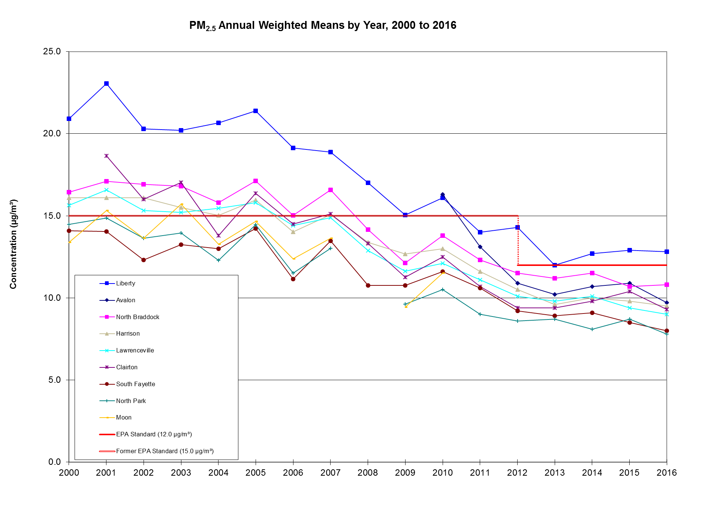

Slide 26
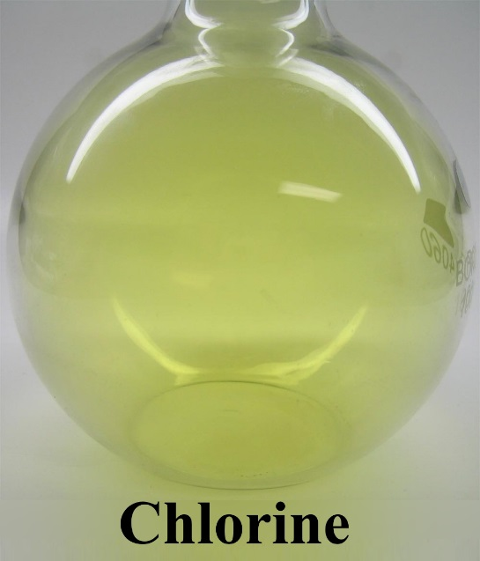
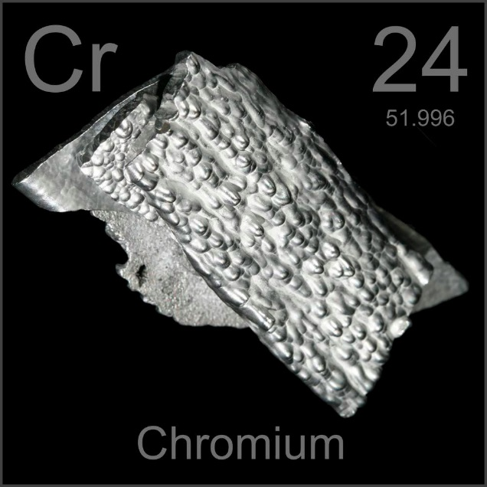
187 Hazardous Air Pollutants as per EPA Air Toxics – Determined by County Policy

Slide 27
Implementation of the Air Toxics Guideline
The Air Toxics Guidelines take into account the health effects of air emissions. Recent medical studies are incorporated from national databases.

Slide 28
Air Dispersion Modeling

Slide 29
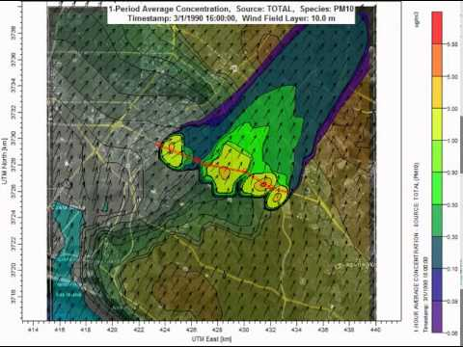
Air Dispersion Modeling

Slide 30
Agenda
Introductions
The Purpose of This Presentation
About the Air Quality Program
The Permitting Process
What is an Air Permit?
Other Permitting Activities
Citizen Involvement in the Permitting Process
The Next Steps

Slide 31
What can the Citizens of Lawrenceville Do?
Come to meetings like this to learn about permits
Review the permit when it becomes available for public comment
Attend the public hearing
Work with groups like GASP to get a better understanding of the permitting process

Slide 32
Agenda
Introductions
The Purpose of This Presentation
About the Air Quality Program
The Permitting Process
What is an Air Permit?
Other Permitting Activities
Citizen Involvement in the Permitting Process
The Next Steps

Slide 33
So What’s Next?
For ACHD, finish drafting the McConway & Torley permit and advertise it for public comment.
For you, review the permit and make informed comments.

Slide 34
Questions?

