Slide 1
Cinderlands
3705 Butler Street

Slide 2
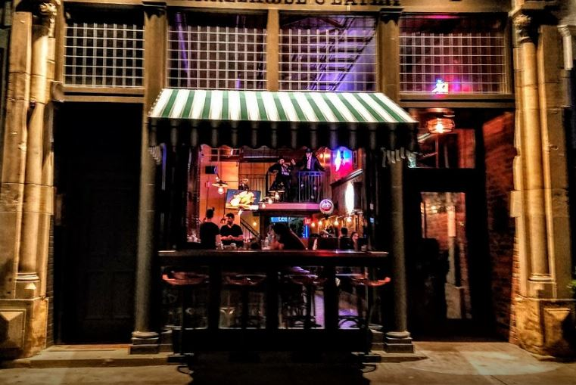
Key Points
Introductions – Jamie & Steve Warden, brothers & Pittsburgh natives, Adam Hoppel – project manager
Hours:
Monday – CLOSED
Tuesday-Thursday – 11:30am-11pm
Friday-Saturday – 11:30am-12am
Sunday 10:30am-9pm
Seasonal American Gastropub faire, featuring local ingredients (when available)
Price Points:
Lunch $8-$14
Dinner $12-$24
Share plates/apps $4-8
Family-Friendly Atmosphere
House-made beer, limited PA craft offerings

Slide 3
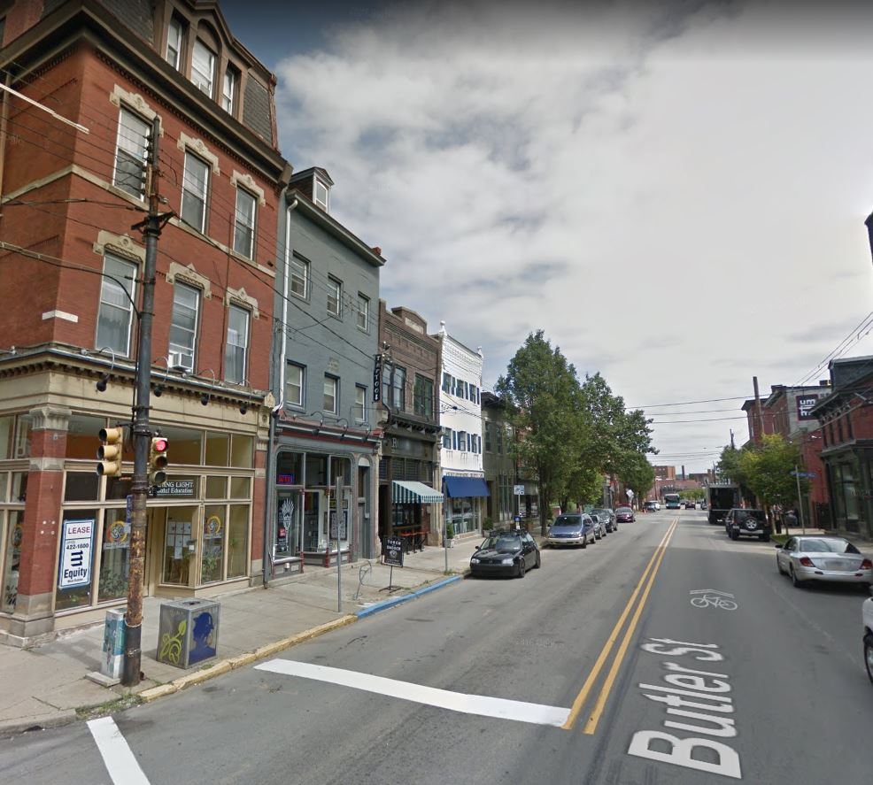
Why Lawrenceville?
Historical Pittsburgh District
Central location and close proximity to city
Diversified mix of new and old demographics, ideas and aesthetics
Great community of residents and business owners alike, coming together to form a progressive and unique urban destination.

Slide 4
First Floor

Slide 5
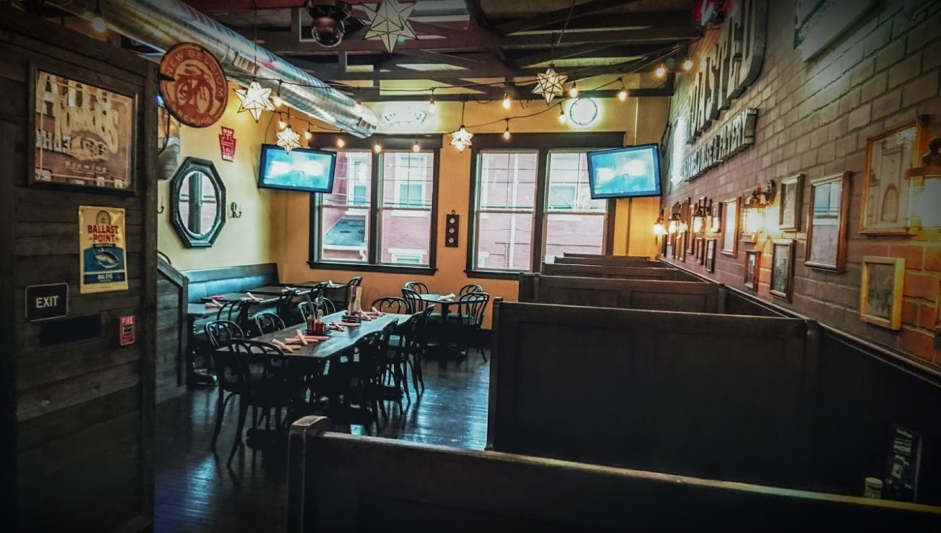
First Floor (Photos)

Slide 6
Basement brewery layout

