Slide 1
46th + Davison
A row of five new townhomes by Regent penn
regentpenn.com

Slide 2
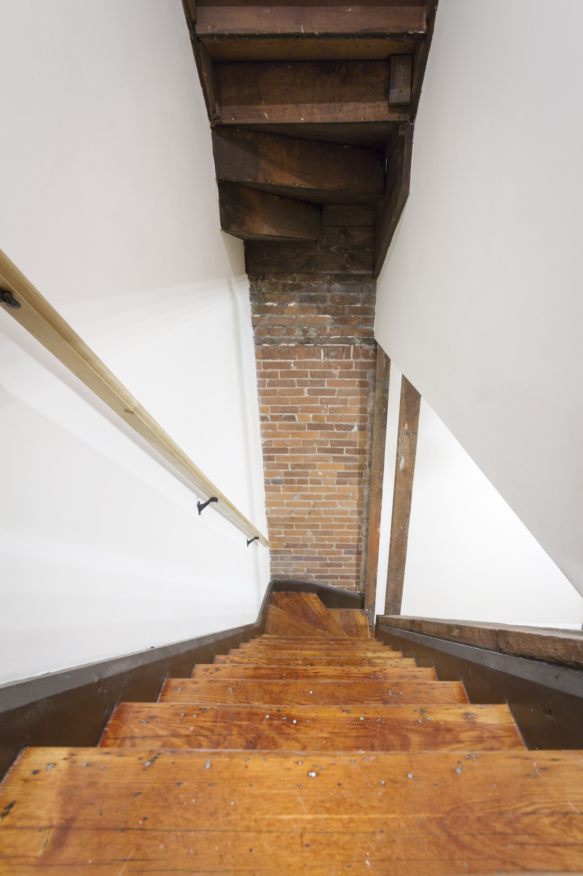
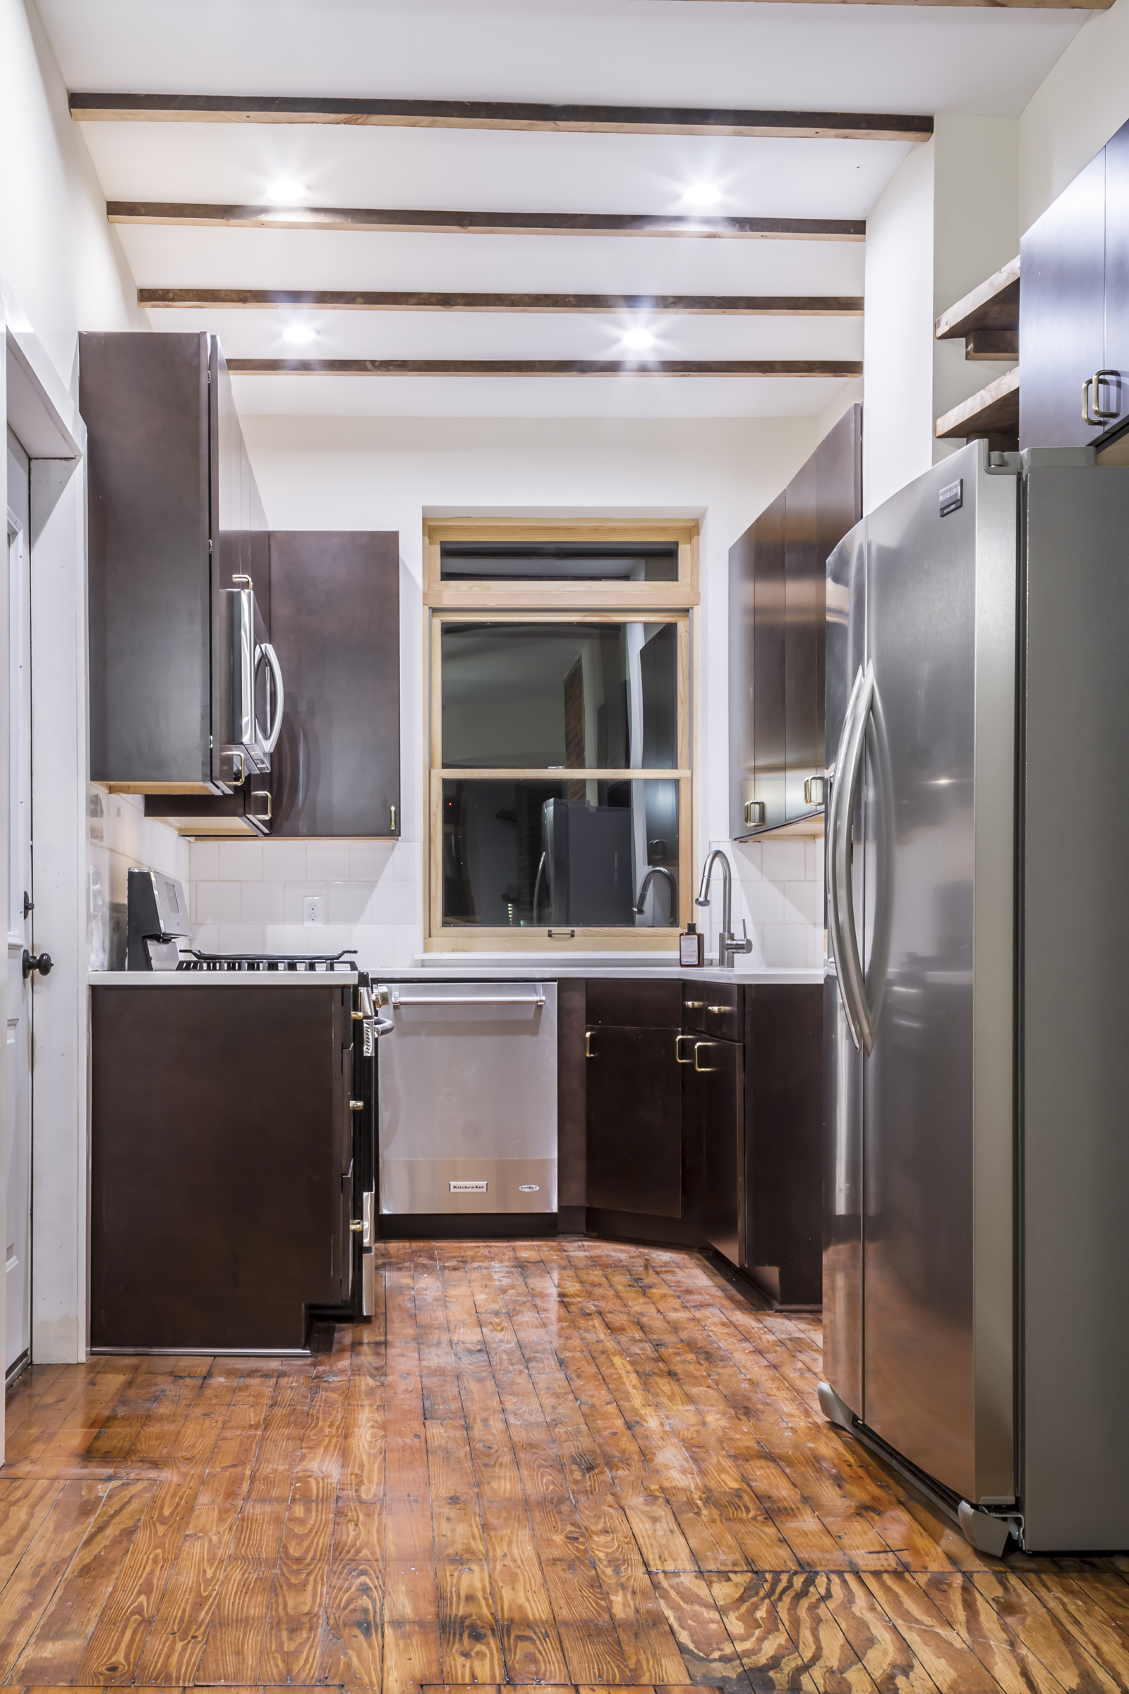
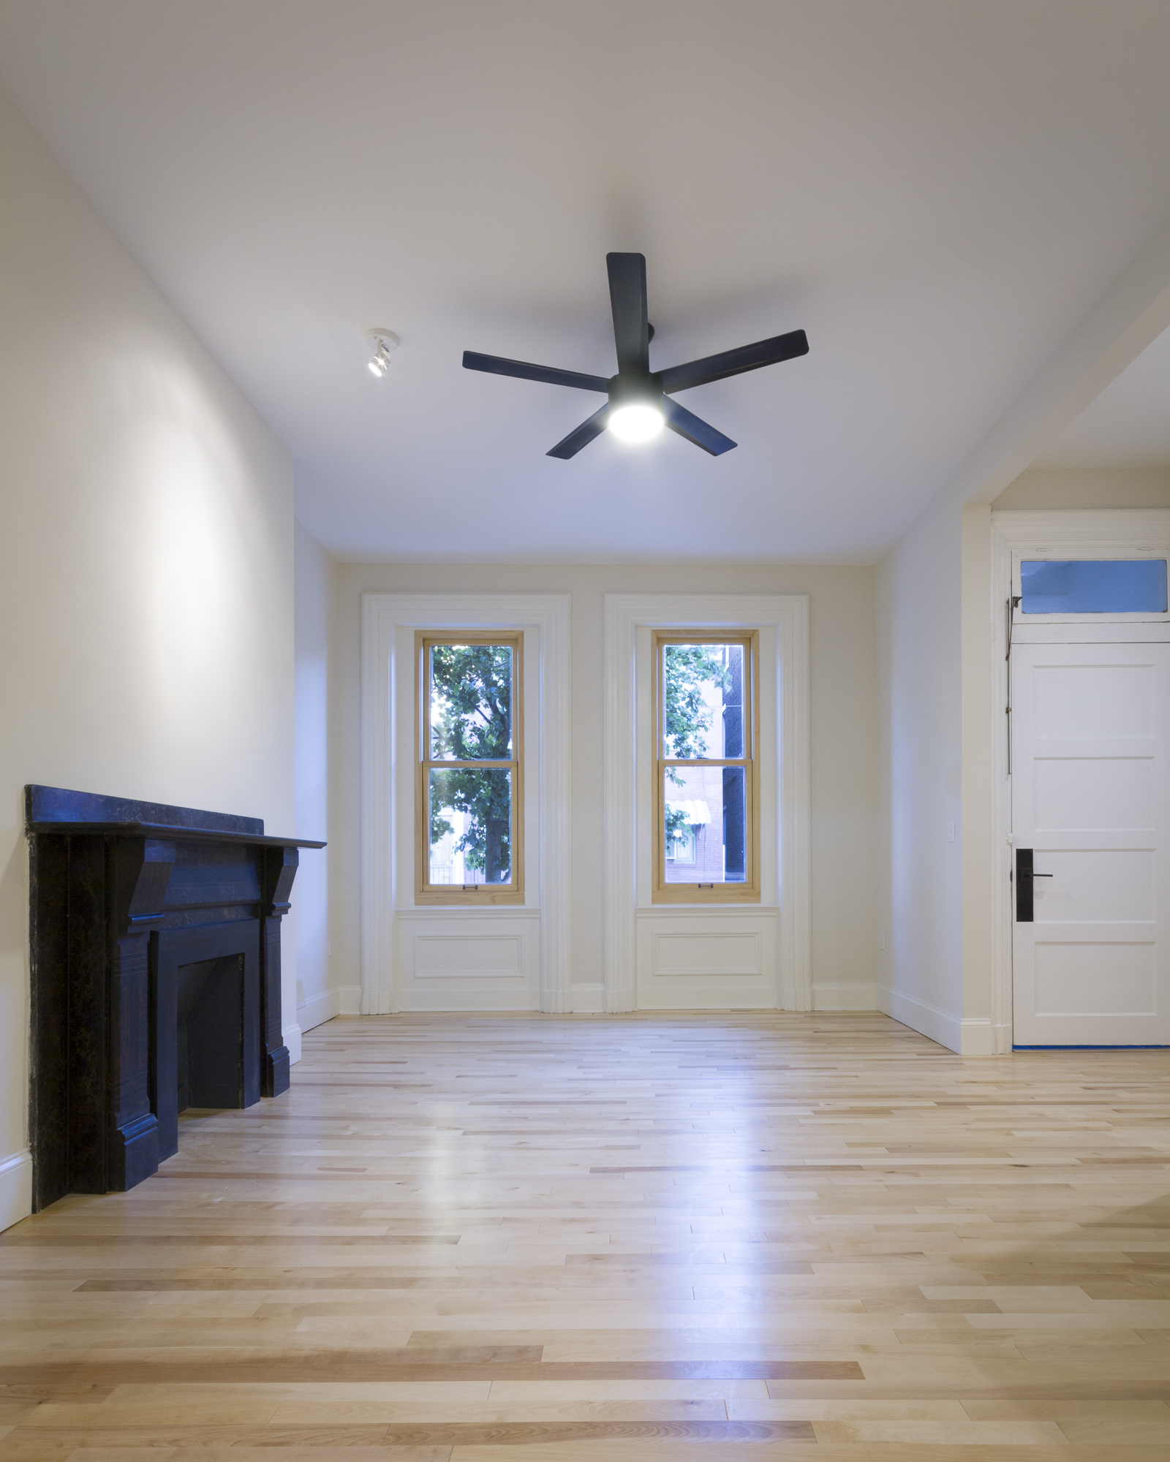
Our work in the neighborhood

Slide 3
Our mission
To focus on updating housing stock for energy efficiency, while reinstating local architectural language.
To build homes geared toward owner-occupants
To construct with minimal site/neighborhood disruption

Slide 4
Site
Variances Requesting:
Front and exterior side yard setbacks, 15 feet required
Minimum lot size, 1,800sf required for all lots
Accessory rooftop deck setbacks for front and side
HVAC units

Slide 5
Context

Slide 6
Context

Slide 7
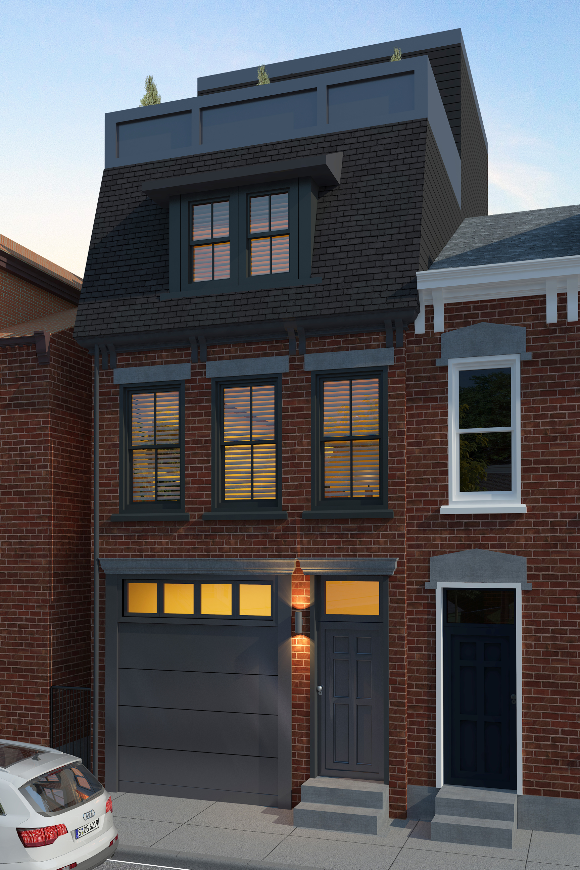
Offering
Five attached rowhomes, contextual to the neighborhood
Brick facades, slate mansard roof, wood windows
Rooftop access, front integral garages

Slide 8
Interior

