Slide 1
Jake Voelker
November 2016

Slide 2
Agenda
-Personal background and our story
-Veterans Outreach
-Background in state legislation, timelines, and general description of a dispensary
-Location (5416 Butler st)
-Signage and outside appearance
-Security Concerns
-Focus on State regulations
-Employees and staffing
-Full time staff members
-Establishment of a Community Impact Fund

Slide 3
Personal Background and Our Story
-Jake’s Professional Background
-Military
-Construction
-Non Profit
-Entrepreneur
-Veterans Outreach and Interest in alternative healing methods

Slide 4
Back Ground to State Legislation
-Application Process
-Strictly regulated
-Merit Based Application
-Timelines
-Costs
-Dispensaries are designed as clean, orderly retail establishments that allow patients to receive medicine.
-The state leaves little room to stray away from a sanitary health care like facility.
-Products that we are allowed to sell

Slide 5
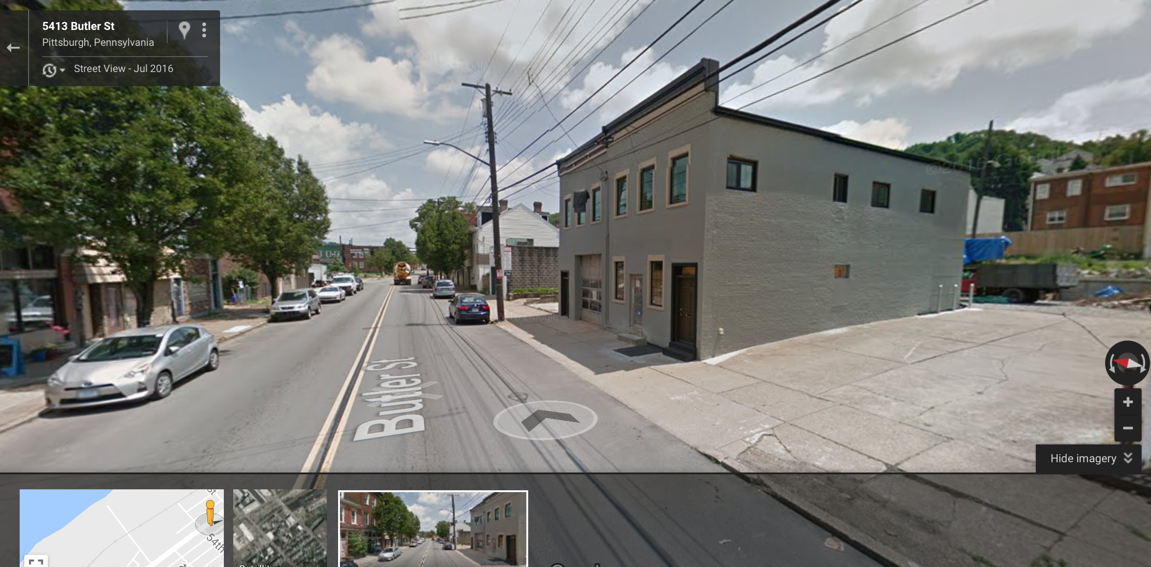
Location (5416 Butler)

Slide 6
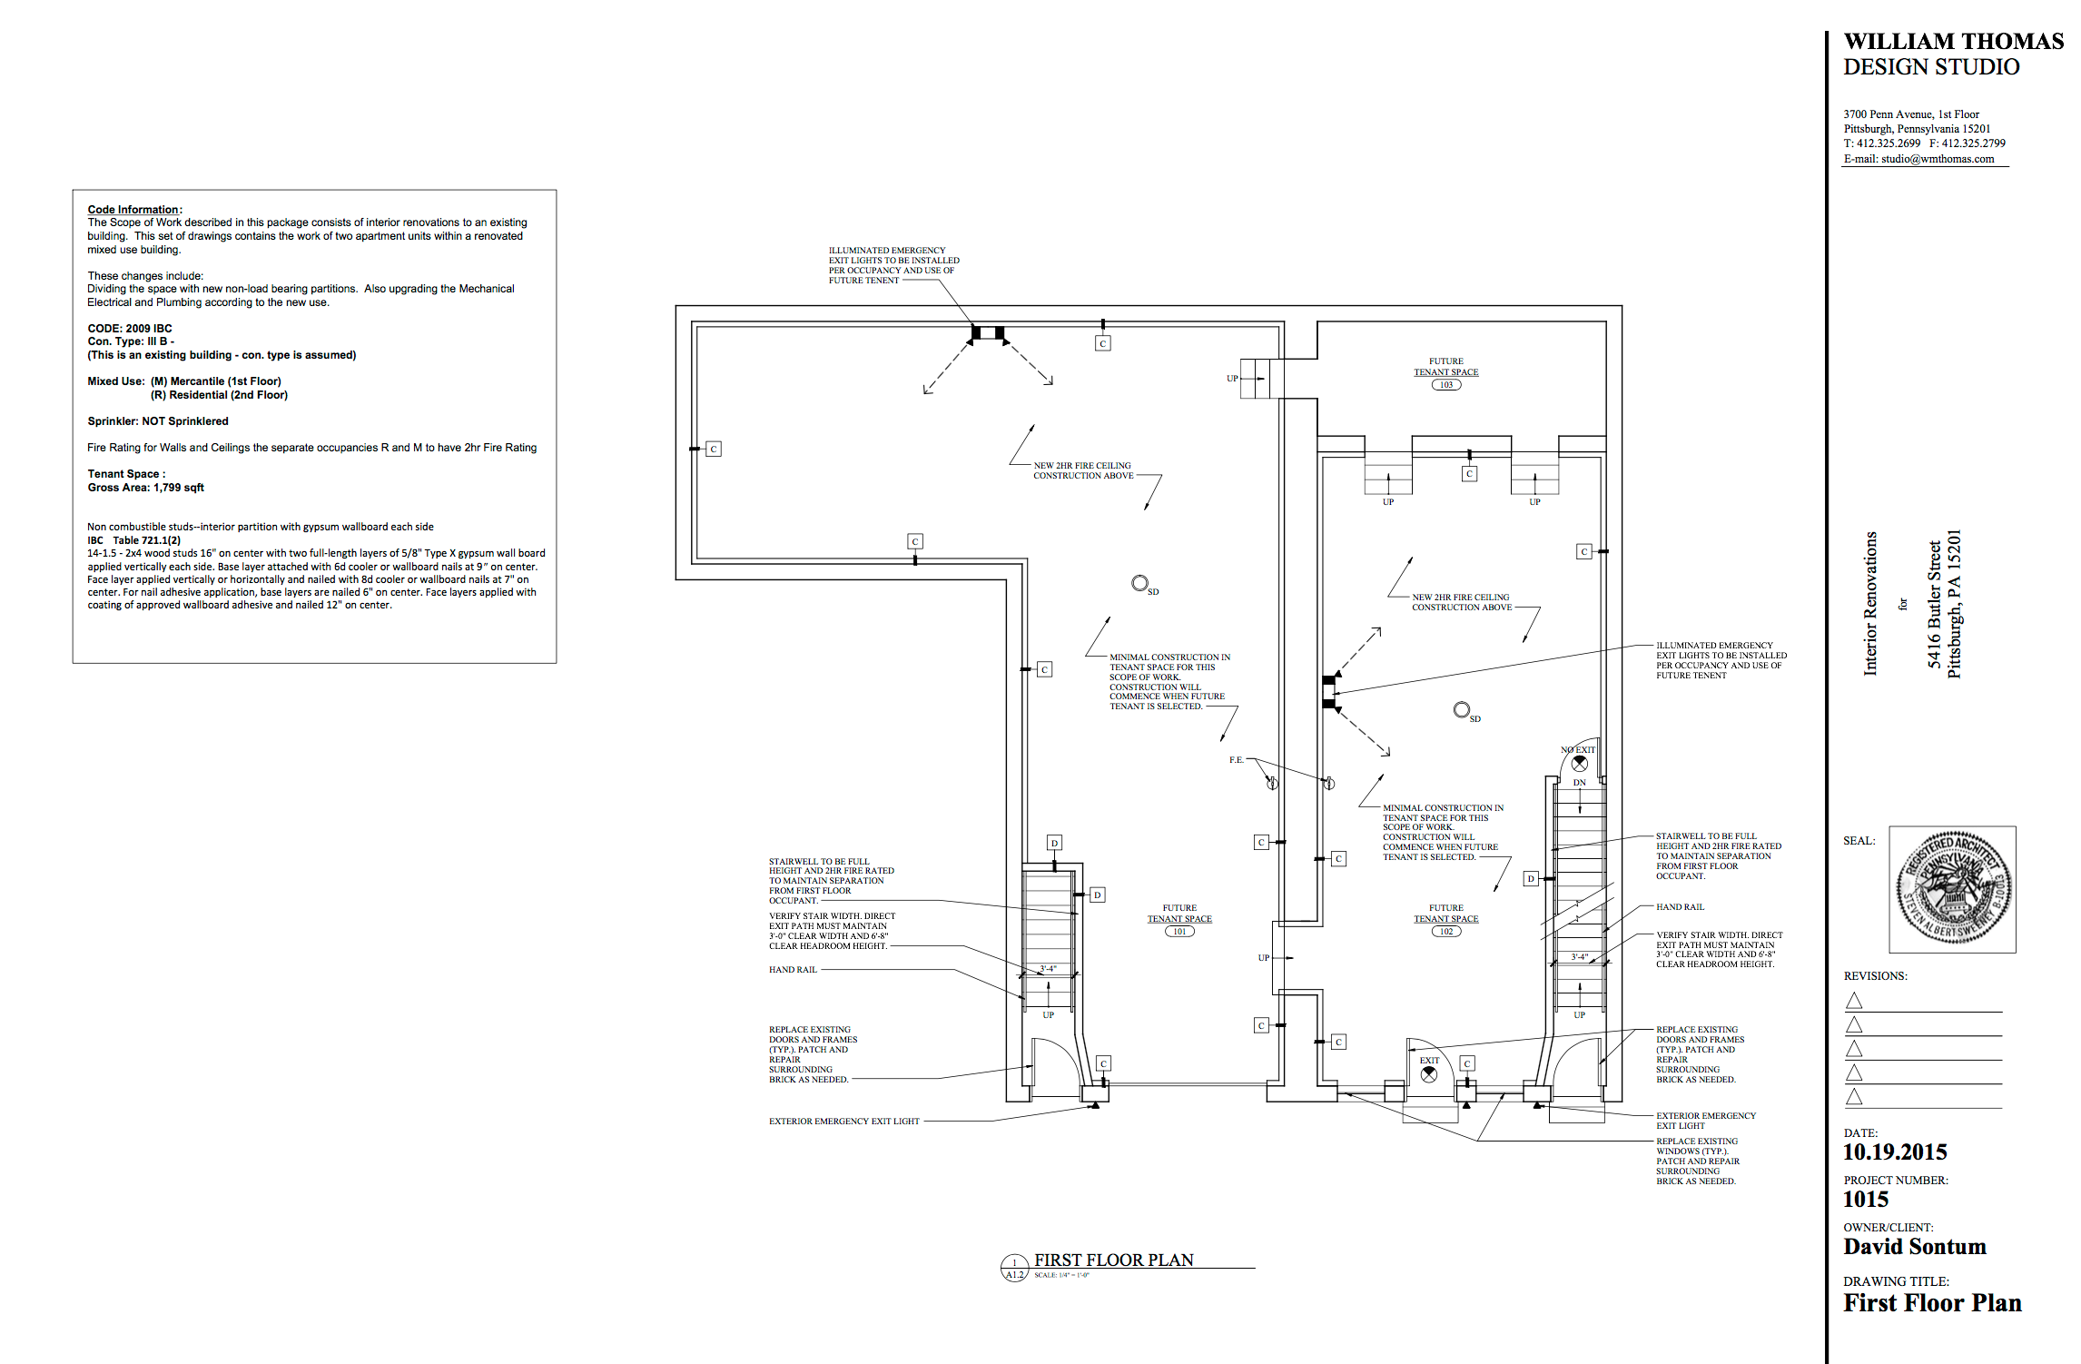

Slide 7
Security Concerns
-External and Internal Security
-Security Infrastructure
-Internal
-External
-State Regulated
-Retired DEA Agent on our BoD
-Movement of Cash and Product
-State Regulated
-Cameras
-Hours of Operation

Slide 8
Employees
-Intense Background checks
-Full time health care professional
-4-5 additional staff
-Encouraged to be active in the community
-Locally recruited with an extreme focus on hiring veterans.

Slide 9
Community Impact
-Creation of a community impact fund that will allow grants to be issued to key community initiatives within the local communities that we live in.
-Examples of key initiatives
-Percentage to be determined - based on demand of product.

