Slide 1
DISRUPTIVE PROPERTIES ADMINISTRATION
Lawrenceville United Presentation
4/11/2015

Slide 2
Department of Public Safety
STEPHEN A. BUCAR, DIRECTOR
400 CITY-COUNTY BUILDING
414 GRANT STREET
PITTSBURGH, PA 15219

Slide 3
Disruptive Property Legislation
Title 6: Conduct
Article VII: Nuisance Properties
Chapter 670: Nuisance Properties-Abatement
Effective December 1, 2008
Services Rendered by Police and Animal Care and Control
Purpose: Since Disruptive Properties place a substantial threat and burden on the common health, safety, and welfare of the residents of the City of Pittsburgh, the Public Safety Director is authorized to charge the cost of law enforcement to the property owner in order to deter repeated violations of state and local law; and when a property remains unabated for an unreasonably long period of time, pursue misdemeanor charges.

Slide 4
When is a Property Declared Disruptive?
An arrest, citation or summons is issued for a charge under the Disruptive Property Ordinance.
Charge constitutes a violation of any City, State, or Federal ordinance or statute under the Disruptive Property Ordinance.
Notice is sent to property owner 3 times within 1 year period.
Disruptive classification can be removed if law enforcement authorities are not called to respond to Disruptive Activity within 12 months.

Slide 5
What if a Property is a rental property?
Includes any disruptive activity by the owner(s), tenant(s), or invitee(s) of a property.
Rental properties containing more than six units, each individual unit shall be considered a property.
Disruptive Activity will be charged to the property address for rental properties with 5 units are less.

Slide 6
Processing Disruptive property violations
Processing Review Screen

Slide 7
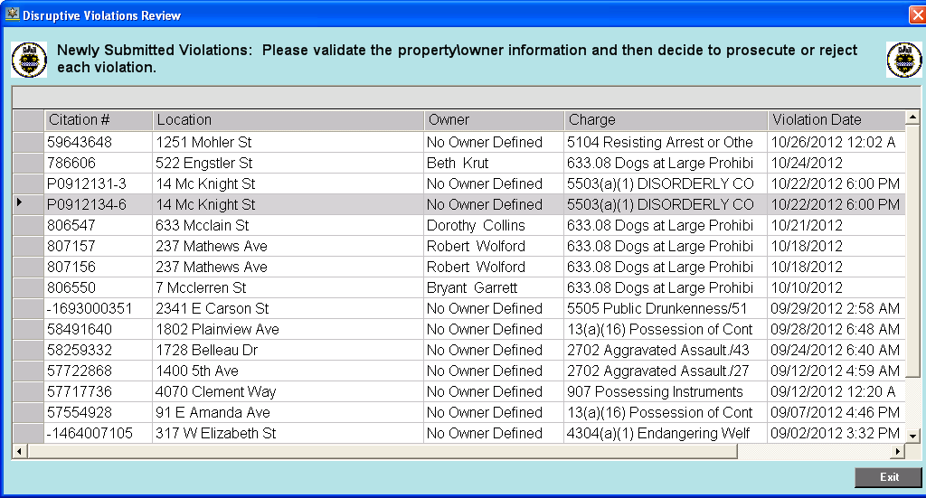

Slide 8
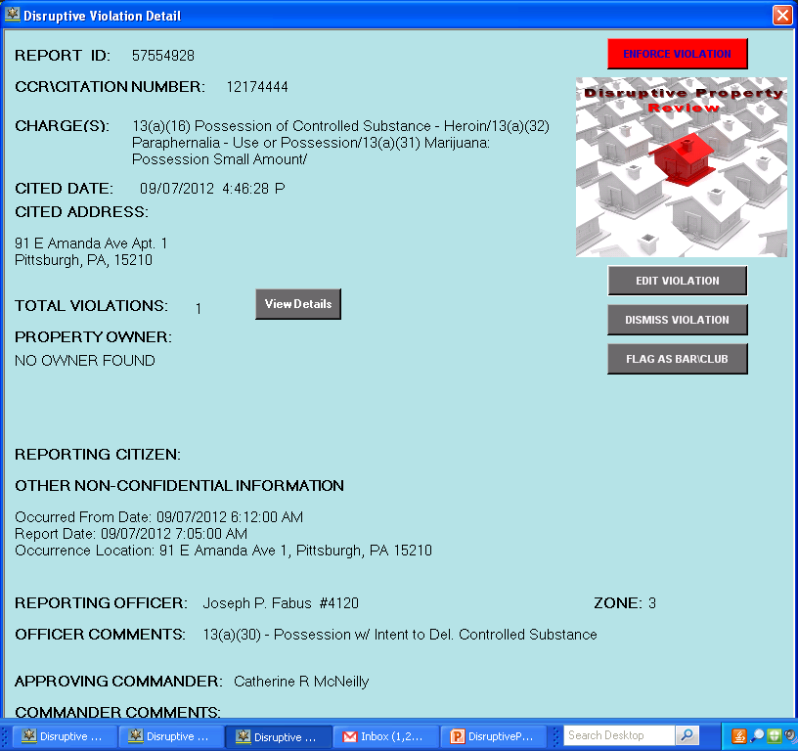

Slide 9
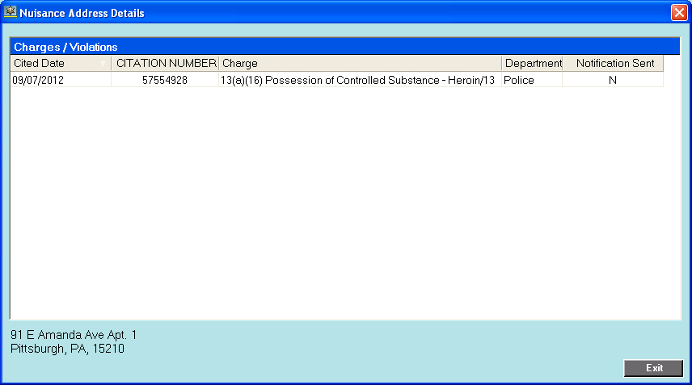

Slide 10
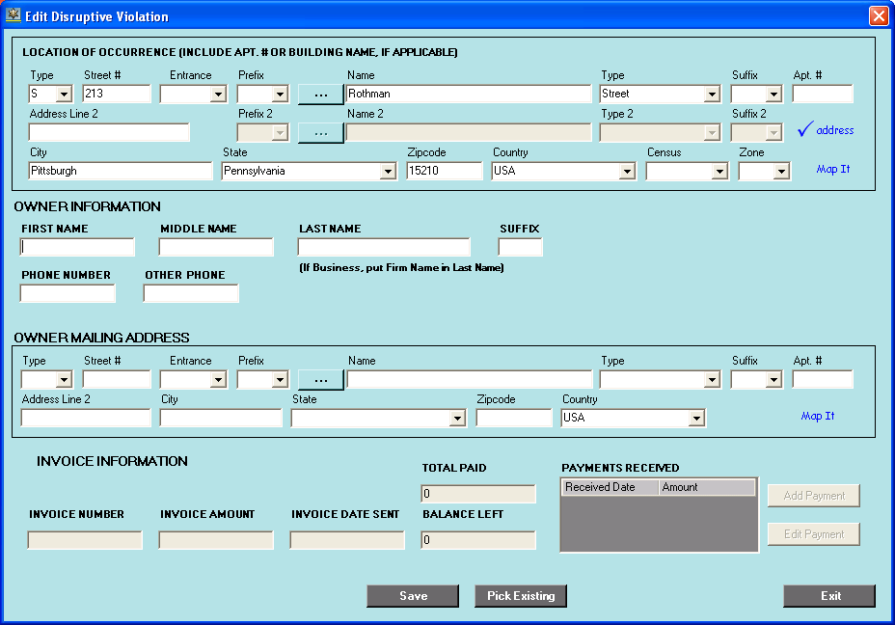

Slide 11
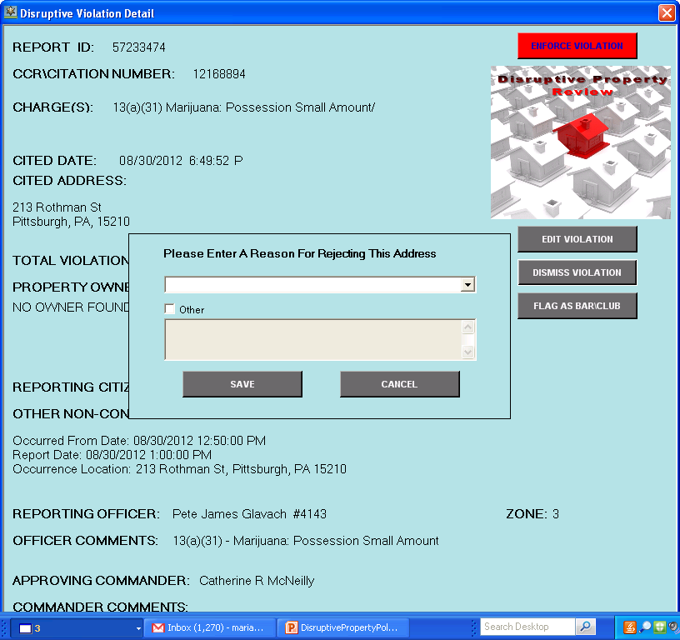

Slide 12
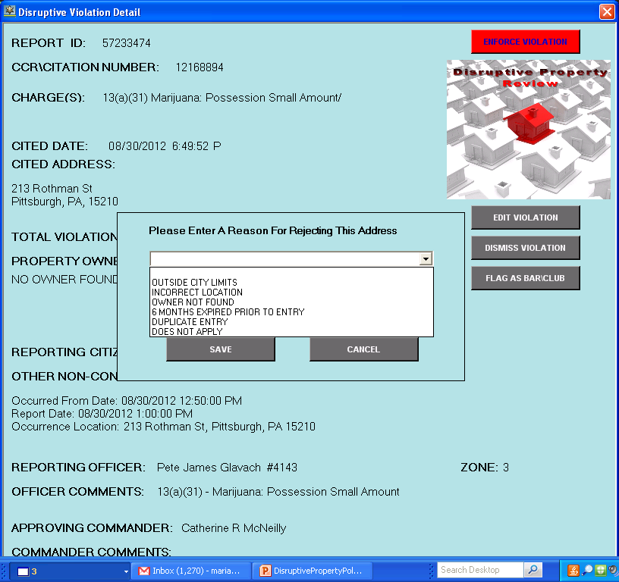

Slide 13
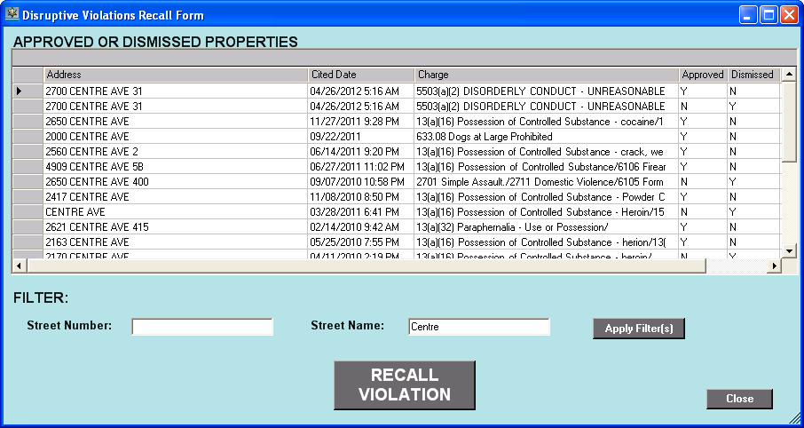

Slide 14
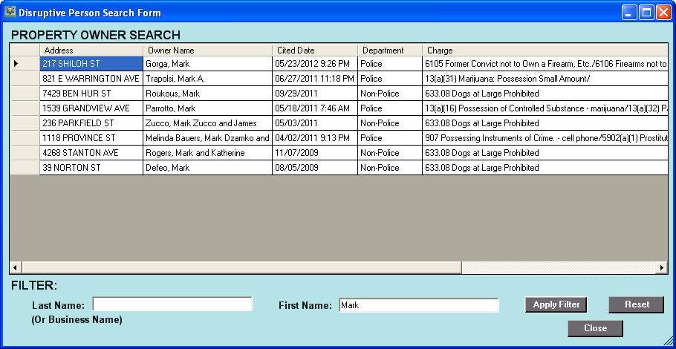

Slide 15
How Processing disruptive properties begins
Police enter arrest/citation/summon information in APRS.
Police check box indicating charge qualifies for Disruptive Property ordinance.
Police Supervisor approves qualifying addresses submitted by police officers.
Zone Commander approves qualifying addresses
Addresses become available for processing in Disruptive Property Database
Notices are generated for qualifying properties and sent to Public Safety Director Bucar for signature and mailed to property owners.

Slide 16
Combatting disruptive activity begins with………

Slide 17
YOU
Completing Thorough Background Checks
Property Maintenance
Monitor Property Regularly
Adding Disruptive Property Ordinance to your lease
Report non-emergencies to 311
Report emergencies to 911

Slide 18
Pittsburgh Police Commanders
Zone 1
Commander LaVonnie Bickerstaff
Zone 2
Commander Anna Kudrav
Zone 3
Commander Larry Scirotto
Zone 4
Commander Daniel Herrmann
Zone 5
Commander Jason Lando
Zone 6
Commander Christopher Ragland

Slide 19
Maria C. Bethel, Disruptive Property Coordinator
DEPARTMENT OF PUBLIC SAFETY
400 CITY-COUNTY BUILDING
414 GRANT STREET
PITTSBURGH, PA 15219
412-255-4789

Slide 20
Created by Maria C. bethel 3/27/2015
THE END

