Slide 1
4412 Butler Street (formerly Boys’ and Girls Club of Pittsburgh) Renovation Plan Crow Hill Development

Slide 5
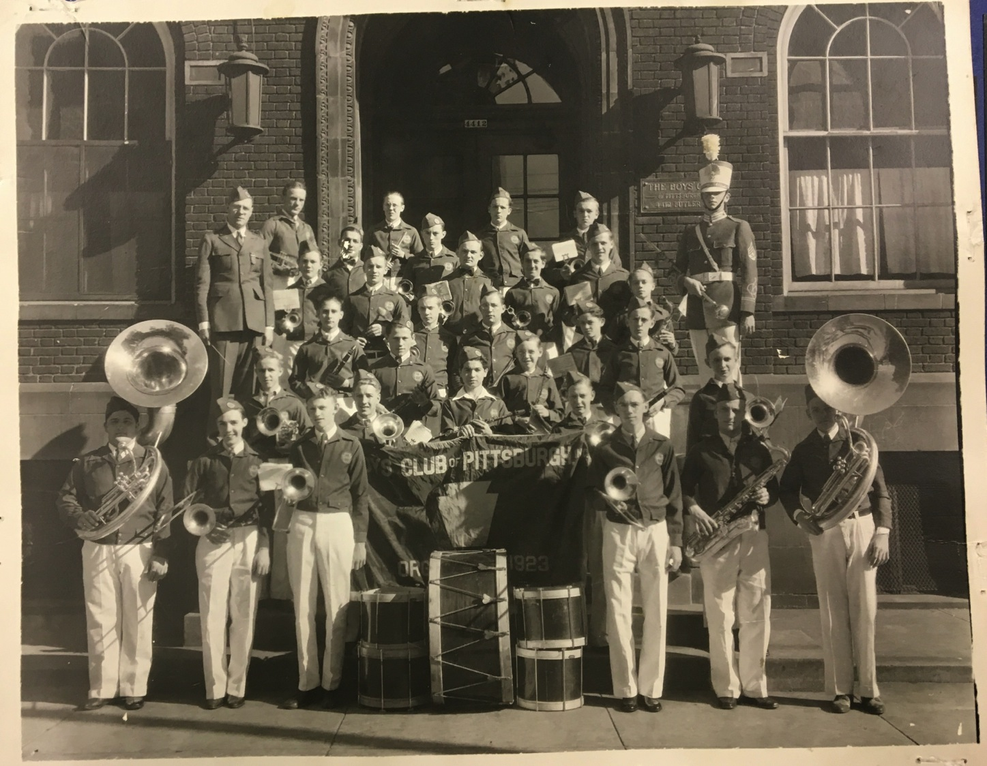

Slide 6
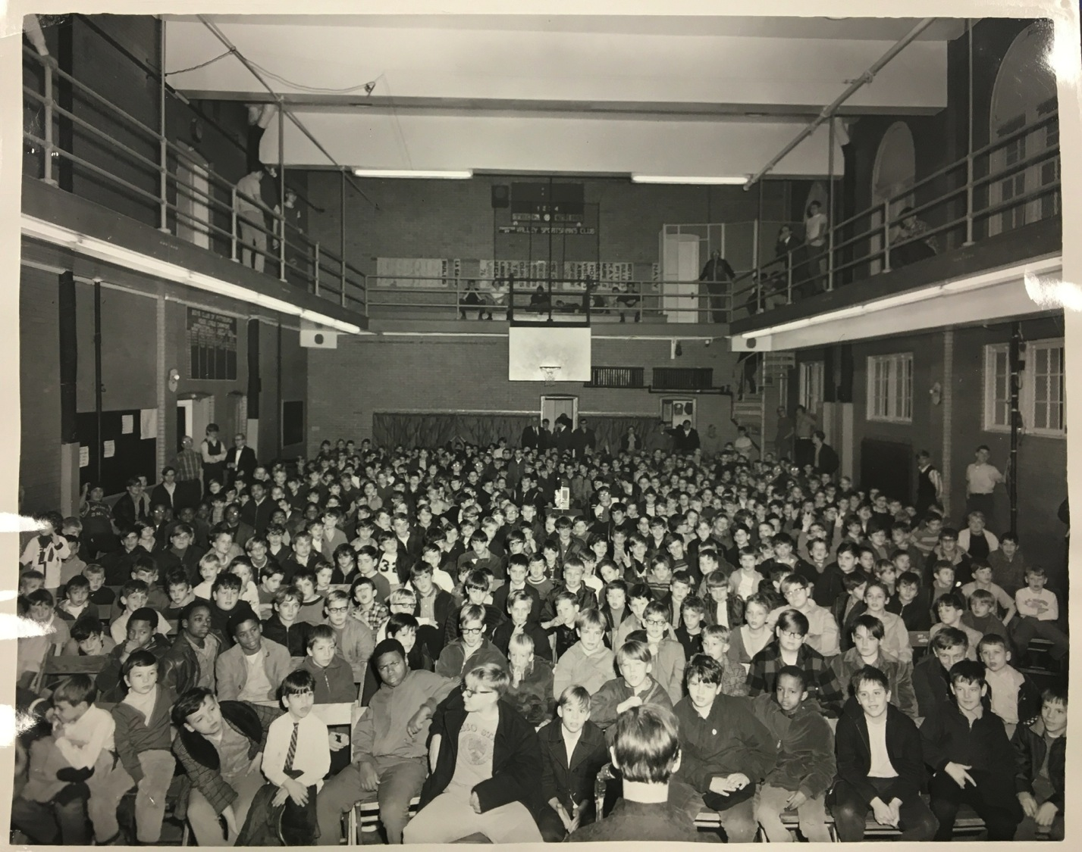

Slide 7
Butler Street Elevation

Slide 8
45th Street Elevation

Slide 9
Cessna Way Elevation

Slide 10
Ground Floor Site Plan

Slide 11
Second Floor Site Plan (Facing Cessna Way)

Slide 12
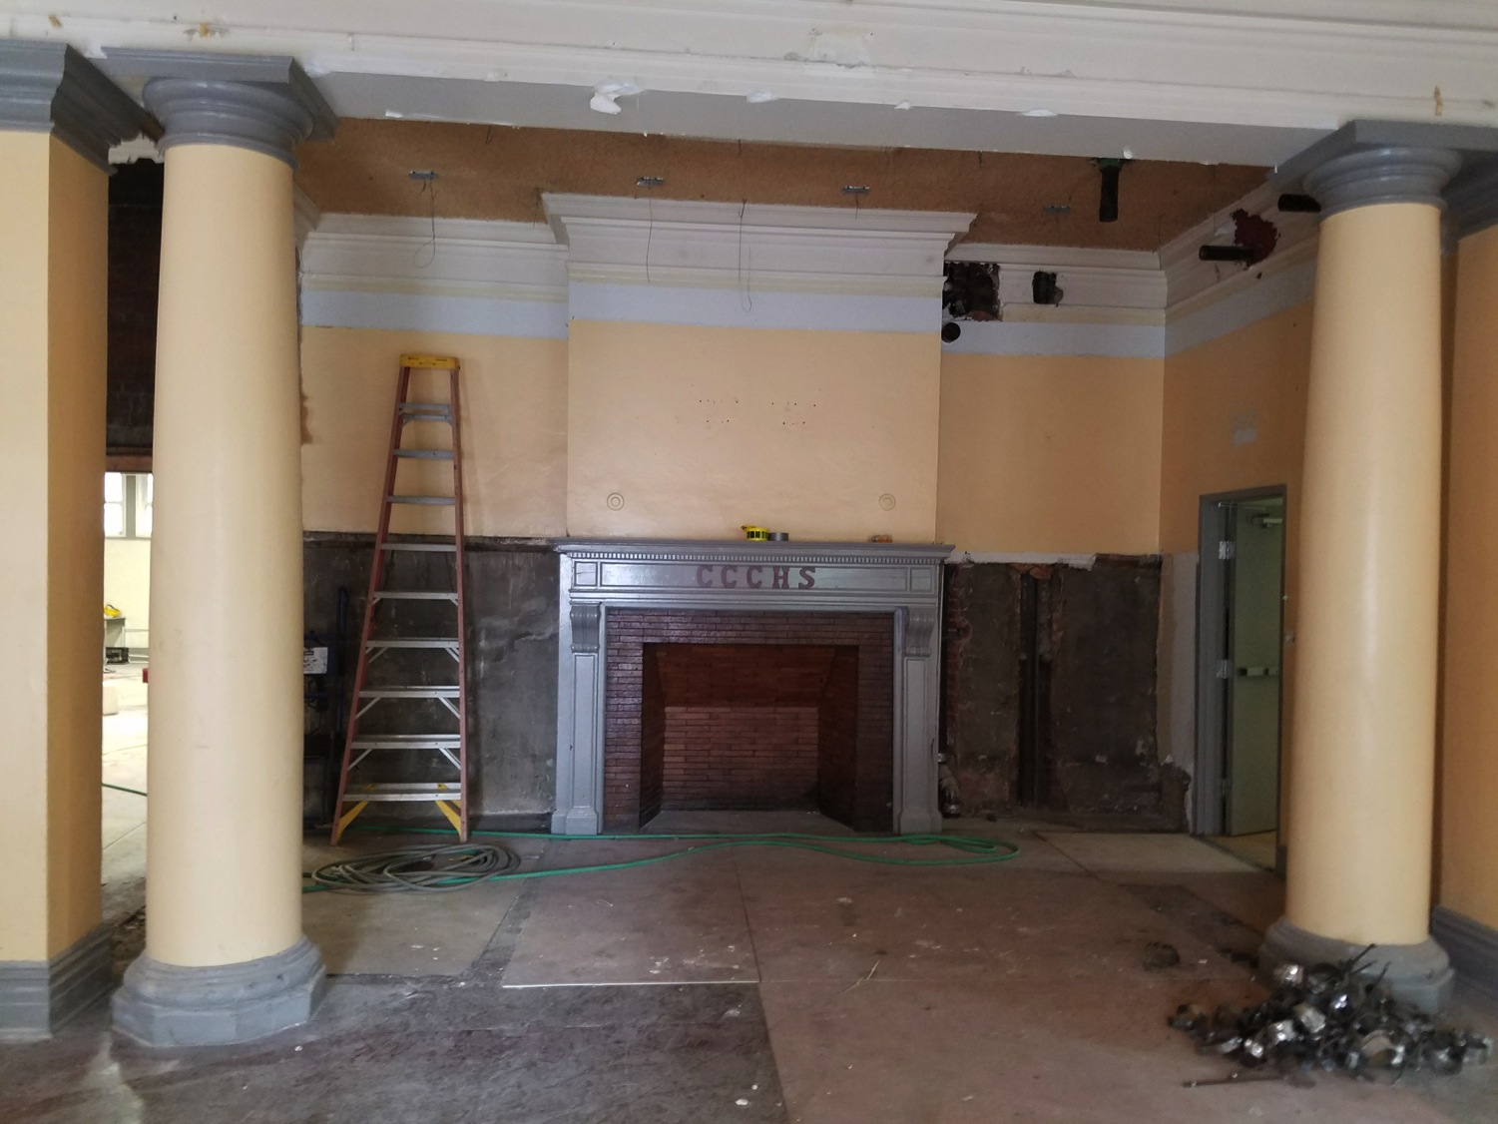

Slide 13
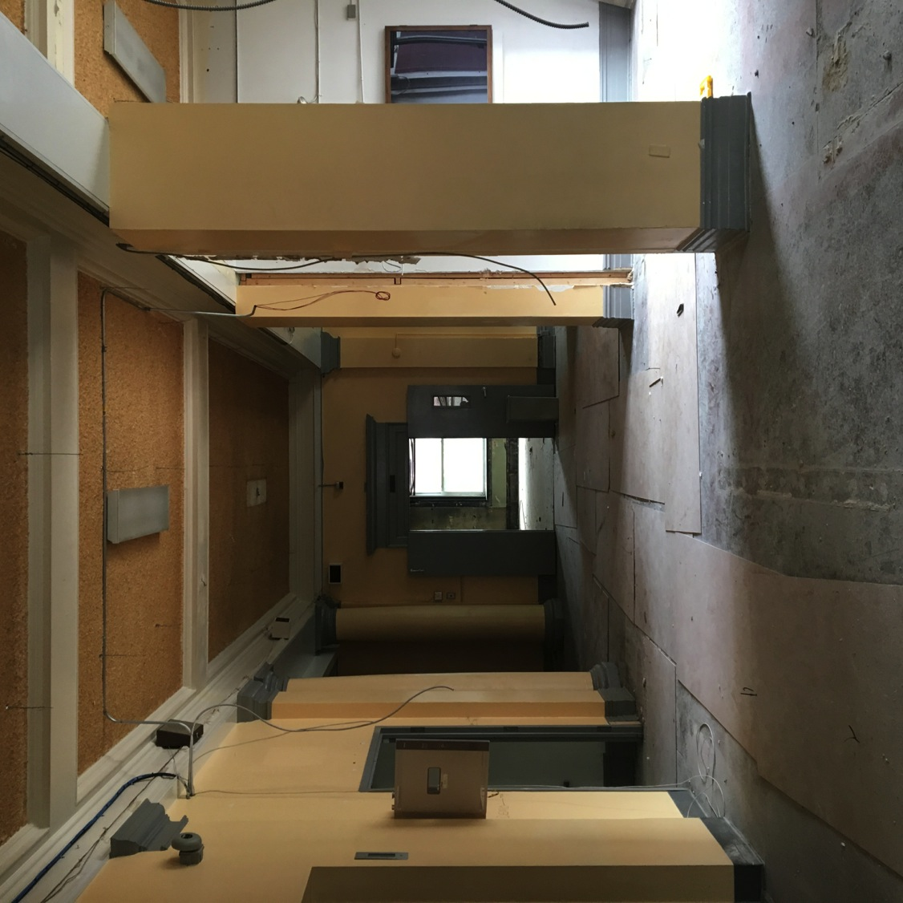

Slide 14
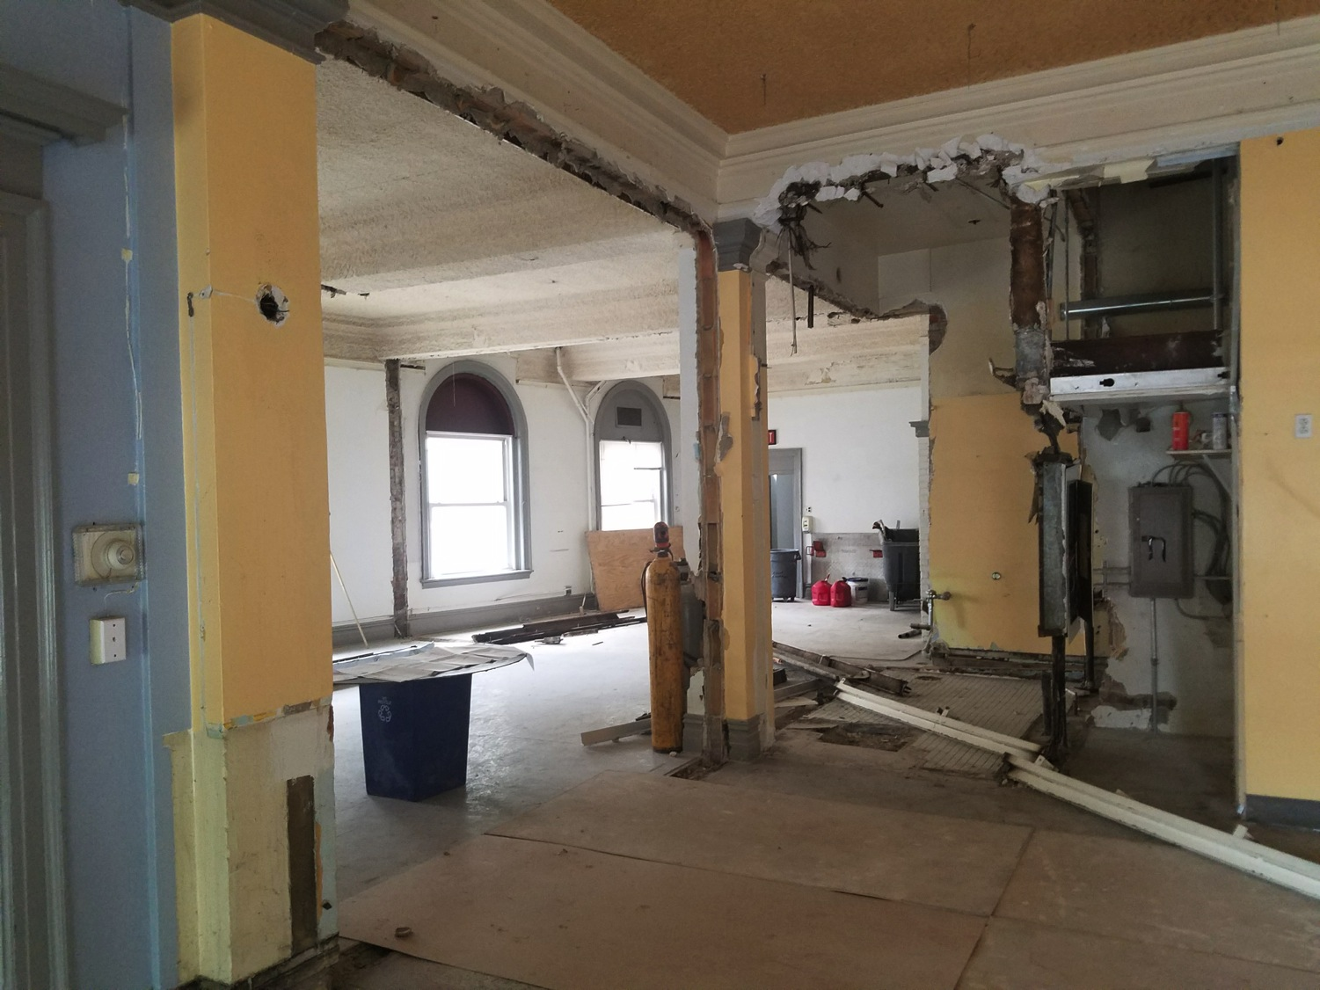

Slide 15
