Slide 1
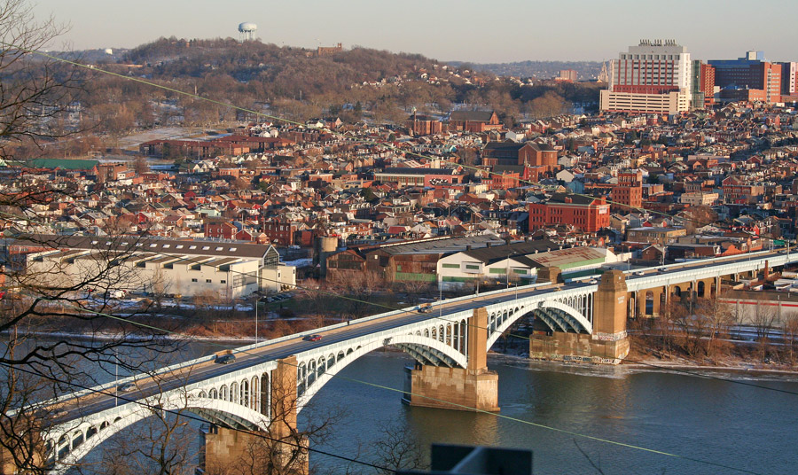
Arsenal Terminal Development Follow-Up Meeting
February 25, 2016
6:30 pm – 8:00 pm
NREC

Slide 2
Meeting Overview
Agenda:
6:30 pm: Welcome and Overview of Meeting - LU/LC
Community Priorities and Project/ Process Background
6:40 pm: Project Overview and Updates – Milhaus
7:00 pm: Facilitated Q&A
7:45 pm: Meeting Wrap Up and Next Steps

Slide 3
Meeting Overview
Ground Rules: The community has worked to establish ground rules for our facilitated meetings. Anyone refusing to follow these ground rules will be asked to leave the meeting in order to ensure that the discussion stays respectful, productive, and constructive.
Please hold all questions until the end of the presentation or when prompted for questions by the facilitators. We will go back to a slide if there is a specific question or comment, so please jot own notes that you may want to revisit when we open it for Q&A.
Once opened for questions and comments, please raise your hand or pass a notecard to the front of the room. Please identify yourself by name, and also your relationship to or interest in the issue once acknowledged by the facilitator or on the notecard.
Please be respectful of all speakers, including those asking questions and making comments.
Questions/ comments will be limited to 2 minutes each. A clarification question or comment will be permitted.
If time permits, we will call on individuals who would like to ask or make a second or additional question or comment.
Please make sure that you sign in to the meeting if you would like to receive a copy of the notes from the meeting and information on future development meetings.
If the ground rules are violated or ignored, we will ask the individual to leave the meeting, and if it continues, we will end the meeting.

Slide 4
Your Priorities (to date)
Affordability - Ensuring that people who live in Lawrenceville can afford to stay living and/ or operating in Lawrenceville, and that the community stays a diverse community – diverse in terms of income, ethnicity, age, gender, etc.
Mobility Issues - Ensuring that Lawrenceville is safe for pedestrians, cyclists, and improving the traffic and road infrastructure to address already overburdened streets.
Parking – We need parking. Both the residential streets and business corridors are over-parked.
Infrastructure Improvements - Failing roads, sewers, water lines, need to be improved.
Historic Preservation - We don’t want to lose the history or authenticity of this place.
Environmental Health and Stormwater Management - We need cleaner air, clean water, and need to become more energy efficient. We need to create and protect greenspace and open space.
Public Safety – As the community develops, safety needs to remain a top priority.
Education and Opportunities- There needs to be a focused effort on connecting residents with new opportunities within local schools, and with new businesses and industry moving into the community.
Construction Impact- Development is occurring in a community – where people live, work, and play. It is not an isolated construction zone. Construction standards need to be set and acknowledged.
Responsible Hospitality-Balancing the neighborhood quality of life with business district vibrancy.
Business Authenticity-Ensuring that Lawrenceville keeps, supports, and grows it’s small-scale independent retail and services.

Slide 7
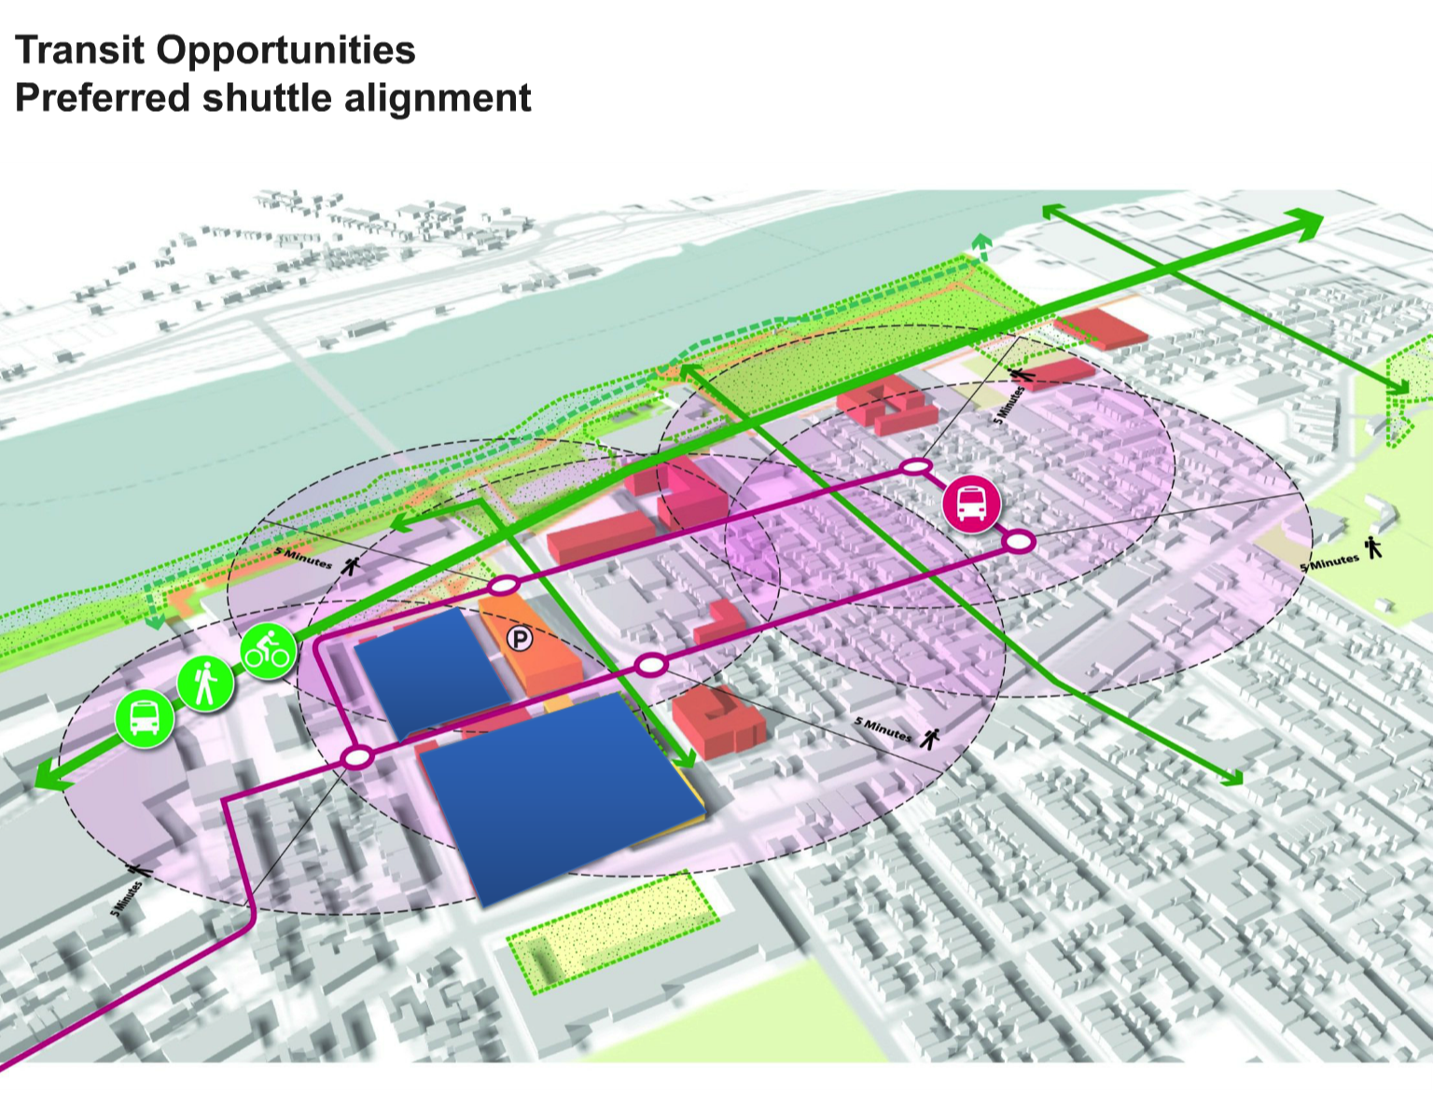

Slide 8
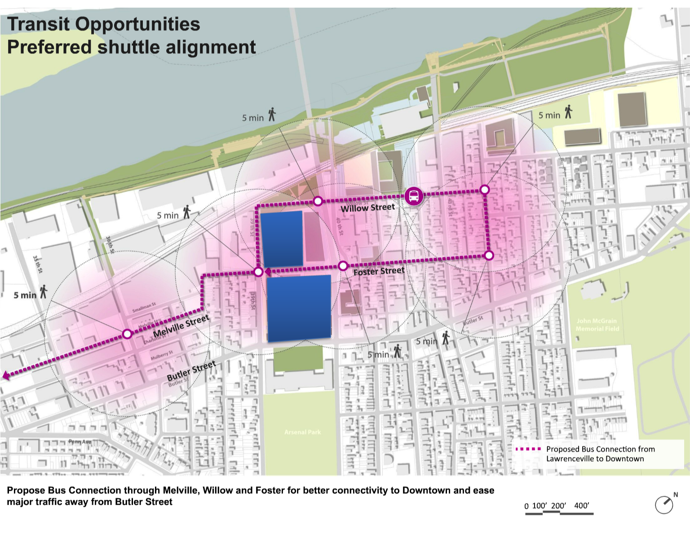

Slide 9
Milhaus Presentation

Slide 10
Facilitated Discussion

Slide 11
Next Steps

